Slide 1

ENGLISH 9
Hello everyone !!!

Slide 2
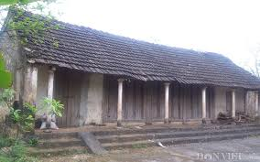
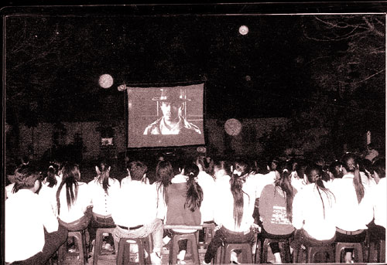
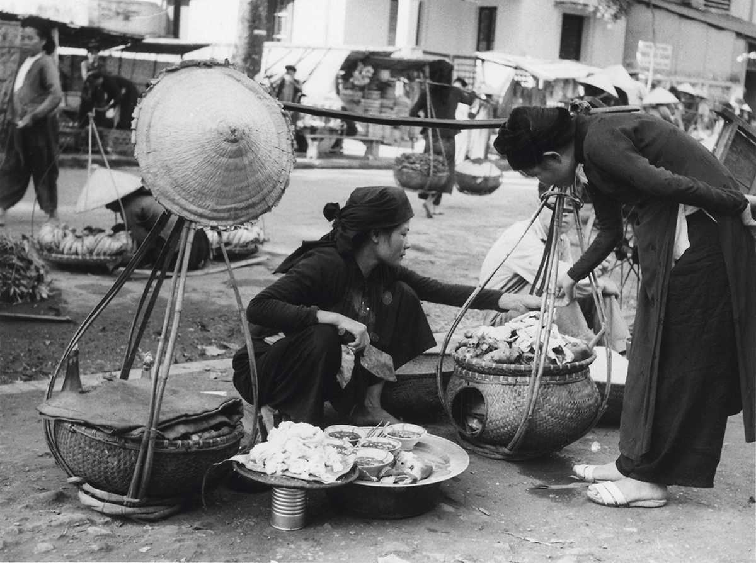
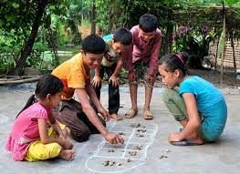
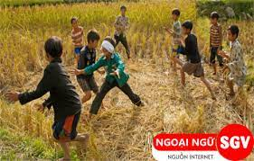
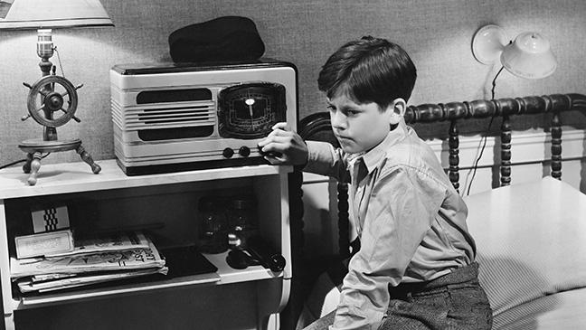
Remembering the past
Looking at these pictures, what do you remember?

Slide 3
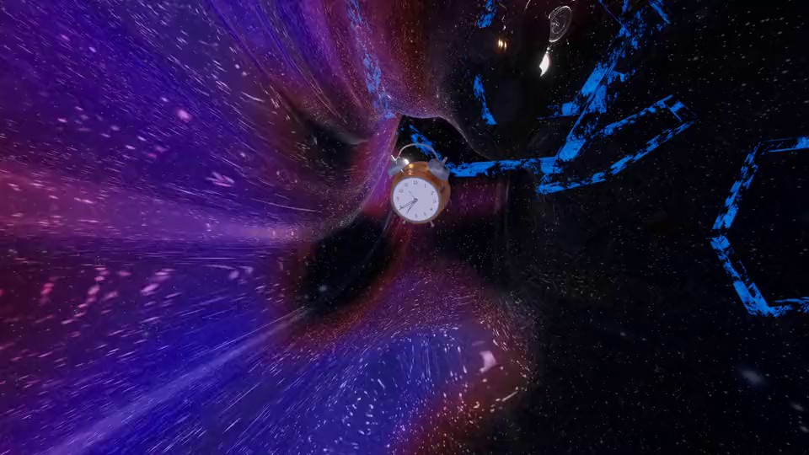


Unit
4
LESSON 1: GETTING STARTED
AT AN ENGLISH LESSON

Slide 4

* Vocabulary
complex (n)
involving a lot of different but related parts
/ˈkɒmpleks/
khu phức hợp, quần thể

Slide 5
* Vocabulary
religious (adj)
Ex: He's deeply religious and goes to church twice a week.
/rɪˈlɪdʒəs/
thuộc tôn giáo

Slide 6
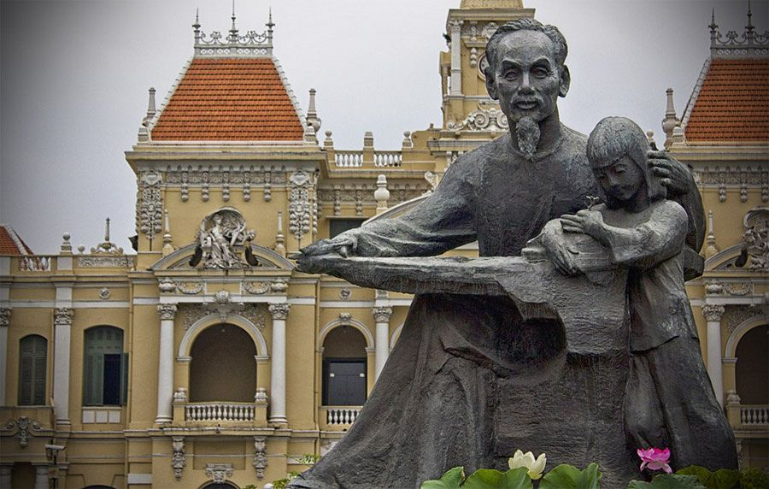
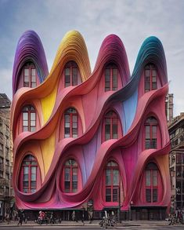
* Vocabulary
monument (n)
/ˈmɒnjumənt/
tượng đài

Slide 7
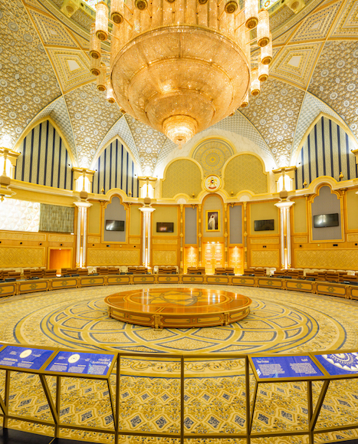
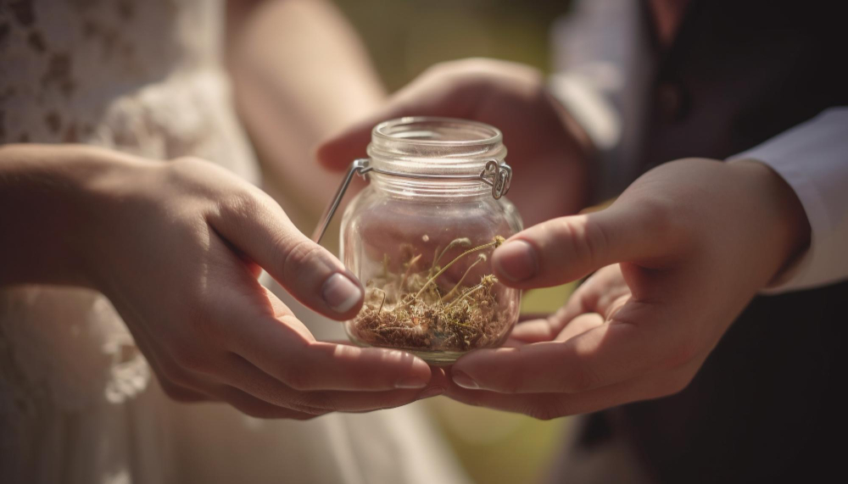
* Vocabulary
magnificent (adj)
/mæɡˈnɪf.ɪ.sənt/
tráng lệ

Slide 8
* Vocabulary
preseve (v)
to keep something as it is.
/prɪˈzɜːv/
bảo tồn

Slide 9
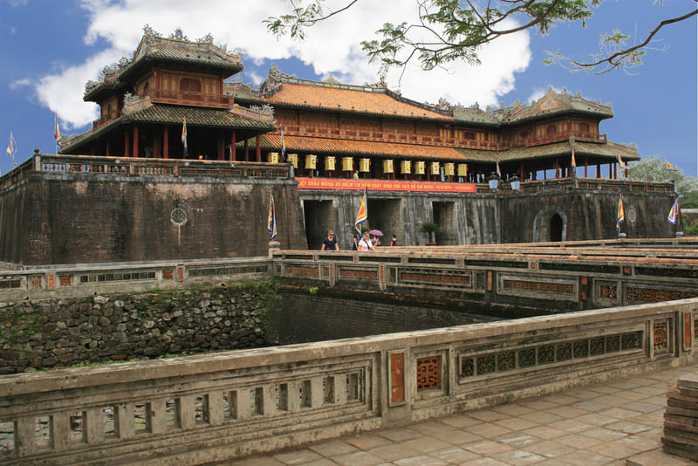
* Vocabulary
heritage (n)
/ˈher.ɪ.tɪdʒ/
di sản
Ex: The historic building is as much part of our heritage as the paintings.

Slide 10
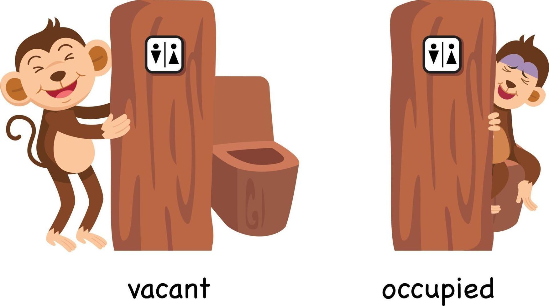
* Vocabulary
occupy (v)
take control
/ˈɒkjupaɪ/
chiếm giữ

Slide 11
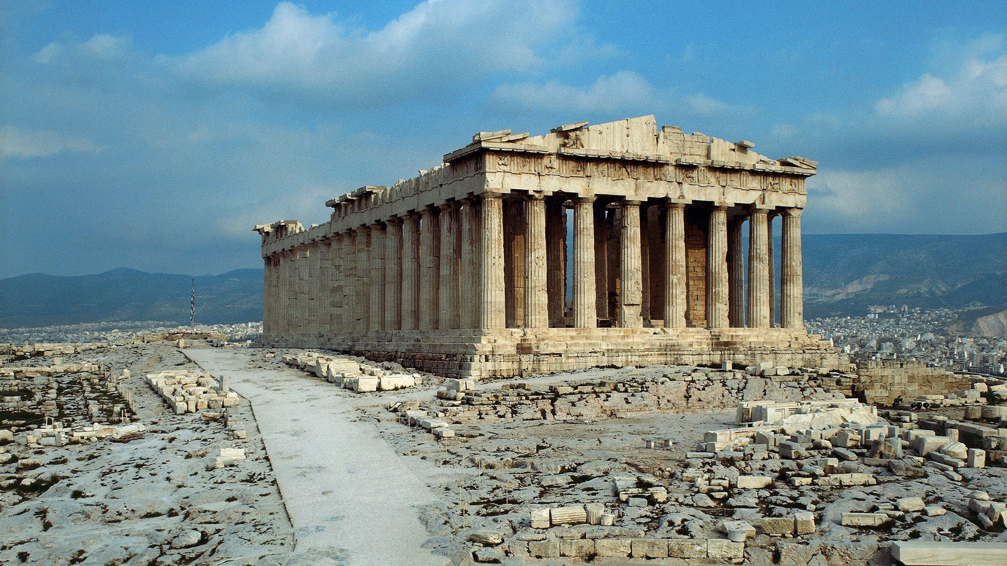
* Vocabulary
being used by someone or with someone in it.
occupied (adj)
/ˈɒkjupaɪd/
có người ở

Slide 12
* Vocabulary
ancient (adj)
of or from a long time ago, having lasted for a very long time.
/ˈeɪnʃənt/
cổ đại, lâu đời

Slide 13
* Vocabulary
generation (n)
all the people of about the same age within a society
/ˌdʒenəˈreɪʃn/
thế hệ

Slide 14
* Vocabulary
New words | Pronunciation | Meaning
1. complex (n) | /ˈkɒmpleks/ | khu phức hợp, quần thể
2. religious (adj) | /rɪˈlɪdʒəs/ | (thuộc) tôn giáo
3. monument (n) | /ˈmɒnjumənt/ | tượng đài
4. magnificent (adj) | /mæɡˈnɪf.ɪ.sənt/ | tráng lệ
5. preserve (v) | /prɪˈzɜːv/ | bảo tồn
6. heritage (n) | /ˈher.ɪ.tɪdʒ/ | di sản

Slide 15
* Vocabulary
New words | Pronunciation | Meaning
7. occupy (v) | /ˈɒkjupaɪ/ | chiếm giữ
8. occupied (adj) | /ˈɒkjupaɪd/ | có người ở
9. ancient (adj) | /ˈeɪnʃənt/ | cổ đại, lâu đời.
10. generation (n) | /ˌdʒenəˈreɪʃn/ | thế hệ

Slide 16
* Checking Vocabulary
New words | Meaning
1. | khu phức hợp, quần thể
2. | (thuộc) tôn giáo
3. | tượng đài
4. | tráng lệ
5. | bảo tồn
6. | di sản
complex (n)
religious (adj)
monument (n)
magnificent (adj)
preserve (v)
heritage (n)
7. | chiếm giữ
8. | có người ở
9. | cổ đại, lâu đời.
10. | thế hệ
occupy (v)
occupied (adj)
ancient (adj)
generation (n)

Slide 17

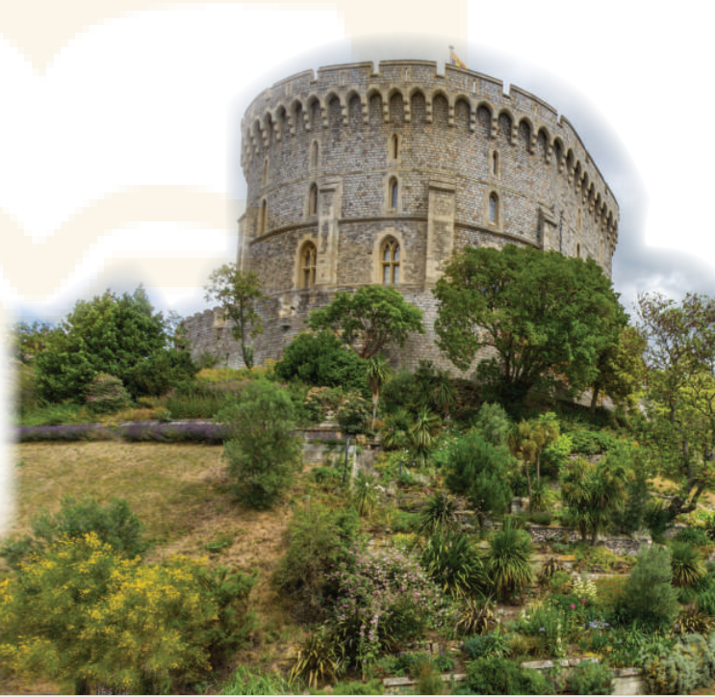
* PRACTICE
- Look at the title of the conversation. Then look at the picture
What do you think they are discussing?
They are talking about historic buildings
What do you see in the picture(s)?
It is Angkor Wat .
It’s a temple complex
What do you know about it / them?
It is in Cambodia. It’s a temple complex, the largest religious monument in the world

Slide 18
1
Listen and read.
Teacher: Now let’s look at what you’ve done on your projects. Group one first, please.
Mi: OK. This is Angkor Wat in Cambodia. It’s a temple complex, the largest religious monument in the world.
Teacher: Fantastic! When did people build it?
Mi: They built it in the 12th century. It’s a World Heritage Site. Millions of visitors go there every year
Teacher: Thank you. I wish I could go there one day too. And now group two, please.

Slide 19
1
Listen and read.
Nam: Our project is about Dinh Bang Communal House in Bac Ninh Province - a national historic site. People were building it for 36 years, and it’s about 300 years old!
Teacher: Great! It’s quite magnificent! Now group three, please.
Lan: Well, this is Windsor Castle in England. It was built about a thousand years ago. It’s been the home for about 40 English kings and queens.
Teacher: Yeah. It’s the oldest and largest occupied castle in the world.
Mi & Nam: Amazing! So we need to preserve our heritage for future
generations.
Teacher: Right. Thanks to preservation efforts, we know a lot about our history and life in the past.

Slide 20
Questions:
- What are they talking about?
They are talking about historic buildings / our history / the past / life in the past …
- Tell me some words in the text that they think are related to the unit’s topic.
Cambodia, complex, monuments, build, communal, …

Slide 21
2
Read the conversation again and answer the questions
1. How old is Angkor Wat?
About 900 years old/ Nearly a thousand years old.
2. What is Dinh Bang Communal House like?
It’s magnificent.
3. Where is Windsor Castle?
In England.
4. What helps us know about our history and life in the past?
preservation
1. The best way to preserve our cultural ___________ is to share it with others.
2. Vietnamese people take great pride in their culture which has been ________________for thousands of years.
3. The foreign tourists gave a _____________performance of the Vietnamese folk songs and dances

Slide 22
3
Complete each sentence with a word or a phrase from the box
occupied magnificent thanks to heritage well preserved
heritage
1. The best way to preserve our cultural ___________ is to share it with others.
2. Vietnamese people take great pride in their culture which has been ________________for thousands of years.
well preserved
magnificent
3. The foreign tourists gave a _____________performance of the Vietnamese folk songs and dances
Thanks to
4. __________ your kind contribution, we were able to save the ancient monument.
occupied
5. Many beautiful old castles are no longer ____________.
5. Many beautiful old castles are no longer ____________.
4. ___________ your kind contribution, we were able to save the ancient monument.

Slide 23

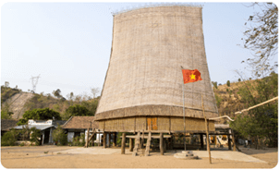
4
Look at the pictures and complete the sentences.
1. This is a standard serving of __________ with a slice of lemon.
fish and chips
2. The ________ house has a significant meaning in the Bahnar community.
communal

Slide 24
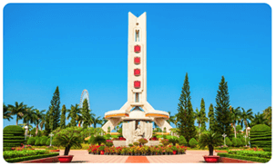
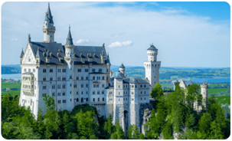
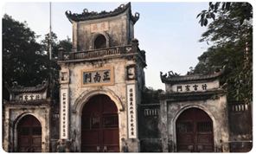
4
Look at the pictures and complete the sentences.
3. In the square, there is a ___________ dedicated to the people killed in the war.
monument
4. They have decided to rebuild the _______ which was damaged in the disaster
castle
5. In Nam Dinh City, there is a complex of three _______where people worship the Tran Dynasty’s Kings and royal family members.
temples

Slide 25
PRODUCTION
5
GAME: Remembering past events
Work in two groups. Give short answers to the following questions. The group with more correct answers wins.

Slide 26


PRODUCTION
5
GAME: Remembering past events
1. Who decided to move our capital from Hoa Lu to Dai La (Thang Long) in 1010?
King Ly Thai To (Ly Cong Uan).

Slide 27
PRODUCTION
5
GAME: Remembering past events
2. When did Columbus discover the Americas?
In 1492

Slide 28
PRODUCTION
5
GAME: Remembering past events
3. When was the United States founded?
In 1776.

Slide 29
PRODUCTION
5
GAME: Remembering past events
4. When did Nguyen Ai Quoc first go abroad?
In 1911.

Slide 30
PRODUCTION
5
GAME: Remembering past events
5. What happened in world history in 1914?
World War I started/ broke out.

Slide 31
PRODUCTION
5
GAME: Remembering past events
6. Who was the last king of Viet Nam?
King Bao Dai (1913 – 1997)

Slide 32

* Homework
Do exercises in the workbook.
Prepair lesson 2: A closer look 1.

Slide 33



Slide 34
LESSON 1: GETTING STARTED
LESSON 1: GETTING STARTED
WARM-UP
Option 1: Think!
Option 2: Memory Lane
Vocabulary
PRESENTATION
Task 1: Listen and read.
Task 2: Read the conversation again and answer the questions.
Task 3: Complete each sentence with a word or a phrase from the box.
Task 4: Look at the pictures and complete the sentences.
PRACTICE
PRODUCTION
Task 5: Game: Remembering past events.
CONSOLIDATION
Wrap-up
Homework

Slide 35

CONSOLIDATION
1
Wrap-up
What have we learnt in this lesson?
Use the words related to the topic remembering the past.
Gain vocabulary to talk about some historical places.

Slide 36
CONSOLIDATION
2
Homework
- Do exercises in the workbook.

Slide 37
CONSOLIDATION
2
Homework
- Prepare for the Project of the unit
- Open book p.49, look at the picture and say what the topic of the project is
- Work in groups to design a poster.
- You will show and present in Lesson 7 – Looking back and Project.

Slide 38
CONSOLIDATION
2
Homework
Step 1: Collecting information (asking your grandparents and / or old people, searching the Internet, reading books / magazines, brainstorming ideas, etc.)
Step 3: Practising explaining their posters and answering questions about the content
Step 2: Organising ideas and visuals, and designing the posters

Slide 39
CONSOLIDATION
2
Homework
Step 1: Collecting information (asking your grandparents and / or old people, searching the Internet, reading books / magazines, brainstorming ideas, etc.)
Step 3: Practising explaining their posters and answering questions about the content
Step 2: Organising ideas and visuals, and designing the posters

Slide 40
CONSOLIDATION
2
Homework
Step 1: Collecting information (asking your grandparents and / or old people, searching the Internet, reading books / magazines, brainstorming ideas, etc.)
Step 3: Practising explaining their posters and answering questions about the content
Step 2: Organising ideas and visuals, and designing the posters

Slide 41
Website: hoclieu.vn
Fanpage: facebook.com/www.tienganhglobalsuccess.vn/

Slide 42
WARM-UP
OPTION 1
Answer the questions:
- Do you care about healthy living?
- What do you often do to keep fit?
- What did your parents / grandparents do to keep fit?
- What do you know about your grandparents’ lifestyle (their clothes / cooking / eating habits, …)?
THINK!

Slide 43

WARM-UP
OPTION 2
- Close your eyes and imagine you are walking down a memory lane.
- What memories do you see?
- Are they happy or sad?
- What do you smell?
- What do you hear?
MEMORY LANE
- Share your memories with the class.
Advantages team | Disadvantages team

Slide 44
* Vocabulary
to bring something into existence.
found (v)
/faʊnd/
Ex: Boston was founded in 1630 by Puritan colonists from England.
thành lập

