Slide 1
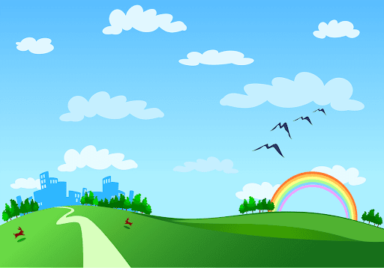

Slide 2






* Play a game : * Guessing game: TV channels
1
football channel
2
Discovery Channel
3
Disney Channel
4
Quang Ngai television
5
Cartoon Network

Slide 3
1
football channel
2
Discovery Channel
3
Disney Channel
4
Quang Ngai television
5
Cartoon Network
1/Among these five channels, which one do you like best?
I like ………… best because I………………
2/ What about you? Do you often read the TV guide before watching TV?
………………………………………………………………………………………………………

Slide 4

Unit 7:
TELEVISION
LESSON 5
SKILLS 1

Slide 5
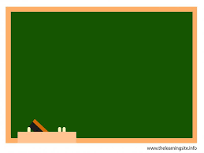
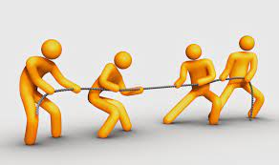


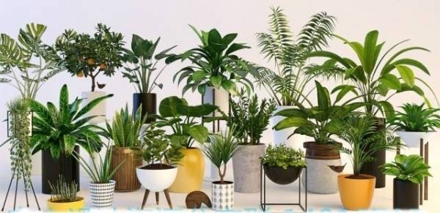
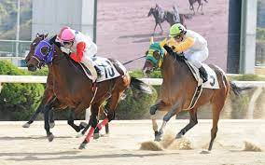
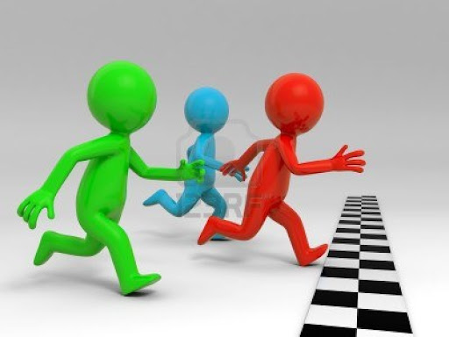
* Vocabulary
- compete (v) :
tranh tài , cạnh tranh
- plant (n):
cây cảnh, thực vật
- comedy (n):
phim hài
- race (n):
cuộc đua

Slide 6
* Checking vocabulary
- compete (v) :
tranh tài , cạnh tranh
- plant (n):
cây cảnh, thực vật
- comedy (n):
phim hài
- race (n):
cuộc đua

Slide 7

I. Reading
Read the first two columns of the TV guide and answer the questions.
TIME | PROGRAMME | DESCRIPTION
8.00 | Wildlife: Cuc Phuong Forest | Watch the colourful world of plants, ﬂowers, and animals in their real life.
9.00 | Comedy: The Fox Teacher | Have a lot of fun with a fox teacher and his students on their first day at school.
10.30 | Sports: The Pig Race | Watch the cute pigs compete in the most exciting races. Who wins?
11.00 | Game show: Children are Always Right | Join this game show today and try to answer interesting questions about pets.
12.15 | Science: The Dolphins | Watch funny and interesting clips of intelligent dolphins in their natural life - the sea.

Slide 8

* Answer the questions.
1. What's in the Wildlife programme?
2. Is The Fox Teacher a comedy?
3. What time is the Sports programme?
4. Can we watch a garne show at 10.30?
5. What is the topic of the Science programme?

Slide 9
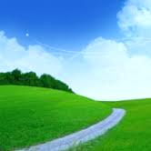



Who’s faster?
3
4
5
1
6
1

Slide 10
Read the first two columns of the TV guide and answer the questions.
1.
What’s in the Wildlife programme?
It’s Cuc Phuong Forest.

Slide 11
Read the first two columns of the TV guide and answer the questions.
2
Is The Fox Teacher a comedy?
Yes, it is.

Slide 12
Read the first two columns of the TV guide and answer the questions.
3.
What time is the Sports programme?
It’s on at 10.30.

Slide 13
Read the first two columns of the TV guide and answer the questions.
4.
Can we watch a game show at 10.30?
No, we can’t.

Slide 14
Read the first two columns of the TV guide and answer the questions.
5
What is the topic of the Science programme?
It’s about dolphins.

Slide 15

LUCKY apple!
YOU GET A GIFT

Slide 16
Read the first two columns of the TV guide and answer the questions.
1.
What’s in the Wildlife programme?
It’s Cuc Phuong Forest.
2.
Is The Fox Teacher a comedy?
Yes, it is.
3.
What time is the Sports programme?
It’s on at 10.30.
4.
Can we watch a game show at 10.30?
No, we can’t.
5.
What is the topic of the Science programme?
It’s about dolphins.

Slide 17

Read the TV guide in 1 and write the programmes that these people may choose to watch.
People | Programmes
1. Phong wants to know more about dogs and cats.
2. Bob likes programmes that make him laugh.
3. Nga loves learning about plants and animals.
4. Minh likes watching races.
5. Linh is interested in sea animals.
Children are Always Right
The Fox Teacher
Cuc Phuong Forest
The Pig Race
The Dolphins

Slide 18

II. Speaking
Work in groups. Share your table in 2 with your group and see if they agree with you.
Example:
A: I think the best programme for Phong is the game show
Children are Always Right.
B: I agree. He wants to know more about pets.

Slide 19


Work in groups. Tell your group about your favourite TV programme. Your talk should include:
the name of the programme
the channel it is on
the content of the programme
You can use these suggestions.
the reason you like it
My favourite programme is ...
It’s on ...
It’s about ...

Slide 20
* Model writing 1
My favorite TV programme is cartoon "Tom and Jerry“. It's on Disney Channel at 5p.m,from Monday to Saturday every week. Tom is a cat and Jerry is a little mouse. Tom always chase Jerry to eat meat. I like Jerry because he's cool. Tom is stupid but funny. I always watch it after school . I like this programme very much because it's very funny and entertaining after study.

Slide 21
* Model writing 2
My favorite TV programme is “Rap Viet "
It's on VTV3 at 9. 15 every Saturday
In this programme , Contestants perform their own rap. Judges watch, comment and vote to award the best rap talent. I like this programme very much because it's interesting and fun.

Slide 22
* Model writing 3
My favorite TV programme is “Discovering of The World”. The programme provides us with a variety of interesting facts about nature, the universe, humans, animals and plans over the world. Through the programme, I have a chance to discover different cultures and have more useful information about aspects of life. “Discovering of The World” is broadcasted on VTV2 every Friday evening. Another reason why I love watching the programme is that I’m always curious about the world and the programme brings convincing answers.

Slide 23
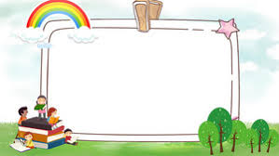
WRAP-UP
- To consolidate what students have learnt in the lesson

Slide 24
homework
- Do exercise in workbook.
- Prepare lesson 5: Skills 2.

Slide 25





