Slide 1







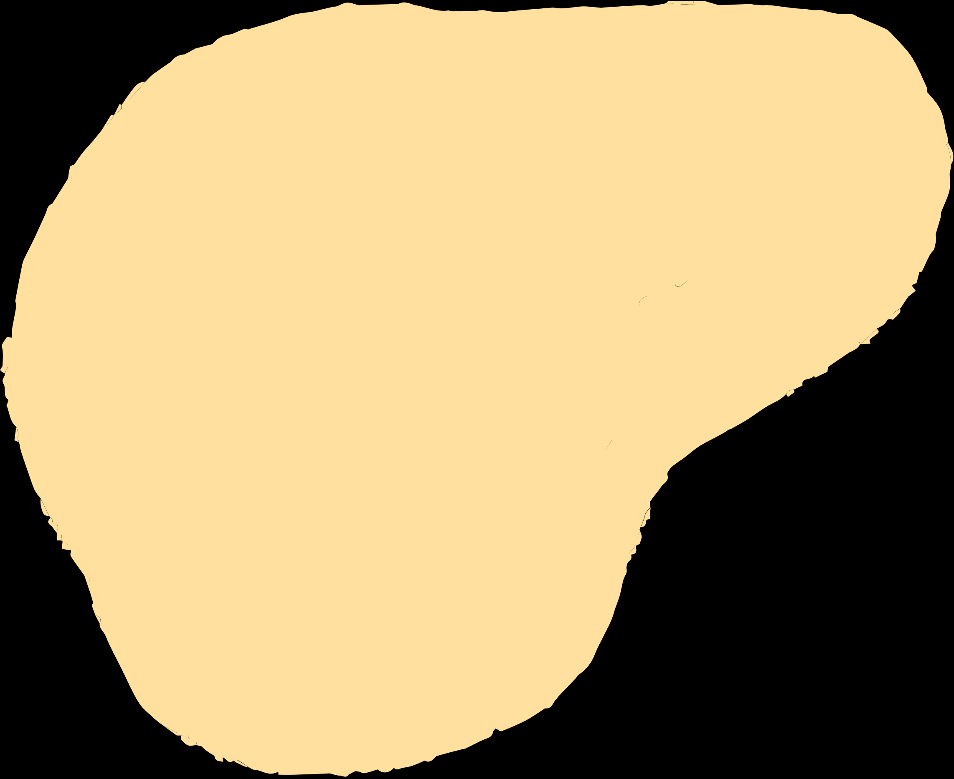
Welcome to our class!
Teacher:….

Slide 2


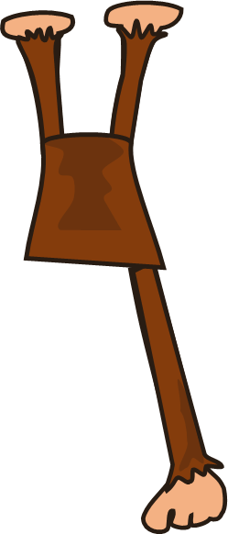

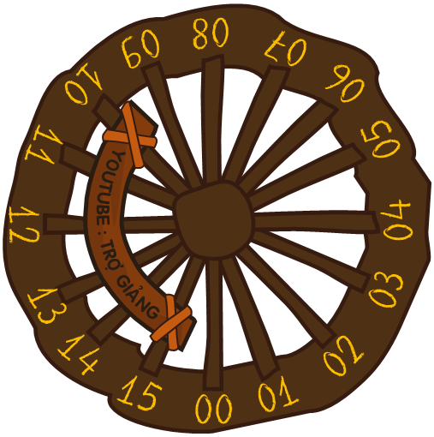





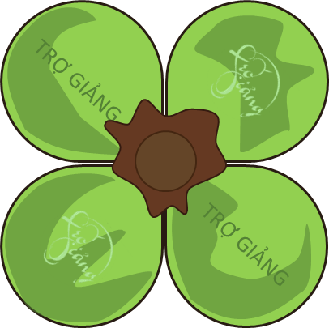

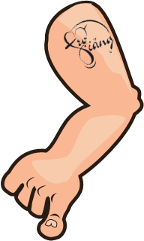



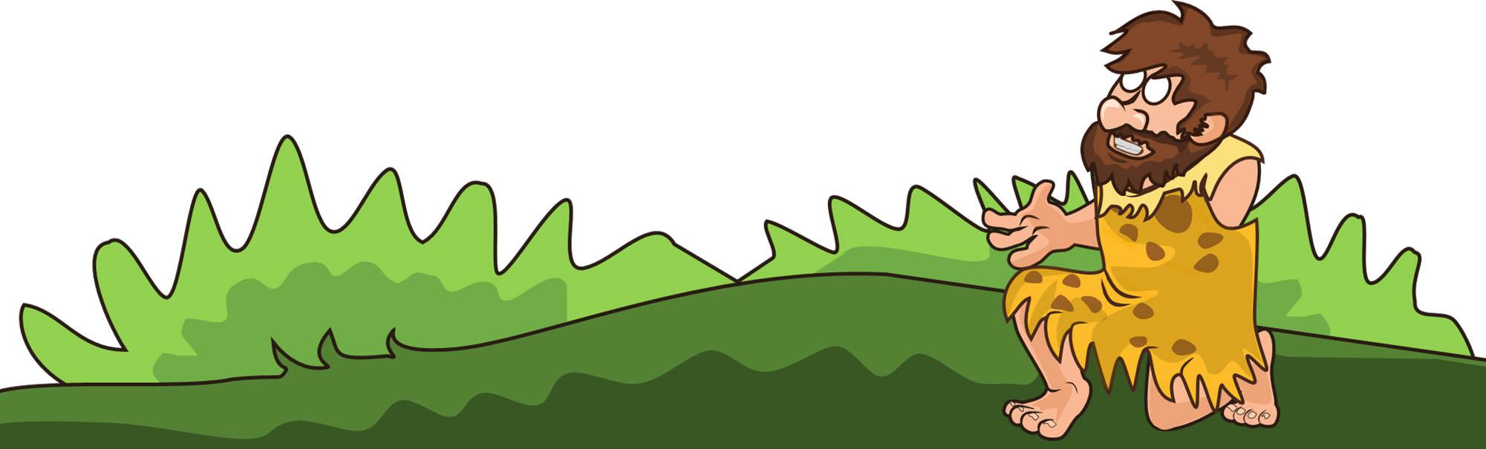


BALLOON GAME
!!!
GAME
BALLOONS

Slide 3

1. In which months is Lunar New Year normally held?
January & February
!!!

Slide 4
2. What month does Mid-Autumn festival take place?
August
!!!

Slide 5
3. Which province is famous for Lim Festival?
Bac Ninh Province
!!!

Slide 6
4. Does the original Hung King Festival take place in Phu Tho province?
Yes, it is.
!!!

Slide 7
5. What city is famous for a lantern festival?
Hoi An
!!!

Slide 8
6. What city is famous for a lantern festival?
Hoi An
!!!

Slide 9
7. Name traditional Tet festival food?
Banh chung, Banh tet, hat dua, Dua hanh, Cu kieu, xoi gac, ….
!!!

Slide 10
8. What is the most important Festival holiday in Vietnam?
Tet
!!!

Slide 11



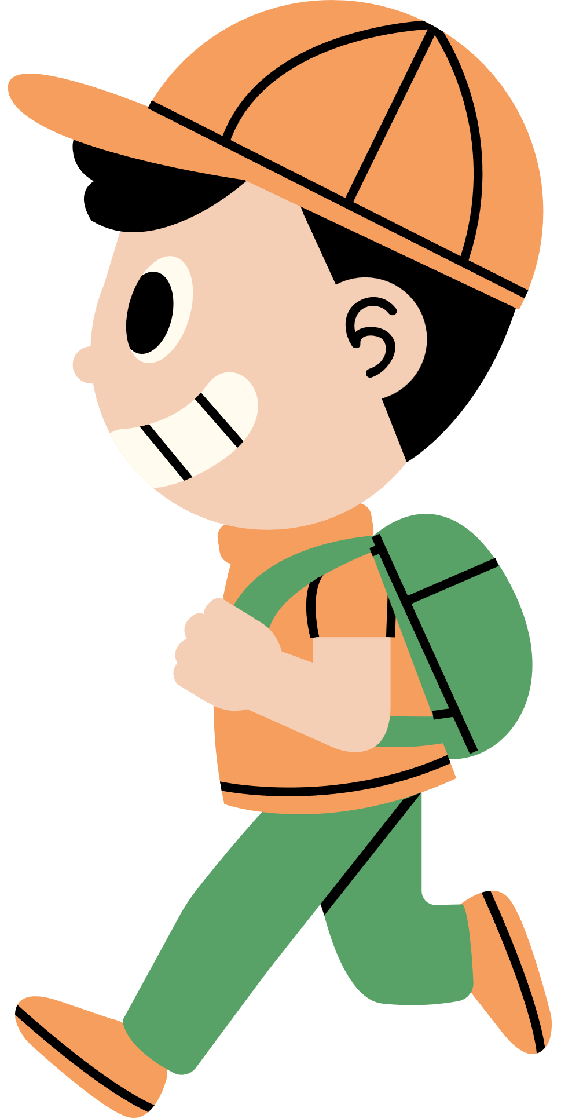

Unit 5:
OUR CUSTOMS AND TRADITIONS
Lesson 5: Skills 1

Slide 12




Vocabulary

Slide 13







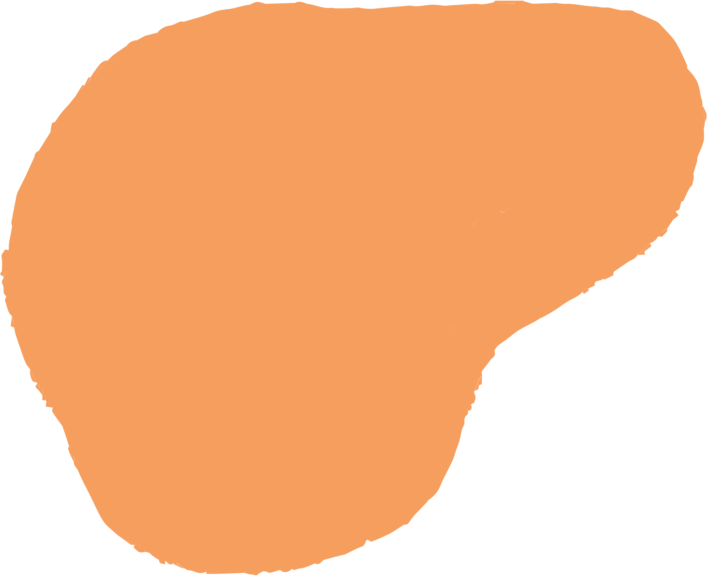
Vocabulary
release (v)
/rɪˈliːs/
thả

Slide 14
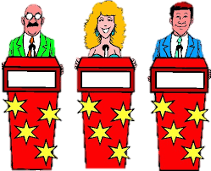
Vocabulary
contestant (n)
/kənˈtestənt/
thí sinh,
người thi đấu

Slide 15
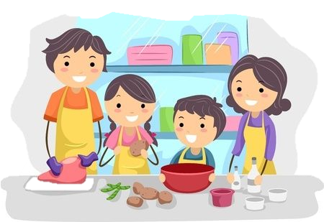
Vocabulary
family bonding
/ˌfæməli ˈbɒndɪŋ/
sự gắn kết tình cảm gia đình

Slide 16


Vocabulary
release (v) | /rɪˈliːs/ | thả
contestant (n) | /kənˈtestənt/ | thí sinh, người thi đấu
family bonding | /ˌfæməli ˈbɒndɪŋ/ | sự gắn kết tình cảm gia đình

Slide 17
Reading

Slide 18

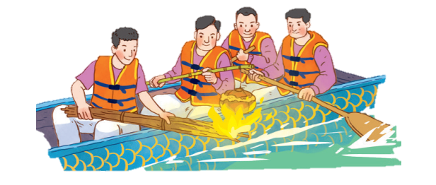

1. Work in pairs. Look at the picture and answer the following questions
1. What are the men doing?
- They are rowing a boat. They are cooking rice on an open fire.
2. When do you think this event occurs?
- This event may occur in a festival in the North of Vietnam.

Slide 19



2. Read the text. Choose the correct answer A, B, or C.
3. The phrase “releases a duck” in the text means ______.
A. gives it freedom
B. catches it
C. takes it home
4. Why is the festival important?
A. Because it is exciting.
B. Because people win valuable prizes.
C. Because it keeps some village traditions alive.
1. What is the text mainly about?
A. A local tradition.
B. A family tradition.
C. A family tradition.
2. To win the boat race, a team must ______.
A. row the boat more quickly than the other teams
B. row the boat the fastest and properly cook the rice
C. cook rice properly and catch the duck

Slide 20

Check your answer
1. What is the text mainly about?
A. A local tradition.
B. A family tradition.
C. A family tradition.
2. To win the boat race, a team must ______.
A. row the boat more quickly than the other teams
B. row the boat the fastest and properly cook the rice
C. cook rice properly and catch the duck
I live in a small village in northern Viet Nam. Every year, people in my village look forward to the third day of Tet. It is one of our most important festival days.
The fastest team with well-cooked rice wins the race.

Slide 21
2. Read the text. Choose the correct answer A, B, or C.
3. The phrase “releases a duck” in the text means ______.
A. gives it freedom
B. catches it
C. takes it home
4. Why is the festival important?
A. Because it is exciting.
B. Because people win valuable prizes.
C. Because it keeps some village traditions alive.
Then, the referee releases a duck into the middle of the river
The village festival helps us maintain our traditions, connect with other people, and strengthen our family bonds.

Slide 22
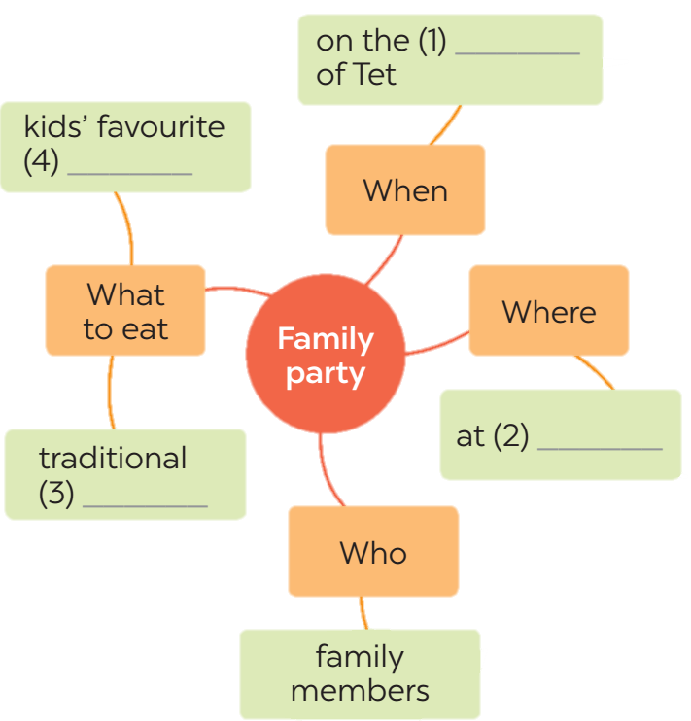
3. Read the text again. Complete the mind map about a family party.
third day
food
home
dishes

Slide 23
Speaking

Slide 24
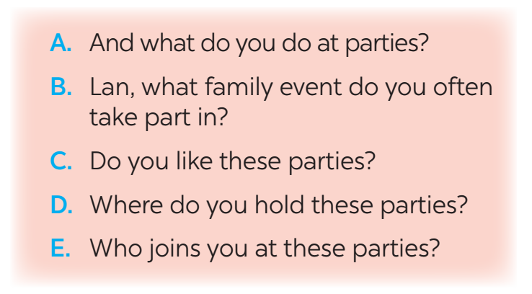
4. Work in pairs. Put the questions (A - E) in the correct blanks (1 - 5) to make a complete dialogue. Then role-play it.
Nick: (1) ______
Lan: Well, I join birthday parties of all my family members.
Nick: (2) ______
Lan: In a Vietnamese restaurant. But sometimes we break with tradition by going to a Western one.
Nick: (3) ______
Lan: Everyone in my family.
Nick: (4) ______
Lan: Well, the birthday person opens the gifts. and everyone has some good food.
Nick: (5) ______
Lan: Yes, I always look forward to them. They are a great time for family bonding.

Slide 25

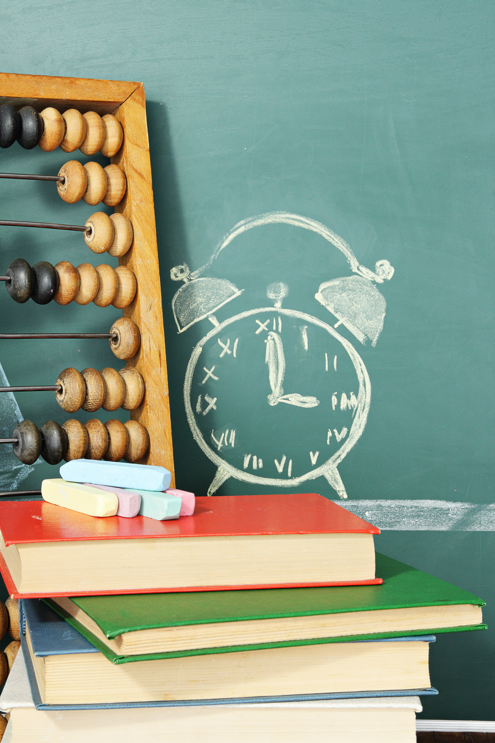

5. Make notes about a normal family event that you take part in. Use the questions below as cues.
1. What is the event?
2. Where and when does it happen?
3. Who joins with you?
4. What do you often do at that event?
5. Do you like it or not? Why or why not?
Full Moon Festival
Now work in pairs.
Make a dialogue asking and answering about the event. You can use your notes.
On the 15th day of the 8th Lunar Month in Asia
My family, my friends,…
Eat moon cake, hang lantern....
Yes, I do. Because I can celebrate with my family.

Slide 26


THANKYOU!
Homework
Learn by heart vocabulary
Do exercises in workbook
Prepare for the next lesson

