Slide 1



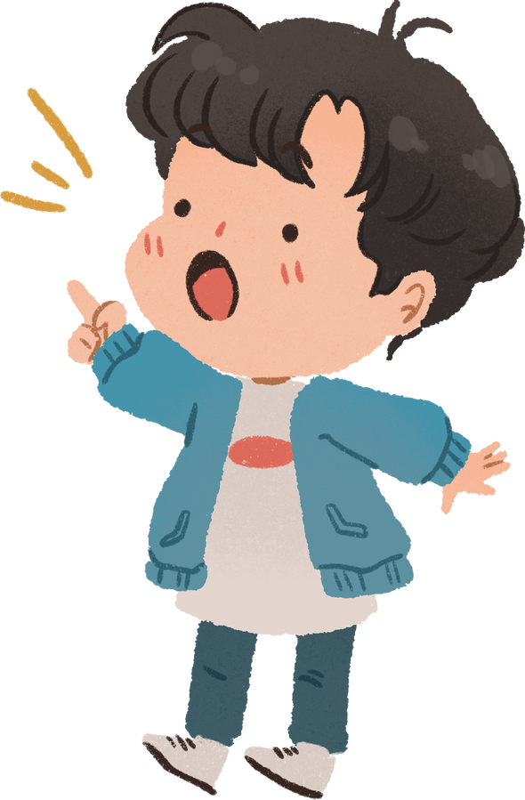
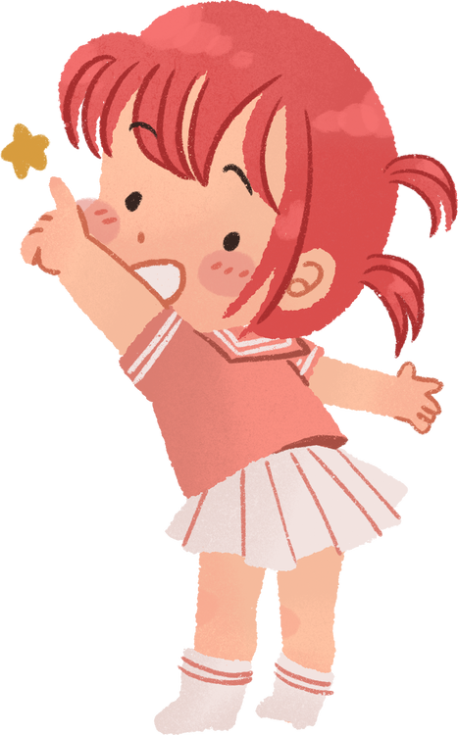




Welcome to our class!
Teacher:

Slide 2

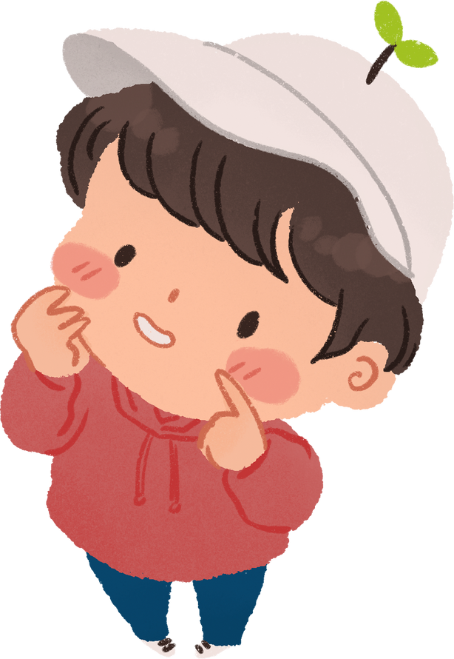

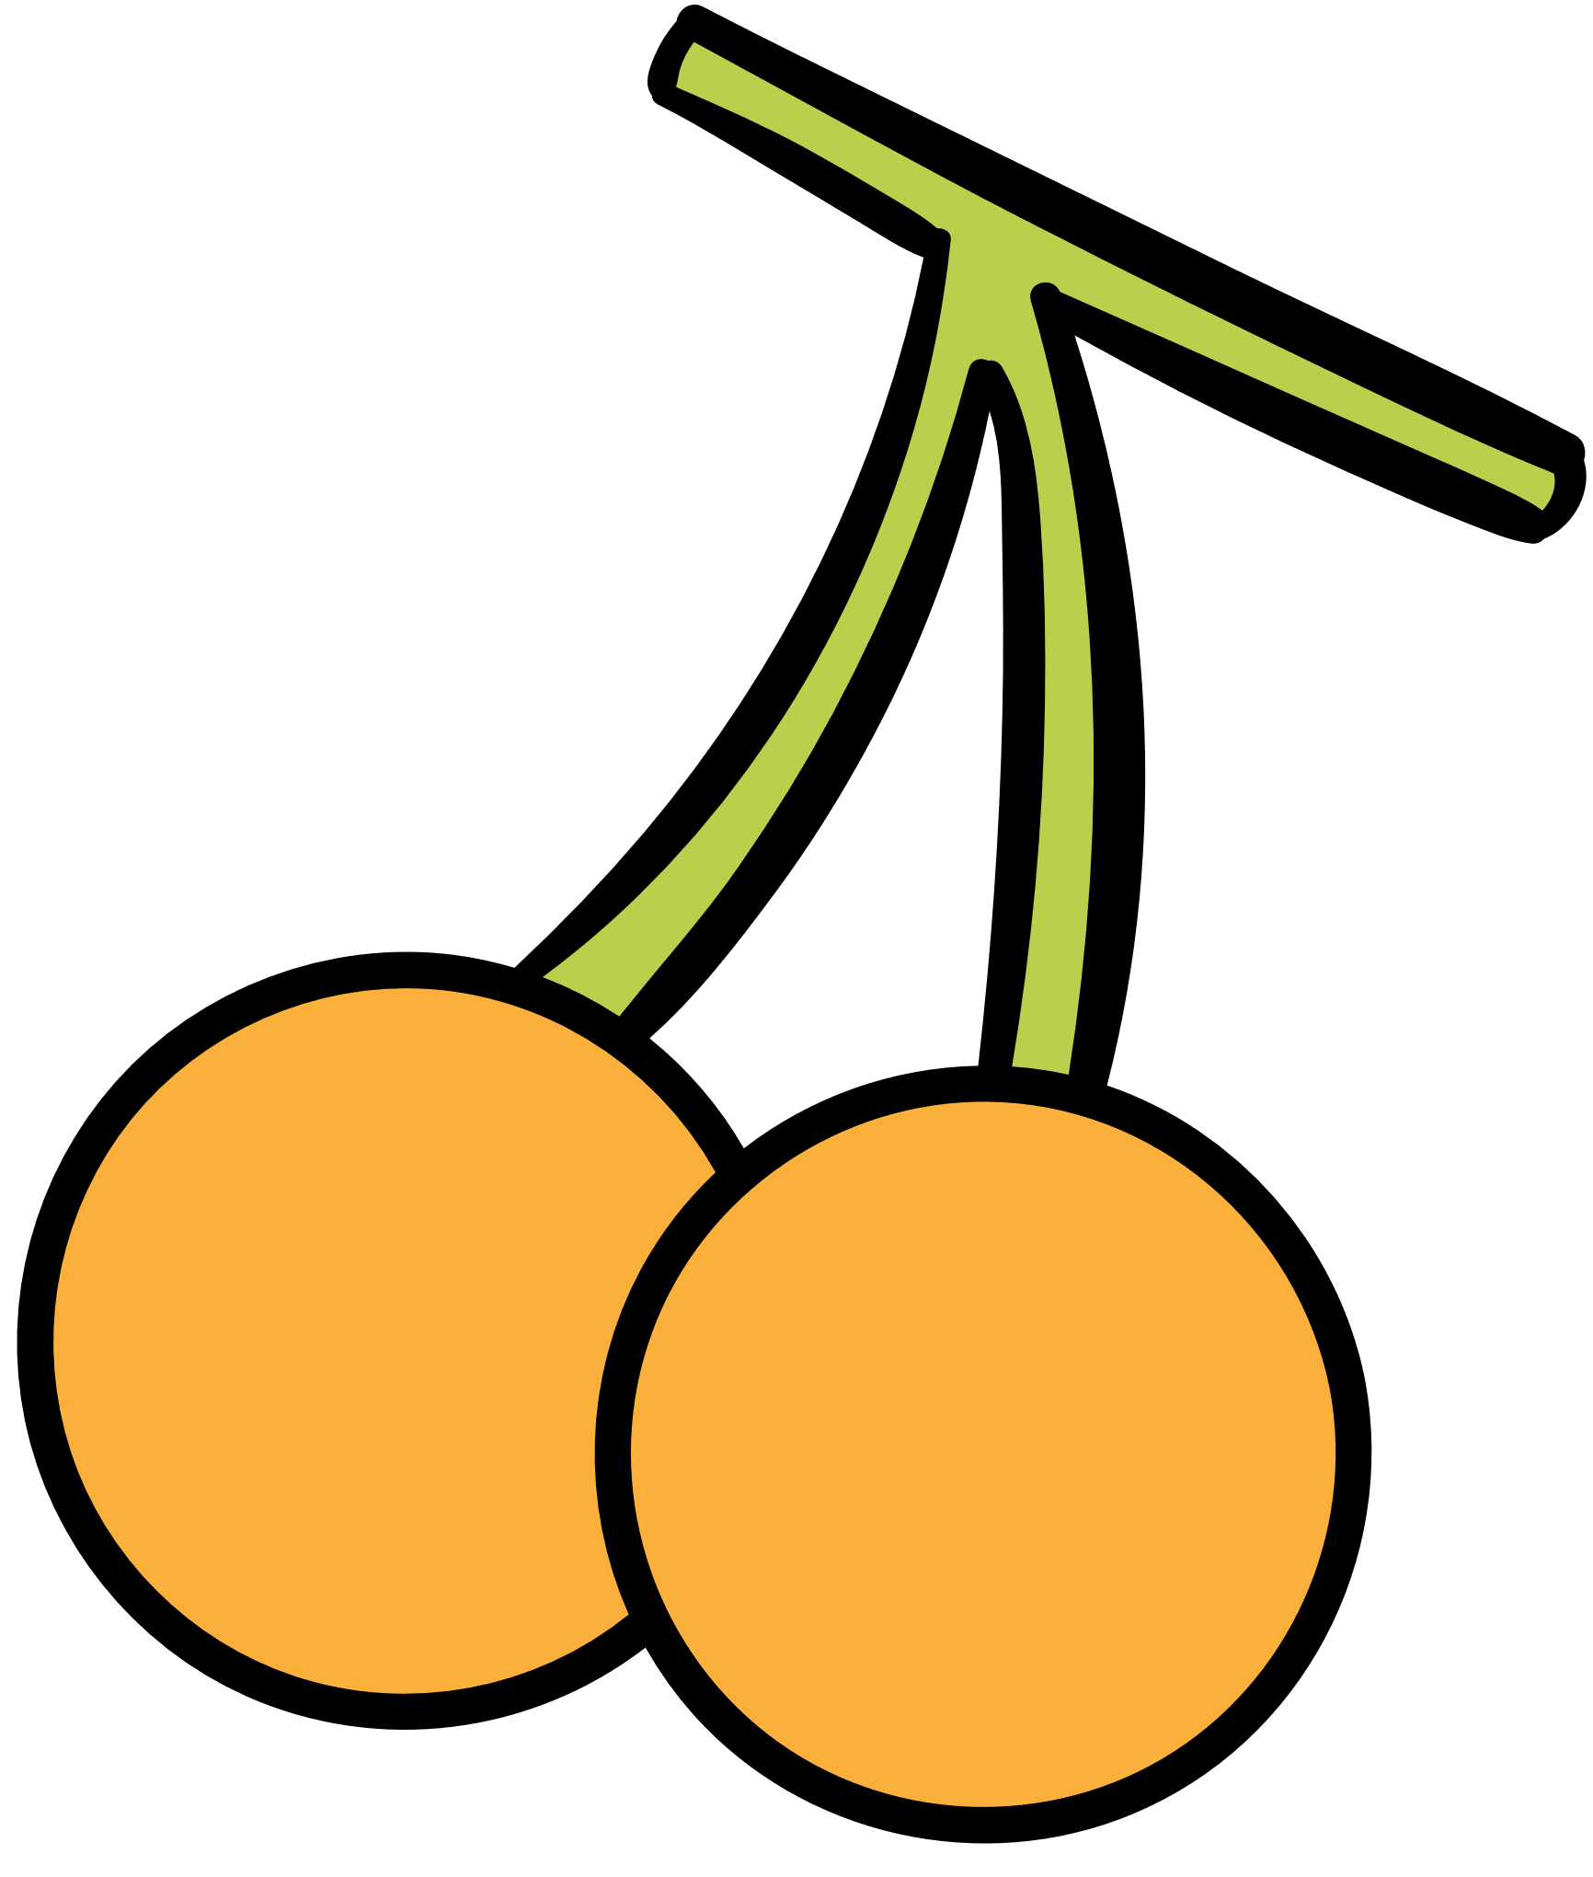

Unit 5:
OUR CUSTOMS AND TRADITIONS
Lesson 7: Looking back and Project

Slide 3




VOCABULARY
MORE
DETAILS

Slide 4
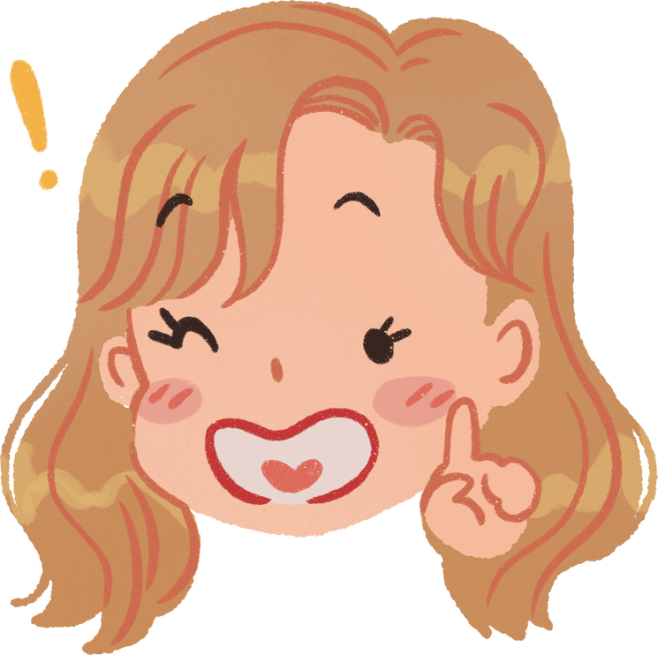

1. Choose the correct option to complete each sentence below.
1. It is becoming a ______ for many families in Viet Nam to celebrate Women’s day and family day.
A. habit B. custom
2. ______, we hold the Spring festival on the 15th of January in lunar calendar.
A. Traditionally B. In the past
3. Janet is from a family of doctors, but she broke with ______ when she went to an art college.
A. tradition B. habit
4. Having dinner at my grandparents’ house on Saturdays is one of the customs our family ______.
A. does B. practises
5. Story telling is a great way to ______ the local tradition alive.
A. maintain B. keep

Slide 5




2. Fill in each blank with the suitable form of the word given.
reunion
1. Kien was so tall that no one recognized him at the family _______ last summer. (union)
2. My mum puts in a lot of effort to prepare ________ to worship our ancestors. (offer)
3. The festival ______ gathered on the riverside to cheer the boat racers. (go)
4. Dragon-snake (Rong ran len may) is a __________ Vietnamese game for children. It is very enjoyable. (tradition)
5. We happened to see some locals ___________ animals in their village temples. (worship)
offerings
goers
traditional
worshipping

Slide 6
GRAMMAR
MORE
DETAILS

Slide 7


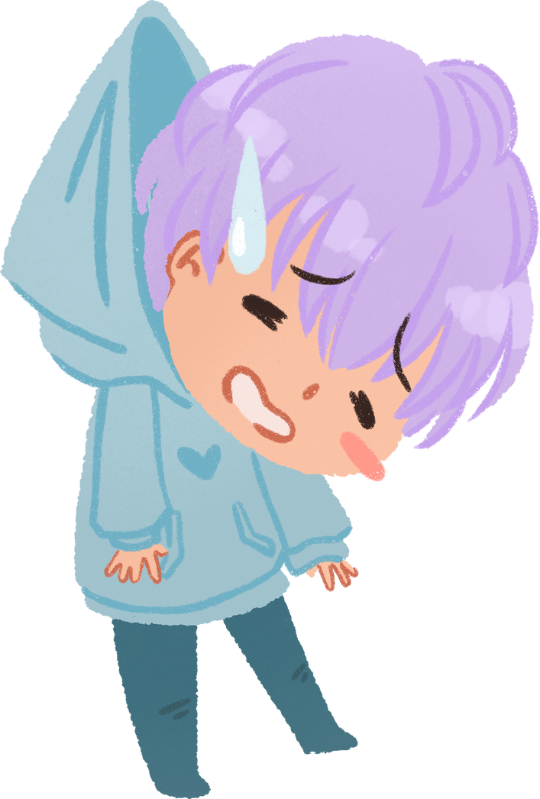



ARTICLES
a: indefinite article
a + singular noun beginning with a consonant
an : indefinite article
an + singular noun beginning with a vowel
the: definite article
zero article:
with uncountable or abstract nouns
when making general statements.
when describing general forms of transport.
Ø

Slide 8


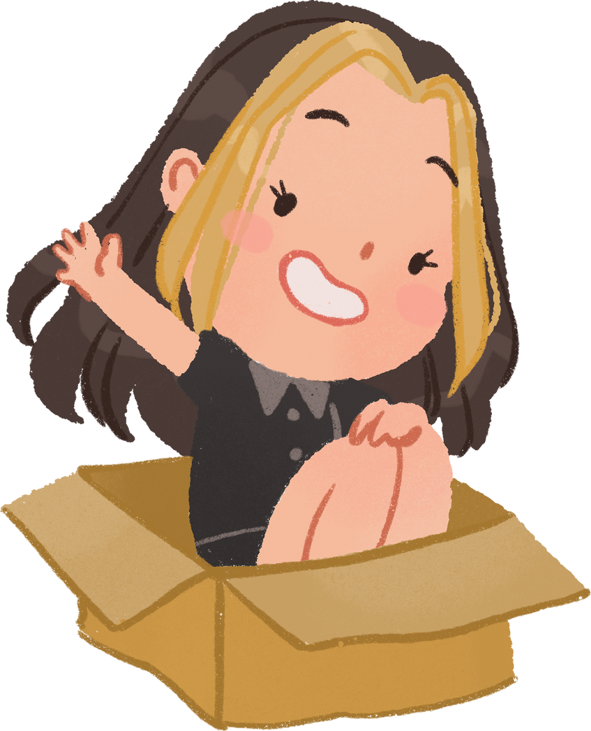


3. Complete the sentences with a, an, the or Ø (zero article).
Ø
1. These days, many teenagers write ______ emails instead of letters.
2. My dad bought ______ ornamental kumquat tree for Tet.
3. I don’t like that restaurant. ______ food there isn’t very good.
4. Don’t wear ______ hat when you go into a temple or a pagoda.
5. It’s becoming a custom for us to stay out very late on ______ New Year’s Eve.
an
The
a
Ø

Slide 9
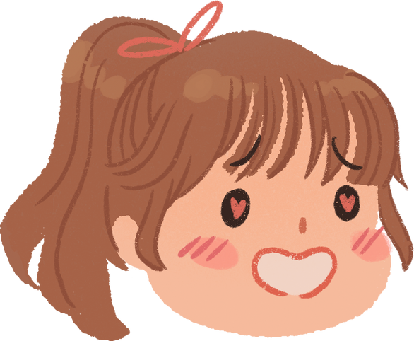
4. Complete the text with a, an, the or Ø (zero article).
Here are two easy ways to raise children’s awareness of (1) ______ customs and traditions. First, it is (2) ______ good idea for parents to teach children to cook. By doing this, children can learn and preserve their family recipes. Second, parents can take children to (3) ______ local festivals. This helps them discover (4) ______ culture of their community and develop (5) ______ understanding of local traditions.
Ø
a
Ø
the
an

Slide 10
PROJECT
PRESENTATION
MORE
DETAILS

Slide 11
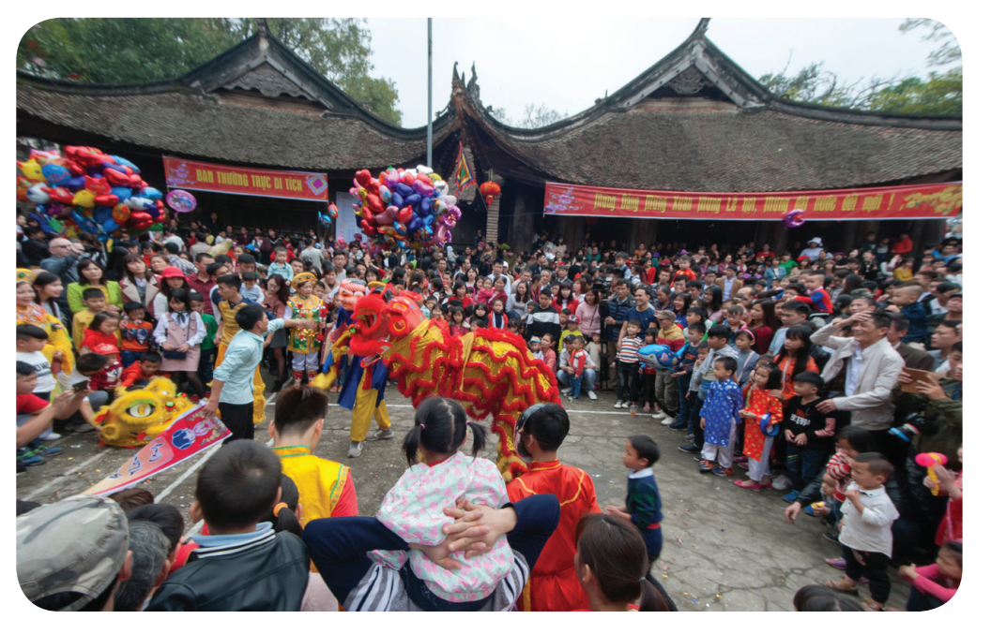



LOCAL CUSTOMS AND TRADITIONS

Slide 12
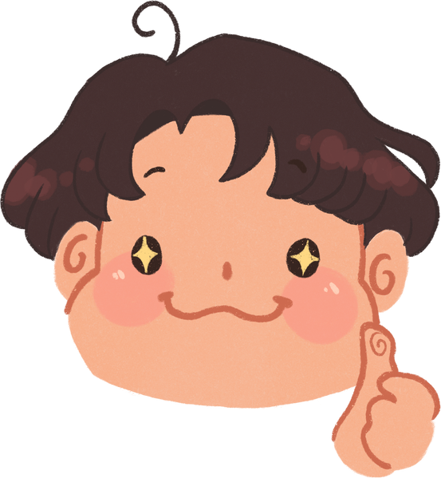
THANK YOU!
Review the vocabulary and grammar in this unit
Do exercises in the workbook
Prepare for the next lesson

