Slide 1

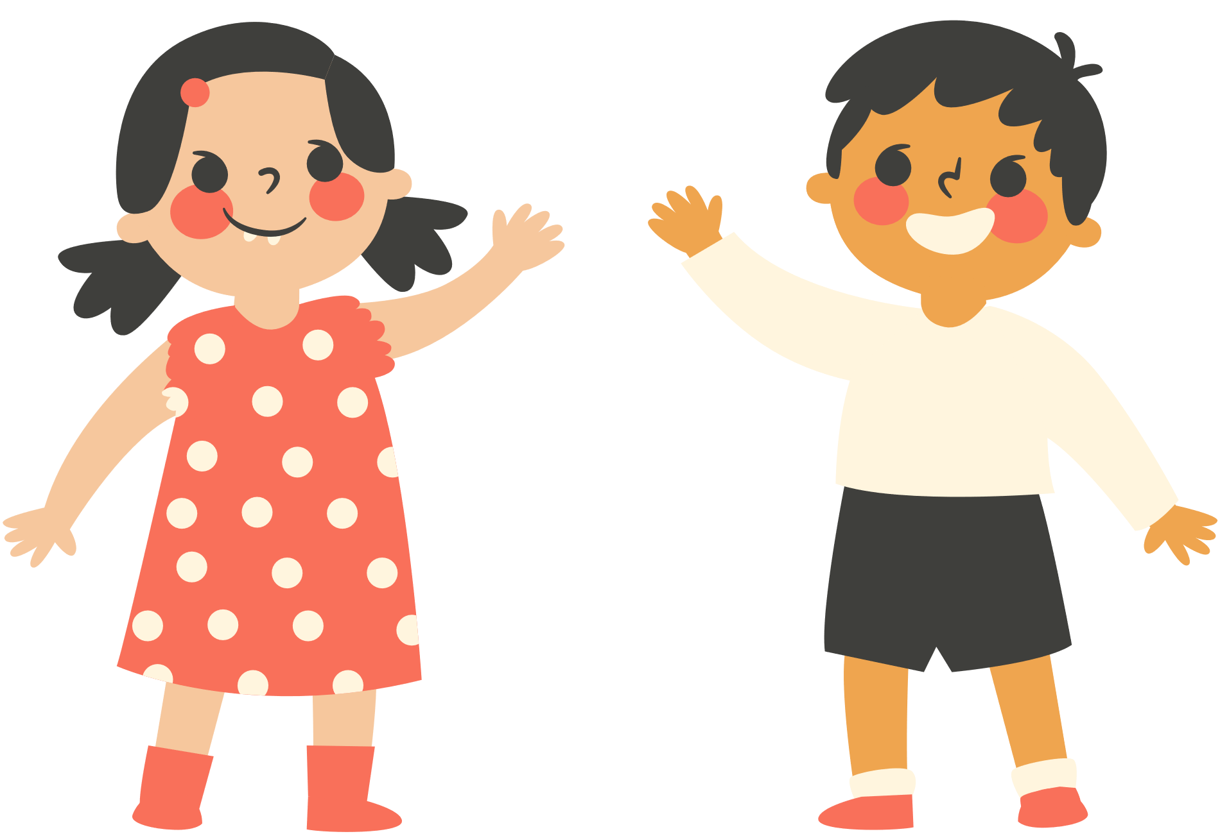


Welcome to our class!

Slide 2
MEMORY GAME

Slide 3
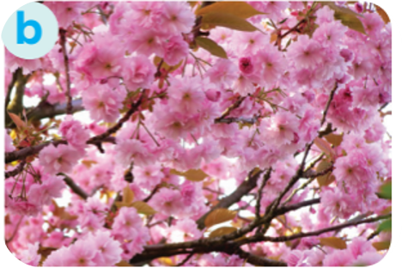
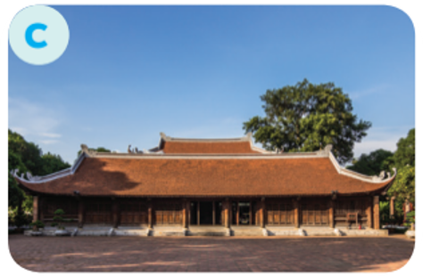
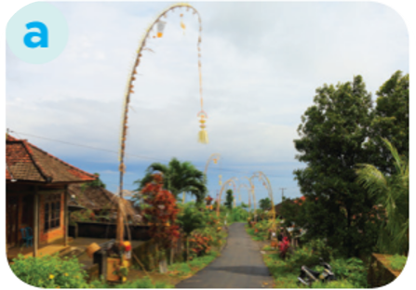
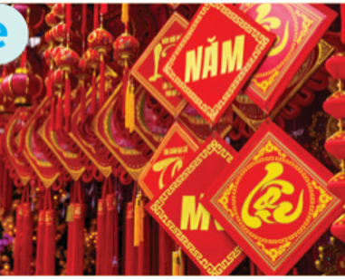
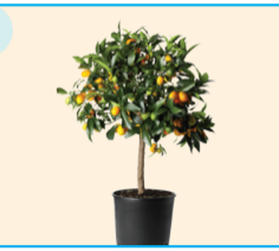
Choose the numbers to match the picture with the correct word.
1
a communal house
2
3
decorative items
5
6
4
blooming flowers
7
8
9
10
a bamboo pole
an ornamental tree

Slide 4
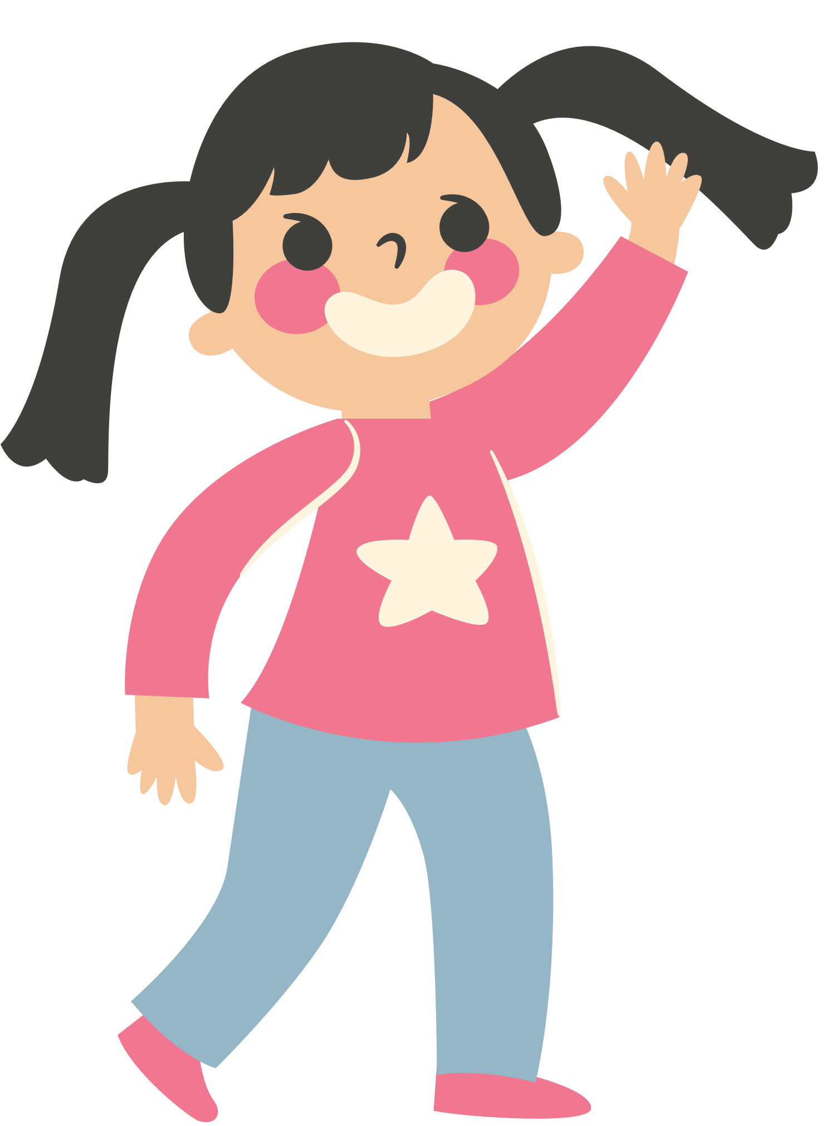
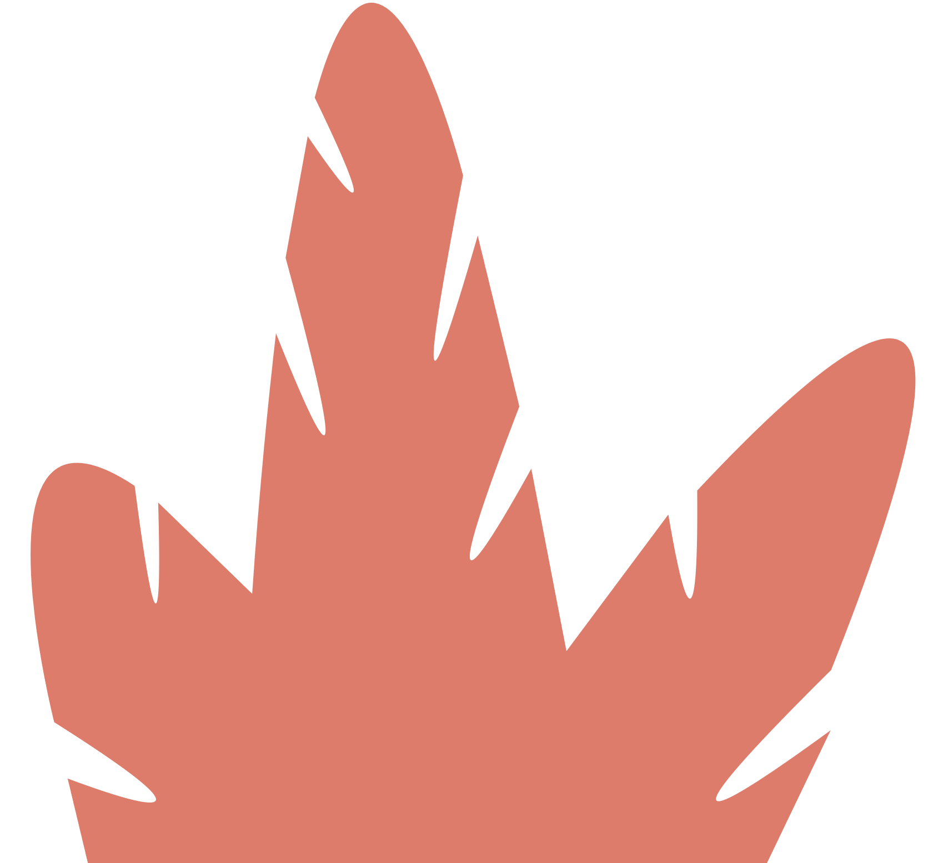

Unit 5:
OUR CUSTOMS AND TRADITION
Lesson 2: A Closer Look 1

Slide 5
VOCABULARY

Slide 6
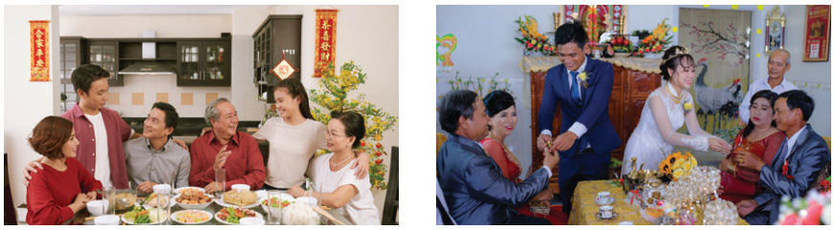
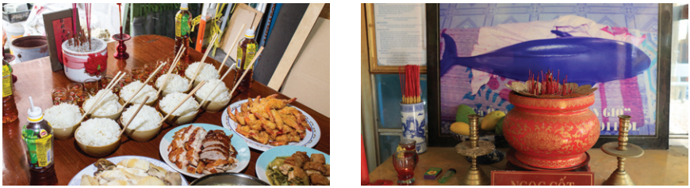
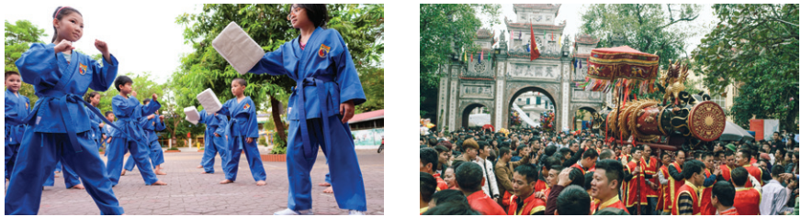
1. Write a phrase from the box under each picture.
wedding ceremony | whale worship | food offerings
family reunion | martial arts | festival goers
1._______________
2.________________
3._______________
4._______________
5.________________
6._______________

Slide 7
HIDDEN PICTURES

Slide 8

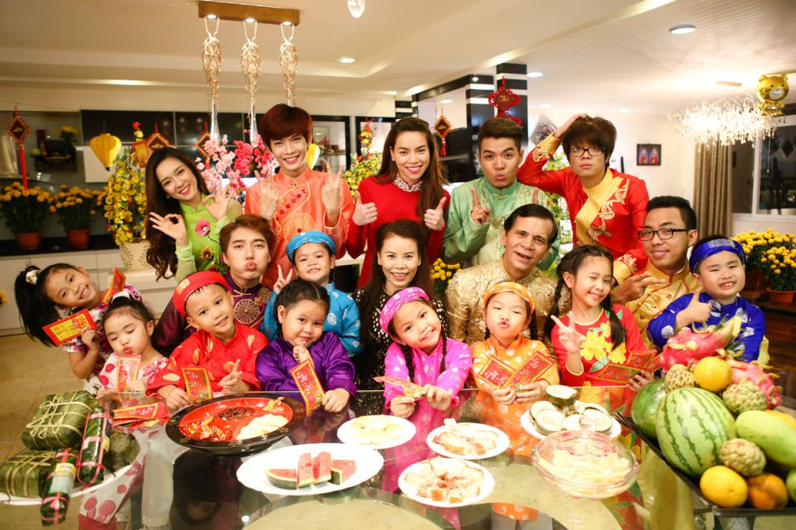
family reunion
/ˌfæmɪli ˌriːˈjuːnjən/
SHOW

Slide 9
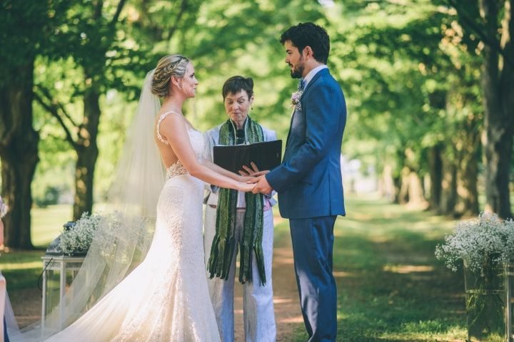
wedding ceremony
/ˈwed.ɪŋ/ /ˌser.ə.mə.ni/
SHOW

Slide 10
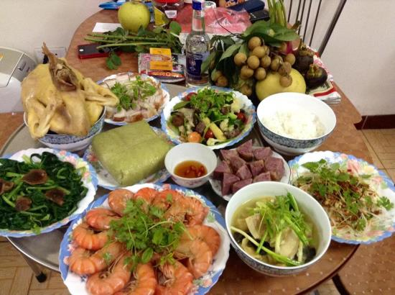
food offerings
/fuːd ˈɑː.fɚ.ɪŋz/
SHOW

Slide 11

whale worship
/weɪl wɜːʃɪp/
SHOW

Slide 12
martial arts
/ˌmɑːrʃl ˈɑːrts/
SHOW

Slide 13
festival goers
/ˈfestɪvl ˈɡəʊə(r)/
SHOW

Slide 14
Look at the answers again.
wedding ceremony | whale worship | food offerings
family reunion | martial arts | festival goers
1. family reunion
2. wedding ceremony
3. food offerings
4. whale worship
5. martial arts
6. festival goers

Slide 15
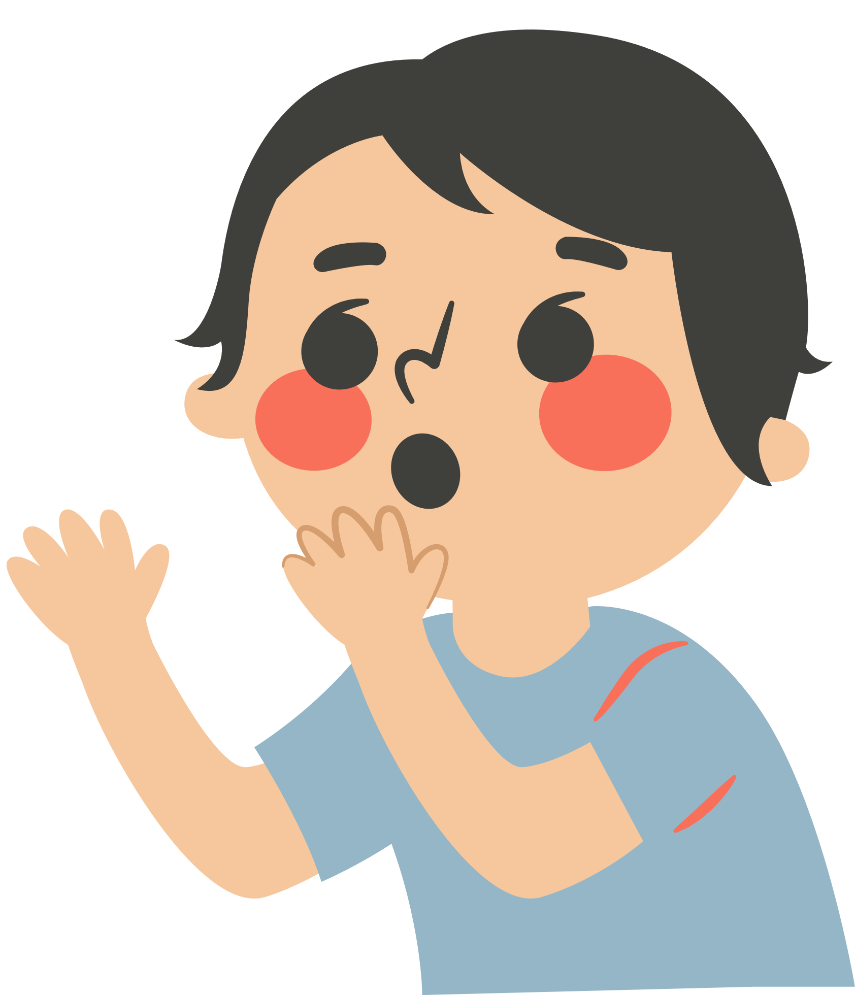
2. Complete each sentence with the correct option A, B, or C
1. We have a tradition of holding a family ______ on the first day of Tet.
A. reunion B. work C. meal
2. It’s a tradition for shops to have a lion dance performance at their opening ______.
A. worship B. celebration C. ceremony
3. The tradition of ______ whales is popular in Vietnamese coastal villages.
A. admiring B. worshipping C. praying
4. She broke with family tradition by not practising ______.
A. acrobat B. martial arts C. offering
5. Traditionally, the Vietnamese prepare ______ to worship their ancestors during Tet.
A. offerings B. decoration C. worshipping

Slide 16

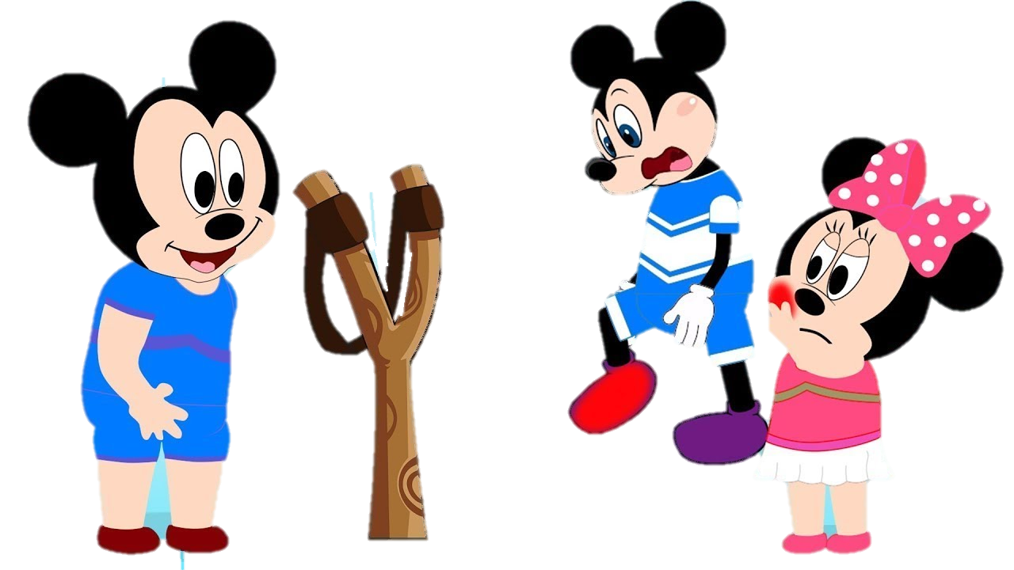



Slide 17
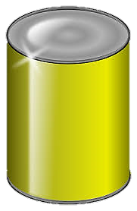
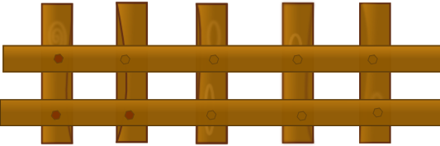
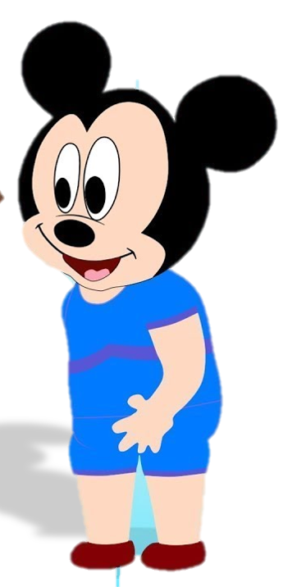
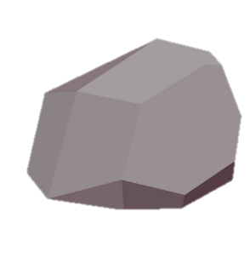
reunion
1. We have a tradition of holding a family ______ on the first day of Tet.
reunion
work
meal
Click on the right can

Slide 18
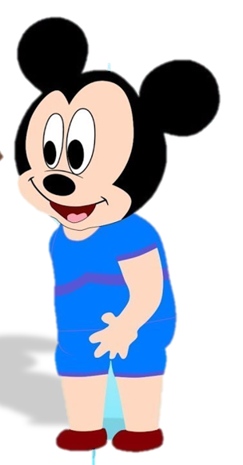
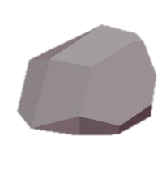
2. It’s a tradition for shops to have a lion dance performance at their opening ________.
ceremony
worship
celebration
ceremony
Click on the right can

Slide 19
worshipping
3. The tradition of __________ whales is popular in Vietnamese coastal villages.
admiring
worshipping
praying
Click on the right can

Slide 20
4. She broke with family tradition by not practising ____________.
martial arts
acrobat
martial arts
offering
Click on the right can

Slide 21
offerings
5. Traditionally, the Vietnamese prepare __________ to worship their ancestors during Tet.
offerings
decoration
worshipping
Click on the right can

Slide 22
Look at the answers again
1. We have a tradition of holding a family ______ on the first day of Tet.
A. reunion B. work C. meal
2. It’s a tradition for shops to have a lion dance performance at their opening ______.
A. worship B. celebration C. ceremony
3. The tradition of ______ whales is popular in Vietnamese coastal villages.
A. admiring B. worshipping C. praying
4. She broke with family tradition by not practising ______.
A. acrobat B. martial arts C. offering
5. Traditionally, the Vietnamese prepare ______ to worship their ancestors during Tet.
A. offerings B. decoration C. worshipping

Slide 23
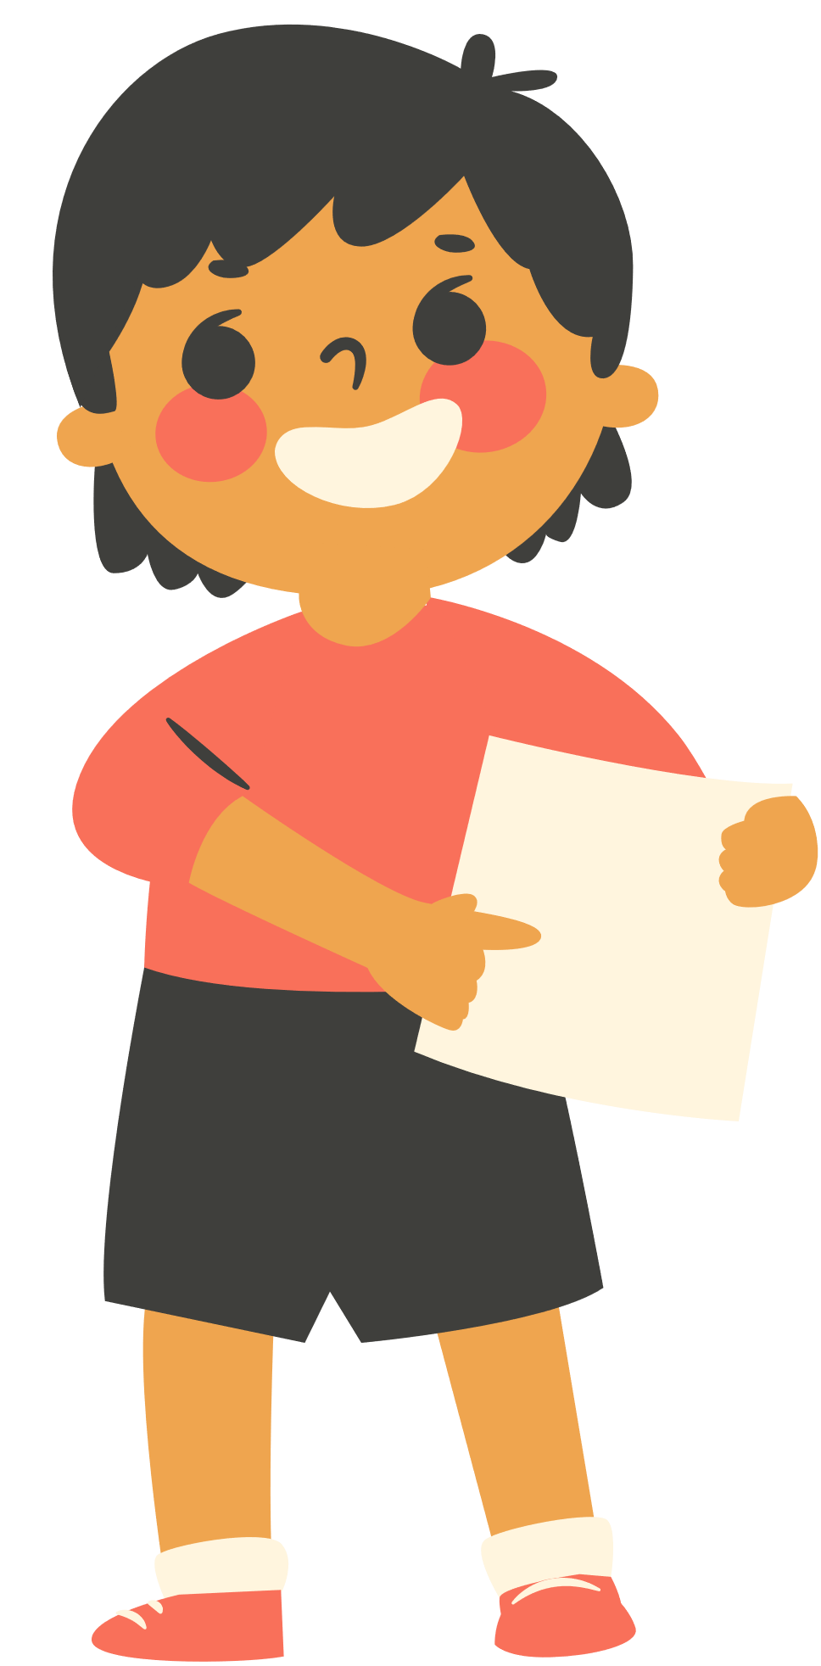
3. Complete the sentences with the words from the box.
custom | practise | keep | break | traditionally
break
1. This year, we will _________ with tradition and go on holiday instead of staying at home during Tet.
2. _____________, children in the US go from house to house to ask for sweets on Halloween.
3. Holding a party to wish our grandparents longevity is one of the customs we __________ at Tet.
Traditionally
practise
keep
4. Organising a folk song club is one way for us to __________ our traditions alive.
5. It’s becoming a __________ for young people to celebrate new years in addition to Tet.
custom

Slide 24
PRONUNCIATION

Slide 25
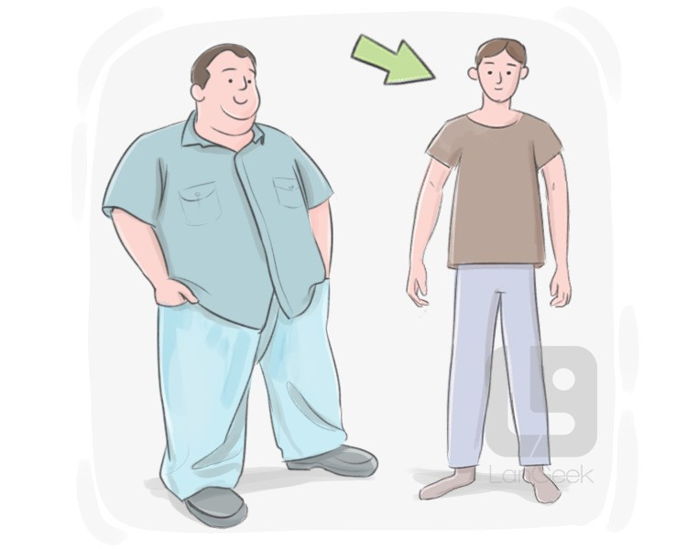
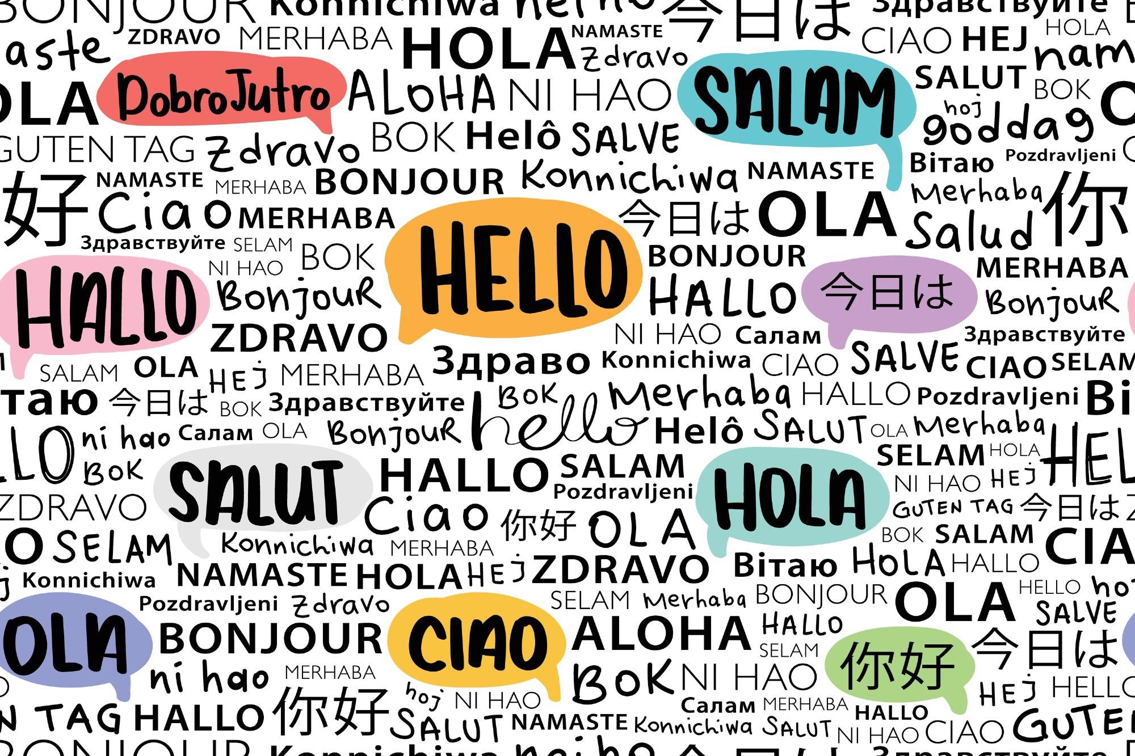

Look and say
thin
language
/n/
/ŋ/

Slide 26
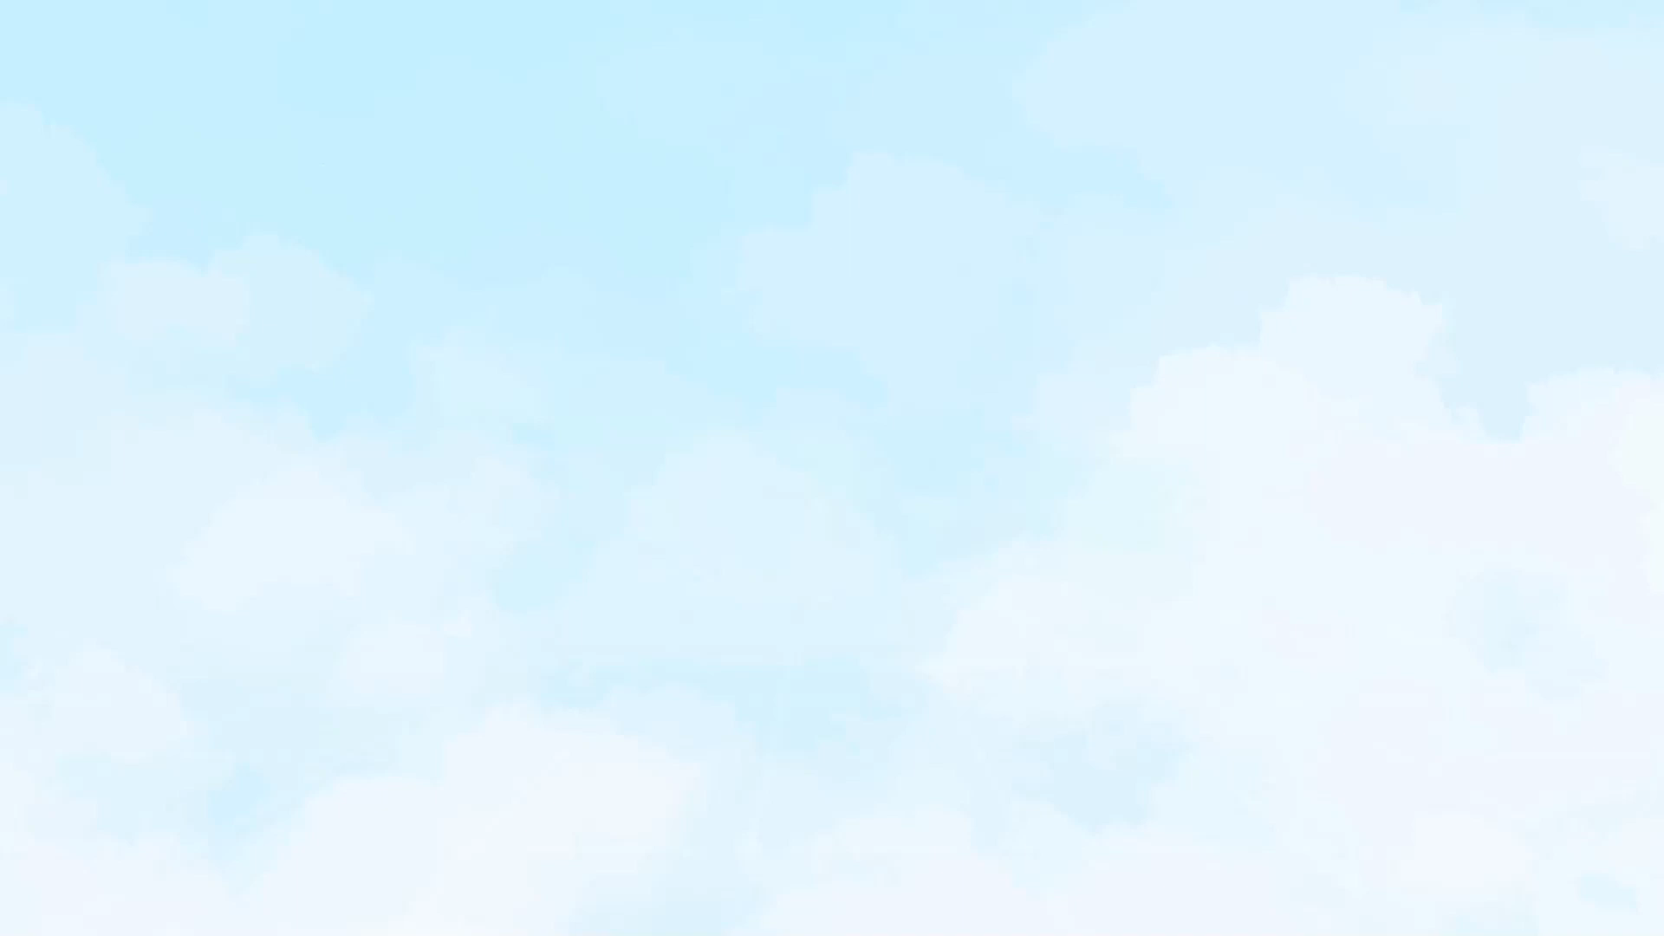
Pay attention to the sound /n/ and /ŋ/

Slide 27
4. Listen and repeat the words. Pay attention to the sounds /n/ and /ŋ/.
/n/ | /ŋ/
thin land ceremony longevity tradition | thing thank single language offering

Slide 28
5. Listen and practise the sentences. Underline the words with the sound /n/ and circle the words with the sound /ŋ/.
1. Mary wore a pink dress last night.
2. I think we should buy this ornamental tree.
3. He thanked the host for the enjoyable party.
4. My mum made the spring rolls for the longevity party.
5. I will bring some food to the party on Saturday.

Slide 29
HOMEWORK
Learn new words by heart.
Practice pronouncing the sound /n/ and /ŋ/.
Do exercises in the workbook.

Slide 30
Thank You

