Slide 1

Hello everyone !!!

Slide 2


Unit
6
LIFESTYLES
LESSON 3: A CLOSER LOOK 2

Slide 3
* GRAMMAR:
THE FUTURE SIMPLE
( thì tương lai đơn)
- ﻿We use the future simple to describe future possibilities or conditions. ( Chúng ta sử dụng thì tương lai đơn để miêu tả những khả năng và điều kiện trong tương lai)
+
S + will + V-inf + …
I will buy a boat.
⎯
S + won’t + V-inf + …
I won’t buy a watch.
?
Will + S + V-inf + …?
Will you buy a helicopter?

Slide 4
FIRST CONDITIONAL
( câu điều kiện loại 1)
﻿- We use first conditional to talk about things which are possible in the present or the future.
(Câu điều kiện loại 1 được dùng để diễn tả sự việc, điều kiện có thể xảy ra ở hiện tại hoặc tương lai.)
If + Present simple , Future simple
If she has 1.000.000 VND , she will buy a closet.
﻿- We can also use unless in conditional sentences. Unless means “if … not” or “except if …”.
Example: You will fail the test unless you study harder.
(Chúng ta có thể sử dụng “unless” trong câu điều kiện. “Unless” có nghĩa “nếu…không…” hoặc “trừ khi…”.)

Slide 5
* PRACTICE
1
﻿Use the verbs from the box with will or won’t to complete these dialogues.
﻿take have tell join attend do
﻿1. Alice: Are you taking exams next week, Phong?
Phong: I’m not sure. The teacher _________ us tomorrow.
2. Linh: Where are you going on the holiday, Chris?
Chris: We’re planning to visit Ta Ho Village. We ___________ the local festival, but we _________ the tribal dance as it is late in the evening.
3. Dad: Are you having online lessons tomorrow?
Daughter: No. We __________ lessons, but we ______ experiments in the lab.
will tell
will attend
won’t join
won’t have
will do

Slide 6
2
Arrange these words and phrases in the correct order to form meaningful sentences.
﻿1. We / first-term exams / our / will take / very soon /.
﻿→ We will take our first-term exams very soon.
2. Alaska / they / in an igloo / stay / when / visit / Will they / ?
→ ﻿Will they stay in an igloo when they visit Alaska?
3. She / the tribal groups / to help them / will work with / revive their culture /.
→ ﻿She will work with the tribal groups to help them revive their culture.

Slide 7
2
Arrange these words and phrases in the correct order to form meaningful sentences.
﻿4. online learning / in / I won’t choose / the second semester /.
→ ﻿I won't choose online learning in the second semester.
5. I’ll come / to / I go / to London / if / this summer / see you / .
→ ﻿I’ll come to see you if I go to London this summer.

Slide 8
3
Give the correct tense of the verbs in brackets, using the first conditional.
﻿1. If you (eat) ______ an apple every day, you will stay healthy.
2. Will Dan wear a kilt if he (go) ______ to Scotland?
3. He (have) _________ sore eyes if he spends too much time on the computer.
4. If you (not do) _________ anything bad, you won’t get into trouble.
5. _____she (be) ____ able to eat the soup if I put some chillies in it?
Game

Slide 9
3
Give the correct tense of the verbs in brackets, using the first conditional.
﻿1. If you (eat) ______ an apple every day, you will stay healthy.
2. Will Dan wear a kilt if he (go) ______ to Scotland?
3. He (have) _________ sore eyes if he spends too much time on the computer.
4. If you (not do) _________ anything bad, you won’t get into trouble.
5. _____she (be) ____ able to eat the soup if I put some chillies in it?
eat
goes
will have
don’t do
Will
be

Slide 10
4
Fill in each blank with IF or UNLESS.
If + S + V: nếu
Unless + S + V: nếu ...... Không, trừ khi
﻿1. _______ we eat lunch now, we won’t arrive at the cinema on time.
2. The teacher will be furious _____ you don’t do the homework.
3. I won’t eat kimchi when I go to Korea ________ I have to.
4. _____ you turn on the light, you will be able to see better.
5. You won’t be able to find the house ________ you use your GPS. There’s no one around.
Unless
if
unless
If
unless

Slide 11
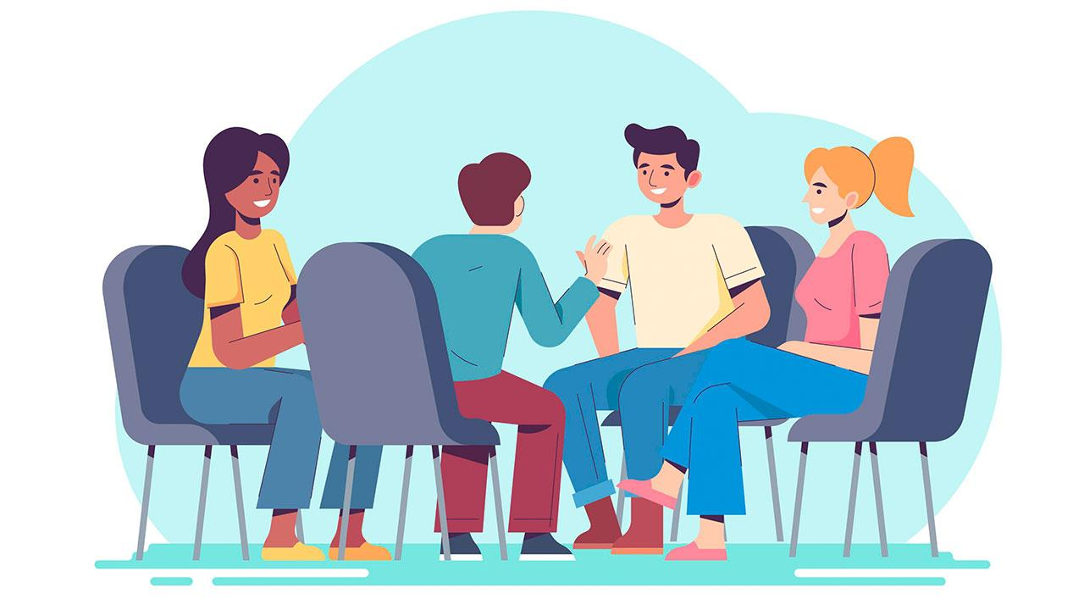
* PRODUCTION
5
﻿Complete the following sentences to make them true for you. Then share your answers with a partner.
﻿1. If it rains tomorrow, ______.
2. Unless I get good marks, ______.
3. If I have free time this weekend, ______.
4. If I study harder, ______.
5. Unless I go to bed early, ______.

Slide 12
* PRODUCTION
we won't go to the cinema.
If it rains tomorrow, …………………………….
2. Unless I get good marks,……………………………..
3. If I have free time this weekend, ………………………………………..
4. If I study harder, ……………………………….
5. Unless I go to bed early, ………………………………
my mum won't buy me a new phone.
I will play badminton with my best friends.
I will get a good marks.
I won't get up early.

Slide 13

* CONSOLIDATION
What have we learnt in this lesson?
How to use future simple and first conditional
1. the future simple
+
S + will + V-inf + …
⎯
S + won’t + V-inf + …
?
Will + S + V-inf + …?
2. First conditional
If + Present simple , Future simple

Slide 14

* homework
Revise the grammars .
Do exercises in the workbook.
Prepare lesson 4 (communication).

Slide 15





