Slide 1
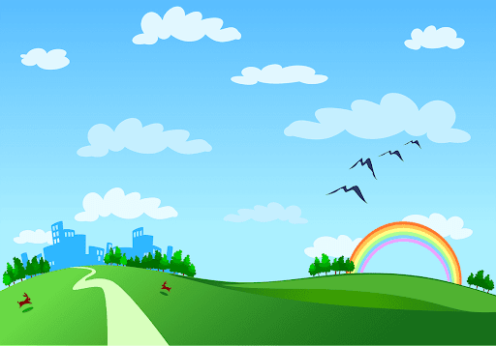
Song Ve secondary school.
Good morning class!!!
Mrs Thu Ba

Slide 2

* Warm up:
Puzzle pieces game
* Write and match conditional sentences.
- Each student has a small piece of paper.
- Each student in group A writes half of the sentence "If..."
- Each student in group B writes half of the sentence "I will..."
=> if the structure and meaning are correct, those 2 students will score 1 plus point

Slide 3
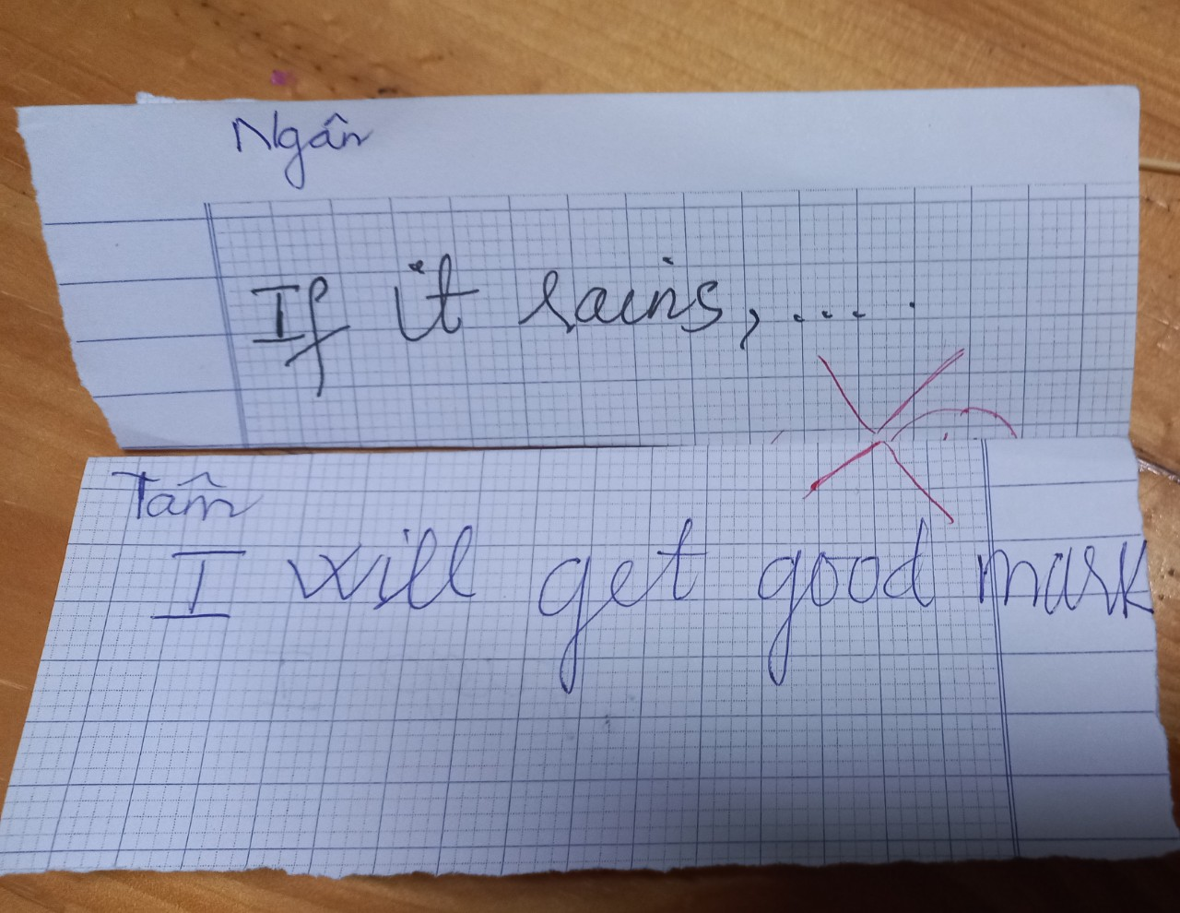
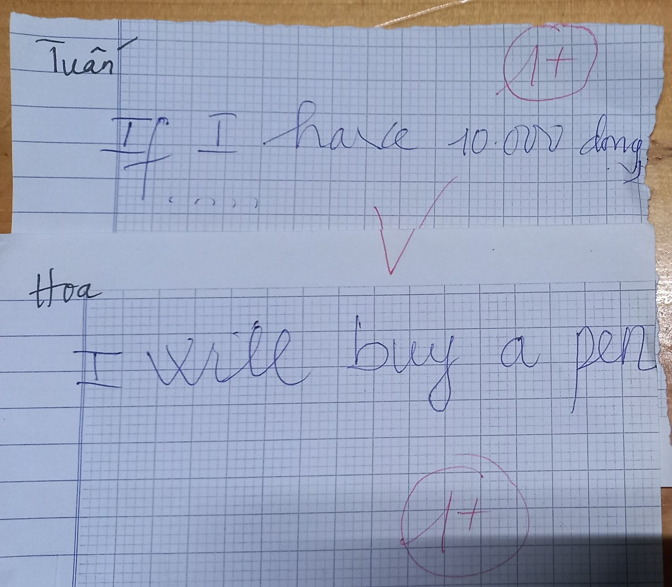


* Warm up:
* Game – Write and match conditional sentences.
Give example:

Slide 4

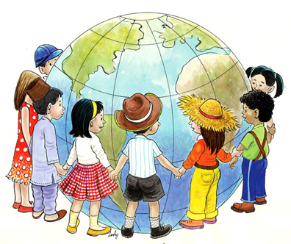
Unit
6
LIFESTYLES
LESSON 7: LOOKING BACK & PROJECT
1

Slide 5
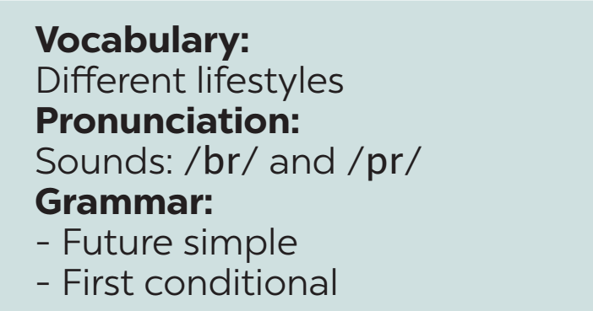
Unit
6
LIFESTYLES
REVISION

Slide 6
* VOCABULARY
1
﻿Match each word or phrase with its meaning.
1. lifestyle | a. making things with one’s hands, using skills
2. common practice | b. a vehicle pulled by dogs (usually over snow)
3. street food | c. the way in which individuals or groups of people live and work
4. making crafts | d. the usual way of doing something
5. dogsled | e. ready-to-eat food or drink sold in a street or other public places
1. C 2. d 3. e 4. a 5. b

Slide 7
* VOCABULARY
2
﻿Complete each sentence with a word or phrase from the box.
maintain | in the habit of | greeted | lifestyle | online lesson
1. My younger sister is _____________ listening to music while studying.
2. The native people there ________ us warmly when we arrived.
3. Many people are trying to adopt a healthy ________ these days.
﻿ in the habit of
greeted
lifestyle

Slide 8
* VOCABULARY
2
﻿Complete each sentence with a word or phrase from the box.
maintain | in the habit of | greeted | lifestyle | online lesson
4. I believe that _______________ are not as interesting as offline lessons.
5. The native people there __________ us warmly when we arrived.
online lessons
maintain

Slide 9
* GRAMMAR
3
﻿Complete the sentences, using the correct tense of the verbs in brackets.
1. No worries. The organisers (send) _________ us an invitation soon.
2. Unless they behave, those children (not be) ________ welcome here.
3. Do you think online learning (become) ___________ the new mode of education?
4. If I (win) ______ the competition, I will donate half of the prize money to charity.
5. ______ we (have to) _______ keep to the left when we drive in Singapore next week?
will send
won’t be
will become
win
Will
have to

Slide 10
* GRAMMAR
4
﻿Rewrite the following sentences, so that their meaning stays the same.
﻿1. Don’t play computer games for too long. You will harm your eyes.
﻿→ If you play ___________________________________________.
2. Be careful with what you eat, or you will get overweight.
→ ﻿You will _____________________________________________.
3. We’ll go to the beach unless it rains
→ ﻿If _____________________________.
→ ﻿If _____________________________.
computer games for too long, you will harm your eyes
get overweight unless you are careful with what you eat
it doesn’t rain, we’ll go to the beach
it rains, we won’t go to the beach

Slide 11
* GRAMMAR
4
﻿Rewrite the following sentences, so that their meaning stays the same.
﻿4. If you don’t hurry up, you will be late.
﻿→ Unless ________________________.
5. Unless the teacher explains the lesson again, we won’t understand it very well.
→ ﻿If ____________________________________
__________________________.
you hurry up, you will be late
the teacher doesn’t explain the lesson again,
we won’t understand it very well

Slide 12


* PROJECT

Slide 13
* CONSOLIDATION
Vocabulary review
Grammar review
Project: Interesting lifestyle around the world

Slide 14

* Homework
Students’ workbook.
Prepare : REVIEW 2

Slide 15

Goodbye.
See you again

Slide 16
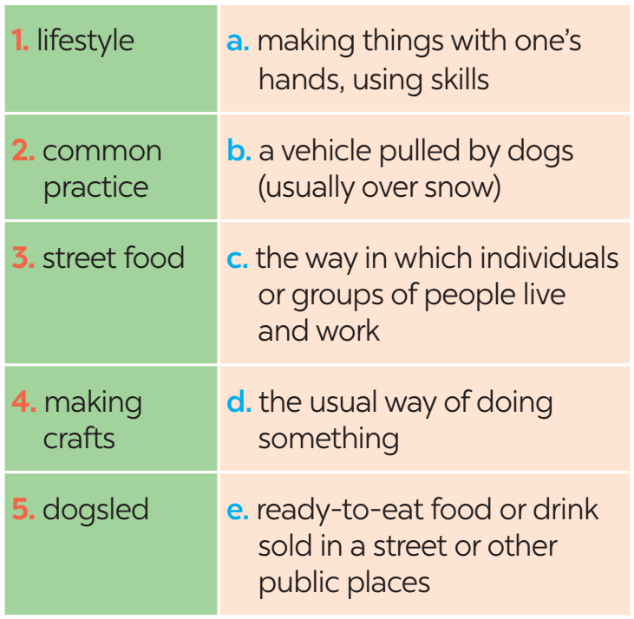
* VOCABULARY
1
﻿Match each word or phrase with its meaning.

