Slide 1


Slide 2

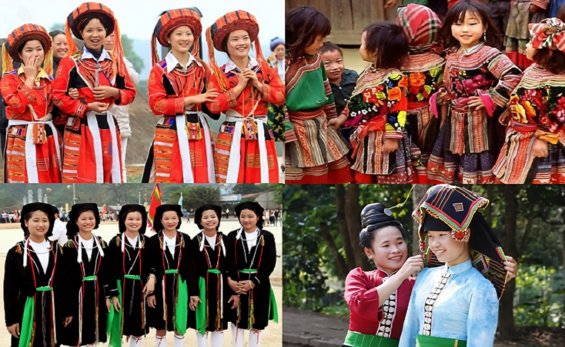
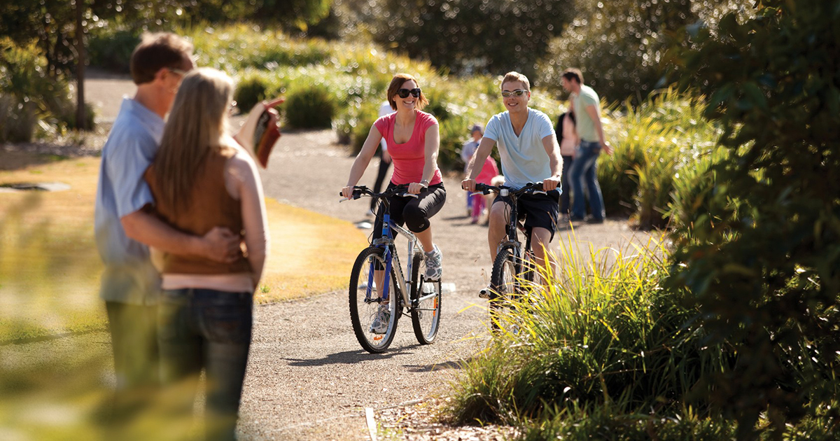
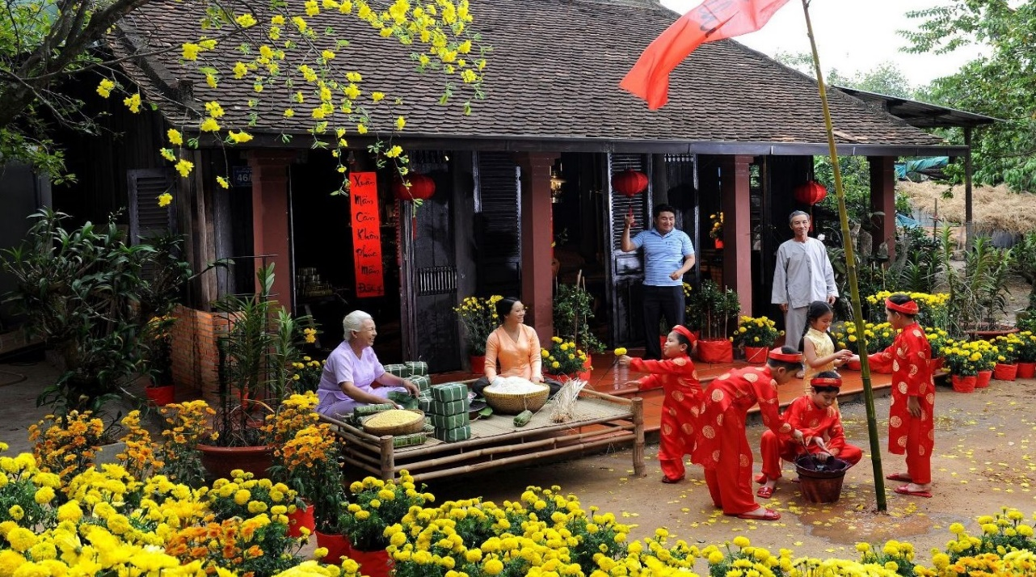
REVIEW 2
Unit
ETHNIC GROUPS OF VIET NAM
LESSON 2: SKILLS

Slide 3
WARM-UP
Customs and traditions

Slide 4

READING
1
Read the schedule of the Spring Fair and select the event that each person wants to attend. Write the event names in the table.
SPRING FAIR (January 16 - 25)
Location: Viet Nam National Village for Ethnic Culture and Tourism
The fair offers opportunities for tourists to learn about the life of ethnic people in Viet Nam.
Ethnic Markets
January 16 - 25
Exhibition of specialities of many ethnic groups featuring vegetables, flowers, crafts, and more.
Photo Exhibition
January 16 - 25
Photos showing the daily activities of ethnic people in their villages.
Performances
January 17 and 24
More than 20 performances demonstrating various traditional songs and dances.
Childhood Fun
January 17 - 18 and 24 - 25
A great day out for the family. Children can have fun taking part in traditional folk games and make handicrafts with the help of local artisans.
A Pottery Village
January 17 - 18 and 24 - 25
An introduction to pottery making by artisans from Bau Truc pottery village

Slide 5
READING
1
Read the schedule of the Spring Fair and select the event that each person wants to attend. Write the event names in the table.
PEOPLE | EVENTS
1. Ann wants to take her children out to play folk games.
2. Tom wants to learn about making pottery.
3. Alice wants to see ethnic dance performances.
4. Mai wants to learn more about farm products.
5. Mark wants to see a collection of ethnic people’s daily activities.
Childhood Fun
A Pottery Village
Performances
Ethnic Markets
Photo Exhibition

Slide 6
SPEAKING
2
Work in pairs. Read the list below and tick the main reason(s) for people moving from the countryside to the city. Explain your choice.
1. To look for well-paid jobs.
2. To look for better services.
3. To enjoy crowded and noisy areas.
4. To have better educational opportunities.
5. To experience different types of food and entertainment.

Slide 7
LISTENING
3
Listen to Phong talking about life in the countryside and complete each sentence with one word.
1. Phong always spends his summer ________ with his grandparents. 2. He likes the _________ games the children play. 3. The villagers sell their home-grown________. 4. They buy food and other _________ things. 5. At the market, the villagers _____ and talk
vacation
traditional
products
necessary
meet

Slide 8
LISTENING
3
Listen to Phong talking about life in the countryside and complete each sentence with one word.
My grandparents live in the countryside. Every year, I spend my whole summer vacation with them. There are many things I like about life there like the open space, the friendly villagers and the traditional games children play. There is one thing which is very different from city life. That is the village open-air market where the villagers sell their home-made or home-grown products.
Not many people in the village have a fridge, so they go to the market every day to buy food and other necessary things. They all come from the same village, so almost everybody knows each other. The market is not just a place for buying and selling. It is also a place for the villagers to meet and talk. The market brings the people in the village closer.

Slide 9
WRITING
4
Write complete sentences from the clues below.
﻿1. Many / Vietnamese families / teach / children / respect / elders.﻿
→ Many Vietnamese families often teach their children to respect the elders.
2. There / many ways / show / respect.
→ ﻿There are many ways to show respect.
3. You / give up / seat / or oﬀer / carry something heavy / elders.
→ ﻿You can give up a seat or offer to carry something heavy for the elders.

Slide 10
WRITING
4
Write complete sentences from the clues below.
﻿4. You / listen / not talk back / elders / speak.﻿
→ You should listen and don’t talk back when the elders speak.
5. At mealtimes / children should not / start / eat / before / elders do.
→ ﻿At mealtimes, children should not start eating before the elders do.

Slide 11

CONSOLIDATION
1
WRAP-UP
In this lesson, you have:
practiced reading for specific information about an event schedule.
practiced talking about the reasons for people moving from the countryside to the city.
practiced listening for specific information about life in the countryside.
practiced writing correct sentences from clues.

Slide 12

CONSOLIDATION
2
HOMEWORK
Do exercises in the workbook.
Prepare for Unit 7 – Getting started

Slide 13

Website: hoclieu.vn
Fanpage: facebook.com/www.tienganhglobalsuccess.vn/

