Slide 1
Unit 9: NATURAL DISASTERS Lesson 1: Getting started
We are all safe!

Slide 2
OBJECTIVES
Knowledge
Competences
Personal qualities
Gain an overview and vocabulary to talk about the topic Natural disasters
Teamwork skills, communication skills, and creativity
Feel sympathy for people who are affected by natural disasters and be willing to help them

Slide 3
Let’s
warm up!
GUESS THE WORDS BASE ON THE GIVEN HINTS

Slide 4

damage (n,v)
/ˈdæmɪdʒ/
thiệt hại, gây tổn hại

Slide 5
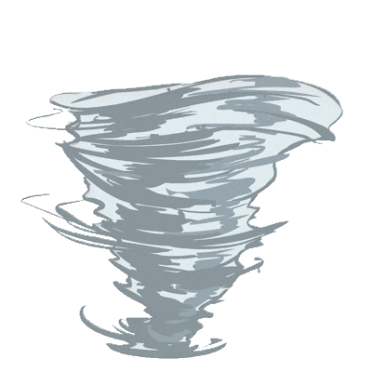

Tornado
~ A funnel of wind
/tɔːˈneɪdəʊ/
funnel (n)
lốc xoáy
/ˈfʌnl/
cái phễu

Slide 6
eruption (n)
/ɪˈrʌpʃn/
sự phun trào

Slide 7
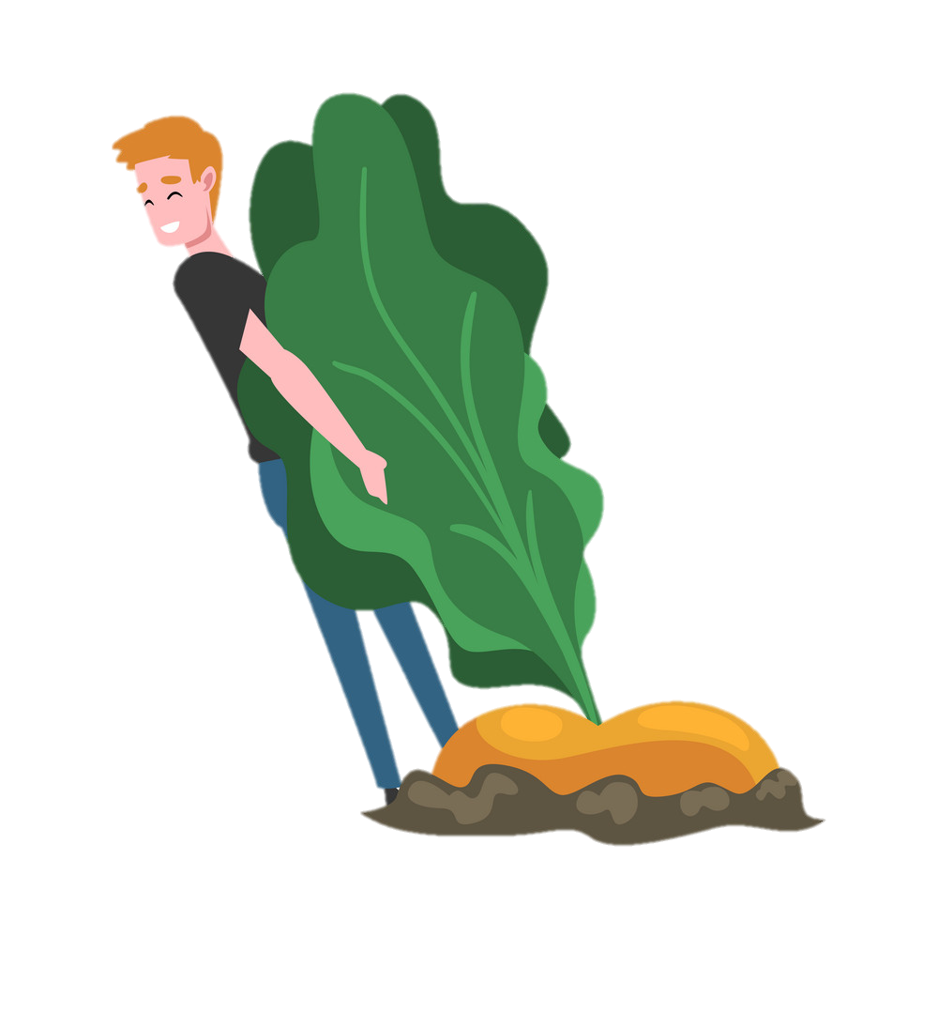
pull up
/pʊl ʌp/
kéo lên, nhổ lên,
lôi lên

Slide 8
landslide (n)
/ˈlændslaɪd/
vụ sạt lở

Slide 9
01
Vocabulary
Natural disasters

Slide 10
VOCABULARY
New words | Pronunciation | Meaning
1. damage (n,v) | /ˈdæmɪdʒ/ | thiệt hại, gây tổn hại
2. funnel (n) | /ˈfʌnl/ | cái phễu
3. tornado (n) | /tɔːˈneɪdəʊ/ | lốc xoáy
4. eruption (n) | /ɪˈrʌpʃn/ | sự phun trào
5. pull up | /pʊl ʌp/ | kéo lên, nhổ lên, lôi lên
6. landslide (n) | /ˈlændslaɪd/ | vụ sạt lở

Slide 11
Match the vocabulary with their meaning
Word |  | Vietnamese equivalent
1. damage (n,v) |  | lốc xoáy
2. funnel (n) |  | sự phun trào
3. tornado (n) |  | thiệt hại, gây tổn hại
4. eruption (n) |  | cái phễu
5. pull up |  | vụ sạt lở
6. landslide (n) |  | kéo lên, nhổ lên, lôi lên

Slide 12
02
Getting started
We are all safe!

Slide 13
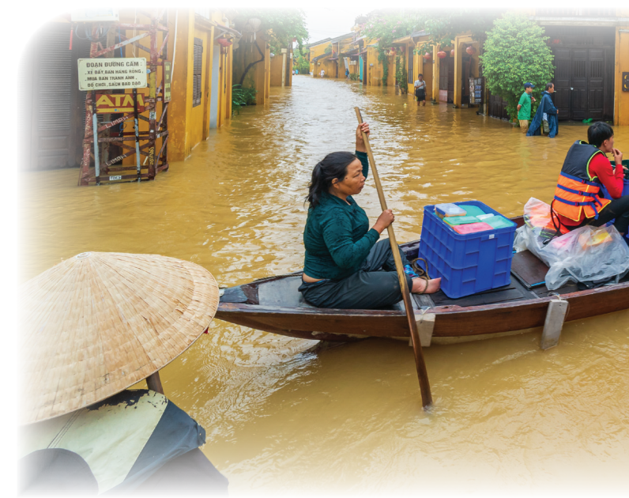
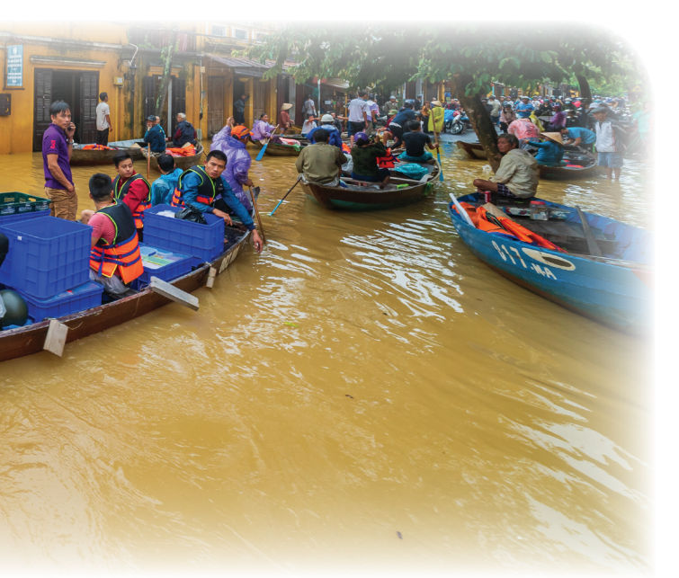
Let’s answer some questions
What can you see in the picture?
What natural disaster is it?

Slide 14
Task 1: Listen and read.
Tom: You look pretty sad, Mi. What’s the matter?
Mi: My uncle called us this morning. Our home town has been affected by a flood. It’s the second time this year.
Tom: I’m sorry to hear that. How are things there now?
Mi: My uncle, his wife, and his children are all safe. They moved everything to the second floor of their house last night. Are there natural disasters in your home town in the US?
Tom: Yes, we sometimes have tornadoes.
Mi: Tornadoes? Sounds strange. What’s a tornado?
Tom: It’s a violent storm that moves in a circle with very strong winds. I still remember the tornado we had last year.
Mi: What happened?
Tom: One evening my parents and I were having dinner. Suddenly we heard a very loud noise. When we looked out of the window, we saw a big funnel of wind moving towards us.
Mi: Did it cause any damage?
Tom: Yes, a lot. It damaged the roof of our house and pulled up some trees in our yard. Fortunately, no one was hurt.

Slide 15
Task 2: Read the conversation again. Complete each sentence with no more than TWO words from it.
1. There is a _____ in Mi’s home town.
2. Her uncle’s family had to move everything to the ______________ last night.
3. A tornado is an example of a _______________.
flood
second floor
natural disaster

Slide 16
Task 2: Read the conversation again. Complete each sentence with no more than TWO words from it.
4. Tom’s family ___________ dinner when the tornado came.
5. The tornado damaged their roof and _______ up some trees in their yard.
was having
pulled

Slide 17
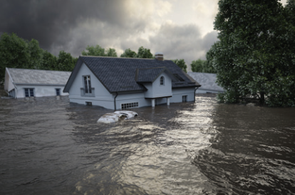
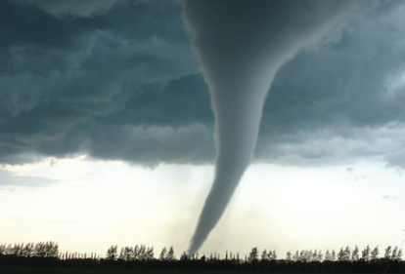
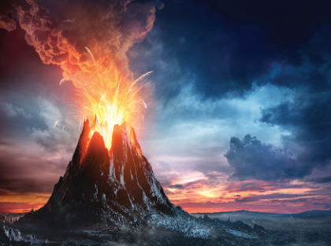
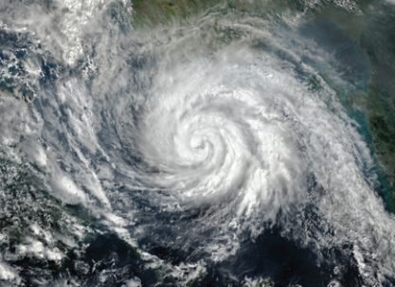
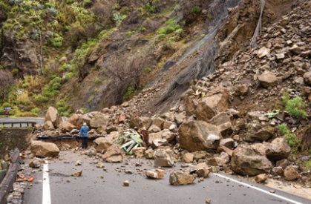
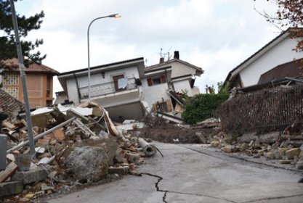
Task 3: Write the natural disasters from the box under the pictures. Then listen, check, and repeat.
volcanic eruption
earthquake
landslide
storm
tornado
flood
1. ………………
2. ………………
3. ……………...
4. ………………
5. ………………
6. …………………

Slide 18
Task 4: Choose the correct answer to complete each sentence.
1. When there is a(n) earthquake / volcanic eruption, hot gases and liquid rock pour out from a mountain.
2. Oh, the house is shaking! I think we’re having a(n) earthquake / flood.
3. We wanted to travel to Ha Giang, but there was a tornado / landslide. Some big rocks and mud came down the mountains.
4. Every year more than ten floods / storms with strong winds and
rain cause damage in our country.
5. A tornado / storm looks like a huge funnel and causes a lot of
damage. Its strong winds can reach 480 km per hour.

Slide 19
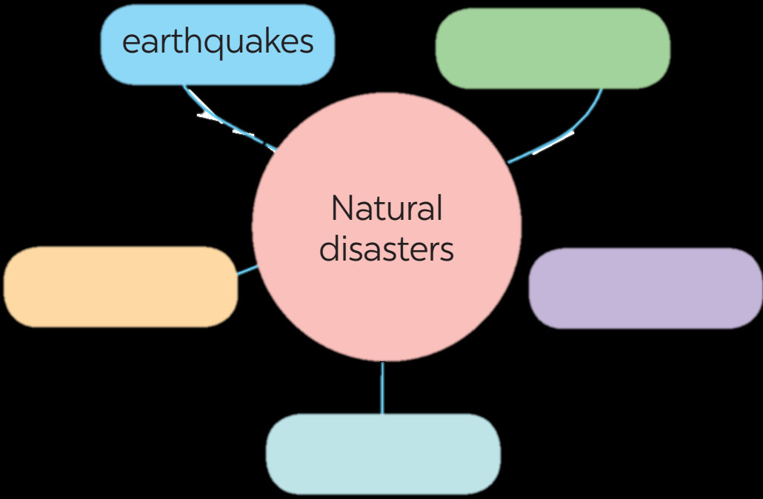
Task 5: Work in groups. Complete the web with all of the words and phrases related to natural disasters you know.

Slide 20
03
Let’s warp up!
Natural diasters

Slide 21
NATURAL VS MAN-MADE
The topic of the Unit
Name some natural disasters
NATURAL DISASTERS
Flood, tornado, volcanic
eruption, storm, landslide, earthquake

Slide 22
Homework
- Learn the new words.
- Do exercises in the workbook.
- Start preparing for the Project of the unit.

Slide 23
Thanks for listening

Slide 24
MOST COMMON NATURAL DISASTERS
FLOODS
LANDSLIDE
EARTHQUAKE
DROUGHT
Venus is the second planet from the Sun
Jupiter is the biggest planet of them all
Despite being red, Mars is a cold place
Saturn is a gas giant and has several rings

Slide 25
—SOMEONE FAMOUS
“This is a quote, words full of wisdom that someone important said and can make the reader get inspired.”

Slide 26
TYPES OF LAND DISASTERS
EARTHQUAKE
LANDSLIDE
VOLCANISM
AVALANCHE
WILDFIRE
CRACKED
Mercury is the closest planet to the Sun
Venus is the second planet from the Sun
Mars is actually a very cold place
Jupiter is the biggest planet of them all
Saturn is the only planet with rings
Neptune is the farthest planet from the Sun

Slide 27
VOLCANIC ERUPTION PARTS
ASH CLOUD
Mercury is the smallest planet
CRATER
Venus has high temperatures
LAVA FLOW
Despite being red, Mars is cold
MAGMA
Earth is the planet where we live

Slide 28
HURRICANES VS TORNADOES
TORNADOES
Venus is the second planet from the Sun
Mars is actually a very cold place
Neptune is the farthest planet from the Sun
HURRICANES
Saturn is a gas giant with several rings
Pluto is now considered a dwarf planet
Jupiter is the biggest planet of the System

Slide 29
NATURAL OR MAN-MADE DISASTERS?
A
B
Write your answer here
Write your answer here
C
D
Write your answer here
Write your answer here

Slide 30
WHAT DO YOU KNOW ABOUT…?
WRITE HERE SOME CHARACTERISTICS OF AN AVALANCHE:
Jupiter is the biggest planet of the whole Solar System
Despite is red, Mars is actually a very cold place
Neptune is the farthest planet from the Sun

Slide 31
ICON PACK: NATURAL DISASTER

Slide 32
ALTERNATIVE RESOURCES
Here’s an assortment of alternative resources whose style fits the one of this template

