Slide 1
Unit 9
Cities of the world
Lesson 1 Getting started

Slide 2
After this lesson, students will be able to
OBJECTIVES
- have an overview of the topic: Cities of the world
□- identify the location and the characteristics of those cities

Slide 3


What a nice photo!
What do you think Mai and Tom are talking about?
What city can you recognise from the photos?
Mai
Tom
Listen and check
What do you know about these cities?

Slide 4
1. Listen and Read
Mai: Tom, are these photos from your holidays?
Tom: Yes, they are. This is Sydney, a city in Australia. Mai: What's it like?
Tom: It's exciting with a lot of beaches.
Mai: What a beautiful place!
Tom: Yes, its beaches are very clean.
Mai: Wonderful. Oh, this is London. Isn't it raining? What bad weather!
Tom: Yes, it rains all the time. Can you see Big Ben?
Mai: Yeah... on the River Thames. It's a landmark of London.
Tom: It is. And this is Times Square in New York, crowded but interesting.
Mai: You're lucky to visit many places.
Tom: I am. What about your holiday?
Mai: Here are some photos of mine. This is...

Slide 5
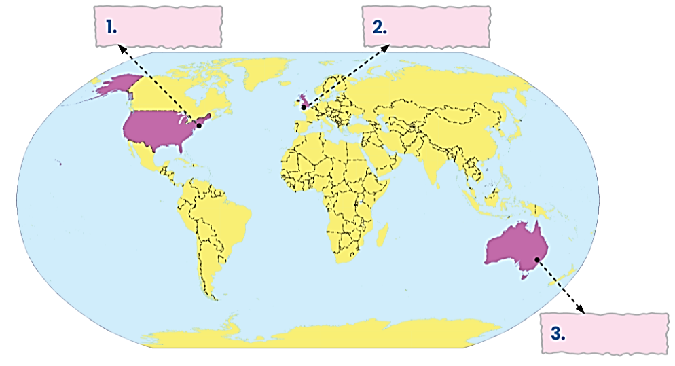
2. (p.27) Write the names of the cities in the correct place.
New York
London
London
New York
Sydney
Sydney

Slide 6
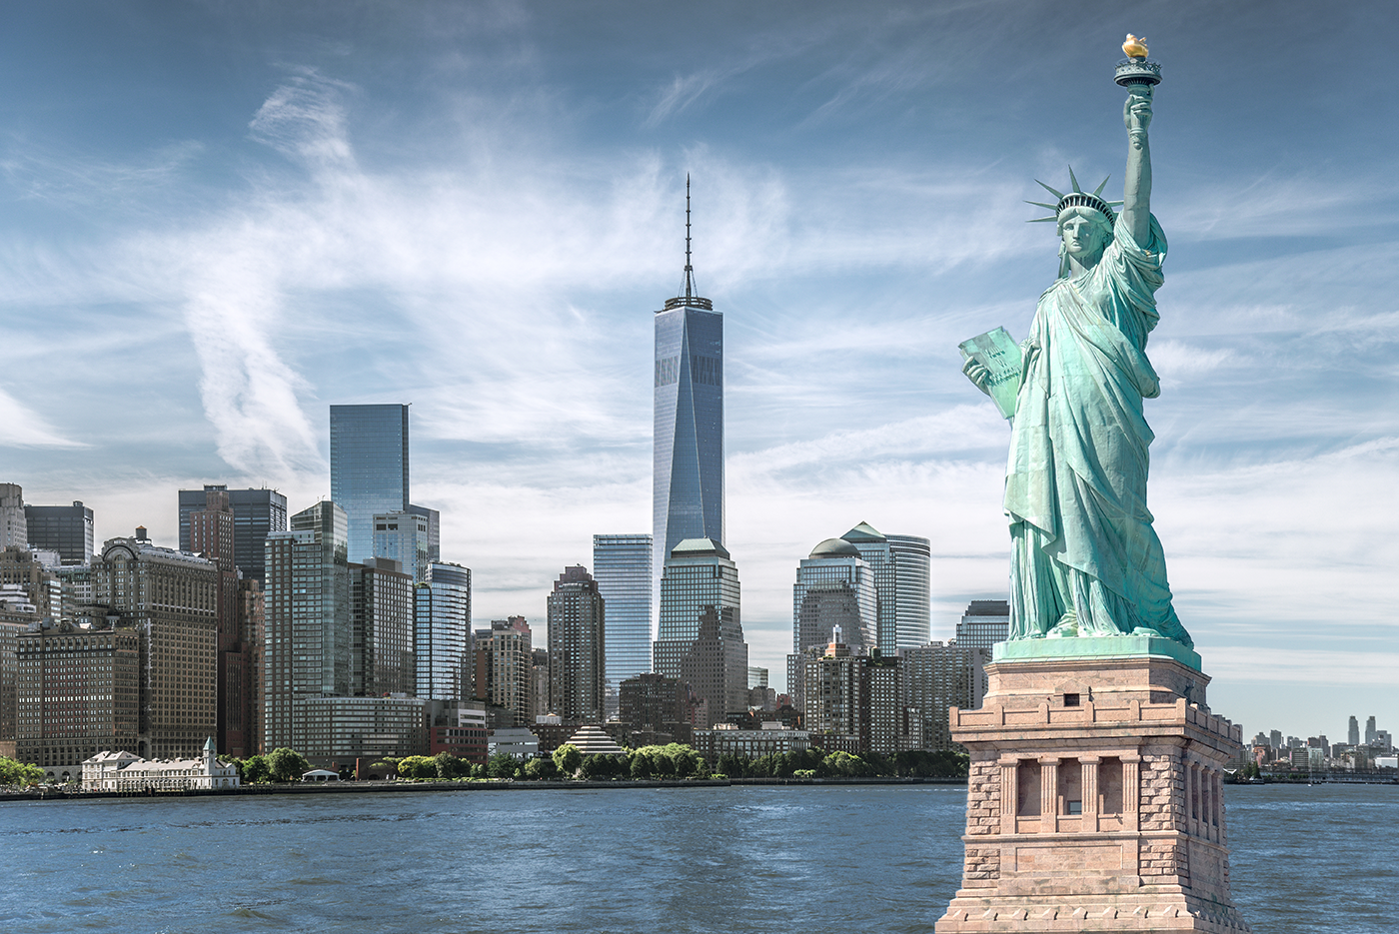
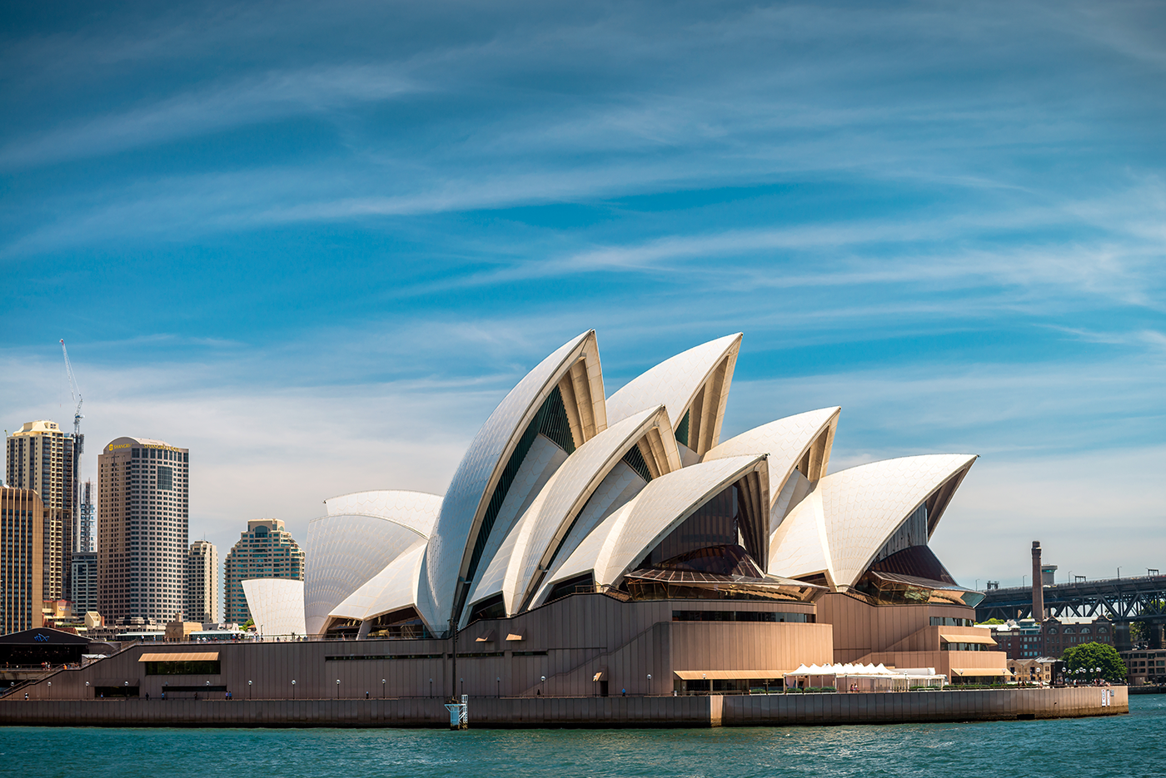
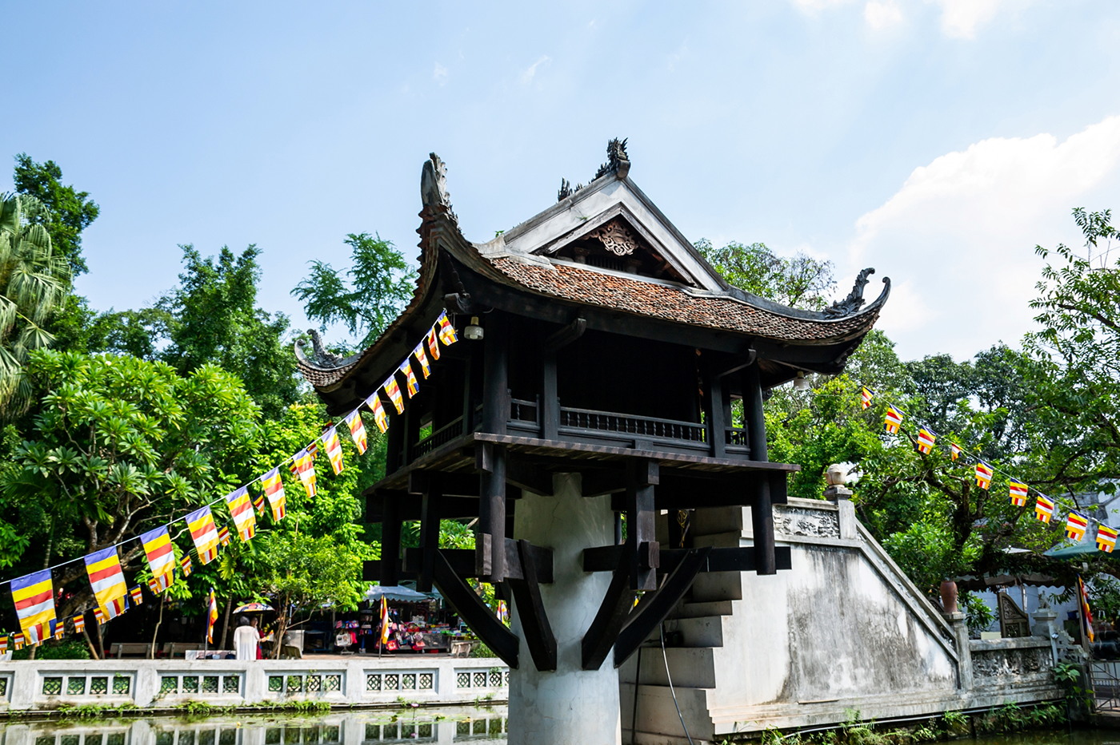
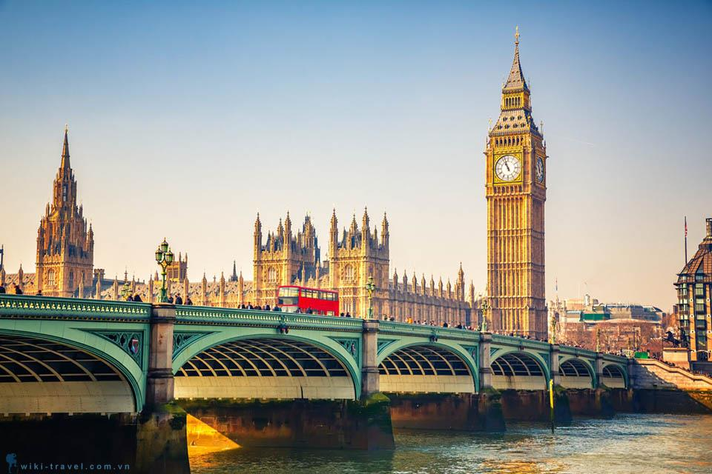
4. (p.27) Match the cities with their landmarks.
a
b
1. Ha Noi
2. London
3. New York
3. New York
4. Sydney
c
d
4. Sydney
1. Ha Noi
2. London

Slide 7
3. (p.27) Read the conversation again and match the cities with the adjectives describing them.
Mai: Tom, are these photos from your holidays?
Tom: Yes, they are. This is Sydney, a city in Australia. Mai: What's it like?
Tom: It's exciting with a lot of beaches.
Mai: What a beautiful place!
Tom: Yes, its beaches are very clean.
Mai: Wonderful. Oh, this is London. Isn't it raining? What bad weather!
Tom: Yes, it rains all the time. Can you see Big Ben?
Mai: Yeah... on the River Thames. It's a landmark of London.
Tom: It is. And this is Times Square in New York, crowded but interesting.
Mai: You're lucky to visit many places.
Tom: I am. What about your holiday?
Mai: Here are some photos of mine. This is...
1. Sydney
a. rainy
2. London
b. crowded
c. exciting
3. New York
d. beautiful
e. interesting

Slide 8
3. (p.27) Read the conversation again and match the cities with the adjectives describing them.
Mai: Tom, are these photos from your holidays?
Tom: Yes, they are. This is Sydney, a city in Australia. Mai: What's it like?
Tom: It's exciting with a lot of beaches.
Mai: What a beautiful place!
Tom: Yes, its beaches are very clean.
Mai: Wonderful. Oh, this is London. Isn't it raining? What bad weather!
Tom: Yes, it rains all the time. Can you see Big Ben?
Mai: Yeah... on the River Thames. It's a landmark of London.
Tom: It is. And this is Times Square in New York, crowded but interesting.
Mai: You're lucky to visit many places.
Tom: I am. What about your holiday?
Mai: Here are some photos of mine. This is...
Mai: Tom, are these photos from your holidays?
Tom: Yes, they are. This is Sydney, a city in Australia. Mai: What's it like?
Tom: It's exciting with a lot of beaches.
Mai: What a beautiful place!
Tom: Yes, its beaches are very clean.
Mai: Wonderful. Oh, this is London. Isn't it raining? What bad weather!
Tom: Yes, it rains all the time. Can you see Big Ben?
Mai: Yeah... on the River Thames. It's a landmark of London.
Tom: It is. And this is Times Square in New York, crowded but interesting.
Mai: You're lucky to visit many places.
Tom: I am. What about your holiday?
Mai: Here are some photos of mine. This is...
1. Sydney
a. rainy
2. London
b. crowded
c. exciting
3. New York
d. beautiful
e. interesting

Slide 9
3. (p.27) Read the conversation again and match the cities with the adjectives describing them.
Mai: Tom, are these photos from your holidays?
Tom: Yes, they are. This is Sydney, a city in Australia. Mai: What's it like?
Tom: It's exciting with a lot of beaches.
Mai: What a beautiful place!
Tom: Yes, its beaches are very clean.
Mai: Wonderful. Oh, this is London. Isn't it raining? What bad weather!
Tom: Yes, it rains all the time. Can you see Big Ben?
Mai: Yeah... on the River Thames. It's a landmark of London.
Tom: It is. And this is Times Square in New York, crowded but interesting.
Mai: You're lucky to visit many places.
Tom: I am. What about your holiday?
Mai: Here are some photos of mine. This is...
Mai: Tom, are these photos from your holidays?
Tom: Yes, they are. This is Sydney, a city in Australia. Mai: What's it like?
Tom: It's exciting with a lot of beaches.
Mai: What a beautiful place!
Tom: Yes, its beaches are very clean.
Mai: Wonderful. Oh, this is London. Isn't it raining? What bad weather!
Tom: Yes, it rains all the time. Can you see Big Ben?
Mai: Yeah... on the River Thames. It's a landmark of London.
Tom: It is. And this is Times Square in New York, crowded but interesting.
Mai: You're lucky to visit many places.
Tom: I am. What about your holiday?
Mai: Here are some photos of mine. This is...
1. Sydney
a. rainy
2. London
b. crowded
c. exciting
3. New York
d. beautiful
e. interesting

Slide 10
3. (p.27) Read the conversation again and match the cities with the adjectives describing them.
Mai: Tom, are these photos from your holidays?
Tom: Yes, they are. This is Sydney, a city in Australia.
Mai: What's it like?
Tom: It's exciting with a lot of beaches.
Mai: What a beautiful place!
Tom: Yes, its beaches are very clean.
Mai: Wonderful. Oh, this is London. Isn't it raining? What bad weather!
Tom: Yes, it rains all the time. Can you see Big Ben?
Mai: Yeah... on the River Thames. It's a landmark of London.
Tom: It is. And this is Times Square in New York, crowded but interesting.
Mai: You're lucky to visit many places.
Tom: I am. What about your holiday?
Mai: Here are some photos of mine. This is...
Mai: Tom, are these photos from your holidays?
Tom: Yes, they are. This is Sydney, a city in Australia. Mai: What's it like?
Tom: It's exciting with a lot of beaches.
Mai: What a beautiful place!
Tom: Yes, its beaches are very clean.
Mai: Wonderful. Oh, this is London. Isn't it raining? What bad weather!
Tom: Yes, it rains all the time. Can you see Big Ben?
Mai: Yeah... on the River Thames. It's a landmark of London.
Tom: It is. And this is Times Square in New York, crowded but interesting.
Mai: You're lucky to visit many places.
Tom: I am. What about your holiday?
Mai: Here are some photos of mine. This is...
1. Sydney
a. rainy
2. London
b. crowded
c. exciting
3. New York
d. beautiful
e. interesting

Slide 11
STRUCTURE
What is Sydney like?
Mai: What a beautiful place!
What is London like?
Mai: Wonderful. Oh, this is London. Isn't it raining? What bad weather!
What + (a/an) + adj + noun!

Slide 12
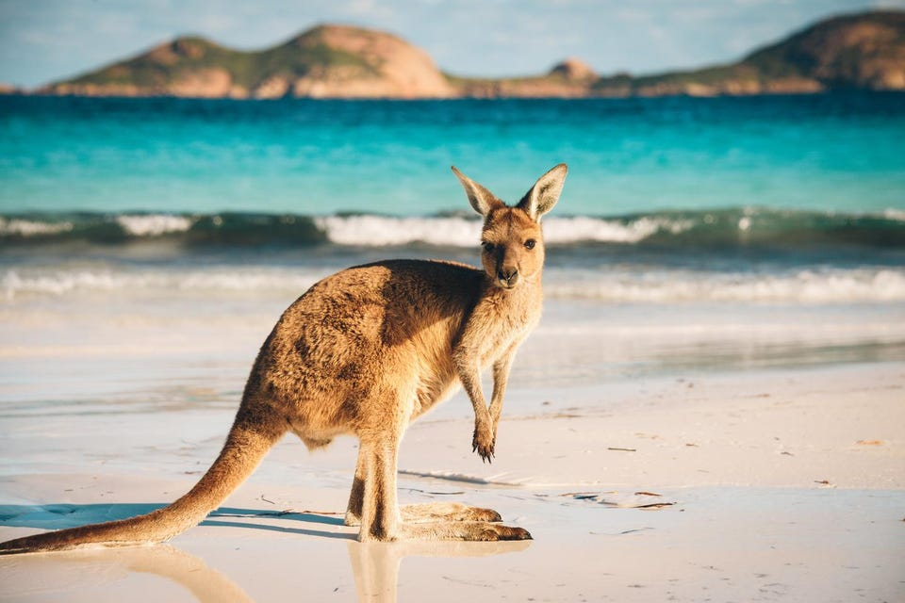
GAME: What city is it?
What's it like?
It has beautiful beaches.
Is it in Australia?
Yes, it is.
It's Sydney.
Right.
Notes:
Example: A: What's it like? a It has beautiful beaches. C Is it in Australia? Ek Yes, it is. A It's Sydney. Ek Right

Slide 13
WRAP UP
1. What is our topic about?
A. Our world B. Cities of the world
C. Worldwide problems D. Man-made wonders
2. Odd one out.
A. rainy B. crowded C. boring
D. interesting E. generous D. beautiful

Slide 14
Thanks!
Does anyone have any questions?

