Slide 1
UNIT 7:
Environment protection
LESSON 3: A CLOSER LOOK 2

Slide 2
OBJECTIVES
By the end of the lesson, students will be able to:
use correctly the complex sentences with
adverb clauses of time.

Slide 3
WARM-UP
Tick the correct answer. Choose the complex sentences.

1. I will take a shower as soon as I get home today.
2. I'm going to the shop, for I have run out of milk.

3. After I have finished my work, I will go to the park with you.
4. She loves her job, but she complains about it a lot.
5. They study hard, so they get good grades.

6. I was not at home when he came to see me.

Slide 4
WARM-UP
Tick the correct answer. Choose the complex sentences.

1. I will take a shower as soon as I get home today.
2. I'm going to the shop, for I have run out of milk.
compound sentence

3. After I have finished my work, I will go to the park with you.
4. She loves her job, but she complains about it a lot.
compound sentence
5. They study hard, so they get good grades.
compound sentence

6. I was not at home when he came to see me.

Slide 5
The complex sentences.

1. I will take a shower as soon as I get home today.

3. After I have finished my work, I will go to the park with you.

6. I was not at home when he came to see me.
What is a complex sentence?

Slide 6
01
Complex sentences

Slide 7
How many clauses are there?
I will take a shower
I will take a shower as soon as I get home today.
1
as soon as I get home today.
Independent clause
Dependent clause
Mệnh đề độc lập
Mệnh đề phụ thuộc
After I have finished my work, I will go to the park with you.
2
After I have finished my work
I will go to the park with you.
Dependent clause
Independent clause
I was not at home when he came to see me.
3
I was not at home
when he came to see me.
Independent clause
Dependent clause

Slide 8
What is a complex sentence?
I will take a shower
I will take a shower as soon as I get home today.
1
as soon as I get home today.
Independent clause
Dependent clause
After I have finished my work, I will go to the park with you.
2
After I have finished my work
I will go to the park with you.
Dependent clause
Independent clause
I was not at home when he came to see me.
3
I was not at home
when he came to see me.
Independent clause
Dependent clause
A complex sentence contains one INDEPENDENT clause and at least one DEPENDENT clause.

Slide 9
02
Complex sentences
with adverb clauses of time

Slide 10
Underline adverb clauses.
I will take a shower as soon as I get home today.
1
as soon as I get home today.
Dependent clause
After I have finished my work, I will go to the park with you.
2
After I have finished my work
Dependent clause
I was not at home when he came to see me.
3
when he came to see me.
Dependent clause
An adverb clause is a dependent clause.
Notes:
What do adverbs clauses of time show?
Are they independent or dependent clauses?

Slide 11
What kind of adverb clause is it?
as soon as
1
I will take a shower as soon as I get home today.
After
2
After I have finished my work, I will go to the park with you.
when
3
I was not at home when he came to see me.
ADVERB CLAUSE OF TIME
Some time connectors:
 before (trước khi)  after (sau khi)
 when (khi)  while (trong khi)
 till/until (cho đến khi)
 as soon as (ngay khi)
 ……
An adverb clause of time shows when something happens.
Notes:
What do adverbs clauses of time show?
Are they independent or dependent clauses?

Slide 12
PRACTICE
Page 75

Slide 13
Ex 1. Read and write I.C if the underlined clause is an independent clause or D.C if it is a dependent clause.
Example:
when
D.C
You must be careful when you cross the street.
adverb clause of time → dependent clause
1. I’ll wait for you here until you get back.
2. Make sure you lock the door when you go out.
3. You must get a permit before you build a campfire at a national park.
4. Don’t use too much water while you are having a shower.
5. As soon as my friends come, we will pick up rubbish on the beach.

Slide 14
Ex 1. Read and write I.C if the underlined clause is an independent clause or D.C if it is a dependent clause.
I.C
1. I’ll wait for you here until you get back.
2. Make sure you lock the door when you go out.
3. You must get a permit before you build a campfire at a national park.
4. Don’t use too much water while you are having a shower.
5. As soon as my friends come, we will pick up rubbish on the beach.
D.C
when
I.C
D.C
while
D.C
As soon as

Slide 15
Ex 2. Choose A, B, or C to complete each sentence.
1. I was not at home ______ he came to see me yesterday.
A. when B. until C. as soon as
2. We called the forest guard unit ______ we saw the bush fire.
A. as soon as B. while C. until
3. I went straight to the gym ______ I left home.
A. while B. before C. after
4. You can stay with us ______ you find a suitable place to stay.
A. as soon as B. before C. until
5. We cleaned up everything at the campsite ______ we left.
A. until B. before C. while

Slide 16
TYPHOON
GAME

Slide 17



Pick a box
Answer the question
Get a random prize below
The winning team has the most points
10
Blow friend’s point
Swap point
Your point

Slide 18

PICK A BOX
10
1
20
2
3
20
4
5
10
6

Slide 19

Choose A, B, or C to complete each sentence.
1. I was not at home ______ he came to see me yesterday.
A. when B. until C. as soon as
khi
cho đến khi
ngay khi
(Tôi đã không có nhà khi anh ấy đến thăm tôi ngày hôm qua.)

Slide 20
Choose A, B, or C to complete each sentence.
2. We called the forest guard unit ______ we saw the bush fire.
A. as soon as B. while C. until
ngay khi
trong khi
cho đến khi
(Chúng tôi đã gọi cho đơn vị bảo vệ rừng ngay khi nhìn thấy cháy rừng.)

Slide 21


Slide 22
Choose A, B, or C to complete each sentence.
3. I went straight to the gym ______ I left home.
A. while B. before C. after
trong khi
trước khi
sau khi
(Tôi đã đi thẳng đến phòng gym sau khi tôi rời khỏi nhà.)

Slide 23
Choose A, B, or C to complete each sentence.
4. You can stay with us ______ you find a suitable place to stay.
A. as soon as B. before C. until
ngay khi
trước khi
cho đến khi
(Bạn có thể ở cùng chúng tôi cho đến khi bạn tìm thấy một nơi thích hợp để ở.)

Slide 24
Choose A, B, or C to complete each sentence.
5. We cleaned up everything at the campsite ______ we left.
A. until B. before C. while
cho đến khi
trước khi
trong khi
(Chúng tôi đã dọn dẹp mọi thứ ở khu cắm trại trước khi chúng tôi rời đi.)

Slide 25
Ex 2. Choose A, B, or C to complete each sentence.
1. I was not at home ______ he came to see me yesterday.
A. when B. until C. as soon as
2. We called the forest guard unit ______ we saw the bush fire.
A. as soon as B. while C. until
3. I went straight to the gym ______ I left home.
A. while B. before C. after
4. You can stay with us ______ you find a suitable place to stay.
A. as soon as B. before C. until
5. We cleaned up everything at the campsite ______ we left.
A. until B. before C. while

Slide 26
Ex 3. Match the clauses in the two columns to form complex sentences.
1. We will clean up the beach
a. until he made a successful light bulb.
2. Don’t forget to turn off the lights
b. as soon as it stops raining.
3. You have to show your ticket
c. while I’m cooking the soup.
4. Can you help me lay the table
d. before you go out.
5. Thomas Edison kept trying
e. when you get on the train.

Slide 27
Ex 3. Match the clauses in the two columns to form complex sentences.
1. We will clean up the beach
b. as soon as it stops raining.
2. Don’t forget to turn off the lights
a. until he made a successful light bulb.
3. You have to show your ticket
c. while I’m cooking the soup.
4. Can you help me lay the table
d. before you go out.
5. Thomas Edison kept trying
e. when you get on the train.

Slide 28
Ex 3. Match the clauses in the two columns to form complex sentences.
1. We will clean up the beach
b. as soon as it stops raining.
2. Don’t forget to turn off the lights
d. before you go out.
3. You have to show your ticket
a. until he made a successful light bulb.
4. Can you help me lay the table
c. while I’m cooking the soup.
5. Thomas Edison kept trying
e. when you get on the train.

Slide 29
Ex 3. Match the clauses in the two columns to form complex sentences.
1. We will clean up the beach
b. as soon as it stops raining.
2. Don’t forget to turn off the lights
d. before you go out.
3. You have to show your ticket
e. when you get on the train.
4. Can you help me lay the table
a. until he made a successful light bulb.
5. Thomas Edison kept trying
c. while I’m cooking the soup.

Slide 30
Ex 3. Match the clauses in the two columns to form complex sentences.
1. We will clean up the beach
b. as soon as it stops raining.
2. Don’t forget to turn off the lights
d. before you go out.
3. You have to show your ticket
e. when you get on the train.
4. Can you help me lay the table
c. while I’m cooking the soup.
5. Thomas Edison kept trying
a. until he made a successful light bulb.

Slide 31
Ex 4. Combine each pair of sentences, using the conjunction in brackets.
1. I arrive at the station. I will call you right after. (as soon as)
2. Many Vietnamese women wear conical hats. They work in the field. (when)
3. My father taught me how to use the computer. Then he bought one for me. (before)
4. Nick is reading a novel. Jack is reading a cartoon. (while)
5. The tornado hit. There were only a few houses left standing. (after)

Slide 32
Ex 4. Combine each pair of sentences, using the conjunction in brackets.
1. I arrive at the station. I will call you right after. (as soon as)
2. Many Vietnamese women wear conical hats. They work in the field. (when)
→ I will call you as soon as I arrive at the station.
As soon as I arrive at the station, I will call you.
→ Many Vietnamese women wear conical hats when they work in the field.

Slide 33
Ex 4. Combine each pair of sentences, using the conjunction in brackets.
3. My father taught me how to use the computer. Then he bought one for me. (before)
→ My father taught me how to use the computer before he bought one for me.
Before my father bought me a computer, he taught me how to use it.

Slide 34
Ex 4. Combine each pair of sentences, using the conjunction in brackets.
4. Nick is reading a novel. Jack is reading a cartoon. (while)
5. The tornado hit. There were only a few houses left standing. (after)
→ Nick is reading a novel while Jack is reading a cartoon.
While Nick is reading a novel, Jack is reading a cartoon.
→ After the tornado hit, there were only a few houses left standing.
There were only a few houses left standing after the tornado hit.

Slide 35

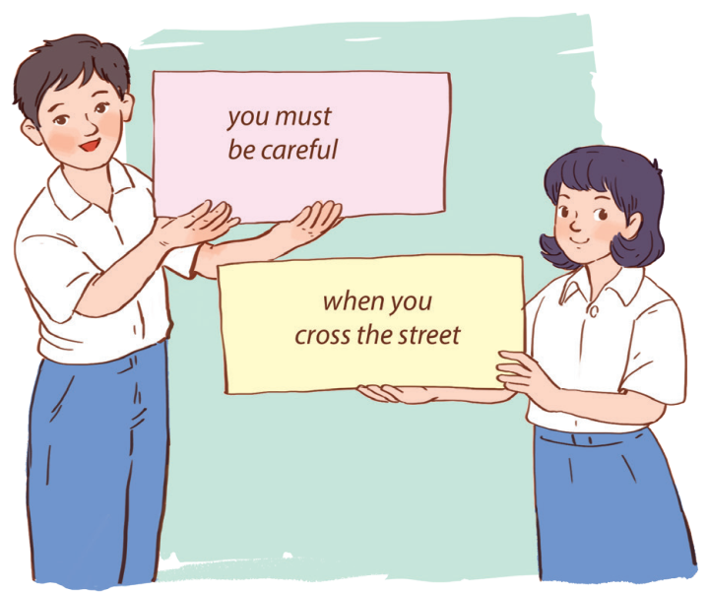
Ex 5. Matching game
Work in 2 groups, A and B.
Group A writes main clauses.
Group B writes adverb clauses of time.
Call randomly one from each group to match.
Do they match? Are there any funny sentences?
GROUP A
GROUP B

Slide 36
WRAP-UP
A complex sentence contains _____.
A. one independent clause and at least one dependent clause.
B. two independent clauses
C. two dependent clauses
You can’t go out to play _____ you finish your homework.
A. as soon as B. after C. before
(Bạn không thể ra ngoài chơi trước khi bạn hoàn thành xong bài tập về nhà.)

Slide 37
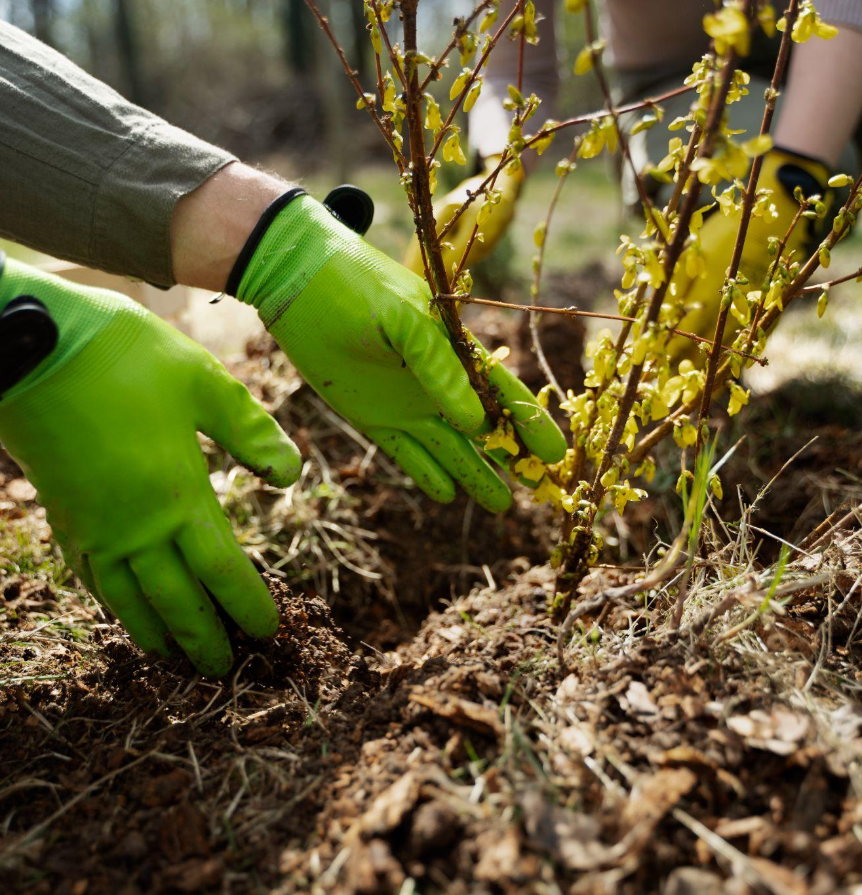
THANKS!
Do you have any questions?

