Slide 1
UNIT 9: FESTIVALS AROUND THE WORLD
Lesson 5: Skills 1

Slide 2
Objectives
Reading
speaking
Develop reading skill about an unusual festival
Develop speaking skill: talking about a festival they enjoy

Slide 3
Let’s warm up!

Slide 4
Guess the words
Work in 4 team
Guess the words base on the given letters and pictures
One correct word = 1 point

Slide 5
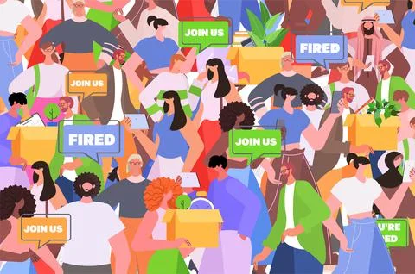
Join
J_i_
/dʒɔɪn/
to get involved in an activity or journey with another person or group

Slide 6

feature
/ˈfiː.tʃər/
To include someone or something as an important part.
Fe_t_re

Slide 7
P_rfo_m_nc_
performance
/pəˈfɔː.məns/
the action of entertaining other people by dancing, singing, acting, or playing music

Slide 8
01
Reading
Twins Day Festival

Slide 9

Vocabulary
Form | Pronunciation | Meaning | Vietnamese equivalent
join | /dʒɔɪn/ | to get involved in an activity or journey with another person or group | tham gia
feature | /ˈfiː.tʃər/ | to include someone or something as an important part | trình diễn đặc biệt
performance | /pəˈfɔː.məns/ | the action of entertaining other people by dancing, singing, acting, or playing music | màn biểu diễn

Slide 10
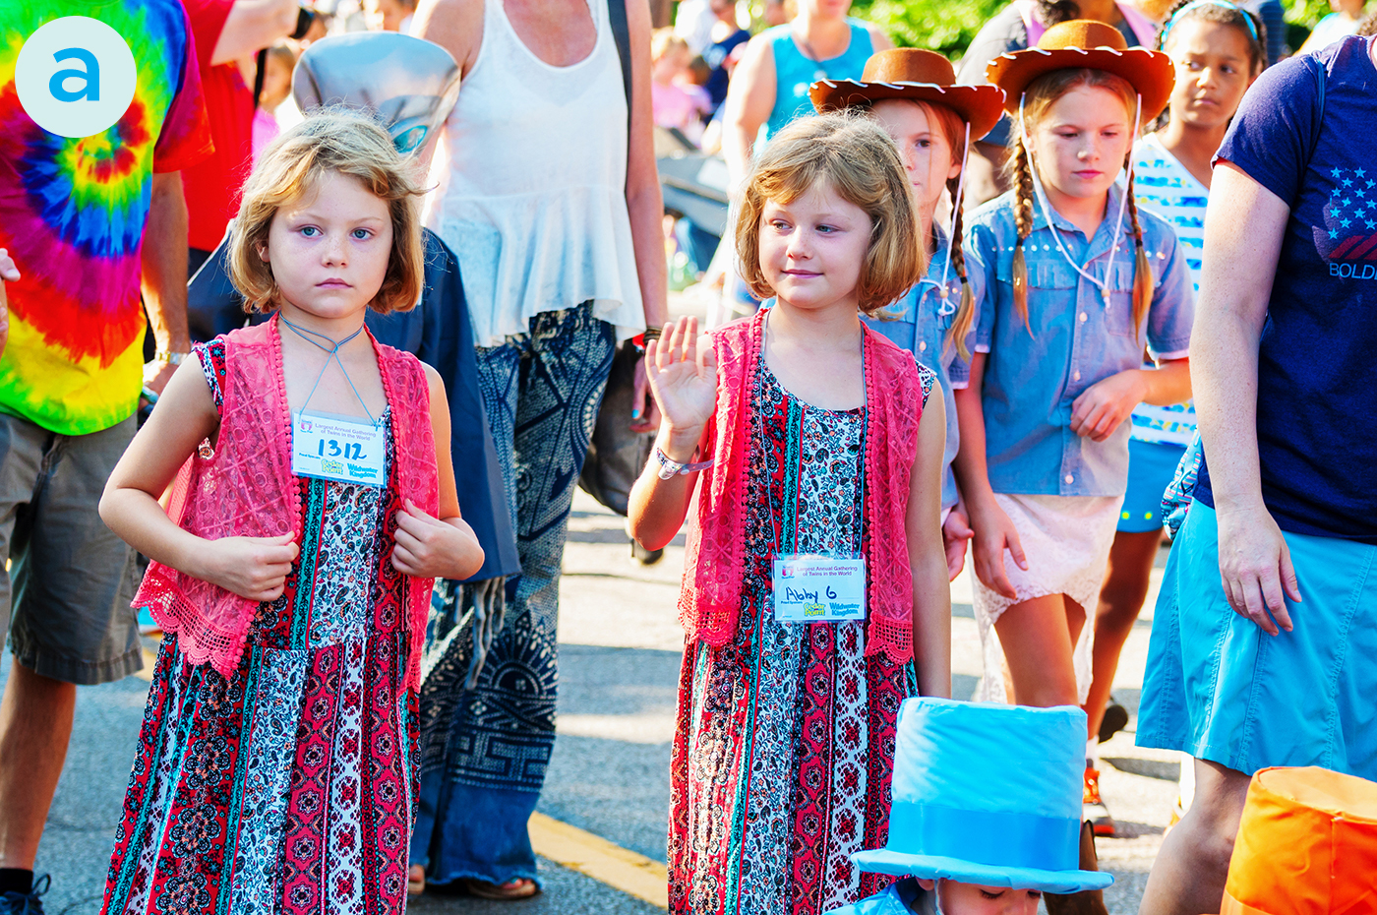
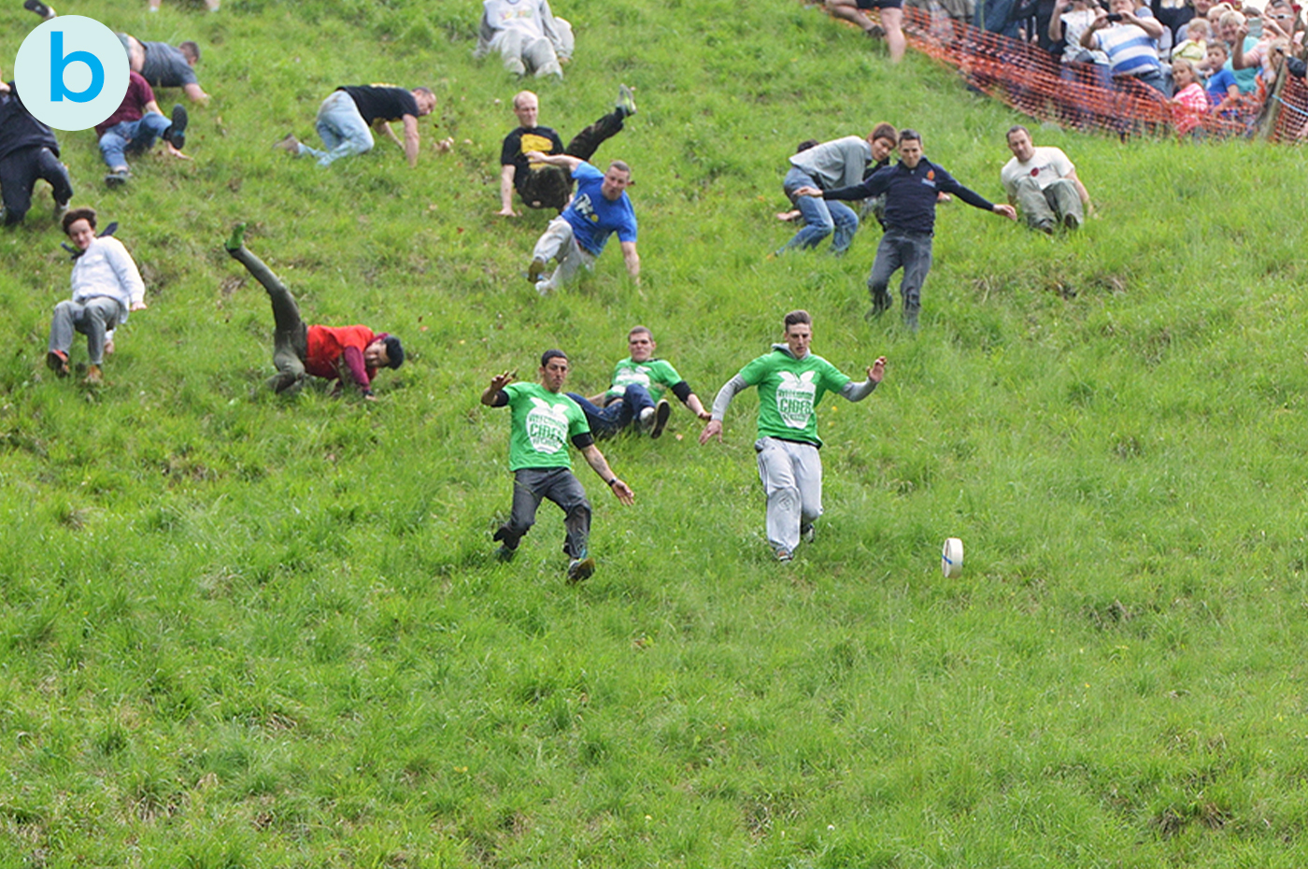
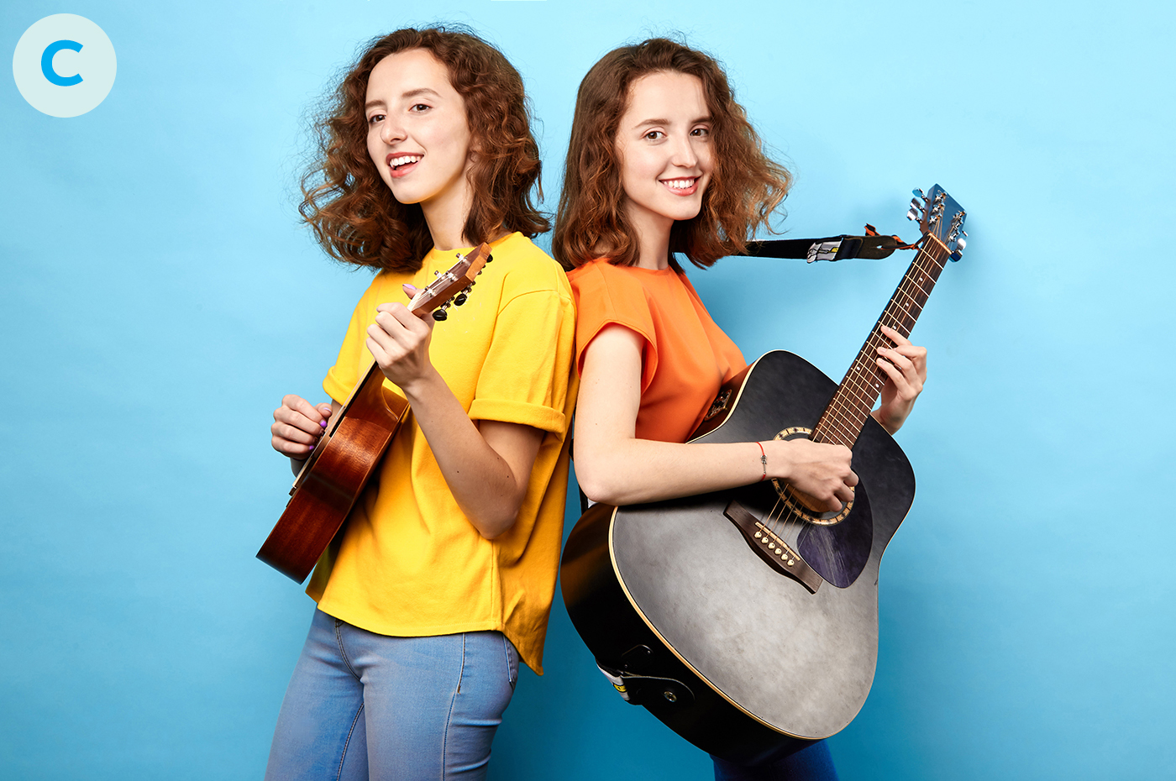
Ex 1: Which events do you think happen at the Twins Day Festival? (p.97)
Scan the text to check your answers
a. Double Take Parade
b, Chesese rolling
c, Talent show

Slide 11
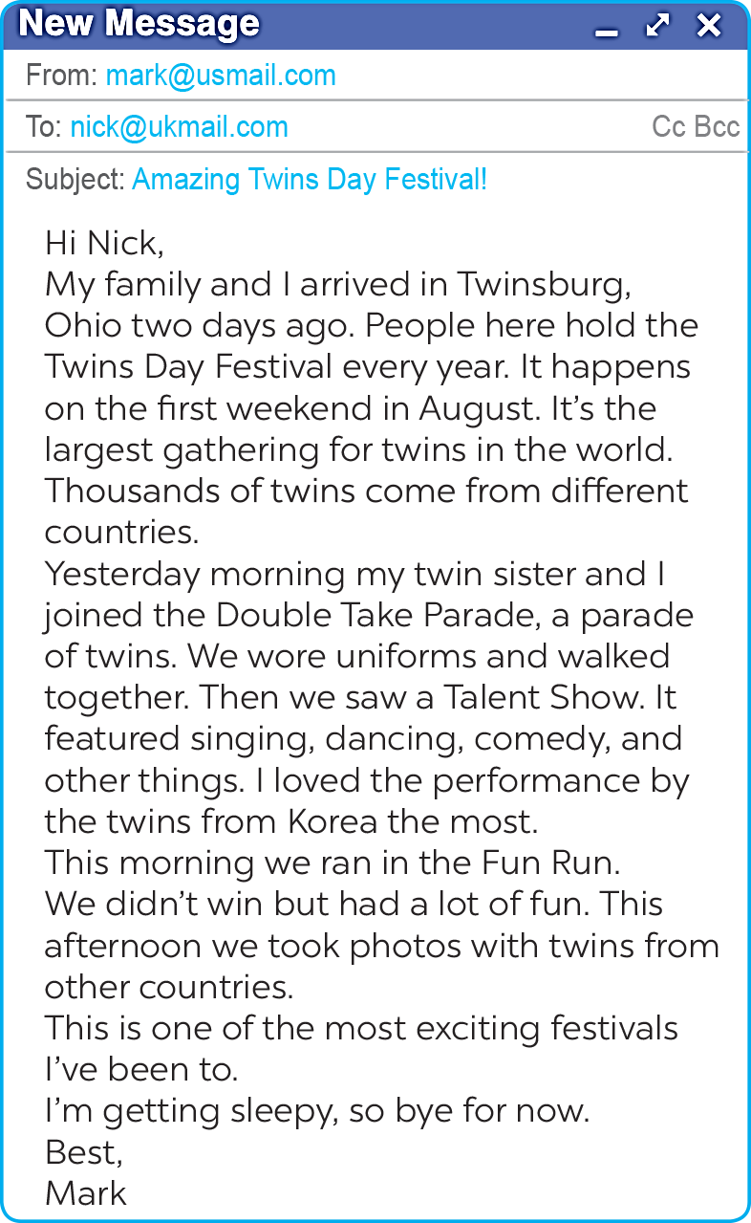
Scan the text to find these words:
1. gathering
2. featured
3. twins
4. performance

Slide 12
Ex 2: Match each word from the email in 1 with its meaning (p.98)
01
02
03
04
a. two children born to the same mother at the same time
gathering
featured
b. meeting
c. the act of entertaining other people by singing, dancing, and playing music, etc.
twins
performance
d. showed something as the most important part

Slide 13
Ex 3: Read the email again. Complete each sentence with no more than TWO words.(p.98)
People hold the festival in Twinsburg on the __________________ every August.
There are twins from many ____________.
In the Double Take Parade, twins in uniforms ____________________.
Mark enjoyed the _______________ by the Korean twins the most.
Mark and his twin sister ran in the ____________.
In his opinion, the festival was very ____________.

Slide 14
Ex 3: Read the email again. Complete each sentence with no more than TWO words.(p.98)
1. People hold the festival in Twinsburg on the ________________ every August.
first weekend

Slide 15
Ex 3: Read the email again. Complete each sentence with no more than TWO words.(p.98)
2. There are twins from many ____________.
countries

Slide 16
Ex 3: Read the email again. Complete each sentence with no more than TWO words.(p.98)
3. In the Double Take Parade, twins in uniforms ____________________.
walked together

Slide 17
Ex 3: Read the email again. Complete each sentence with no more than TWO words.(p.98)
4. Mark enjoyed the _______________ by the Korean twins the most.
performance

Slide 18
Ex 3: Read the email again. Complete each sentence with no more than TWO words.(p.98)
5. Mark and his twin sister ran in the ____________.
Fun Run

Slide 19
Ex 3: Read the email again. Complete each sentence with no more than TWO words.(p.98)
6. In his opinion, the festival was very ____________.
exciting

Slide 20
Ex 3: Read the email again. Complete each sentence with no more than TWO words.(p.98)
People hold the festival in Twinsburg on the __________________ every August.
There are twins from many ____________.
In the Double Take Parade, twins in uniforms ____________________.
Mark enjoyed the _______________ by the Korean twins the most.
Mark and his twin sister ran in the ____________.
In his opinion, the festival was very ____________.
first weekend
countries
walked together
performance
Fun Run
exciting

Slide 21
02
Speaking
Ask and answer about festivals

Slide 22
Ex 4: Match the questions and answer about a festival someone joined (p.98).
a. Yes, very much because there was a lot to do.
01
What festival did you join?
b. I joined the festival in Phu Yen last March.
c. I watched people play drums, sing traditional songs, and dance. I also played traditional games with the children there.
d. I joined the Hoi Mua Festival.
e. They celebrate it to thank the Rice God and pray for a better new crop.

Slide 23
Ex 4: Match the questions and answer about a festival someone joined (p.98).
a. Yes, very much because there was a lot to do.
b. I joined the festival in Phu Yen last March.
Where and when did you join it?
c. I watched people play drums, sing traditional songs, and dance. I also played traditional games with the children there.
02
d. I joined the Hoi Mua Festival.
e. They celebrate it to thank the Rice God and pray for a better new crop.

Slide 24
Ex 4: Match the questions and answer about a festival someone joined (p.98).
a. Yes, very much because there was a lot to do.
b. I joined the festival in Phu Yen last March.
c. I watched people play drums, sing traditional songs, and dance. I also played traditional games with the children there.
03
Why do people celebrate it?
d. I joined the Hoi Mua Festival.
e. They celebrate it to thank the Rice God and pray for a better new crop.

Slide 25
Ex 4: Match the questions and answer about a festival someone joined (p.98).
a. Yes, very much because there was a lot to do.
b. I joined the festival in Phu Yen last March.
What did you do there?
c. I watched people play drums, sing traditional songs, and dance. I also played traditional games with the children there.
04
d. I joined the Hoi Mua Festival.
e. They celebrate it to thank the Rice God and pray for a better new crop.

Slide 26
Ex 4: Match the questions and answer about a festival someone joined (p.98).
a. Yes, very much because there was a lot to do.
b. I joined the festival in Phu Yen last March.
Did you like the festival?
Why or why not?
c. I watched people play drums, sing traditional songs, and dance. I also played traditional games with the children there.
05
d. I joined the Hoi Mua Festival.
e. They celebrate it to thank the Rice God and pray for a better new crop.

Slide 27
Ex 4: Match the questions and answer about a festival someone joined (p.98).
a. Yes, very much because there was a lot to do.
01
What festival did you join?
b. I joined the festival in Phu Yen last March.
Where and when did you join it?
c. I watched people play drums, sing traditional songs, and dance. I also played traditional games with the children there.
02
03
Why do people celebrate it?
d. I joined the Hoi Mua Festival.
What did you do there?
e. They celebrate it to thank the Rice God and pray for a better new crop.
04
05
Did you like the festival? Why or why not?

Slide 28
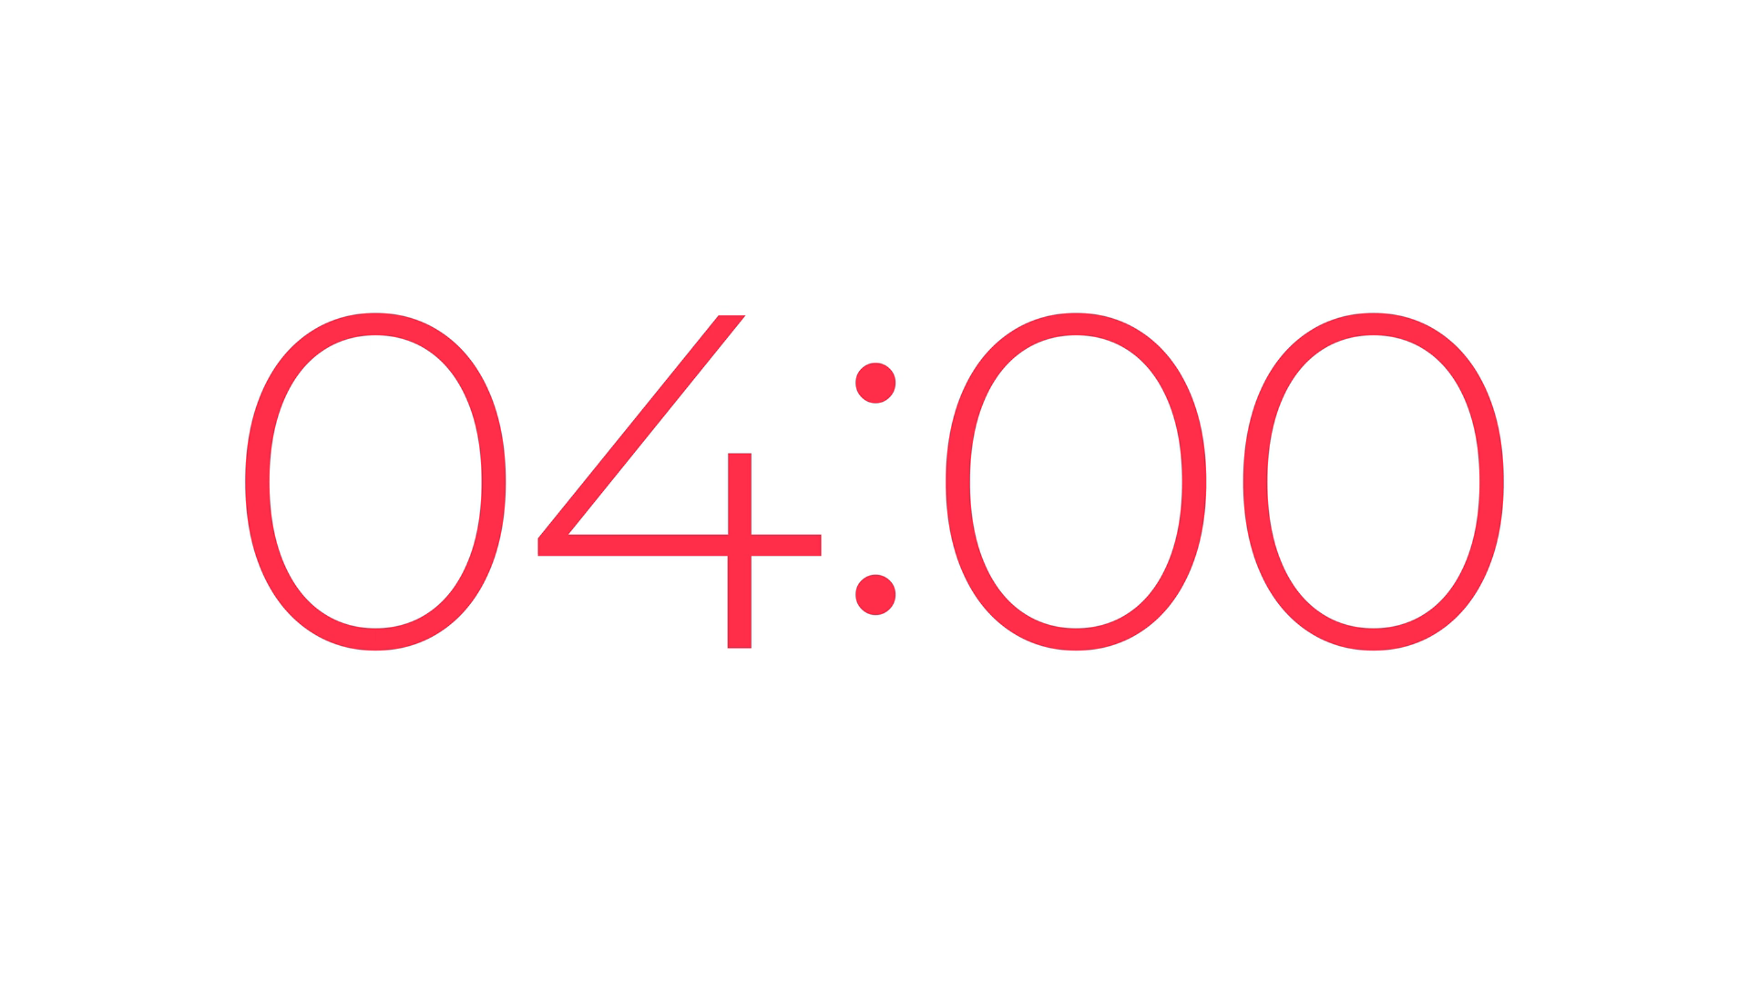
Ex 5: Work in pairs. Ask and answer about a festival you and your friend joined, using the questions in 4 as cues. Then report to the class about the festival your partner joined.

Slide 29
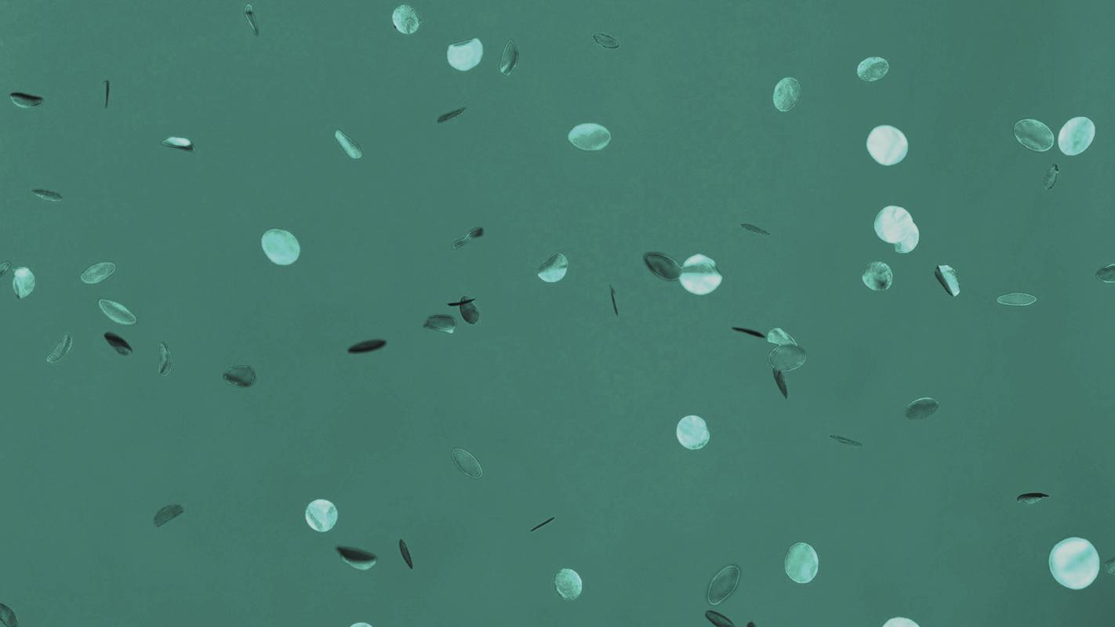
Present time!!

Slide 30
Let’s recap

Slide 31
Let’s recap!!!
What did you read about?
Do twins wear uniform in the parade?
What did you talk about?
Twins Day Festival
Festivals we joined in
Yes, they do

Slide 32
Thanks!
Homework:
Do the exercise in Work book
Prepare for the next lesson

