Slide 1
LUCKY WHEEL
Answer the questions and pin the wheel.

Slide 2





LUCKY WHEEL
one more turn
10
1
2
3
-10
20
50
lose your turn
4
5
6
-10
30
PIN THE WHEEL
Notes:
Ấn vào trái tim màu vàng để sang slide tiếp theo

Slide 3

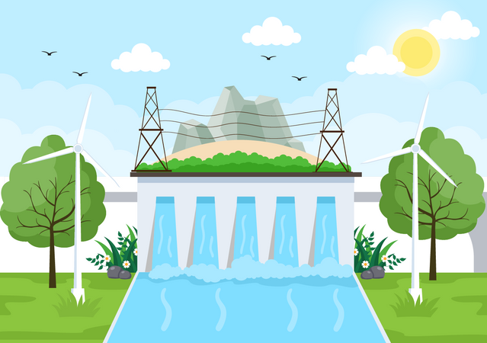
What type of energy is it?
HYDRO ENERGY
BACK

Slide 4
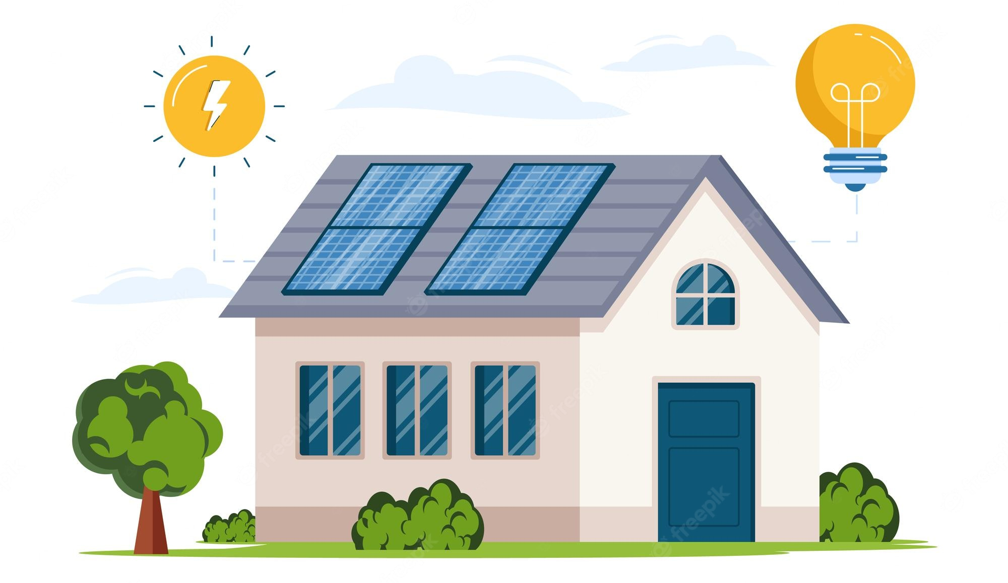
What type of energy is it?
SOLAR ENERGY
BACK

Slide 5

What type of energy is it?
NUCLEAR ENERGY
BACK

Slide 6

What type of energy is it?
WIND ENERGY
BACK

Slide 7
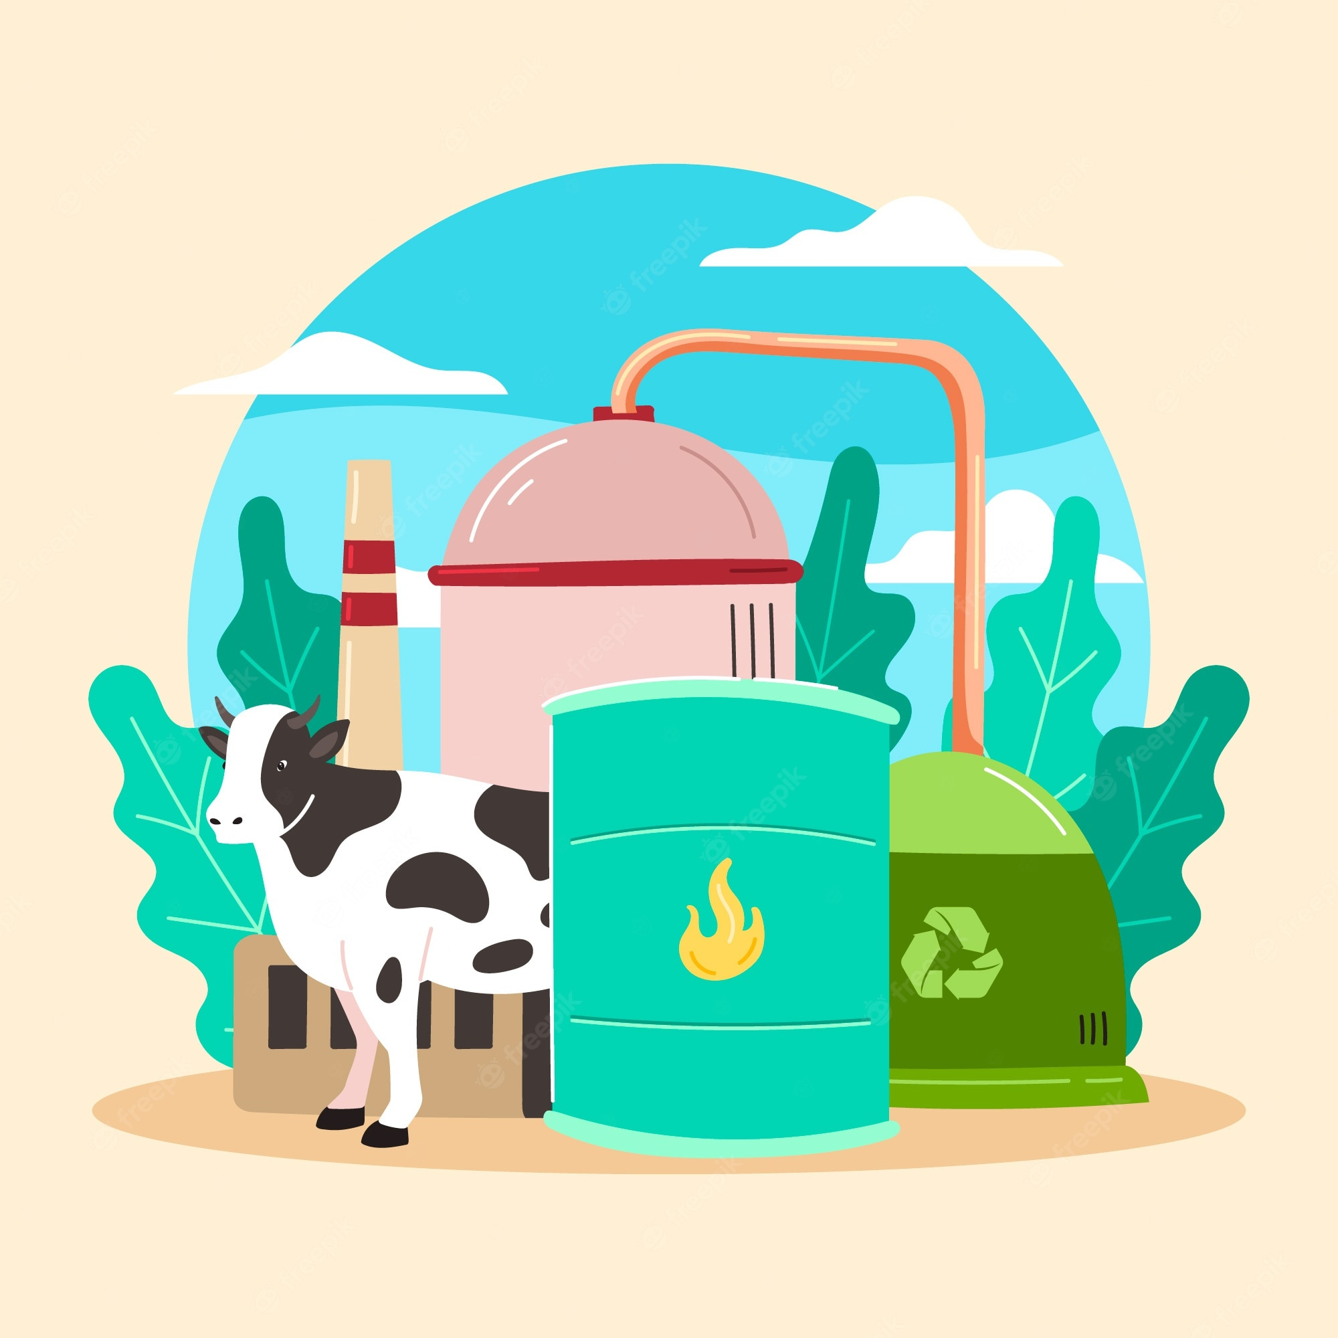
What type of energy is it?
BIOGAS ENERGY
BACK

Slide 8
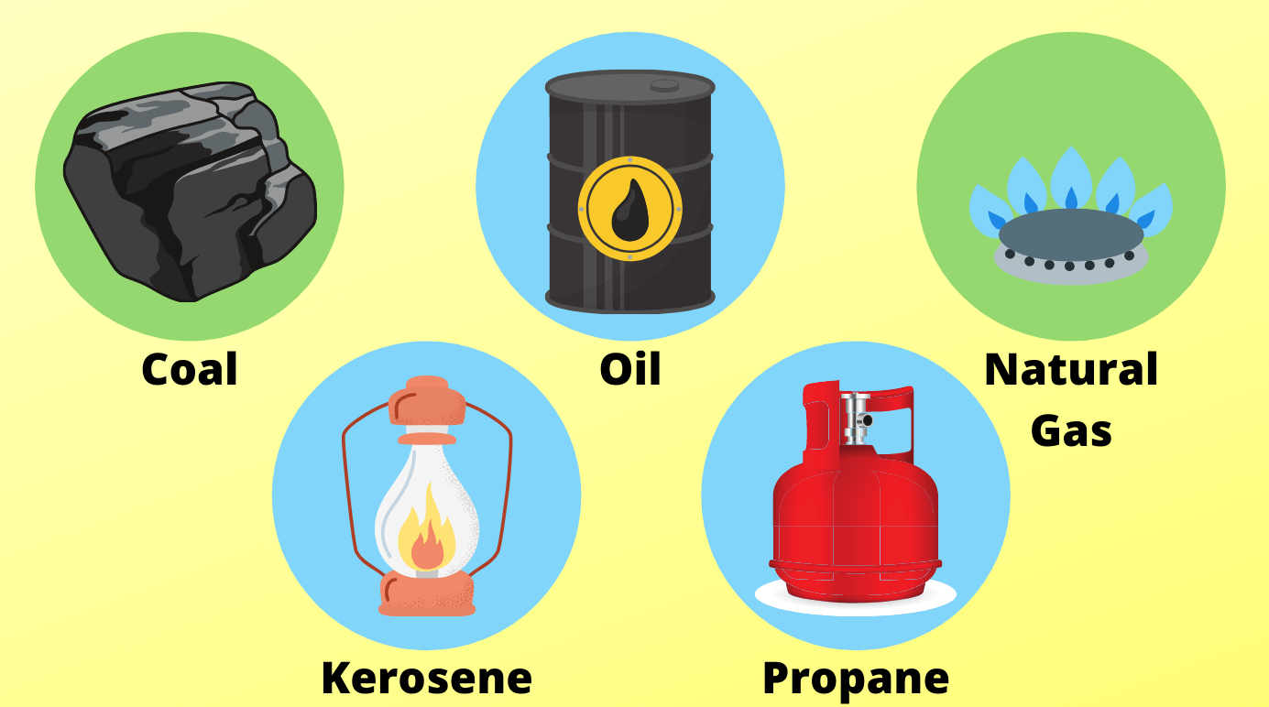
What is it?
FOSSIL FUELS
BACK

Slide 9
UNIT 10:
ENERGY SOURCES
Lesson 6: Skills 2

Slide 10
OBJECTIVES
By the end of the lesson, students will be able to:
listen for main ideas and specific information about the topic how to save energy at home
Listening
write about how you save energy at home
Writing

Slide 11
1
LISTENING

Slide 12
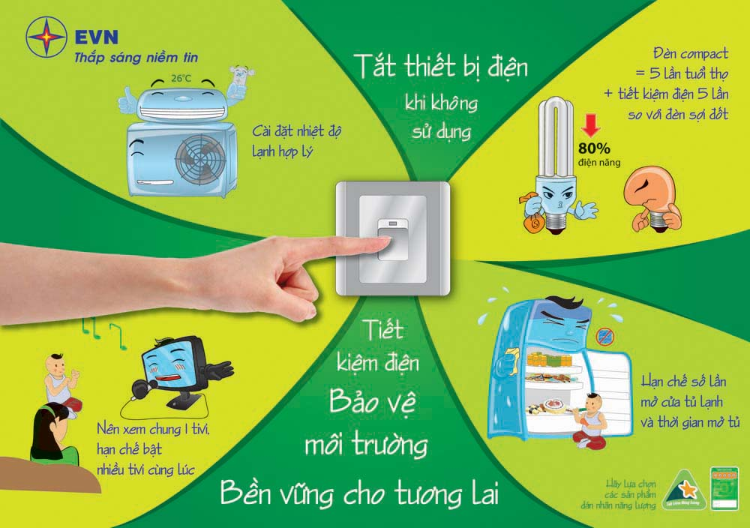
Newwords
save energy:
/seɪv ˈenədʒi/
tiết kiệm năng lượng

Slide 13
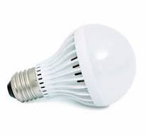
+ low energy light bulb:
/ləʊ ˈenədʒi laɪt bʌlb/
bóng đèn tiết kiệm điện năng

Slide 14

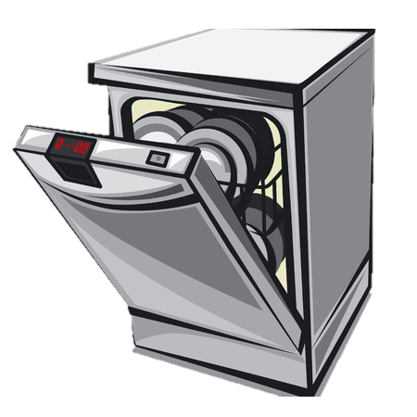
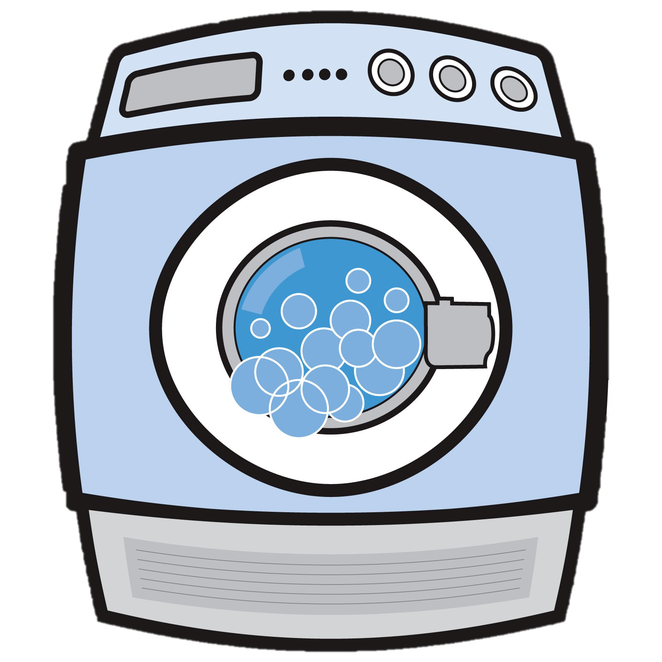
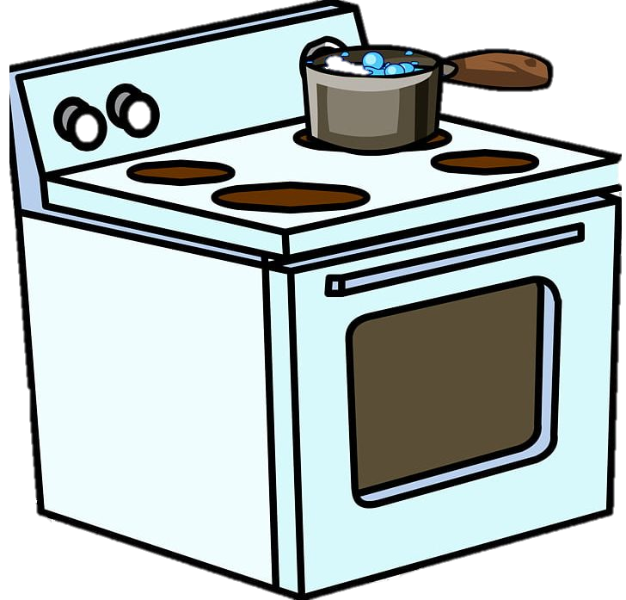
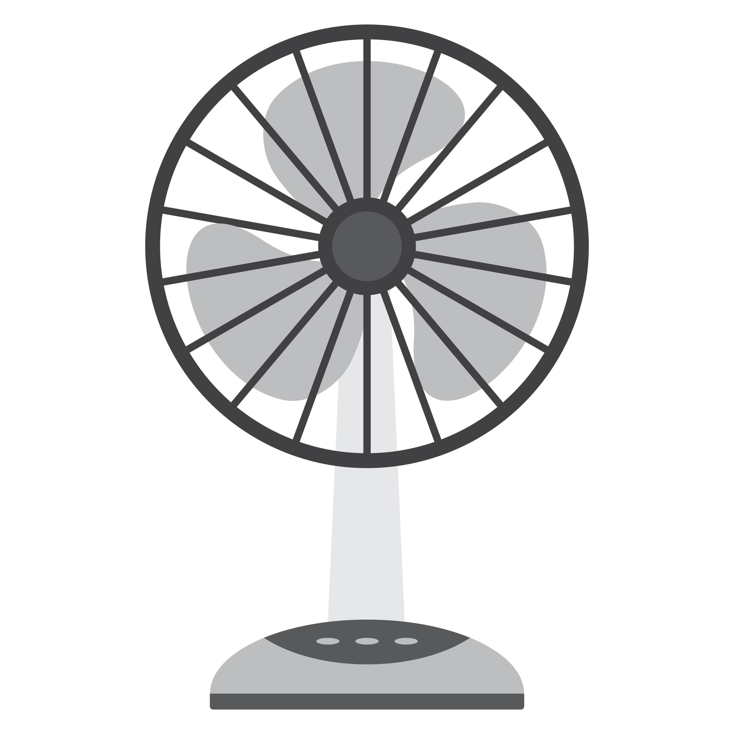

+ electrical appliance :
/ɪˈlektrɪkl əˈplaɪəns /
thiết bị điện
Notes:
dishwasher washing machine wireless TV fridge electric fan computer smart clock

Slide 15
Newwords
+ save energy:
/seɪv ˈenədʒi/
tiết kiệm năng lượng
+ low energy light bulb:
/ləʊ ˈenədʒi laɪt bʌlb/
bóng đèn tiết kiệm điện năng
+ electrical appliance :
/ɪˈlektrɪkl əˈplaɪəns /
thiết bị điện

Slide 16
Checking the newwords
+ save energy:
tiết kiệm năng lượng
+ low energy light bulb:
bóng đèn tiết kiệm điện năng
+ electrical appliance :
thiết bị điện

Slide 17
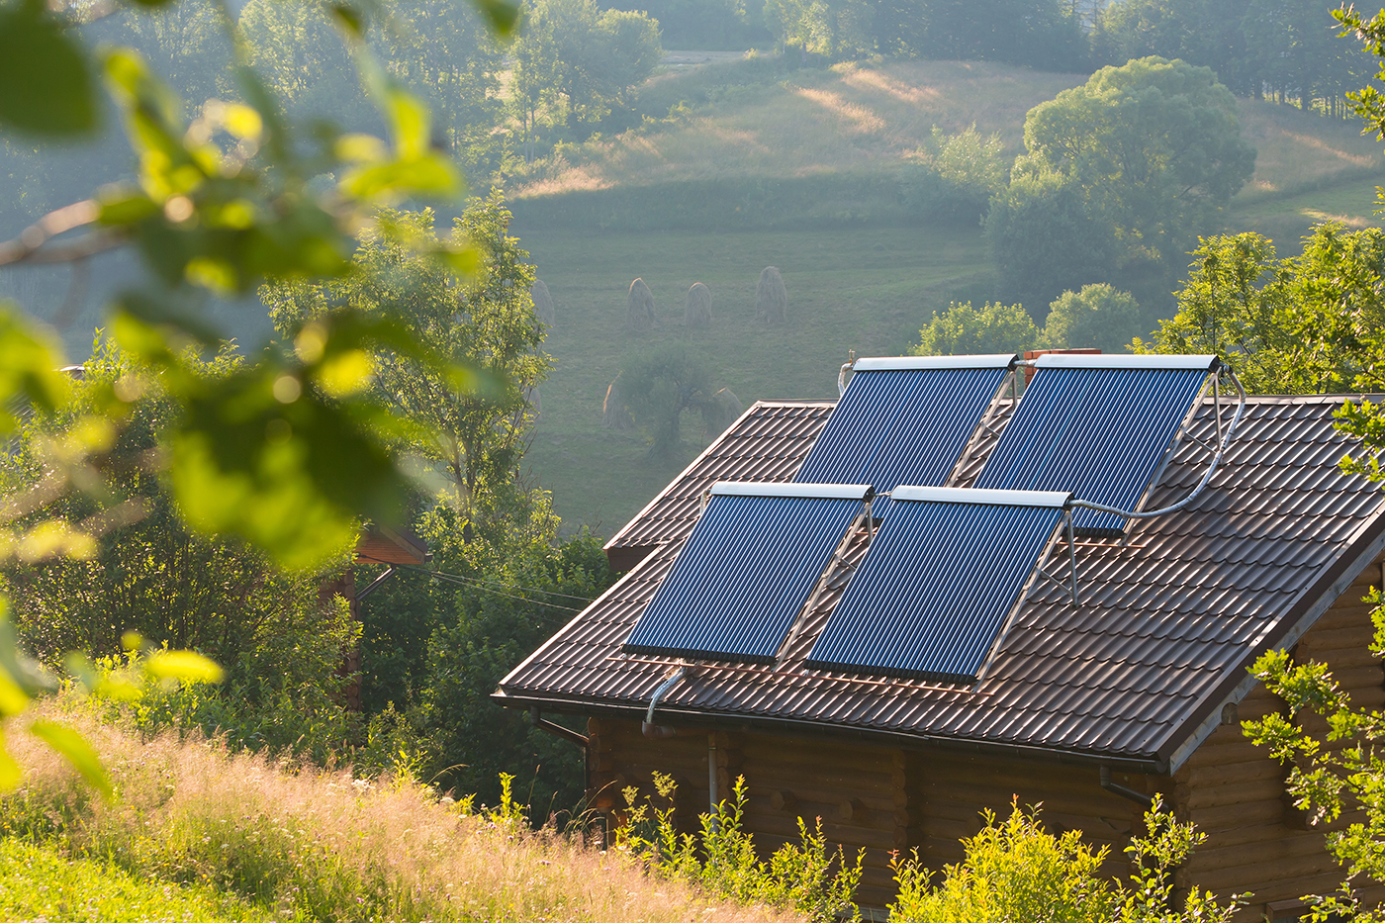
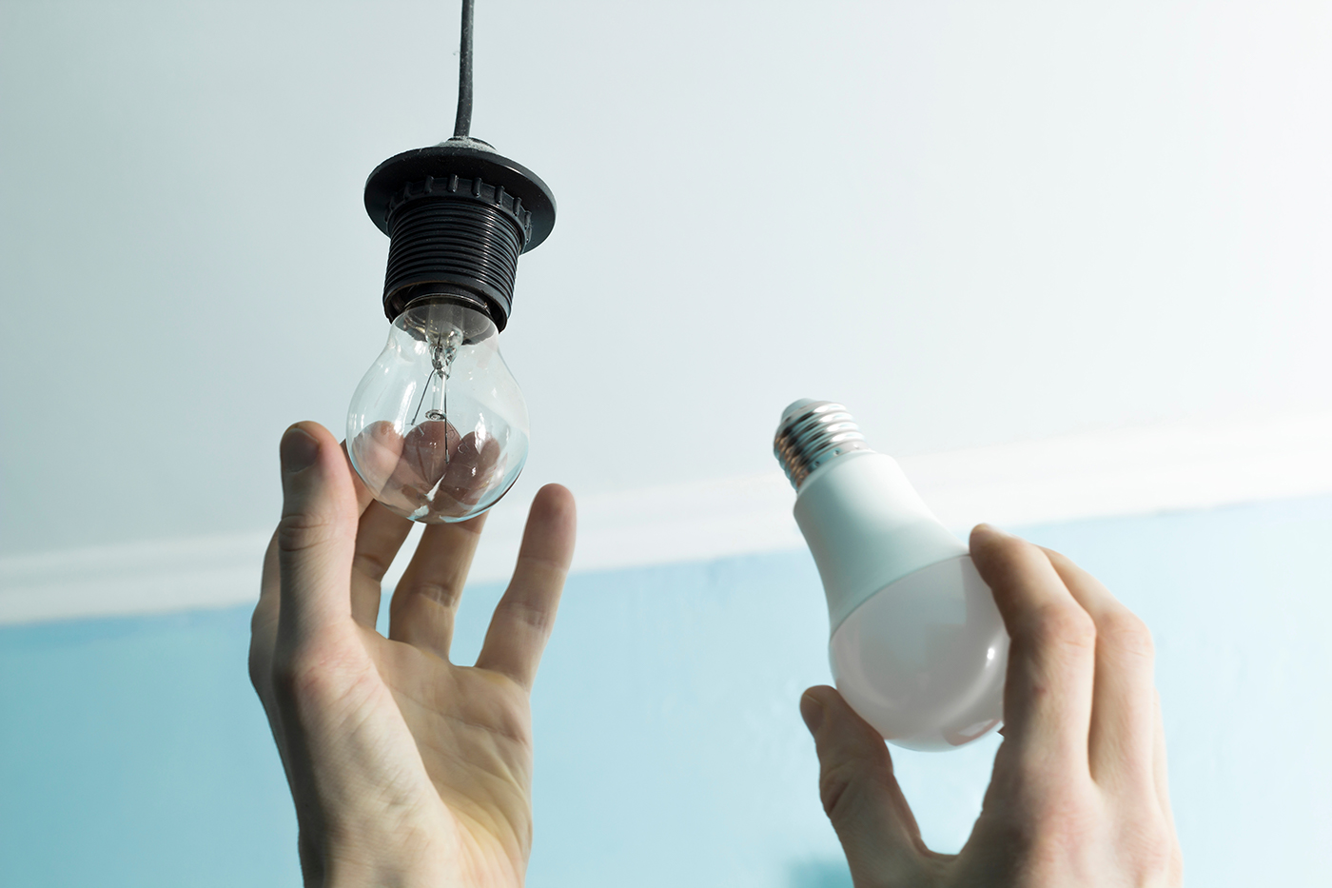
Ex 1. Work in pairs. Discuss
What type of energy do you use at home?
What do you usually do to save energy?

Slide 18

Ex 2. Mr Lam is discussing with his students about how to save energy at home. Listen and circle the phrases you hear.
1. save energy
2. turn oﬀ the lights
3. save money
4. use low energy light bulbs
5. produce electricity
6. use solar panels

Slide 19
Ex 3. Listen again and tick T (True) or F (False) for each sentence.
 | T | F
1. Mr Lam says we use energy for cooking, heating and lighting.
2. Linh always turns oﬀ the lights when going out.
3. Linh turns oﬀ electrical appliances when not using them.
4. Minh uses low energy light bulbs at his house.
5. Minh uses solar energy to cook meals.

Slide 20

Let’s check!
 | T | F
1. Mr Lam says we use energy for cooking, heating and lighting.
Mr Lam: As you know we use energy for cooking, heating and lighting. But it’s not cheap. So how can we save energy at home? Linh, what do you do to save electricity?

Slide 21
Let’s check!
 | T | F
2. Linh always turns oﬀ the lights when going out.
Linh: Well, I always turn off the lights before going to bed. I have some electrical appliances, such as a TV, a CD player,... I turn them off when I don’t use them. I think it helps us save electricity.

Slide 22
Let’s check!
 | T | F
3. Linh turns oﬀ electrical appliances when not using them.
Linh: Well, I always turn off the lights before going to bed. I have some electrical appliances, such as a TV, a CD player,... I turn them off when I don’t use them. I think it helps us save electricity.

Slide 23
Ex 3. Listen again and tick T (True) or F (False) for each sentence.
 | T | F
4. Minh uses low energy light bulbs at his house.
Mr Lam: You’re right. What about you, Minh?
Minh: Well, we use low energy light bulbs at my house. We always turn them off when leaving the room. We use solar panels to warm water too. It’s cheap and clean.

Slide 24
Ex 3. Listen again and tick T (True) or F (False) for each sentence.
 | T | F
5. Minh uses solar energy to cook meals.
Mr Lam: You’re right. What about you, Minh?
Minh: Well, we use low energy light bulbs at my house. We always turn them off when leaving the room. We use solar panels to warm water too. It’s cheap and clean.

Slide 25
Ex 3. Listen again and tick T (True) or F (False) for each sentence.
 | T | F
1. Mr Lam says we use energy for cooking, heating and lighting.
2. Linh always turns oﬀ the lights when going out.
3. Linh turns oﬀ electrical appliances when not using them.
4. Minh uses low energy light bulbs at his house.
5. Minh uses solar energy to cook meals.

Slide 26
What is the most effective way to save energy?

Slide 27
2
WRITING

Slide 28
Ex 4. Work in pairs. Read some ways to save energy at home.
Choose three ways and write them in your notebook.
• Use low energy light bulbs
• Use solar panels to warm water
• Turn off the lights when leaving the room
• Turn off electrical appliances when not using them

Slide 29
Ex 5. Write a paragraph of about 70 words about how you save energy at home.
To save energy, we should …
Moreover, we should …
Therefore, …
Most importantly, …
It’s necessary to …

Slide 30
YOUR TURN
5 minutes

Slide 31
SWAP & CHECK!
1. Does he/she use verb phrases correctly?
2. Does he/she have spelling mistakes?
3. Does he/she use correct verb tenses?

Slide 32
RECAP
1
2
LISTENING
WRITING
listen for how to save energy at home
write about how you save energy at home

Slide 33
HOMEWORK
DO EXERCISES IN WORKBOOK
DO EXERCISES IN LOOKING BACK P.112
PREPARE FOR YOUR PROJECT

Slide 34
Thanks
Do you have any questions?

Slide 35
We use a lot of energy at home and it costs us a lot. To save energy, we should try making more use of natural light instead of keeping the lights unnecessarily in the morning and afternoons. Moreover, we should unplug your electrical gadgets when not in use. These devices consume at least 10% of electricity even when inactive. Therefore, unplug them to save electricity. Most importantly, installing solar panels can help you excessively. They are very economical and help in saving a lot of energy. This can help in getting cheap electricity and protect the environment.

