Slide 1
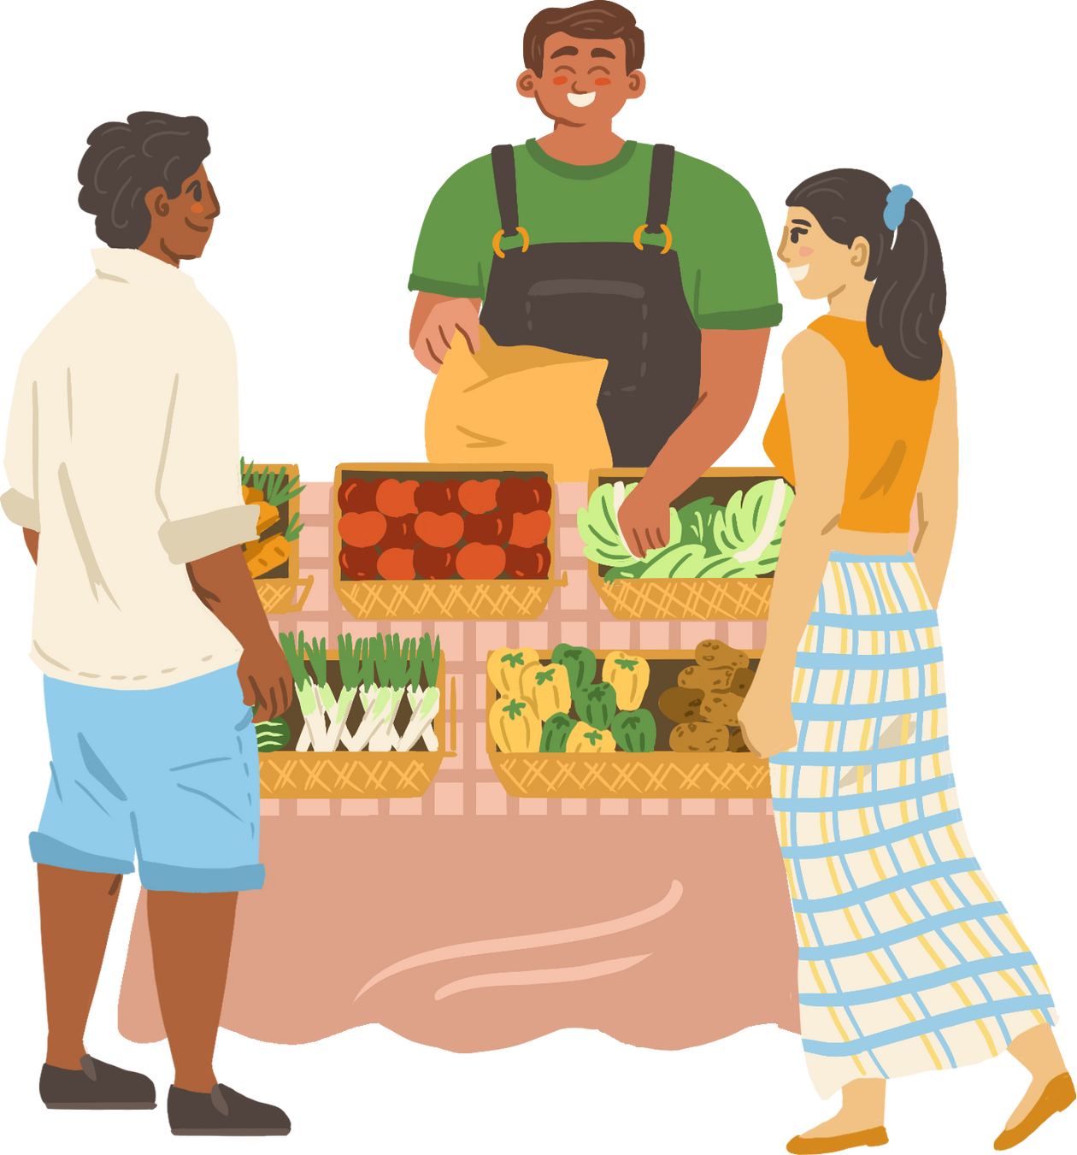
WELCOME TO OUR CLASS!
Teacher: ……………………

Slide 2
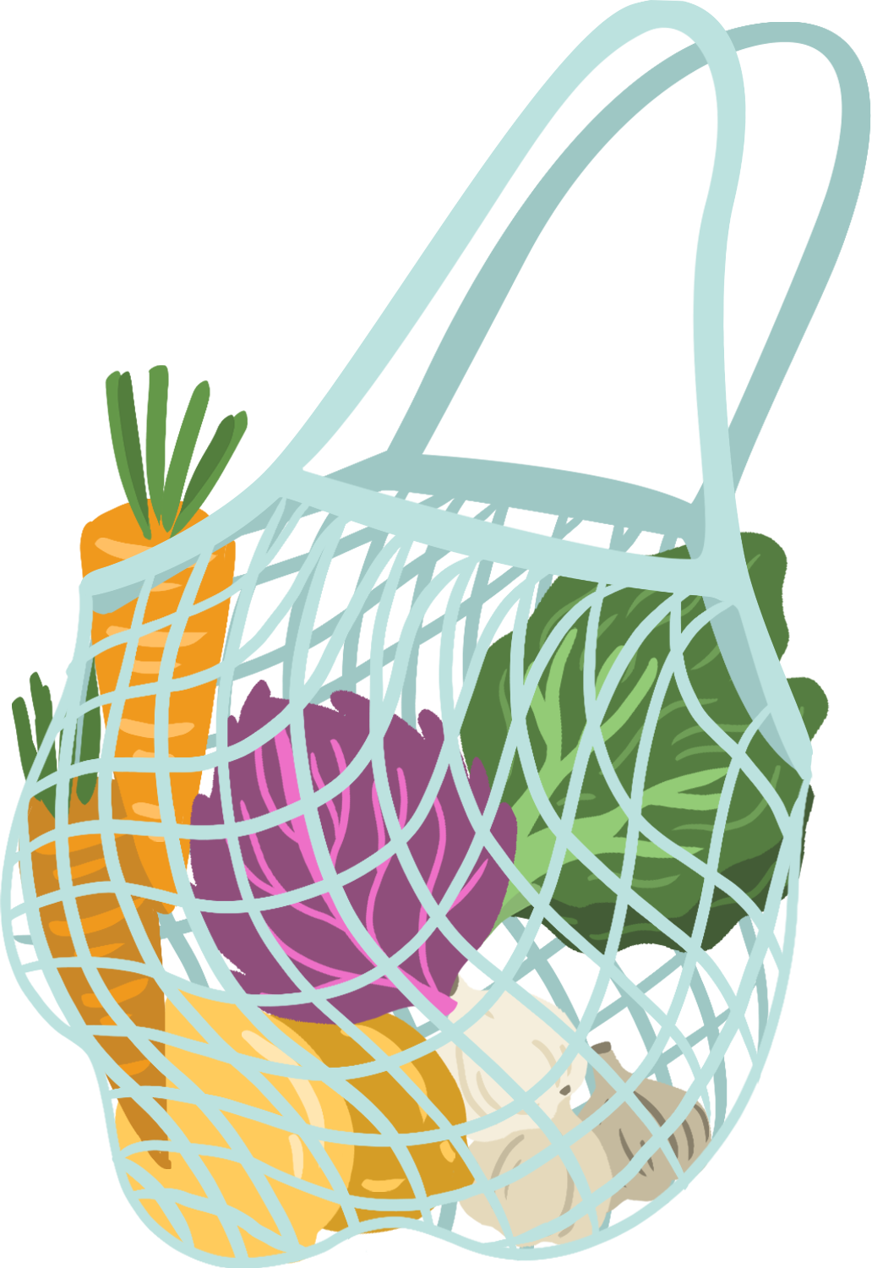



Unit 8:
SHOPPING
Lesson 7: Looking back Project

Slide 3

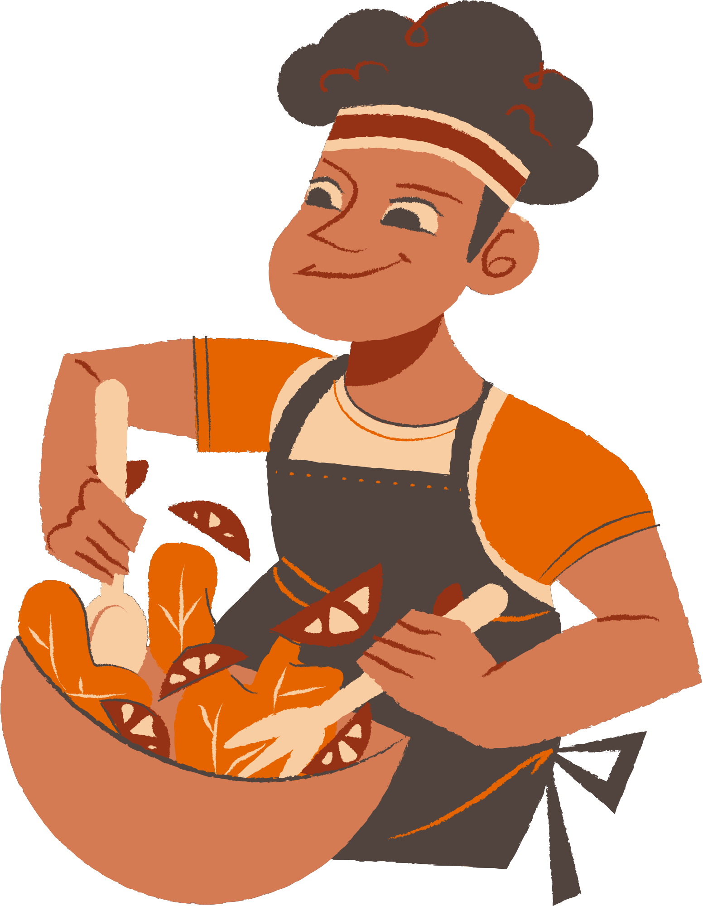



VOCABULARY

Slide 4
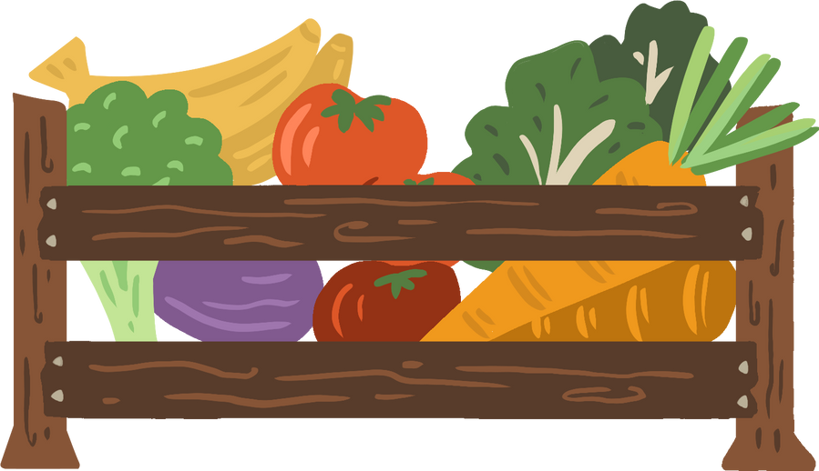



1. Match the words and phrases (1-5) with the meanings (a-e)
a. the other action of using the Internet to order food or goods.
b. a time when many things in a shop are at lower prices than usual
c. a person who is addicted to shopping
d. going round and looking at the things on display
e. a great number of goods.
1. during sales
2. browsing
3. online shopping
4. wide range of products
5. shopaholic
1b
2d
3a
4e
5c

Slide 5
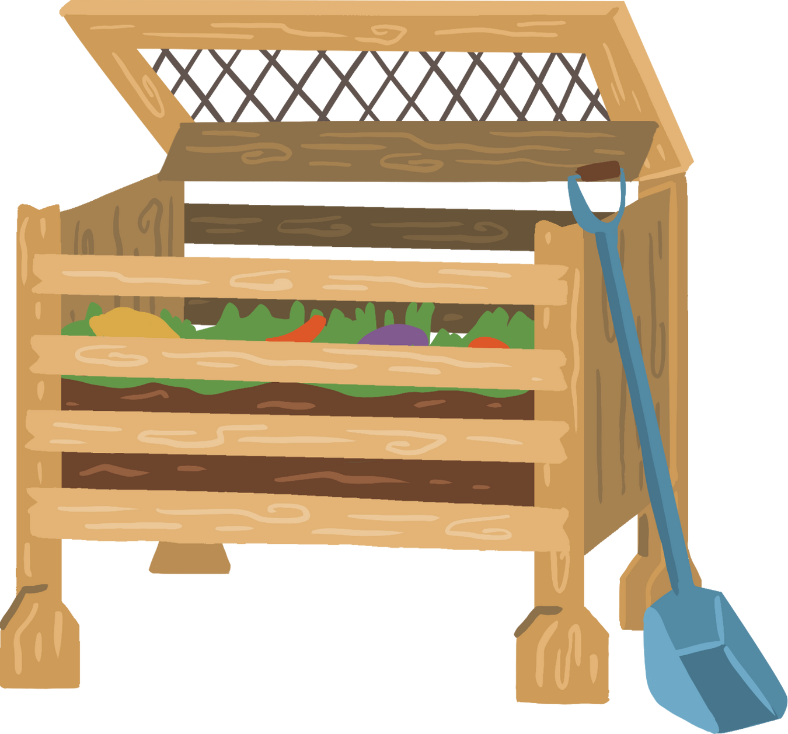
2. Complete the sentences with the words and phrases from the box.
Internet access
offline
home-grown
bargain
on sale
1. Look! These sports shoes are __________. They are 30% off.
2. This item has a price tag, so you cannot ___________.
3. Do you have ______________ here? I want to check my email.
4. When you visit a farmers’ market, you will find a lot of ___________.
fruit and vegetables.
5. My mother always shops __________. She never shops online.

Slide 6
GRAMMAR

Slide 7
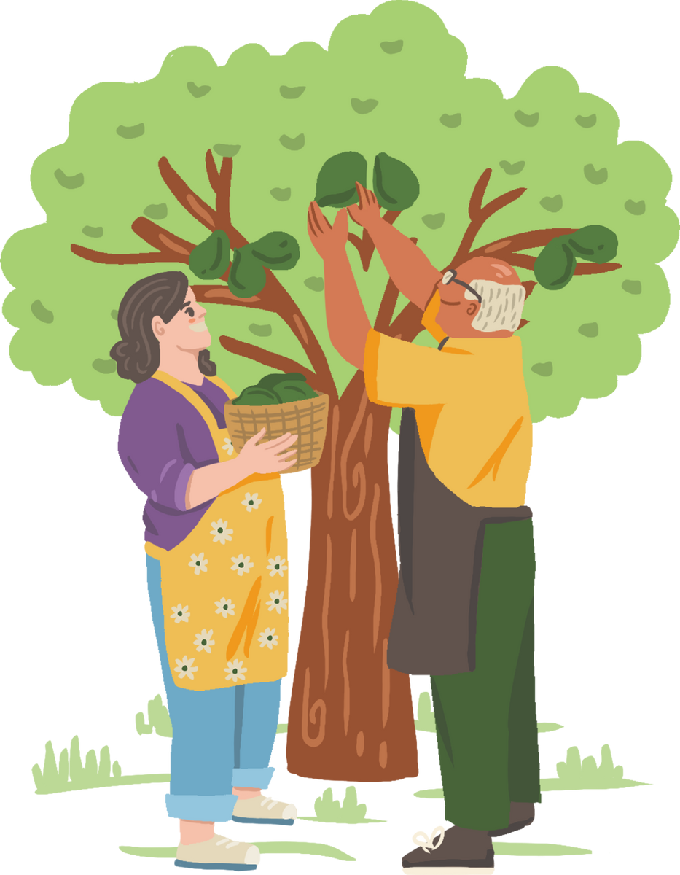
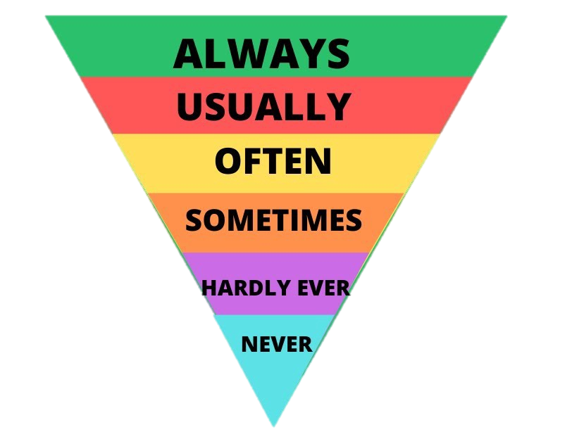
Adverb of frequency

Slide 8

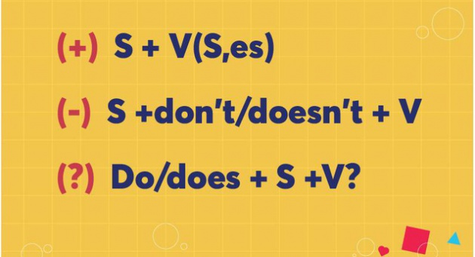
Present simple for future events

Slide 9



3. Complete each sentence with a suitable adverb of frequency.
always
My sister __________watches the Junior Master Chef programme. She never misses an episode.
My mom________________ shops at the supermarket. But I don’t go there often.
My father __________ goes to a dollar store. He says there’s nothing worth buying there.
We don’t _____________ go to the supermarket. It’s far from our home.
Theses brands are _________ on sale, just once or twice a year.
always/ usually
never
often/ usually
rarely

Slide 10
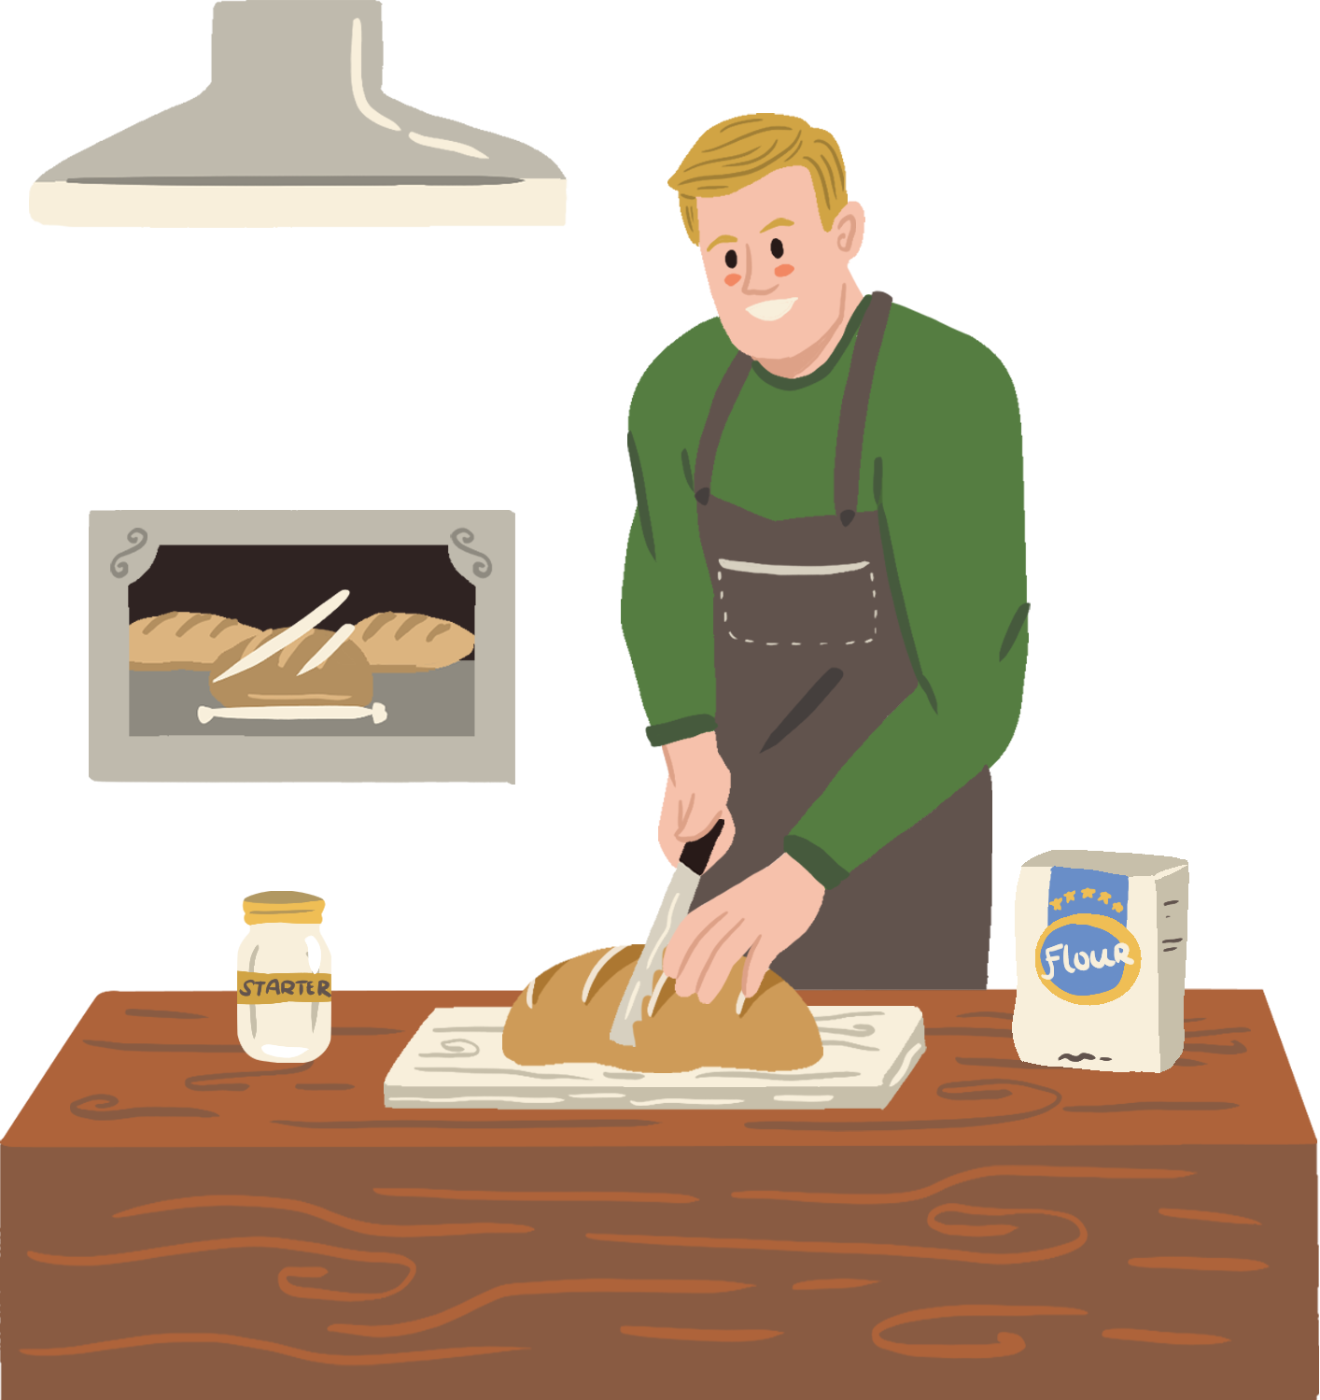
4. Use the correct tense and form of the verbs in brackets to complete the sentences.
leaves
The shuttle bus (leave)__________every 15 minutes to take customers to the parking lot.
- Mum, what time (be)________ the show tonight?
- Let me check.
3. We (can use)__________ these vouchers for the next shopping.
4. The announcement says that the sale (last)________for just two hours, from 17:00 to 19:00 tomorrow.
5. We (not have)____________ home economics next semester. We have music instead.
is
can use
lasts
don’t have

Slide 11

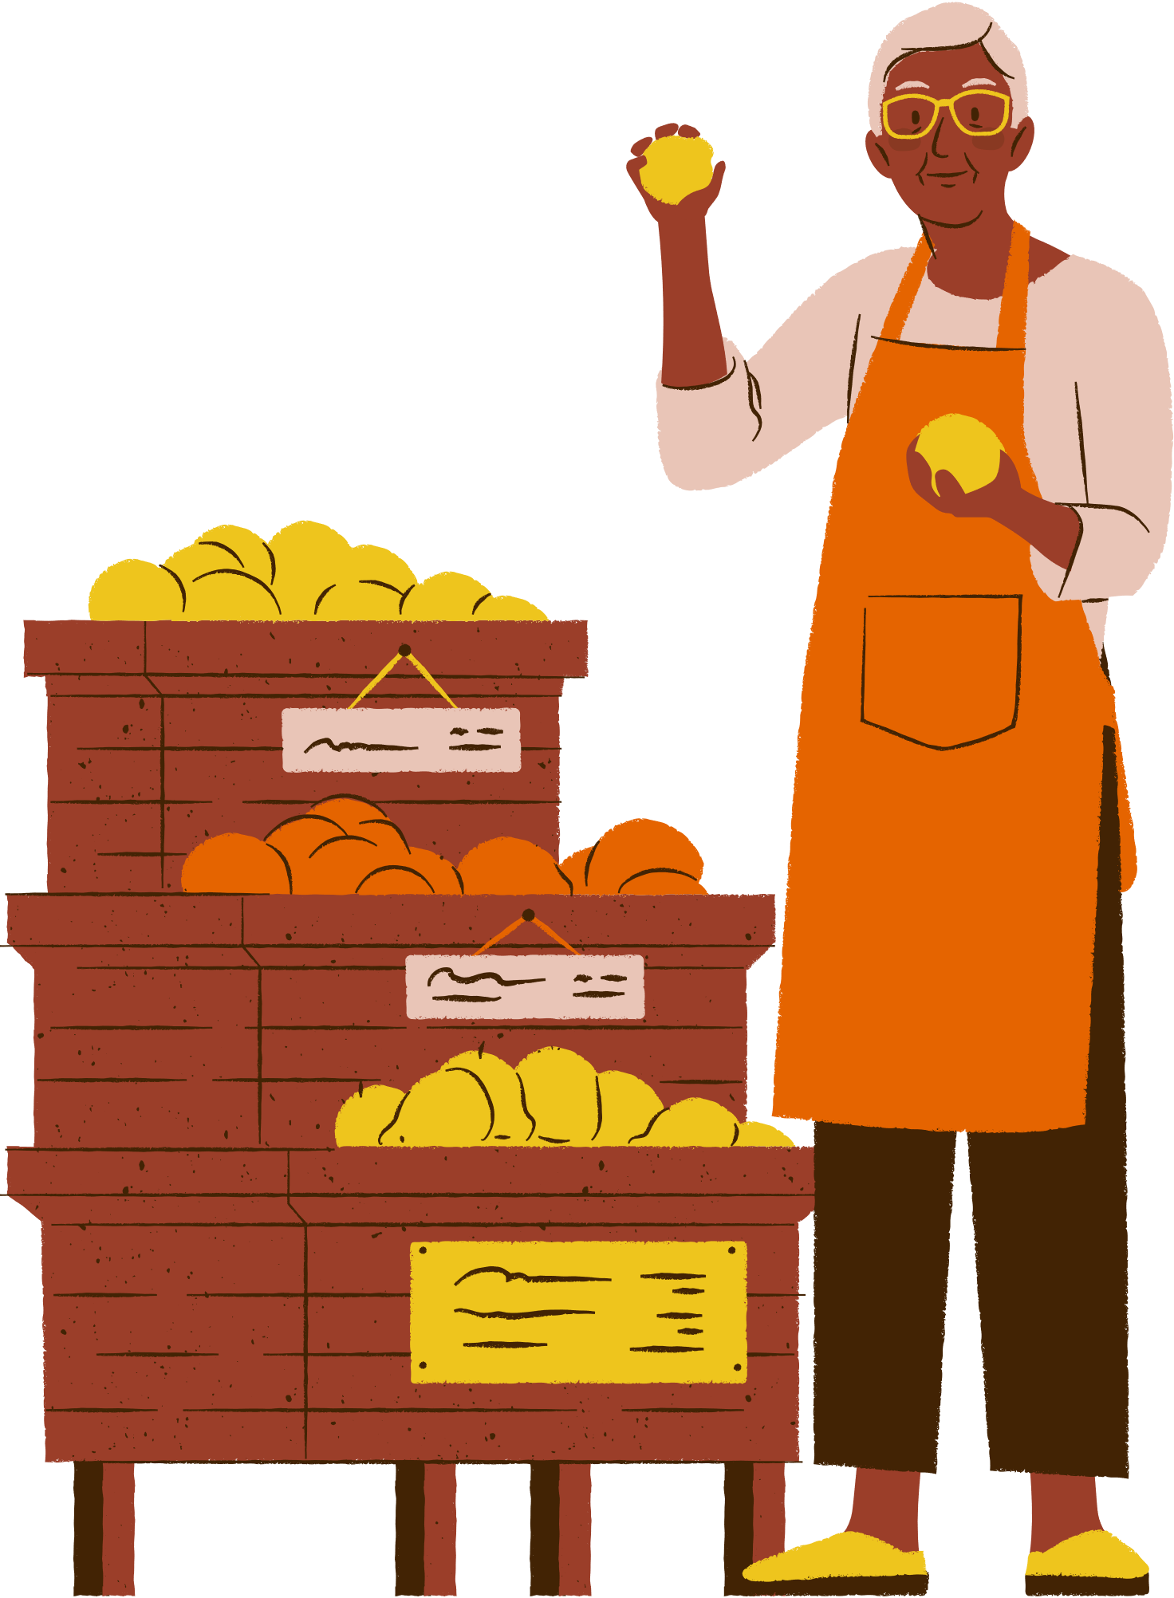
Imagine a shopping place you would like to have in your neighbourhood.
Draw it or find a picture similar to it.
Present it to the class.
PROJECT PRESENTATION

Slide 12

WRAP – UP
Reviewing present simple and adverbs of frequency
Reviewing vocabulary in Unit 8

Slide 13
THANK YOU !

