Slide 1

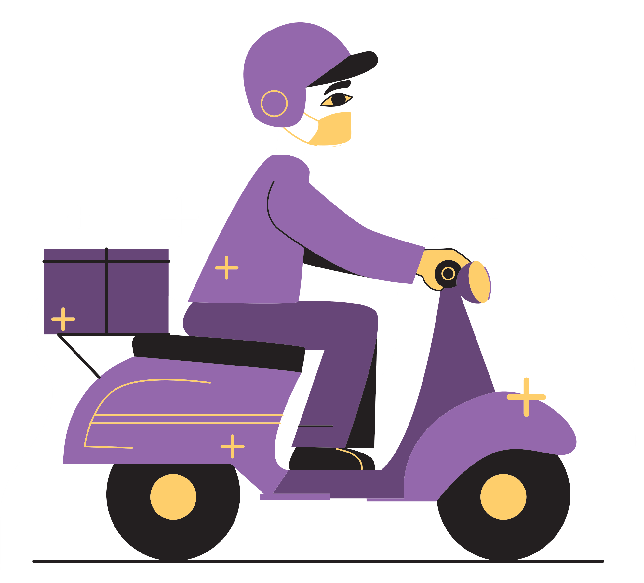
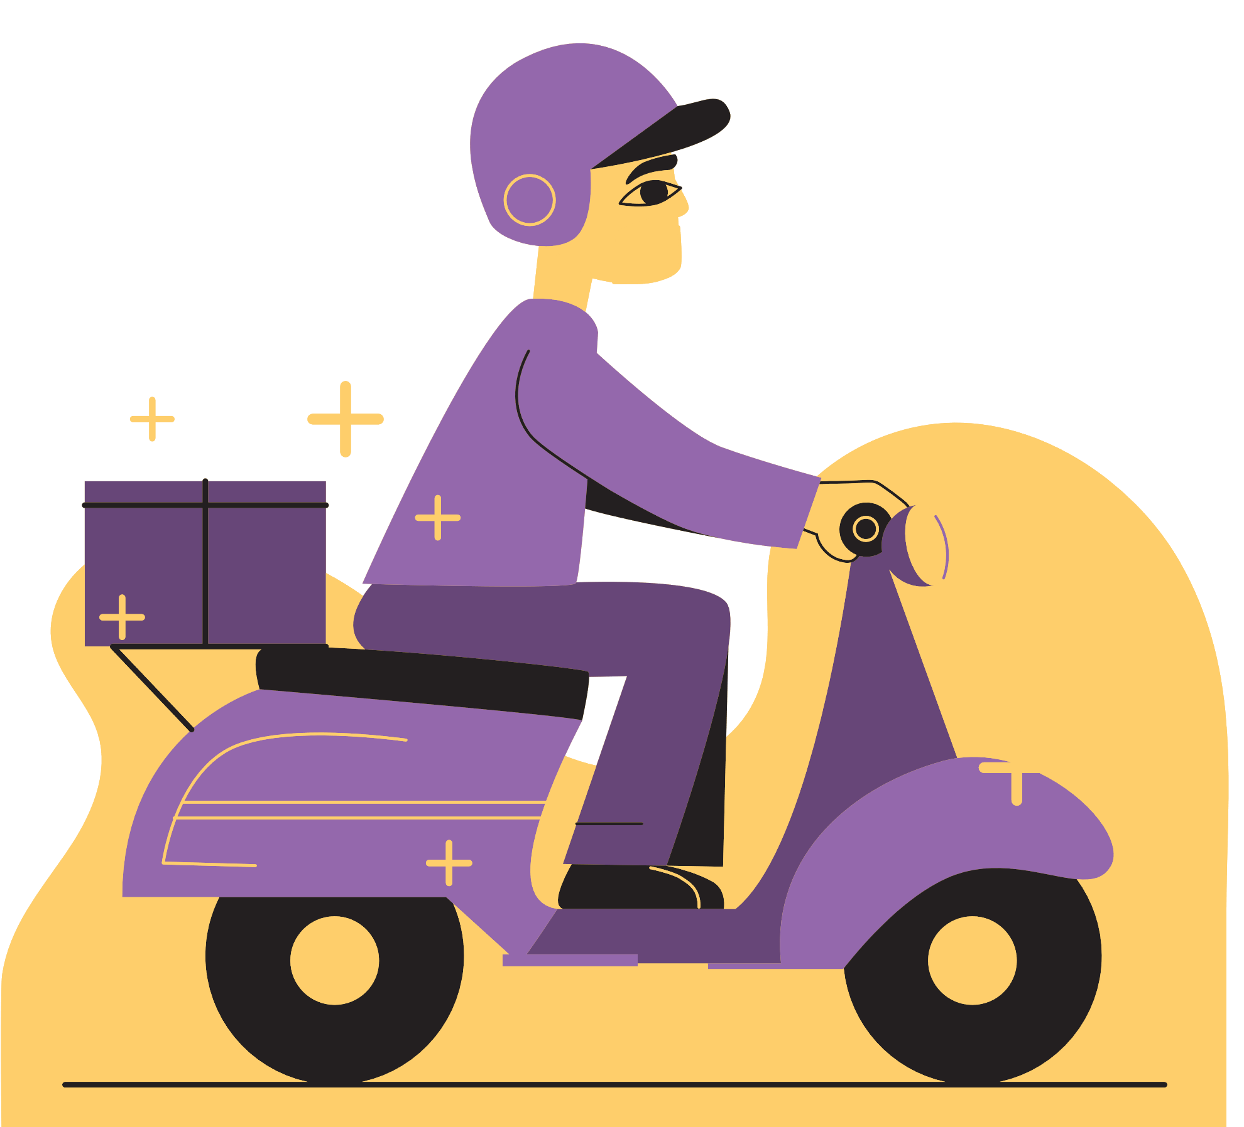
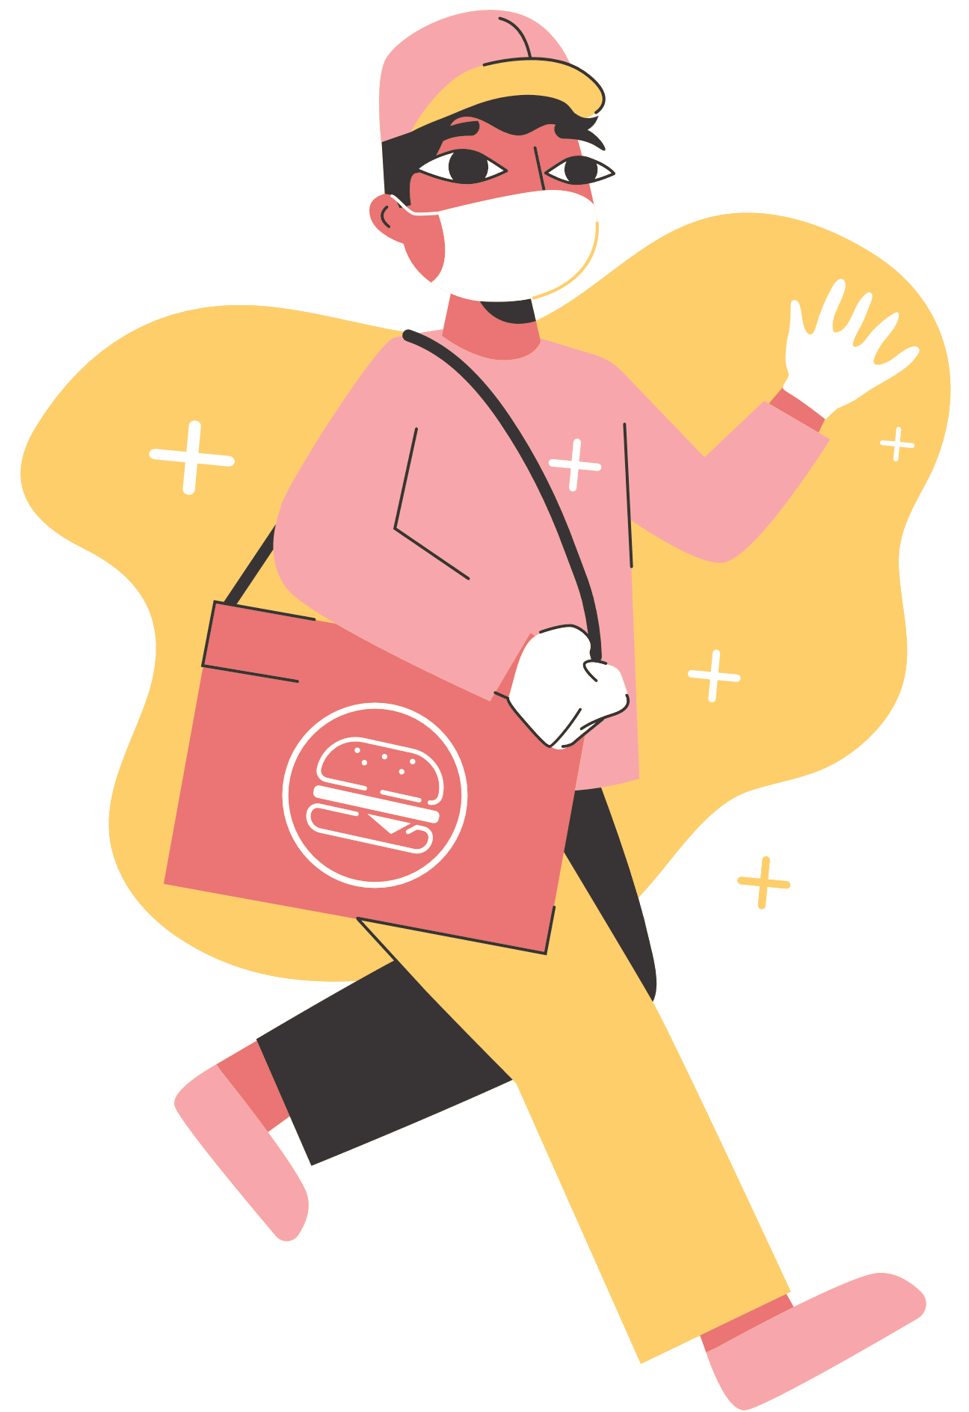
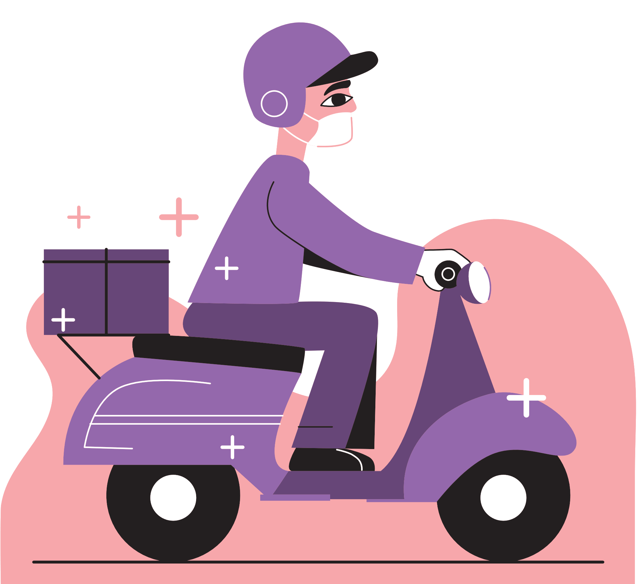
WELCOME TO OUR CLASS!
Teacher: ……………….

Slide 2
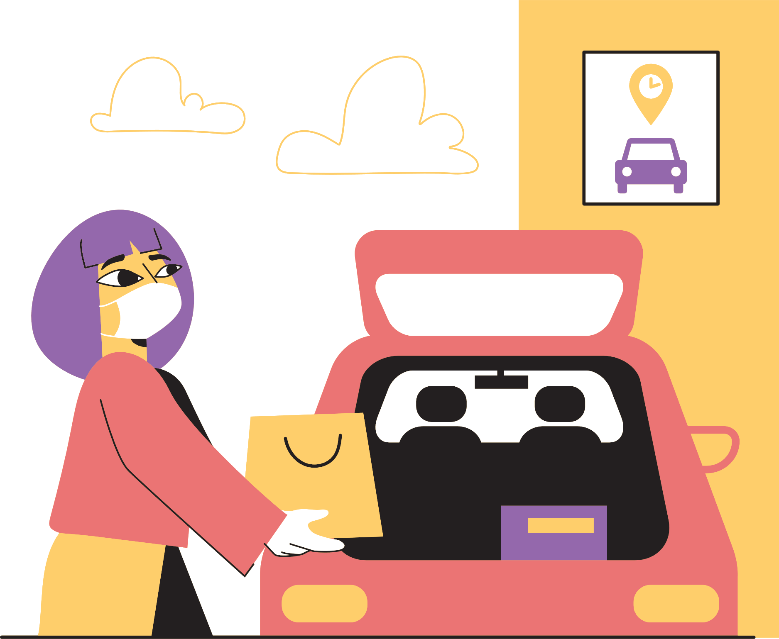
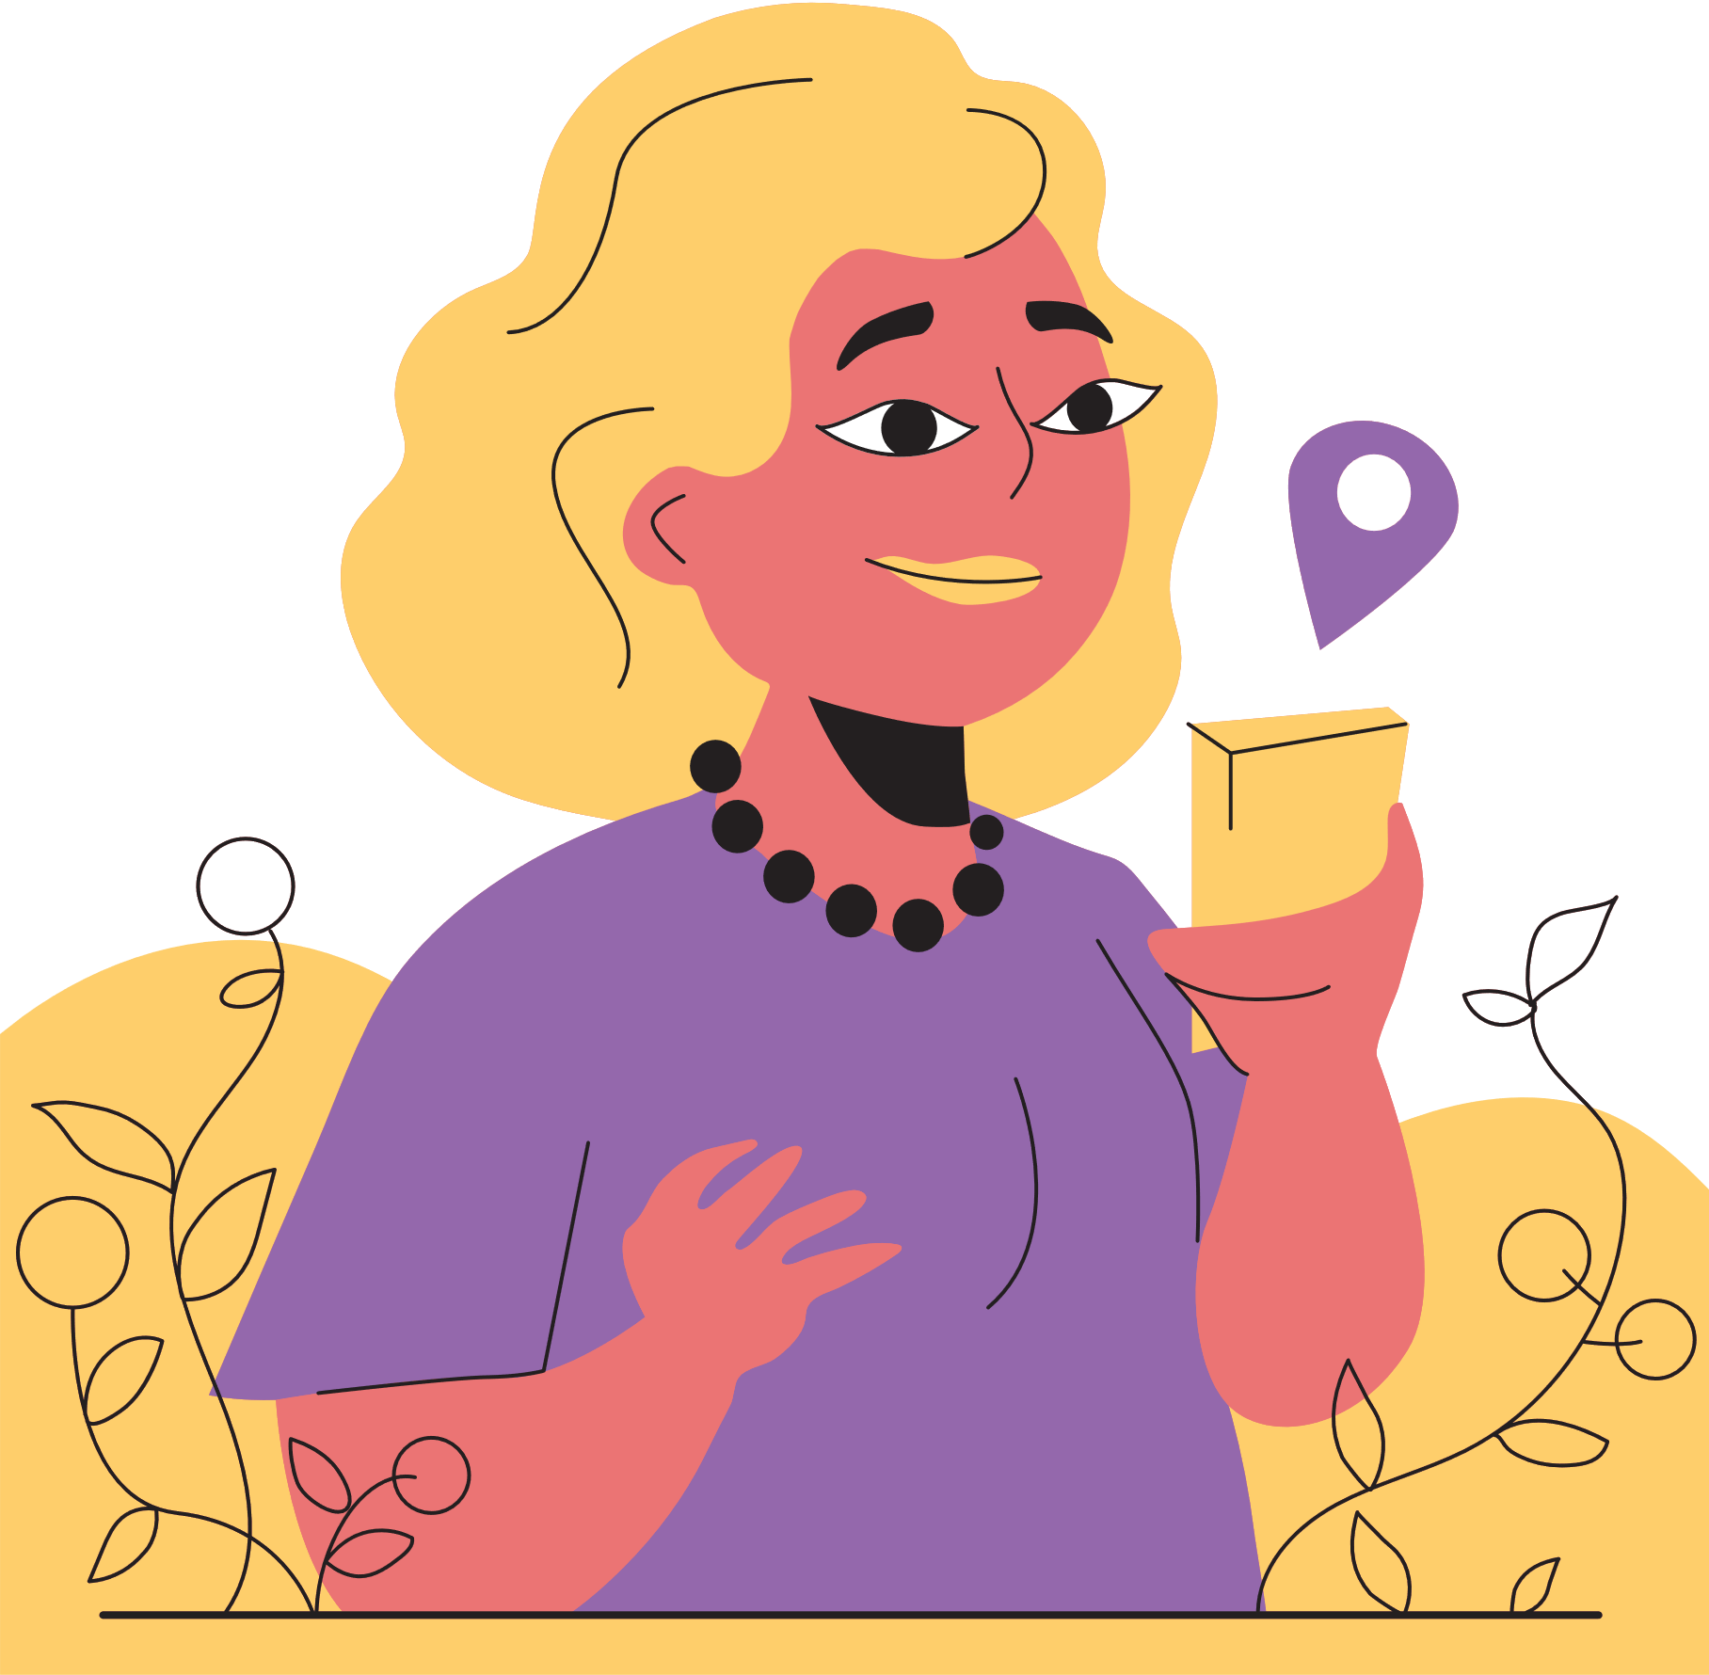
Chatting
A
Do you like shopping?
B
How often do you go shopping?
C
Why do you go to shopping centers?

Slide 3
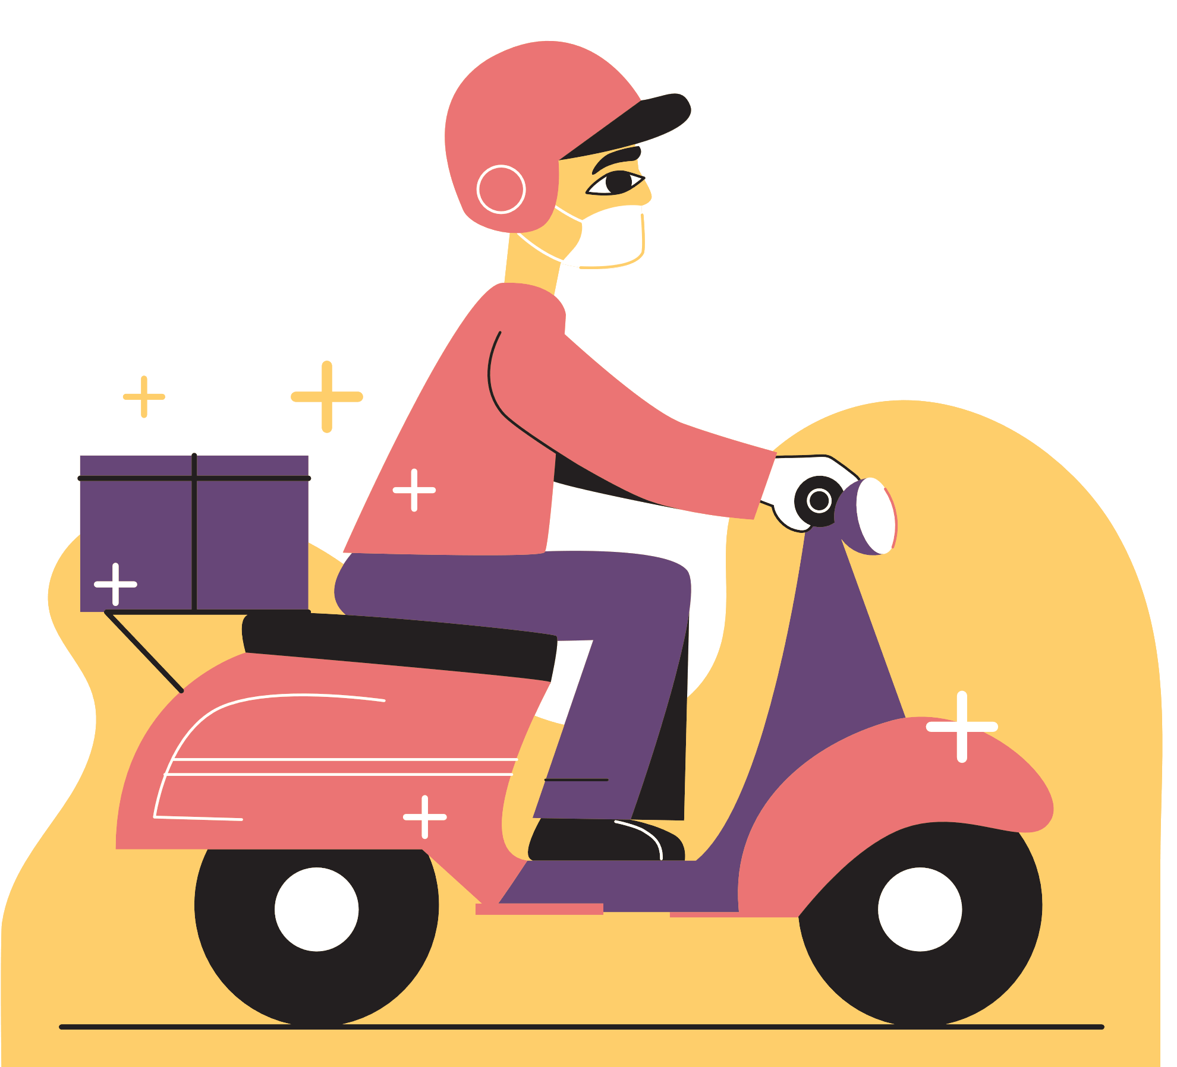
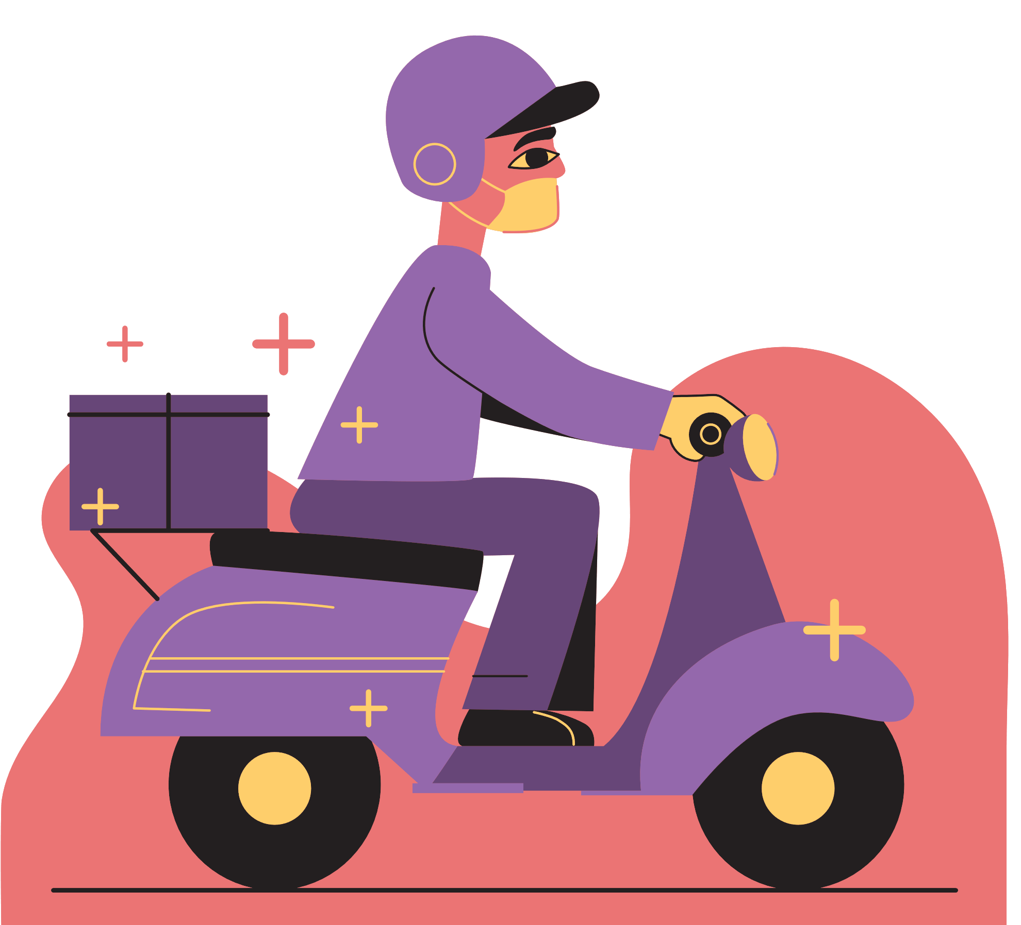
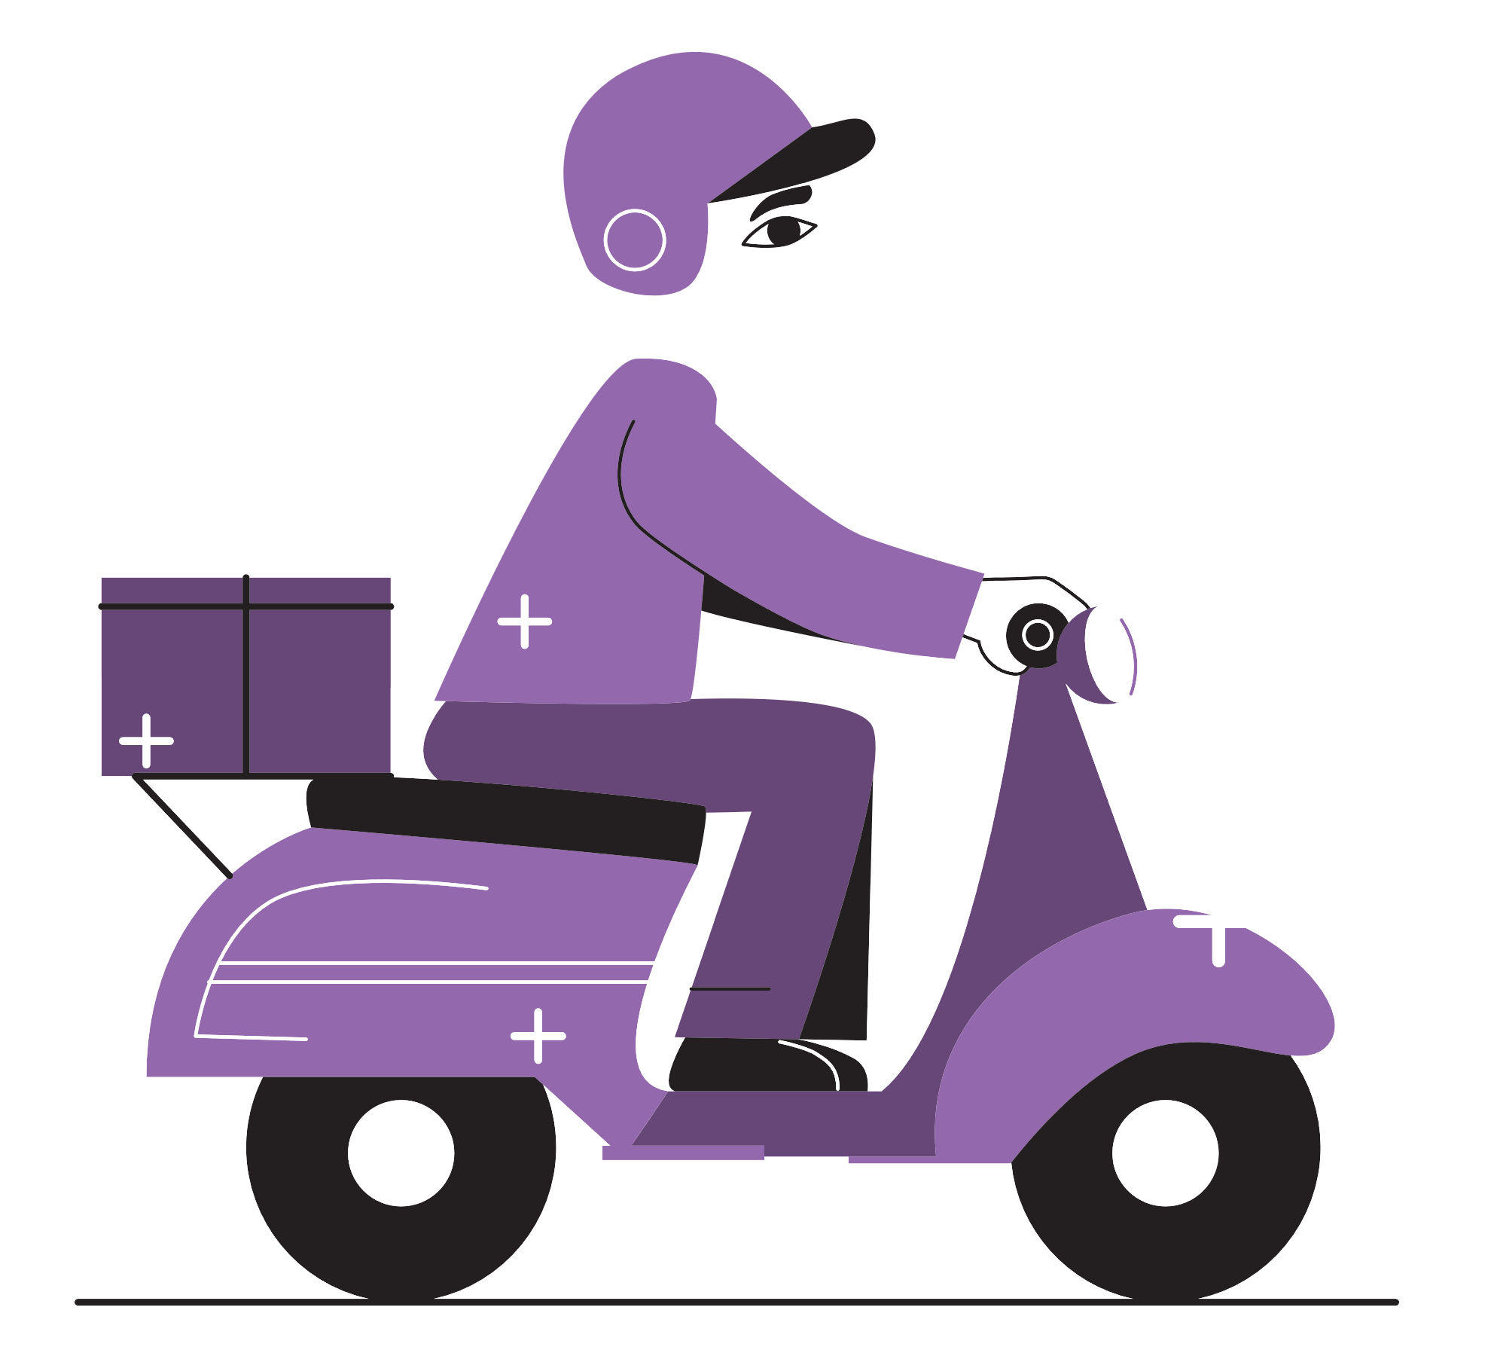
Unit 8:
Shopping
Lesson 5: Skills 1

Slide 4
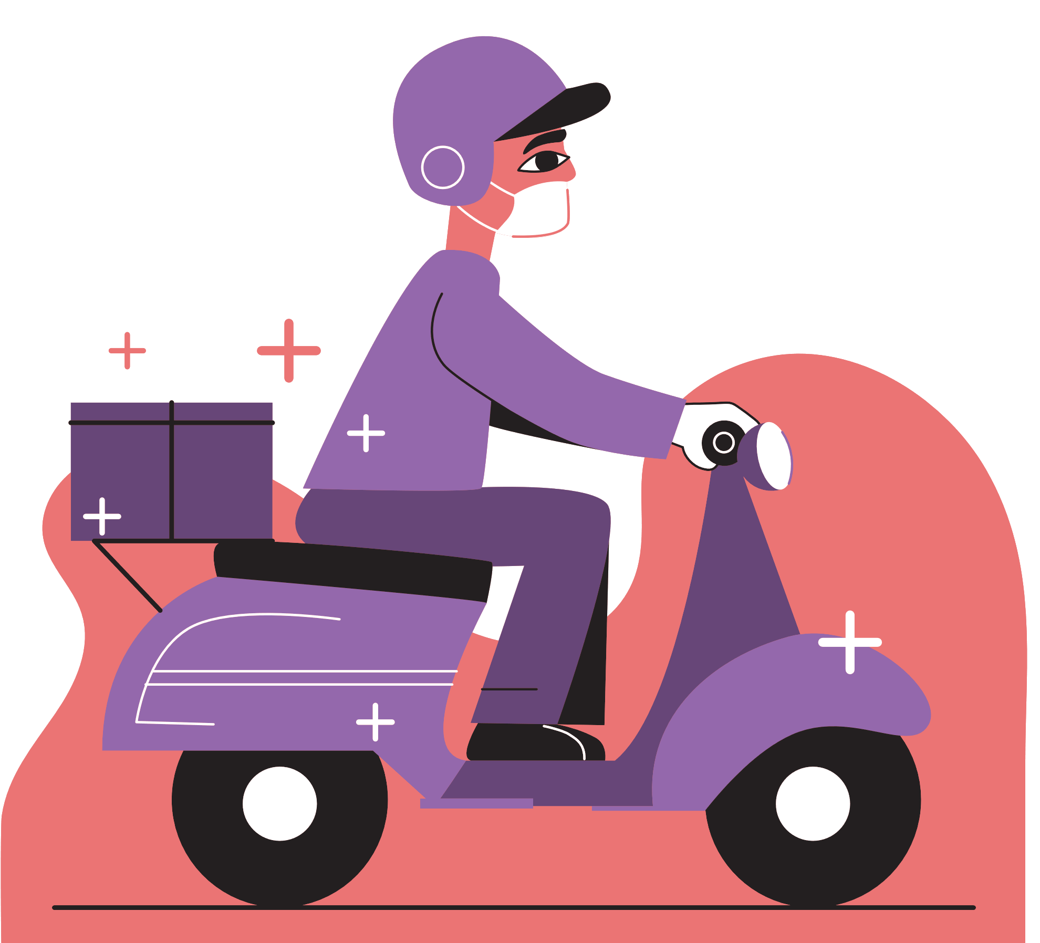
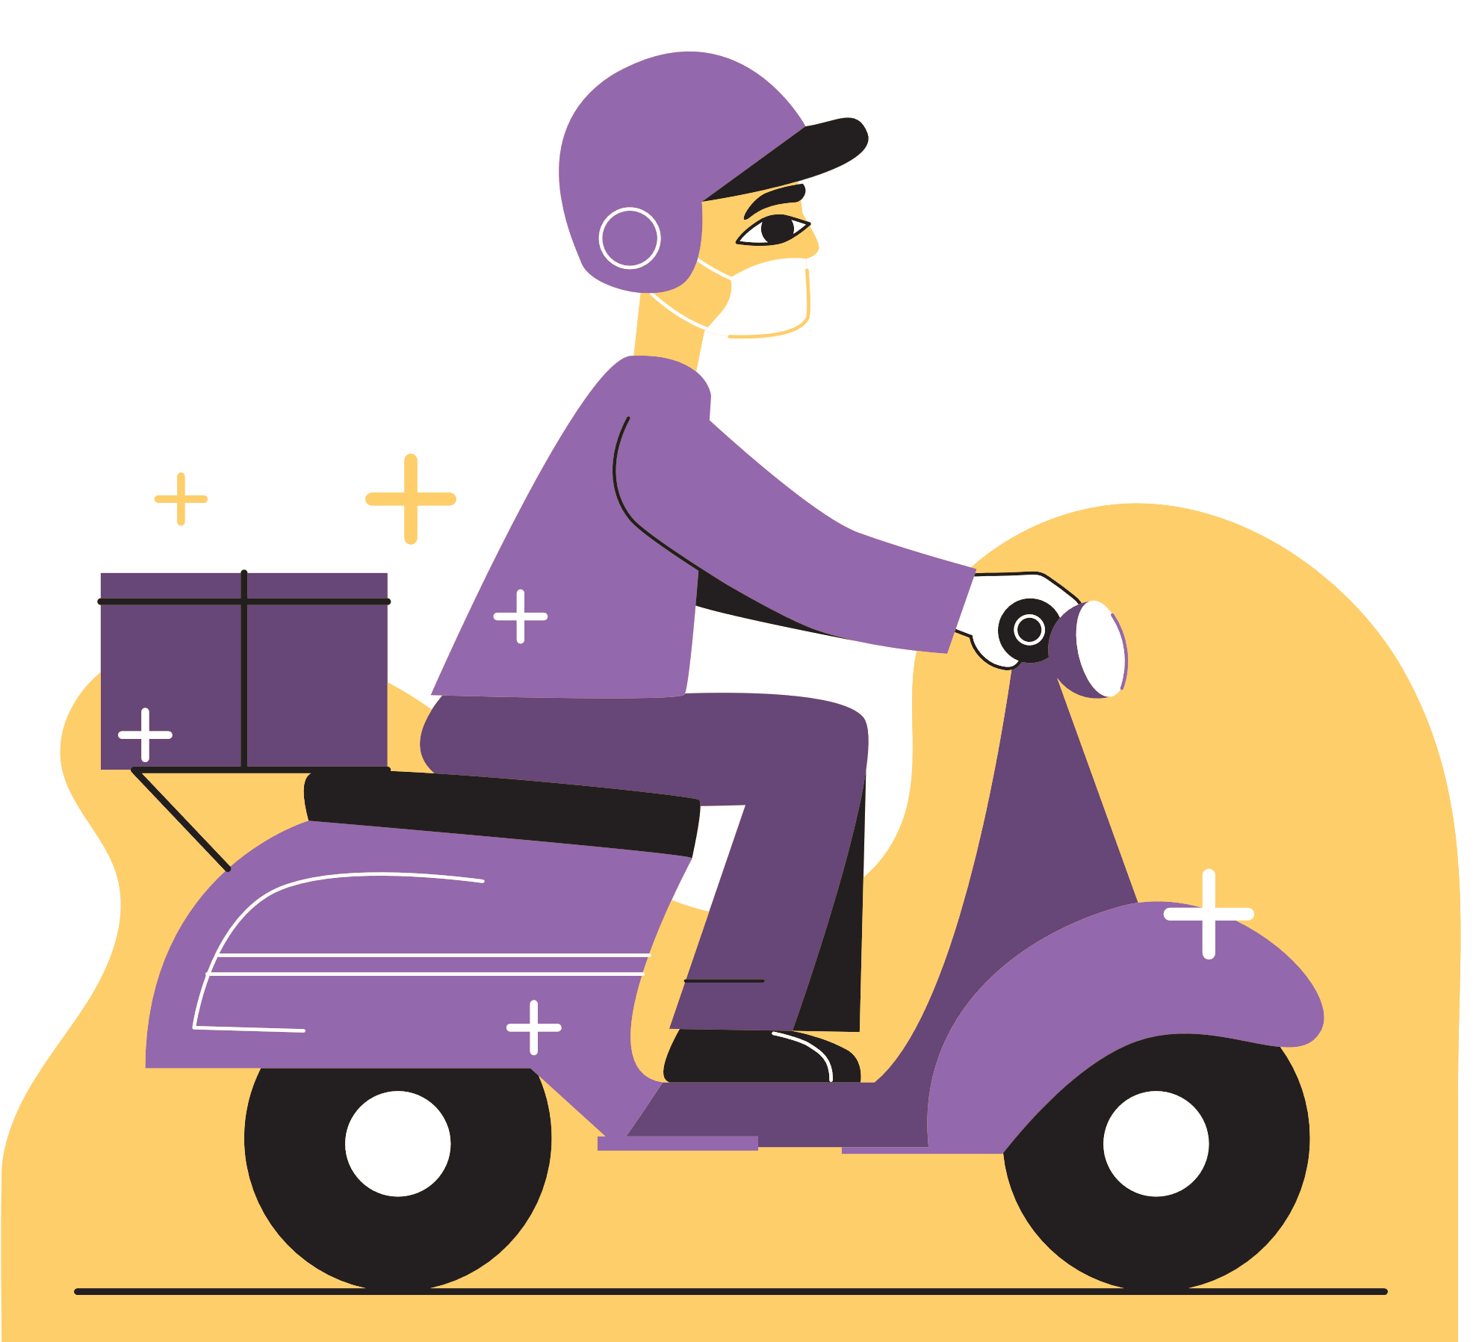
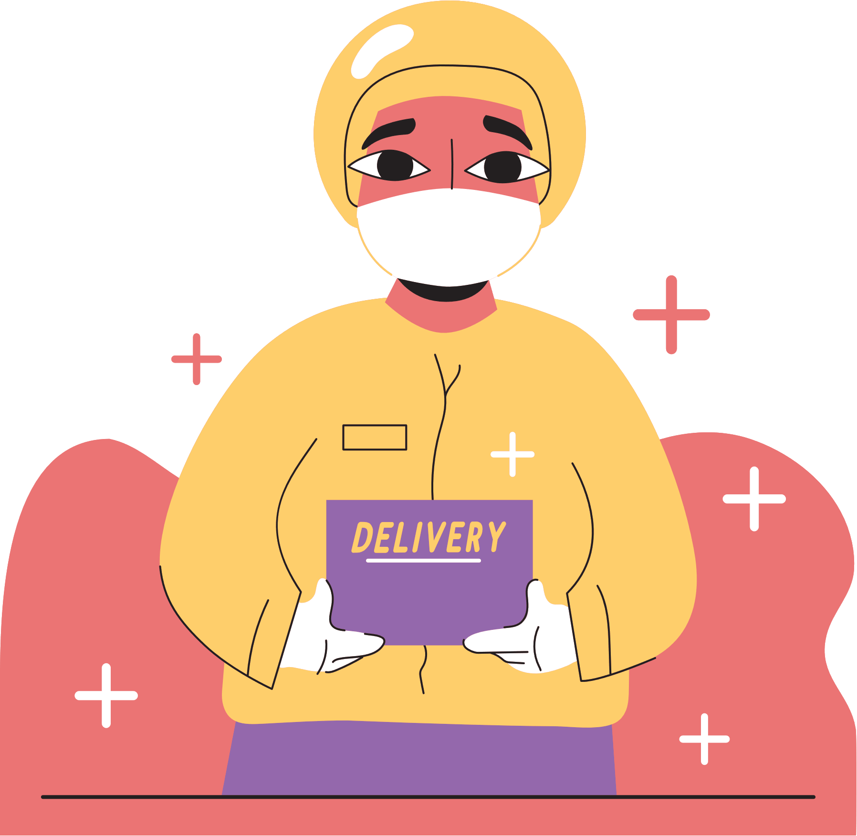
READING

Slide 5
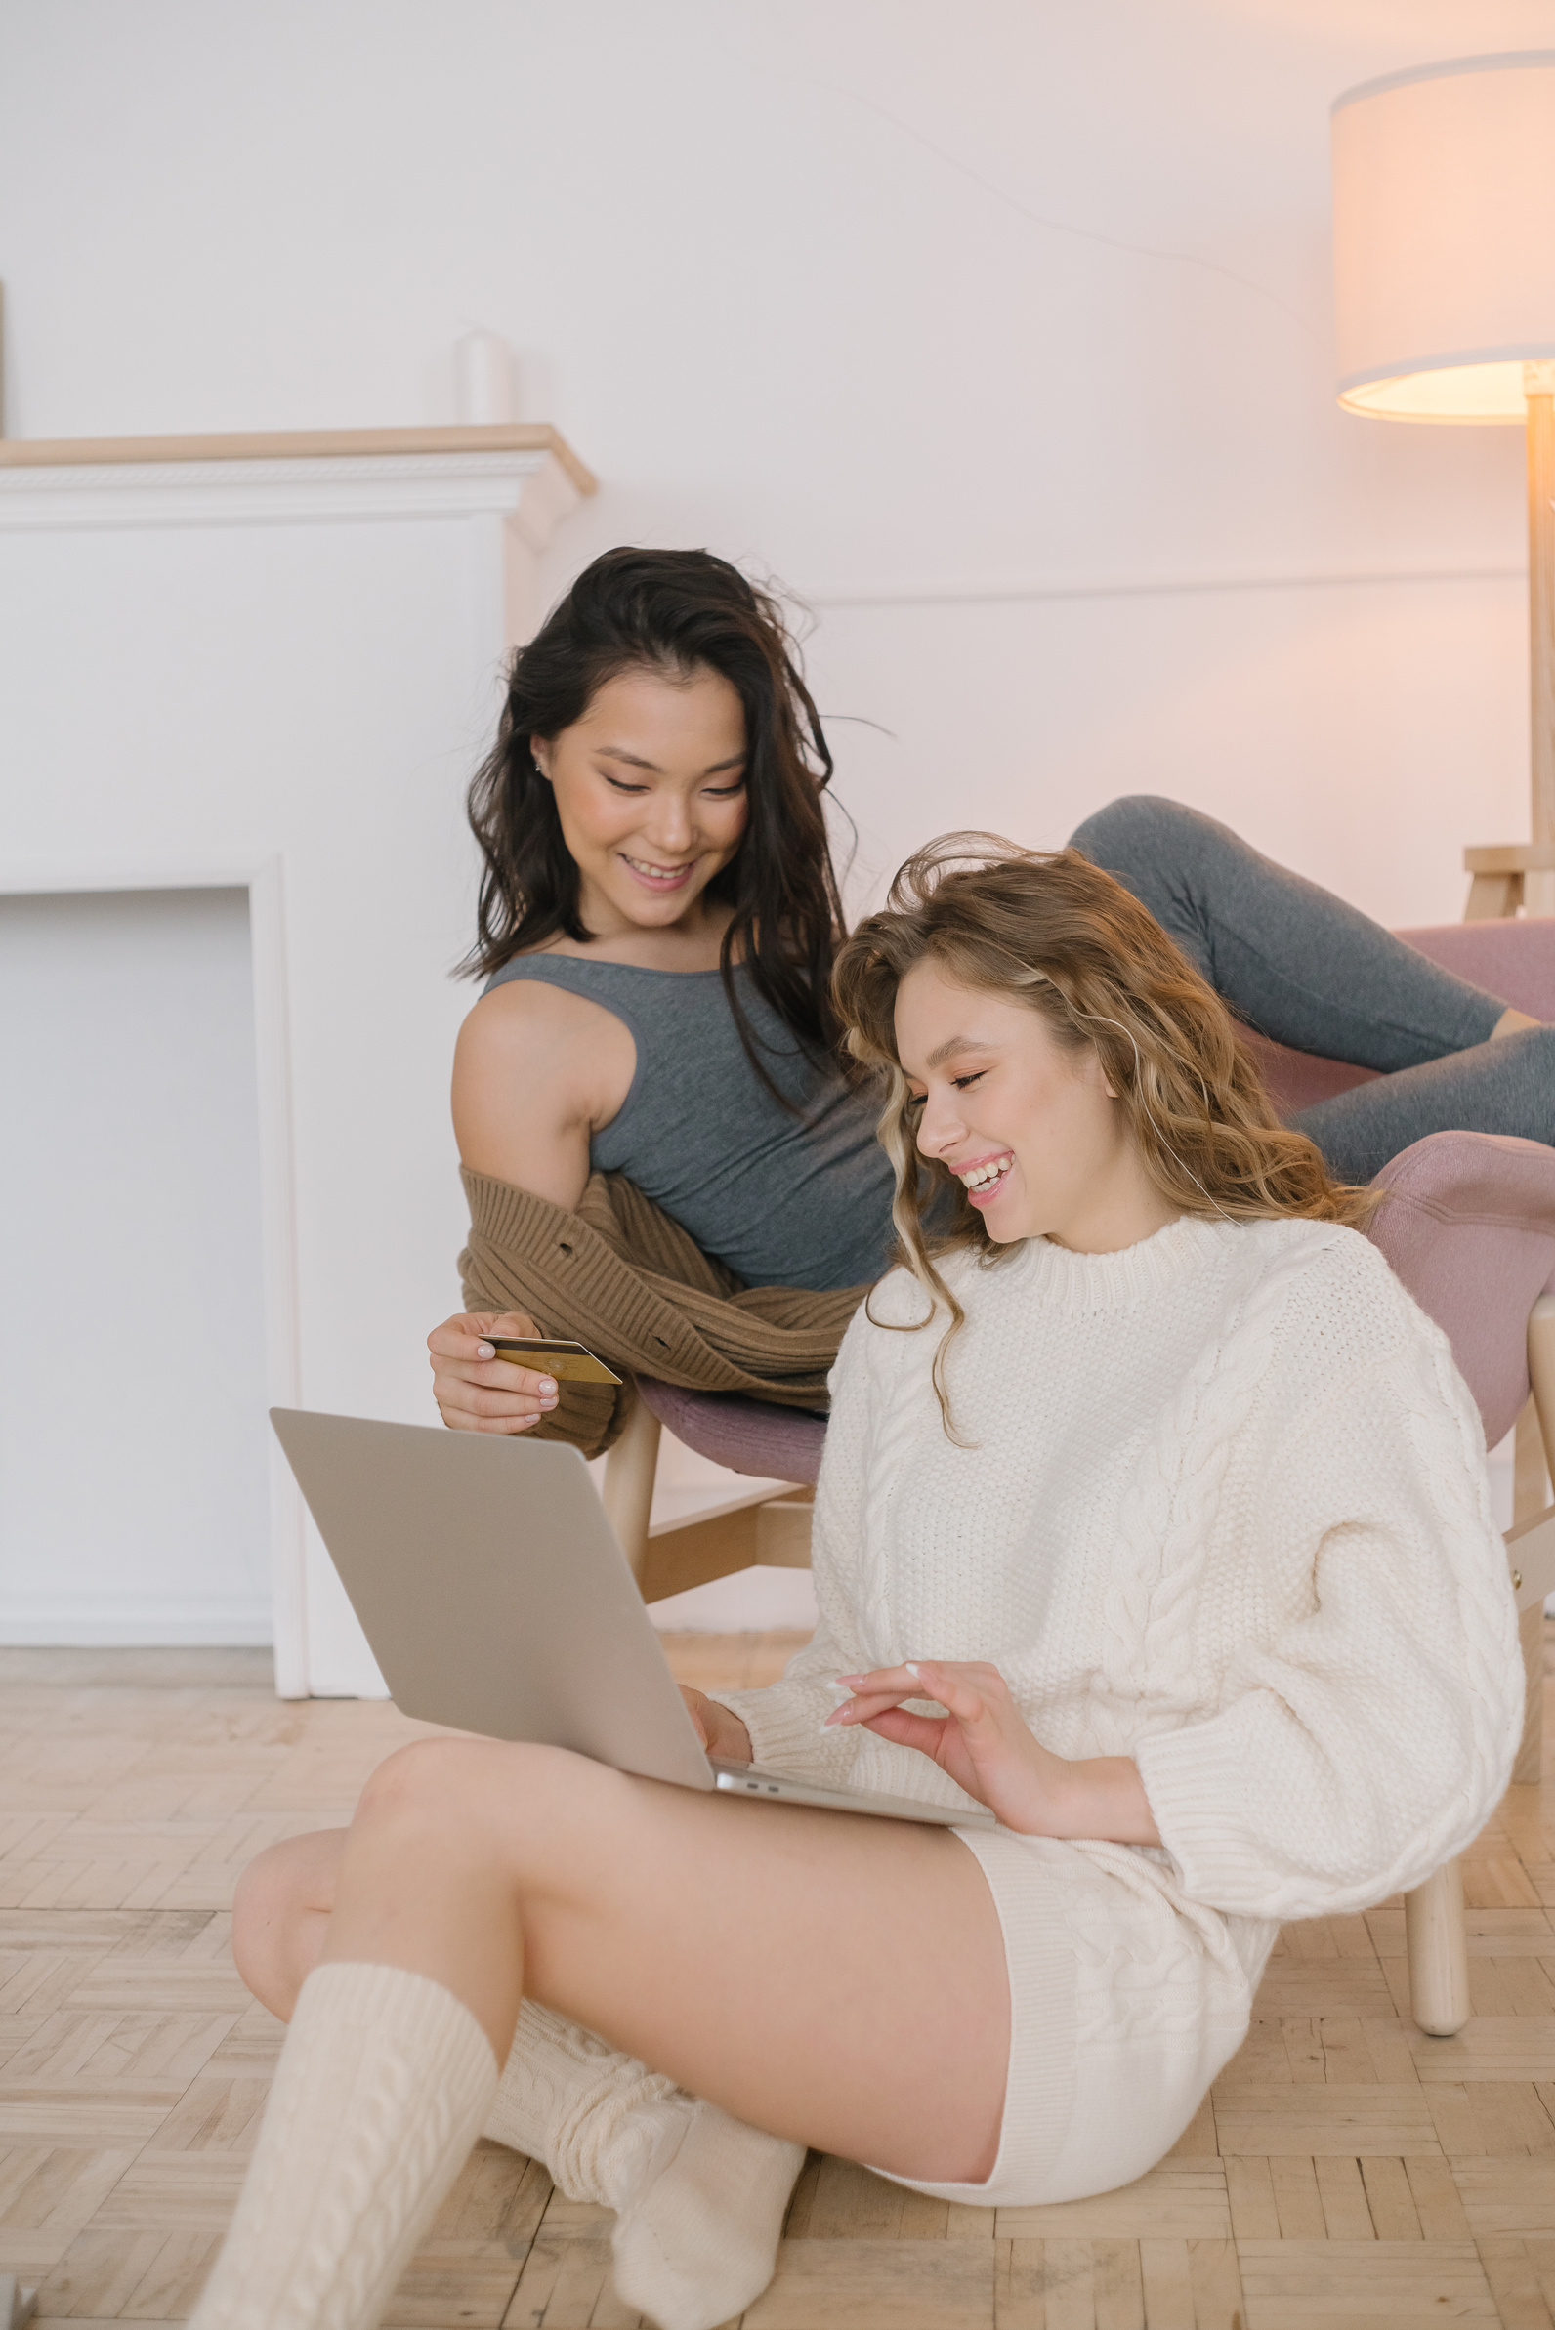
VOCABULARY

Slide 6
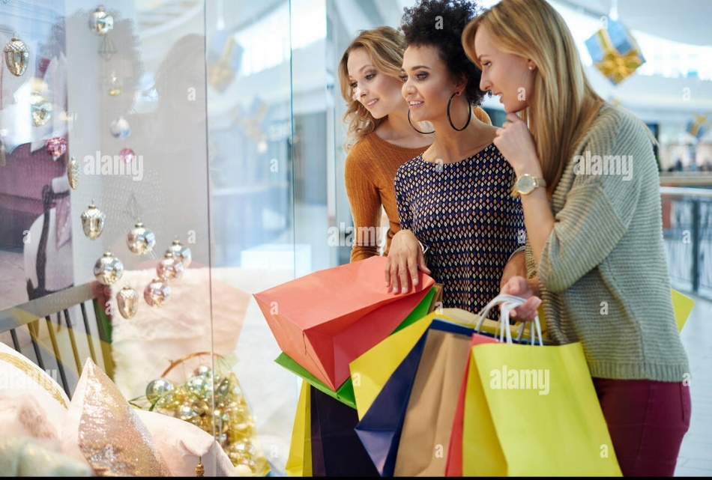
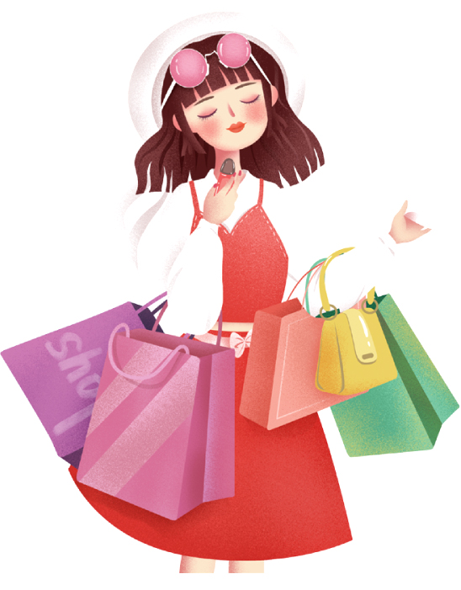
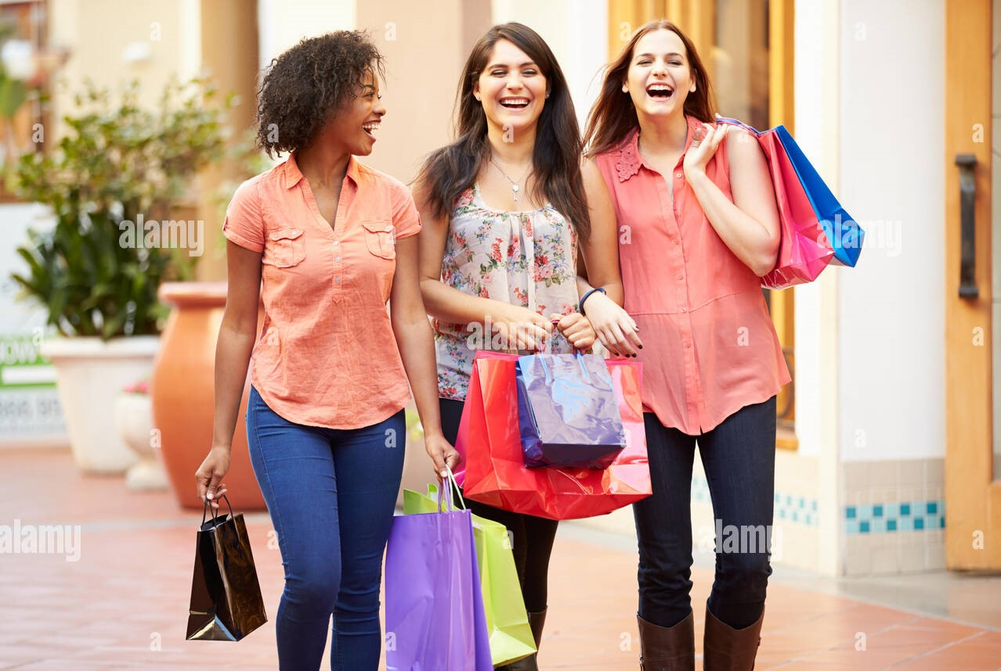
1. Read the list below and tick () the most common reason(s) why you go shopping.
Hanging out with friends
Reducing stress
Buying goods
Exercising
Browsing

Slide 7
2. Read the passage and pay attention to the underlined words and guess their meaning.
Shopping centres attract a lot of customers, especially at the weekend, on holidays, or during sales. People go there to shop. Shopping centres offer a wide range of products to choose from. Customers can touch the products and try on clothes and shoes. This makes them feel more comfortable when they decide to buy something.
However, people also go to shopping centres for many other reasons. Some people go there for entertainment. These centres often offer year-round free entertainment for customers of all ages such as live music and special performances. During holidays, shoppers can see decorations and join in the holiday excitement. It’s a good way to relax. Some people go there just to hang out with friends. They go browsing and chat while wandering through the shopping malls. Others visit shopping centres to get exercise.

Slide 8
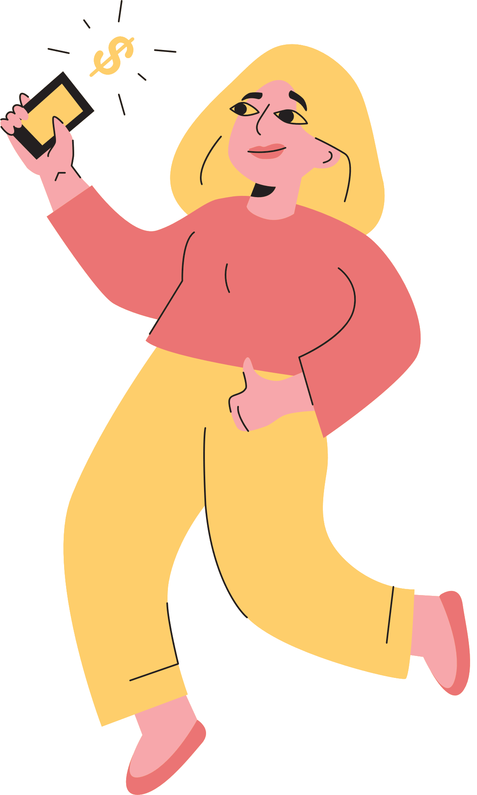

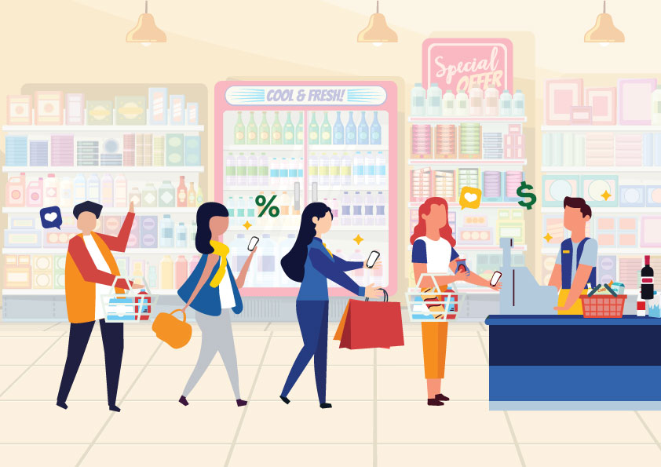
Vocabulary
customer (n)
/ˈkʌstəmə(r)/
khách hàng

Slide 9
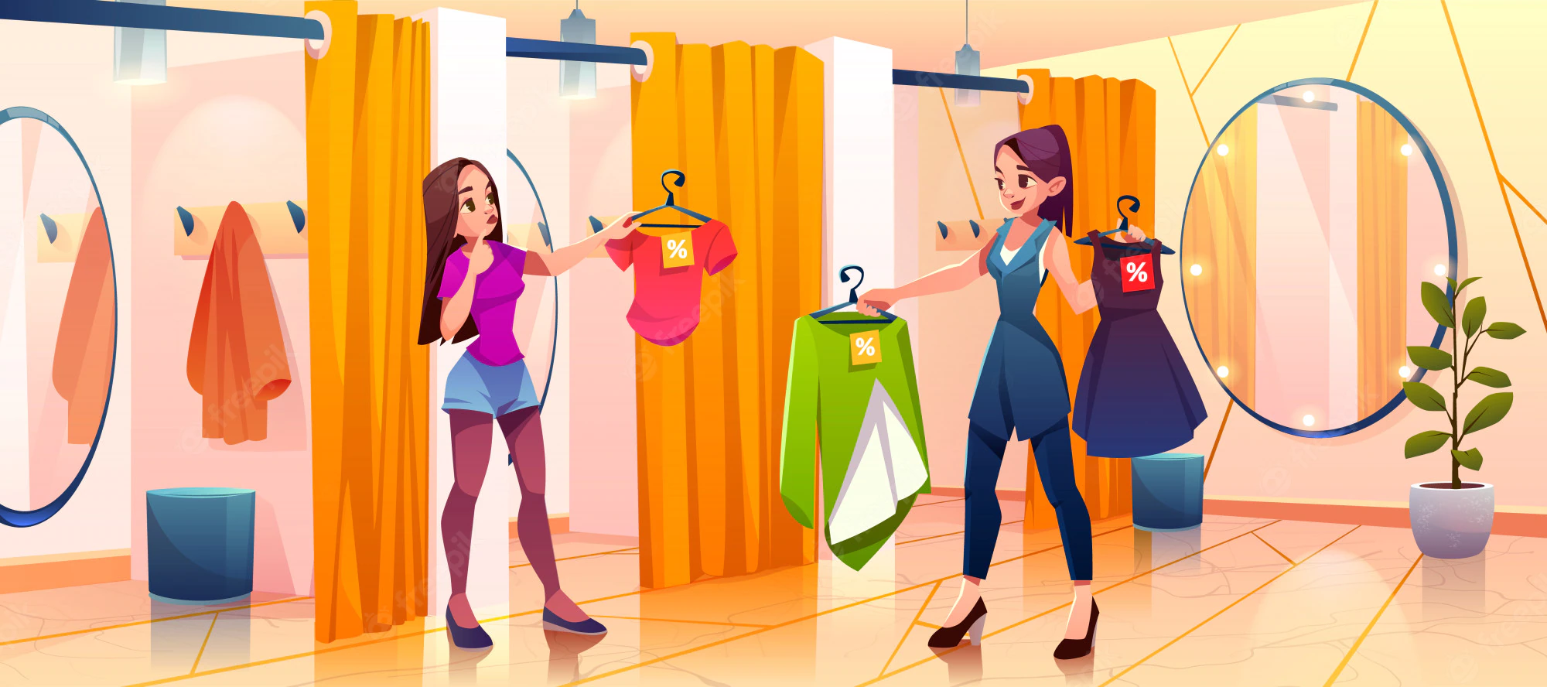
Vocabulary
try on (v)
/traɪ ɒn/
thử (quần áo, giày dép)

Slide 10
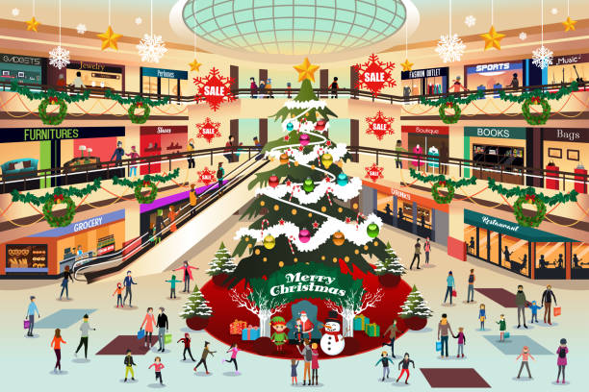
Vocabulary
decoration (n)
/ˌdekəˈreɪʃn/
đồ trang trí

Slide 11
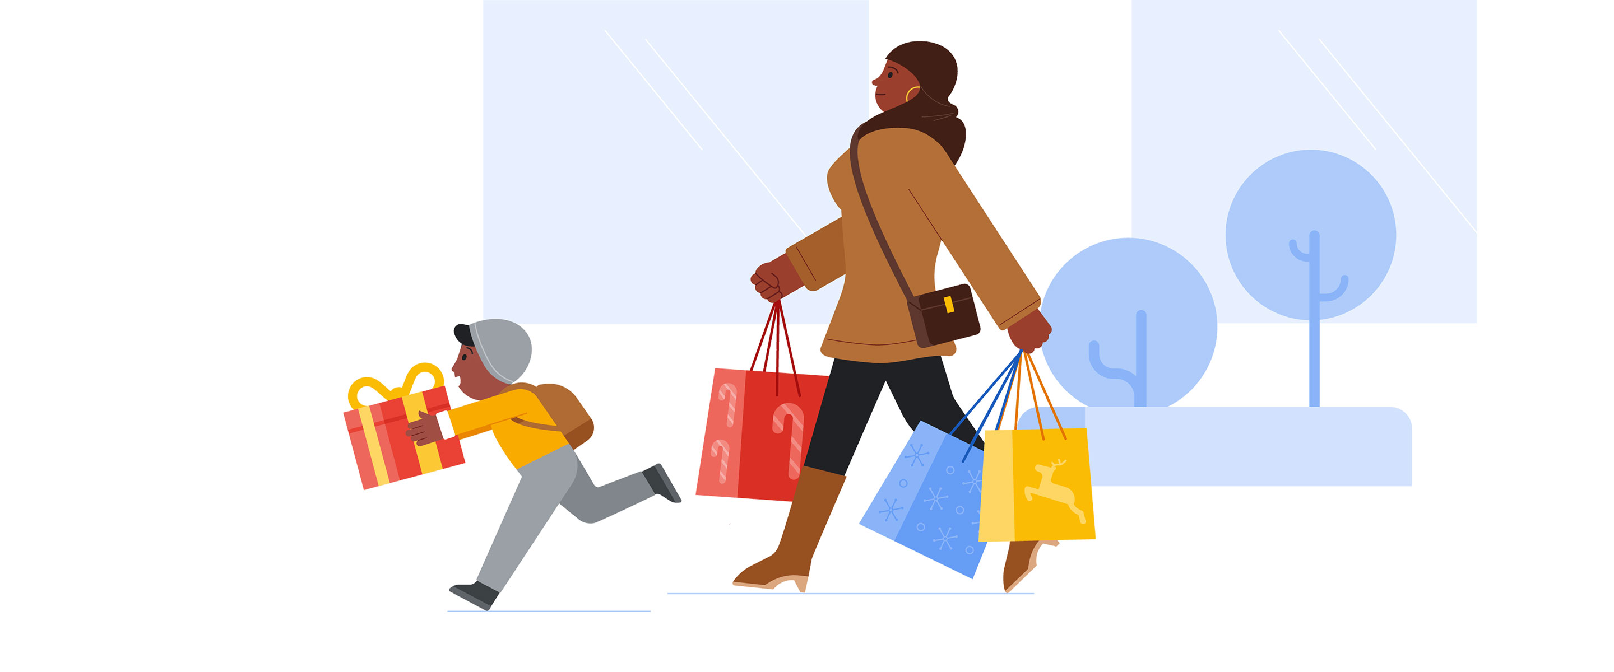
Vocabulary
wander (v)
/ˈwɑːndər/
đi lang thang, thả bộ

Slide 12
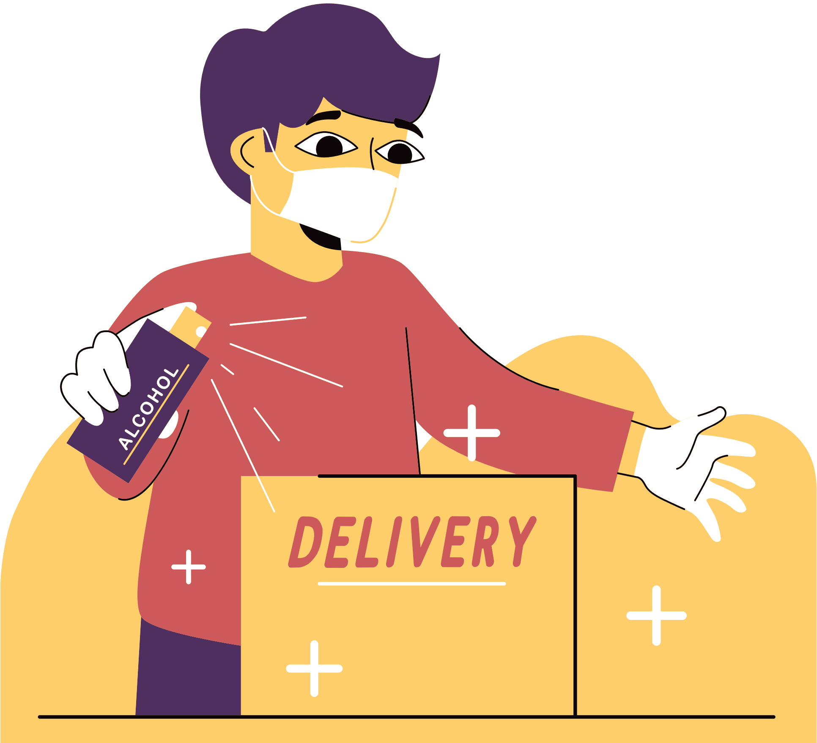
Vocabulary
customer (n)
/ˈkʌstəmə(r)/
khách hàng
try on (v)
/traɪ ɒn/
thử (quần áo, giày dép)
decoration (n)
/ˌdekəˈreɪʃn/
đồ trang trí
wander (v)
/ˈwɑːndər/
đi lang thang, thả bộ

Slide 13
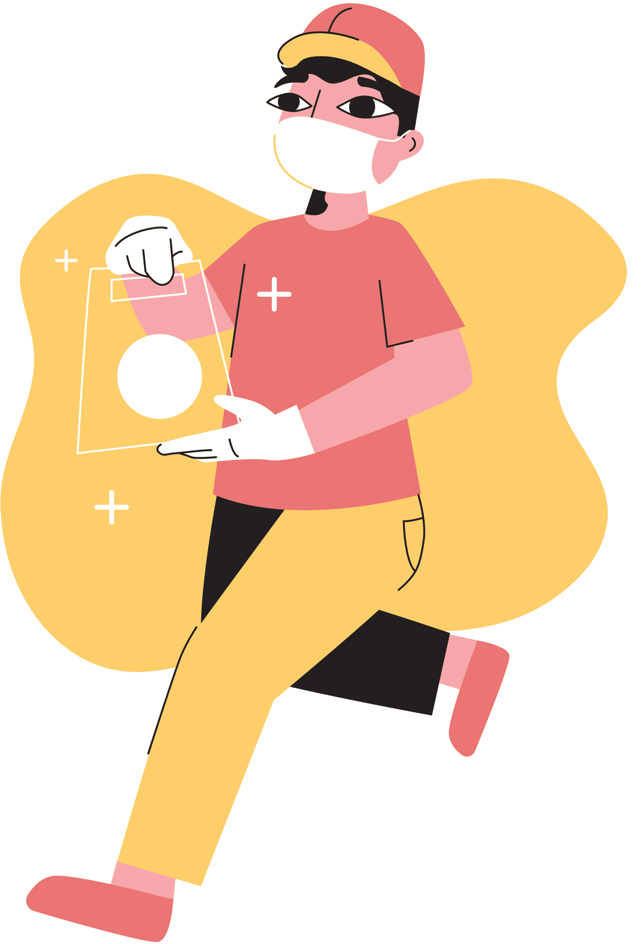
2. Read the passage and choose the correct answer A, B or C
1. People go to a shopping centre______.
A. only for shopping B. mainly to hang out C. for many reasons
2. At shopping centres, customers can ______.
A. touch the product
B. bargain to get lower prices
C. pay to watch live performances.
3. A kind of entertainment at a shopping centre is _______.
A. fashion contests B. live music C. painting exhibitions
4. Some people exercise at a shopping centre because they like its ______.
A. crowds B. well-lit areas C. shops
5. The word “year-round” in paragraph 2 is similar in meaning to ______.
A. always B. sometimes C. rarely

Slide 14

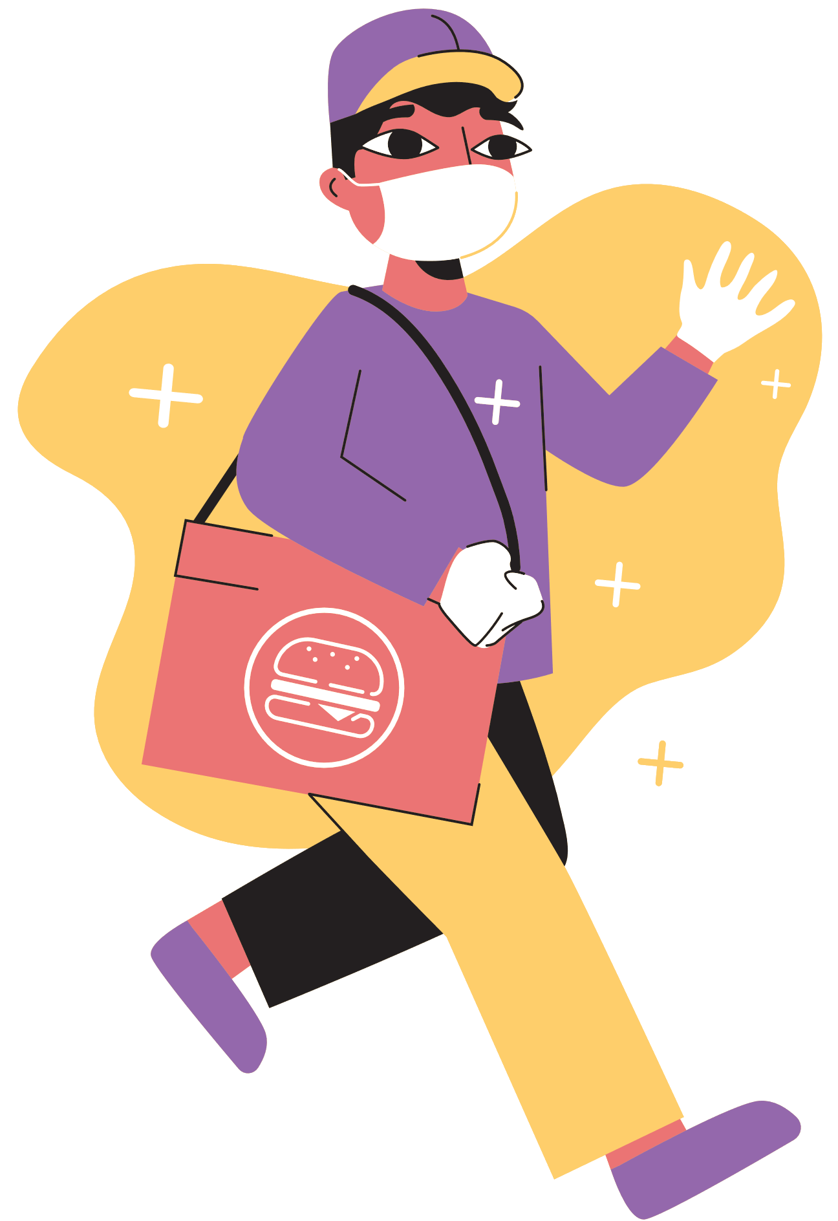
2. Read the passage and choose the correct answer A, B or C
1. People go to a shopping centre______.
A. only for shopping
B. mainly to hang out
C. for many reasons
However, people also go to shopping centres for many other reasons. Some people go there for entertainment. These centres often offer year-round free entertainment for customers of all ages such as live music and special performances.

Slide 15
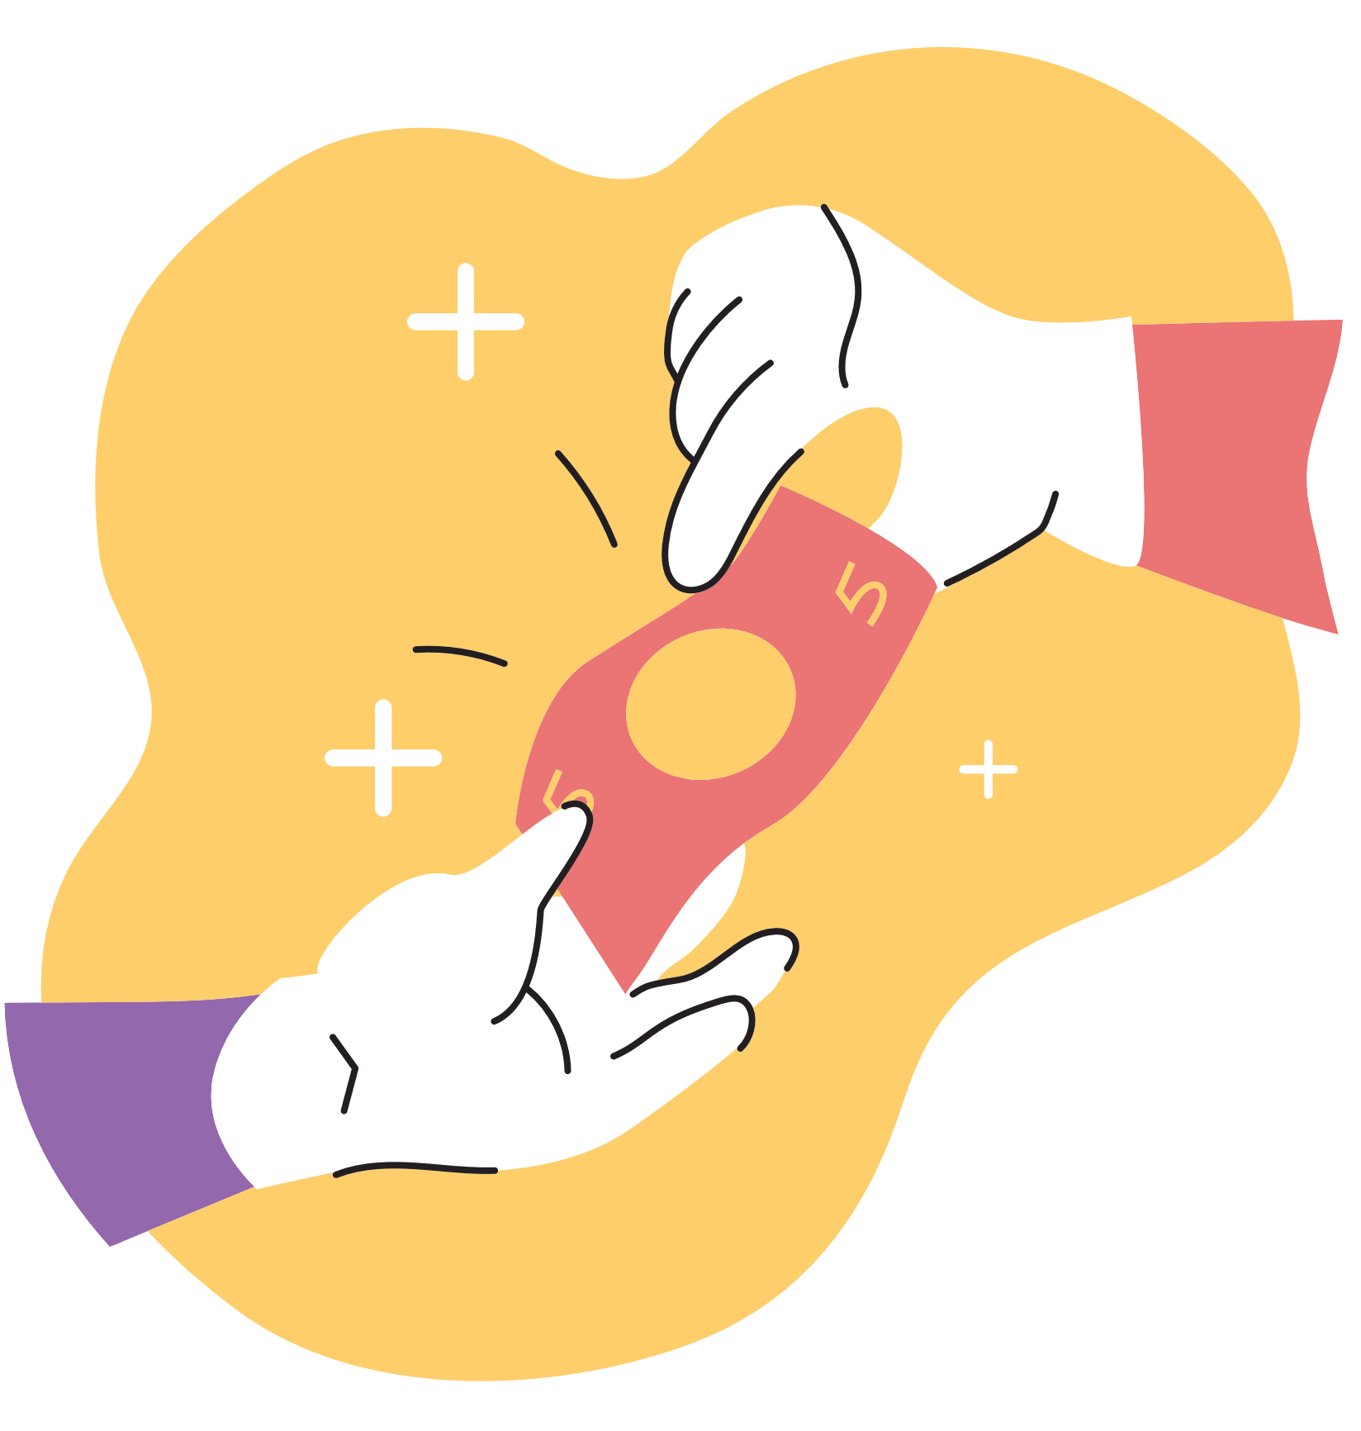
2. Read the passage and choose the correct answer A, B or C
2. At shopping centres, customers can ______.
touch the product
bargain to get lower prices
pay to watch live performances.
Shopping centres attract a lot of customers, especially at the weekend, on holidays, or during sales. People go there to shop. Shopping centres offer a wide range of products to choose from. Customers can touch the products and try on clothes and shoes. This makes them feel more comfortable when they decide to buy something.

Slide 16
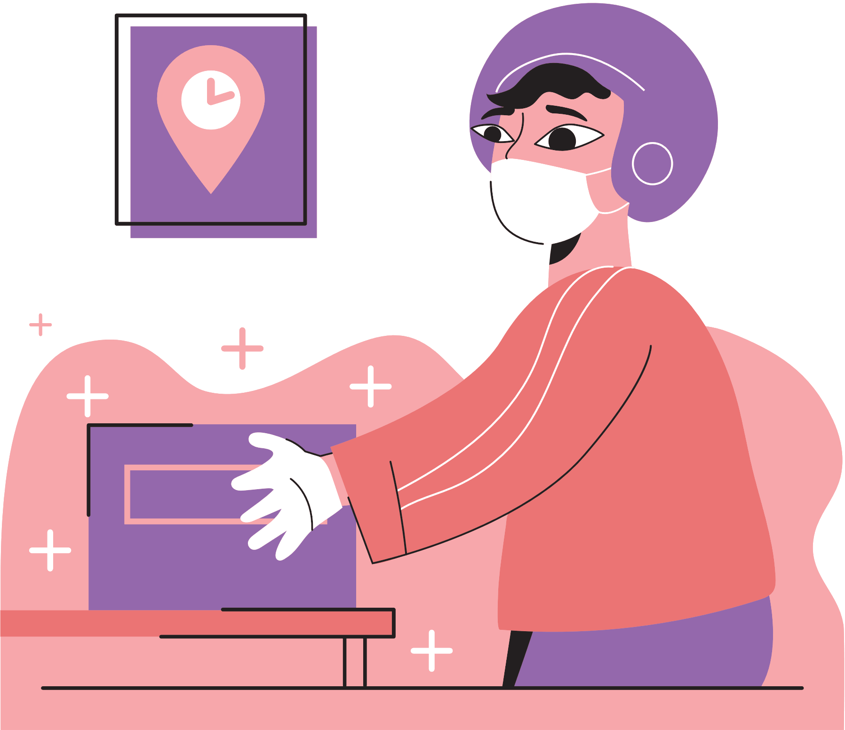
2. Read the passage and choose the correct answer A, B or C
3. A kind of entertainment at a shopping centre is _______.
A. fashion contests
B. live music
C. painting exhibitions
However, people also go to shopping centres for many other reasons. Some people go there for entertainment. These centres often offer year-round free entertainment for customers of all ages such as live music and special performances. During holidays, shoppers can see decorations and join in the holiday excitement. It’s a good way to relax. Some people go there just to hang out with friends. They go browsing and chat while wandering through the shopping malls. Others visit shopping centres to get exercise.

Slide 17
2. Read the passage and choose the correct answer A, B or C
4. Some people exercise at a shopping centre because they like its ______.
A. crowds
B. well-lit areas
C. shops
They enjoy walking for one or two hours in clean and well-lit areas. Some people even go there to avoid the heat or cold outside. Shopping centres offer free air conditioning and heating.

Slide 18
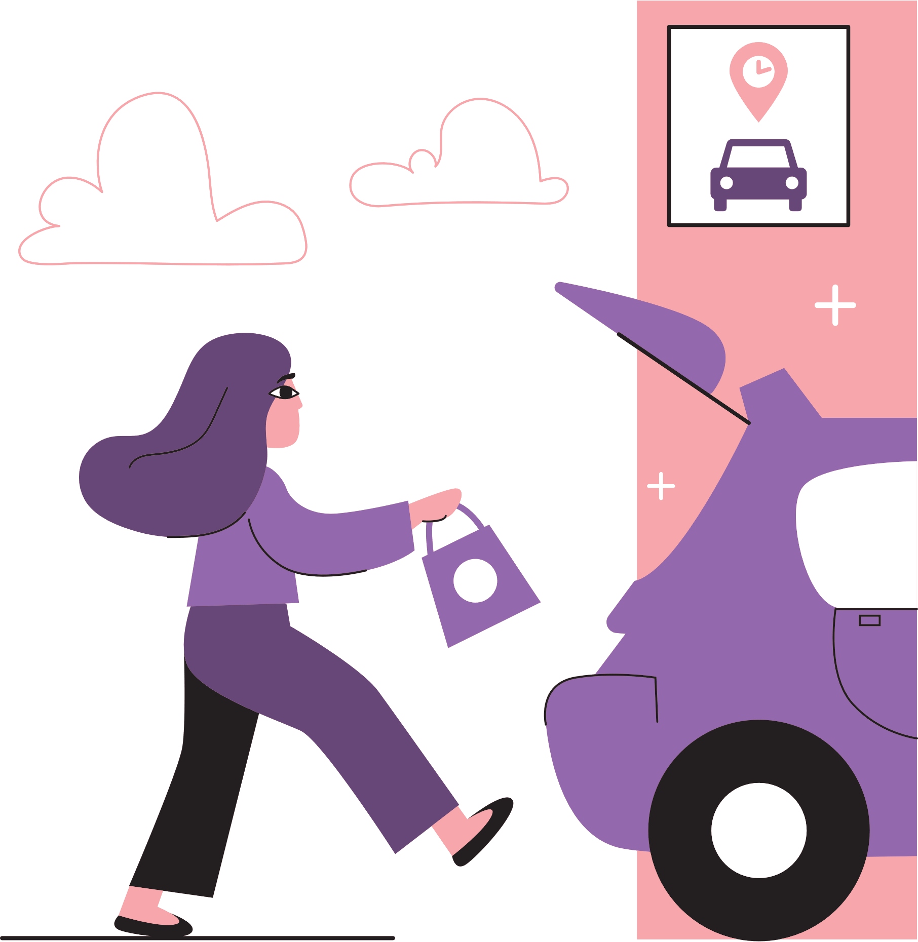
2. Read the passage and choose the correct answer A, B or C
5. The word “year-round” in paragraph 2 is similar in meaning to ______.
A. always B. sometimes C. rarely
However, people also go to shopping centres for many other reasons. Some people go there for entertainment. These centres often offer year-round free entertainment for customers of all ages such as live music and special performances.

Slide 19
Look at the answers again
1. People go to a shopping centre______.
A. only for shopping B. mainly to hang out C. for many reasons
2. At shopping centres, customers can ______.
A. touch the product
B. bargain to get lower prices
C. pay to watch live performances.
3. A kind of entertainment at a shopping centre is _______.
A. fashion contests B. live music C. painting exhibitions
4. Some people exercise at a shopping centre because they like its ______.
A. crowds B. well-lit areas C. shops
5. The word “year-round” in paragraph 2 is similar in meaning to ______.
A. always B. sometimes C. rarely

Slide 20
3. Fill in each blank with ONE word from the passage.
Shopping centres
attract a lot of customers during _______. allow customers to _______ on clothes and shoes. offer free _________________ for customers of all ages. are full of________________ during holidays. offer ______ air conditioning and heating.
sales
try
entertainments
decorations
free

Slide 21
SPEAKING

Slide 22
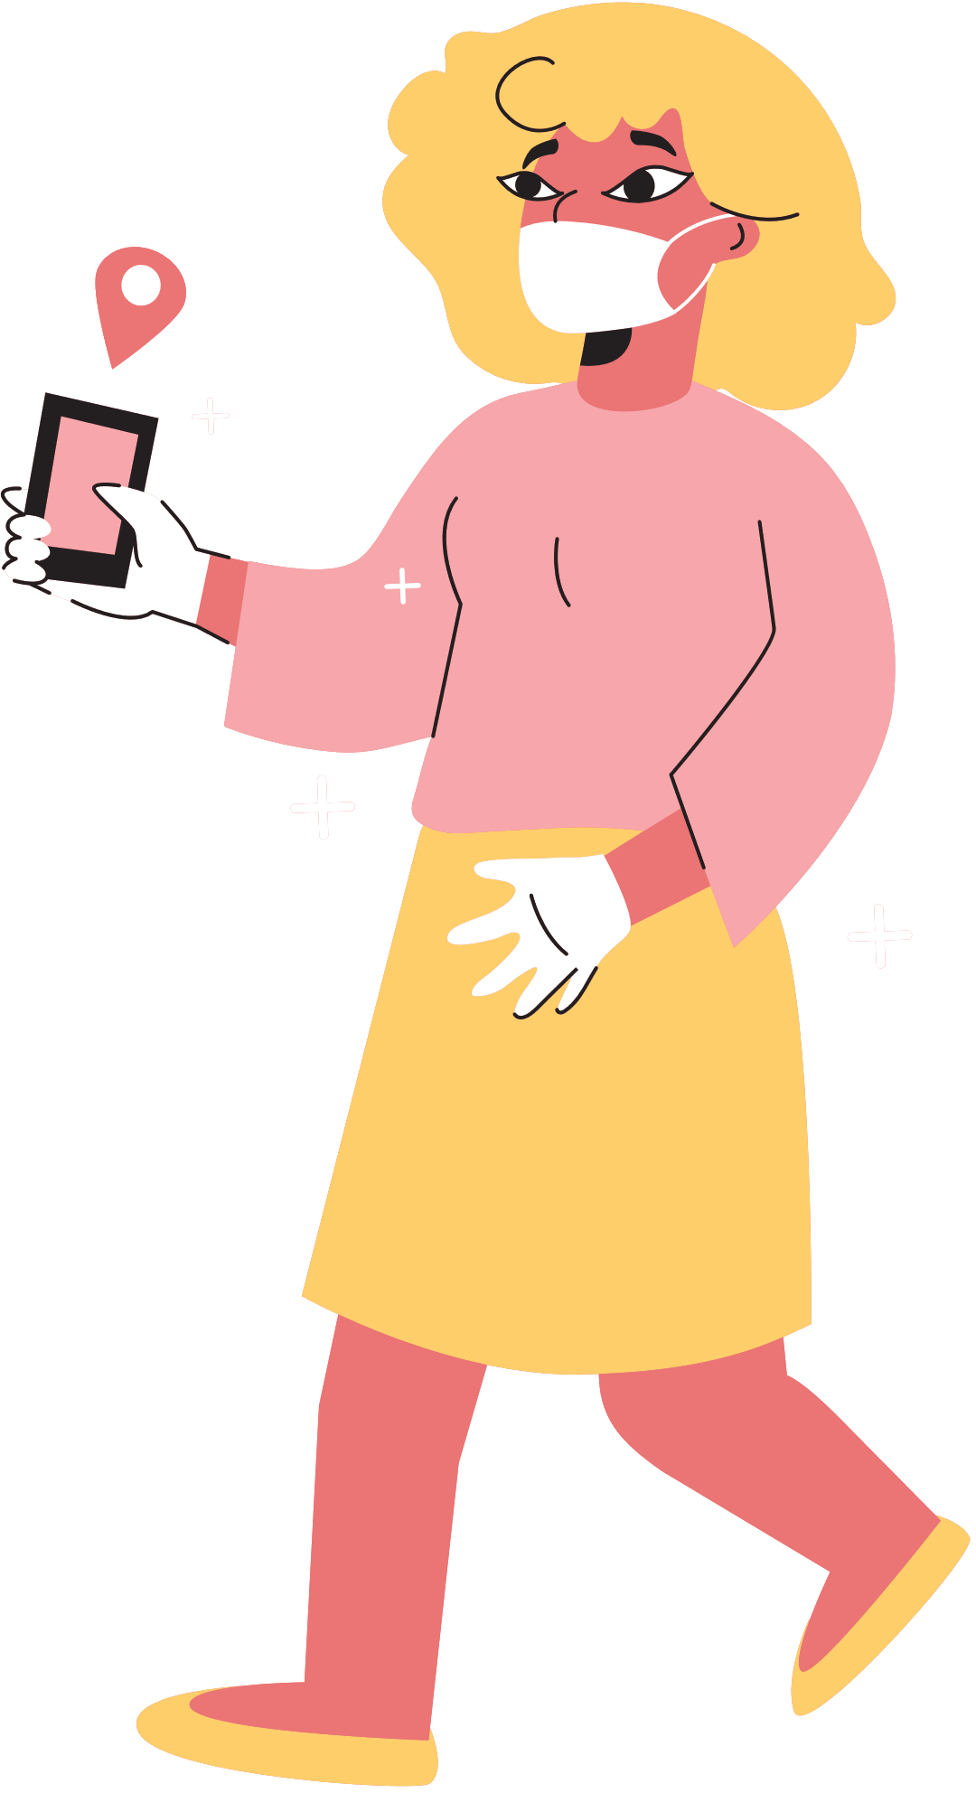
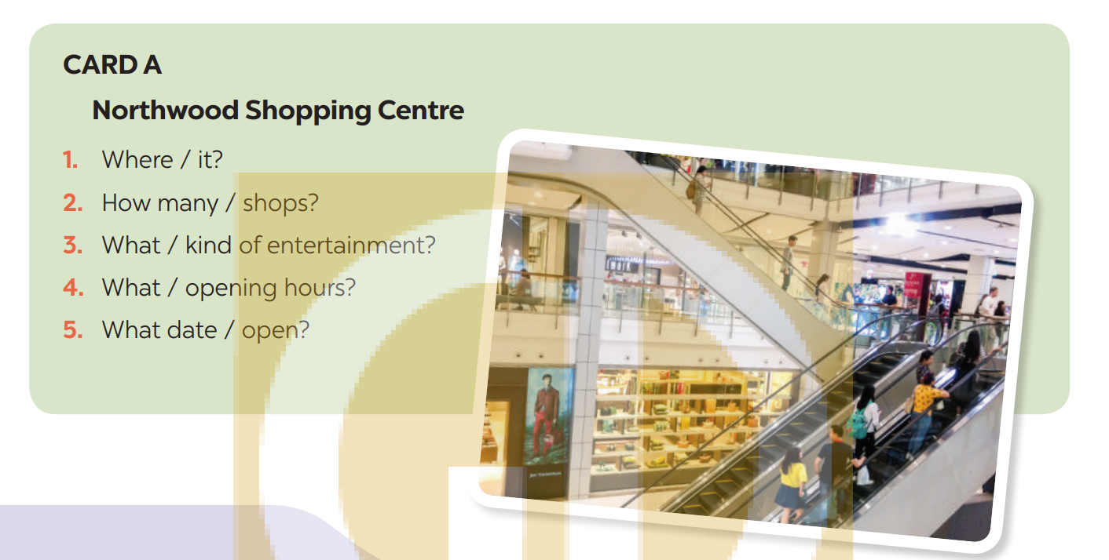
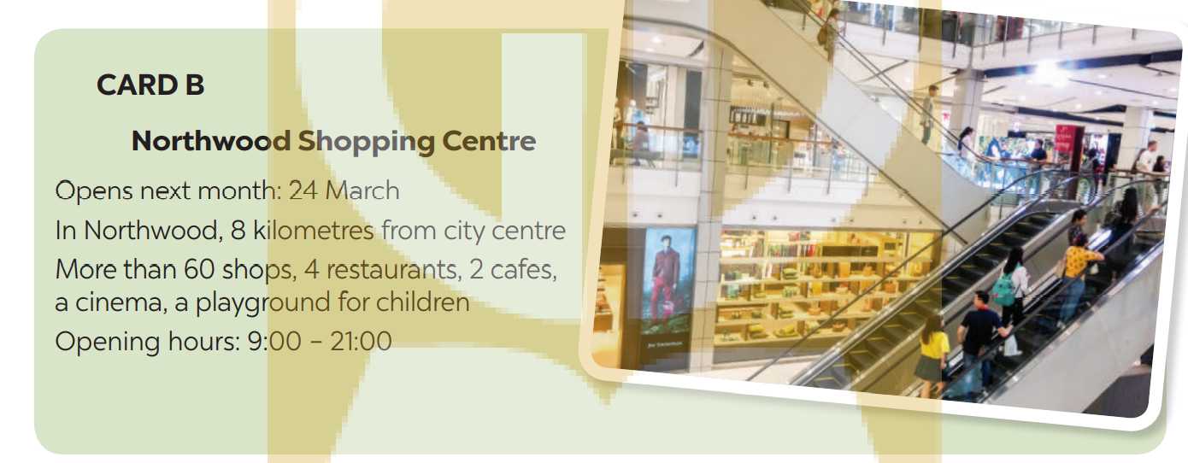
4. Work in pairs. Ask and answer about a new shopping centre.
Student A reads the suggestions for questions on card A
Student B reads the information about the new shopping centre on card B (page 91)

Slide 23
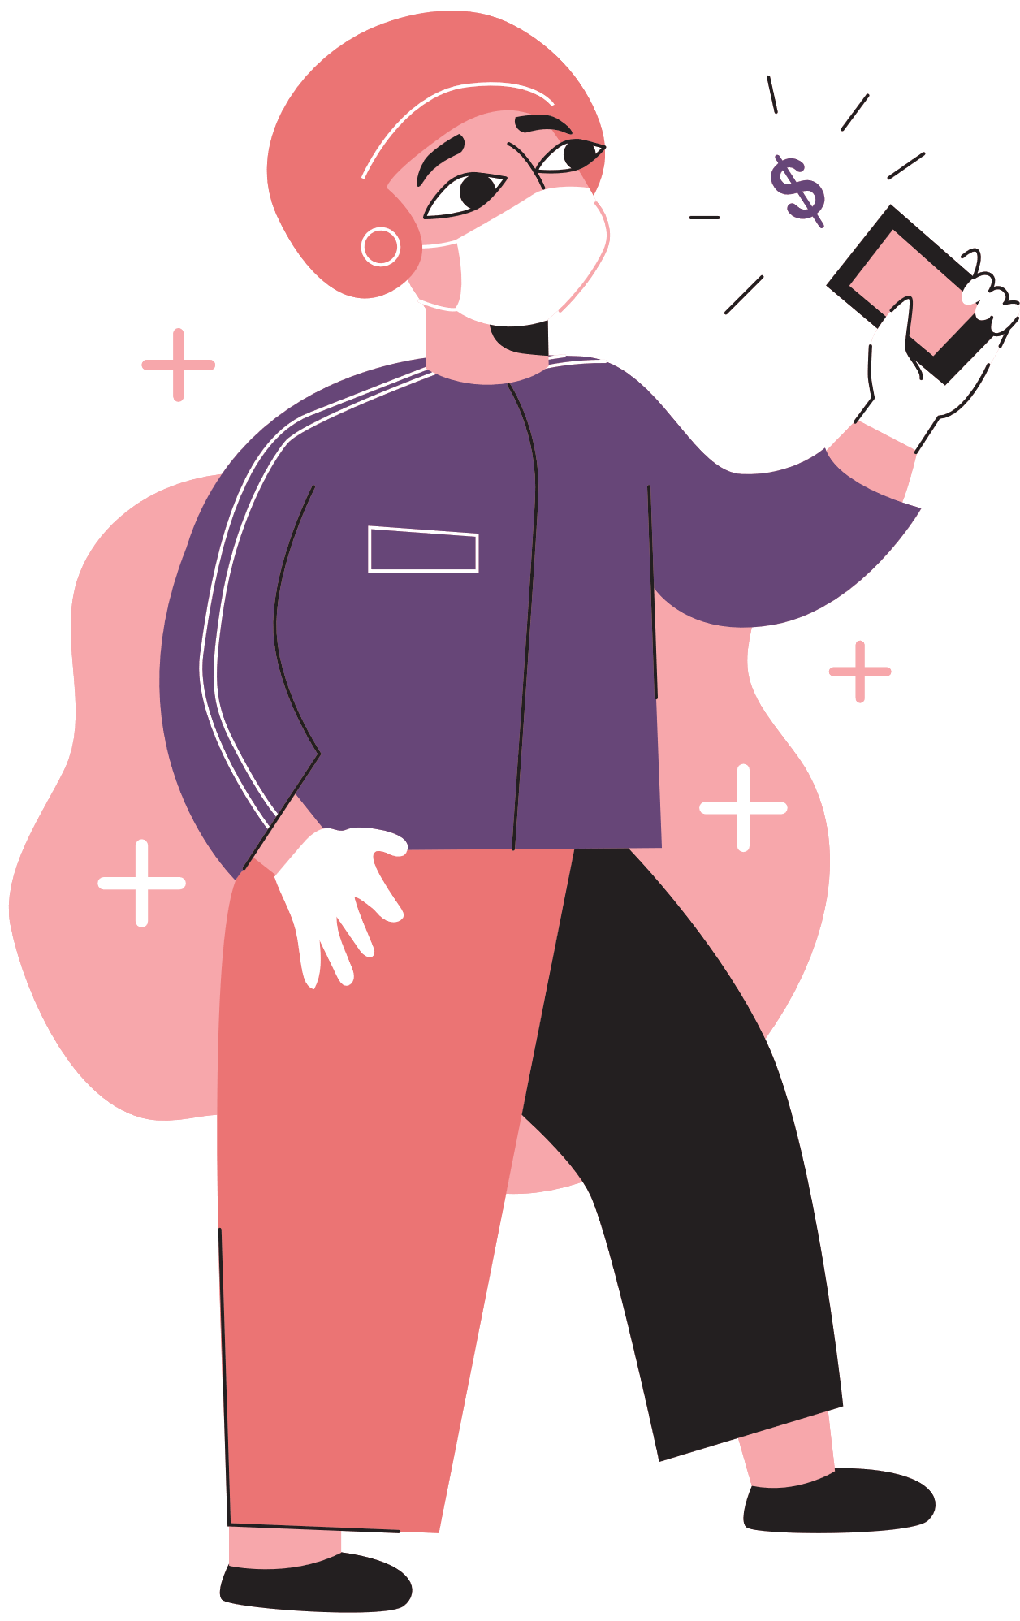
5. Work in pairs. Ask and answer about a shopping centre, a supermarket, or an open-air market in your area. Take notes of your partner’s answers and report them to the class.
You can use the suggestions below:
where it is
how you get there
what its opening hours are
what you do there
what you like/ don’t like about it.

Slide 24
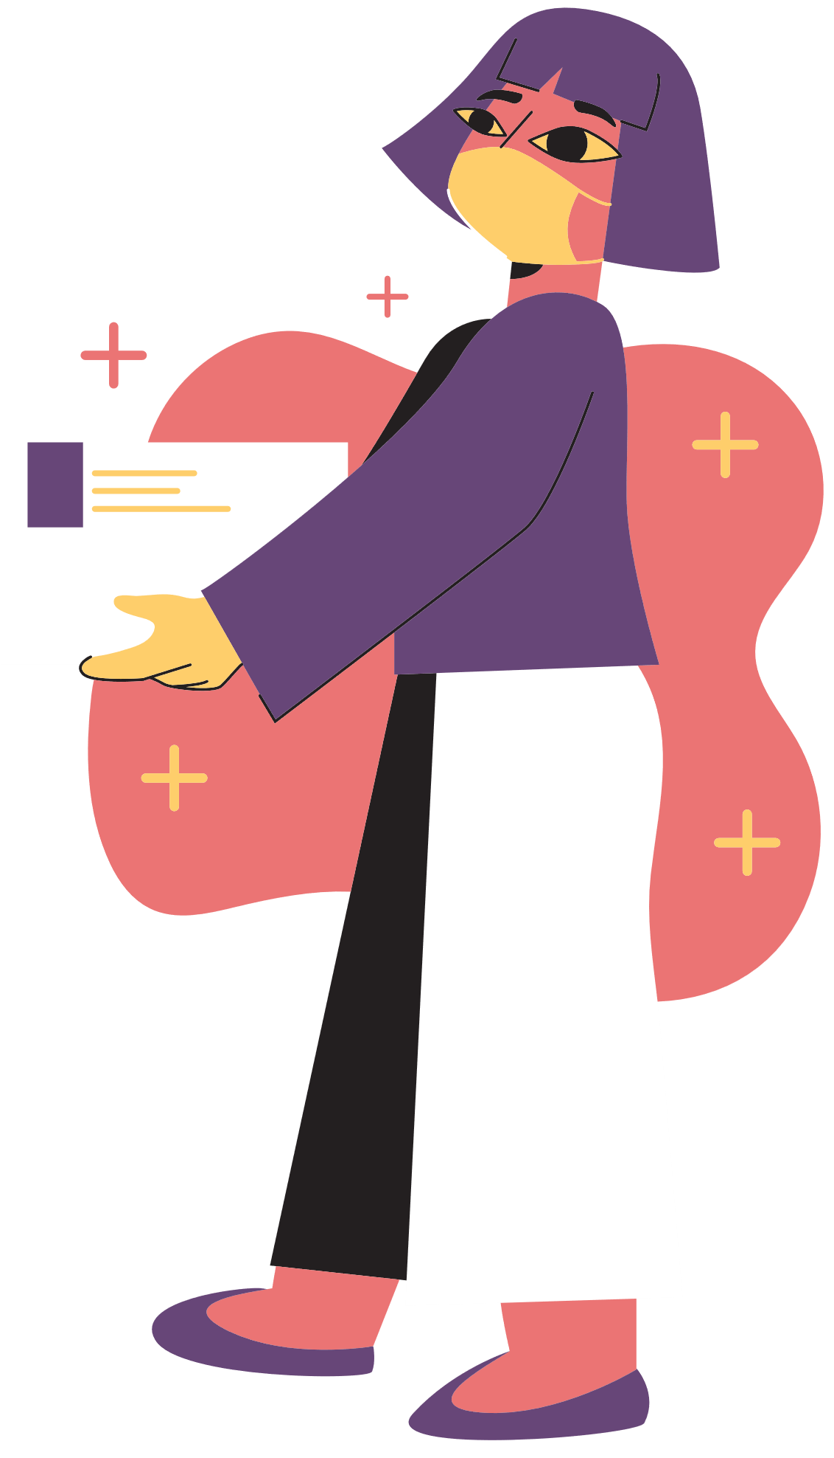
Wrap-up
What have we learnt in this lesson?
Reasons why we go to shopping centres.
Information about new shopping centres.

Slide 25
Thank you!
HOMEWORK
Learn the new words by heart.
Make a speech introducing a new shopping centre in your city.
Prepare for the next lesson

Slide 26
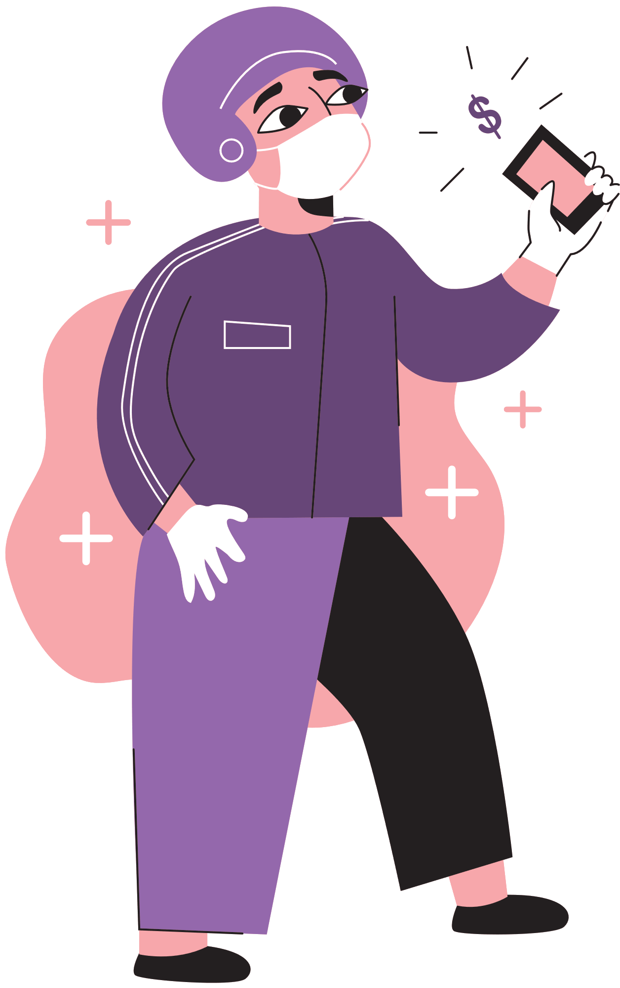
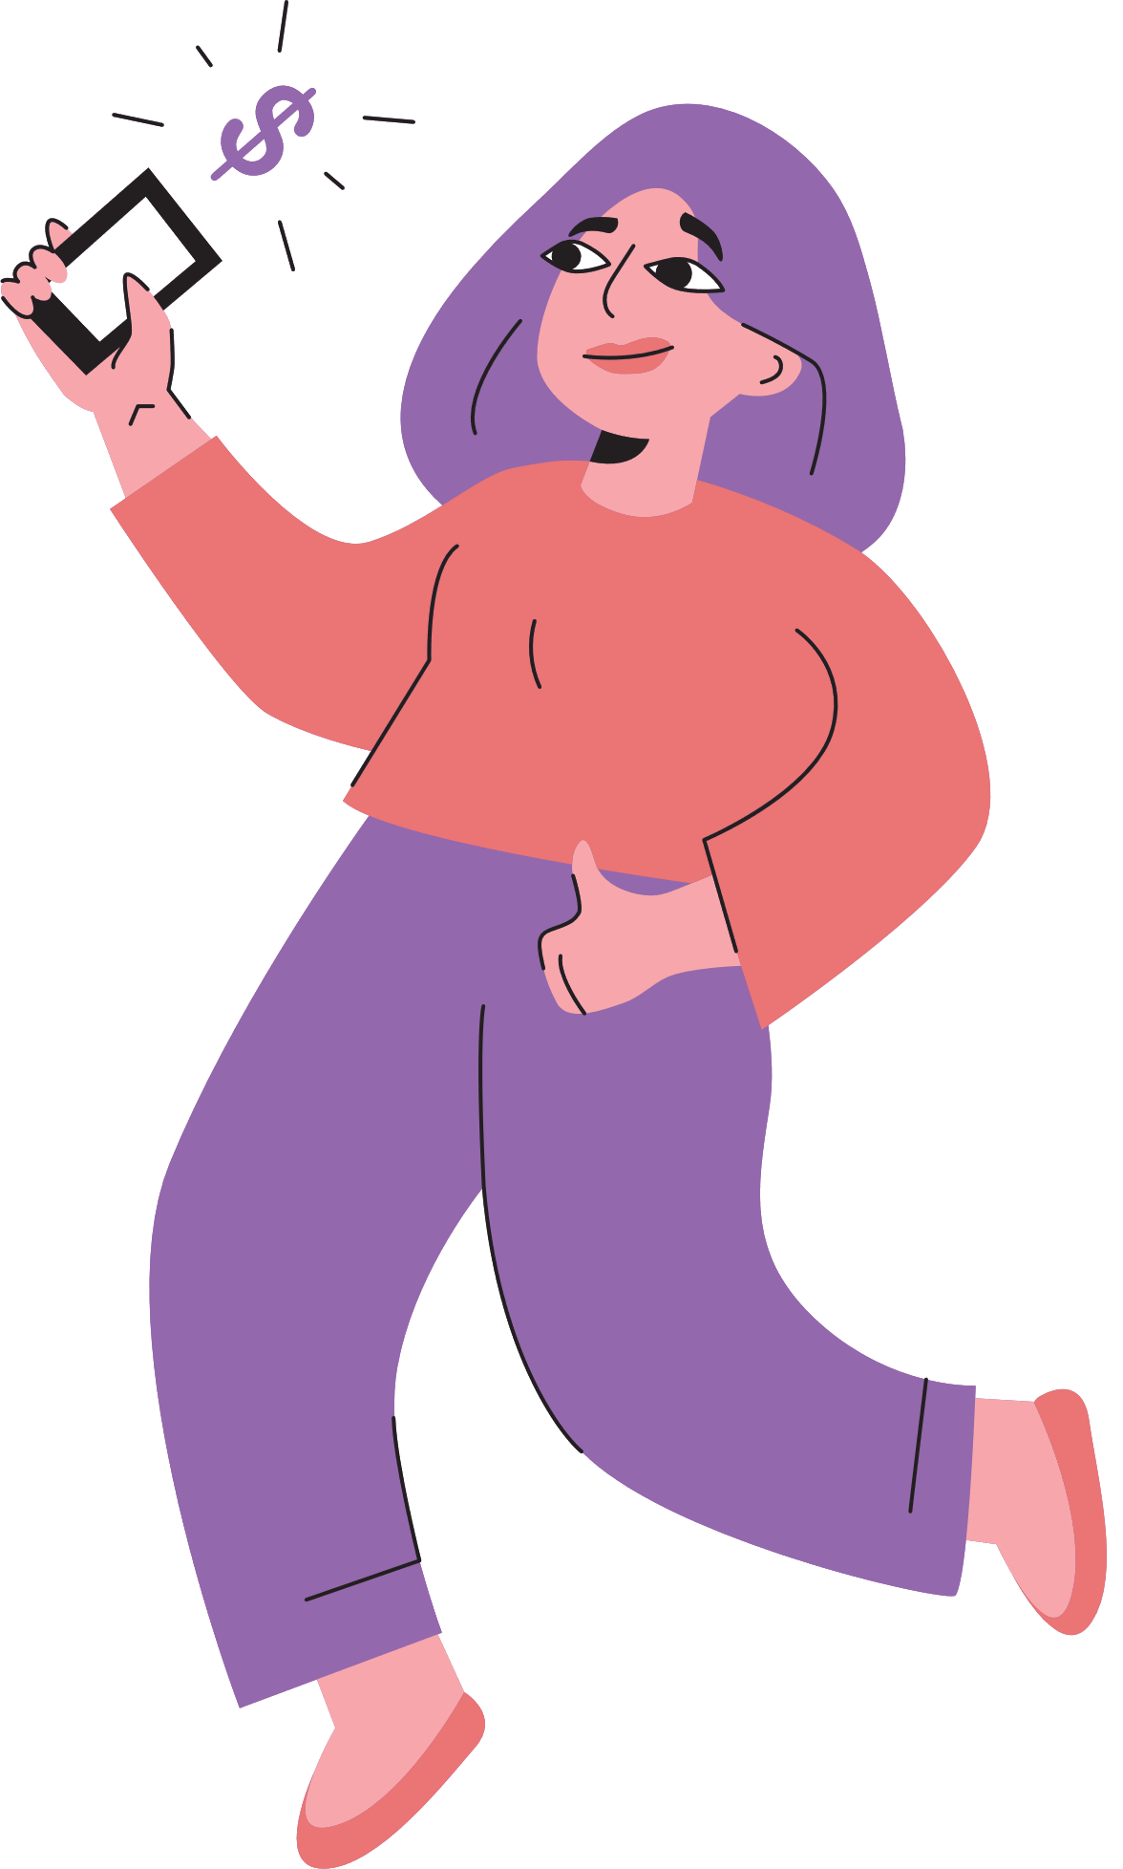
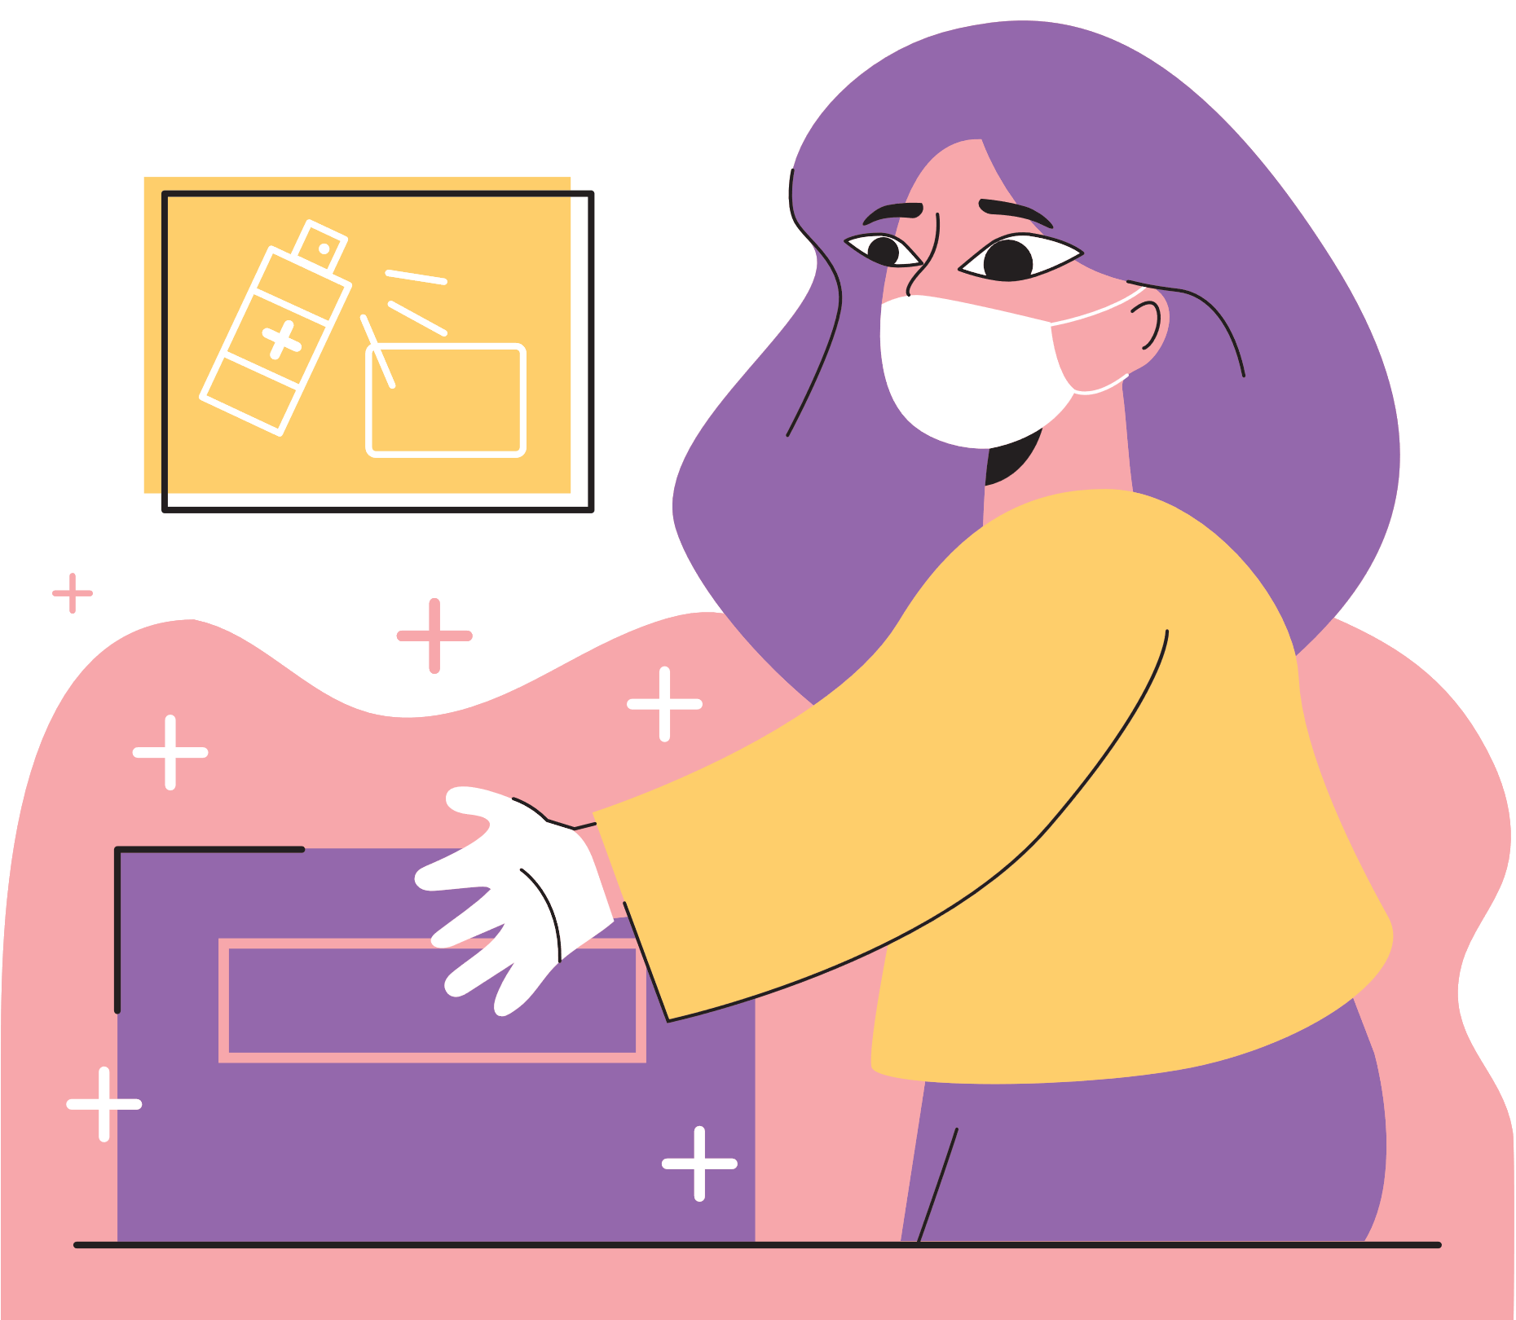
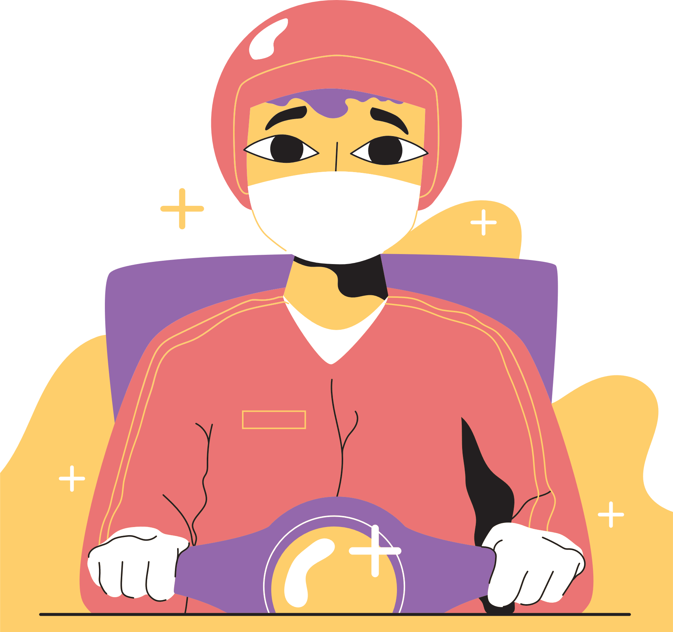
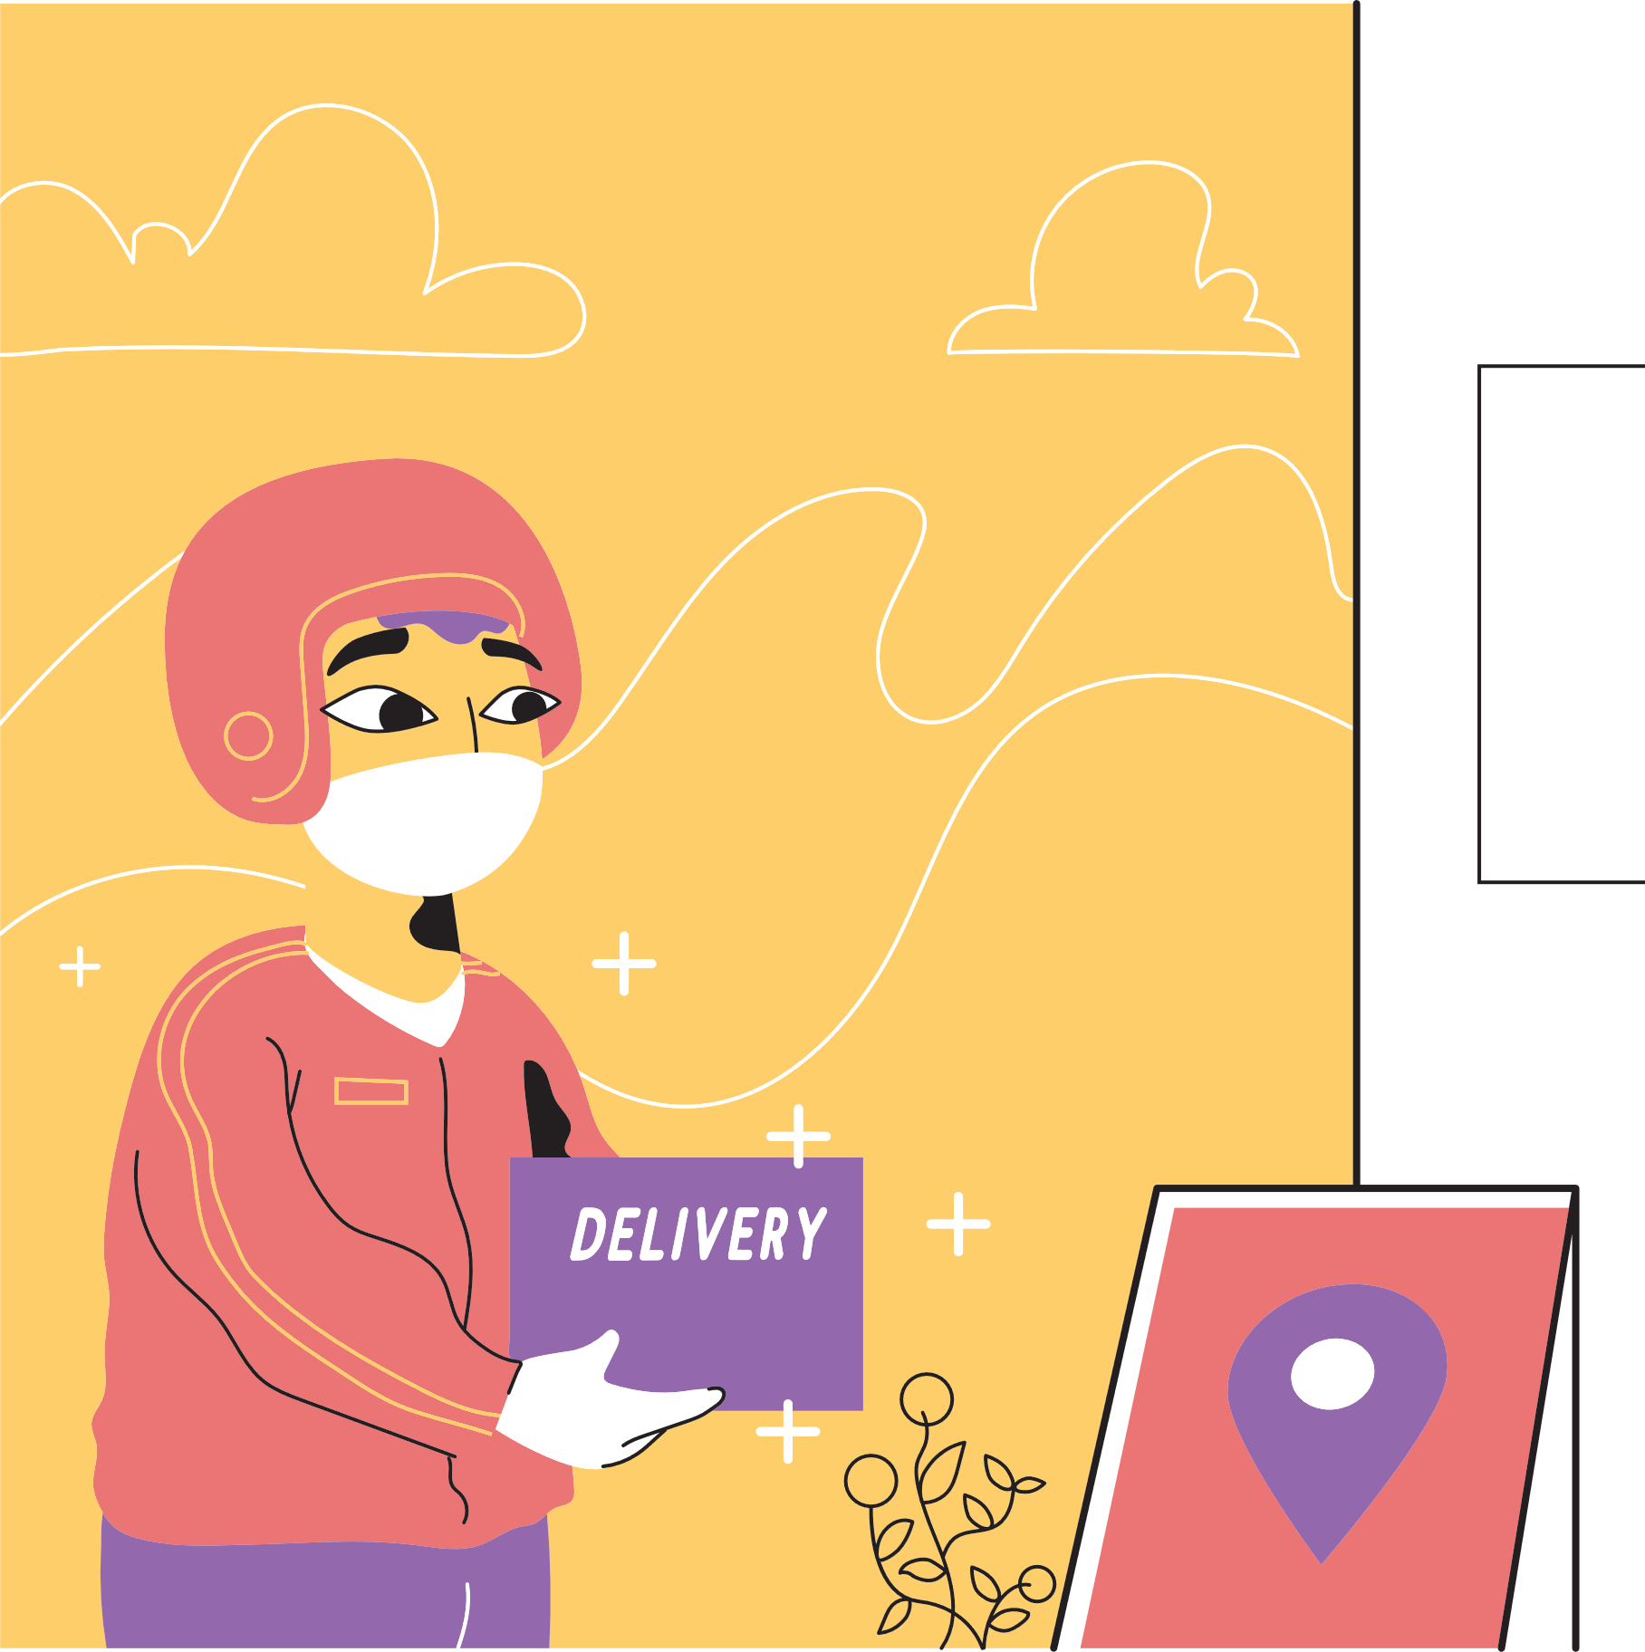
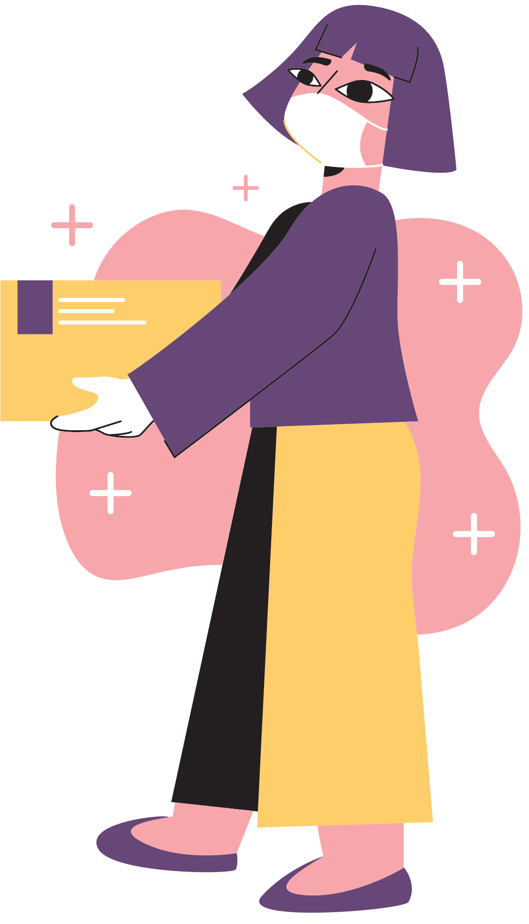
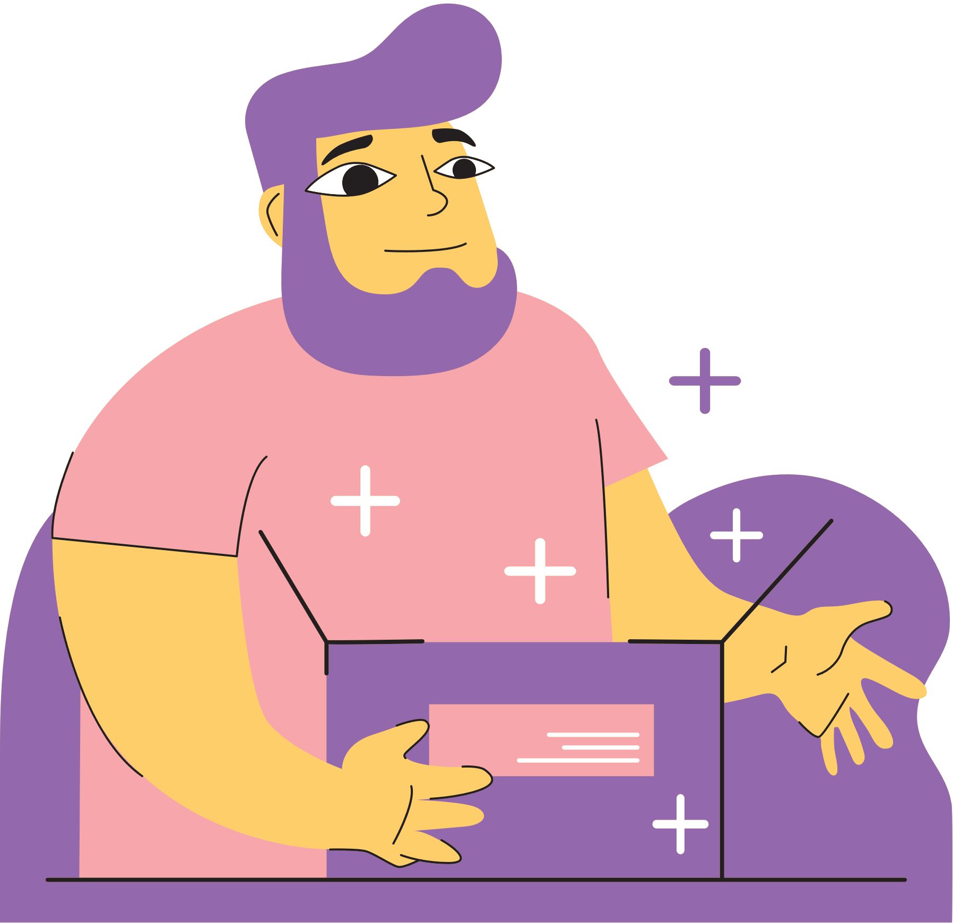
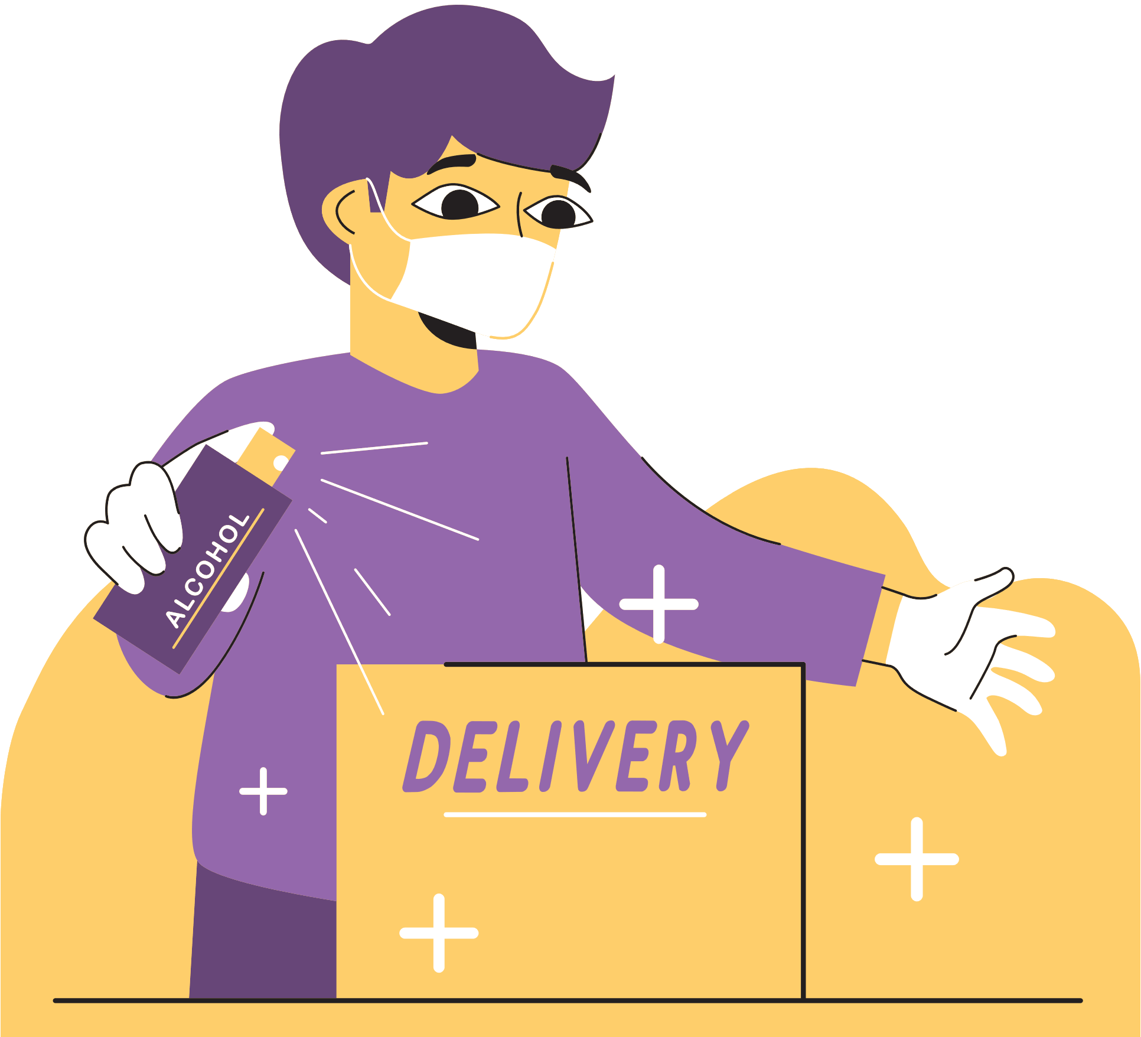
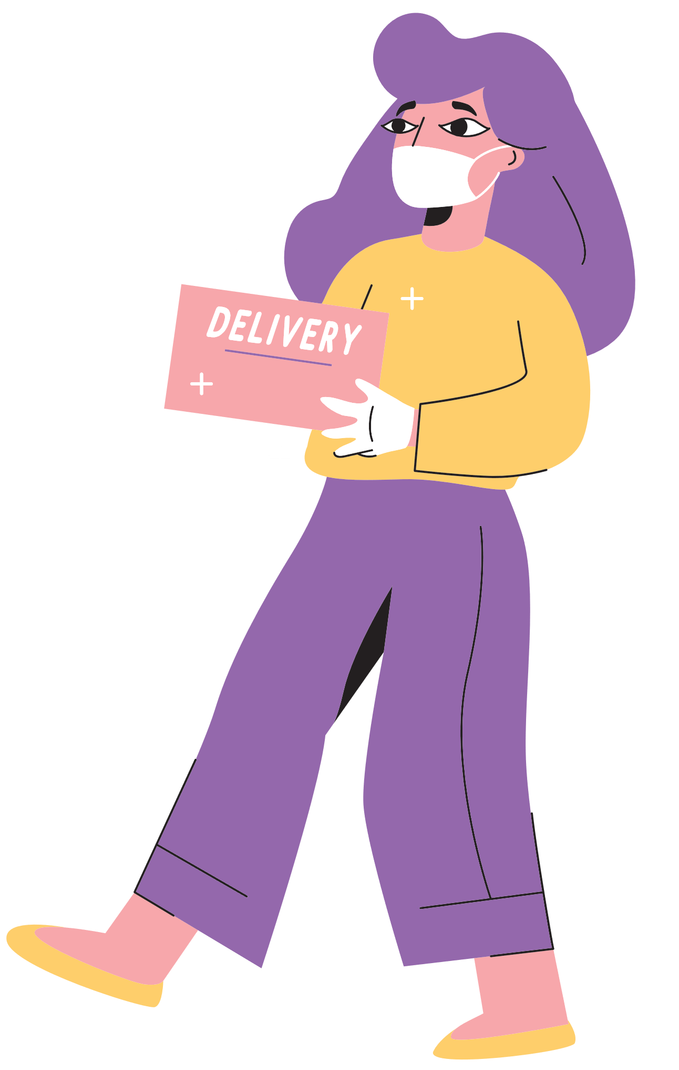
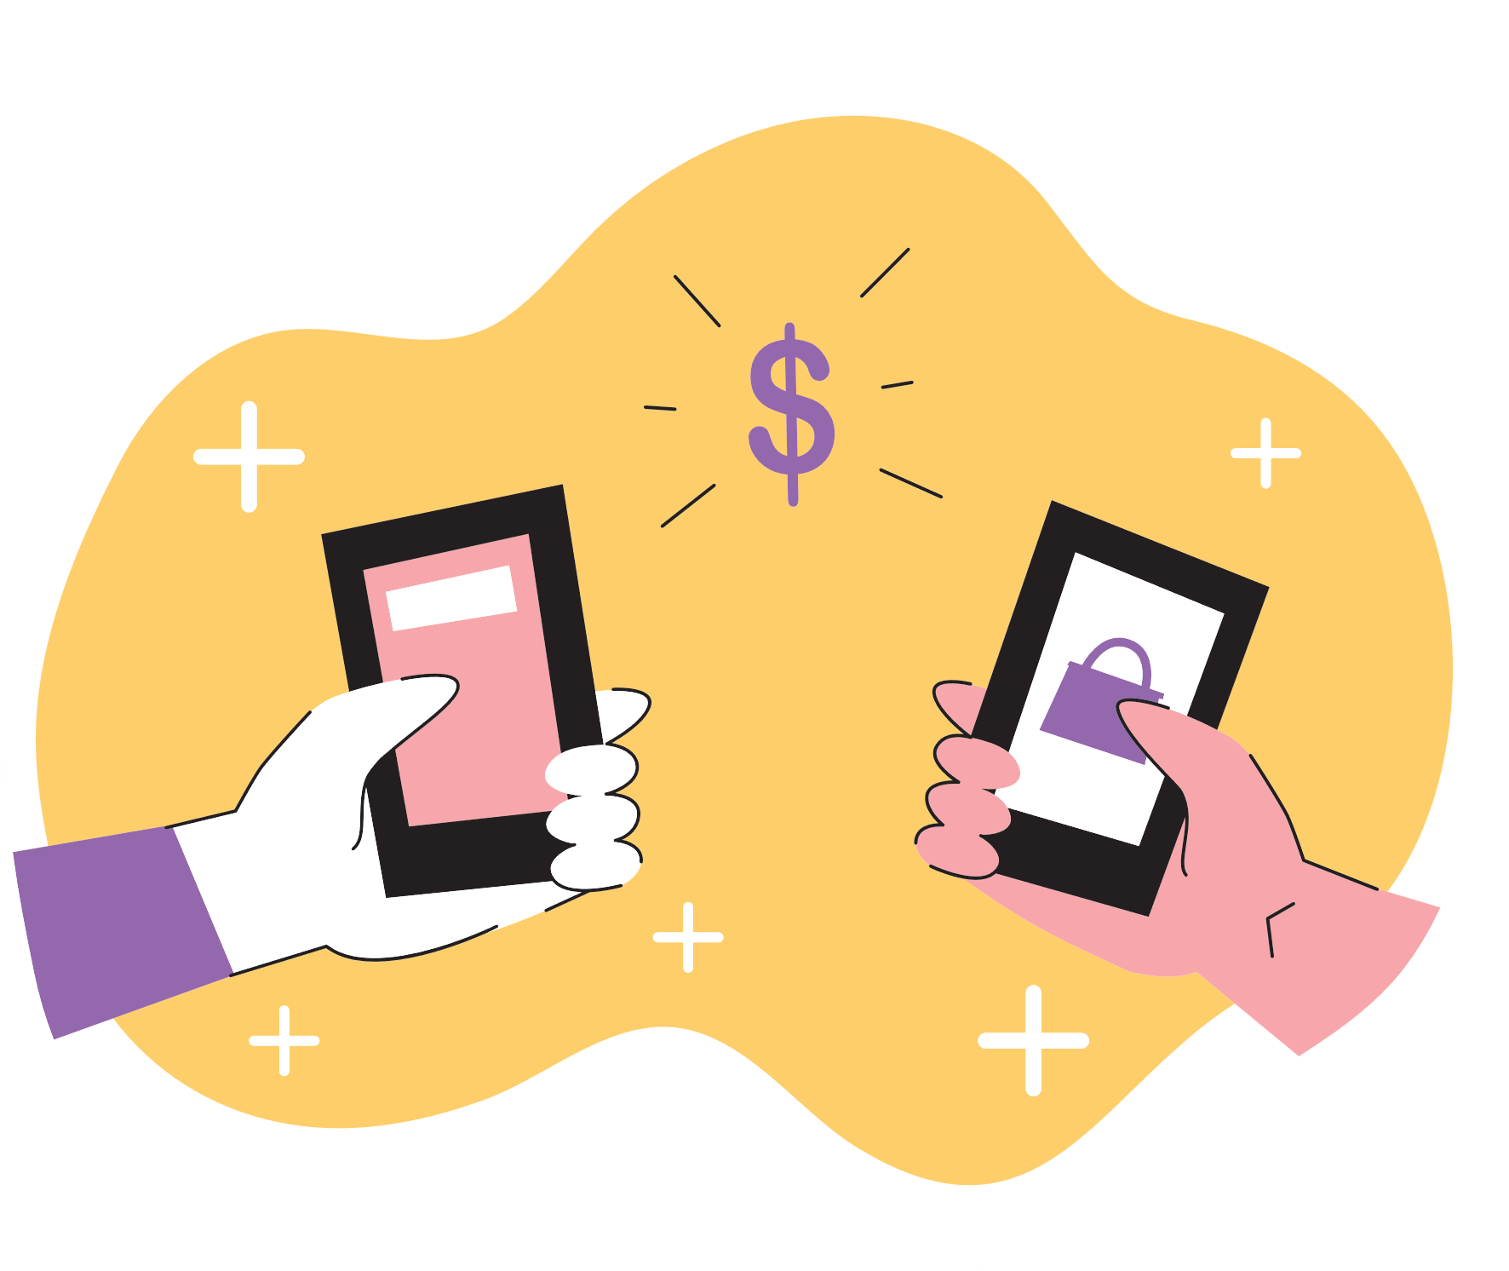
Free Resource Page

