Slide 1




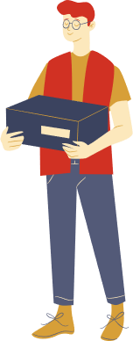


……………… secondary school
WELCOME TO OUR CLASS!
Teacher:………………………………………………

Slide 2
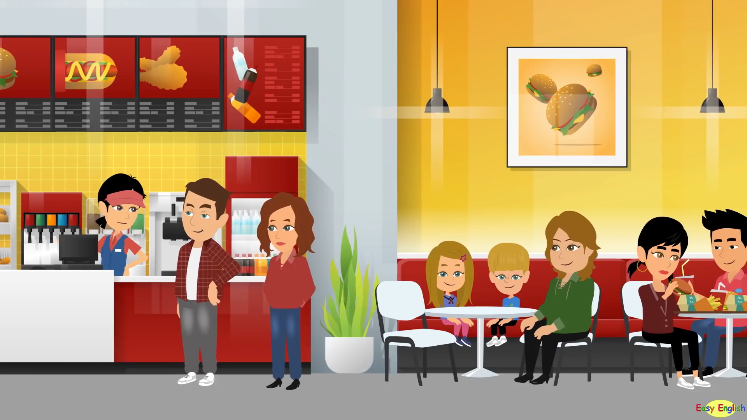
What’s happened in the video?

Slide 3
Unit 8:
SHOPPING
Lesson 4: Communication

Slide 4

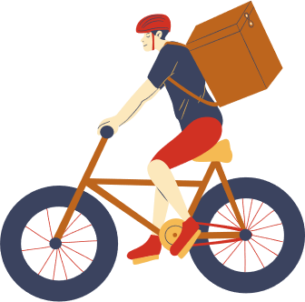
1. Listen and read the conversation, paying attention to the highlighted parts.
Tom: I’m calling to make a complaint about the SMART backpack I ordered from you last week. I got it this morning and It’s smaller than the one you advertised online.
Trang: Well…Let me check it.
Tom: And I’m not happy with the colour, either. In your picture, it’s dark brown, and this one is yellowish brown.
Trang: I’m sorry about that. I’ll send you another one.

Slide 5
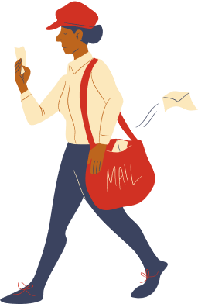
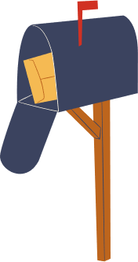
Making complaints
I’m calling to make a complaint about…
I’m not happy with……

Slide 6
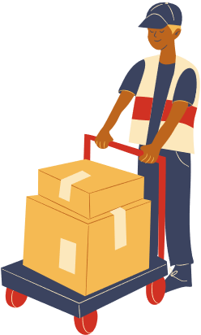

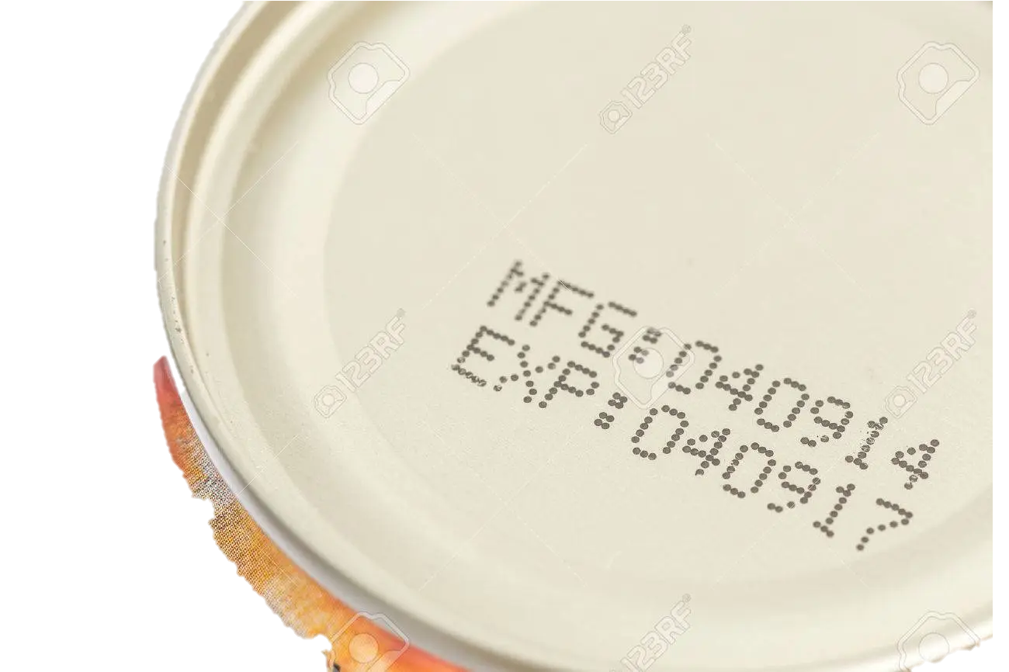
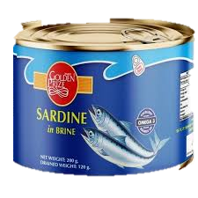
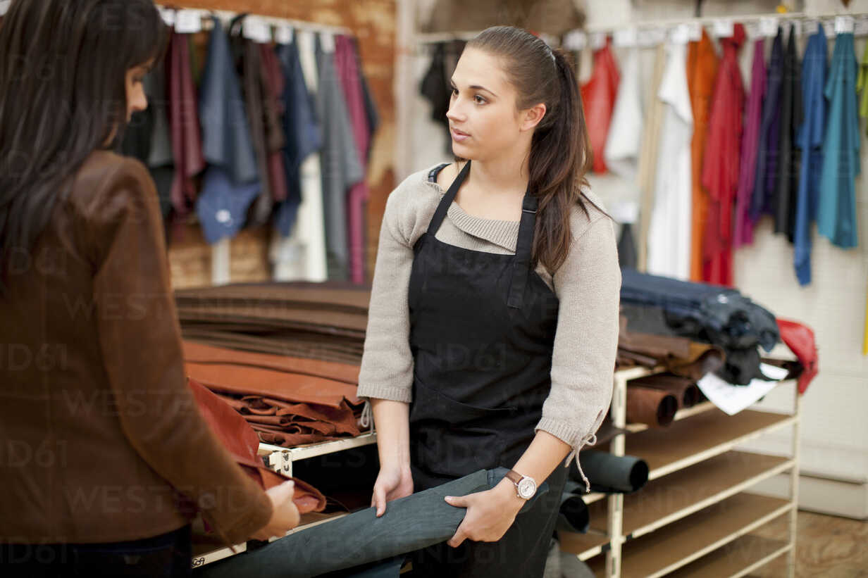
2. Work in pairs. In turn, make complaints about the situations below.
The cans of fish you bought at the shop expired five days ago.
An assistant at the shop was not very helpful.

Slide 7
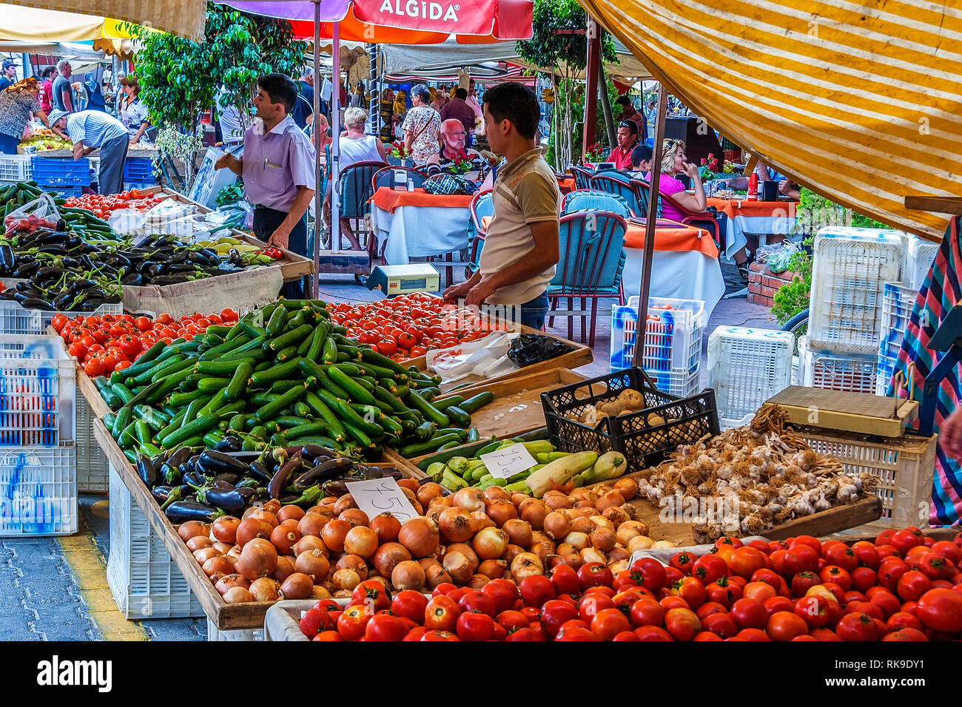
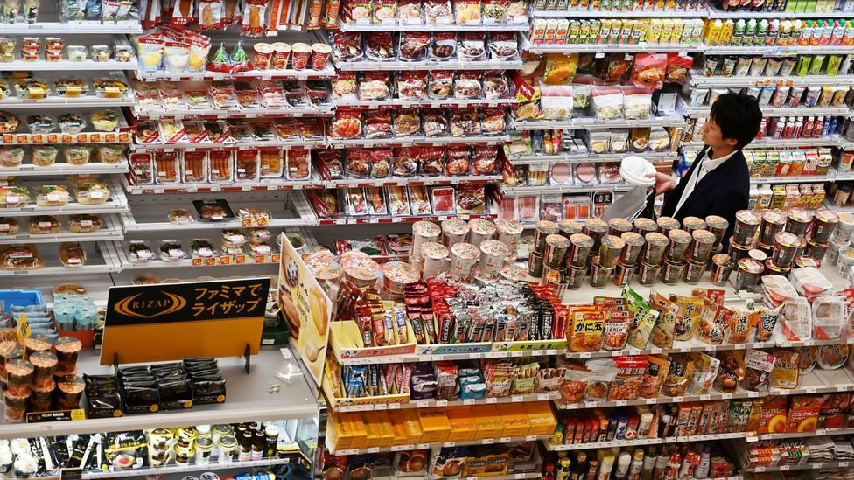

Where do you like shopping?
My favourite shopping place
Open-air market
Convenience store
Discount shop

Slide 8


3. Listen to three people talking about their favourite shopping places and tick () the place they mention.
People | Open-air market | Discount shop | Convenience store
1. Mai
2. Nam
3. Alice

Slide 9
4. Work in pairs. Take turns to ask and answer what each person in 3 likes about their shopping place
People | Open-air market | Discount shop | Convenience store
1. Mai
2. Nam
3. Alice
Example:
A: What does Nam like about shopping at a convenience store?
B: It saves him time.

Slide 10
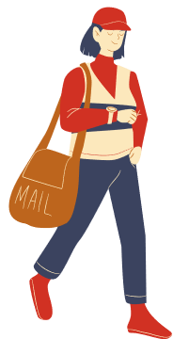
5. Work in groups. Share your favourite shopping place with your group.
You can conclude:
The name of the place
The reason(s) why you like it
Example:
I’m really into convenience store. It’s simply convenient. You can find them everywhere you go. Convenience stores offer a smaller range of goods for you to buy. As there are not much goods, we don’t waste time thinking about what to pick. Convenience stores can contribute to a local business because they can sold what locals grow and make a lot of money.

Slide 11
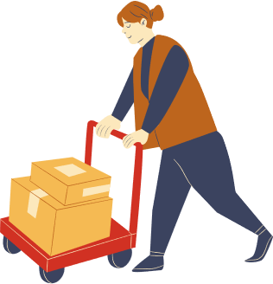
Wrap-up
What have we learnt in this lesson?
Making complaints
Some favourite shopping places

Slide 12
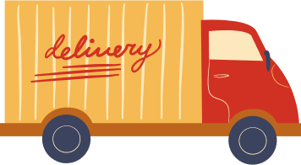
HOMEWORK
Learn the ways to make complaints by heart.
Write a paragraph of 50-70 words about your favourite shopping place.
Prepare for the next lesson

Slide 13
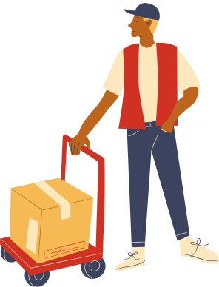
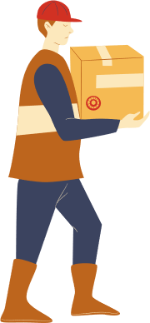
Thank you!

Slide 14





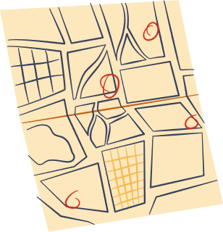
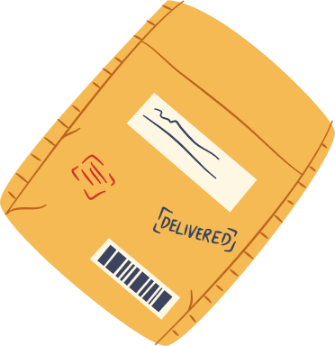
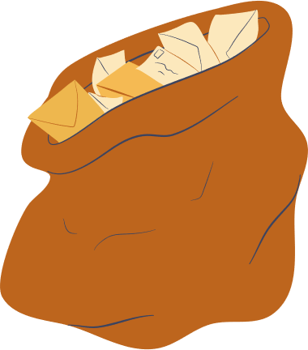
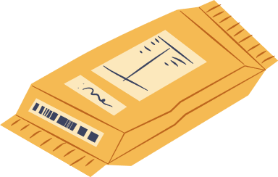
Free Resource Page

Slide 15
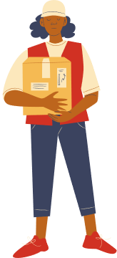
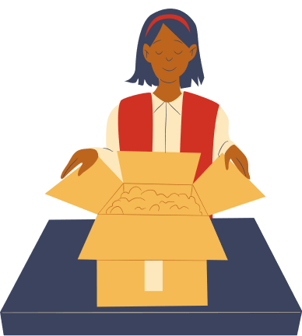
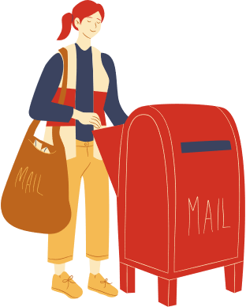
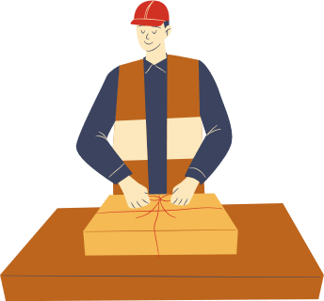
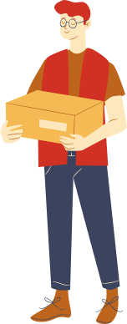
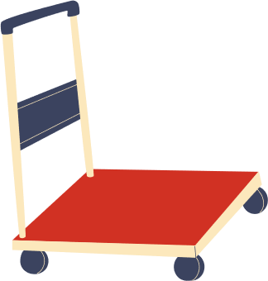
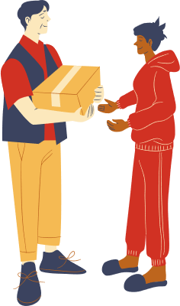
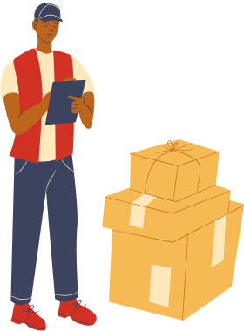

Free Resource Page

