Slide 1
Unit 12: ENGLISH – SPEAKING COUNTRIES
LESSON 7: LOOKING BACK

Slide 2
VOCABULARY
People and places in: native people, local people, tourist, visitor, guard, island country, castle, coastline, valley, state, tower, capital city, countryside
English-speaking countries: The USA, Canada, The UK, Australia, New Zealand

Slide 3
PRONUNCIATION
Rising and falling intonation for questions:
We use rising intonation for yes / no questions.
Example: Can you speak English?
We use falling intonation for wh-questions.
Example: What is the capital of Scotland?

Slide 4
GRAMMAR
Articles:
- There are two indefinite articles in English: ‘a’ and ‘an’. ‘An’ is used before vowel sounds.
Example: There's a good film on TV tonight.
- There is one definite article in English: ‘the’.
We use ‘the’:
+ with superlatives.
Example: The largest city in Australia is Sydney.
+ with the names of some places.
Example: My son is studying in the USA.
+ if one of the words in the place name is a common noun (island, bridge, river, tower, ...).
Example: The Tower Bridge in London is over one hundred years old.

Slide 5
01
VOCABULARY

Slide 6
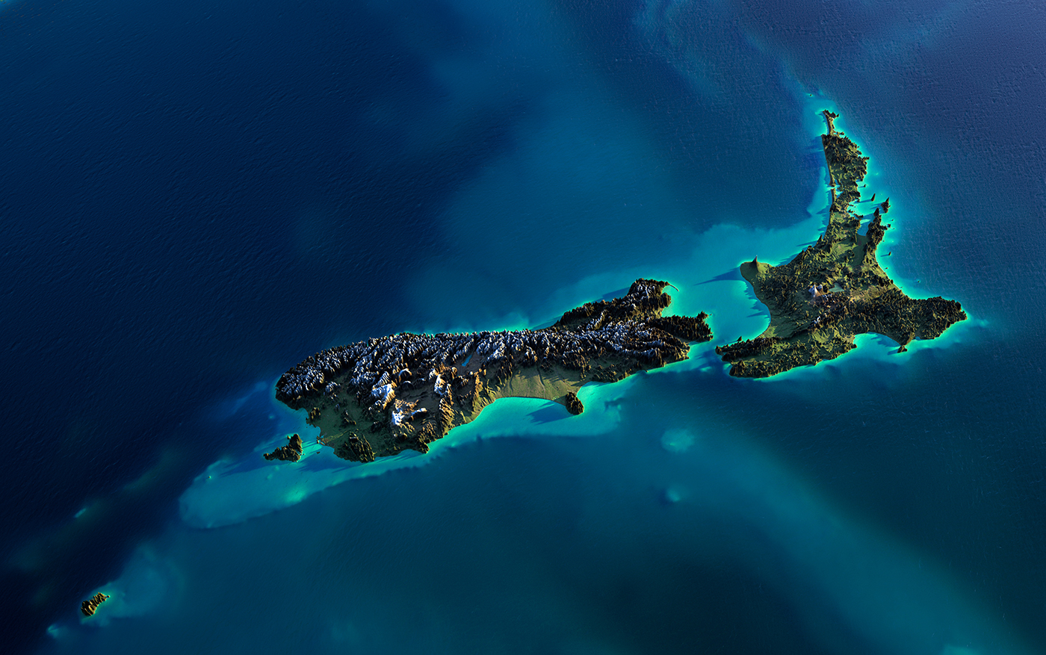
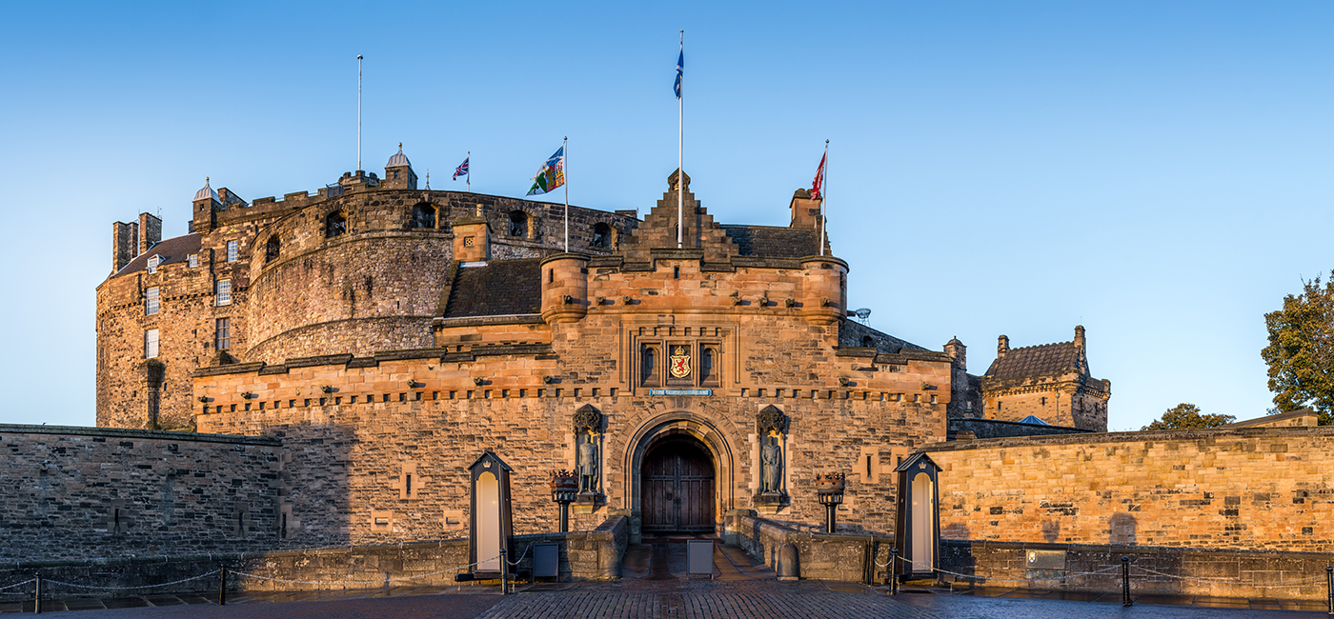
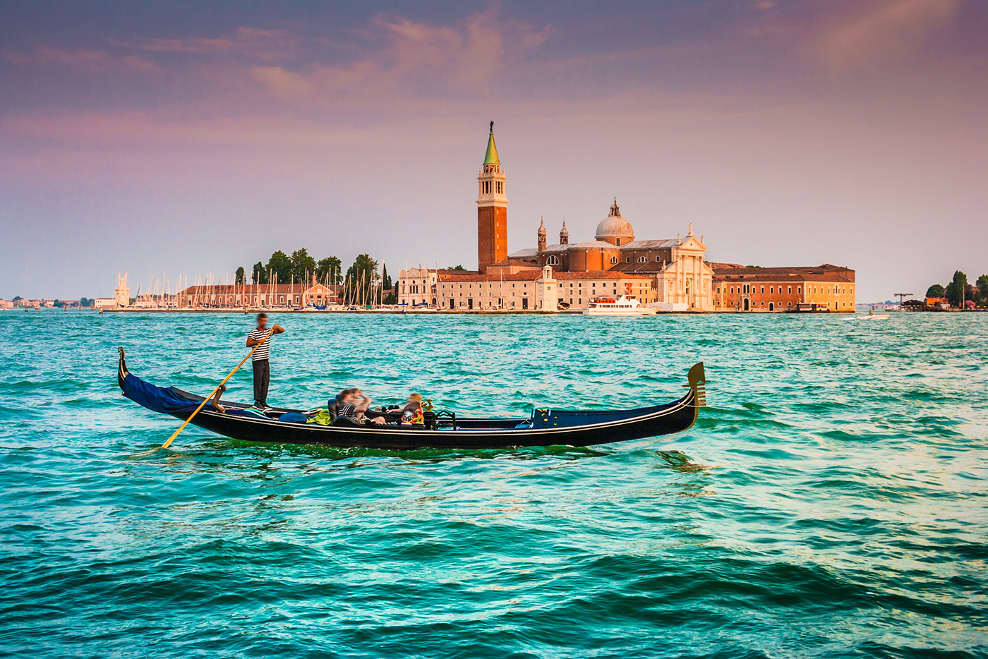
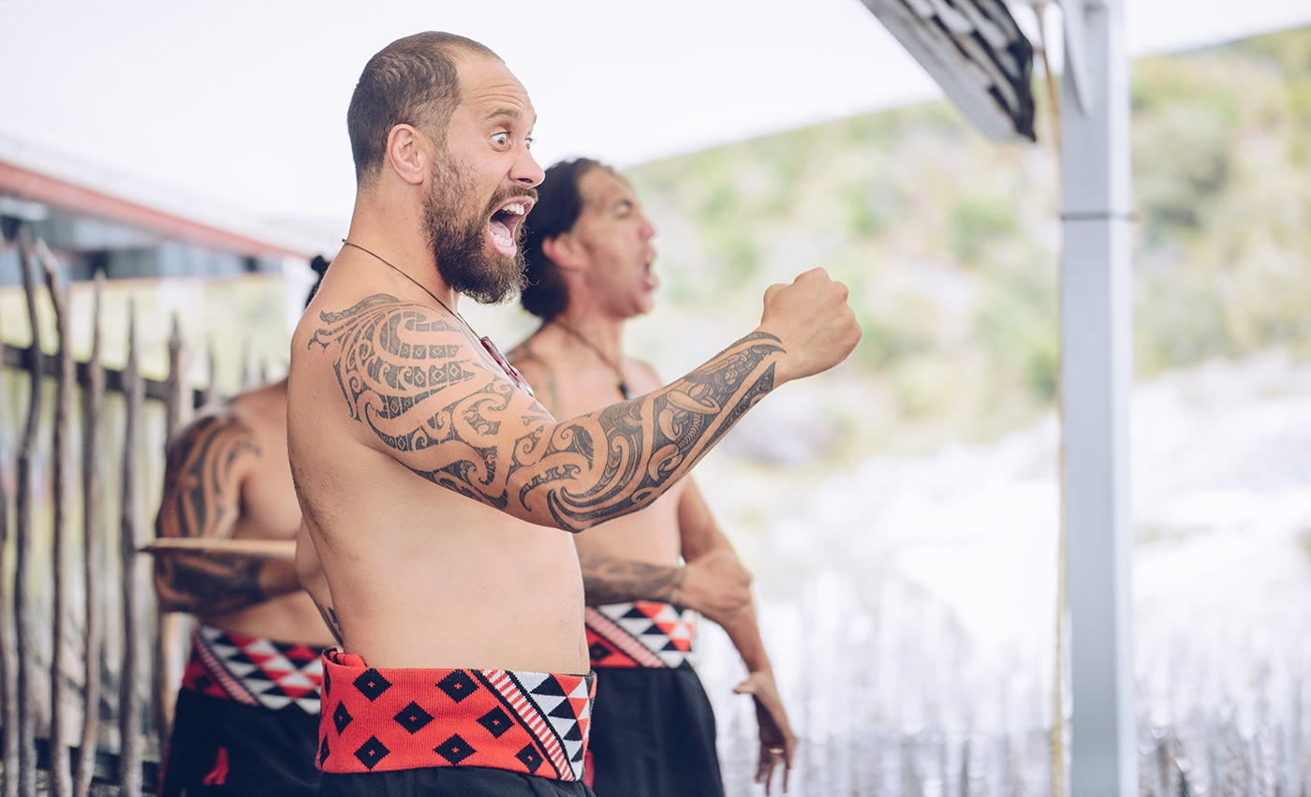
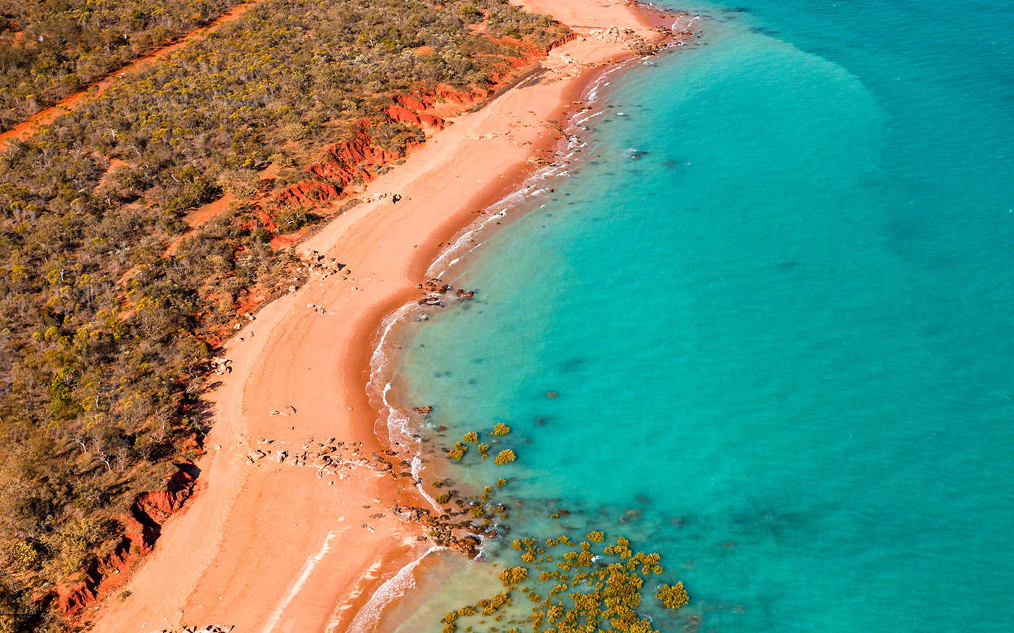
Ex 1: Look at the pictures and write the correct words or phrases to complete the sentences.
1. Both England and New Zealand are ..…….. countries.
1. Both England and New Zealand are island countries.
island country: Quốc đảo
attraction: sự thu hút
castle: lâu đài
go sightseeing: ngắm cảnh
boat ride: đi tàu
tattoo: hình xăm
arm: cánh tay
famous for: nổi tiếng vì
coastline: đường bờ biển
2. A great attraction of Scotland is the ……….
2. A great attraction of Scotland is the castle.
3. People can go sightseeing by taking a …………...
3. People can go sightseeing by taking a boat ride.
4. Most Maori men have ……….. on their arms.
4. Most Maori men have tattoos on their arms.
5. California is famous for its long sunny …………...
5. California is famous for its long sunny coastline.

Slide 7

Ex 2: Choose the best answer A, B, or C to complete each sentence.
1. What do you call the people from Canada? – ___________.
A. Canadians B. Canadian C. Canada people
2. Scotland, with its ___________ landscapes, attracts millions of visitors every year.
A. warm B. amazing C. local
3. What is a ___________ of London? – The red telephone box.
A. capital B. symbol C. landscape
4. Niagara Falls is a great ___________ on the border of the USA and Canada.
A. forest B. river C. attraction
5. Aborigines are the ___________ people of Australia.
A. native B. historical C. foreign
Canadian: người Ca-na-đa
landscape: phong cảnh
visitor: khách đến thăm
symbol: biểu tượng
capital: Thủ đô
attraction: sự thu hút
border: biên giới
native people: người bản địa
the people from Canada
The red telephone box
Niagara Falls

Slide 8
02
GRAMMAR

Slide 9
Ex 3: Complete the sentences with a / an or the.
1. Auckland is ………. biggest city on ……. North Island of New Zealand.
2. ……. castle is ……… strong building with thick and high walls.
3. Surrounding ……… UK is ………. Atlantic Ocean.
4. Hawaii is ……… state of …….. USA.
5. ……… attraction is ……… interesting place for visitors.
1. Auckland is the biggest city on the North Island of New Zealand.
2. A castle is a strong building with thick and high walls.
3. Surrounding the UK is the Atlantic Ocean.
4. Hawaii is a state of the USA.
5. An attraction is an interesting place for visitors.
“biggest”: so sánh nhất → “the”
“North Island”: danh từ riêng chỉ quần đảo → “the”
“castle”, “building”: các danh từ người nói nhắc đến không đặc biệt → “a”
“UK”: danh từ chỉ địa điểm → “the”
“Atlantic Ocean”: danh từ riêng chỉ đại dương → “the”
“state”: danh từ số ít → “a”
“USA”: danh từ chỉ địa điểm → “the”
“attraction”: danh từ có âm tiết đầu là nguyên âm → “an”
“interesting place”: có chữ đằng sau bắt đầu là 1 nguyên âm → “an”
There are two indefinite articles in English: ‘a’ and ‘an’.
- ‘An’ is used before vowel sounds.
We use ‘the’:
+ with superlatives.
+ with the names of some places.
+ if one of the words in the place name is a common noun (island, bridge, river, tower, ...).

Slide 10
Ex 4: Underline and correct the article mistakes in the sentences below.
1. Ottawa is a capital of Canada.
a → the
2. He’s the Englishman. He lives in Oxford.
the → an
3. When people travel, they use an map to find their way round.
an → a
4. Can you see a Big Ben from where you are standing?
a → the
5. Canadians love ice hockey, the winter sport.
the → a
“capital”: thủ đô → “the”
“Englishman”: người đàn ông Anh: danh từ số ít → “an”
“map”: chữ đứng đầu là 1 phụ âm → “a”
“Big Ben”: tên riêng của một địa danh → “the”
“winter sport”: danh từ số ít → “a”

Slide 11
Thanks!
Do you have any questions?

