Slide 1
UNIT 12 English speaking country
Lesson 6: Skills 2

Slide 2
OBJECTIVES
LISTENING
WRITING
By the end of the lesson, students will be able to:
listen for specific information about a tour of a city
write a diary entry about a tour of a city

Slide 3

What city is it?
1
2
3
4
5
6
7
8
9
10
11
12

Slide 4
London

Slide 5
01
LISTENING
a tour of a city

Slide 6
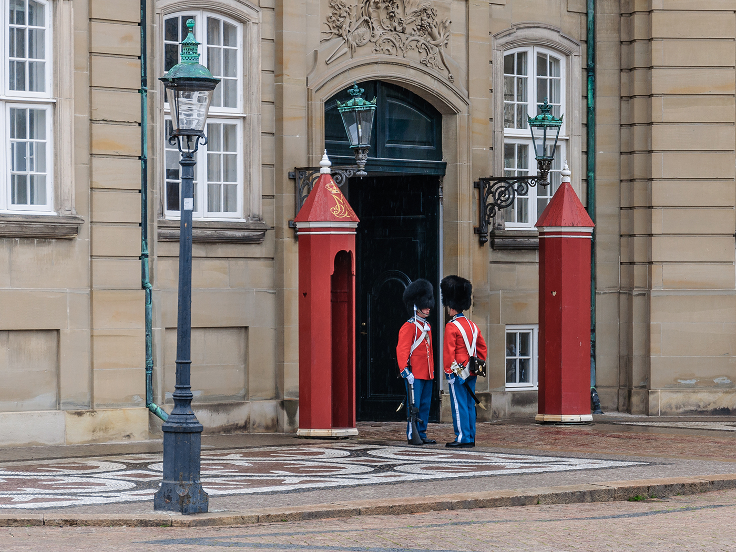
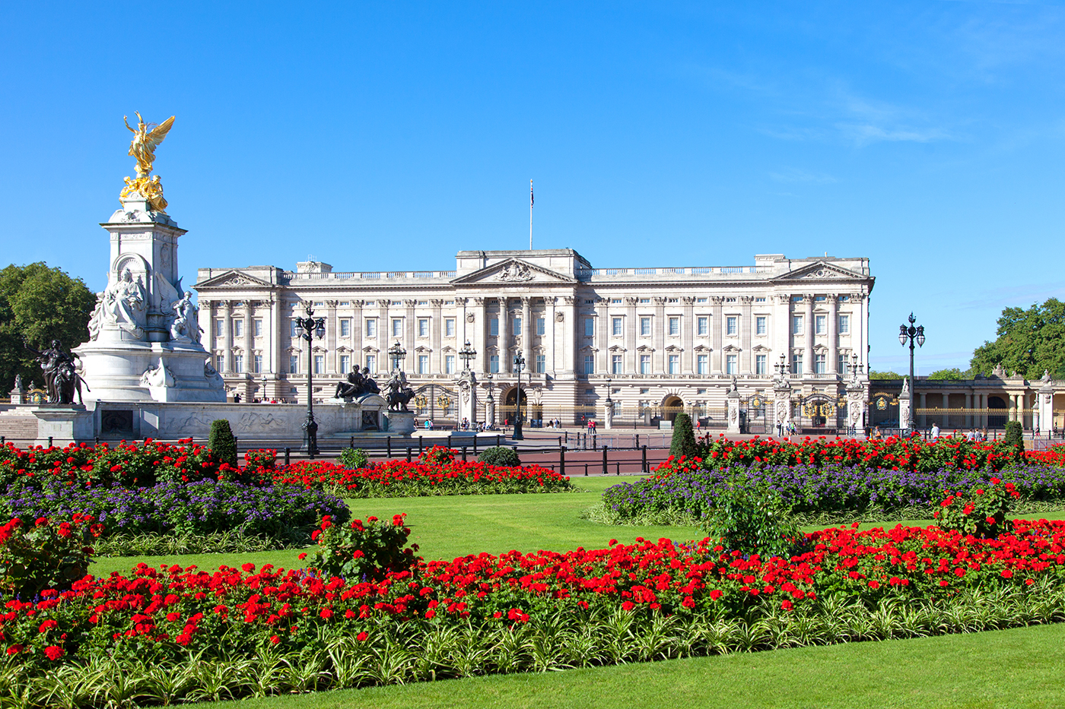
1. (p 131) Match the phrases to the pictures.
Buckingham Palace
Changing of the Guard
Changing of the Guard
Buckingham Palace
1. _________________________
2. _________________________

Slide 7

2. (p 131) A tour guide is talking about the schedule for a day trip in London. Listen and fill in the times.
Go to Buckingham Palace: 9:30 a.m.
Watch the Changing of the Guard: (1) ________________
Lunch: (2) ________________
The boat ride: (3) ________________
Back to the hotel: (4) ________________

Slide 8
2. (p 131) A tour guide is talking about the schedule for a day trip in London. Listen and fill in the times.
Go to Buckingham Palace: 9:30 a.m.
Watch the Changing of the Guard: (1) ________________
Lunch: (2) ________________
The boat ride: (3) ________________
Back to the hotel: (4) ________________
Remember to watch the Changing of the Guard at 11:30 a.m.
11:30 a.m
Lunch is at 1:00 p.m.
1:00 p.m.
3:15 p.m.
We will return for a boat ride at 3:15 p.m.
5:00 p.m.
We will return to our hotel at 5:00 p.m.

Slide 9
3. (p 131) Listen again and complete each sentence with ONE word.
1. The ________________ and her family live in Buckingham Palace. 2. At the Palace, you can see the Queen’s beautiful ________________. 3. Another name for Big Ben is the ________________ Tower. 4. After lunch, you can go around and take ________________. 5. On the boat ride, you can see historic ________________ along the river.

Slide 10
3. (p 131) Listen again and complete each sentence with ONE word.
Queen
At 9:30 a.m., we’ll go to Buckingham Palace. The Queen and her family live there.
1. The ________________ and her family live in Buckingham Palace. 2. At the Palace, you can see the Queen’s beautiful ________________. 3. Another name for Big Ben is the ________________ Tower. 4. After lunch, you can go around and take ________________. 5. On the boat ride, you can see historic ________________ along the river.

Slide 11
3. (p 131) Listen again and complete each sentence with ONE word.
Queen
1. The ________________ and her family live in Buckingham Palace. 2. At the Palace, you can see the Queen’s beautiful ________________. 3. Another name for Big Ben is the ________________ Tower. 4. After lunch, you can go around and take ________________. 5. On the boat ride, you can see historic ________________ along the river.
At 9:30 a.m., we’ll go to Buckingham Palace. The Queen and her family live there. You can see the Queen’s beautiful garden, and her collection of artworks.
garden

Slide 12
3. (p 131) Listen again and complete each sentence with ONE word.
Queen
1. The ________________ and her family live in Buckingham Palace. 2. At the Palace, you can see the Queen’s beautiful ________________. 3. Another name for Big Ben is the ________________ Tower. 4. After lunch, you can go around and take ________________. 5. On the boat ride, you can see historic ________________ along the river.
We will then visit Big Ben. It is the Clock Tower on the River Thames.
garden
Clock

Slide 13
3. (p 131) Listen again and complete each sentence with ONE word.
Queen
1. The ________________ and her family live in Buckingham Palace. 2. At the Palace, you can see the Queen’s beautiful ________________. 3. Another name for Big Ben is the ________________ Tower. 4. After lunch, you can go around and take ________________. 5. On the boat ride, you can see historic ________________ along the river.
Lunch is at 1:00 p.m. You can then go around and take photos.
garden
Clock
photos

Slide 14
3. (p 131) Listen again and complete each sentence with ONE word.
Queen
1. The ________________ and her family live in Buckingham Palace. 2. At the Palace, you can see the Queen’s beautiful ________________. 3. Another name for Big Ben is the ________________ Tower. 4. After lunch, you can go around and take ________________. 5. On the boat ride, you can see historic ________________ along the river.
We will return for a boat ride at 3:15 p.m. on the River Thames. You will see historic attractions along the river.
garden
Clock
photos
attractions

Slide 15
WRITING
02
a diary entry about a tour of a city

Slide 16
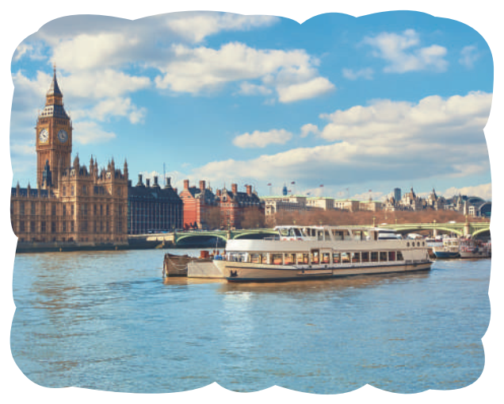

4. (p 131) Work in pairs. Fill in the table with information about the London tour.
MEMORY CHECK
Time | Place | Activity
9:30 a.m. | Buckingham Palace | – see the Queen’s garden
– see the Queen’s collection of artworks
11:30 a.m.
Buckingham Palace
– watch the Changing of the Guard
1 p.m.
Around Big Ben
– have lunch – tour the place and take photos
3:15 p.m.
The River Thames
– take a boat ride
5:00 p.m.
return to the hotel

Slide 17
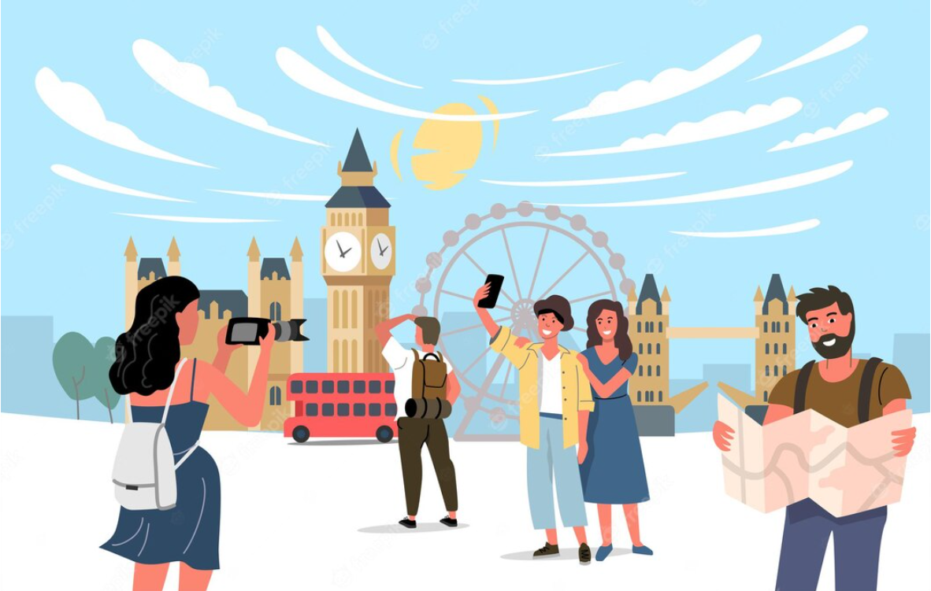
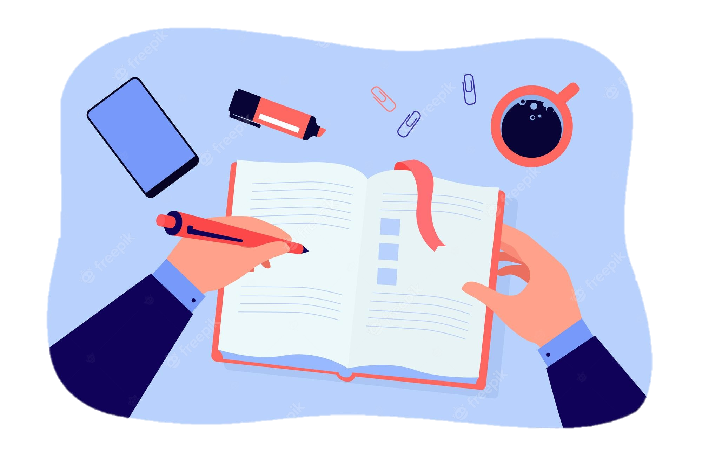
5. 1 (p 131) In group. Brainstorm your tour to London, based on the table in 4 or use your imagination.

Slide 18
5. 2 (p 131) In group, write a diary entry of about 70 words about your tour to London, based on the table in 4 or use your imagination.
Suggested answers:
The tour of London began at 9:30 a.m. First, we went to Buckingham Palace. We visited the Queen’s Garden and saw her collection of artworks. At 11:30 a.m. we watched the Changing of the Guard. We then went to Big Ben. We took a lot of photos there. At 3:15 p.m., we took a boat ride on the River Thames. We saw many historic attractions along the river. I enjoyed the tour very much.

Slide 19
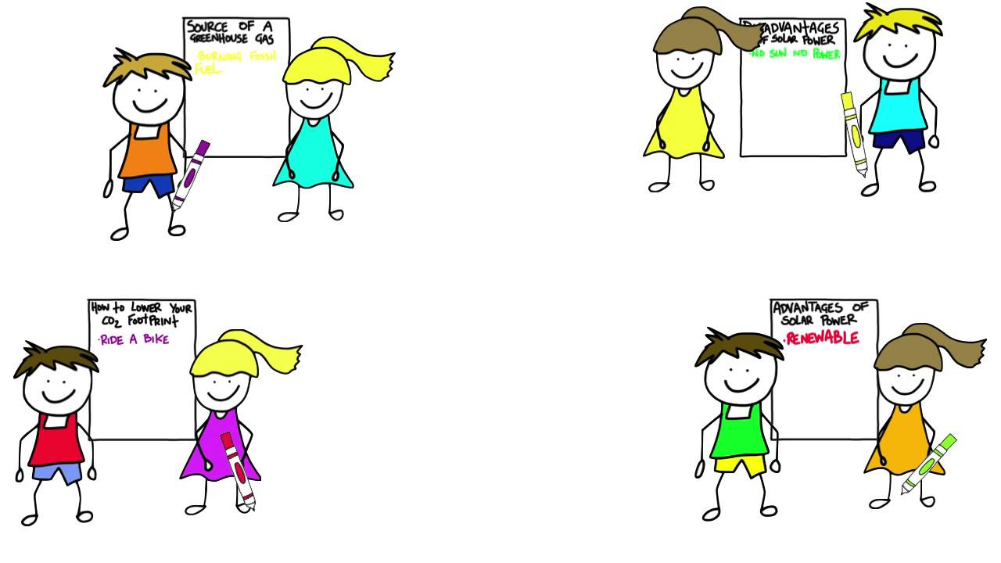
Students go to see other’s work and give comments to each other.
CLASS GALLERY
Do they write
the schedule for the trip ?
the tourist attractions?
some activities they can do during the trip?

Slide 20
RECAP
01
LISTENING
02
WRITING
In this lesson, we have learnt to:
listen for specific information about a tour of a city
write a diary entry about a tour of a city

Slide 21
THANK YOU FOR YOUR ATTENTION

