Slide 1





English-speaking Countries
UNIT 12
Hi
LESSON 4. COMMUNICATION
Hello

Slide 2

Objectives
01
02
By the end of the lesson, students will be able to:
Everyday english
Expressing amazement
Interesting facts about English-speaking countries

Slide 3
01
Everyday English
Expressing amazement

Slide 4

Ex 1. (p 128) Listen and read the conversations, paying attention to the highlighted parts.
Can you add more expressing amazement?
Scottish men wear kilts, short skirts at their traditional festivals.
Wow … I didn’t know that!
In 2019, Walt Disney World in Canifornia attracted nearly 21 million visitors.
Amazing!

Slide 5

Ex 2. (p 128) Work in pairs.
Make similar conversations in Ex 1.
Use 3 situations below.
Use expressions of amazement.
Work in 2 minutes.
Situation:
Amazement
1. New Zealand has the cleanest and safest air on the planet.
Really?
Wow
2. There are no snakes in New Zealand.
Amazing!
3. More than half of all lakes in the world are in Canada.
What a surprise!

Slide 6
02
Interesting facts about English-speaking countries
Do you know any facts
about English-speaking countries?

Slide 7





Ex 3. (p 129) Work in groups. Discuss and write the name of the country next to the fact.
Canada
The USA
The UK
Australia
New Zealand
FACT | COUNTRY
1. This country is famous for its kangaroos.
2. This country has a large population, only smaller than that of China and India.
3. This country lies close to the North Pole and is very cold in winter.
4. This country is famous for its royal family.
5. This is a small island country in the Pacific Ocean.
Australia
The USA
Canada
The UK
New Zealand

Slide 8
Ex 4. (p 129) Work in pairs. Read some facts below and tick the column true for you. Then read out loud and respond to the facts.
New York is the biggest city but not the capital of the USA.
 | This is new to me | I know this
1. There are more sheep than people in New Zealand, around 6 sheep per person.
2. The Statue of Liberty is in New York.
3. Canada has the longest coastline in the world.
4. About 90% of Australians live on the coast.
5. Football is the most popular sport in England.
I know this.
The state of Alaska in the USA has over 2,600 islands.
This is new to me.

Slide 9
Ex 5. (p 129) Work in groups.
- Share some interesting facts you know about English-speaking countries.
- Take note and present its findings to the class.
5 biggest cities of the UK
population
flag
currency

Slide 10

Union Jack
The official flag is the Union Flag, nicknamed the ‘Union Jack’.
It was designed to include the flags that represented Scotland, England and Ireland at the time.

Slide 11

Population
England has the largest population (number of people who live there) in the UK.
The population of the UK is around 67 million!

Slide 12
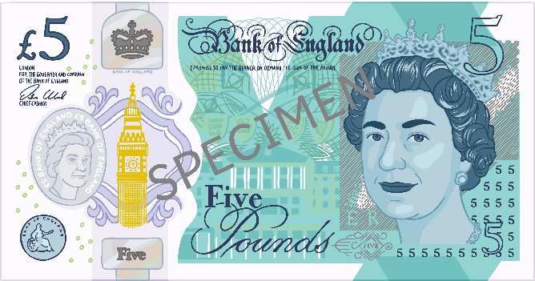
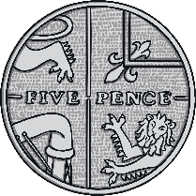
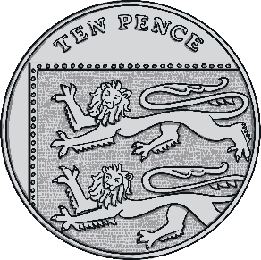

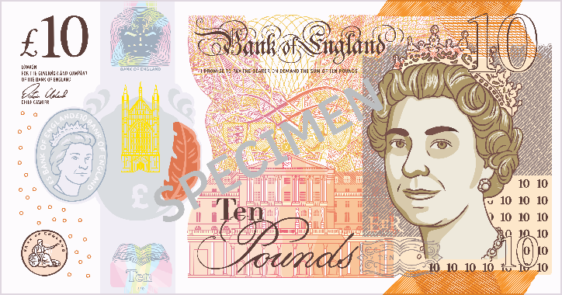

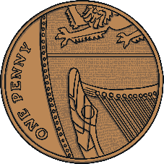
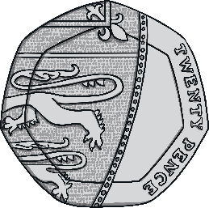
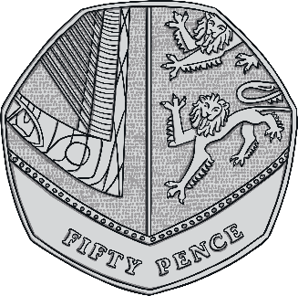
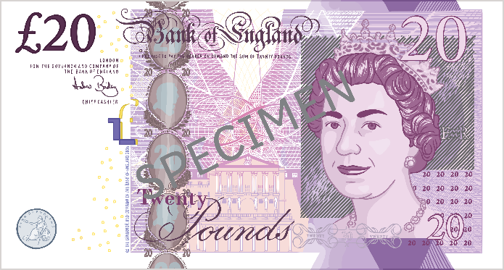
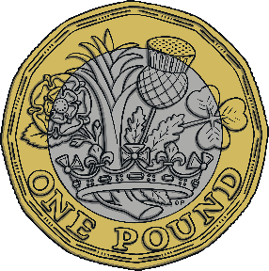
Currency
The currency in the UK is the pound sterling.

Slide 13
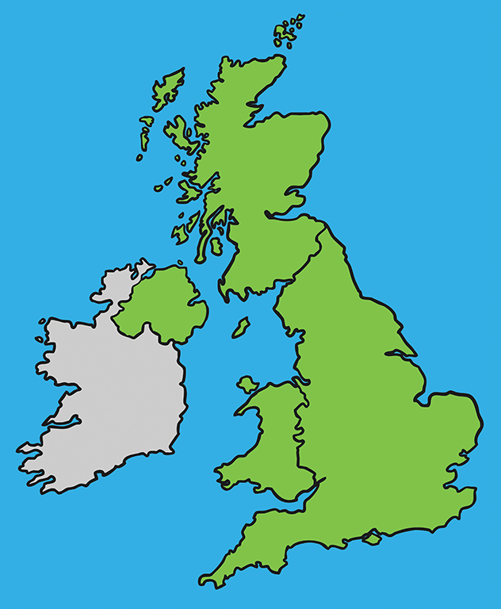
UK Cities
Top 5 biggest Cities of the UK:
London
Birmingham
Glasgow
Leeds
Leeds
Manchester
Glasgow
Birmingham
London
Manchester

Slide 14
Which sentences expresses amazement?
RECAP
No way!
I don’t believe it.
Oh no! That’s not true.
Excuse me

Slide 15
RECAP
What have you known about English-speaking countries?
About some interesting facts.

Slide 16
Thank you!

Slide 17
Alternative resources
Did you like the resources on this template? Get them for free at our other websites:
Vector
Flat back to school elements collection

