Slide 1





LET'S EXPLORE THE WORLD!
Warm up

Slide 2

Remember the countries

Slide 3


How many countries
can you name?

Slide 4





Check your answer
Germany
Turkey
France
Brazil
Vietnam
Australia
The USA
Canada
Italy
Greece
Argentina
Japan
The UK
India
Korea

Slide 5


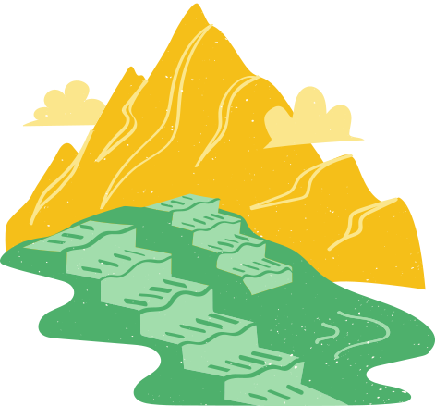
Lesson 3: A closer look 2
English 7
Unit 12
English speaking countries

Slide 6

Objectives
By the end of this lesson, students will be able to:
understand the use of articles
practice using articles correctly
Notes:
understand the use of use articles
practice using articles correctly

Slide 7
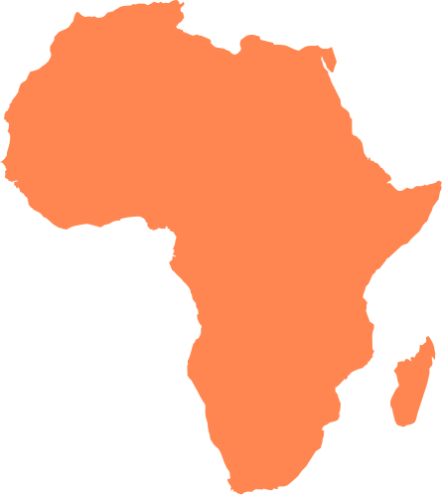
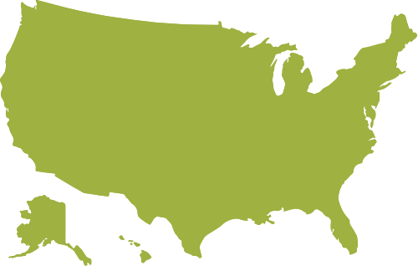
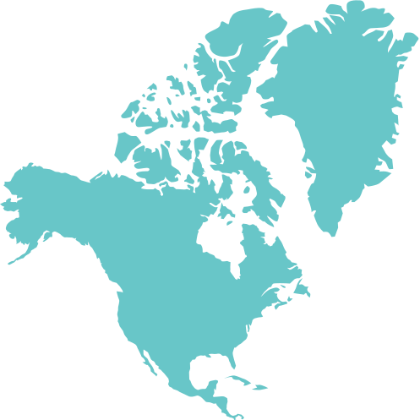
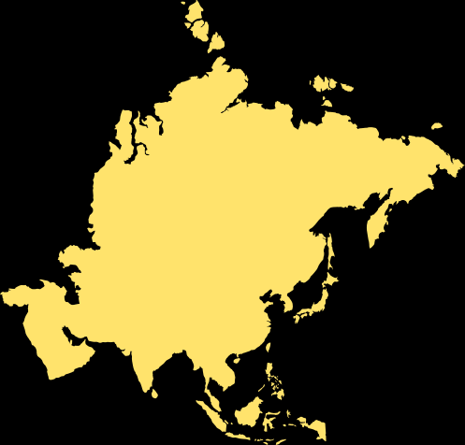
Watch a video

Slide 8


Slide 9
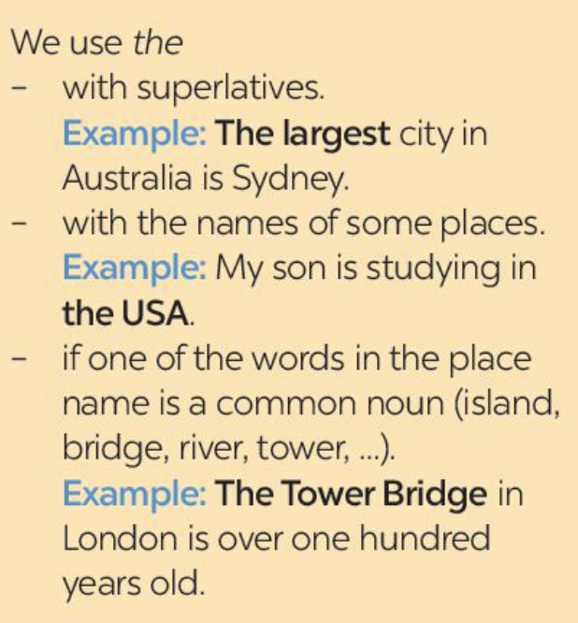
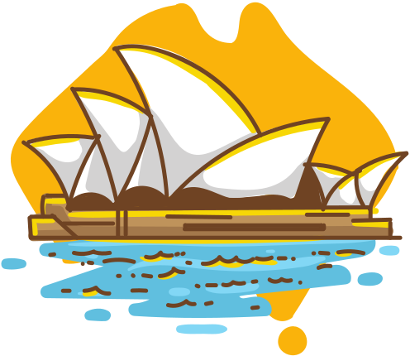

When do we use article “the”?
The largest city in Australia is Sydney.
superlatives
My son is studying in the USA.
with names of some places

Slide 10
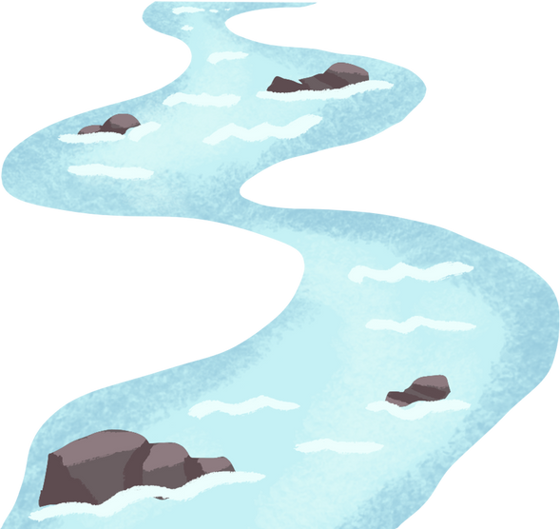
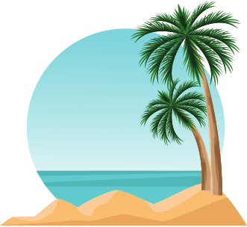

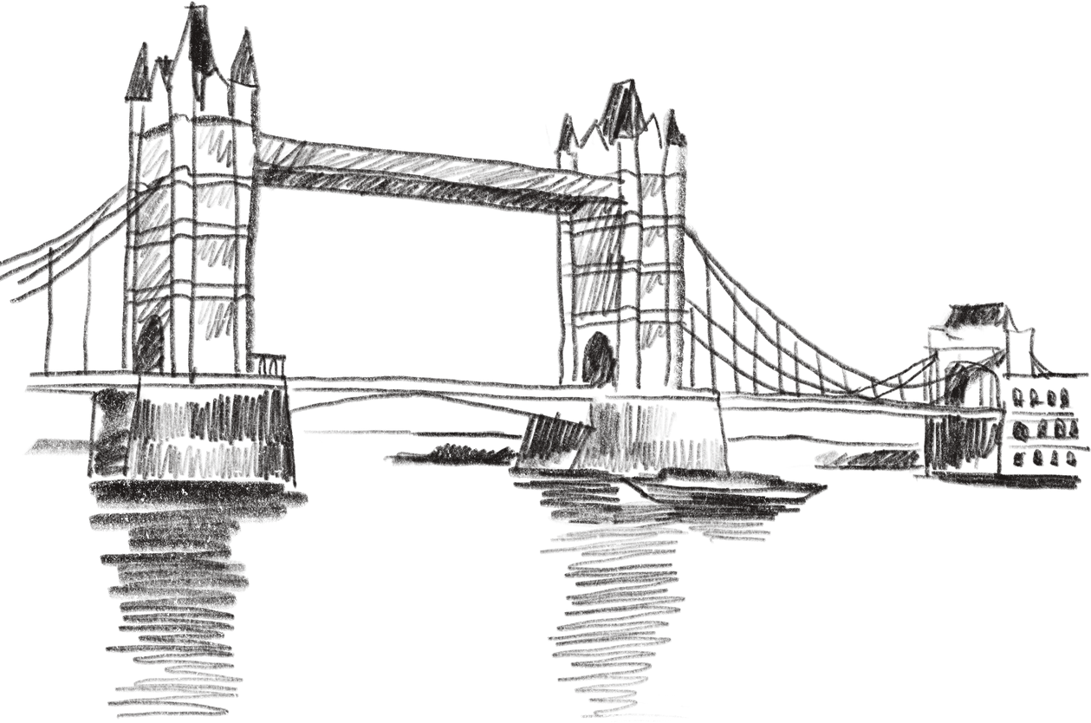
When do we use article “the”?
after names of some places
river
bridge
island
tower

Slide 11
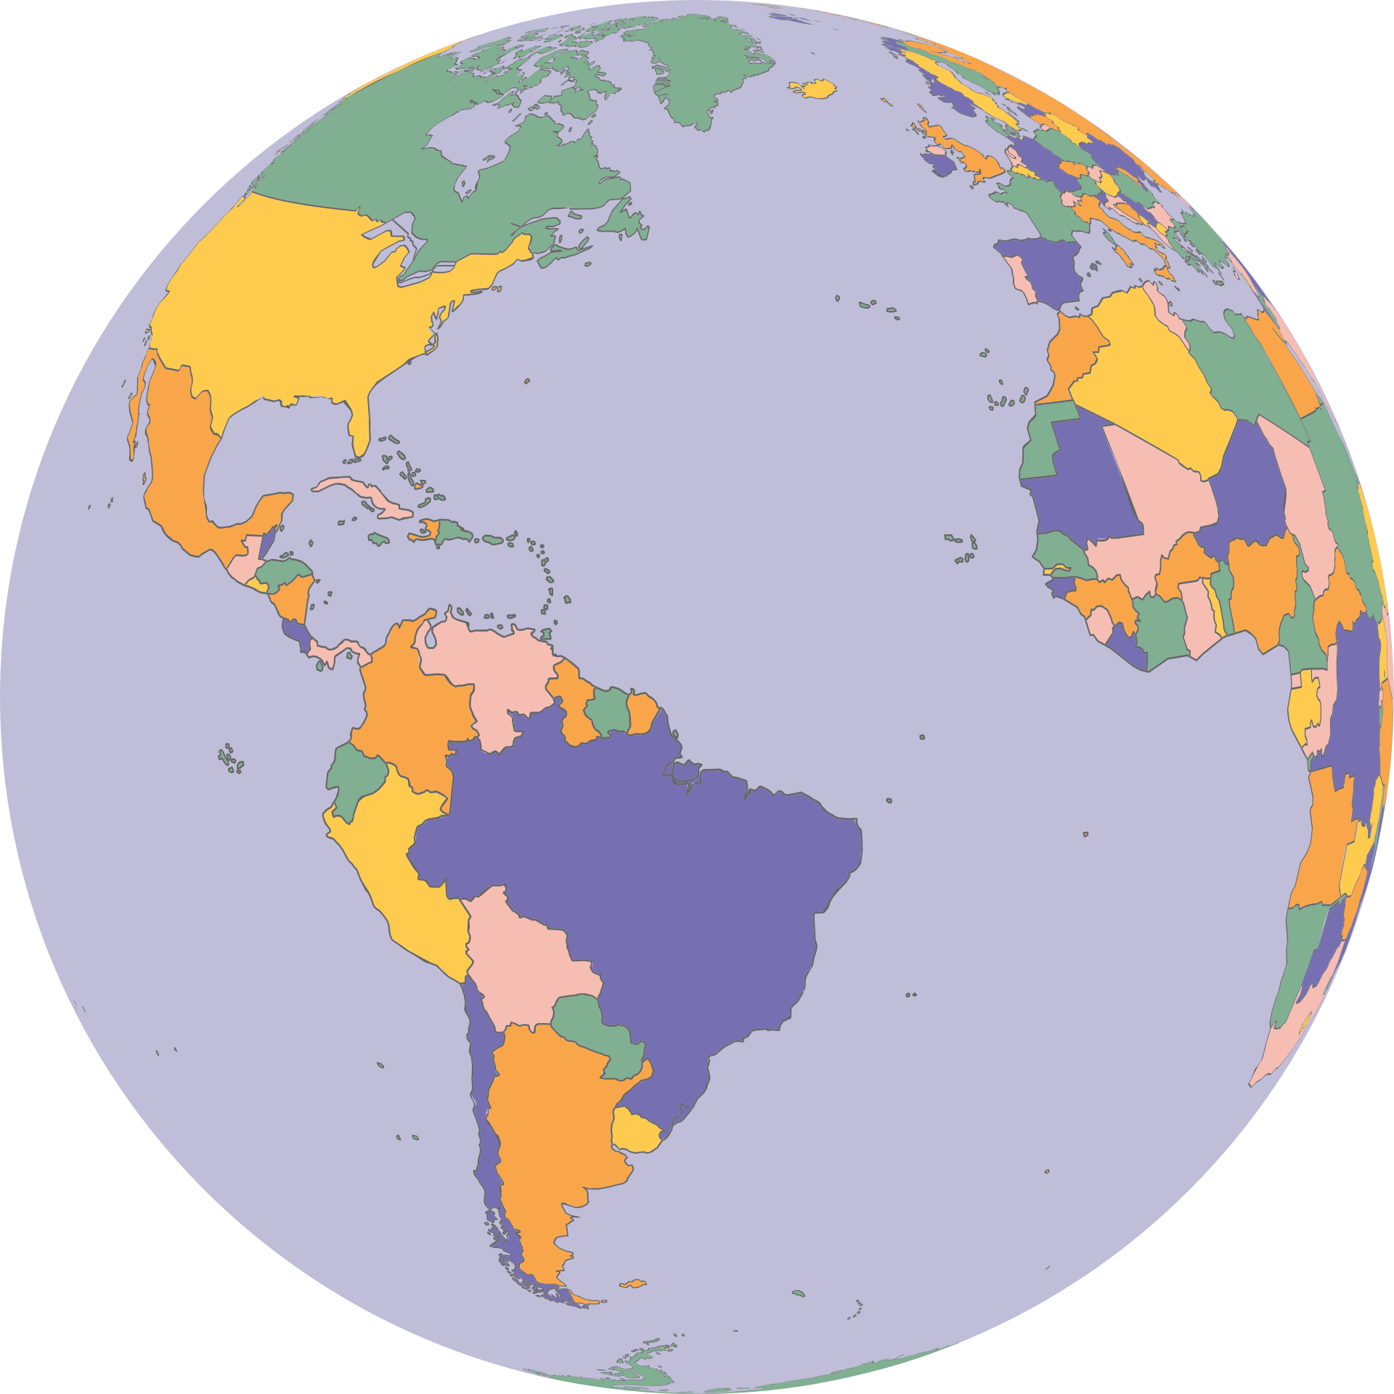
Travelling
around the
world

Slide 12

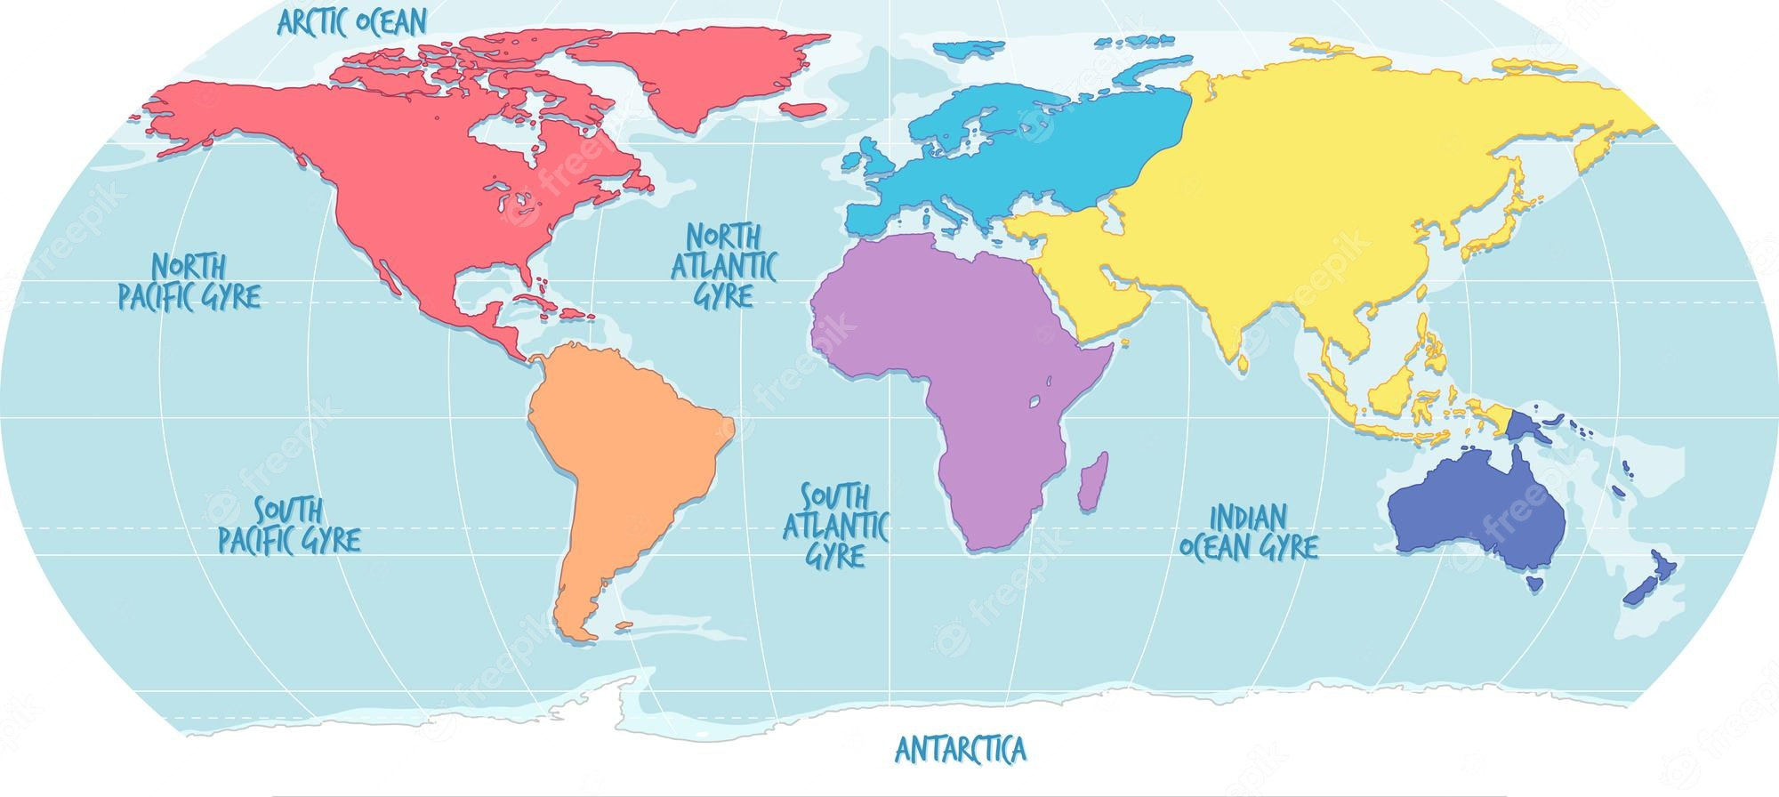
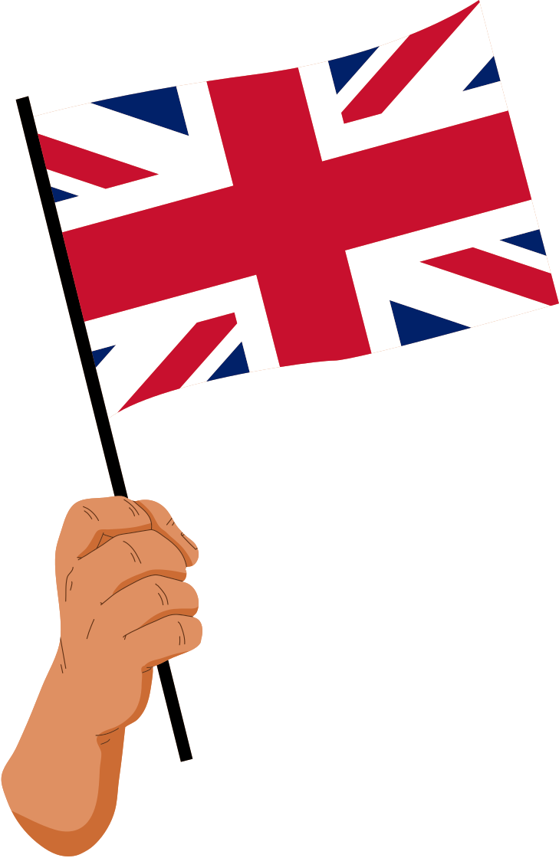
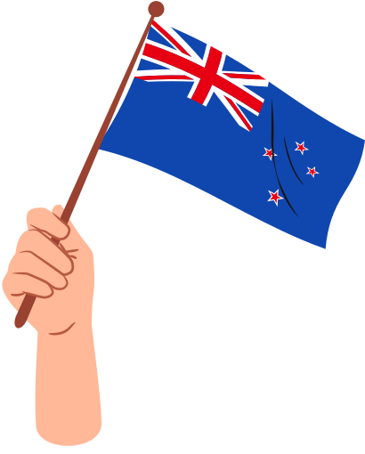
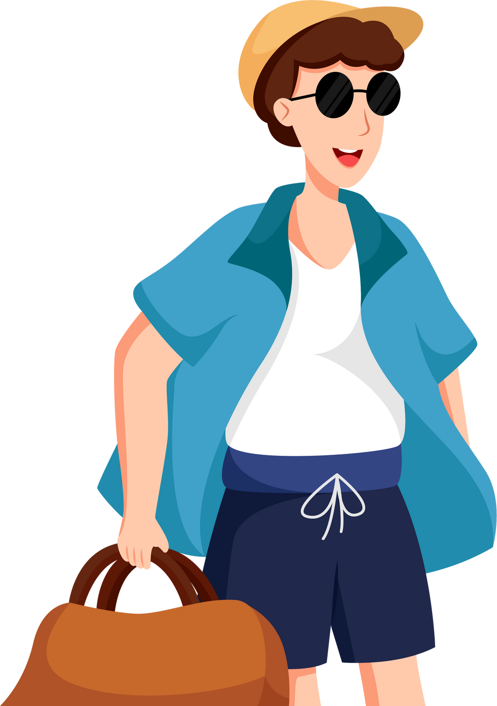


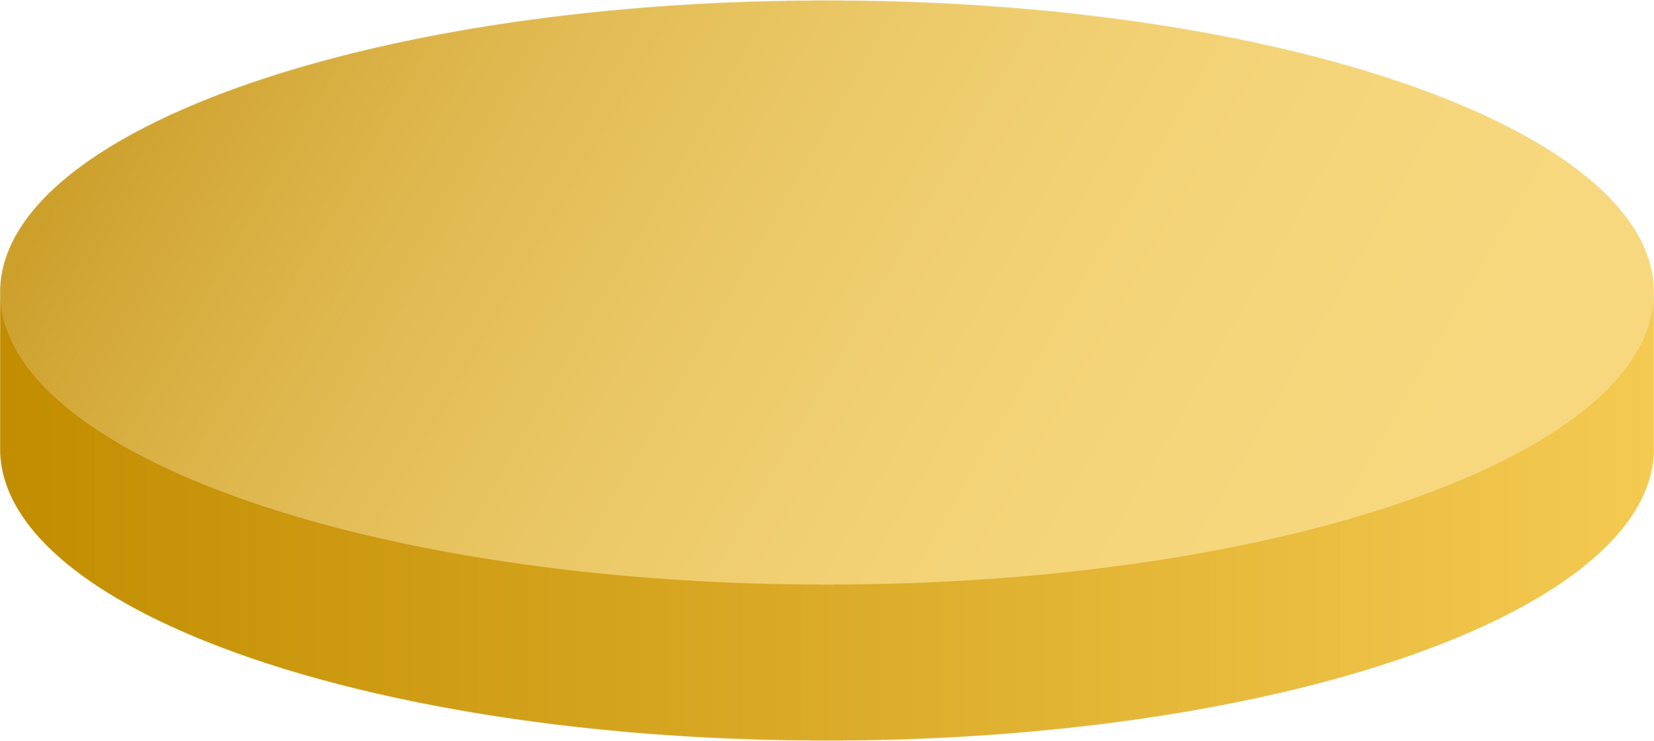


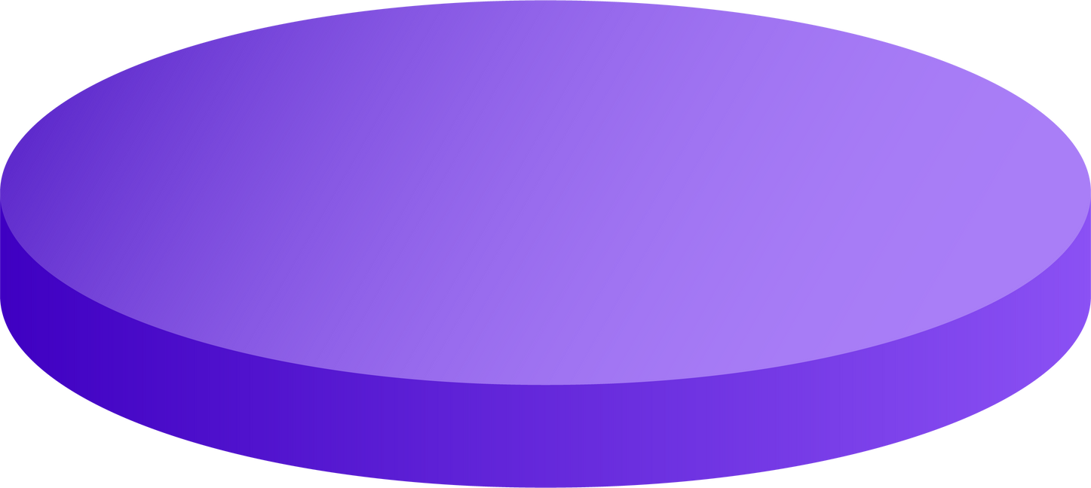

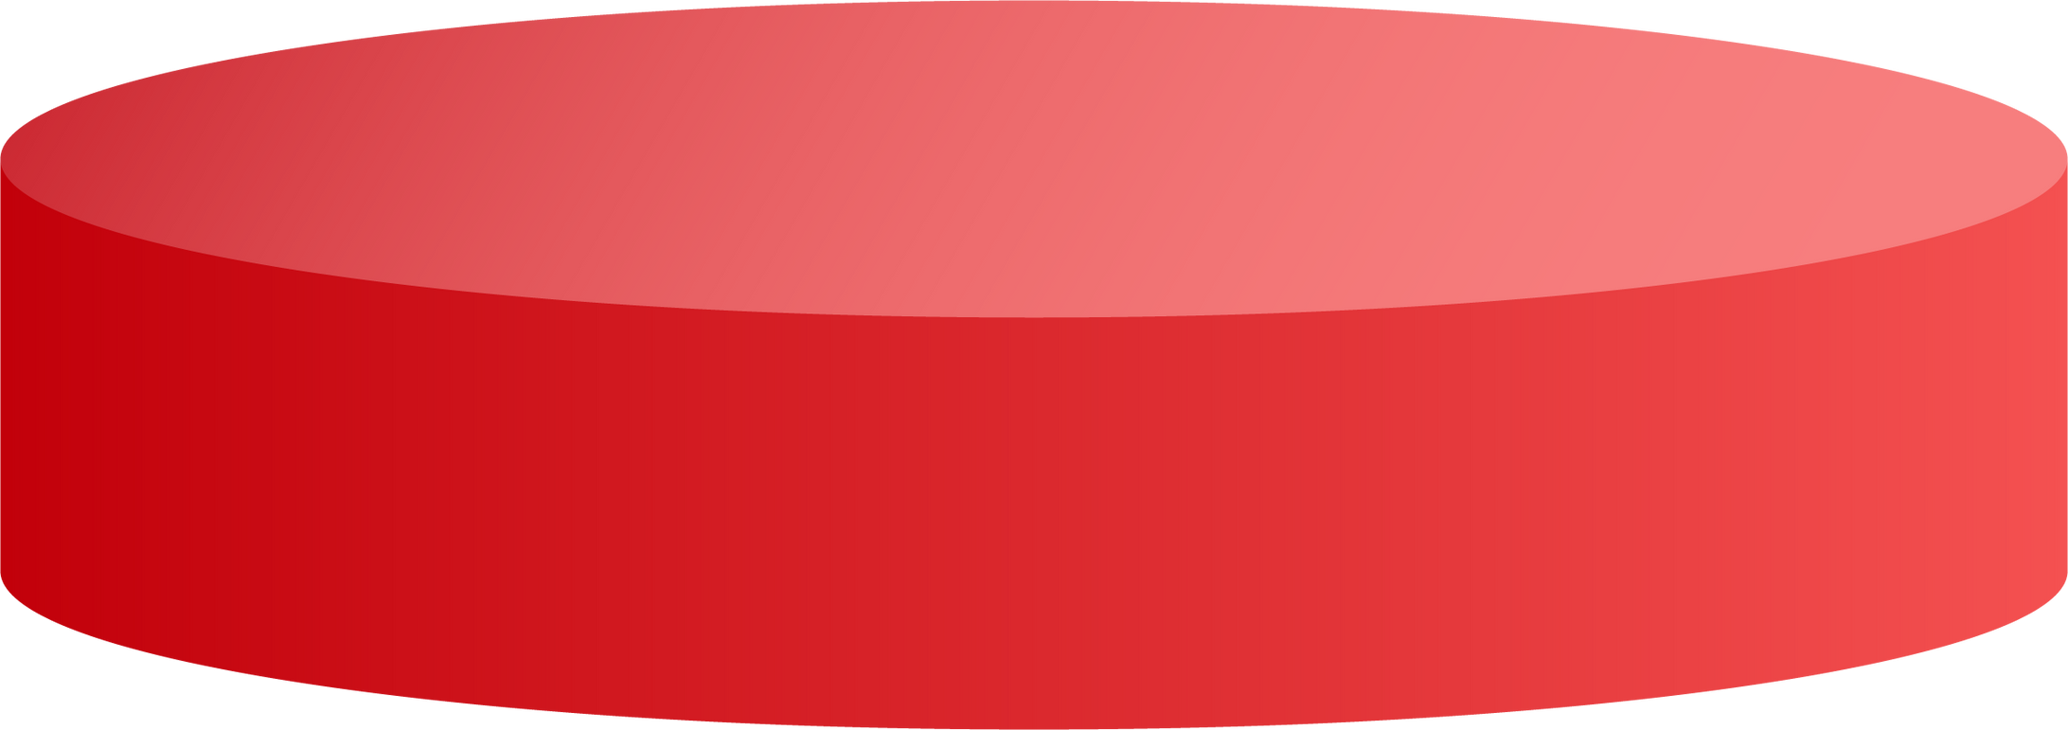

Slide 13
Complete the sentences with “a / an” or “the”
the
Is Washington D.C. __________ capital of the USA?

Slide 15
Complete the sentences with “a / an” or “the”
a
The London Eye is __________ great attraction in London.

Slide 17
Complete the sentences with “a / an” or “the”
a
Canada is __________ very cold country.

Slide 19
Complete the sentences with “a / an” or “the”
the
I love __________ New Zealand’s countryside.

Slide 21
Complete the sentences with “a / an” or “the”
an
Can you give me __________ example of an English-speaking country?

Slide 22
(pg 127) Check your answer.
the
1. Is Washington D.C __________ capital of the USA?
2. Can you give me __________ example of an English-speaking country?
3. The London Eye is __________ great attraction in London.
4. Canada is __________ very cold country.
5. I love __________ New Zealand’s countryside.
an
a
a
the

Slide 23
(pg 127) Put in "the" where necessary.
1. __________ Statue of Liberty is in __________ New York.
2. __________ Scotland is a part of __________ UK.
3. New Zealand consists of __________ North Island and __________ South Island.
4. Disneyland in California is one of __________ biggest entertainment centres in the world.
5. Bangkok is __________ most popular city for tourists in __________ Kingdom of Thailand.

Slide 24
(pg 127) Check your answer.
The
x
1. __________ Statue of Liberty is in __________ New York.
2. __________ Scotland is a part of __________ UK.
3. New Zealand consists of __________ North Island and __________ South Island.
a specific noun
city
x
the
country
specific group of countries
the
the
island
island

Slide 25
(pg 127) Check your answer.
the
4. Disneyland in California is one of __________ biggest entertainment centres in the world.
5. Bangkok is __________ most popular city for tourists in __________ Kingdom of Thailand.
superlative
the
superlative
the
a specific country with a unique name

Slide 26
(pg 127) Check your answer.
the
4. Disneyland in California is one of __________ biggest entertainment centres in the world.
5. Bangkok is __________ most popular city for tourists in __________ Kingdom of Thailand.
superlative
the
superlative
the
a specific country with a unique name

Slide 27


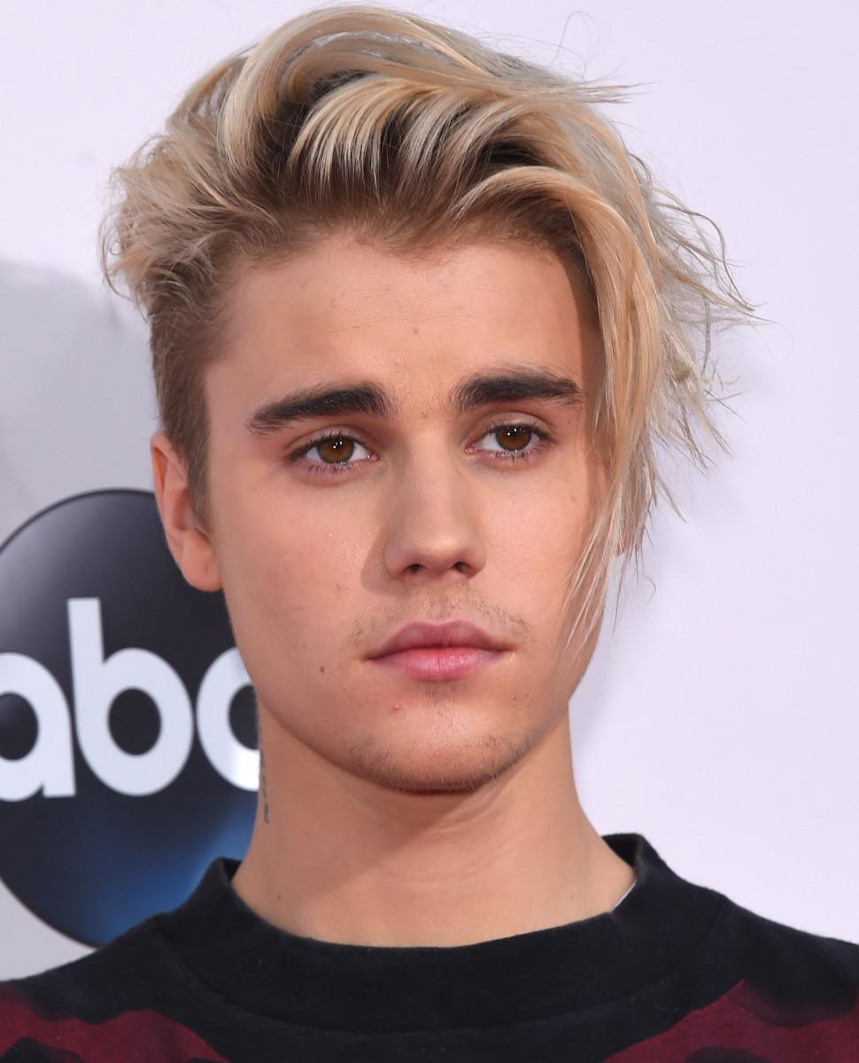
Guess the famous people
Canada
A Canadian
Canadians
singular
plural
Justin Bieber

Slide 28


Guess the famous people
The USA
An American
Americans
singular
plural
Taylor Swift

Slide 29


Guess the famous people
England
An English man
the English
singular
plural
David Beckham

Slide 30

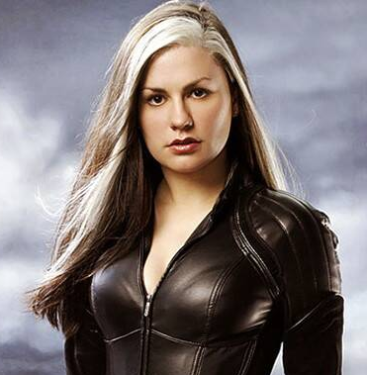
Guess the famous people
New Zealand
A New Zealander
New Zealanders
Anna Paquin
singular
plural

Slide 31
(pg 127) Complete the sentences with “a / an”, or “the”
1. The man sitting next to her is ____________ Englishman.
2. ____________ River Thames runs through London.
3. Here is ____________ map of the city of Edinburgh.
4. What is ____________ most popular sport in Canada?
5. We want to visit ____________ attraction in Sydney.
6. ____________ Statue of Liberty was a present from France.

Slide 32
(pg 127) Complete the sentences with “a / an”, or “the”
an
1. The man sitting next to her is ____________ Englishman.
2. ____________ River Thames runs through London.
3. Here is ____________ map of the city of Edinburgh.
singular
The
river
the
thing

Slide 33
(pg 127) Complete the sentences with “a / an”, or “the”
the
4. What is ____________ most popular sport in Canada?
5. We want to visit ____________ attraction in Sydney.
6. ____________ Statue of Liberty was a present from France.
superlative
an
thing
The
a specific noun

Slide 34


(pg 127). Tick if the underlined articles are correct.
If they aren’t, write the correct ones in the space provided.
1. ‘What do you call a person from England?’ - The Englishman.
2. Edinburgh is a capital city of Scotland.
3. Queenstown is a amazingly beautiful town.
4. Are ancient castles an attraction of Scotland?
5. Where can you see a red telephone box?
A
singular
Edinburgh is the capital city of Scotland.
a specific city
Queenstown is an amazingly beautiful town.

Slide 35

Thank You
for watching!

Slide 36
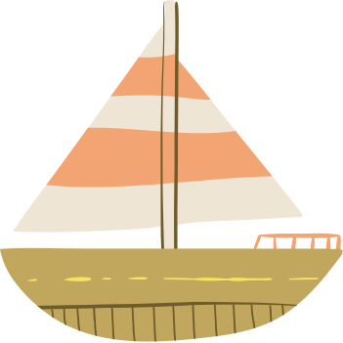

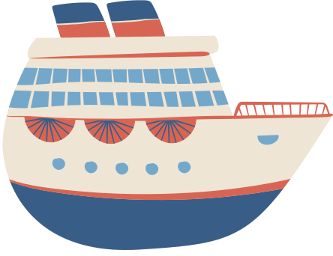


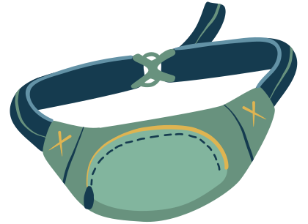

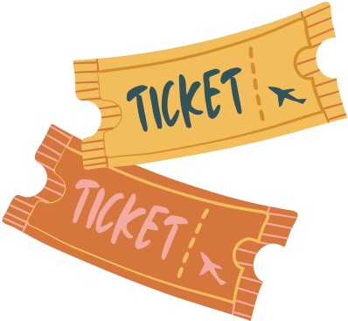
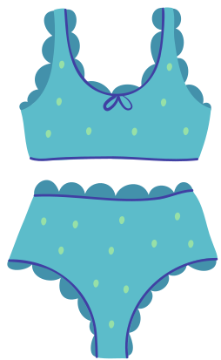
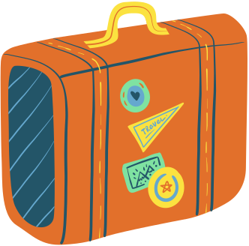
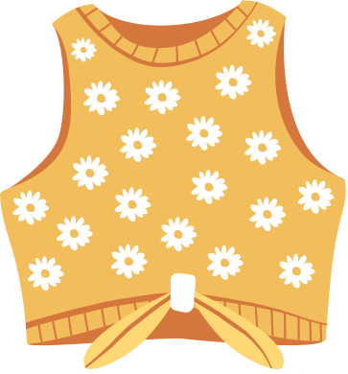
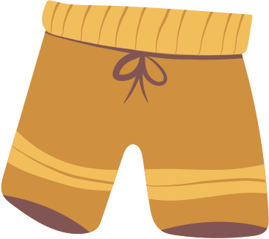


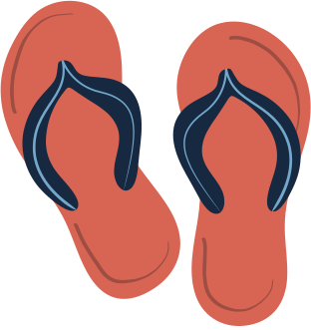


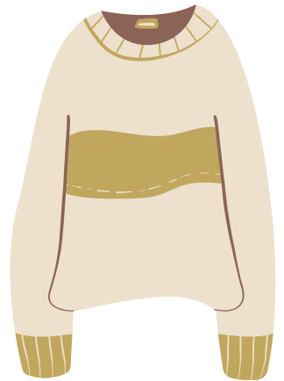

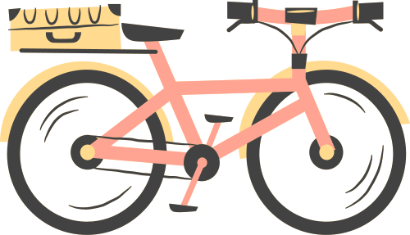

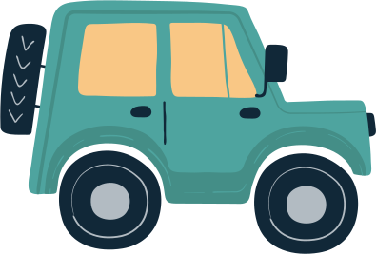
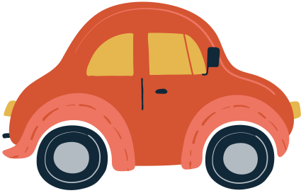
FREE RESOURCE PAGE

Slide 37

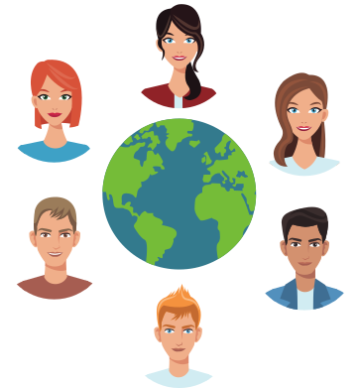
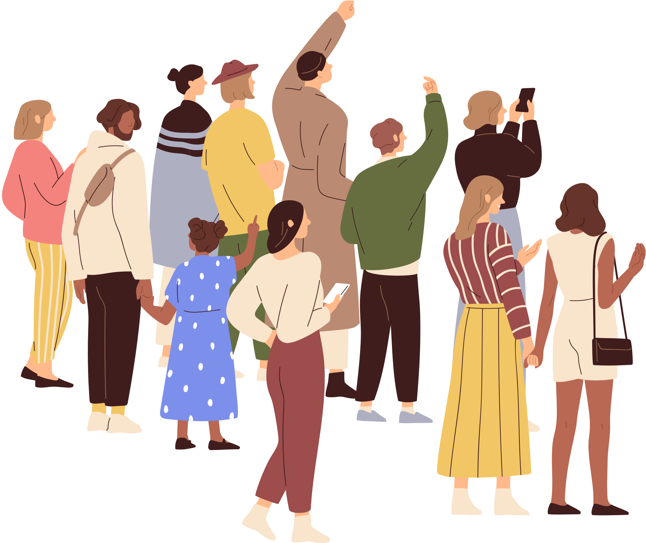
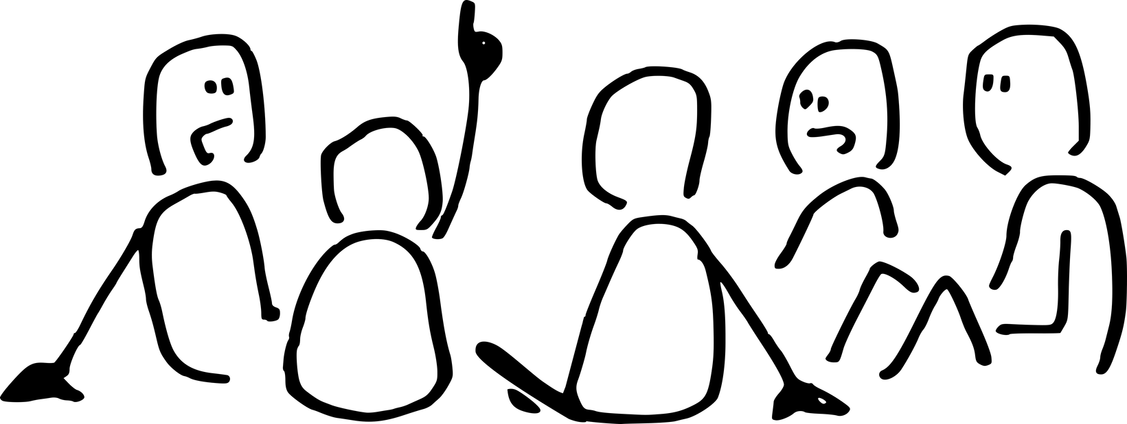

Slide 38






Slide 39




Slide 40



Slide 41


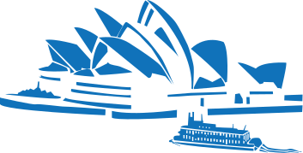

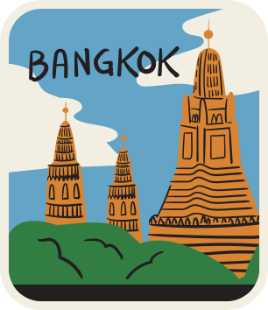

Slide 42
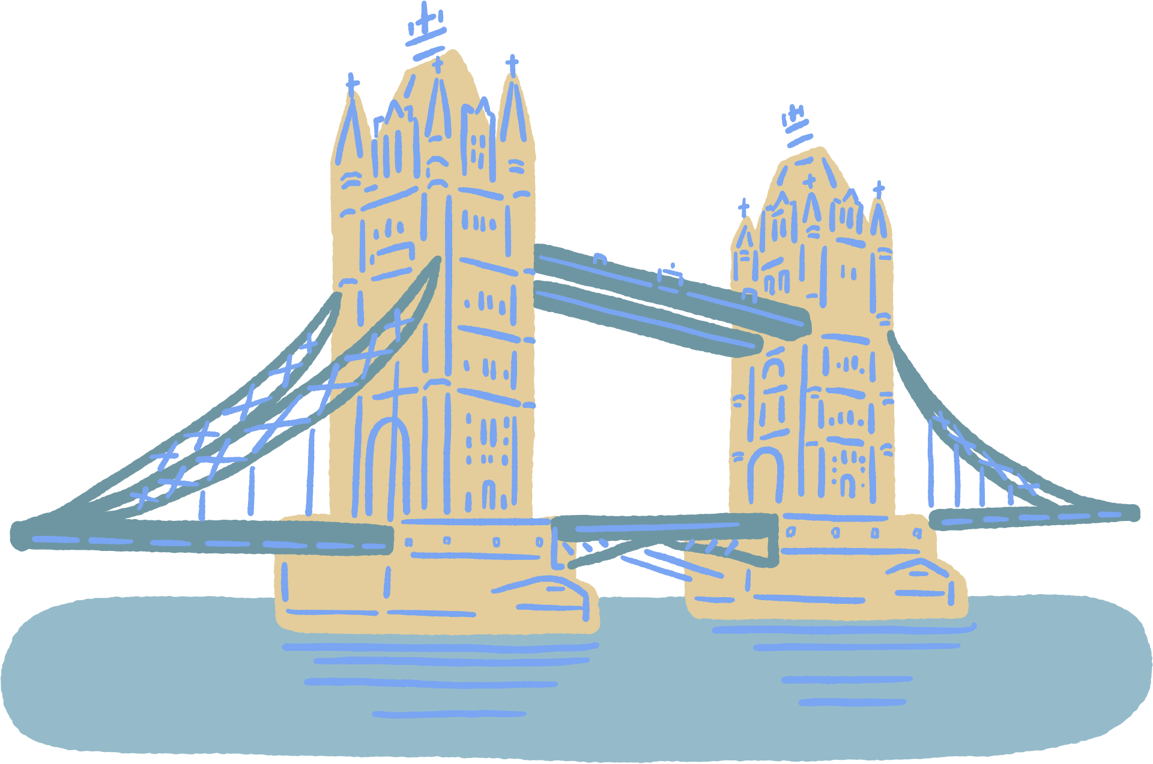
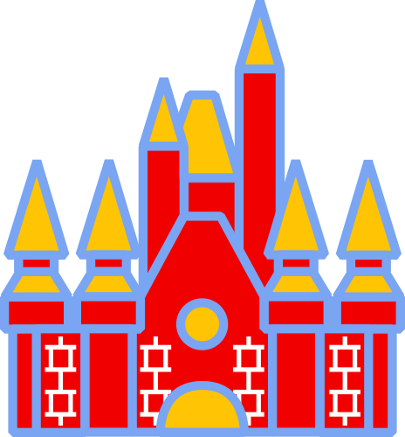
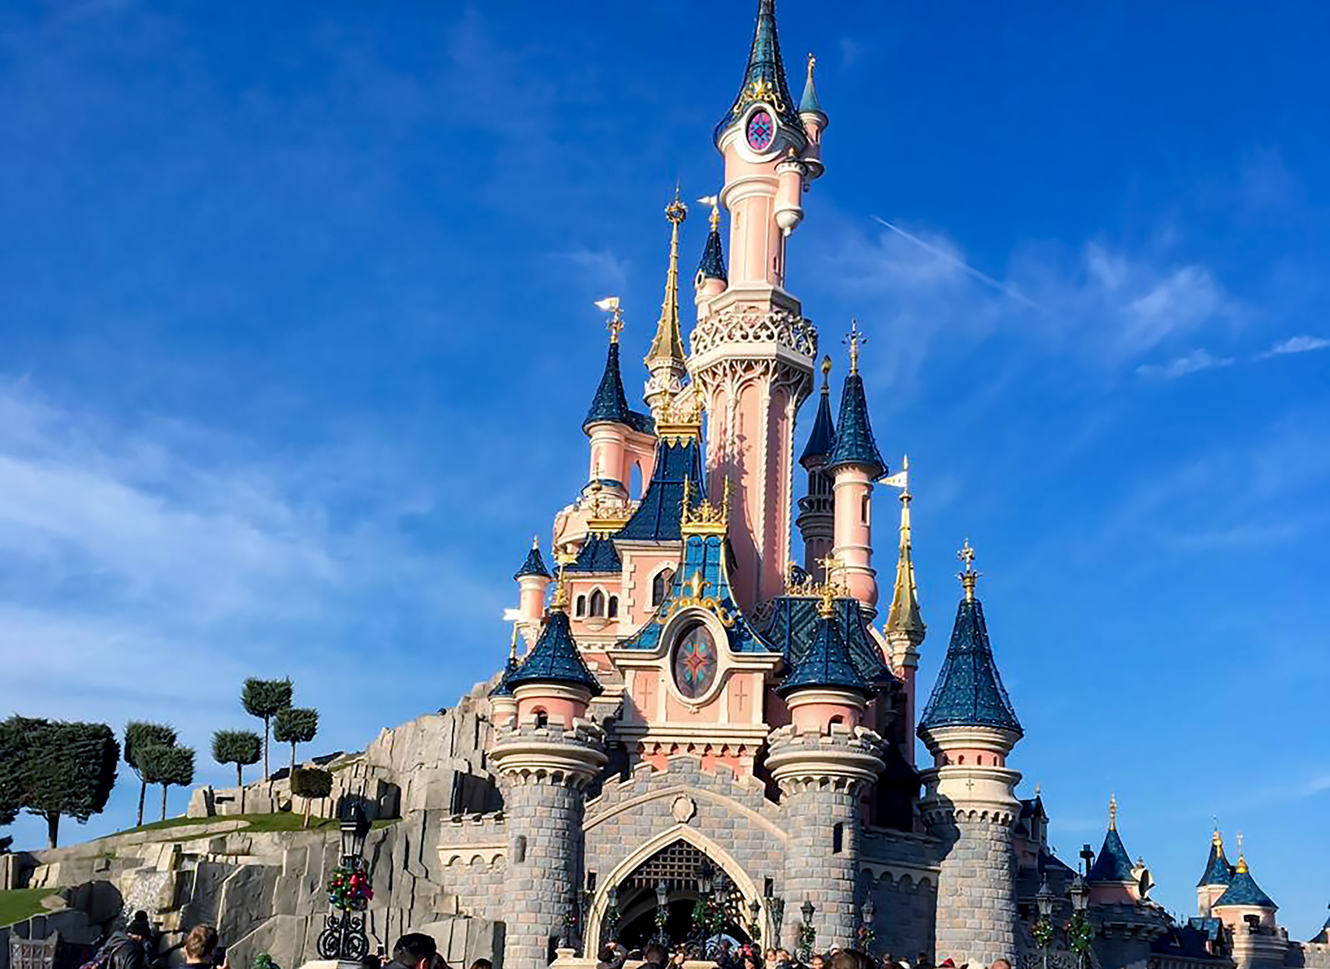

Slide 43
