Slide 1
GUESS THE NAMES!
Look at the pictures
Guess the names of the countries and their capitals.
10 seconds

Slide 2


GUESS THE NAMES!
Capital?
Washington D.C.
THE USA
Country?

Slide 3

GUESS THE NAMES!
Capital?
Canberra
AUSTRALIA
Country?

Slide 4

GUESS THE NAMES!
Capital?
LONDON
THE UK
Country?

Slide 5

GUESS THE NAMES!
Capital?
OTTAWA
CANADA
Country?

Slide 6

GUESS THE NAMES!
Capital?
WELLINGTON
NEW ZEALAND
Country?

Slide 7
Unit 12: English-speaking countries
LESSON 2: A CLOSER LOOK 1

Slide 8
OBJECTIVES
01
VOCABULARY
02
PRONUNCIATION
By the end of the lesson, students will be able to:
Use words related to people and places in the English-speaking countries
Ask questions with the correct rising and falling intonation

Slide 9
01
VOCABULARY

Slide 10
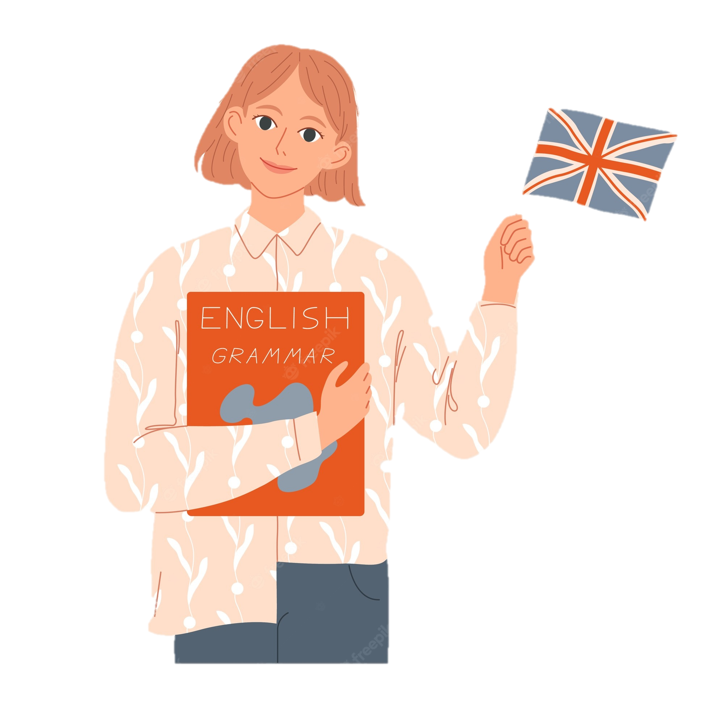

New words
“Kate is a native British.”
native
native (adj)
/ˈneɪtɪv/
bản ngữ, nguyên quán

Slide 11

New words
= wonderful, beautiful
amazing (adj)
/əˈmeɪzɪŋ/
tuyệt vời

Slide 12
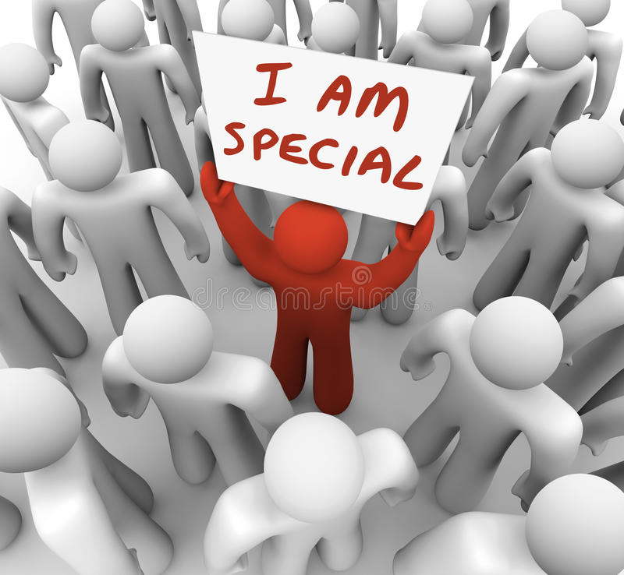
New words
= rare, not many
unique (adj)
/juˈniːk/
độc nhất

Slide 13

New words
local (adj)
= belonging to a place
/ˈləʊkl/
thuộc về địa phương

Slide 14
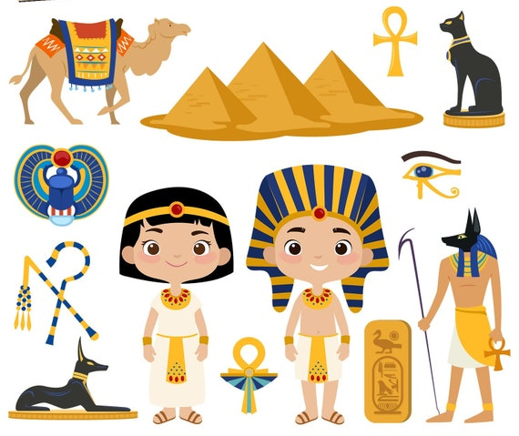
New words
ancient (adj)
/ˈeɪnʃənt/
cổ, xưa

Slide 15
New words
New words | Pronunciation | Meaning
native (adj) | /ˈneɪtɪv/ | bản ngữ, nguyên quán
amazing (adj) | /əˈmeɪzɪŋ/ | tuyệt vời
unique (adj) | /juˈniːk/ | độc nhất
local (adj) | /ˈləʊkl/ | thuộc về địa phương
ancient (adj) | /ˈeɪnʃənt/ | cổ, xưa

Slide 16
Ex 2. (P.126) Use the words in the box to complete the sentences.
native
amazing
unique
local
ancient
1. From the top of the mountain, we had a(n) _______ view of the valley below. 2. Scotland is famous for its long history and _______ castles. 3. The long fences around the sheep farms in Australia are _______. You can’t find them anywhere else in the world. 4. When you visit a new place, talk to the _______ people. 5. Kangaroos are _______ to Australia. It is their home.

Slide 17
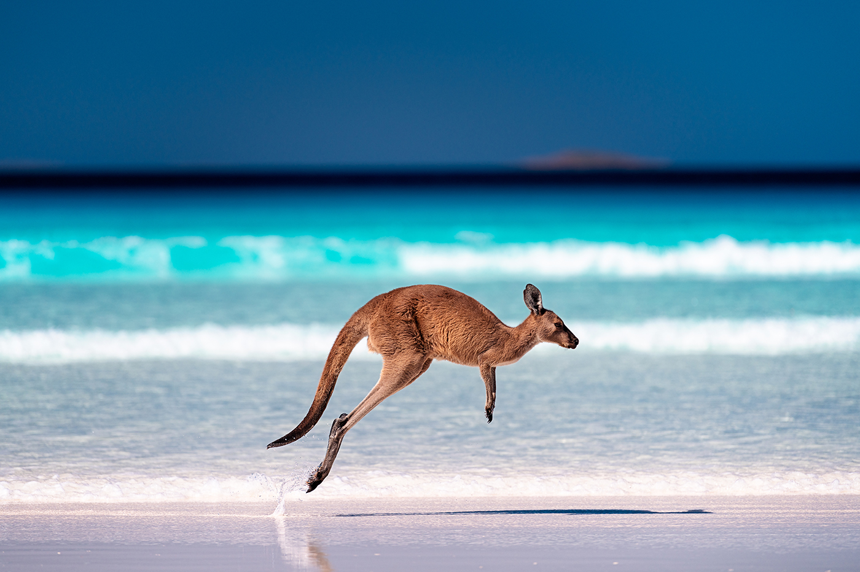
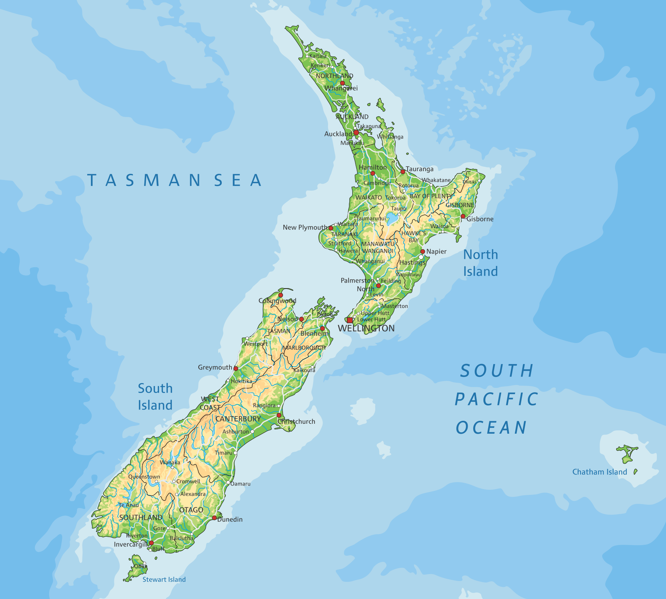
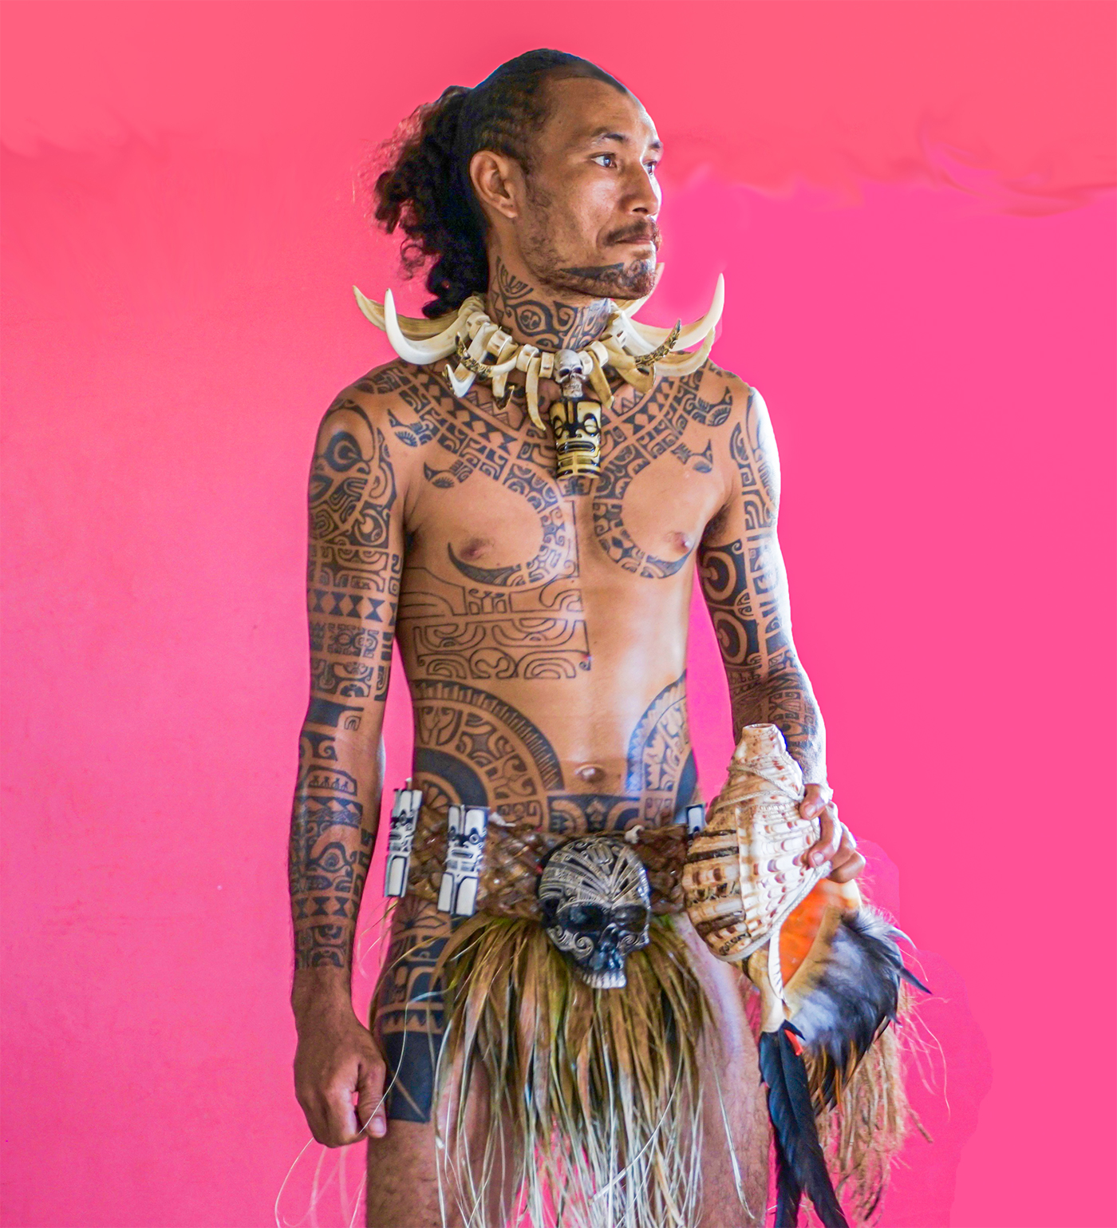
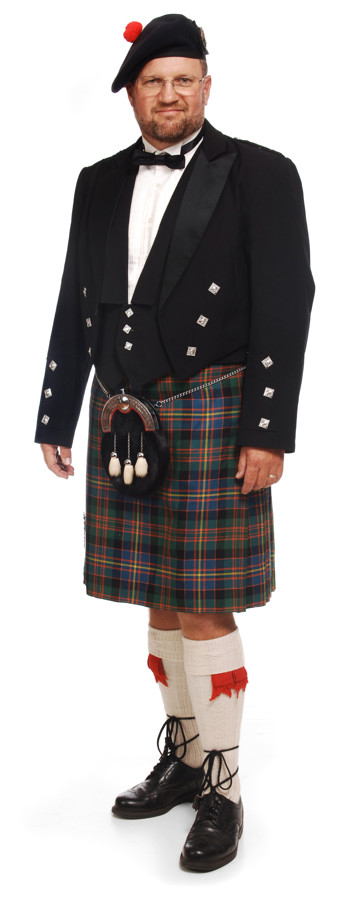
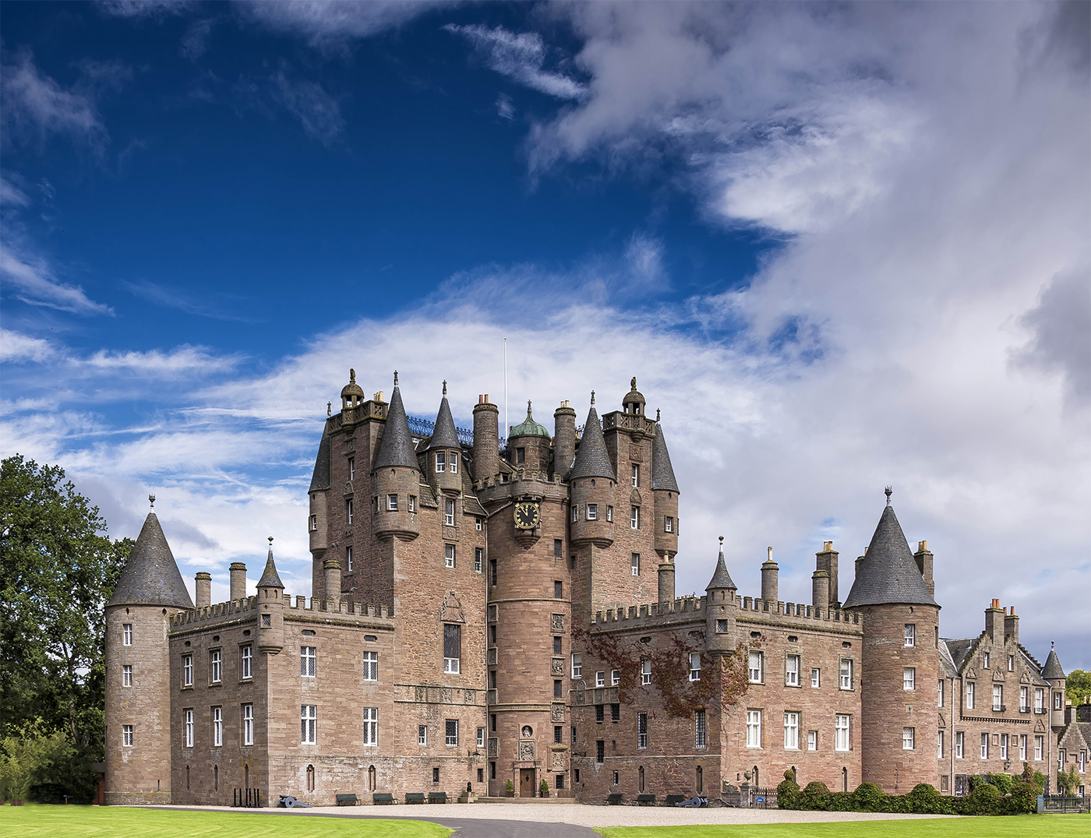
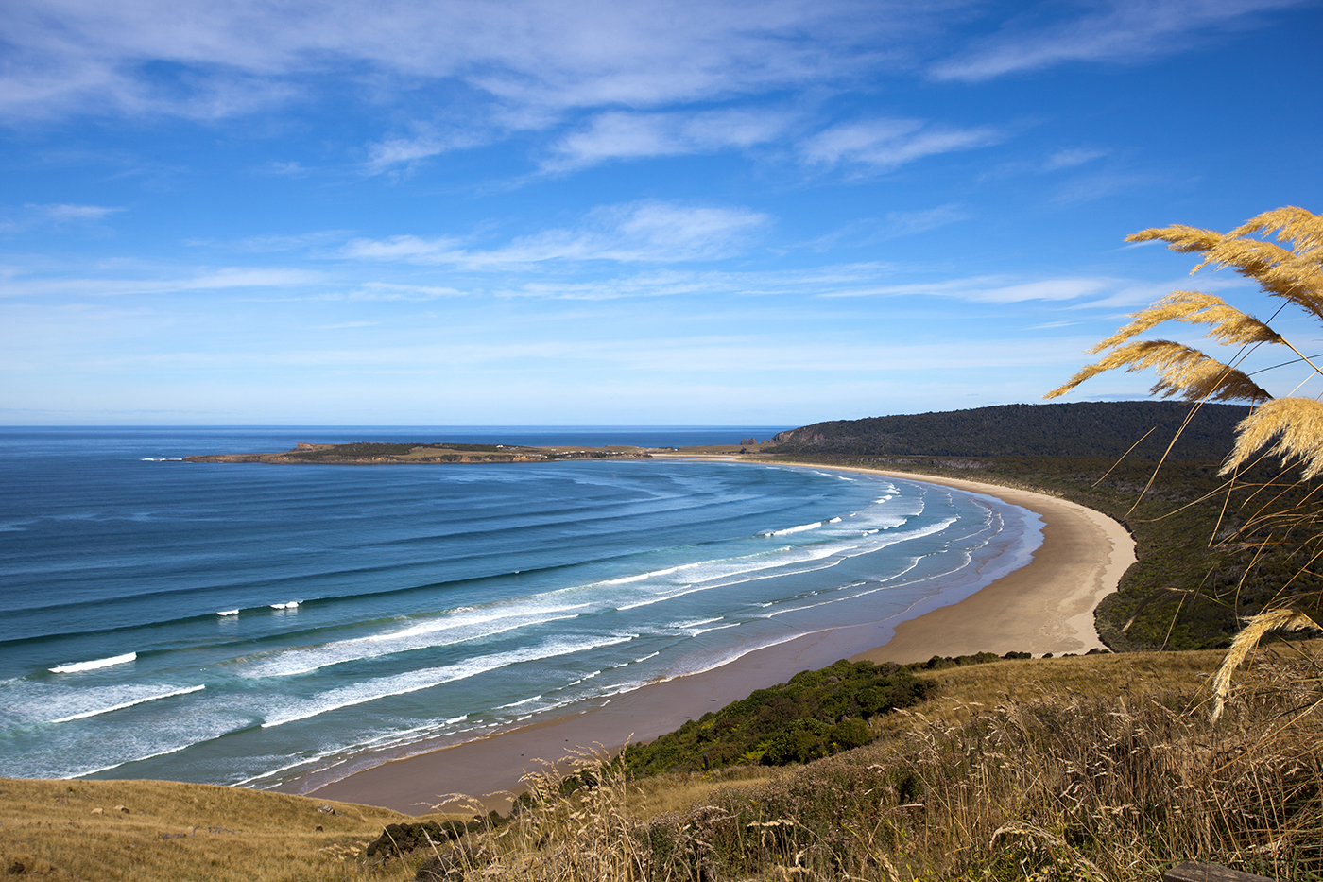
Ex 1. (P.126) Write the words or phrases under the correct pictures.

Slide 18
Ex 1. (P.126) Write the words or phrases under the correct pictures.
kangaroo

Slide 19
Ex 1. (P.126) Write the words or phrases under the correct pictures.
island country

Slide 20
Ex 1. (P.126) Write the words or phrases under the correct pictures.
tattoo (n)

Slide 21
Ex 1. (P.126) Write the words or phrases under the correct pictures.
Scottish kilt

Slide 22
Ex 1. (P.126) Write the words or phrases under the correct pictures.
castle

Slide 23
Ex 1. (P.126) Write the words or phrases under the correct pictures.
coastline (n)

Slide 24
Ex 2. (P.126) Work in pairs. Discuss and write the word or phrase in the box next to its explanation.
symbol
boat ride
capital
tower
1. a tall narrow building with a small top
2. an object representing a place
3. the most important city of a country
4. a tour on a river
tower
……………………………………
symbol
……………………………………
capital
……………………………………
boat ride
……………………………………

Slide 25
02
PRONUNCIATION

Slide 26
Say out these questions.
- Can you speak English?
- What is the capital of Scotland?
Which one do you rise your voice? Which one do you fall your voice?

Slide 27
Rising and falling intonation for questions

Slide 28

Watch and note!

Slide 29


NOTE!
Can you speak English?
rising intonation
YES/NO QUESTIONS
What is the capital of Scotland?
falling intonation
WH - QUESTIONS

Slide 30


Ex 4. Listen and repeat, paying attention to the intonation of the following questions.
1. Can you speak English? 2. Is Australia an island? 3. Will you visit Washington next year? 4. What is the capital of Scotland? 5. How big is Canada?

Slide 31
Ex 5. Listen to the sentences and pay attention to the underlined parts. Tick the appropriate sounds. Practise the sentences.
1. Where is Canada? 2. Could you show me Singapore on this map? 3. How many states are there in the USA? 4. Is English an official language in Malaysia? 5. Do you know much about New Zealand?

Slide 32
RECAP
Question 1
Question 2
What is the traditional costume of Scottish men?
A. shirt B. tattoo C. kilt
What do you know about Australia?
A. Rising intonation
B. Falling intonation

Slide 33
Thanks!
Do you have any questions?

