Slide 1
Objectives
Knowledge
Core competence
Personal qualities
By the end of this lesson, Ss will be able to gain:
An overview and lexical items about the topic “English-speaking countries”
Develop communication skills and cultural awareness
- Self-study skills
- Raise students’ awareness of the need to learn English.

Slide 2

Warm-up: Hidden countries
Notes:
Gv bấm vào các ô để mở ảnh ra dần dần

Slide 3
HIDDEN COUNTRIES
5 rounds - 5 pictures
Work in 4 teams and choose the tile to open a part of the picture
Guess the name of the country
The fastest one to have the correct answer receives 10 points for his teams.

Slide 4

AUSTRALIA

Slide 5

CANADA

Slide 6

The USA

Slide 7
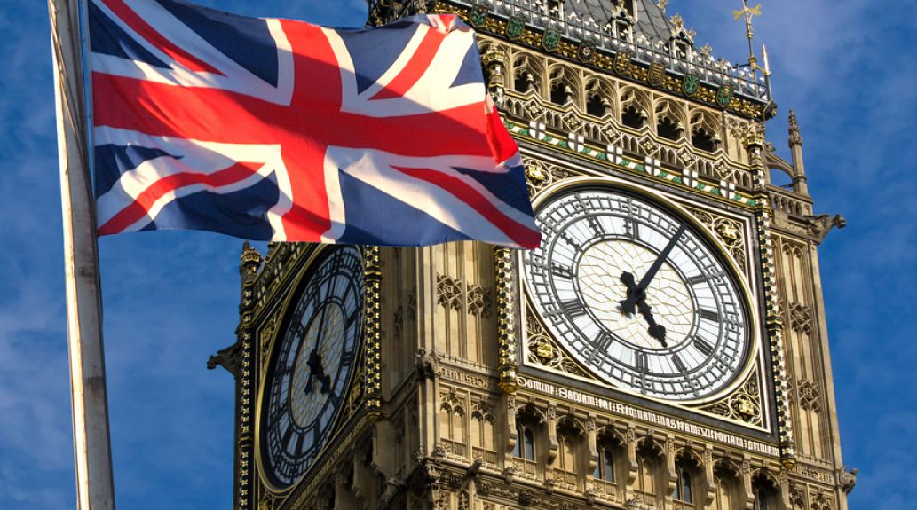
The UK

Slide 8
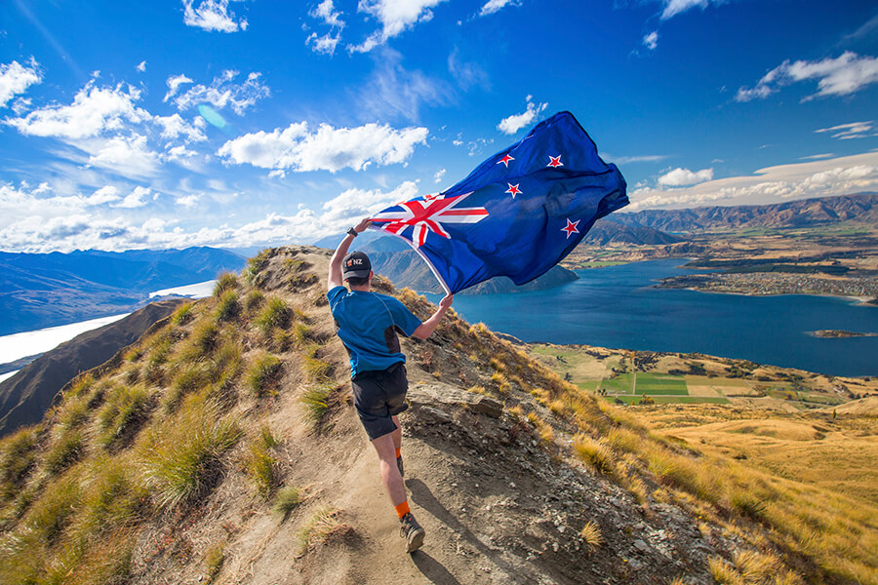
NEW ZEALAND
Notes:
What do those countries have in common? They are English-speaking countries

Slide 9

Unit 12: English-speaking countries
Lesson 1: Getting started

Slide 10
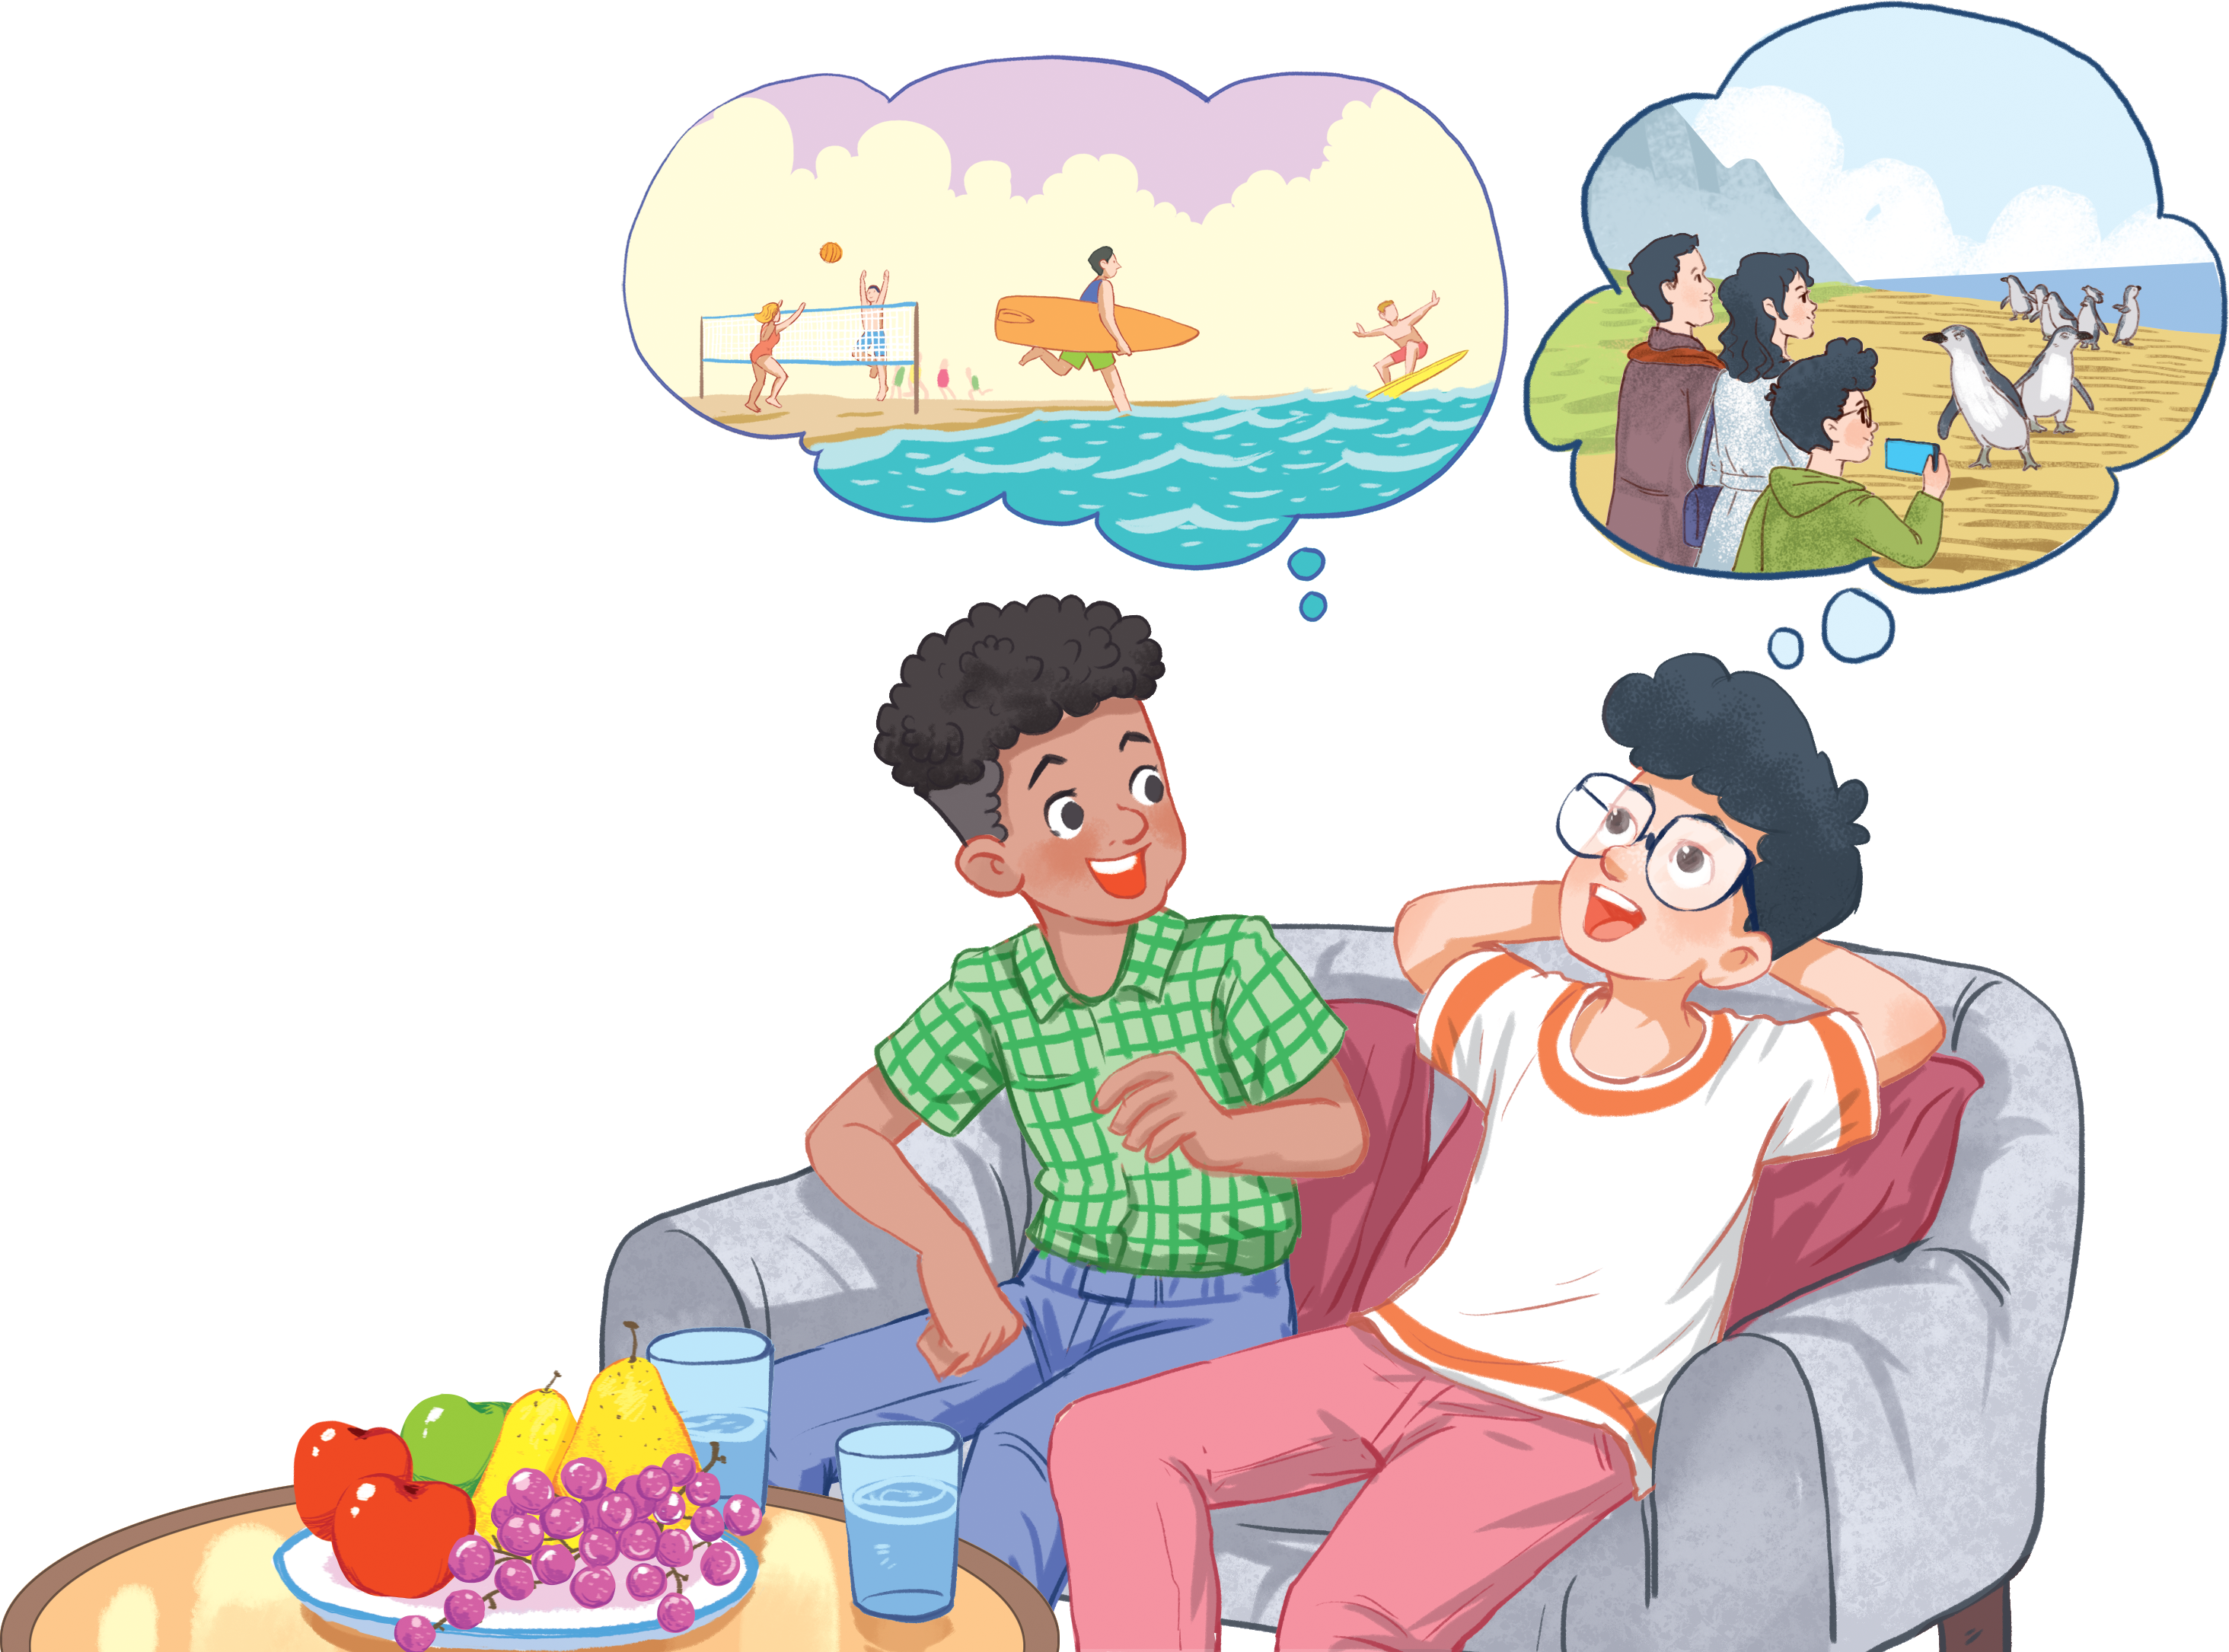
Look at the picture and answer the questions
1. Who are they?
2. What did Phong do?
He went surfing and penguin watching.
3. What might they be talking about?
They might be talking about Phong’s holiday
Phong
Mark

Slide 11


1. Listen and read (p. 124)
Mark: How was your holiday in Australia, Phong?
Phong: It was fantastic! I got to use my English in real life: asking for directions, reading maps, talking to local people, ...
Mark: Oh... Your English is much better.
Phong: Thanks.
Mark: Did you travel a lot?
Phong: Just around Melbourne, the city with four seasons in a day.
Mark: Wow... I didn’t know that. How was it?
Phong: It was great! We took a tour to Phillip Island.
Mark: What did you see?
Phong: We went penguin watching.
Mark: It sounds pretty exciting.
Phong: It was. Australia has amazing landscapes.
Mark: Yes, and Australians love outdoor activities.
Phong: Right. There were plenty of people enjoying the parks and beaches.
Mark: I’m glad that you had a wonderful time there.
Phong: Thanks, Mark.

Slide 12

2. What are Phong and Mark talking about? (p. 125)
Phong’s holiday in Australia.
English-speaking countries.
The tour to Phillip Island
Mark: How was your holiday in Australia, Phong?
Notes:
Guess – evidence - answer

Slide 13
3. Read again and tick the information you can find in the conversation. (p. 125)
1. In Australia, Phong used English in real life.
2. Phong visited some museums.
3. Phillip Island is far from Melbourne.
4. Australia is beautiful.
5. Australians love outdoor activities.
Phong: It was fantastic! I got to use my English in real life: asking for directions, reading maps, talking to local people, ...
Phong: It was. Australia has amazing landscapes.
Mark: Yes, and Australians love outdoor activities.

Slide 14
4. Complete the sentences with the words and phrases from the box. (p. 125)
Island
Sunset
Landscape
Australians
Penguin watching
landscape
1. This is a picture of the _____________ in my village.
2. - Where did you go ______________?
- On the beach.
3. Is Phu Quoc a(n) _______ ?
– Yes, it is.
4. We had dinner on the beach after_____
5. Most _____________ like outdoor sports and games.
penguin watching
island
sunset
Australians

Slide 15
Game time!
Guess the city!
Work in 4 team and guess the city through the given hints
1 correct answer = 10 points

Slide 16

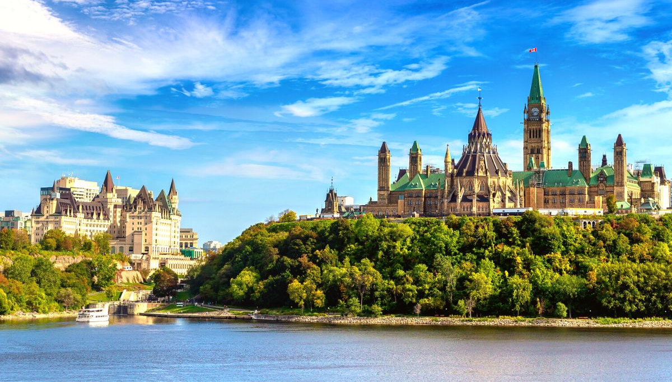
It’s Home to the World’s Largest Naturally Frozen Skating Rink
OTTAWA
Notes:
The capital of the Canada

Slide 17
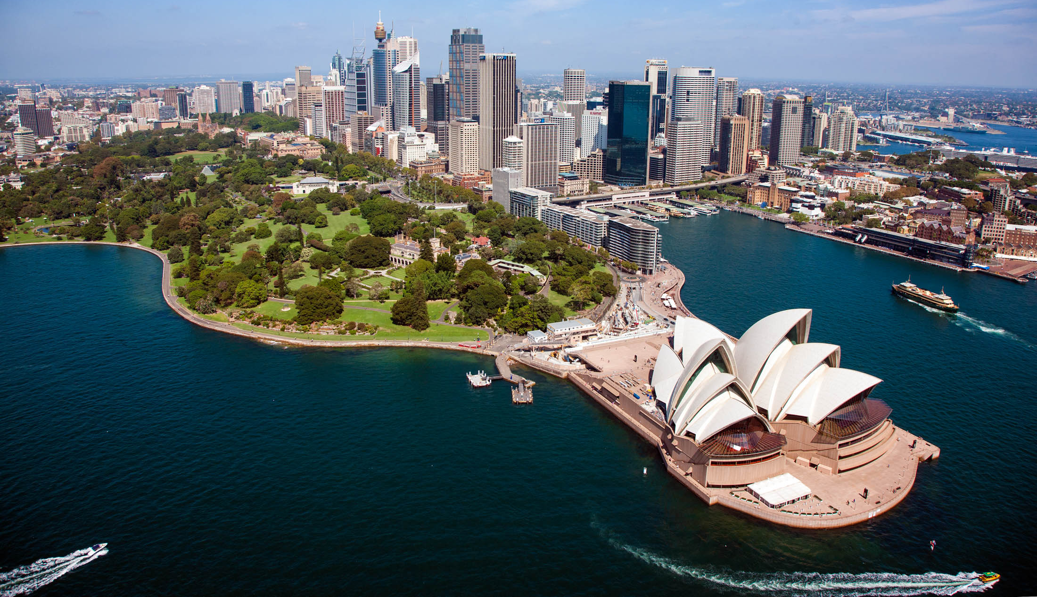
This city has OVER 100 BEACHES.
SYDNEY
Notes:
NOTE: not the capital of the Australia

Slide 18
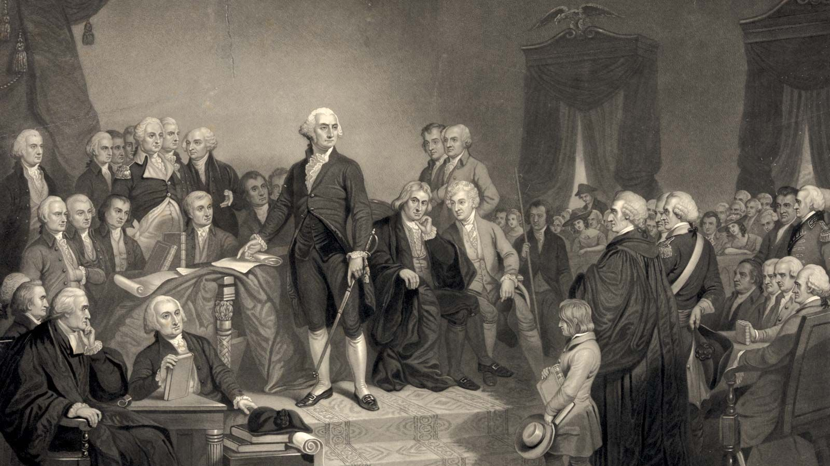
The city was named after the first president of the country
Washington D.C
Notes:
The capital of the USA

Slide 19
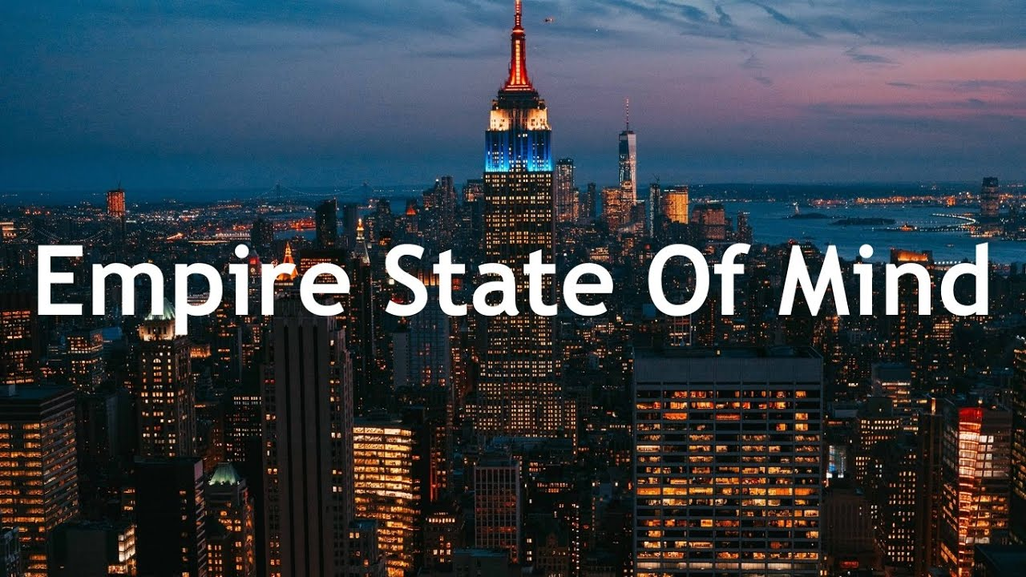
Which city did the singer mention?
NEW YORK
Notes:
The capital of the Australia

Slide 20
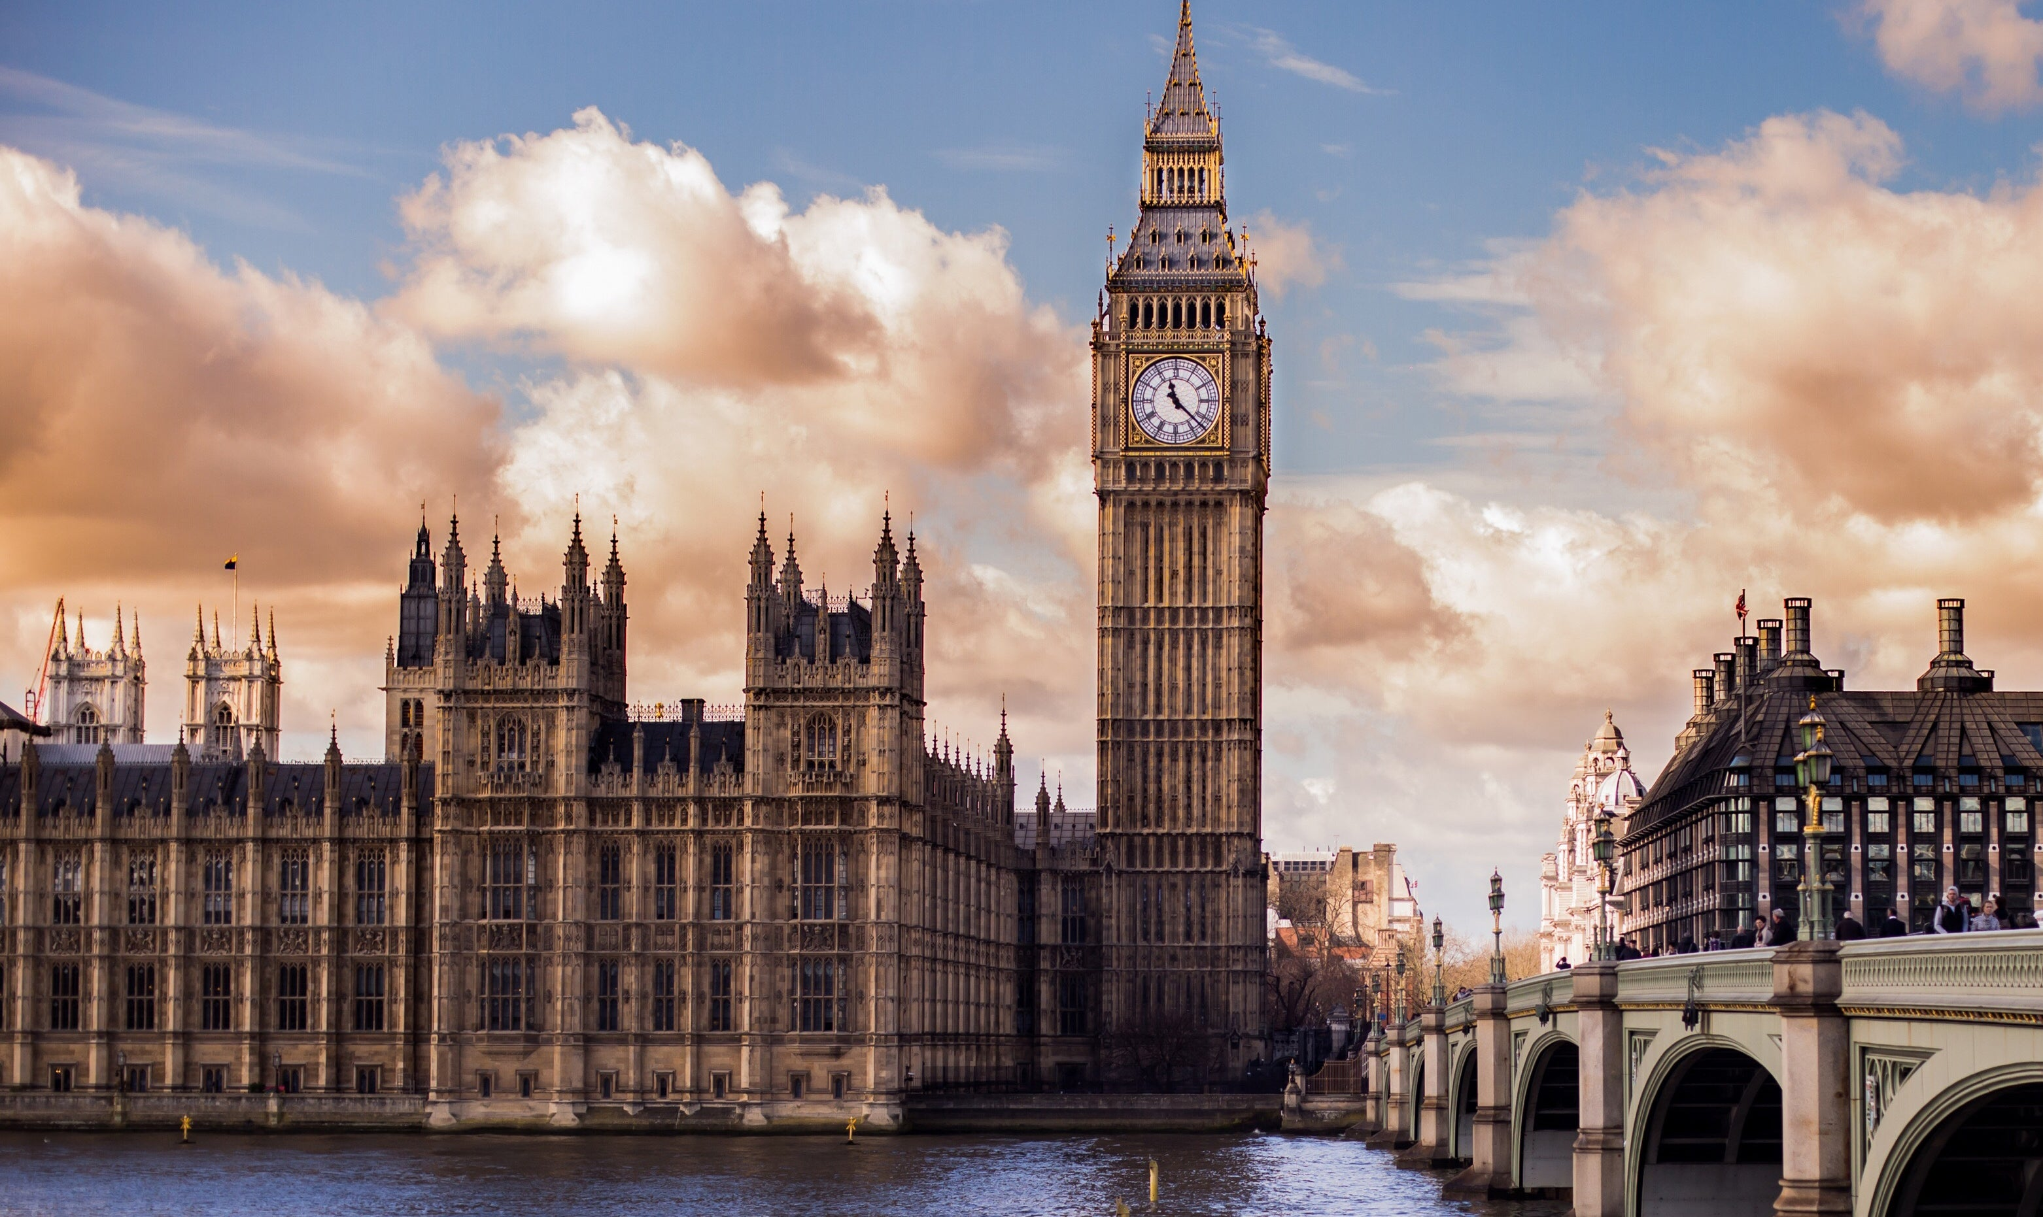
The city was named after the first president of the country
LONDON
Notes:
The capital of the USA

Slide 21



A STATE COUNTRY
SINGAPORE
Notes:
The capital of the USA

Slide 22
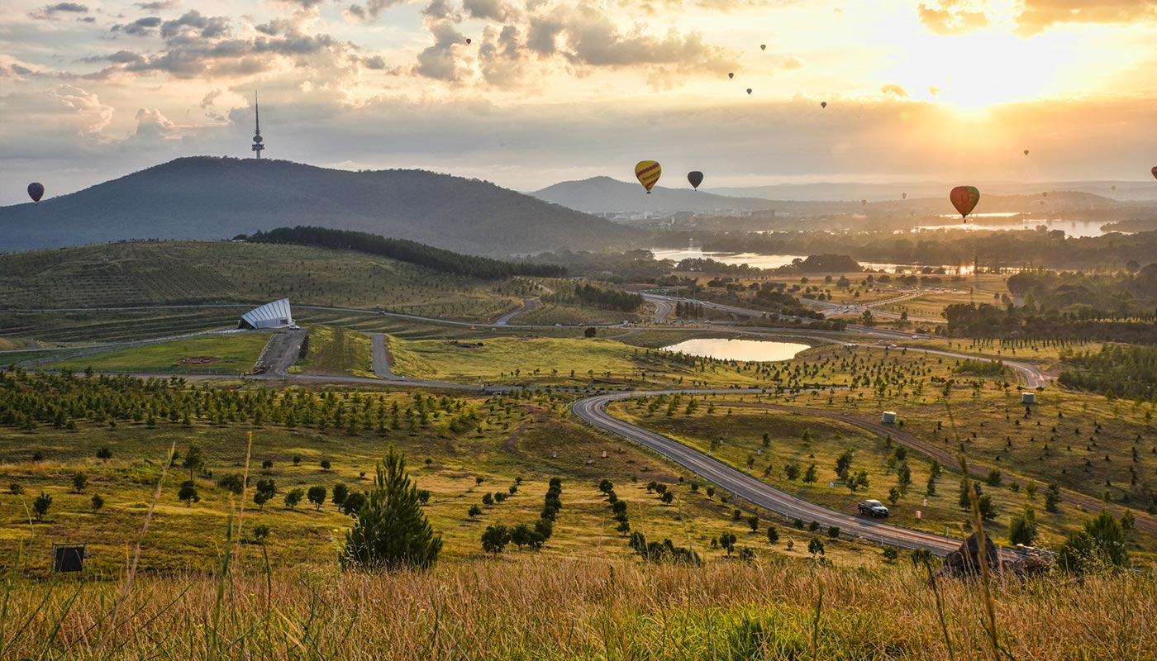
This city is the capital of Australia.
CANBERRA
Notes:
The capital of the Australia

Slide 23
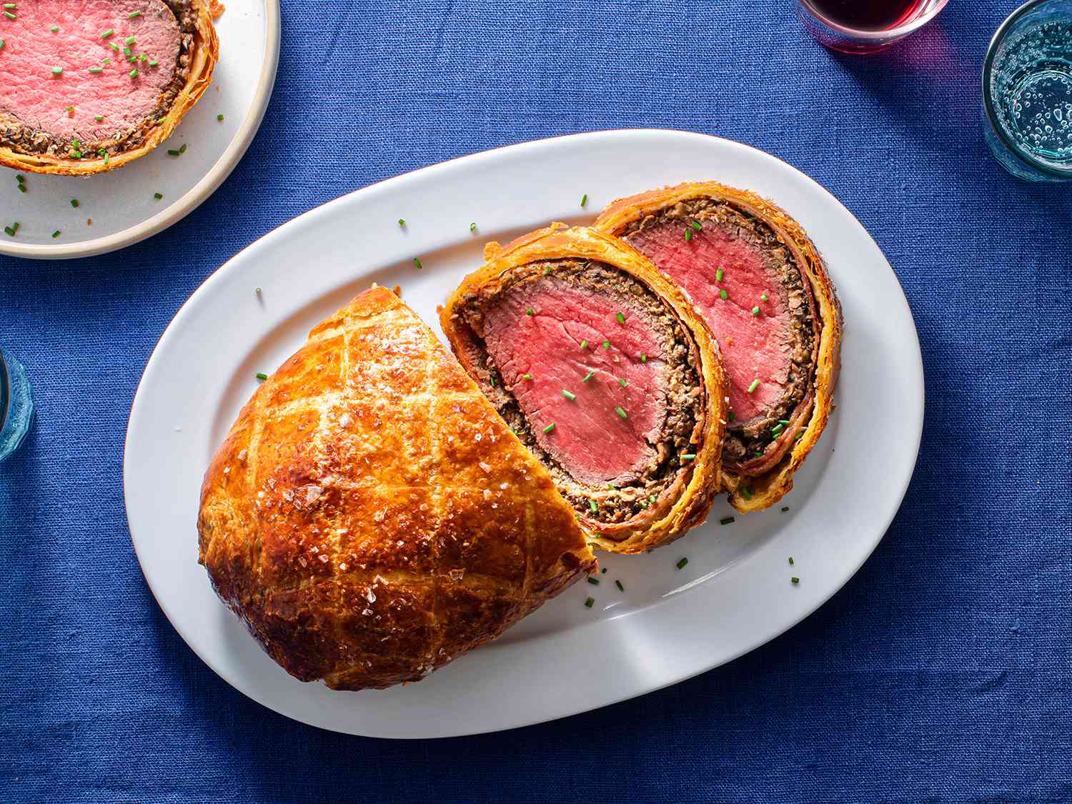
Beef Wellington but without beef
WELLINGTON
Notes:
The capital of the Australia

Slide 24
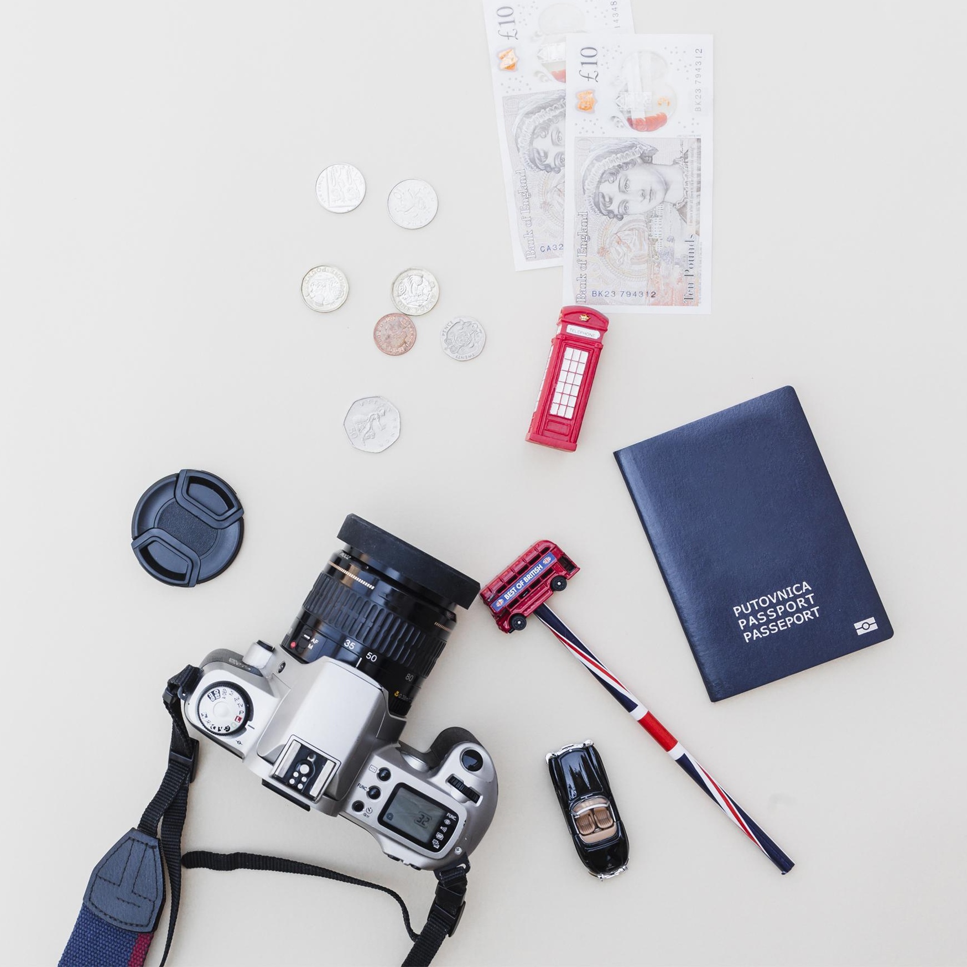
Let’s recap!
What have we learnt today?
Thanks for listening!

