Slide 1
Unit 11: Travelling in the future
Lesson 7: Looking back

Slide 2
Objective
“Review the vocabulary and grammar of Unit 2.”

Slide 3
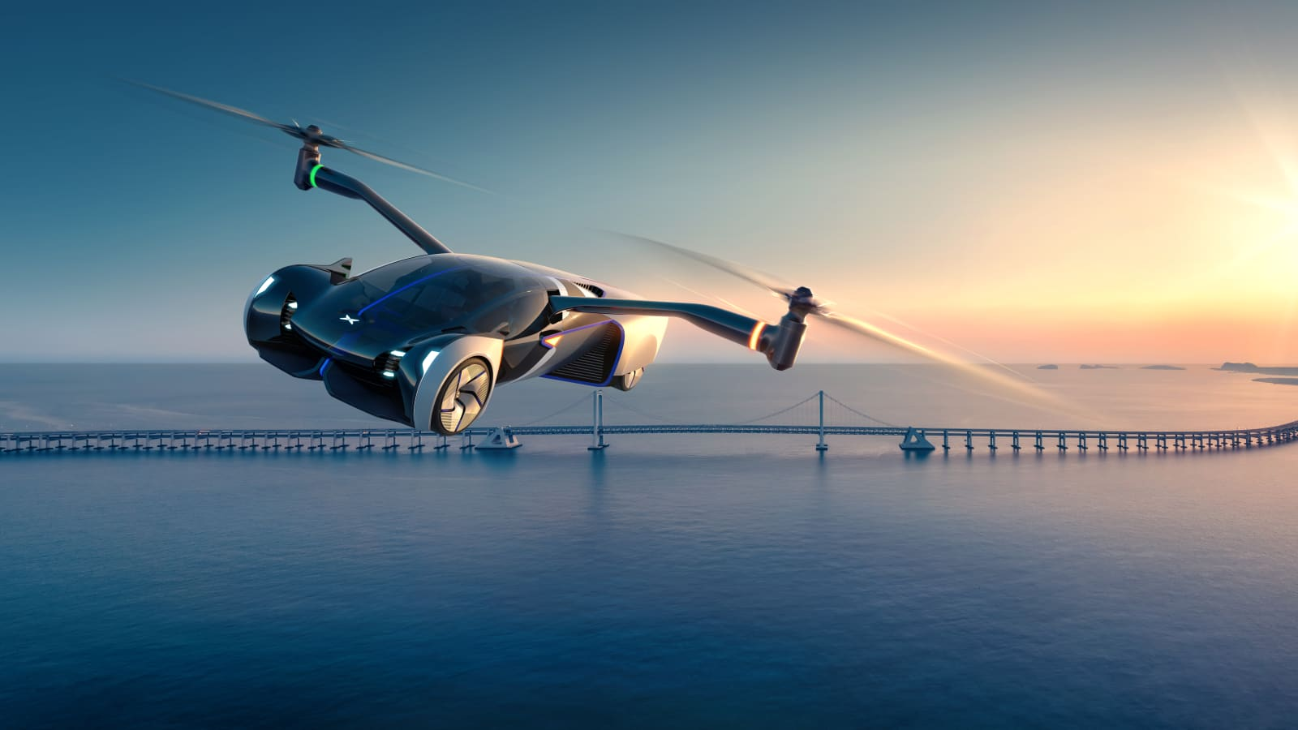
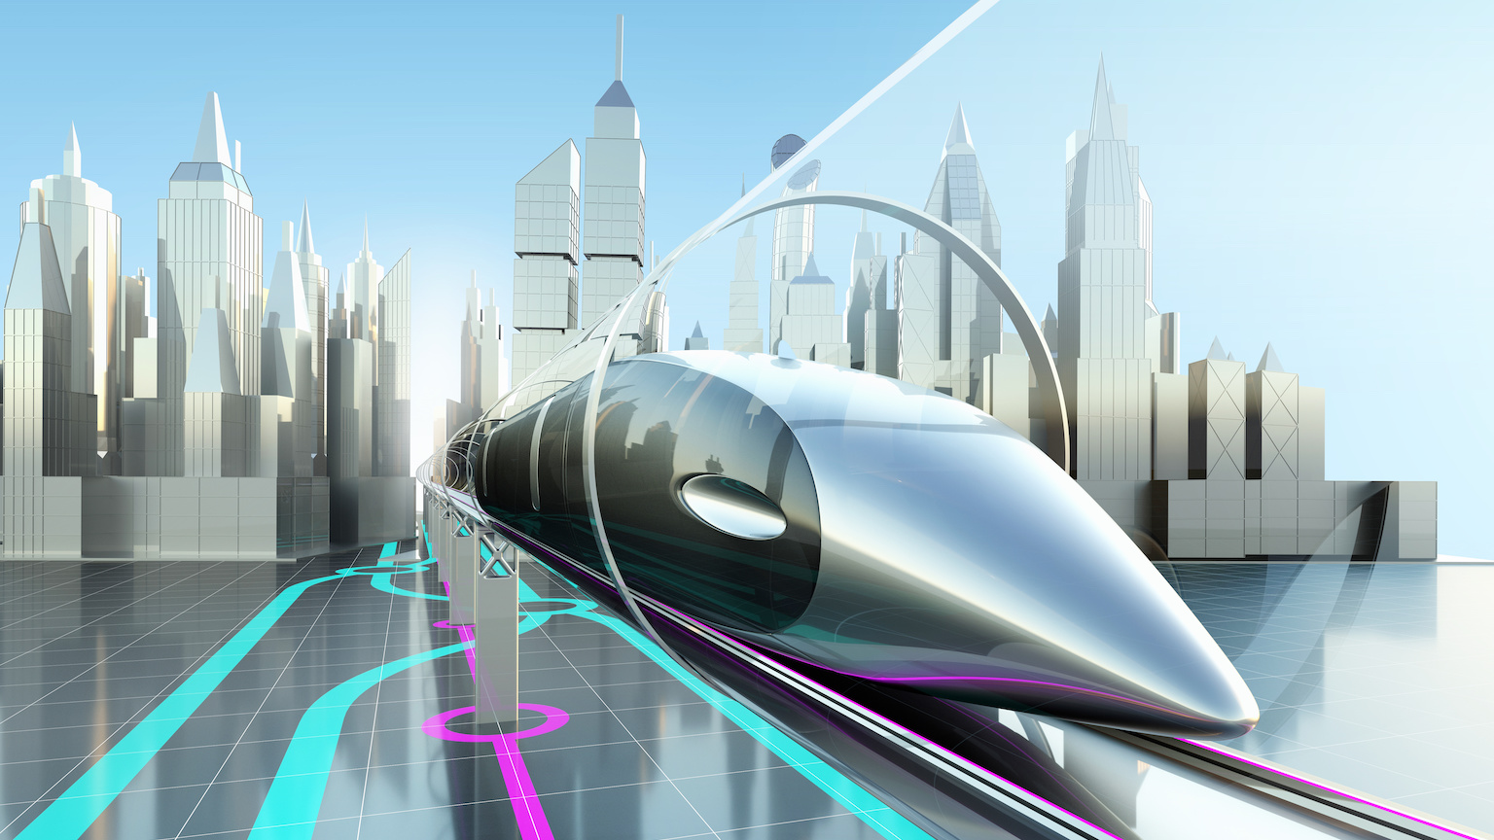
VOCABULARY
Future means of transport: flying car, bamboo-copter, hyperloop, skyTrain, soler-power ship, driverless car, bullet train, electric car

Slide 4
PRONUNCIATION
In a sentence there are stressed words and unstressed words.
- We usually stress the words that are nouns, main verbs, adjectives, adverbs, and negative auxiliaries.
Example: We don't like travelling.
- We don't usually stress the words that are prepositions, pronouns, articles, and auxiliary verbs.
Example: I will go by car.

Slide 5
GRAMMAR
We use the future simple:
- to talk about future activities.
Example:
We will buy an electric scooter soon.
- to make predictions.
Example: We will probably use electric cars because normal cars cause too much pollution.
The negative of will is won’t.
Example: In the future we won't drive normal cars any more.
Statement | S + will/shall + V-inf
Negative | S + will/shall + not + V-inf
Question | Will/Shall + S + V-inf ?

Slide 6
GRAMMAR
Possessive pronouns | Example
mine (của tôi) | That car is mine. (Chiếc xe đó là của tôi.)
ours (của chúng tôi) | That car is ours. (Chiếc xe đó là của chúng tôi.)
yours (của bạn) | That car is yours. (Chiếc xe đó là của bạn.)
his (của anh ấy) | That car is his. (Chiếc xe đó là của anh ấy.)
hers (của cô ấy) | That car is hers. (Chiếc xe đó là của cô ấy.)
theirs (của họ) | That car is theirs. (Chiếc xe đó là của họ.)
its (của nó) | I have a guinea pig, this carrot is its. (Tôi có một con chuột lang, đây là củ cà rốt của nó.)

Slide 7
01
VOCABULARY REVIEW

Slide 8
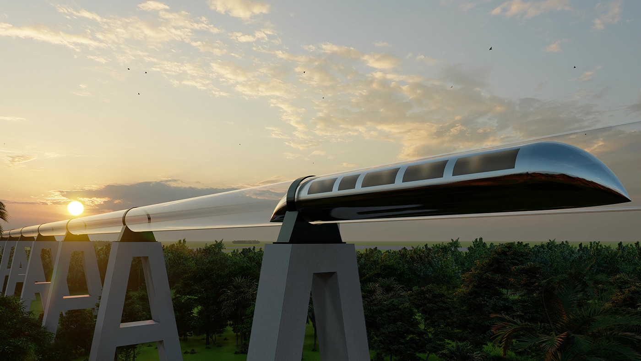
Ex 1: Write three adjectives or phrases to describe each picture.
fast, green, carrying many passengers

Slide 9
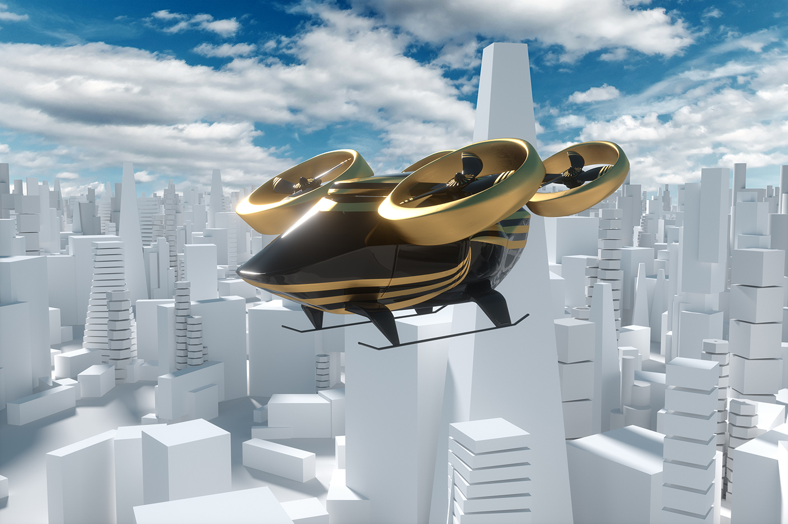
Ex 1: Write three adjectives or phrases to describe each picture.
fast, convenient, autopilot function

Slide 10
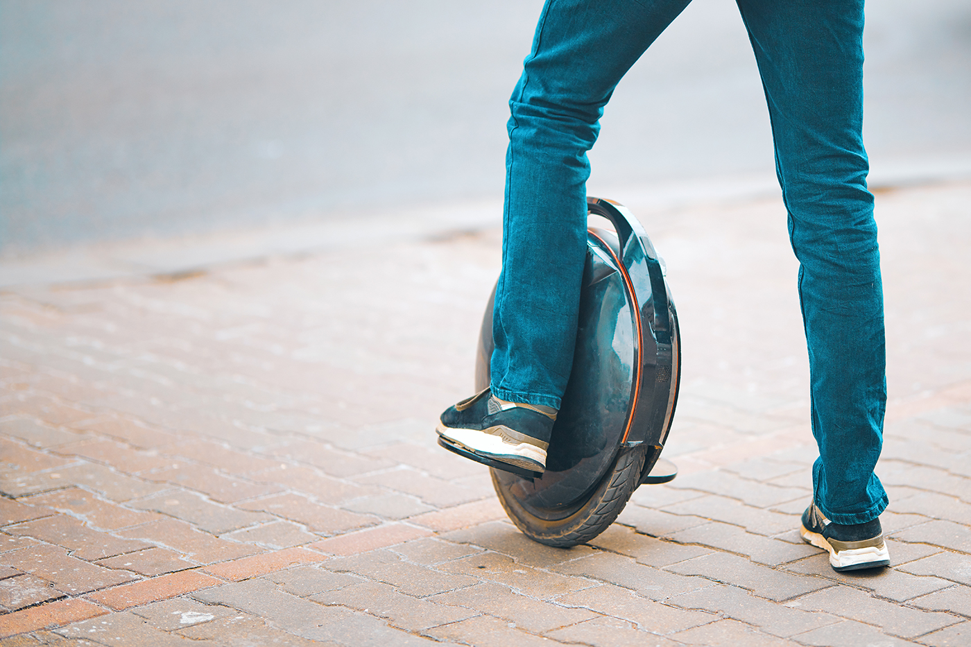
Ex 1: Write three adjectives or phrases to describe each picture.
electric, green, convenient

Slide 11
Ex 2: Complete the sentences with the words and phrases from the box.
driverless | bullet trains | runs on | bamboo-copter | eco-friendly
1. A teleporter is eco-friendly, so it does not cause pollution.
2. A solowheel runs on electricity, so it is safe for the environment.
3. A convenient way to go to school is by bamboo-copter. Just put it on and fly away.
4. You can sleep when you travel by driverless car.
5. Bullet trains are faster and greener than normal trains.
eco-friendly: thân thiện với môi trường
runs on: được chạy bằng
convenient: thuận tiện
bamboo-copter: chong chóng tre
driverless car: xe không người lái
Bullet trains: tàu cao tốc
does not cause pollution
electricity
A convenient way to go
can sleep when you travel
faster and greener

Slide 12
02
GRAMMAR REVIEW

Slide 13
Ex 3: Find one mistake in each sentence and correct it.
1. My motorbike is an electric one. Her is not.
Her → Hers
2. Her car can carry four passengers. Our can carry seven passengers.
Our → Ours
3. Their car runs on petrol. My runs on solar energy.
My → Mine
4. We go to school together. I ride my bike, and he rides its.
its → his
5. My city has a skyTran system. Does yours city have one?
yours → your
“Her”, “Our”, “My” là tính từ sở hữu, mà đầu câu phải là danh từ nên đổi thành lần lượt thành “Hers”, “Ours”, “Mine” là các danh từ sở hữu.
“its” thành “his” để nhấn mạnh rằng anh ấy lái chiếc xe của anh ấy.
“your” là tính từ bổ nghĩa cho “city” nên không được phép đổi tuỳ tiện thành danh từ sở hữu ”yours”.
Her
Our
My
its
yours

Slide 14
Ex 4: Read the passage and put the verbs in brackets in the correct future form.
In the future, we will travel much further than we do now. We will also visit new places for our holidays. Some scientists think we (1. travel) will travel to new planets. We (2. go) won't go / will not go there by spaceship, but we (3. need) will need new special means of transport. These new means of transport (4. carry) won't carry / will not carry one or two passengers, but many. Will our dream (5. come) come true soon? Let’s wait and see.
The simple future tense:
(+): S + will/shall + V-inf
(-): S + will/shall + not + V-inf
(?): Will/Shall + S + V-inf ?

Slide 15
Thanks!
Does anyone have any questions?

