Slide 1
WELCOME TO OUR CLASS

Slide 2

What can you see in the video?

Slide 3
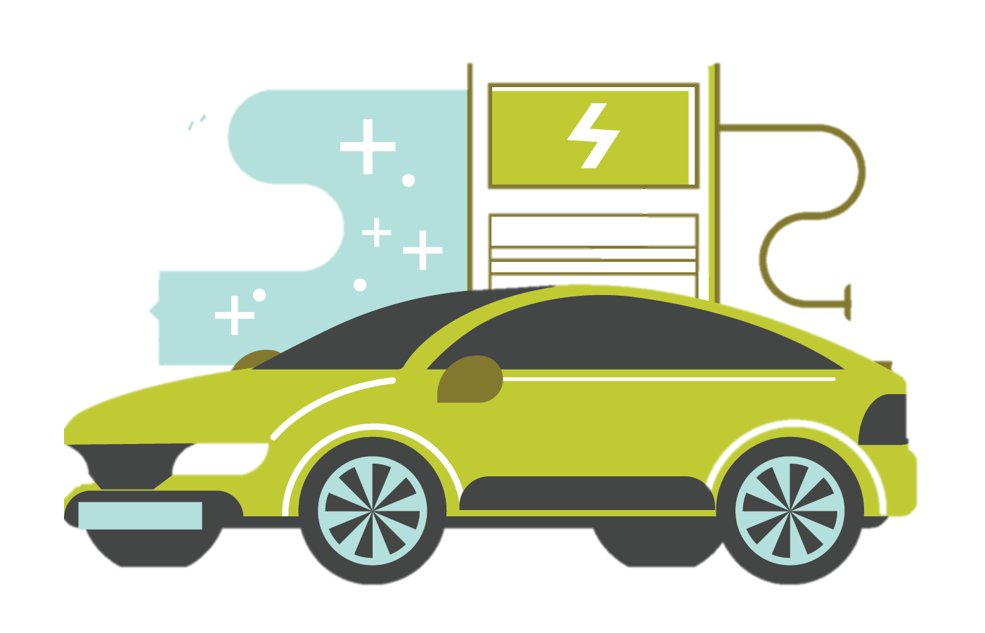
UNIT 11:
TRAVELLING IN THE FUTURE
Monday, April 10th, 2022
LESSON 5: SKILLS 1

Slide 4
OBJECTIVES
01
02
READING
Read for general and specific information about a future car
SPEAKING
Talk about why a means of transport will/ won’t be popular

Slide 5
01
READING

Slide 6

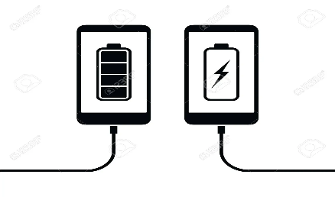
VOCABULARY
charge (v)
/tʃɑːdʒ/
sạc pin

Slide 7

VOCABULARY
passenger (n)
/ˈpæs.ən.dʒər/
hành khách

Slide 8

VOCABULARY
economical (adj)
/ˌiː.kəˈnɒm.ɪ.kəl/
tiết kiệm nhiên liệu

Slide 9
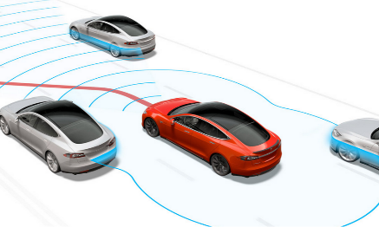
VOCABULARY
autopilot (adj, n)
/ˈɔː.təʊˌpaɪ.lət/
lái tự động

Slide 10

VOCABULARY
function (n)
/ˈfʌŋk.ʃən/
chức năng

Slide 11
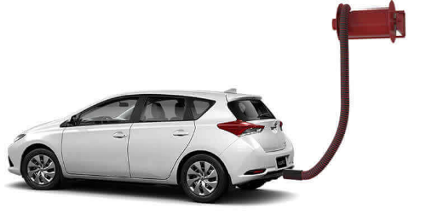
VOCABULARY
run on (v)
/rʌn ɒn/
chạy bằng
(nhiên liệu nào)

Slide 12
VOCABULARY
- charge (v) | /tʃɑːdʒ/ | sạc pin
- passenger (n) | /ˈpæs.ən.dʒər/ | hành khách
- economical (a) | /ˌiː.kəˈnɒm.ɪ.kəl/ | tiết kiệm nhiên liệu
- autopilot (adj, n) | /ˈɔː.təʊˌpaɪ.lət/ | lái tự động
- function (n) | /ˈfʌŋk.ʃən/ | chức năng
- run on (v) | /rʌn ɒn/ | chạy bằng (nhiên liệu nào)

Slide 13
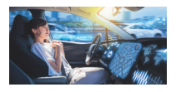
1. Look at the picture and tick the words or phrases to describe it.

x

convenient
autopilot
dangerous

safe

comfortable
x
need to drive

modern
x
old

automatic
Can you add more?

Slide 14
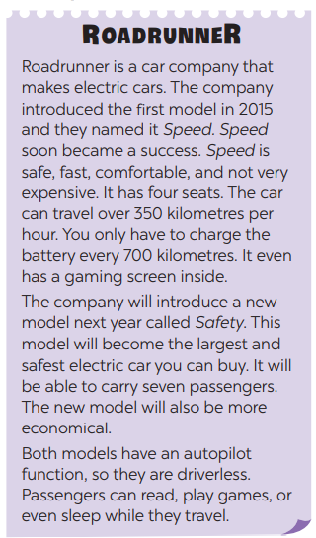
2. Read the passage and answer the question.
What is its main idea?
A. Roadrunner is a success.
B. Roadrunner is a car company.
C. Roadrunner’s cars have an autopilot function.

Slide 15
2. Read the passage again and complete the fact file with no more than TWO words or a number.
Fact File
Name of the company | Roadrunner
Speed was introduced in | (1) ______________
Safety will be the | (2) _________ and (3) ________ electric car
Both models have | a gaming screen and an (4) __________
Both models run on | (5) _______________
Passengers can | read, sleep, play games

Slide 16




LUCKY WHEEL
30
20
1
2
3
40
10
50
80
4
5
6
60
70
PLAY
Notes:
CLICK PLAY ĐỂ QUAY, CLICK VÒNG QUAY ĐỂ DỪNG QUAY.
CLICK TRÁI TIM VÀNG ĐỂ CHUYỂN SLIDE XEM CÂU TL.

Slide 17
Check your answer
Speed was introduced in | (1) ______________
2015
The company introduced the first model in 2015 and they named it Speed.
BACK

Slide 18
Check your answer
Safety will be the | (2) _________ and (3) ________ electric car
largest
safest
The company will introduce a new model next year called Safety. This model will become the largest and safest electric car you can buy.
BACK

Slide 19
Check your answer
Both models have | a gaming screen and an (4) __________
autopilot function
Both models have an autopilot function, so they are driverless.
BACK

Slide 20
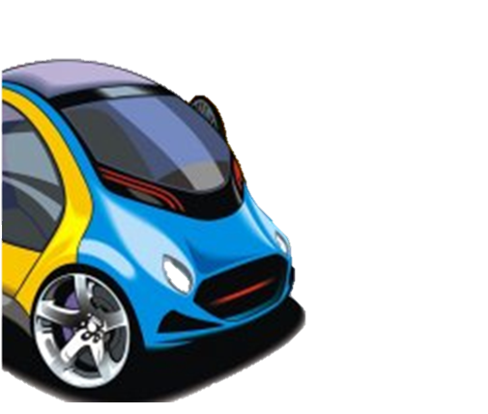
Check your answer
Both models run on | (5) _______________
electricity
Roadrunner is a car company that makes electric cars.
BACK

Slide 21

BACK

Slide 22
BACK

Slide 23

Look at the answers again.
Fact File
Name of the company | Roadrunner
Speed was introduced in | (1) 2015
Safety will be the | (2) largest and (3) safest electric car
Both models have | a gaming screen and an (4) autopilot function
Both models run on | (5) electricity
Passengers can | read, sleep, play games

Slide 24
02
SPEAKING

Slide 25


4. Look at the fact file then ask and answer questions.
Fact File
Name of the company | Roadrunner
Speed was introduced in | (1) 2015
Safety will be the | (2) largest and (3) safest electric car
Both models have | a gaming screen and an (4) autopilot function
Both models run on | (5) electricity
Passengers can | read, sleep, play games
What is the name of the company?
Roadrunner.
When was Speed introduced?
In 2015.
What will Safety be?
It will be the ……
What do both models have?
They have….
What do both models run on?
…..
What can passengers do?
They can …..

Slide 26



5. Discuss why Roadrunner’s cars will or won’t become popular in the near future. Report your reasons to the class.
- We think Roadrunner’s car will become popular in the near future because they are eco-friendly.
- We think Roadrunner’s car won’t become popular in the near future because they might be dependent on battery.
- We think Roadrunner’s car will become popular in the near future because they allow passengers read, sleep, play games.

Slide 27
RECAP
READING
Read for general and specific information about a future car
SPEAKING
Talk about why a means of transport will/ won’t be popular

Slide 28
THANK YOU!
Please keep this slide for attribution

