Slide 1











WHAT'S BEHIND
THE BINOCULARS?
PLAY

Slide 2

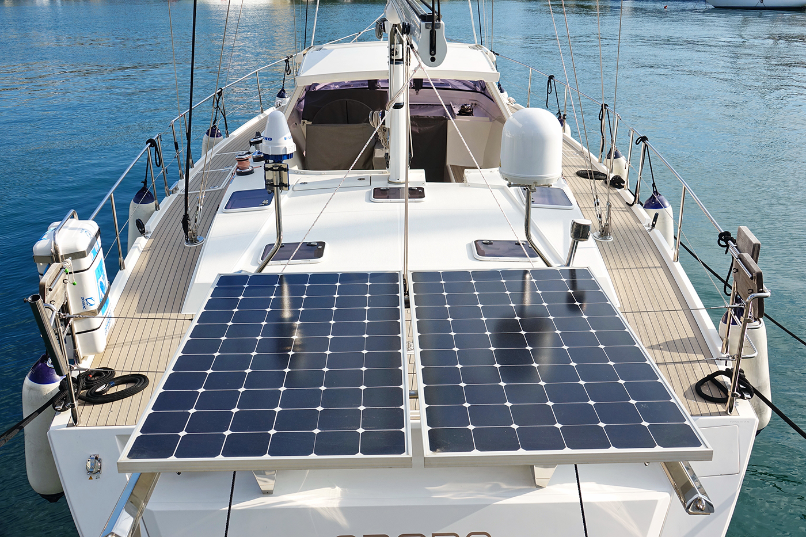
Can you guess what it is?
Photo courtesy of Lisa L Wiedmeier (@flickr.com) - granted under creative commons licence - attribution
It’s a solar-powered ship.

Slide 3
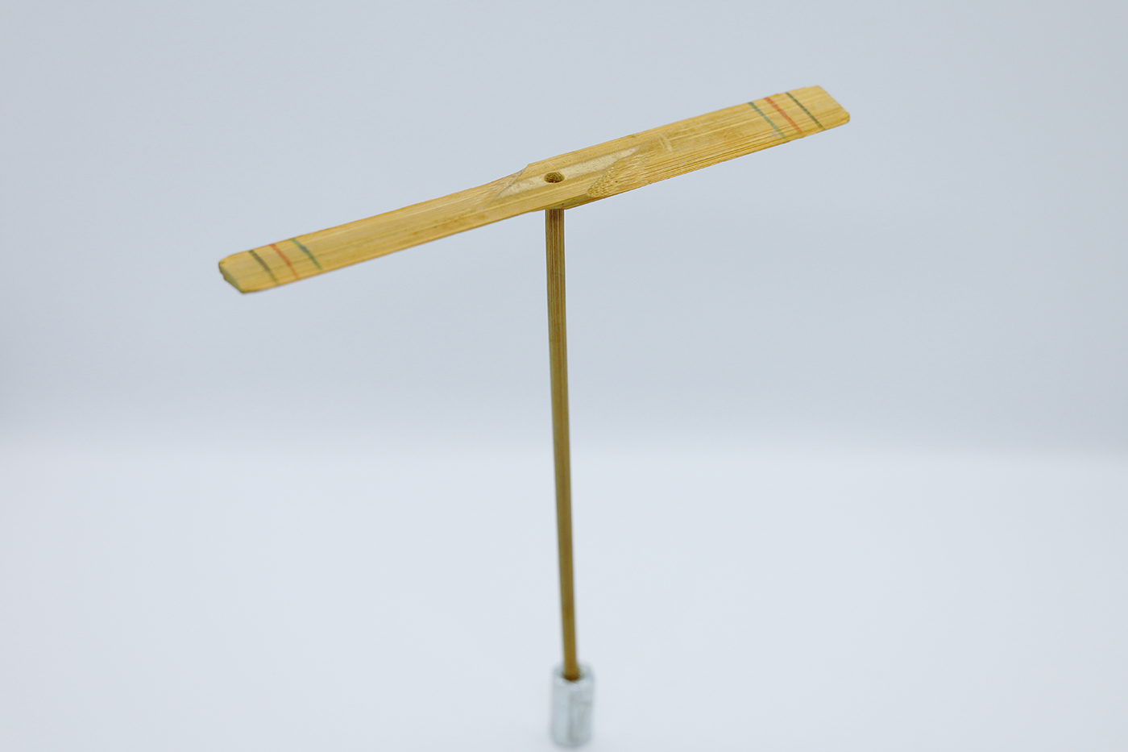
Can you guess what it is?
It’s a bamboo-copter.

Slide 4
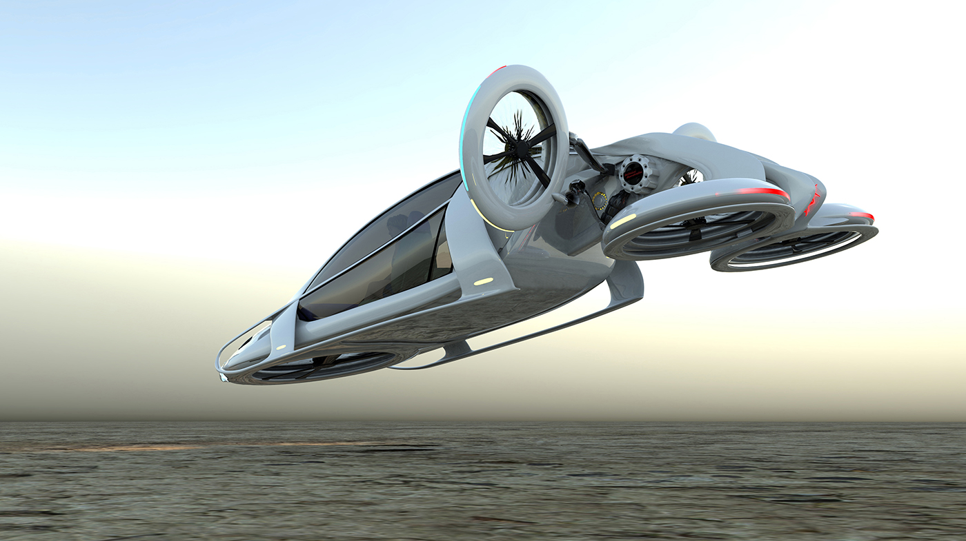
Can you guess what it is?
It’s a flying car.

Slide 5
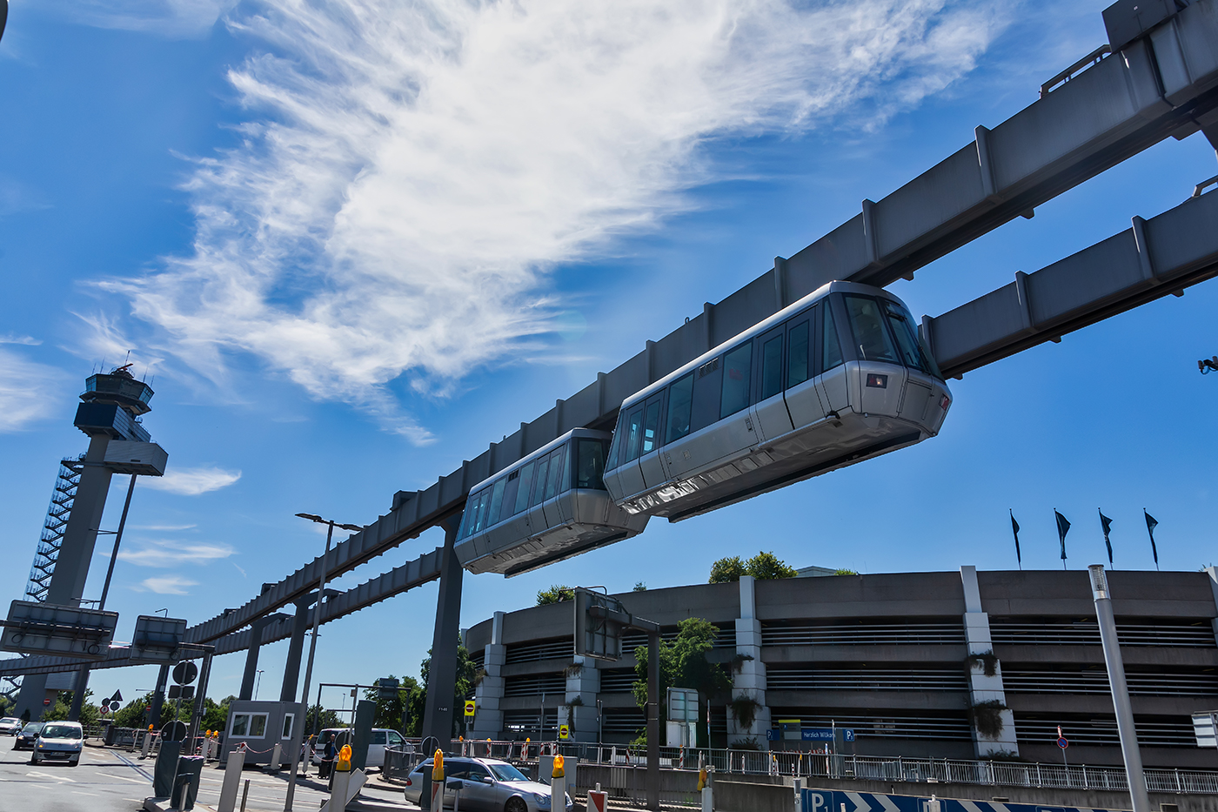
Can you guess what it is?
It’s a skyTran.

Slide 6
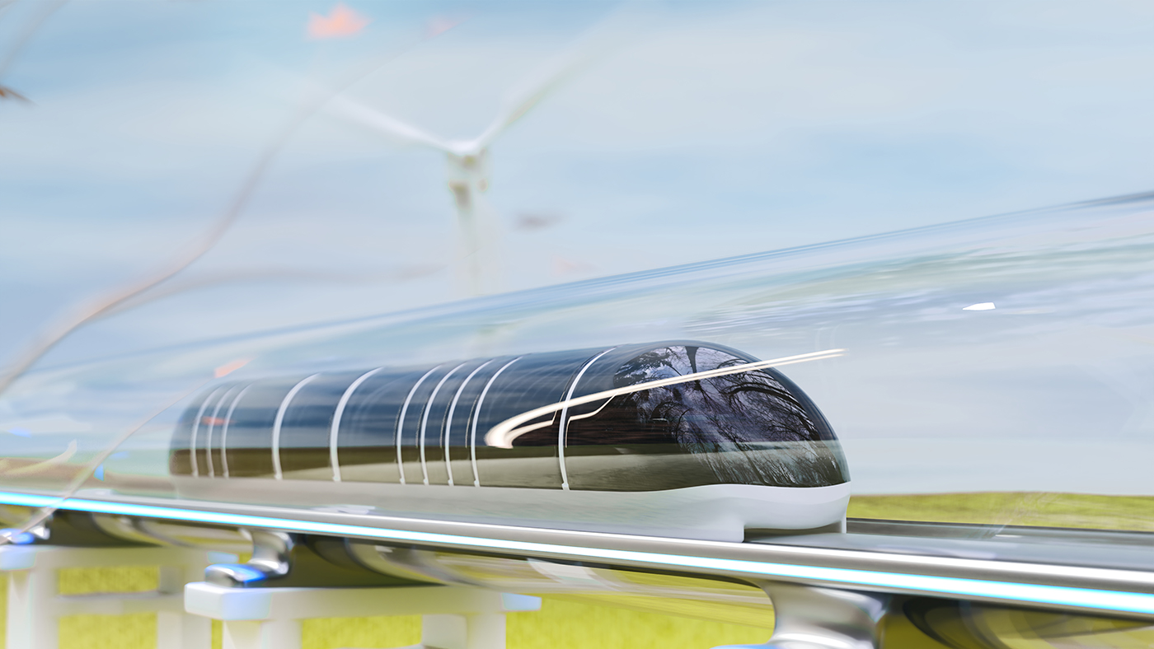
Can you guess what it is?
Photo courtesy of Lisa L Wiedmeier (@flickr.com) - granted under creative commons licence - attribution
It’s a hyperloop.

Slide 7





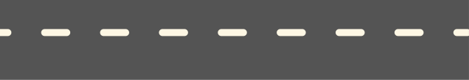
UNIT 11
Travelling
in the future
Lesson 4: Communication

Slide 8




After the lesson,
Ss will be able to:
learn how to how to
make predictions
practice using some grammar points and vocabulary related to the topic.

Slide 9


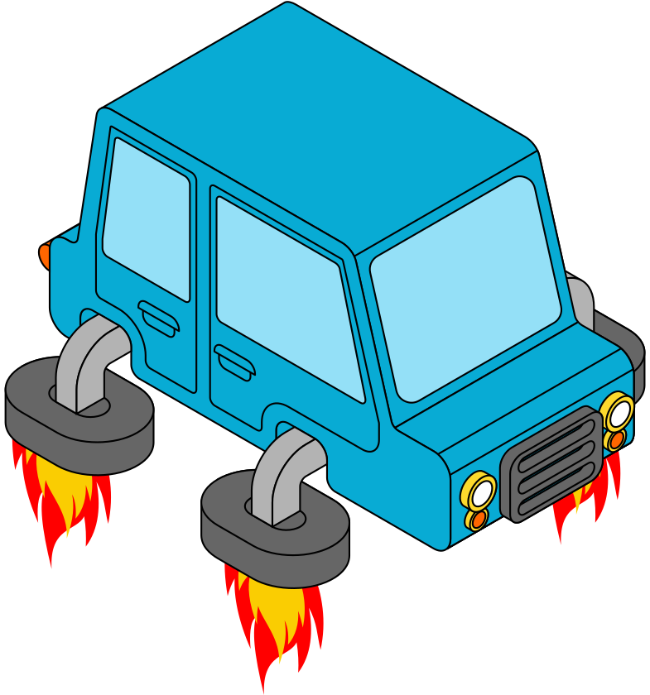
Exercise 1. (pg 119) Listen and read the conversation.
Pay attention to the highlighted sentences.
Ann: Do you think we will travel by flying car in the future?
Tom: We certainly will.
Ann: Will it be able to fly across oceans?
Tom: It probably won't

Slide 10




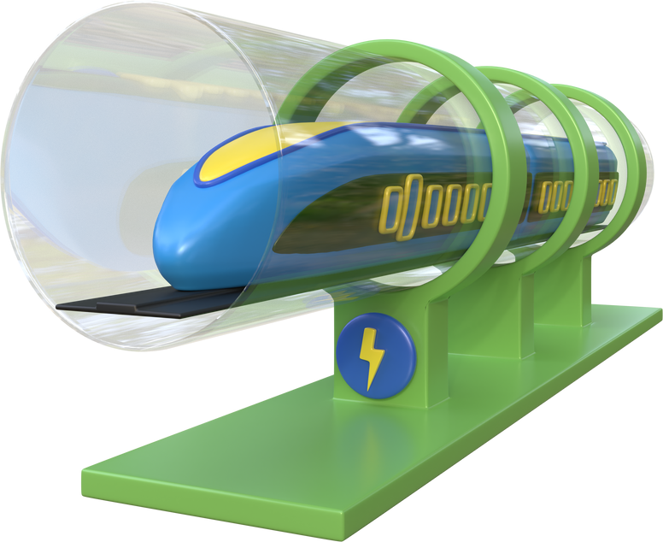

Exercise 2. (p119). Work in pairs.
Make similar conversations about future travelling.
1. travelling long distances by hyperloop.
2. travelling to other planets for holidays.
Practice

Slide 11

Practice
Student A: Do you think we will …………… in the future?
Student B: ………..
1. travelling long distances by hyperloop.

Slide 12
Practice
Student A: Do you think we will …………… in the future?
Student B: ………..
2. travelling to other planets for holidays.

Slide 13
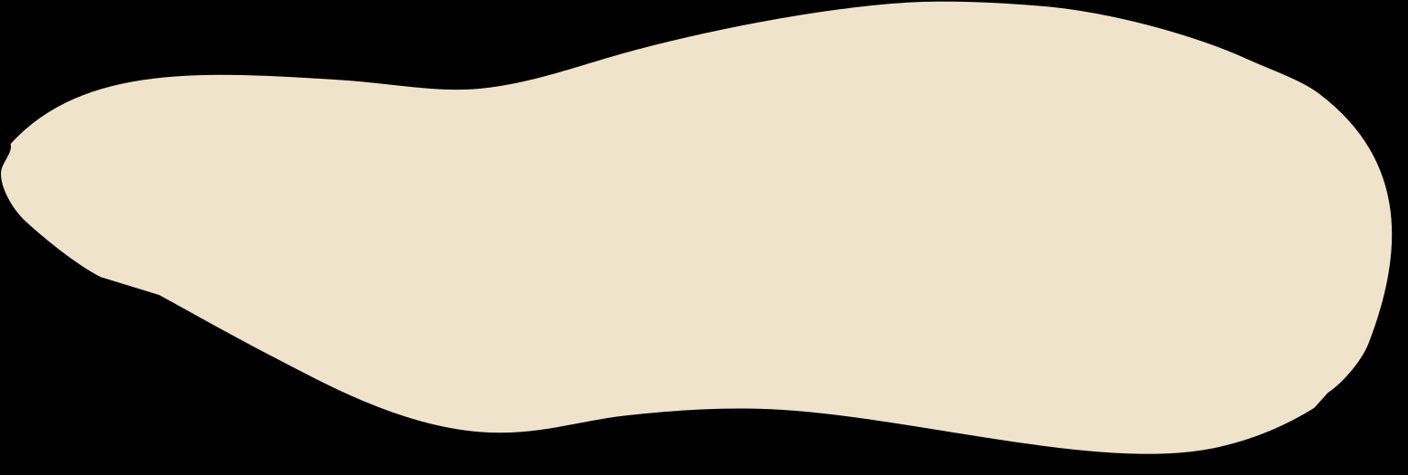
Exercise 3. (pg 119). Complete the conversation between Mark and Lan with the questions and answers from the box.
Mark: So what means of transport will students use to go to school?
Lan: (1) ______________
Mark: Walkcar? (2) __________
Lan: Four.
Mark: How will it work?
Lan: You stand on it then turn on the switch and drive away.
Mark: (3) ______________
Lan: Electricity.
Mark: Won't riders fall off it? It sounds dangerous.
Lan: No, they won't. (4) _________
Mark: I can't wait to get one.
A. How many wheels will a walkcar have?
B. I think they will go by walkcar.
C. It is self-balancing.
D. What will it run on?

Slide 14
Exercise 3. (pg 119). Check the answer.
Mark: So what means of transport will students use to go to school?
Lan: (1) ______________
Mark: Walkcar? (2) __________
Lan: Four.
Mark: How will it work?
Lan: You stand on it then turn on the switch and drive away.
Mark: (3) ______________
Lan: Electricity.
Mark: Won't riders fall off it? It sounds dangerous.
Lan: No, they won't. (4) _________
Mark: I can't wait to get one.
A. How many wheels will a walkcar have?
B. I think they will go by walkcar.
C. It is self-balancing.
D. What will it run on?
B. I think they will go by walkcar.

Slide 15
Exercise 3. (pg 119). Check the answer.
Mark: So what means of transport will students use to go to school?
Lan: (1) ______________
Mark: Walkcar? (2) __________
Lan: Four.
Mark: How will it work?
Lan: You stand on it then turn on the switch and drive away.
Mark: (3) ______________
Lan: Electricity.
Mark: Won't riders fall off it? It sounds dangerous.
Lan: No, they won't. (4) _________
Mark: I can't wait to get one.
A. How many wheels will a walkcar have?
B. I think they will go by walkcar.
C. It is self-balancing.
D. What will it run on?
B. I think they will go by walkcar.
A. How many wheels will a walkcar have?

Slide 16
Exercise 3. (pg 119). Check the answer.
Mark: So what means of transport will students use to go to school?
Lan: (1) ______________
Mark: Walkcar? (2) __________
Lan: Four.
Mark: How will it work?
Lan: You stand on it then turn on the switch and drive away.
Mark: (3) ______________
Lan: Electricity.
Mark: Won't riders fall off it? It sounds dangerous.
Lan: No, they won't. (4) _________
Mark: I can't wait to get one.
A. How many wheels will a walkcar have?
B. I think they will go by walkcar.
C. It is self-balancing.
D. What will it run on?
B. I think they will go by walkcar.
A. How many wheels will a walkcar have?
D. What will it run on?

Slide 17
Exercise 3. (pg 119). Check the answer.
Mark: So what means of transport will students use to go to school?
Lan: (1) ______________
Mark: Walkcar? (2) __________
Lan: Four.
Mark: How will it work?
Lan: You stand on it then turn on the switch and drive away.
Mark: (3) ______________
Lan: Electricity.
Mark: Won't riders fall off it? It sounds dangerous.
Lan: No, they won't. (4) _________
Mark: I can't wait to get one.
A. How many wheels will a walkcar have?
B. I think they will go by walkcar.
C. It is self-balancing.
D. What will it run on?
B. I think they will go by walkcar.
A. How many wheels will a walkcar have?
D. What will it run on?
C. It is self-balancing

Slide 18


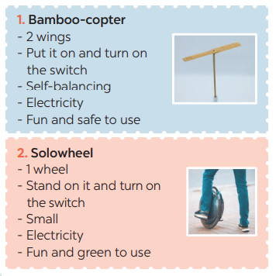
Exercise 4. (pg 119). Choose one means of transport below and make
a similar conversation as in 3.

Slide 19


Present
time!

Slide 20
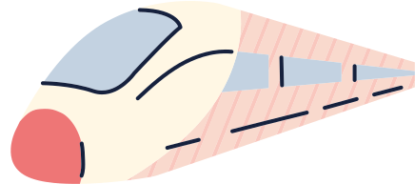
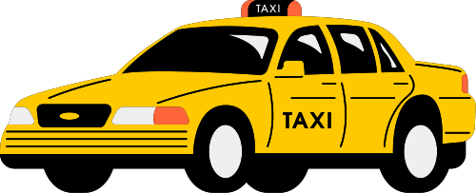
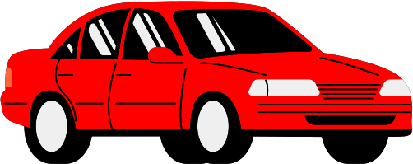
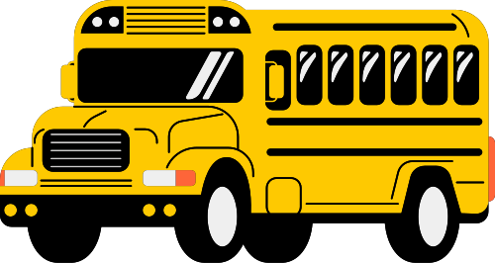
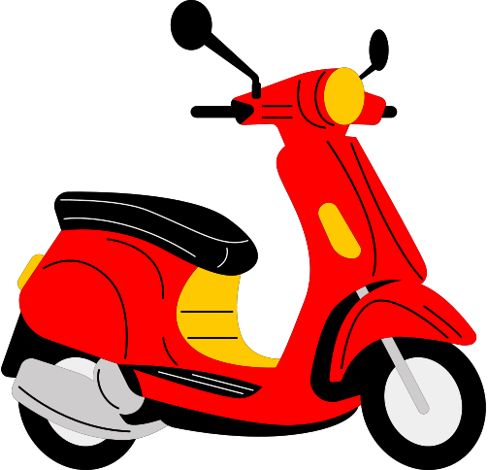
Exercise 5. (pg 119). Choose one means of transport that you would like to use to travel to school. Give reasons.
Sample
One mean of transport that students would like to use to travel to school is the bus. Taking the bus is an easy way to get to school. You can sit back and relax during the ride, and you don't need to worry about finding a parking spot. Additionally, buses are generally safe, and you can meet new friends on the bus. However, you need to be careful when getting on and off the bus and make sure to follow the bus rules.

Slide 21


Tick what you have learnt today
learn how to how to make predictions
talk about transport you will use to travel
discuss about traffic jams.

Slide 22


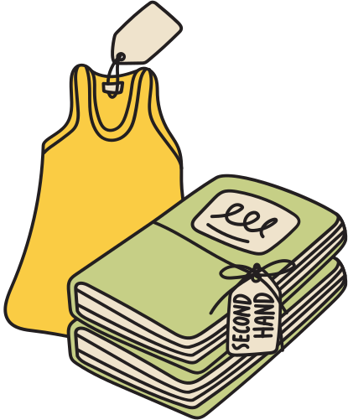


Thanks for watching

