Slide 1


…. Secondary School
Teacher: …..

Slide 2


START
What’s behind the wall?
BRICKS DOWN

Slide 3
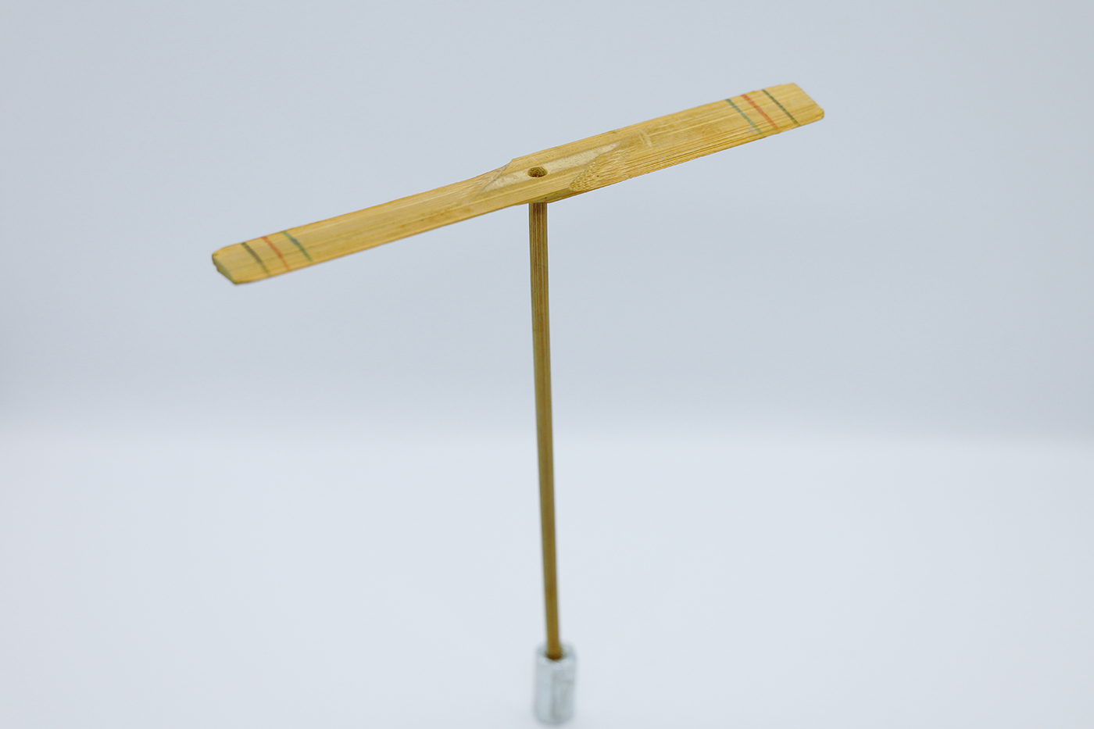
bamboo-copter
NEXT
CHECK
Click on the bricks

Slide 4
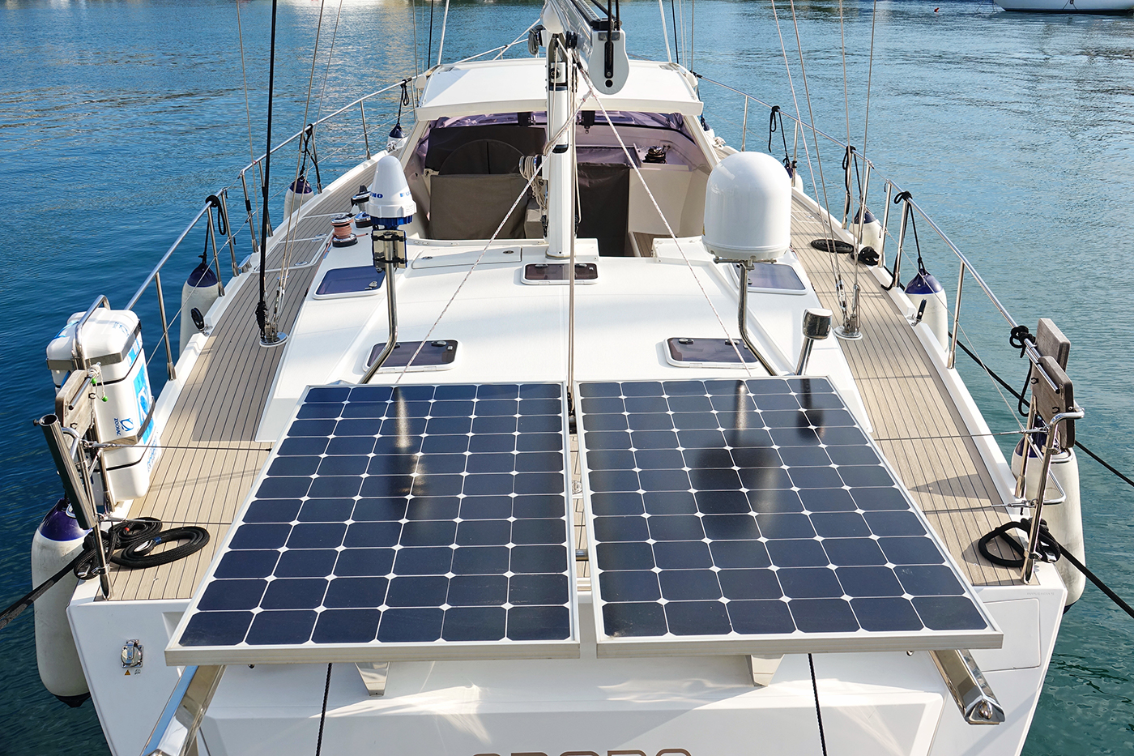
solar-powered ship
NEXT
CHECK
Click on the bricks

Slide 5
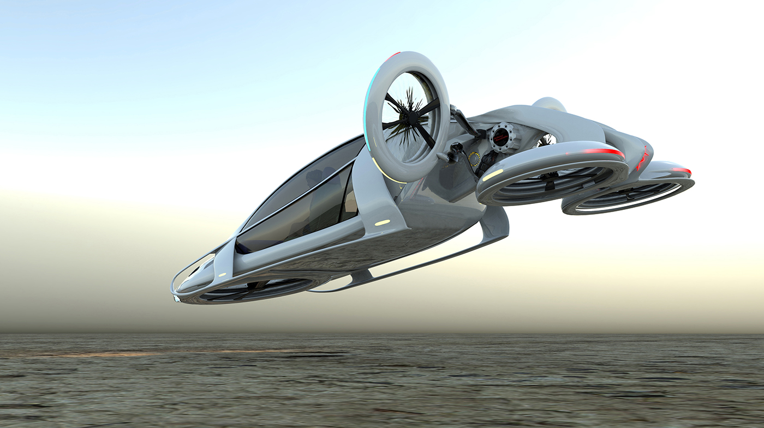
flying car
NEXT
CHECK
Click on the bricks

Slide 6
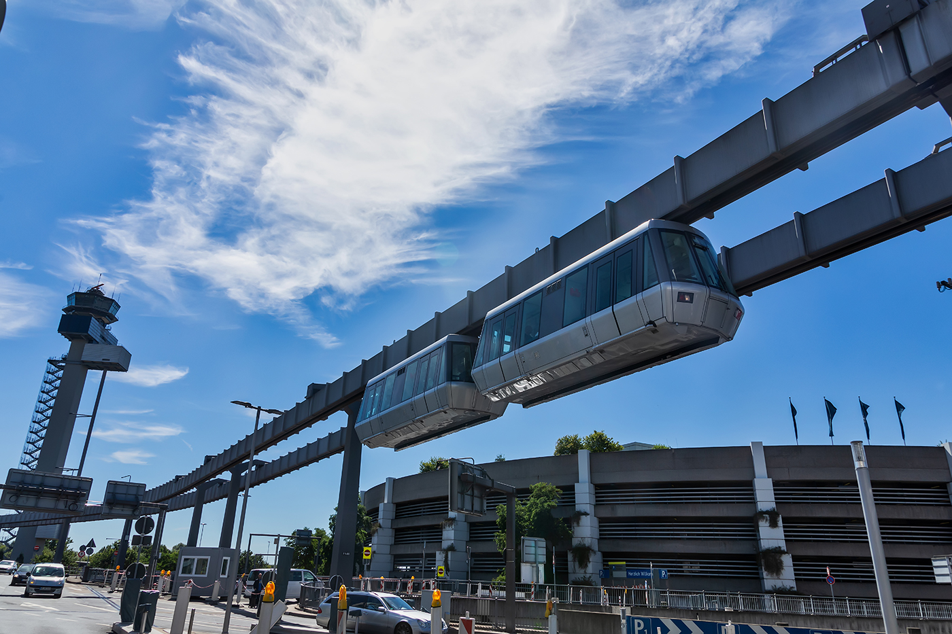
NEXT
skytran
CHECK
Click on the bricks

Slide 7
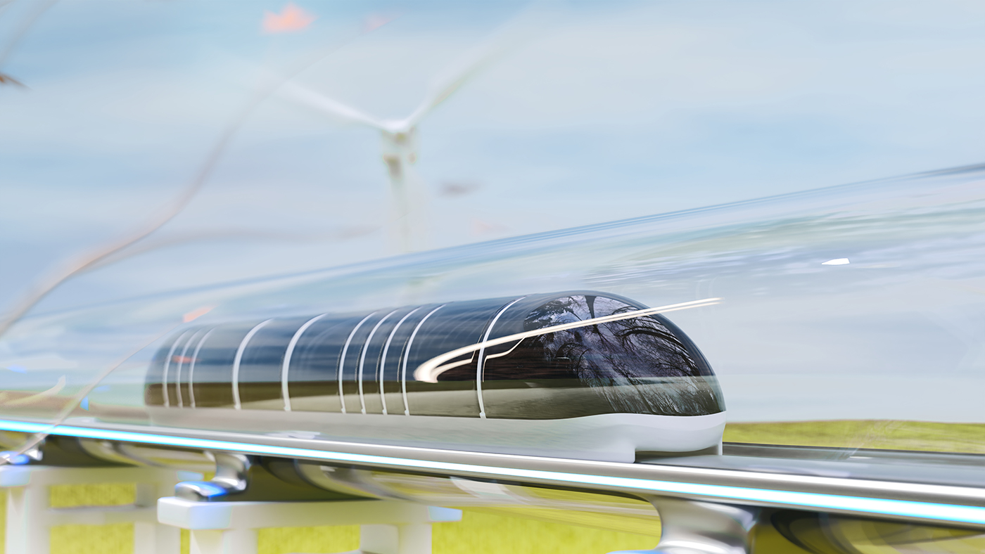
hyperloop
NEXT
CHECK
Click on the bricks

Slide 8
Listen and repeat.
Solar-powered ship
Flying car
Bamboo-copter
skyTran
hyperloop

Slide 9
Unit 11: TRAVELLING IN THE FUTURE
Thursday, April 13th, 2023
Lesson 6: Skills 2

Slide 10
OBJECTIVES
01
02
By the end of this lesson, students will be able to:
LISTENING
Listen for specific information about some future means of transport
WRITING
Write about the advantages of a future means of transport

Slide 11
VOCABULRY

Slide 12
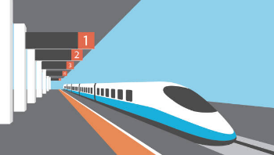
VOCABULRY
bullet train (n)
/ˈbʊl.ɪt ˌtreɪn/
tàu cao tốc

Slide 13
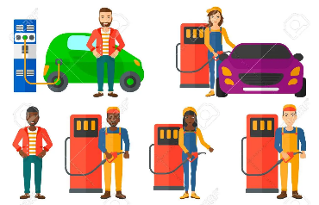
VOCABULRY
use up (v)
/juz up/
sử dụng hết

Slide 14
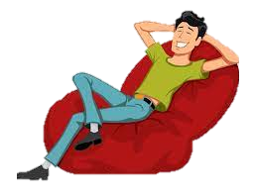
VOCABULRY
comfortable (a)
/ˈkʌm.fə.tə.bəl/
thoải mái

Slide 15
Vocabulary
- bullet train (n) | /ˈbʊl.ɪt ˌtreɪn/ | tàu cao tốc
- use up (v) | /juz up/ | sử dụng hết
- comfortable (a) | /ˈkʌm.fə.tə.bəl/ | thoải mái

Slide 16
LISTENING

Slide 17
1. Which words/ phrases that you think are used to describe the future means of transport?

A. comfortable

B. eco – friendly

C. having an autopilot function
D. running on petrol

Slide 18

1. How many means of transport are they talking about?
A. 2
B. 3
C. 4
Bullet trains
SkyTrans
Bamboo-copters
Solar-powered ships
Mr. Ha

Slide 19
2. Listen to the talk again and complete each sentence with ONE word.
Listen and check your answer.
1. Bullet trains will be faster, safer, and riders can avoid traffic _______.
2. SkyTrans will use less space and run on __________.
3. SkyTrans may be too _______for students.
4. ______will be cheaper and easier to use.
5. Solar-powered ships will be _______and comfortable.

Slide 20
2. Listen to the talk again and complete each sentence with ONE word.
1. Bullet trains will be faster, safer, and riders can avoid traffic ___________.
accidents
Mr Ha: Now, let's turn to future means of transport. How do you think people will travel in 2050, Tom?
Tom: I think people will use bullet trains. Bullet trains will be faster and safer than cars and they can help avoid traffic accidents.

Slide 21
2. Listen to the talk again and complete each sentence with ONE word.
2. SkyTrans will use less space and run on __________.
autopilot
Lan: I think skyTrans will also be popular, too. They will not use up much space and will be safe because they run on autopilot.

Slide 22
2. Listen to the talk again and complete each sentence with ONE word.
expensive
3. SkyTrans may be too ___________for students.
Tom: But skyTrans may be too expensive for students to use.

Slide 23
2. Listen to the talk again and complete each sentence with ONE word.
4. _________________will be cheaper and easier to use.
Bamboo – copters
Tom: But skyTrans may be too expensive for students to use. Bamboo-copters will be cheaper and easier for them to use. They will just put on their bamboo-copters and fly to school.

Slide 24
2. Listen to the talk again and complete each sentence with ONE word.
5. Solar-powered ships will be ______________ and comfortable.
eco-friendly
Lan: I think people will use use solar-powered ships to travel on sea. They will be eco-friendly and comfortable...

Slide 25
Look at the answers again.
Listen and check your answer.
1. Bullet trains will be faster, safer, and riders can avoid traffic accidents.
2. SkyTrans will use less space and run on autopilot.
3. SkyTrans may be too expensive for students.
4. Bamboo – copters will be cheaper and easier to use.
5. Solar-powered ships will be eco- friendly and comfortable.

Slide 26
WRITING

Slide 27
4.Tick the words and phrases that describe the advantages of means of transport. Can you add more words or phrases.
Advantages | Tick (✓)
green
polluting the environment
expensive
safe
comfortable
convenient
causing noise
fast
Suggested answers: economical, carrying many passengers, avoiding traffic jams, having an autopilot function, driverless, etc.





Slide 28
4. Work in pairs. What are the advantages of these means of transport?
Means of transport | Advantages
Bullet train
Skytran
Bamboo- copter
Solar-powered ship
fast, safe, avoiding traffic accidents,
less space, autopilot
cheap, easy to use
eco – friendly, comfortable,

Slide 29
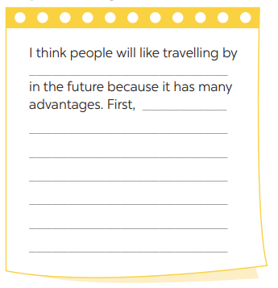

5. Write a paragraph about the advantages of the means of transport you’ve chosen.
Means of transport | Advantages
Bullet train
Skytran
Bamboo- copter
Solar-powered ship
fast, safe, avoiding traffic accidents, …
less space, autopilot…
cheap, easy to use..
eco – friendly, comfortable, ..

Slide 30
5. Write a paragraph about the advantages of the means of transport you’ve chosen.
Suggested answer:
I think people will like travelling by bullet trains in the future because it has many advantages. First, travelling by bullet trains is very eco-friendly. It helps reducing the huge amount of transport and traffic jams. Second, travelling bullet trains are much faster than driving a car. Finally, using bullet trains are safe. Tens of thousands of people die each year in automobile accidents, but trains are one of the safest forms of transportation we currently have.

Slide 31
RECAP
SKILLS 2
LISTENING
WRITING
Listen for specific information about some future means of transport
Write about the advantages of a future means of transport

Slide 32
Homework
1
- Learn by heart vocabulary
2
- Complete your own writing about the advantages of a future means of transport.
3
- Prepare: Unit 11: Looking back and Project

Slide 33
Thank you!

