Slide 1
UNIT 11
TRAVEL IN FUTURE
Lesson 2: A closer look 1

Slide 2
OBJECTIVES
01
02
By the end of this lesson, students will be able to:
Use some lexical items related to the topic Travelling in the future.
say sentences with correct stress

Slide 3
I. Vocabulary

Slide 4
- Work in 8 groups.
- 3 hints will be given
- Raise hands to guess the transportations.
- The fastest group to have the correct answer using:
1 hints gains 3 points | 2 hints gains 2 points | 3 hints gains 1 point
Let’s warm-up

Slide 5

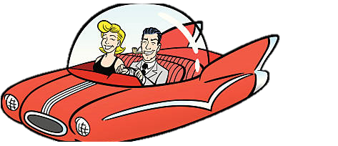


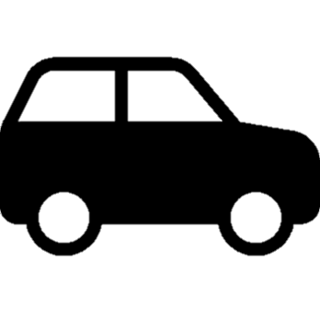
2 words
Flying car

Slide 6




Solar-powered ship

Slide 7



Starts with H
HYPERLOOP

Slide 8
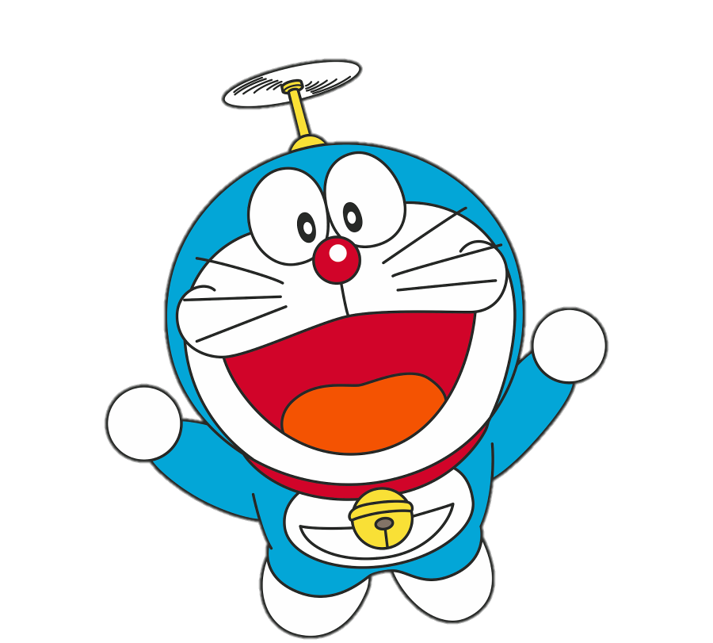


12 letters
Bamboo-copter

Slide 9



Has a T
skyTrain

Slide 10


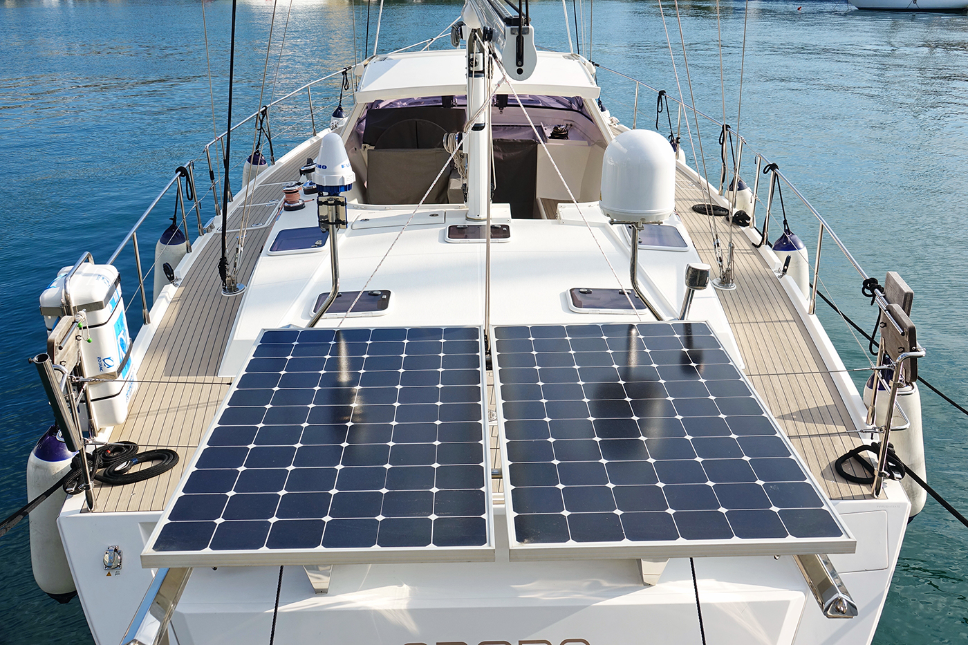
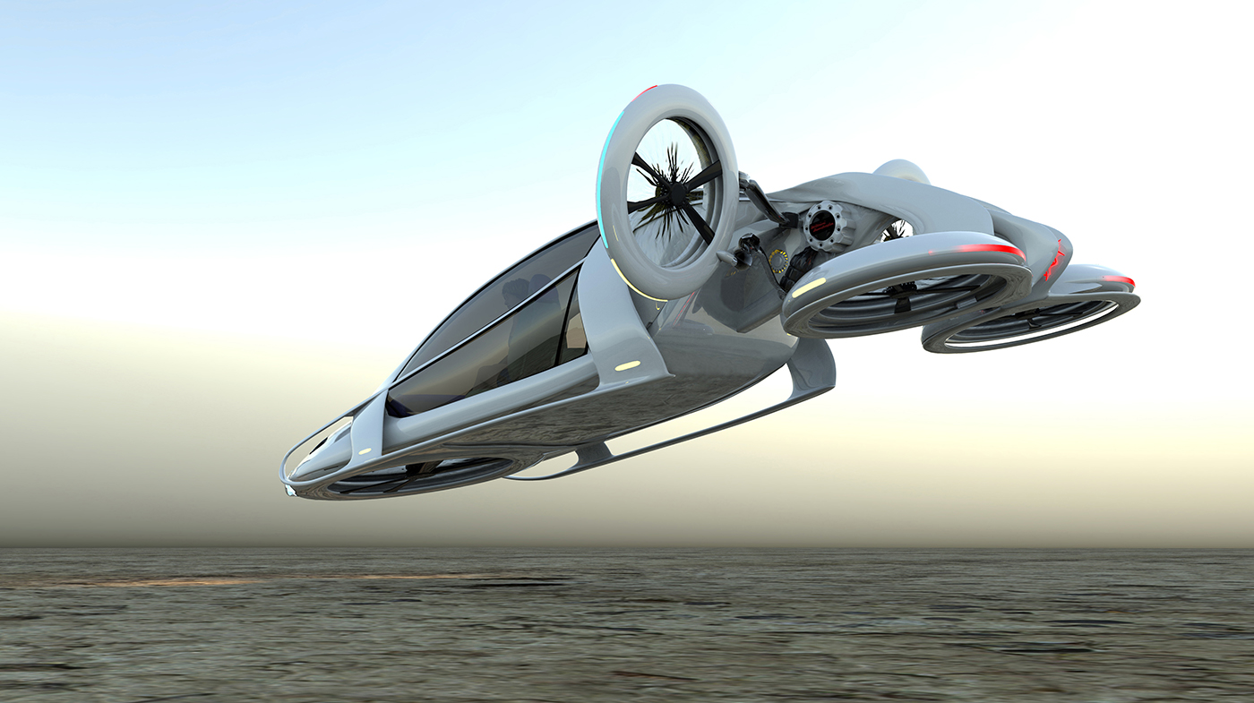
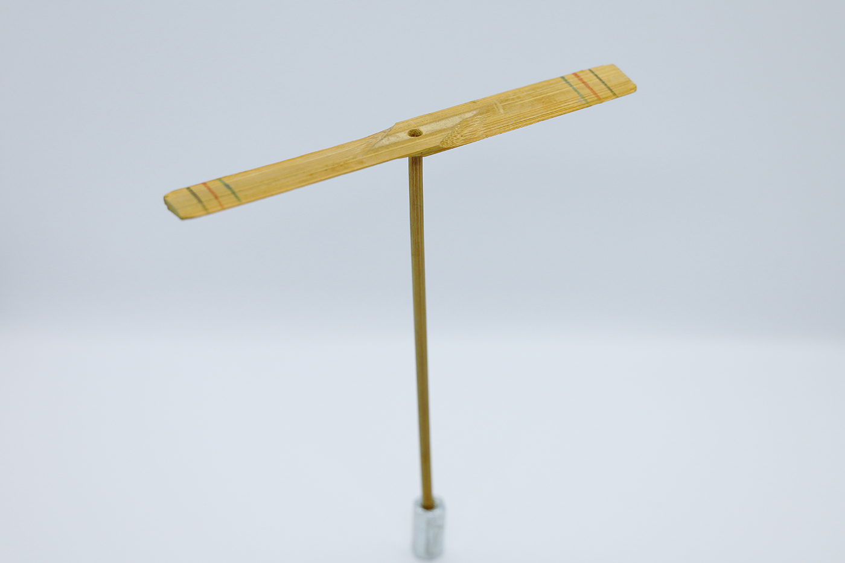
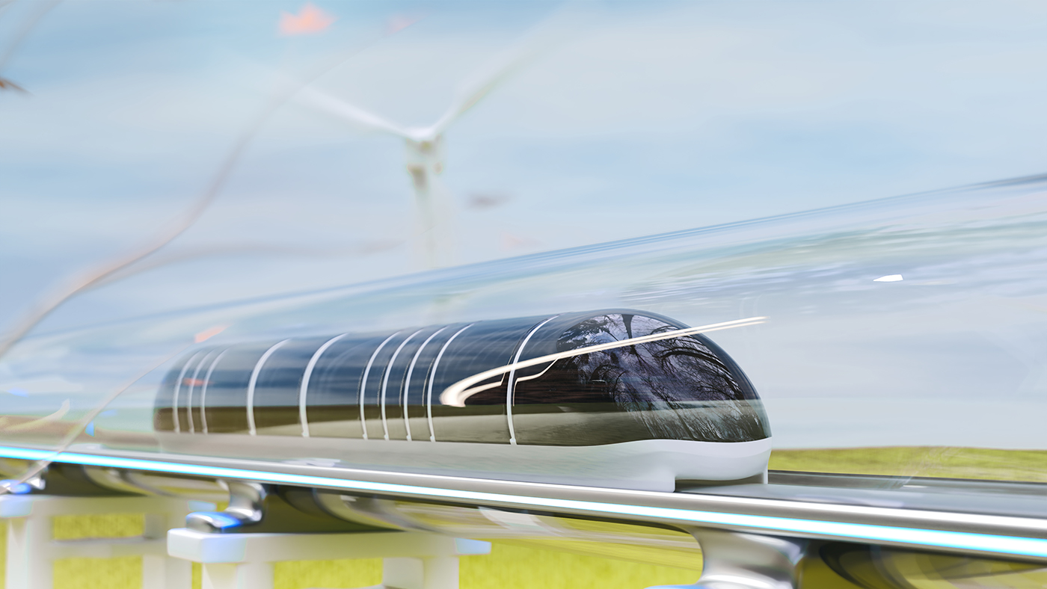
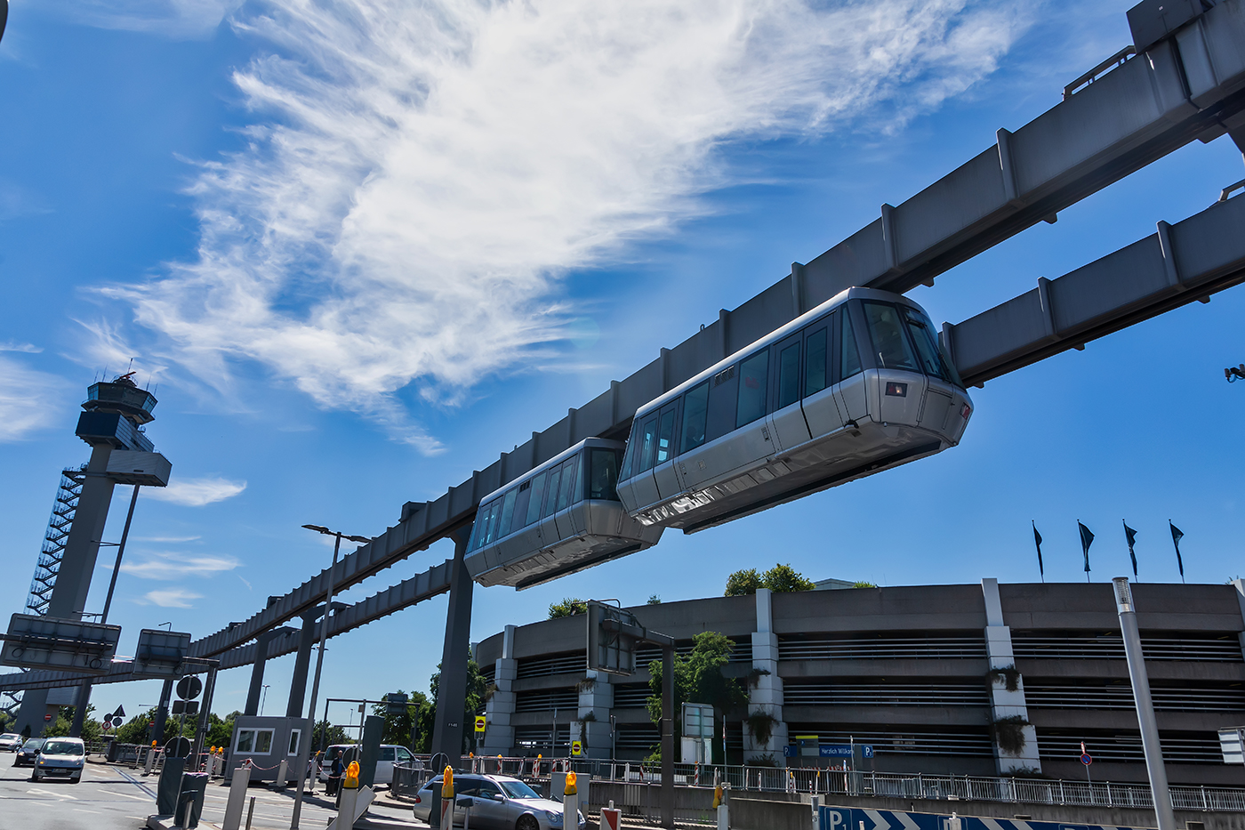
1. Write the words or phrases under the correct pictures. Then listen, check, and repeat. (p. 116)
Solar-powered ship
Flying car
Bamboo-copter
hyperloop
skyTrain
Notes:
Teacher has Ss practice saying the words, then call 1-2 Ss to repeat them individually

Slide 11
2. Write words or phrases from 1 in the correct columns. (p. 116)
Ride | Fly | Sail
Flying car
skyTran
Bamboo-copter
Hyperloop
Solar-powered ship
Notes:
Can you add more?

Slide 12
3. Complete the sentences, using the words from the box. (p. 116)
eco-friendly
fly
ride
bamboo-copter
hyperloop
bamboo-copter
1. Travelling by …………….......... is simple. You just put it on and fly away.
2. People will soon …………….......... in flying cars instead of driving normal cars.
3. It will be fun to …………….......... a skyTran to work.
4. Travelling by …………….......... will be faster than by airplane.
5. Solar-powered ships are …………….......... They will not cause pollution.
fly
ride
hyperloop
eco-friendly
Notes:
Teacher has Ss look at the box, practice saying the words, then work individually to complete the sentence.
then swap the books to check

Slide 13
Learning English is so easy!
Can you read this sentence
Where did you raise your voice?
Notes:
Have the students to notice whether they raised or lowered their voice or not.
Lead to sentence stress

Slide 14
2. Pronunciation
SENTENCE STRESS

Slide 15


Slide 16
SENTENCE STRESS
1. Stressed words: N, main V, Adj, Adv, and negative auxiliaries.
EG: we don’t like travelling
2. Unstressed words:
- Preposition (in/on/at…) - Pronouns (I, you, he,…)
- Articles (a/an/the) - Auxiliary verbs (do, did,…)

Slide 17
4. Listen to the sentences and repeat.
Pay attention to the bold syllables. (p. 116)
1. We’ll have driverless cars.
2. We’ll have driverless cars in the future.
3. I think driverless cars will run faster.
4. I don’t think we’ll have driverless cars.
5. I think driverless cars will be safer and greener.

Slide 18
5. Listen to the sentences and repeat. How many stresses are there in each sentence? (p.116)
Before listening, work in pairs and underline the stressed syllables
1. That is a solar-powered ship.
2. They will travel by flying car.
3. They introduced a new autopilot model.
4. Will bullet trains pollute the environment?
5. I don’t think those trains will be popular here.
3
3
4
4
5
Notes:
Listen to check and then correct and count the stressed syllables

Slide 19
Let’s wrap up
01
02
What have we learned today?
VOCABULARY
- Some future transportations
- How to use the verbs: ride/fly/sail
PRONUNCIATION
Sentence stress

Slide 20
Thanks
for listening!

