Slide 1
Unit 12:
LIFE ON OTHER PLANETS
Lesson 7: Looking back

Slide 2
VOCABULARY: outer space
alien, commander, creature, destroy, oppose, spaceship, thrilling, crater, galaxy, rocket, satellite, gravity, habitable, promising, trace, telescope, UFO, Jupiter, Mars, Mercury, Neptune, Uranus, Venus, etc.

Slide 3
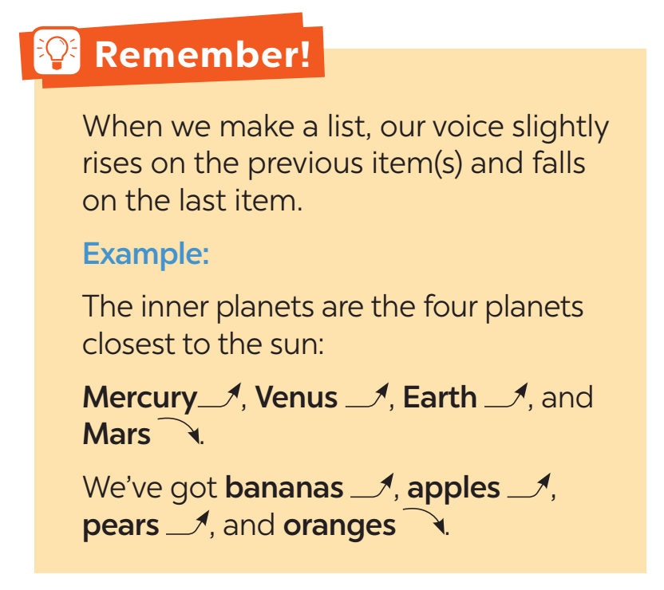
PRONUNCIATION

Slide 4
GRAMMAR: reported speech (questions)
1. Với câu hỏi Có/ Không (Yes/No questions) :
- Trong câu hỏi Có/ Không, chúng ta sử dụng từ ‘if' hoặc “whether” để tường thuật lại câu hỏi.. “If” được sử dụng phổ biến hơn.
Cấu trúc: S + ask/wonder/want to ask + B + whether/if + S + V
- She asked, "Are you going to the party tonight?" (Cô ấy hỏi: “Liệu cậu có tới bữa tiệc tối nay không?”
→ She asked if I was going to the party that night. (Cô ấy hỏi rằng liệu tớ có tới bữa tiệc tối nay không.)
- The teacher asked, "Did you complete your homework?" (Giáo viên hỏi: “Bạn đã hoàn thành bài tập về nhà chưa?)
→ The teacher asked if I had completed my homework. (Giáo viên hỏi rằng liệu tôi đã hoàn thành bài tập về nhà chưa.)

Slide 5
GRAMMAR: reported speech (questions)
2. Với câu hỏi có các từ để hỏi (WH- questions)
- Trong các câu hỏi what, where, why, who, when hoặc how, chúng ta sử dụng từ nghi vấn để tường thuật câu hỏi.
Cấu trúc: S + ask/wonder/want to ask + B + WH- word + S + V
Ví dụ:
- She asked, "What time does the movie start?"
→ She asked what time the movie started.
- He wanted to ask,, "Where did you go for your vacation?"
→ He wanted to ask where I had gone for my vacation.

Slide 6
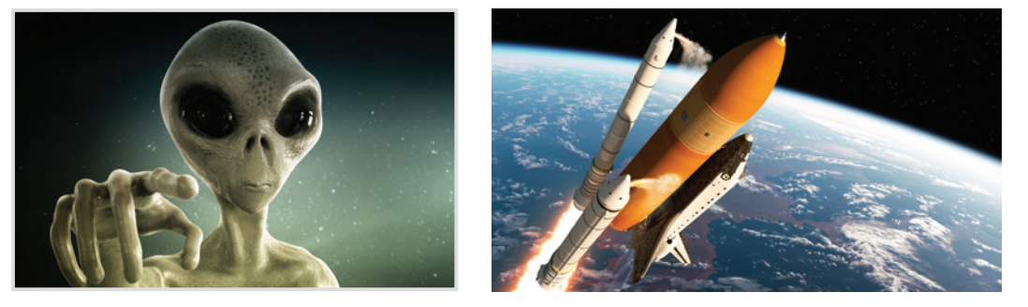
Write a word under each picture.
1.
alien
2.
rocket

Slide 7
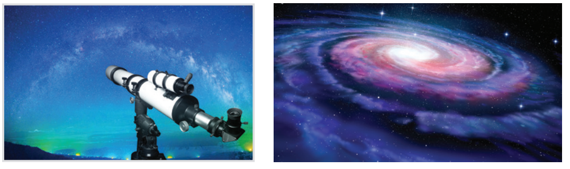
Write a word under each picture.
3.
galaxy
telescope
4.

Slide 8
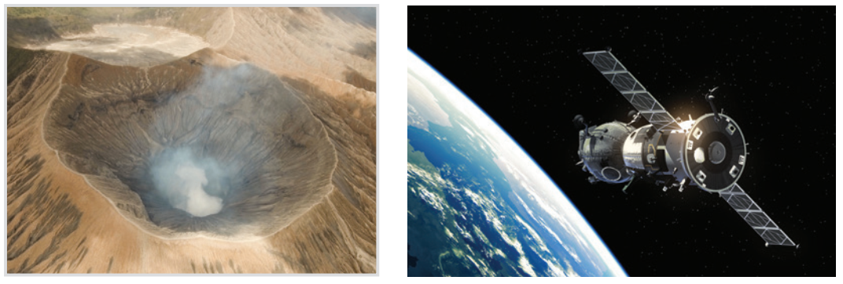
Write a word under each picture.
5.
crater
6.
satellite

Slide 9
Circle the correct words to complete the sentences.
1. UFOs / Rockets are spaceships from another planet.
2. We have no possibility / condition of making our own spaceship.
3. We can’t find any living craters / creatures in the solar system except for us.
4. Scientists are working to find a habitat / habitable planet.
5. The gravity / atmosphere of the Earth makes things fall to the ground when we drop them.
UFOs / Rockets: UFO / Tên lửa
possibility / condition: khả năng/điều kiện
craters / creatures: miệng núi lửa /sinh vật sống
habitat / habitable: môi trường sống/nơi ở được
gravity / atmosphere: lực hấp dẫn/khí quyển

Slide 10
Rewrite each sentence so that it is closest in meaning to the original one.
1. “What is this novel about?” said Mary.
⭢ Mary wanted to know ______________________.
2. “Who’s your favourite actor, Nick?” I said.
⭢ I asked Nick _______________________.
3. “What time does the next train leave?” Mai said to me.
⭢ Mai asked me ________________________.
4. How do the scientists observe the other planets?” the students asked.
⭢ The students wondered ______________________________________.
5. Mai wondered, “Why can’t humans live on Mars?”
⭢ Mai wondered _____________________________.
what that novel was about
who his favourite actor was
what time the next train left
how the scientists observed the other planets
why humans couldn’t live on Mars

Slide 11
Our mission and vision
1. The teacher asked the pupils what they are doing then.
A B C
2. My father wondered me what I was going to do the following weekend.
A B C
3. My brother wanted to know who the scientists were exploring other planets.
A B C
4. I asked my teacher what food spacemen eat when they were travelling in a spacecraft.
A B C
5. Scientists are still wondering how many planets are there in our galaxy.
A B C
→ were
→ asked
→ how/ why
→ ate
→ there are

Slide 12
THANK YOU!

