Slide 1
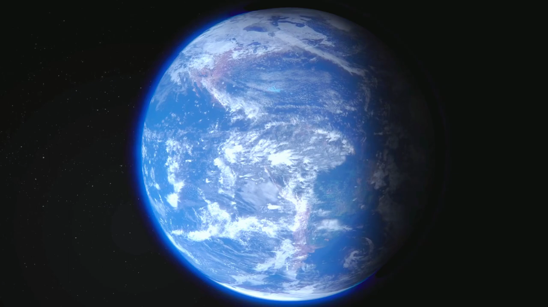
What can you see?

Slide 2
1. What do you think about OUTER SPACE?
2. Can we live on other planets in the future?

Slide 3
Unit 12:
LIFE ON OTHER PLANETS
LESSON 1: GETTING STARTED

Slide 4
OBJECTIVES
By the end of the lesson, students will be able to:
gain an overview about the topic:
Life on other planets.
use lexical items related to the topic:
Life on other planets.

Slide 5
01
NEW WORDS
01
You can enter a subtitle here if you need it

Slide 6
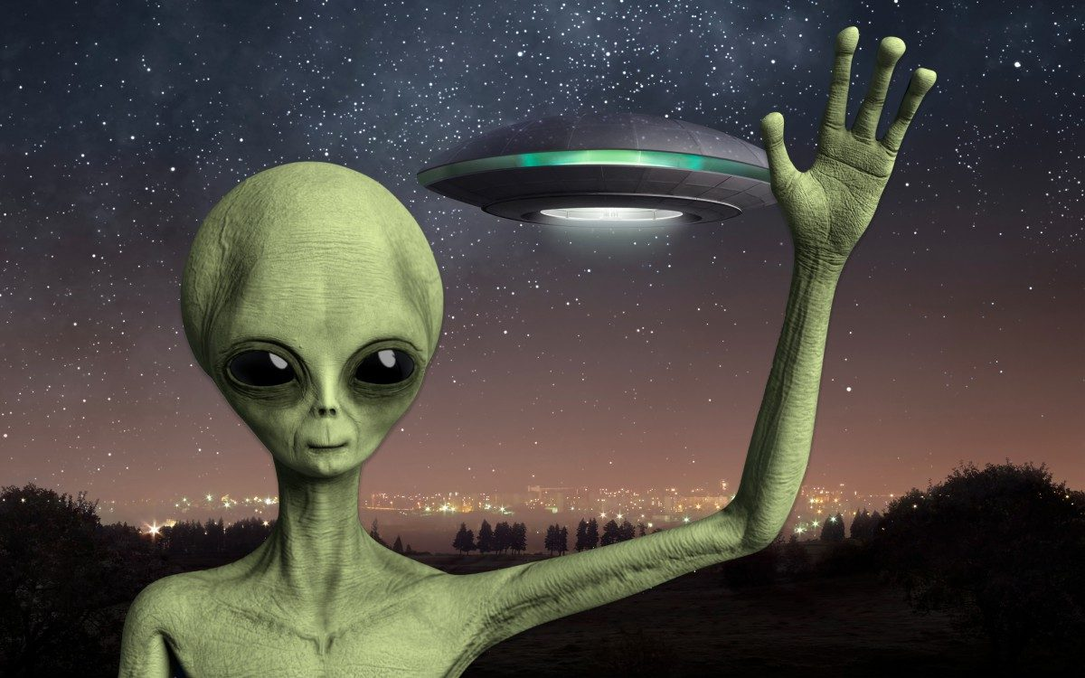

alien (n)
/ˈeɪ.li.ən/
người ngoài hành tinh

Slide 7
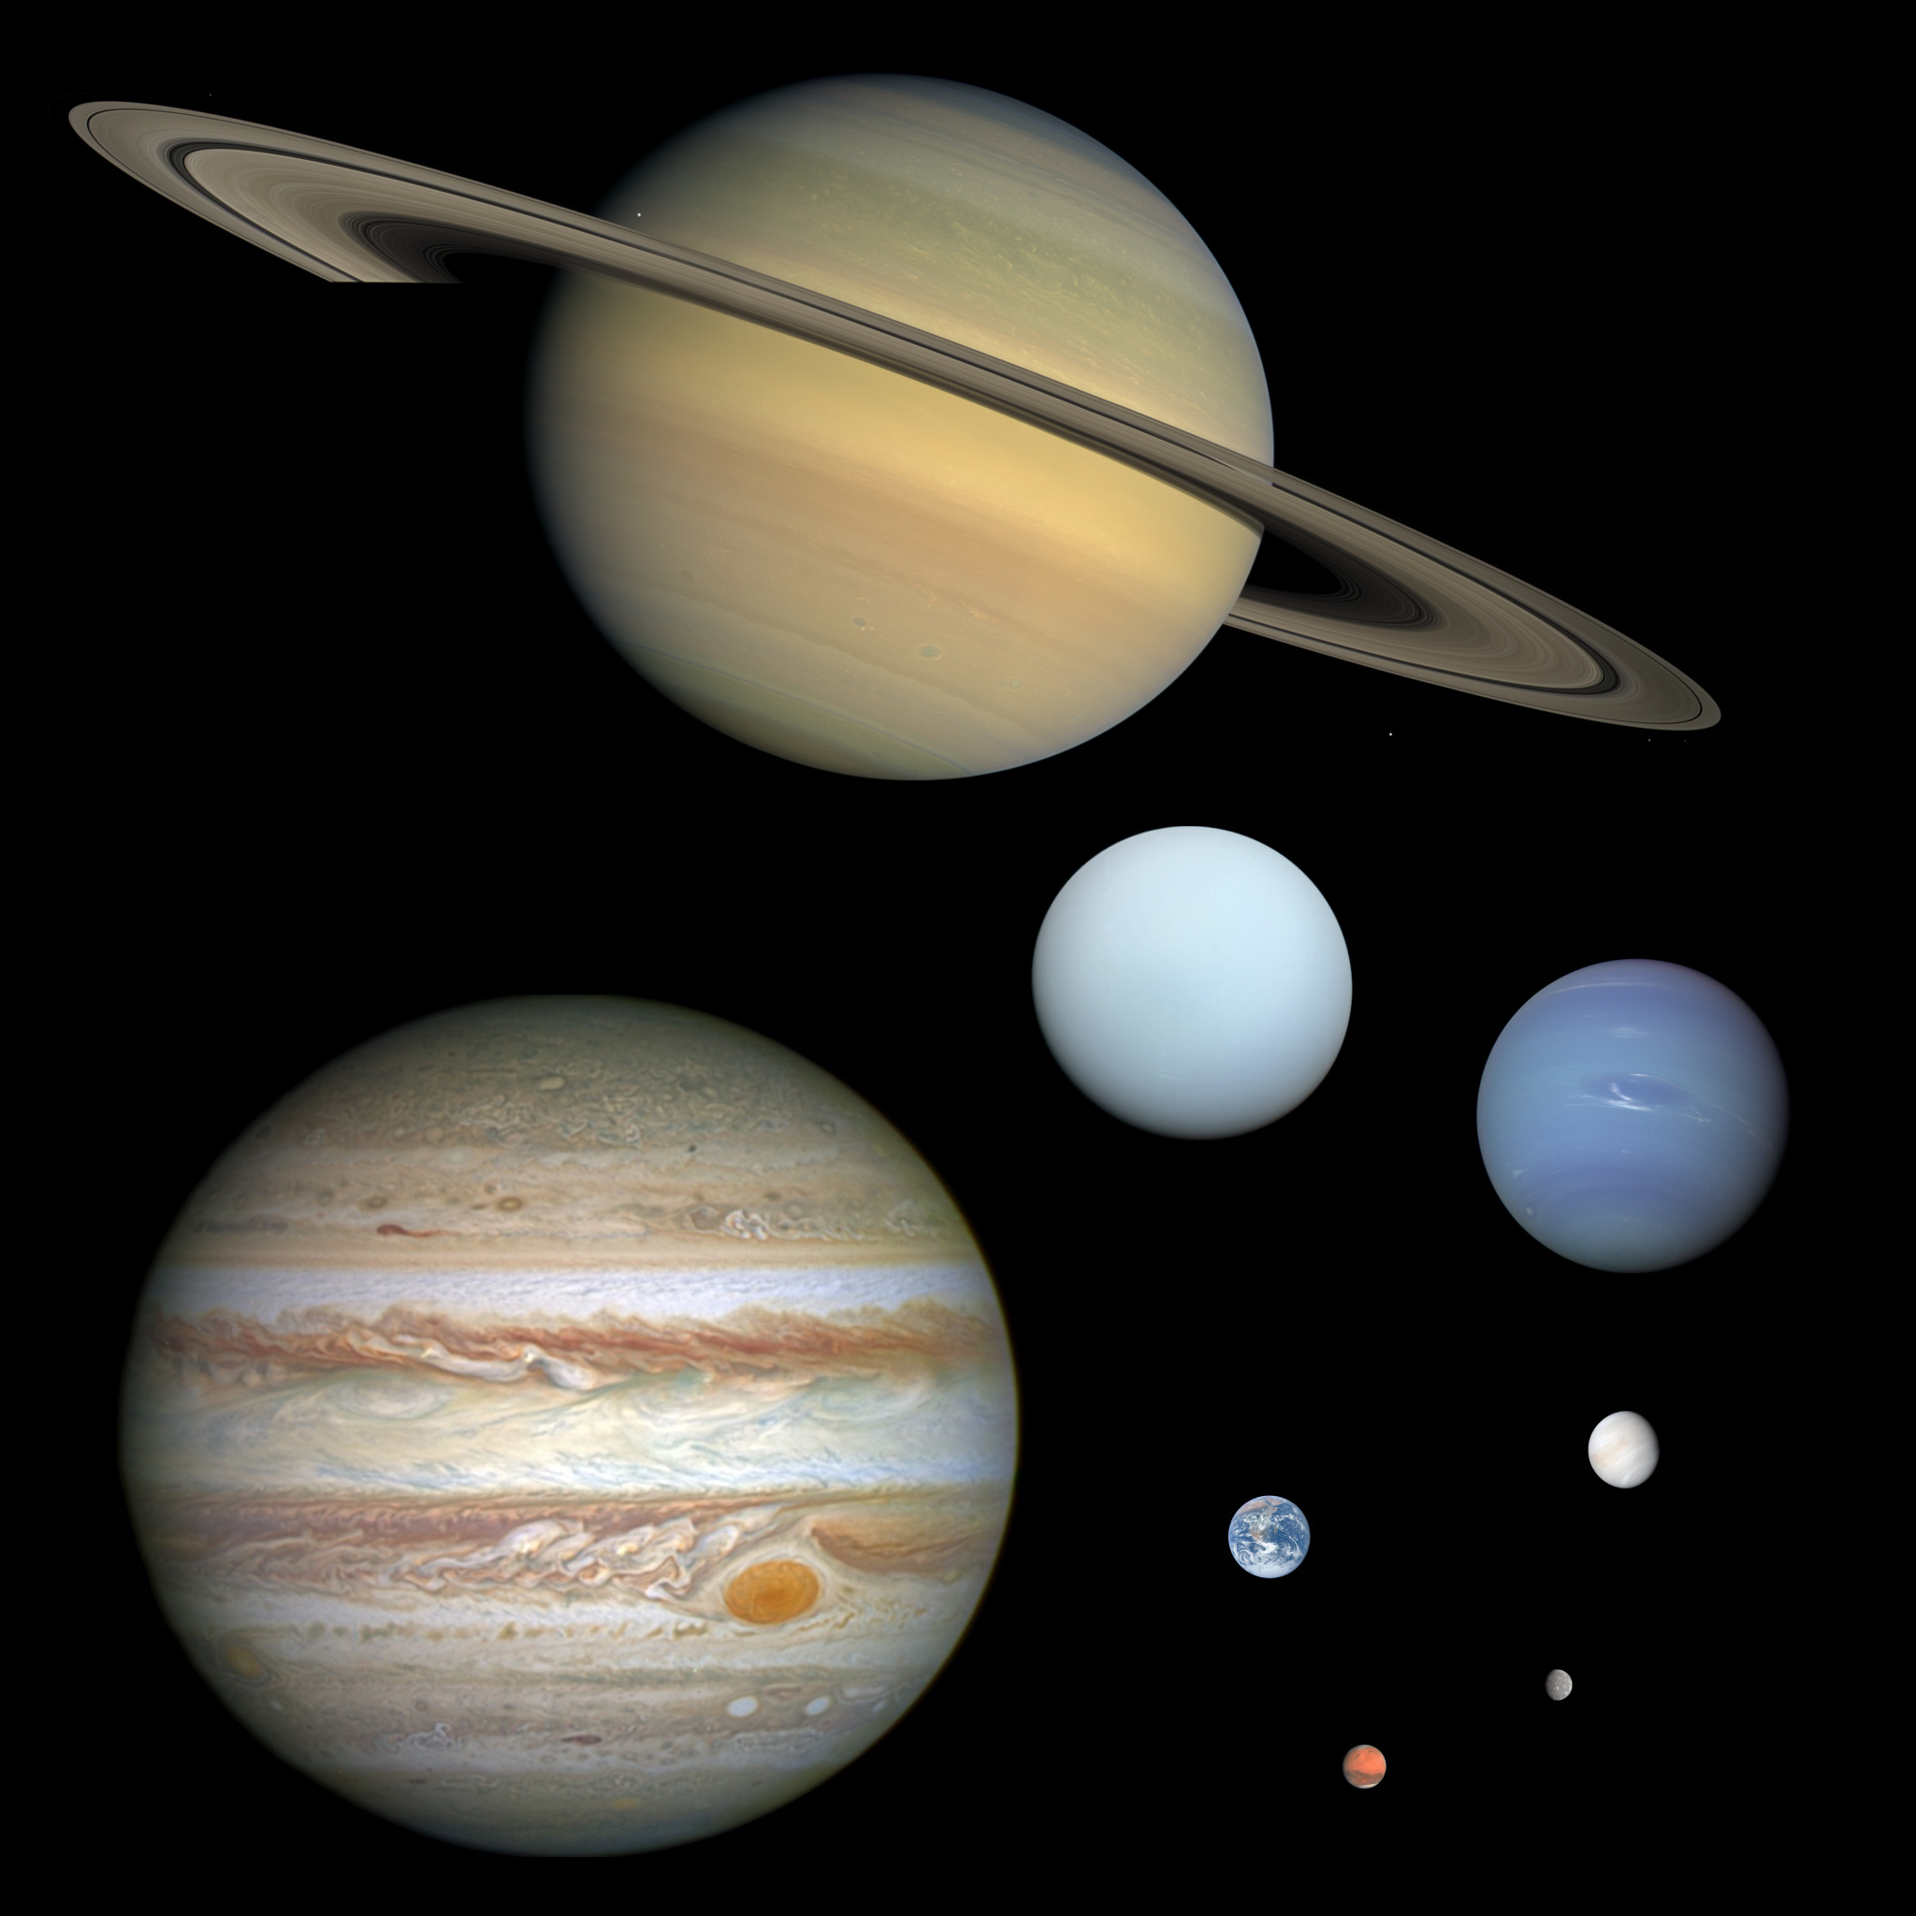
planet (n)
/ˈplæn.ɪt/
hành tinh

Slide 8
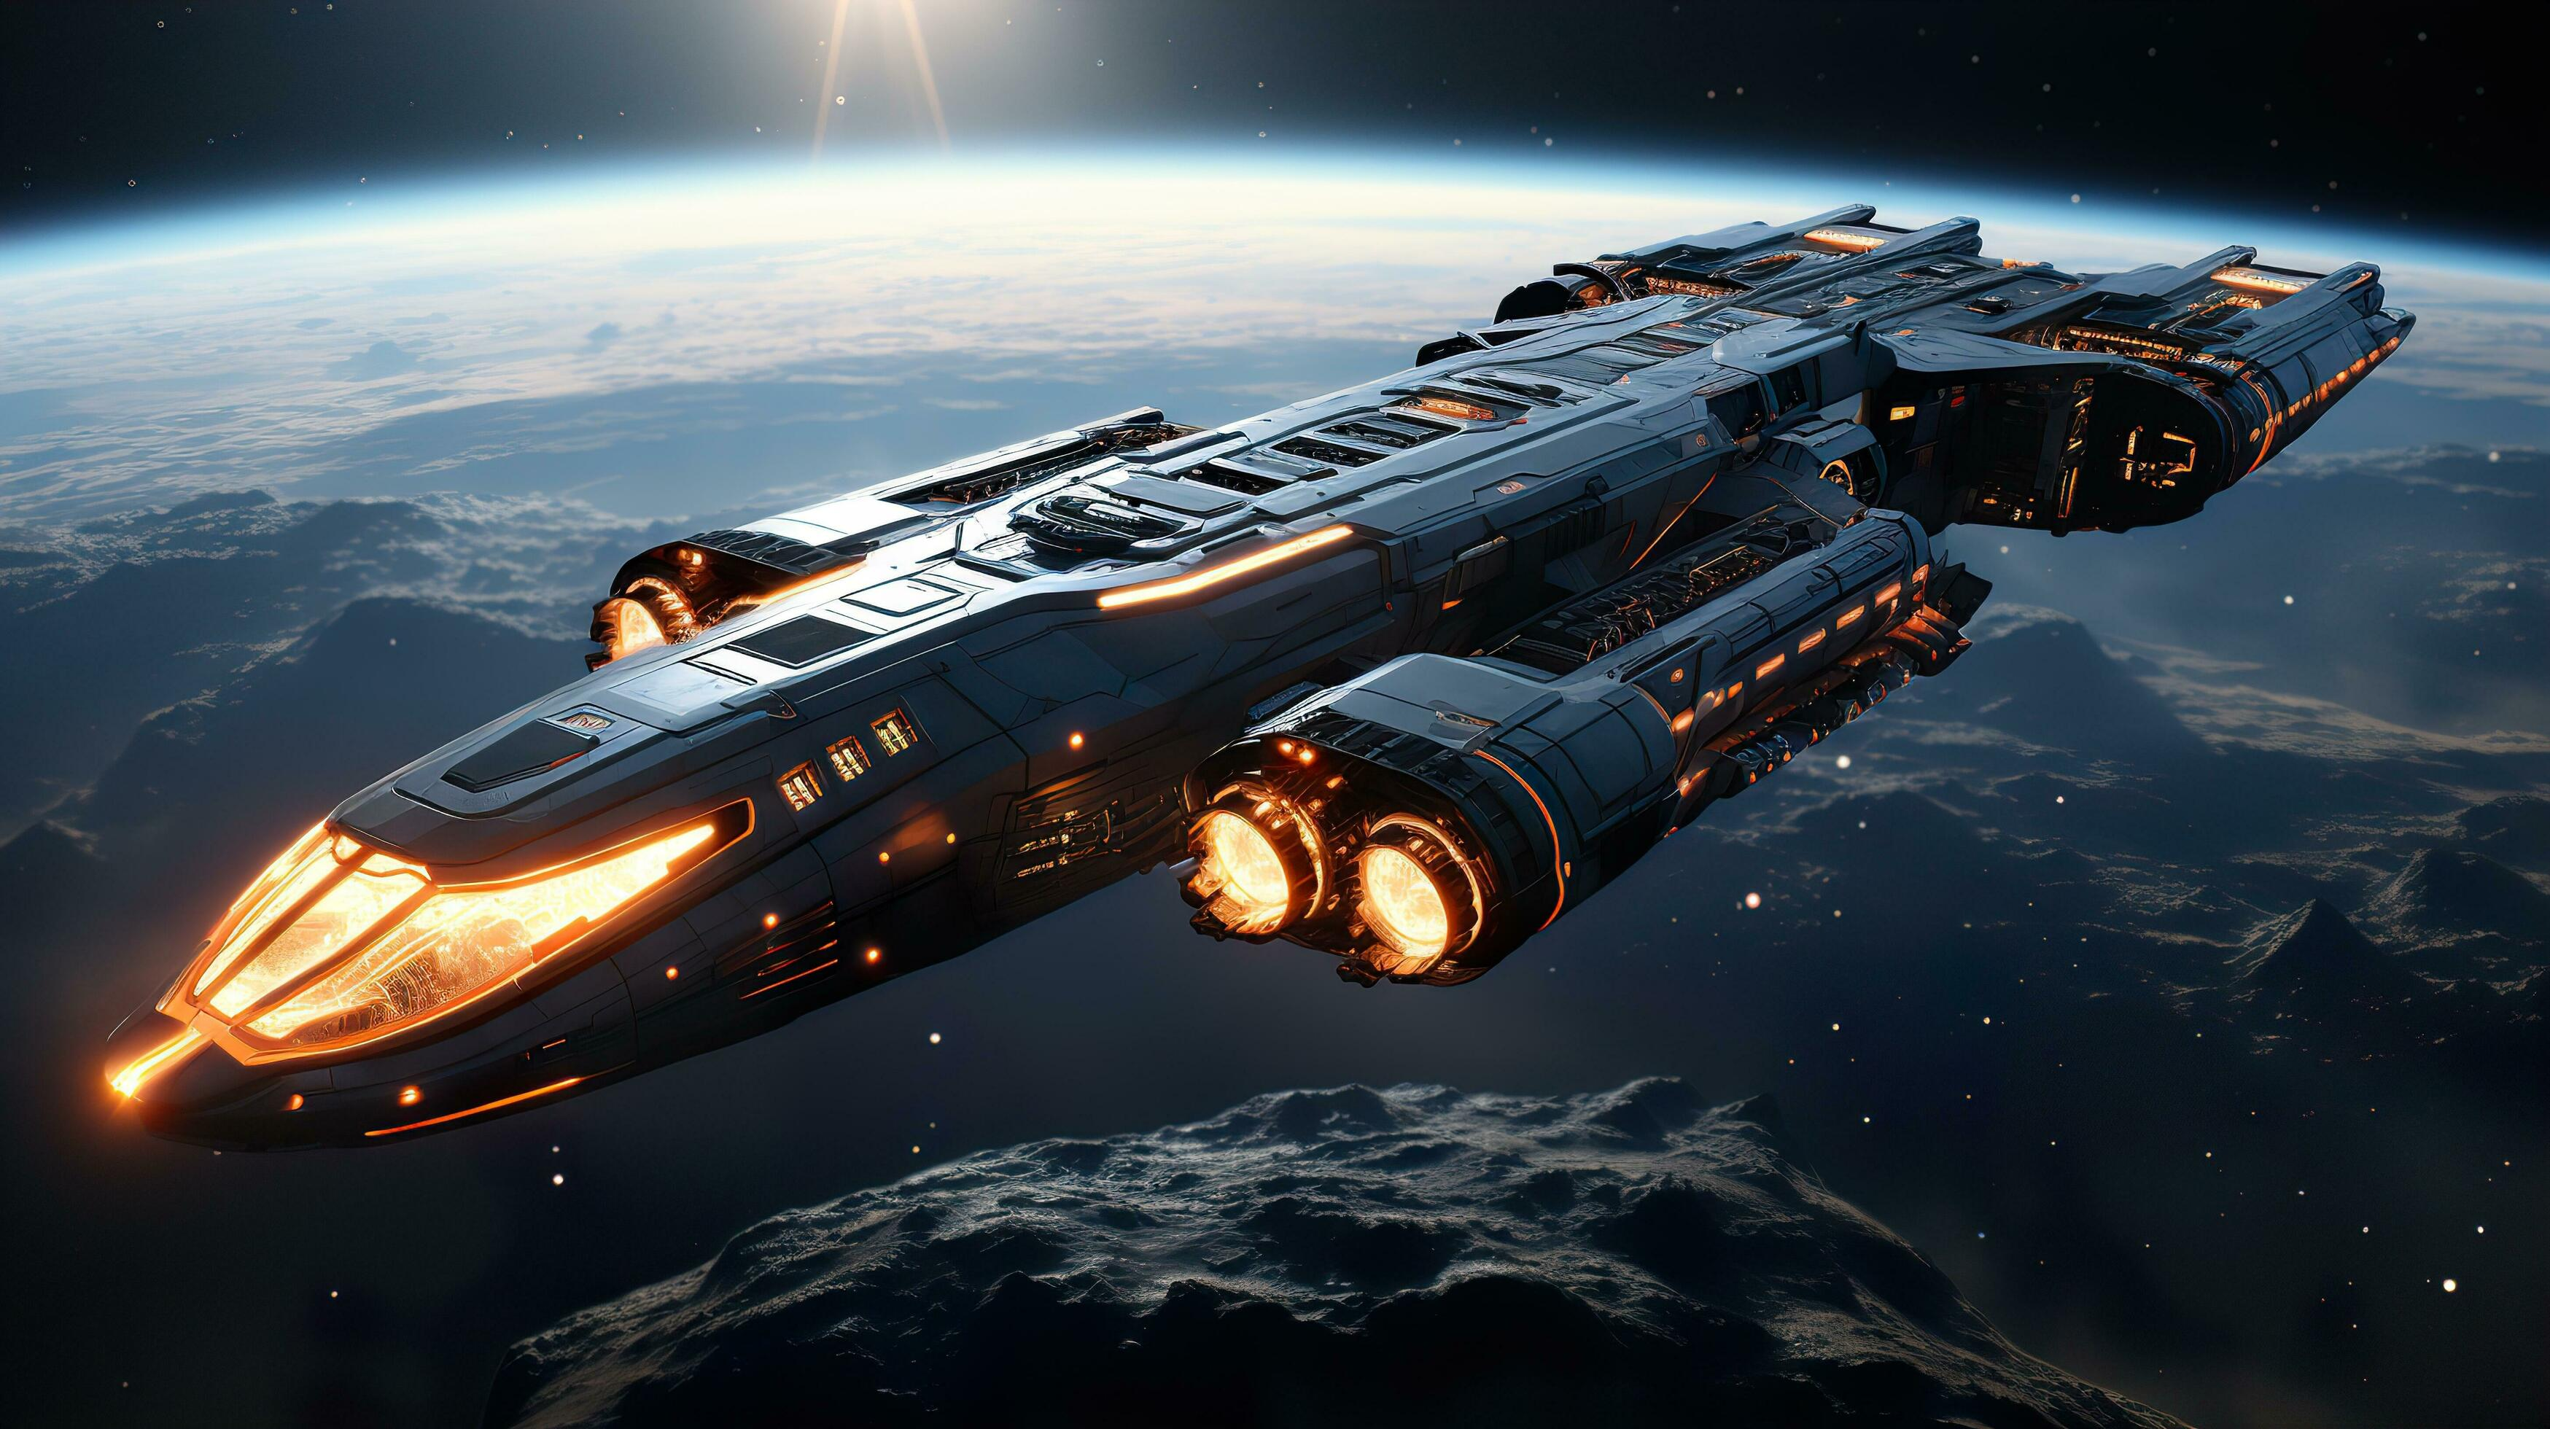
spaceship (n)
/ˈspeɪs.ʃɪp/
phi thuyền

Slide 9

commander (n)
/kəˈmɑːn.dər/
người chỉ huy, người cầm đầu

Slide 10
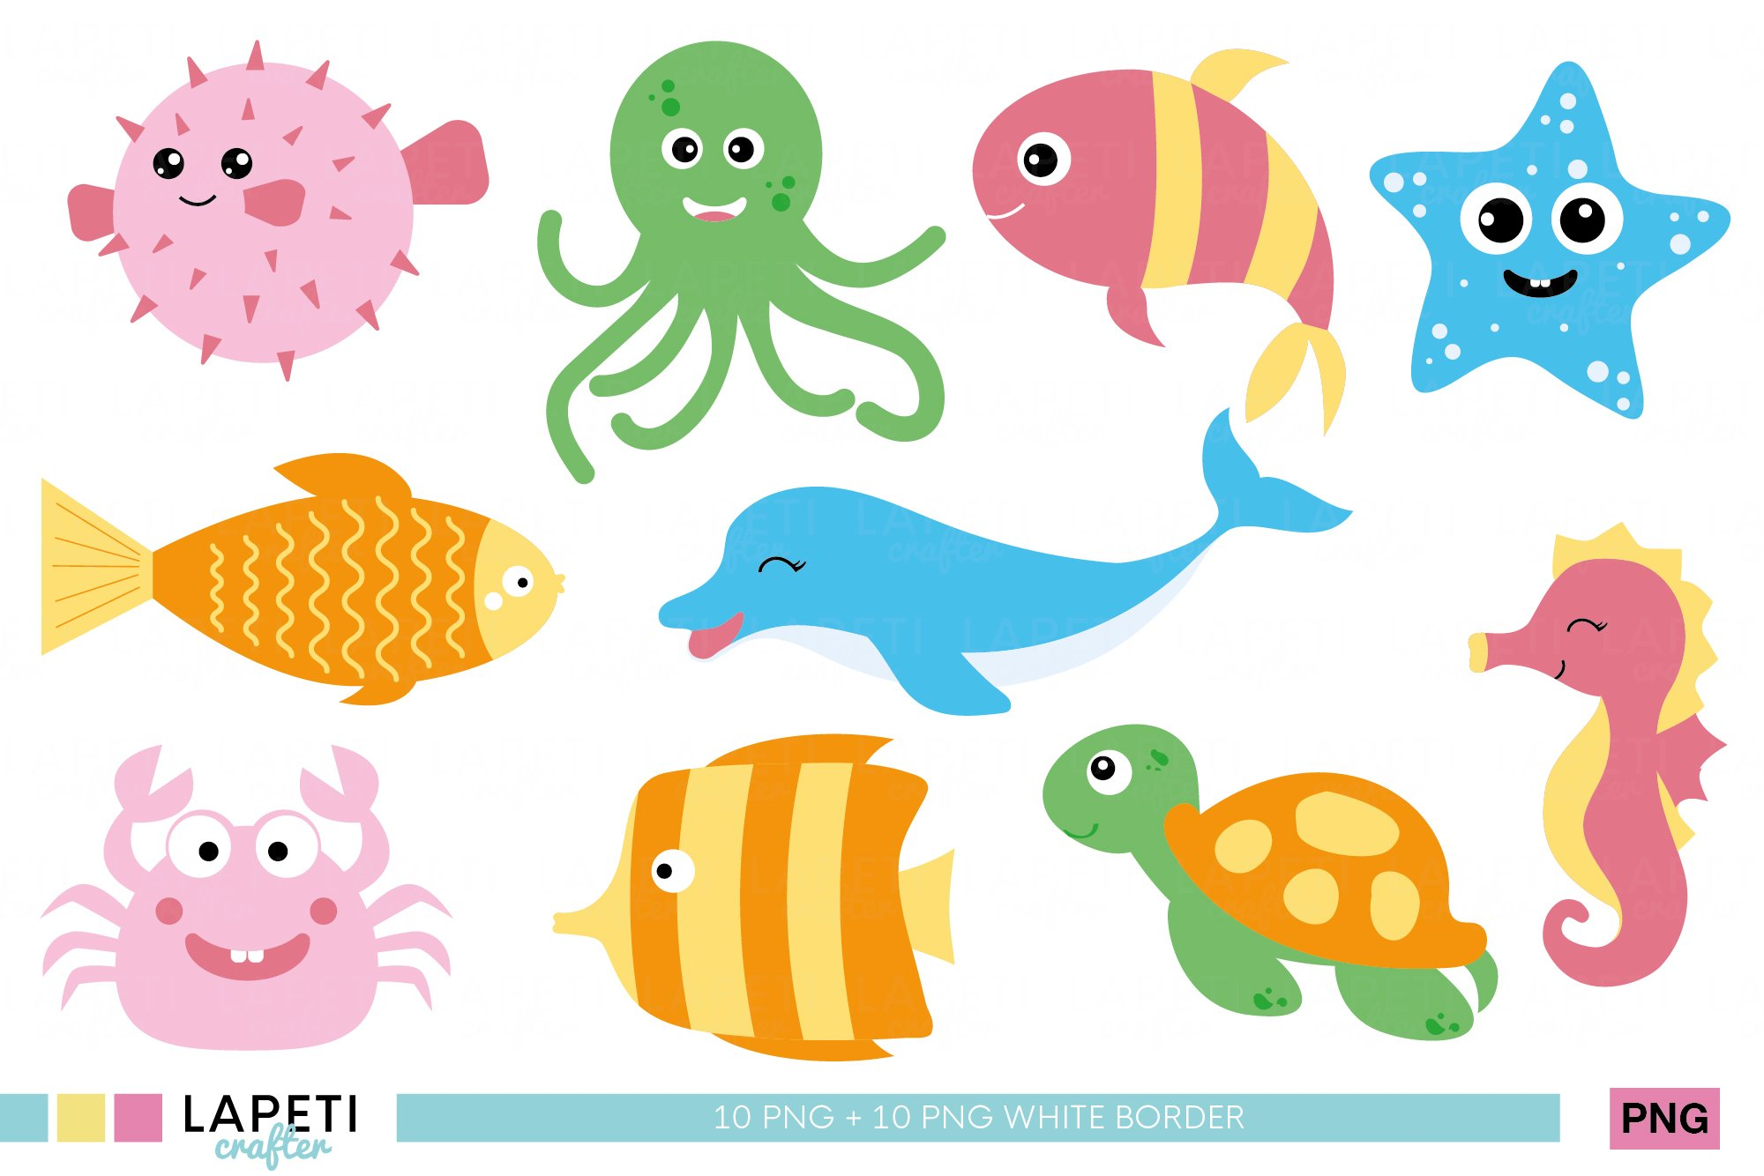
creature (n)
/ˈkriː.tʃər/
sinh vật

Slide 11
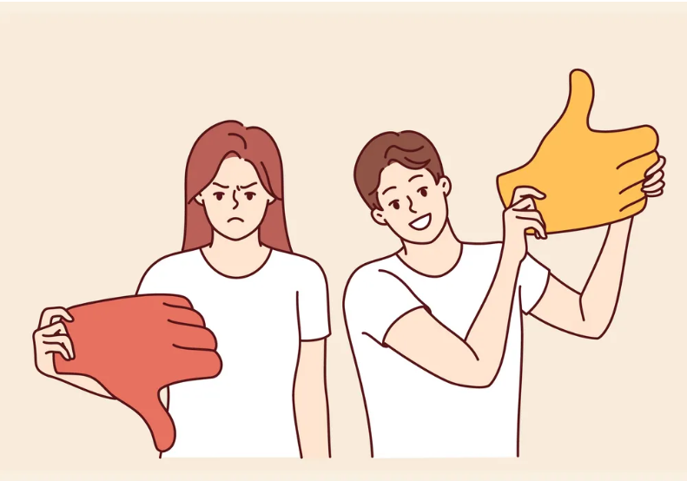
oppose (v)
/əˈpəʊz/
phản đối, chống đối lại

Slide 12
Birthdays
NEW WORDS
Words | Pronunciation | Meanings
alien (n) | /ˈeɪ.li.ən/
planet (n) | /ˈplæn.ɪt/
spaceship (n) | /ˈspeɪs.ʃɪp/
commander (n) | /kəˈmɑːn.dər/
creature (n) | /ˈkriː.tʃər/
oppose (v) | /əˈpəʊz/
JAN
FEB
MAR
APR
MAY
JUN
người ngoài hành tinh
1.
2.
3.
4.
1.
2.
3.
4.
1.
2.
3.
4.
1.
2.
3.
4.
1.
2.
3.
4.
1.
2.
3.
4.
hành tinh
phi thuyền
người chỉ huy, người cầm đầu
JUL
AUG
SEP
OCT
NOV
DEC
1.
2.
3.
4.
1.
2.
3.
4.
1.
2.
3.
4.
sinh vật
1.
2.
3.
4.
1.
2.
3.
4.
phản đối, chống đối lại

Slide 13
“This is a quote, words full of wisdom that someone important said and can make the reader get inspired.”
—Someone Famous
02
PRACTICE

Slide 14
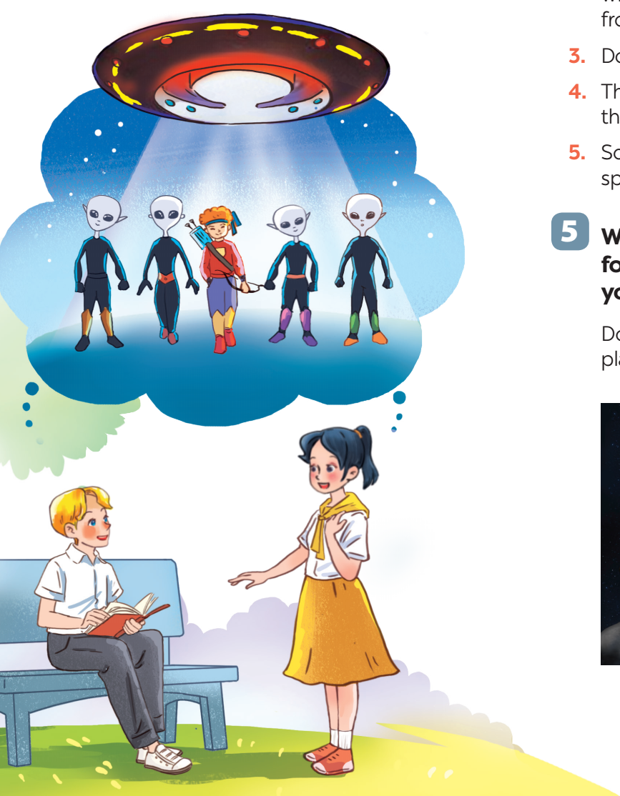

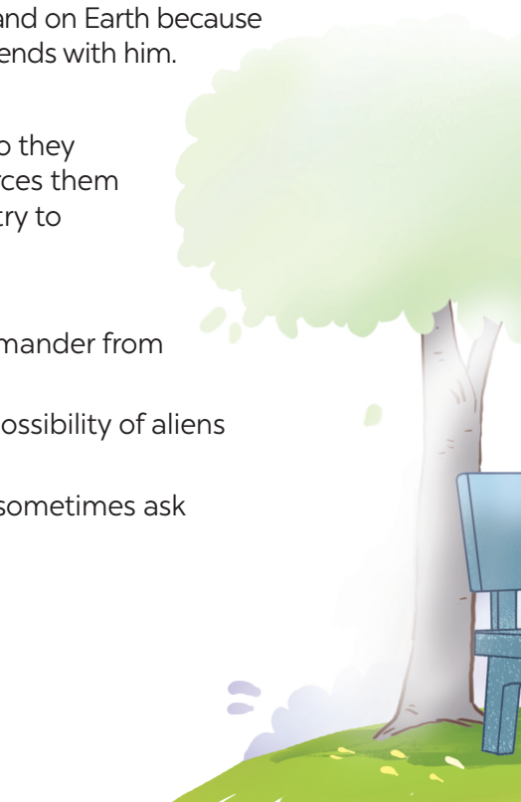
Look and answer.
1. Who are they?
Mai and Nick
2. What is Nick doing?
He is reading a book.
3. What are they talking about?
Listen and check.
Nick
Mai

Slide 15
Read and listen
Mai: What book are you reading, Nick?
Nick: A journey back to Soduka. I’m on the last page.
Mai: That’s a science fiction book, isn’t it? What’s it about?
Nick: Yes, it is. It’s about four creatures Titu, Kaku, Hub, and Barb. They’re travelling back to Soduka, a planet like Earth. Along the way they have to land on Earth because their spaceship breaks down. They meet Tommy and become friends with him.
Mai: What happens next?
Nick: Tommy helps the four creatures repair their spaceship, so they can travel back to their home planet. But their commander forces them to return to Earth to destroy it. Tommy and the four creatures try to oppose the commander.
Mai: Sounds thrilling!
Nick: Tommy and the four creatures manage to stop the commander from destroying Earth.
Mai: So it has a happy ending! What do you think about the possibility of aliens attacking Earth?
Nick: I’m not sure about it. But I’m starting to think about it. I sometimes ask myself what we would do if aliens took over our planet.

Slide 16
Look and answer.
1. Who are they?
Mai and Nick
2. What is Nick doing?
He is reading a book.
3. What are they talking about?
They are talking about the science fiction book Nick is reading.
Nick
Mai

Slide 17
Ex 2. Read again and tick T (True) or F (False)
Statements | T | F
1. Soduka is a planet that is very different from Earth.
2. Titu, Kaku, Hub, and Barb have to land on Earth because their spaceship breaks down.
3. Tommy helps the four creatures make a new spaceship so that they can return to Soduka.
4. The four creatures travel to Earth again to visit Tommy.
5. The novel makes Nick and Mai think about the possibility that Earth might be attacked by aliens.
Soduka
different
Earth
Titu, Kahu, Hub, and Barb
land on Earth
spaceship
breaks down
Tommy
helps
four creatures
make
new spaceship
return
Soduka
four creatures
travel
Earth
again
visit
Tommy
novel
Nick and Mai
think
possibility
Earth
be attacked
by aliens

Slide 18
Ex 2. Read again and tick T (True) or F (False)
Statements | T | F
1. Soduka is a planet that is very different from Earth.

Mai: That’s a science fiction book, isn’t it? What’s it about?
Nick: Yes, it is. It’s about four creatures Titu, Kaku, Hub, and Barb. They’re travelling back to Soduka, a planet like Earth. Along the way they have to land on Earth because their spaceship breaks down. They meet Tommy and become friends with him.

Slide 19
Ex 2. Read again and tick T (True) or F (False)
Statements | T | F
2. Titu, Kaku, Hub, and Barb have to land on Earth because their spaceship breaks down.

Mai: That’s a science fiction book, isn’t it? What’s it about?
Nick: Yes, it is. It’s about four creatures Titu, Kaku, Hub, and Barb. They’re travelling back to Soduka, a planet like Earth. Along the way they have to land on Earth because their spaceship breaks down. They meet Tommy and become friends with him.

Slide 20
Ex 2. Read again and tick T (True) or F (False)
Statements | T | F
3. Tommy helps the four creatures make a new spaceship so that they can return to Soduka.

Mai: That’s a science fiction book, isn’t it? What’s it about?
Nick: Yes, it is. It’s about four creatures Titu, Kaku, Hub, and Barb. They’re travelling back to Soduka, a planet like Earth. Along the way they have to land on Earth because their spaceship breaks down. They meet Tommy and become friends with him.
Mai: What happens next?
Nick: Tommy helps the four creatures repair their spaceship, so they can travel back to their home planet. But their commander forces them to return to Earth to destroy it. Tommy and the four creatures try to oppose the commander.

Slide 21
Ex 2. Read again and tick T (True) or F (False)
Statements | T | F
4. The four creatures travel to Earth again to visit Tommy.

Mai: What happens next?
Nick: Tommy helps the four creatures repair their spaceship, so they can travel back to their home planet. But their commander forces them to return to Earth to destroy it. Tommy and the four creatures try to oppose the commander.

Slide 22
Ex 2. Read again and tick T (True) or F (False)
Statements | T | F
5. The novel makes Nick and Mai think about the possibility that Earth might be attacked by aliens.

Mai: So it has a happy ending! What do you think about the possibility of aliens attacking Earth?
Nick: I’m not sure about it. But I’m starting to think about it. I sometimes ask myself what we would do if aliens took over our planet.

Slide 23
Ex 2. Read again and tick T (True) or F (False)
Statements | T | F
1. Soduka is a planet that is very different from Earth.
2. Titu, Kaku, Hub, and Barb have to land on Earth because their spaceship breaks down.
3. Tommy helps the four creatures make a new spaceship so that they can return to Soduka.
4. The four creatures travel to Earth again to visit Tommy.
5. The novel makes Nick and Mai think about the possibility that Earth might be attacked by aliens.

Soduka
different
Earth
Titu, Kahu, Hub, and Barb
land on Earth

spaceship
breaks down
Tommy
helps
four creatures
make
new spaceship

return
Soduka

four creatures
travel
Earth
again
visit
Tommy
novel
Nick and Mai
think
possibility

Earth
be attacked
by aliens

Slide 24
Ex 3. Match the words (1 - 5) with their definitions (a - e).
a. real or imaginary living things
1. oppose
b. living things from another world or planet
2. creatures
c. to fight against
3. commander
d. the fact that something might exist or happen, but is not certain to
4. aliens
5. possibility
e. an officer in charge of a particular group of soldiers

Slide 25
Ex 4. Complete the sentences with the words in 3.
oppose
creatures
commander
aliens
possibility
1. There is a _________ that we might visit Mars in the near future.
2. The main character in the film is a boy who makes friends with some _____ from a planet.
3. Dogs are more social ________ than cats.
4. These soldiers were punished because they didn’t obey their _________.
5. Some people _______ sending spaceships to explore other planets.
possibility
might visit
in the near future
some
aliens
from a planet
Dogs
creatures
cats
soldiers
didn’t obey
commander
oppose
sending
oppose + V-ing: không đồng tình, phản đối, chống đối điều gì

Slide 26
DEBATING
AGREE or DISAGREE?
Do you believe that there is life on other planets?
The Sun’s mass compared to Earth’s
Distance between Earth and the Moon

Slide 27
IS THERE LIFE ON OTHER PLANETS?
3 teams
AGREE
NEUTRAL
DISAGREE
3 minutes to discuss and give reasons why you agree/disagree.
2 minutes to present in front of class.
1 minute for the opposing team to argue.
Neutral team listens and decides the winner.

Slide 28
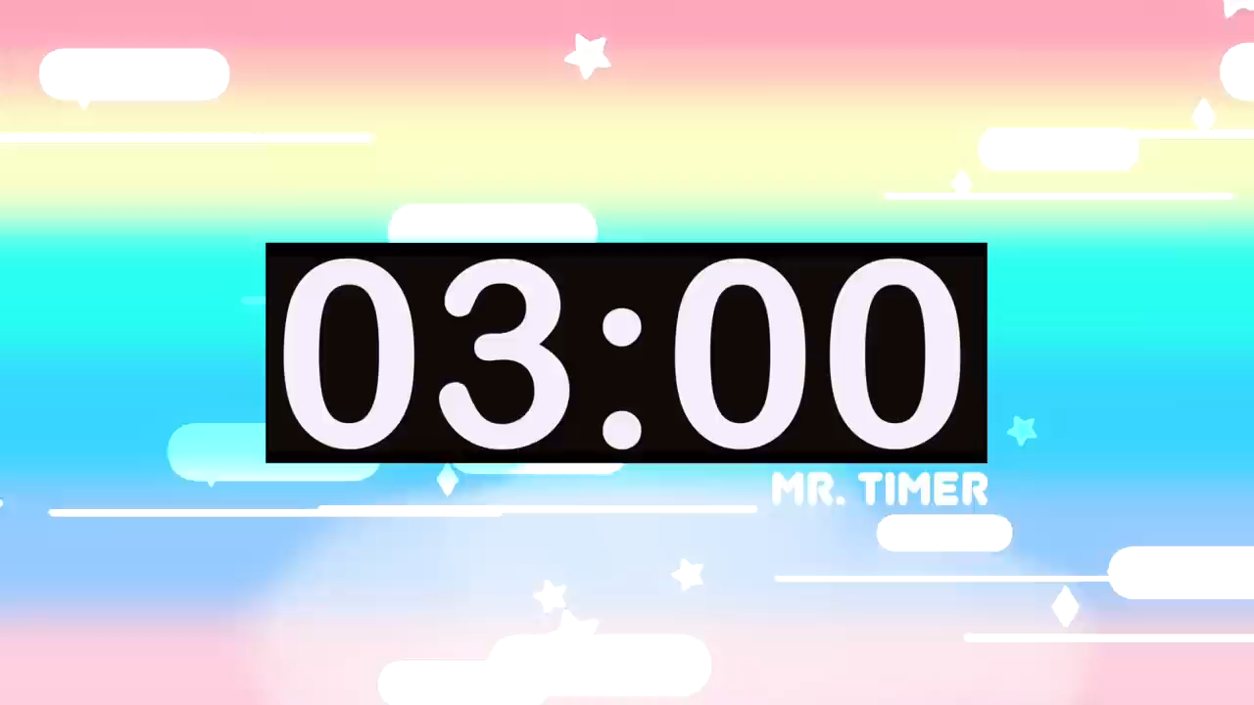
DISCUSSING
IS THERE LIFE ON OTHER PLANETS?
AGREE
DISAGREE

Slide 29

DEBATING
IS THERE LIFE ON OTHER PLANETS?
AGREE
DISAGREE

Slide 30
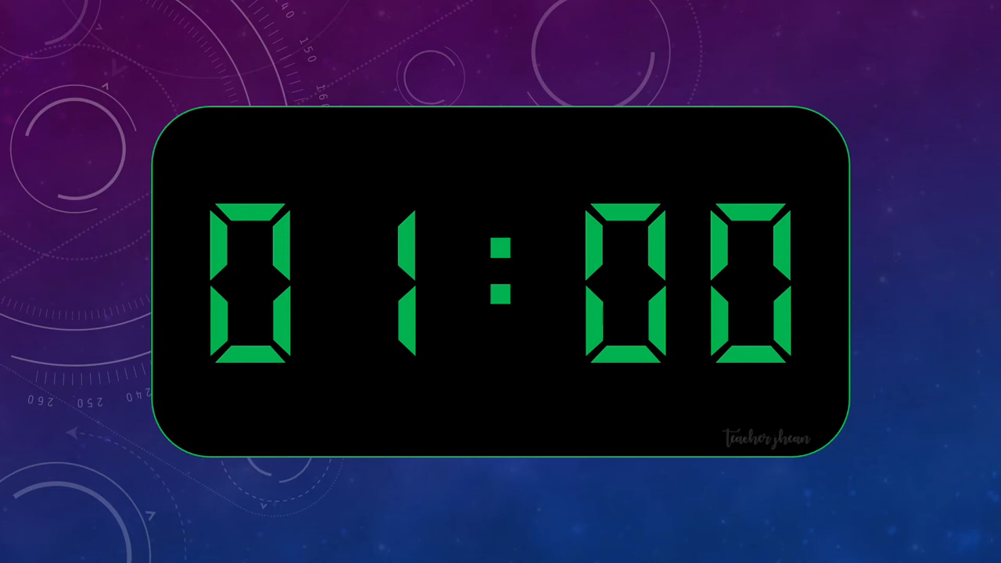
ARGUING

Slide 31
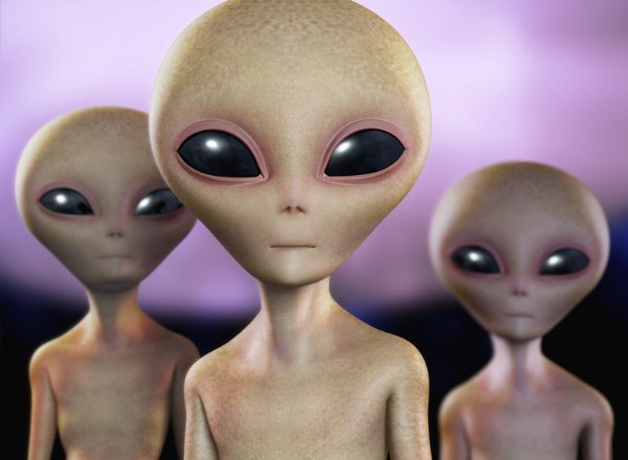
WRAP-UP
01
Who forces four creatures Titu, Kahu, Hub and Barb to return to Earth and destroy it?
A. Tommy
B. Their commander
C. Mai and Nick
02
The living things from another world or planet are called ______
Images reveal large amounts of data, so remember: use an image instead of a long text. Your audience will appreciate it
A. creatures
B. humans
C. aliens

Slide 32
Thanks!
Do you have any questions?

