Slide 1
Unit 1. Leisure time
LESSON 6. SKILLS 2

Slide 2
OBJECTIVES
By the end of this lesson, Ss will be able to:
Knowledge
Personal qualities
Listen to someone talking about their leisure activities with friends
Write a paragraph about leisure activities with friends
Love reading and talking about activities in leisure time

Slide 3
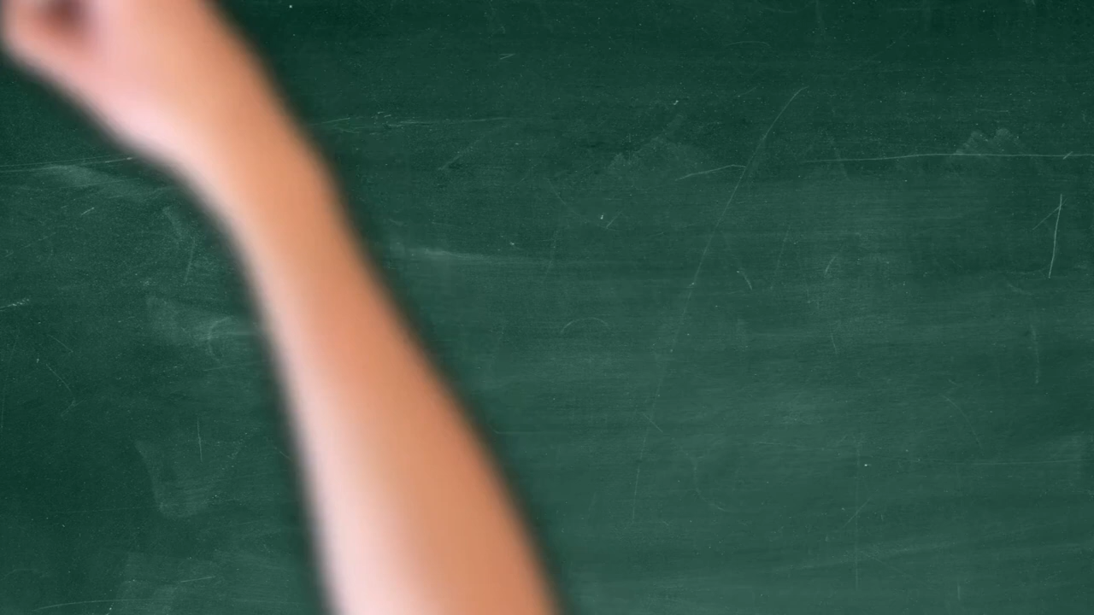
What am I doing?

Slide 4
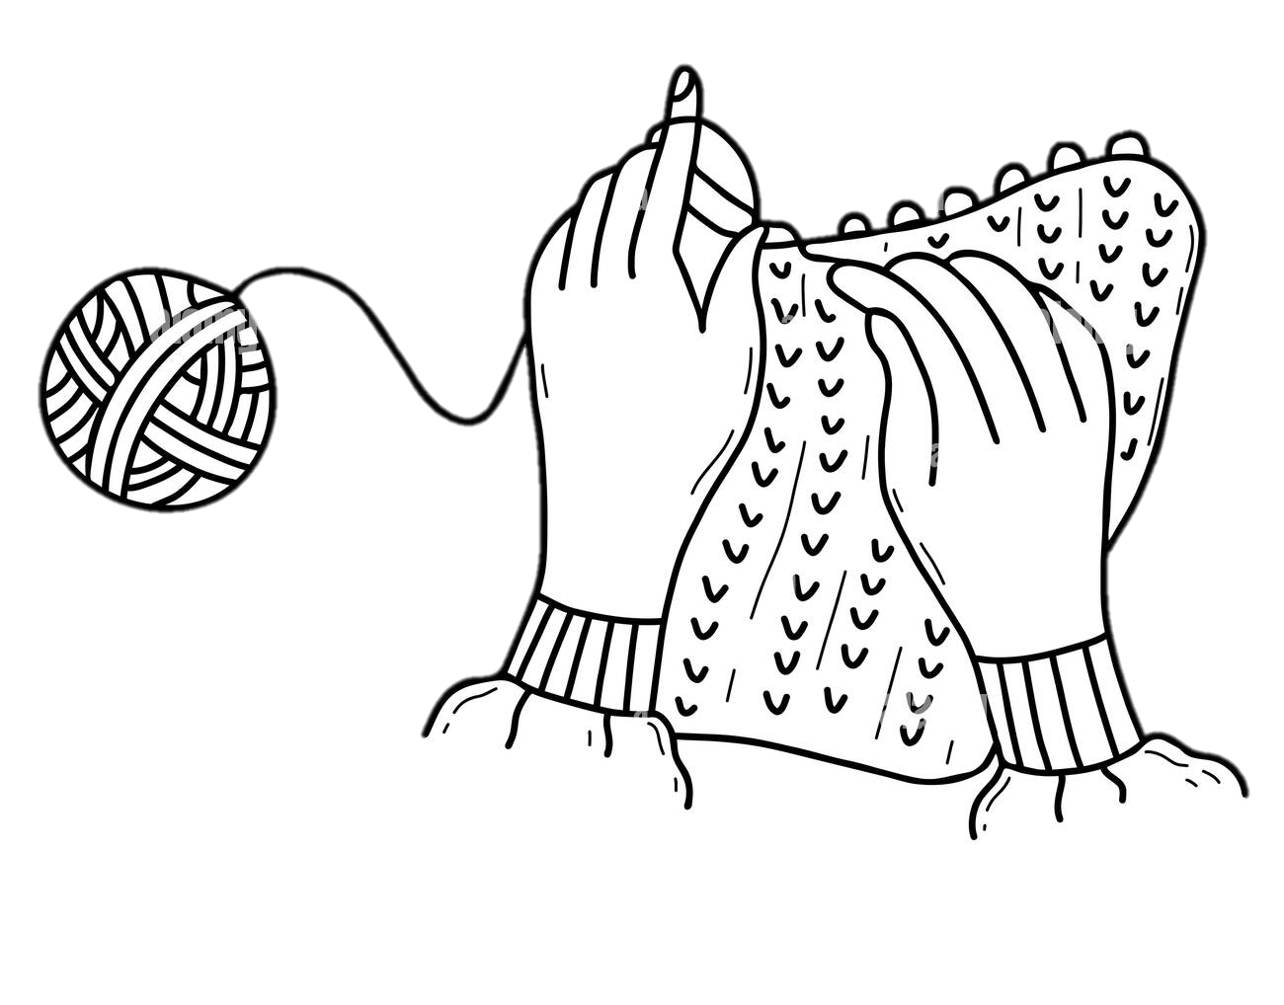
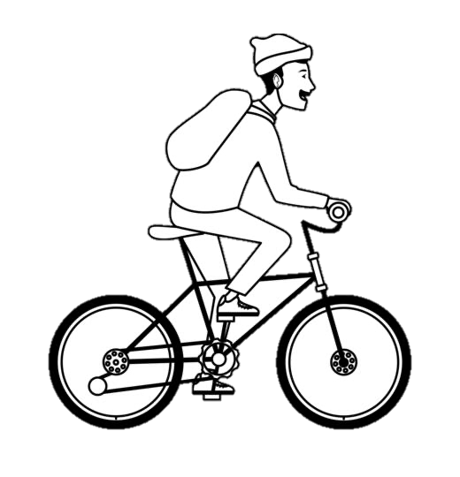
What am I doing?
Knitting
Reading book
Taking photo
Gardening
Playing Guitar
Cycling

Slide 5
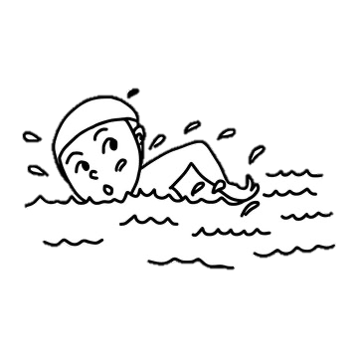

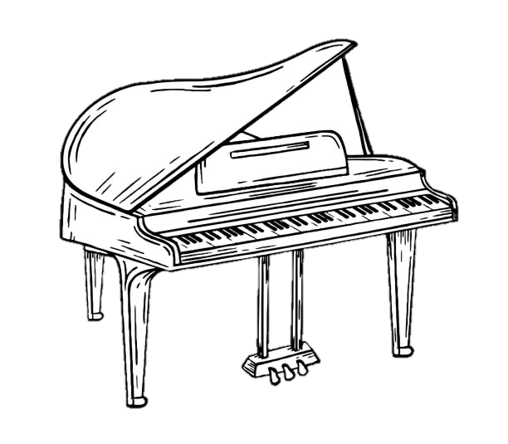
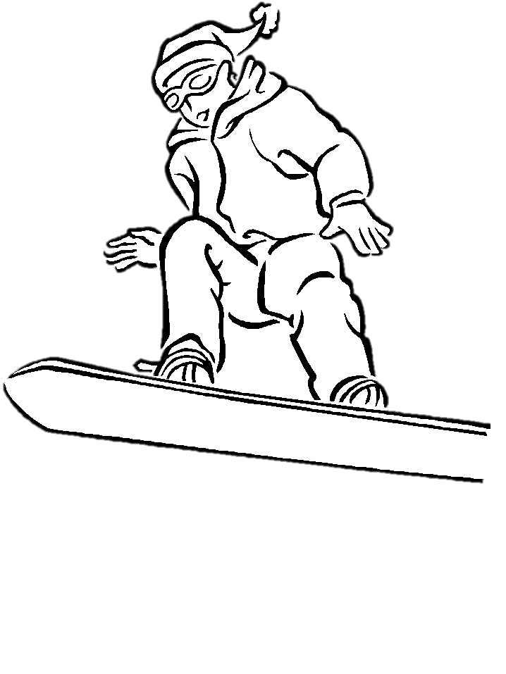
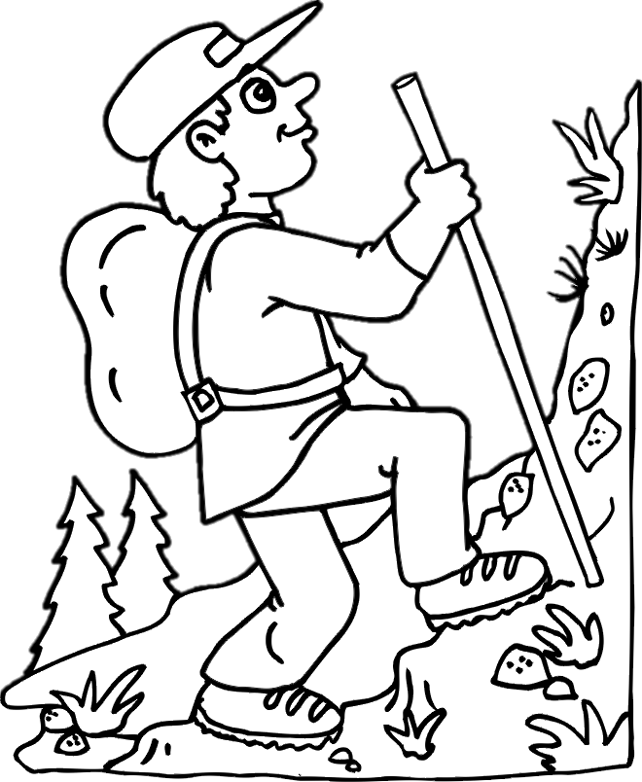
What am I doing?
Swimming
Doing puzzle
Playing piano
Painting
Snowboarding
Climbing mountain

Slide 6



Ex 1 (p 15). Answer these questions.
1. In your opinion, what activities can we do with our friends in our leisure time?
2. Why should we spend time with our friends?

Slide 7



Ex 2 (p 15). Listen to an interview with Mark about his leisure activities. Choose the correct answer.
Interviewer: When do you usually have free time?
Mark: I usually have free time at the weekend.
1
When does Mark usually have free time?
A. At weekends. B. On Sundays. C. On Saturdays.
2
Who does he spend his free time with?
A. His neighbours and friends.
B. His family and relatives.
C. His family and friends.
Interviewer: So how do you spend it?
Mark: I spend time to connect with my family on Saturdays. We do puzzles, play board games or go camping.
Interviewer: What about Sundays?
Mark: I usually spend Sundays with my friends. I have a group of friends and we do lots of things together.

Slide 8
Ex 3 (p 15). Listen again. Fill in each blank in the table with no more than two words.
Activities | Reason
- Inviting friends to his house - Cooking and watching a (1) _________ | - Fun and better than going to the (2) ___________
- Going to the (3) ________ to play volleyball or skateboard | - Stay in (4) ___________
- Going for a (5) ____________ around our city | - See different (6) _________
6.
Mark: Sometimes we go for a bike ride around our city. This gives us a chance to see different places in our city.
2.
Mark: Sometimes I invite them to my house. We cook our favourite food and watch a video. It's fun and better than going to the cinema.
1.
Mark: Sometimes I invite them to my house. We cook our favourite food and watch a video. It's fun and better than going to the cinema.
4.
Mark: Yes, we love spending time outdoors. We go to the park to play volleyball or skateboard. It helps us stay in shape.
5.
Mark: Sometimes we go for a bike ride around our city. This gives us a chance to see different places in our city.
3.
Mark: Yes, we love spending time outdoors. We go to the park to play volleyball or skateboard. It helps us stay in shape.
cinema
video
park
shape
bike ride
places

Slide 9
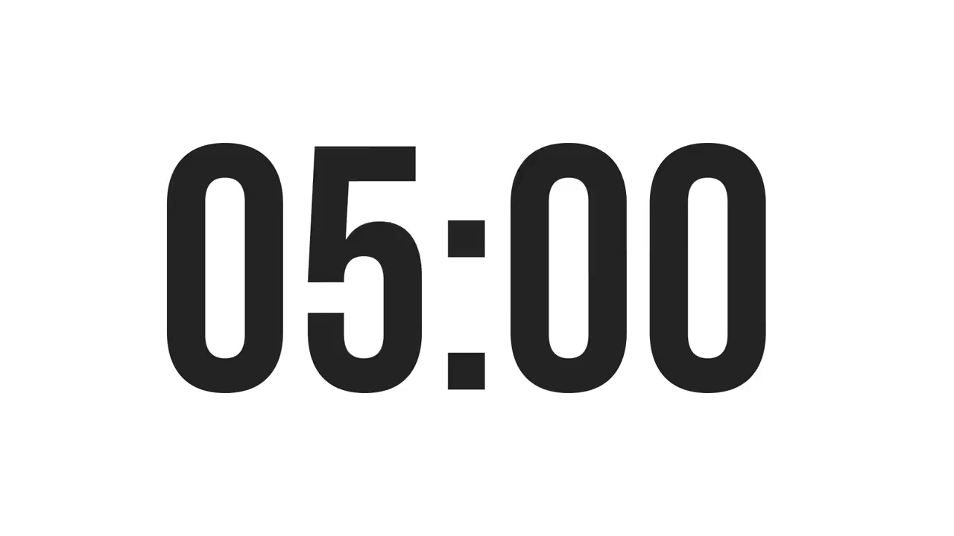
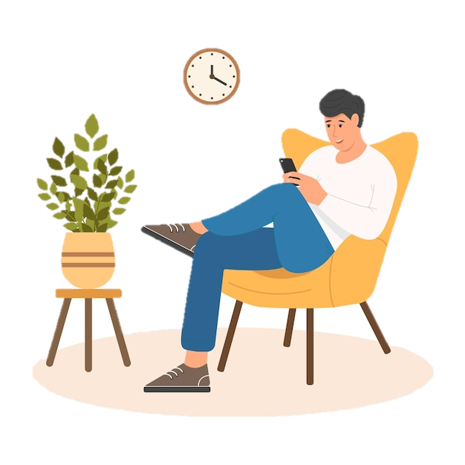
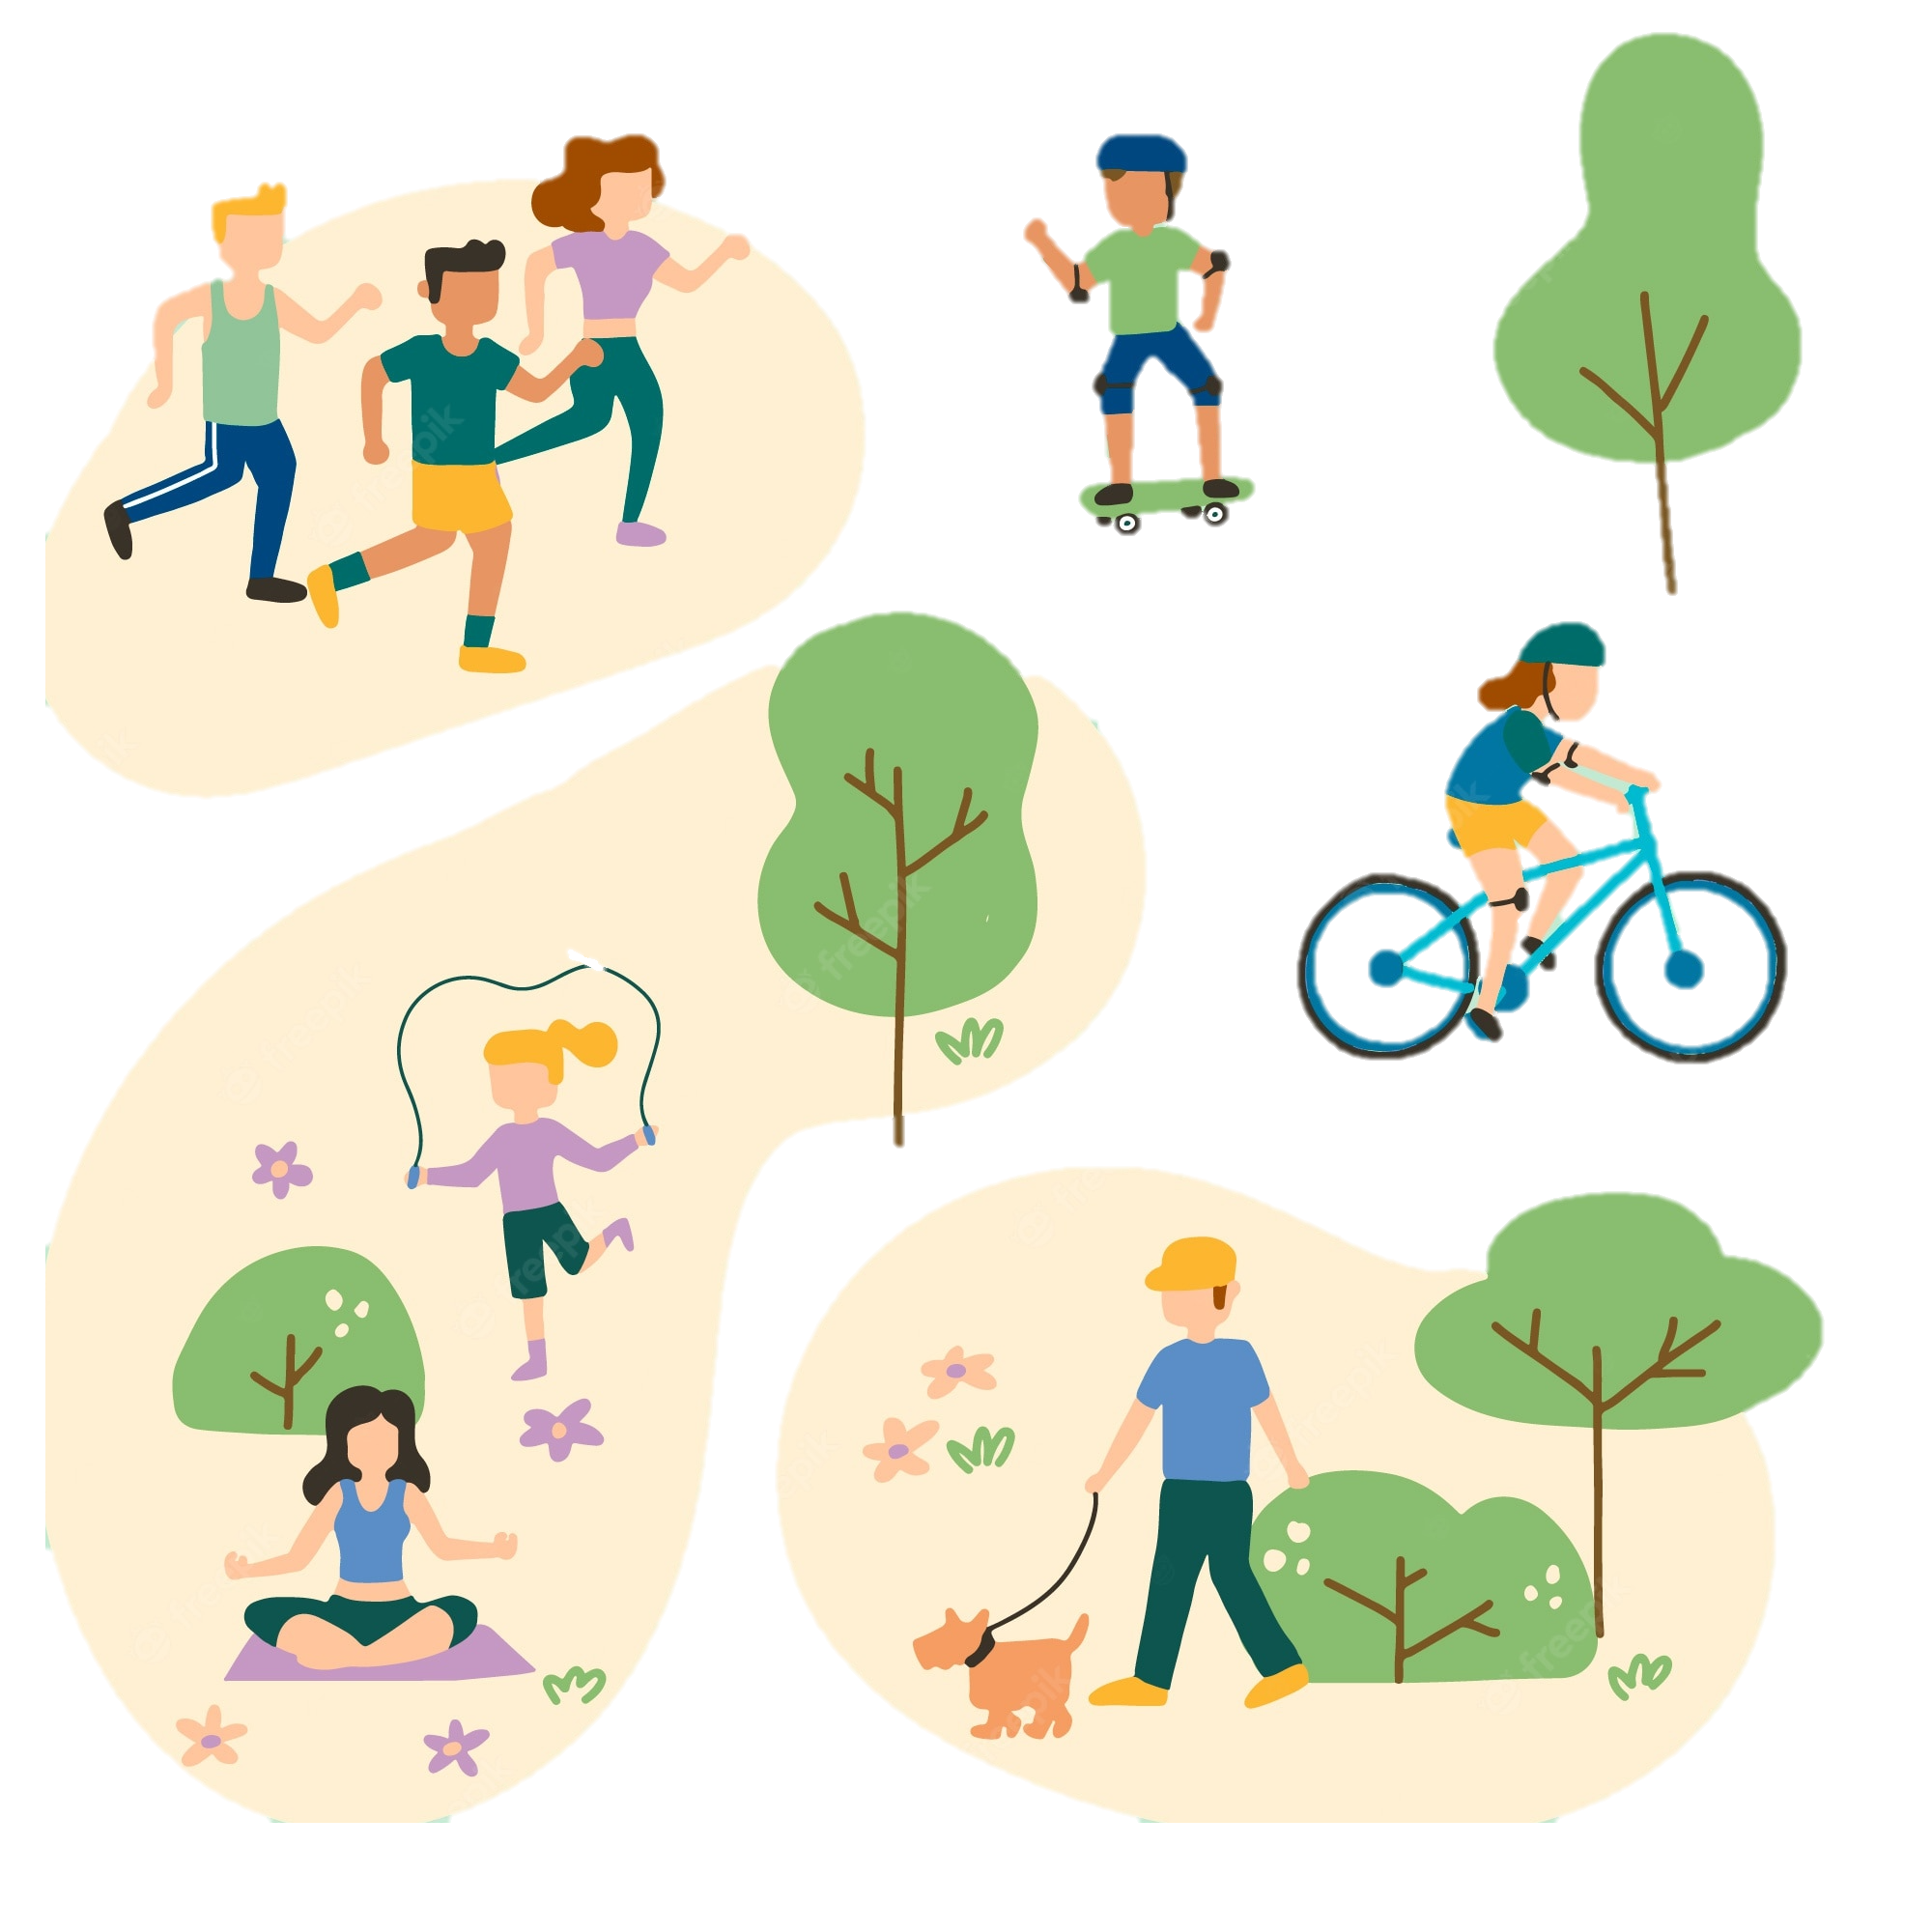

Ex 4 (p 15). Work in pairs. Ask and answer the questions.
When do you usually have free time?
What do you usually do with your friends in your free time?
Why do you do these activities?

Slide 10
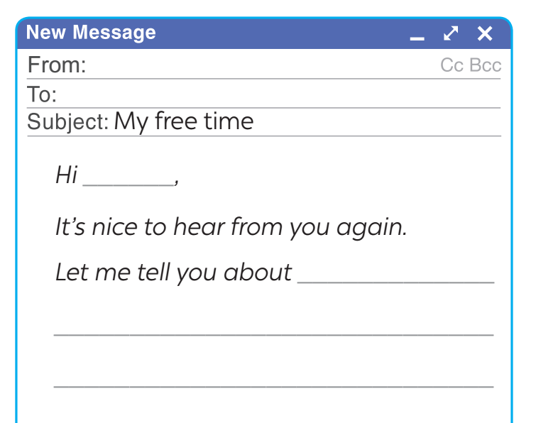

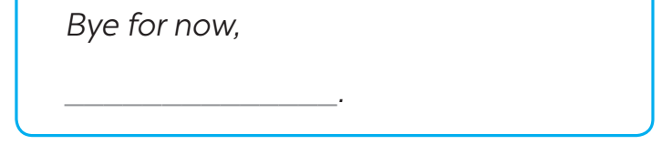
Ex 5 (p 15). Write an email (80 - 100 words) to a penfriend to tell him / her about what you usually do with your friends in your free time. Use your answers in Ex 4.
Start and end the email as follows:
Suggestions:
1. When do you usually have free time?
2. What do you usually do with your friends in your free time?
3. Why do you do these activities?
Hi,
It’s nice to hear from you again,
Let me tell you about how I spend my free time. When I finish all my homework, I often read books and listen to my favorite songs. On Saturday, I usually go swimming with my friends at a nearby pool. We also play football in the afternoon. On Sunday, I always help my mom with housework and cooking meals. Then I do DIY with my younger sister.
How do you spend your free time? I’m looking forward to your reply.
Bye for now,
Mina.

Slide 11
What have you learnt today?
RECAP
Listen to someone talking about their leisure activities
Write an email to talk about leisure activities

Slide 12
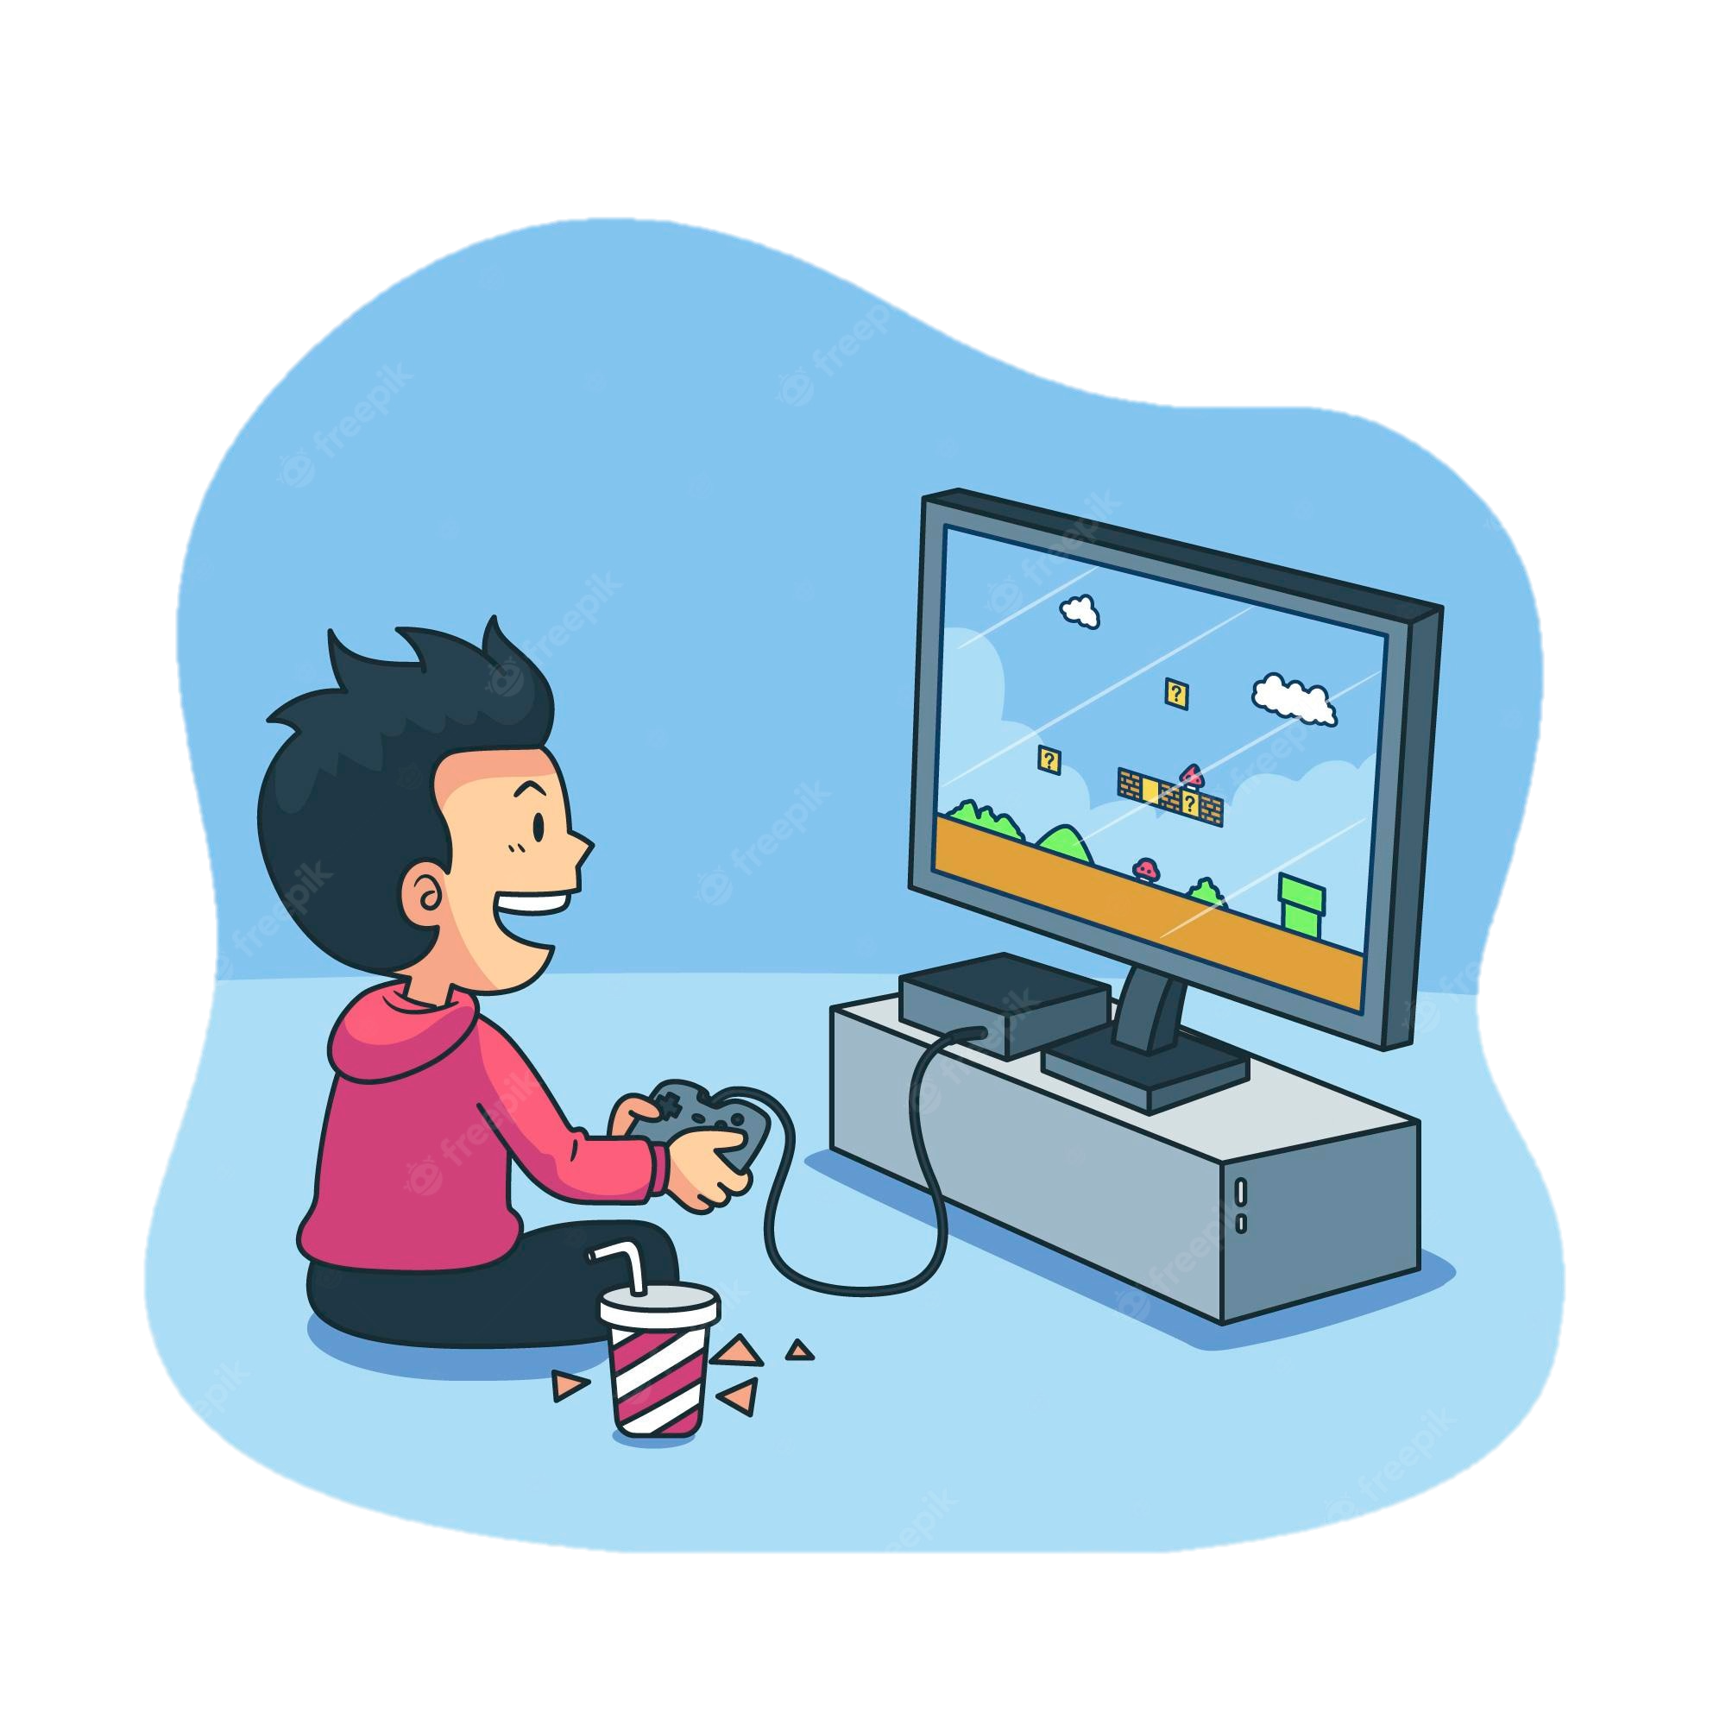
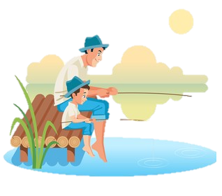

What reason do you choose leisure activities in your free time?
RECAP
Playing video games
Going fishing
Encourage you to change or avoid unhealthy lifestyle habits.
Make connections with the community.
Boost your happiness and reduce your stress.
Reduce eyesight.

Slide 13

Reading
Arts
Sports
Maths

