Slide 1



Unit 1: Leisure time
Lesson 5 – Skills 1
(Page 14)

Slide 2
01
READING

Slide 3
New words | Pronunciation | Meaning
1. connect (v) | /kəˈnekt/ | kết nối
2. recipe (n) | /ˈresɪpi/ | công thức
3. ingredient (n) | /ɪnˈɡriːdiənt/ | nguyên liệu
4. costume (n) | /ˈkɒstʃuːm/ | trang phục

Slide 4
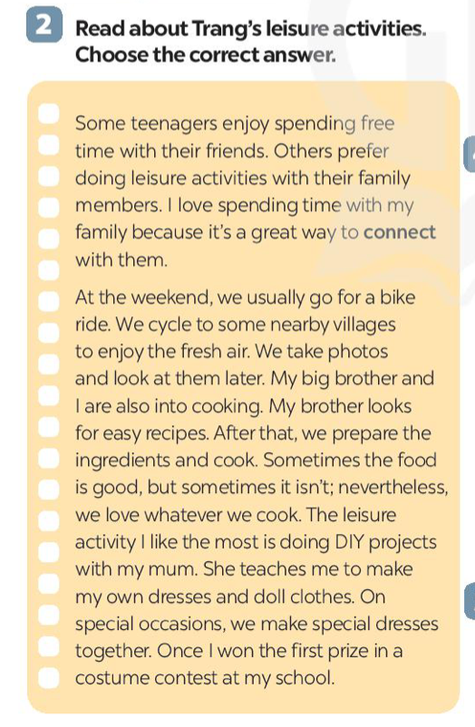
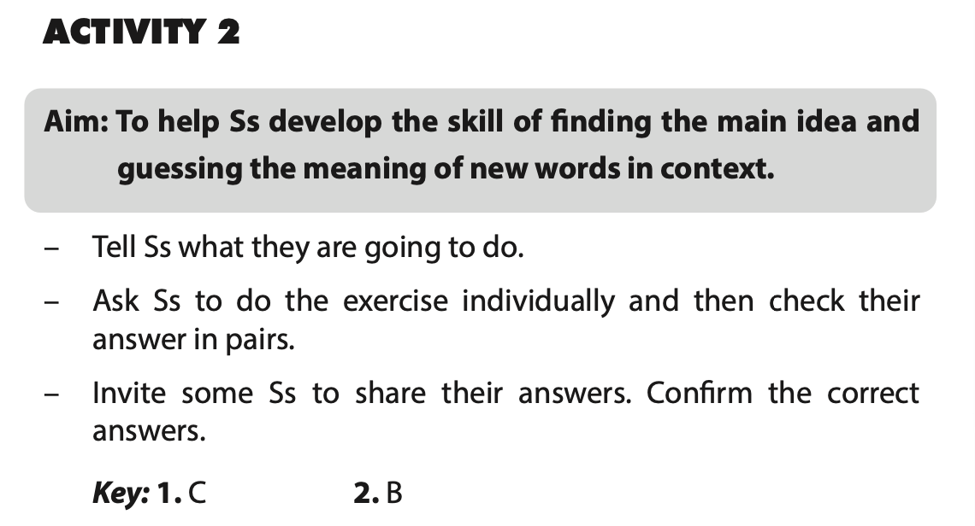
Exercise 2. Read about Trang’s leisure activities. Choose the correct answer.
Some teenagers enjoy spending free time with their friends. Others prefer doing leisure activities with their family members. I love spending time with my family because it's a great way to connect with them.
At the weekend, we usually go for a bike ride. We cycle to some nearby villages to enjoy the fresh air. We take photos and look at them later. My big brother and I are also into cooking. My brother looks for easy recipes. After that, we prepare the ingredients and cook. Sometimes the food is good, but sometimes it isn't; nevertheless, we love whatever we cook. The leisure activity I like the most is doing DIY projects with my mum. She teaches me to make my own dresses and doll clothes. On special occasions, we make special dresses together. Once I won the first prize in a costume contest at my school.
1. The text is about Trang’s leisure activities ______.
A. in the past
B. with her friends
C. with her family
2. The word “connect” is closest in meaning to ______. A. join with something
B. better understand someone
C. speak to someone by phone

Slide 5
Exercise 2. Read about Trang’s leisure activities. Choose the correct answer.
Some teenagers enjoy spending free time with their friends. Others prefer doing leisure activities with their family members. I love spending time with my family because it's a great way to connect with them.
At the weekend, we usually go for a bike ride. We cycle to some nearby villages to enjoy the fresh air. We take photos and look at them later. My big brother and I are also into cooking. My brother looks for easy recipes. After that, we prepare the ingredients and cook. Sometimes the food is good, but sometimes it isn't; nevertheless, we love whatever we cook. The leisure activity I like the most is doing DIY projects with my mum. She teaches me to make my own dresses and doll clothes. On special occasions, we make special dresses together. Once I won the first prize in a costume contest at my school.
Some teenagers enjoy spending free time with their friends. Others prefer doing leisure activities with their family members. I love spending time with my family because it's a great way to connect with them.
At the weekend, we usually go for a bike ride. We cycle to some nearby villages to enjoy the fresh air. We take photos and look at them later. My big brother and I are also into cooking. My brother looks for easy recipes. After that, we prepare the ingredients and cook. Sometimes the food is good, but sometimes it isn't; nevertheless, we love whatever we cook. The leisure activity I like the most is doing DIY projects with my mum. She teaches me to make my own dresses and doll clothes. On special occasions, we make special dresses together. Once I won the first prize in a costume contest at my school.
1. The text is about Trang’s leisure activities ______.
A. in the past
B. with her friends
C. with her family

Slide 6
Exercise 2. Read about Trang’s leisure activities. Choose the correct answer.
Some teenagers enjoy spending free time with their friends. Others prefer doing leisure activities with their family members. I love spending time with my family because it's a great way to connect with them.
At the weekend, we usually go for a bike ride. We cycle to some nearby villages to enjoy the fresh air. We take photos and look at them later. My big brother and I are also into cooking. My brother looks for easy recipes. After that, we prepare the ingredients and cook. Sometimes the food is good, but sometimes it isn't; nevertheless, we love whatever we cook. The leisure activity I like the most is doing DIY projects with my mum. She teaches me to make my own dresses and doll clothes. On special occasions, we make special dresses together. Once I won the first prize in a costume contest at my school.
Some teenagers enjoy spending free time with their friends. Others prefer doing leisure activities with their family members. I love spending time with my family because it's a great way to connect with them.
At the weekend, we usually go for a bike ride. We cycle to some nearby villages to enjoy the fresh air. We take photos and look at them later. My big brother and I are also into cooking. My brother looks for easy recipes. After that, we prepare the ingredients and cook. Sometimes the food is good, but sometimes it isn't; nevertheless, we love whatever we cook. The leisure activity I like the most is doing DIY projects with my mum. She teaches me to make my own dresses and doll clothes. On special occasions, we make special dresses together. Once I won the first prize in a costume contest at my school.
1. The text is about Trang’s leisure activities ______.
A. in the past
B. with her friends
C. with her family
2. The word “connect” is closest in meaning to ______. A. join with something
B. better understand someone
C. speak to someone by phone

Slide 7
Exercise 3. Read the questions and underline key words.
1. What does Trang do with her family members at the weekend?
She goes for a bike ride, takes photos, prepare the ingredients, cook food, does DIY projects.
At the weekend, we usually go for a bike ride. We cycle to some nearby villages to enjoy the fresh air. We take photos and look at them later. My big brother and I are also into cooking. My brother looks for easy recipes. After that, we prepare the ingredients and cook. Sometimes the food is good, but sometimes it isn't; nevertheless, we love whatever we cook. The leisure activity I like the most is doing DIY projects with my mum.

Slide 8
Exercise 3. Read the questions and underline key words.
2. Who looks for recipes when Trang and her brother cook?
Her brother does.
My big brother and I are also into cooking. My brother looks for easy recipes. After that, we prepare the ingredients and cook.

Slide 9
Exercise 3. Read the questions and underline key words.
3. Which leisure activity does she love the most?
She loves doing DIY projects.
The leisure activity I like the most is doing DIY projects with my mum. She teaches me to make my own dresses and doll clothes.

Slide 10
Exercise 3. Read the questions and underline key words.
4. What does Trang’s mum teach her to do?
She teaches Trang to make her own dresses and doll clothes.
The leisure activity I like the most is doing DIY projects with my mum. She teaches me to make my own dresses and doll clothes.

Slide 11
Exercise 3. Read the questions and underline key words.
5. What did she win?
She won the first prize in a costume contest at her school.
On special occasions, we make special dresses together. Once I won the first prize in a costume contest at my school.

Slide 12
02
SPEAKING

Slide 13
Exercise 4. Work in groups. Take turns to ask and answer the questions.
1. What leisure activities do you usually do with your family?
2. Which one do you like the most? Why?
3. How do you feel when you spend time with
your family members?

Slide 14
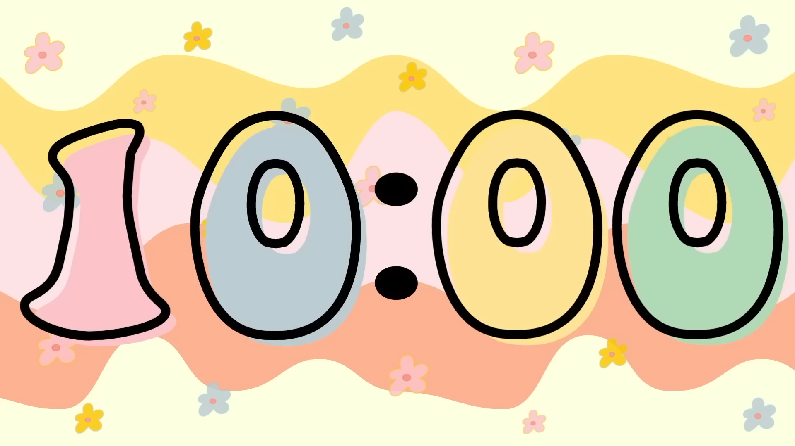
Record your friends’ answer in the table below.
Friends’ name (1 pt) | Questions 1 (3 pts) | Questions 2 (3 pts) | Questions 3 (3 pts)
1. What leisure activities do you usually do with your family?
2. Which one do you like the most? Why?
3. How do you feel when you spend time with your family members?

Slide 15
Checking
Did he/she introduce about his/her group?
Did he/she interview all the members?
Did he/ she answer all the questions?
Did he/she speak confidently?

Slide 16
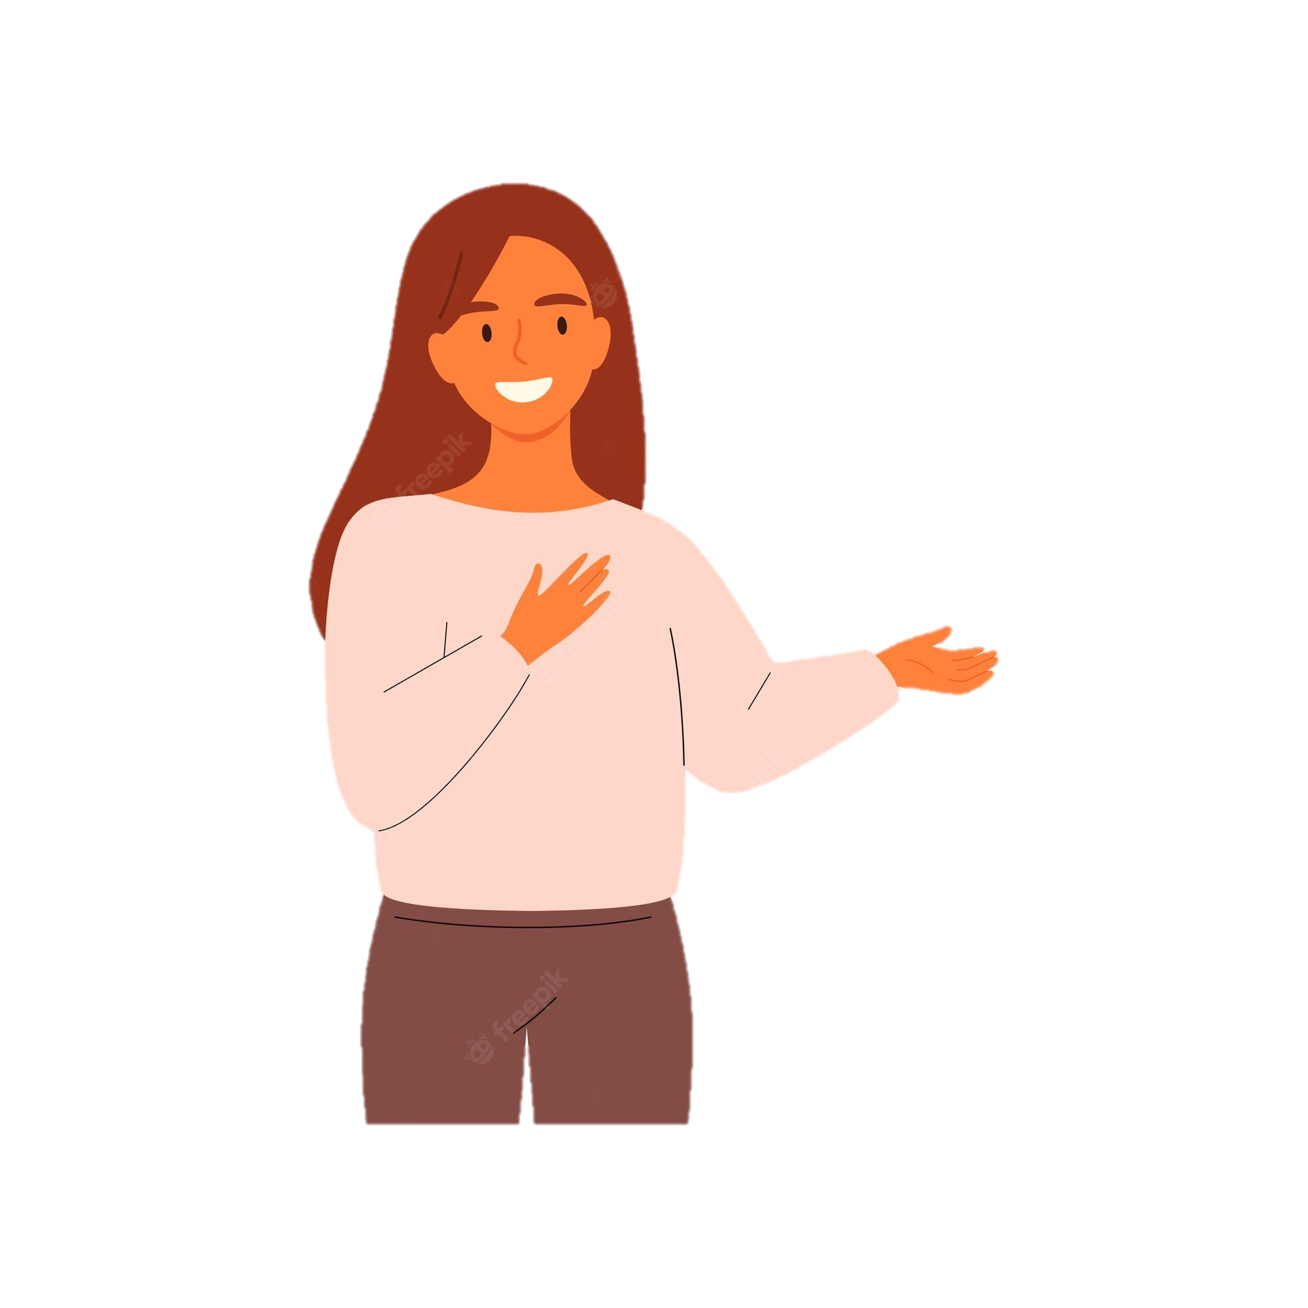
Exercise 5. Report your group members’ answers. What activities are the most common?
The most common activity in my group is …

Slide 17
Wrap up
1. What did we read about?
A. Trang’s mom and her hobbies
B. Trang’s leisure activities
C. Trang’s recipes for cooking
2. What did we speak about?
A. Leisure activities with friends
B. Leisure activities with family
C. Leisure activities with neighborhood

