Slide 1
UNIT 1 LEISURE TIME
Lesson 1: Getting started

Slide 2
OBJECTIVES
01
02
After this lesson, students will be able to:
Have an overview about the topic LEISURE TIME
use lexical items related to LEISURE ACTIVITIES

Slide 3
WARM UP
Work in group.
In 2 mins.
Write as many LEISURE ACTIVITIES as you can.

Slide 4
01
EXTRA VOCABULARY

Slide 5
Vocabulary
New words | Pronunciation | Meaning
1. DIY (n) | /ˌdiːaɪˈwaɪ/ | tự tay làm
2. knitting kit (n) | /ˈnɪtɪŋ kɪt/ | bộ dung cụ đan len
3. dollhouse (n) | /ˈdɒlˌhaʊs/ | nhà búp bê
4. make paper flowers (v.phr) | /meɪk 'peɪpər 'flaʊərz/ | làm hoa giấy
5. hang out (v) | /hæŋ aʊt/ | đi chơi

Slide 6
02
LISTENING READING
Leisure time

Slide 7

Look and guess.
What are they talking about?
What do they do in their free time?
Listen and check.
Mai
Tom

Slide 8
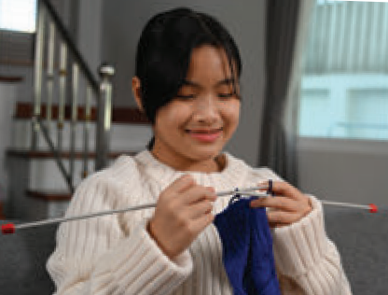
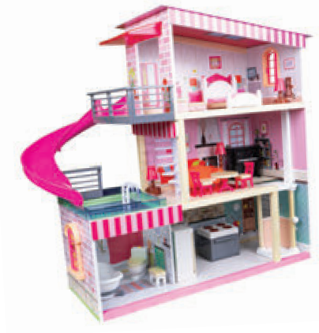
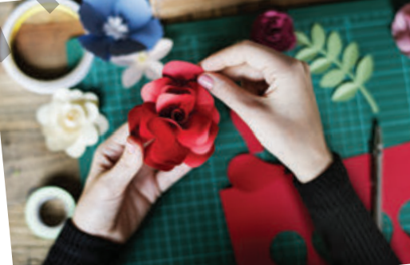
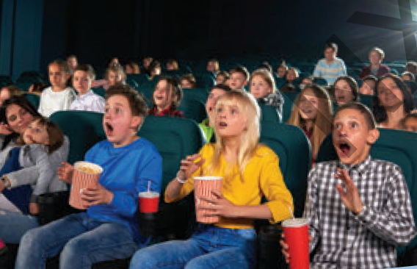
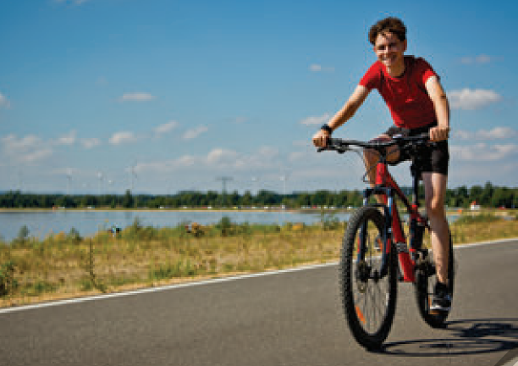
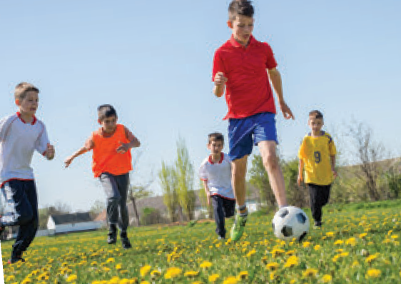
Listen and check.
What do they do in their free time?
knitting
building dollhouses
making paper flowers
go to the cinema
go cycling
play sport in the park
Mai
Tom

Slide 9
2. Read the conversation again and complete the sentences.
Tom: Hi, Trang. Surprised to see you. What brings you here?
Trang: Oh, hello Tom. I’m looking for a knitting kit.
Tom: A knitting kit? I didn’t know you like knitting. Trang: Actually, I’m keen on many DIY activities. In my leisure time, I love knitting, building dollhouses, and making paper flowers.
Tom: I see. So, you like spending time on your own.
Trang: Yes. What do you do in your free time?
Tom: I’m a bit different. I usually hang out with my friends. We go to the cinema, go cycling, or play sport in the park.
Trang: You love spending free time with other people, don’t you?
Tom: That’s right. By the way, would you like to go to the cinema with me and Mark this Sunday? There’s a new comedy at New World Cinema.
Trang: Yes, I’d love to. Can I ask Mai to join us?
Tom: Sure. Let’s meet outside the cinema at 9 a.m.

Slide 10
2. Read the conversation again and complete the sentences.
Trang is looking for a ____________.
She likes doing DIY in her ____________.
Tom loves spending his free time with ____________.
Tom and his friends usually _________ together.
Tom, Mark, Trang, and Mai are going to see a comedy this _______.
knitting kit
Tom: Hi, Trang. Surprised to see you. What brings you here?
Trang: Oh, hello Tom. I’m looking for a knitting kit.

Slide 11
2. Read the conversation again and complete the sentences.
Trang is looking for a ____________.
She likes doing DIY in her ____________.
Tom loves spending his free time with ____________.
Tom and his friends usually _________ together.
Tom, Mark, Trang, and Mai are going to see a comedy this _______.
knitting kit
Trang: Actually, I’m keen on many DIY activities. In my leisure time, I love knitting, building dollhouses, and making paper flowers.
leisure time

Slide 12
2. Read the conversation again and complete the sentences.
Trang is looking for a ____________.
She likes doing DIY in her ____________.
Tom loves spending his free time with ____________.
Tom and his friends usually _________ together.
Tom, Mark, Trang, and Mai are going to see a comedy this _______.
knitting kit
Trang: You love spending free time with other people, don’t you?
Tom: That’s right.
leisure time
other people

Slide 13
2. Read the conversation again and complete the sentences.
Trang is looking for a ____________.
She likes doing DIY in her ____________.
Tom loves spending his free time with ____________.
Tom and his friends usually _________ together.
Tom, Mark, Trang, and Mai are going to see a comedy this _______.
knitting kit
Trang: Yes. What do you do in your free time?
Tom: I’m a bit different. I usually hang out with my friends. We go to the cinema, go cycling, or play sport in the park.
leisure time
other people
hang out

Slide 14
2. Read the conversation again and complete the sentences.
Trang is looking for a ____________.
She likes doing DIY in her ____________.
Tom loves spending his free time with ____________.
Tom and his friends usually _________ together.
Tom, Mark, Trang, and Mai are going to see a comedy this _______.
knitting kit
Tom: That’s right. By the way, would you like to go to the cinema with me and Mark this Sunday? There’s a new comedy at New World Cinema.
Trang: Yes, I’d love to. Can I ask Mai to join us?
Tom: Sure.
leisure time
other people
hang out
Sunday

Slide 15
03
SPORT ACTIVITIES
Leisure time

Slide 16
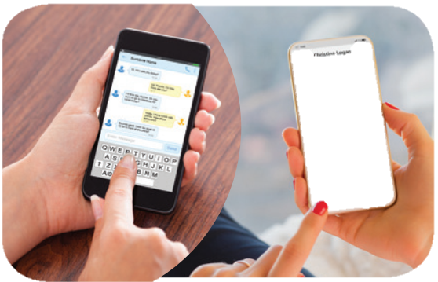
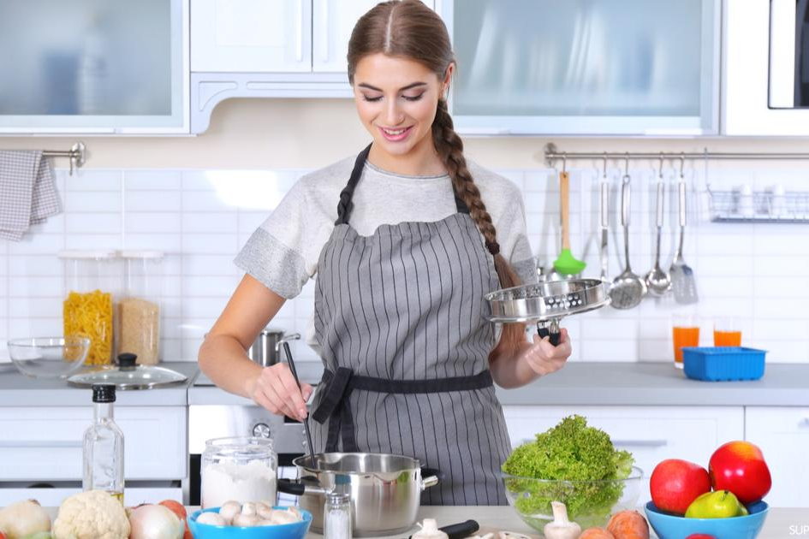
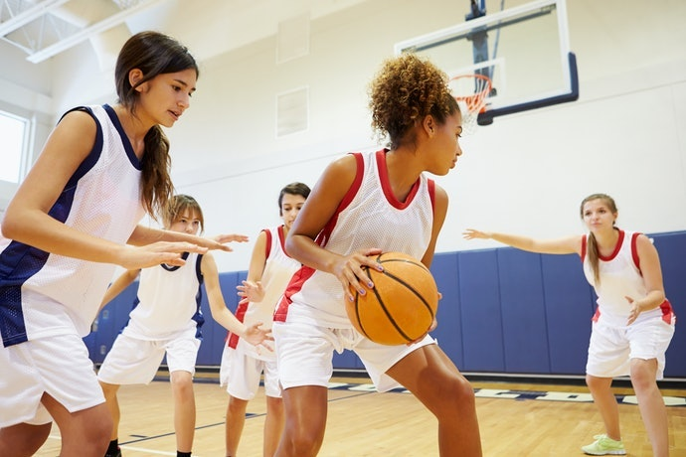
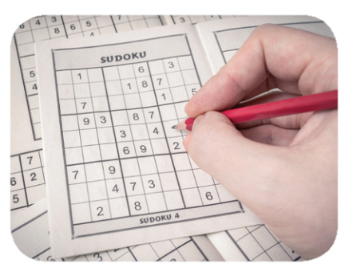
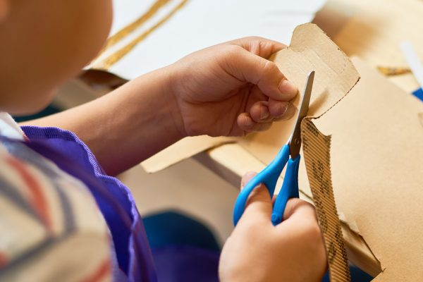
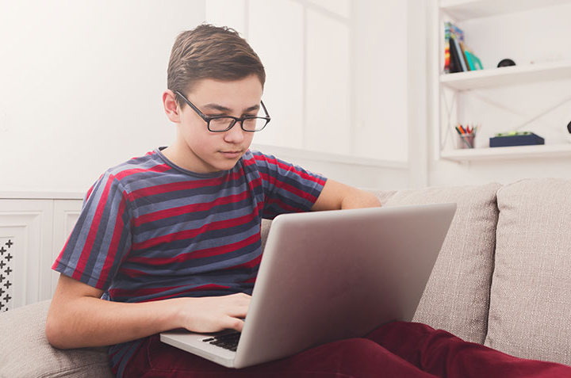
3. Work in pairs. Write the activities under the correct pictures.
doing DIY
cooking
doing puzzles
playing sport
surfing the net
messaging friends
1. messaging friends
2. cooking
3. playing sport
4. doing puzzles
5. doing DIY
6. surfing the net

Slide 17

4 CLUES
1 WORD
Notes:
This template is for educational, non-commercial purposes only. For more free game templates like this one, visit https://www.taysteachingtoolkit.com

Slide 18

I will show you 4 clues.

Slide 19

widen your knowledge
relax
EX.
improve memory
reduce stress

Slide 20
Guess the secret word from the 4 clues.

Slide 21
widen your knowledge
relax
EX.
improve memory
reduce stress
Notes:
GV bấm lần lượt thì các gợi ý sẽ hiện ra. Nếu HS chỉ cần 1,2 gợi ý đã đoán được thì GV có thể bấm vào giữa để hiện luôn đáp án

Slide 22


reading books

Slide 23
If you want to guess, raise your hand.

Slide 24
If you’re right, your team gets 1 point.

Slide 25
The team with the most points at the end of the game wins!

Slide 26
LET’S PLAY!

Slide 27

improve memory
a mental exercise
#1
better problem-solving skills
increased IQ

Slide 28

doing puzzles

Slide 29

save money
increase creativity
#2
spend more time with others
work with your hands

Slide 30

doing DIY

Slide 31

improve physical health
make friends
#3
better sleep
healthier heart

Slide 32

playing sport

Slide 33

keep in touch
develop social skills
#4
improve interpersonal relationships
be relaxed

Slide 34

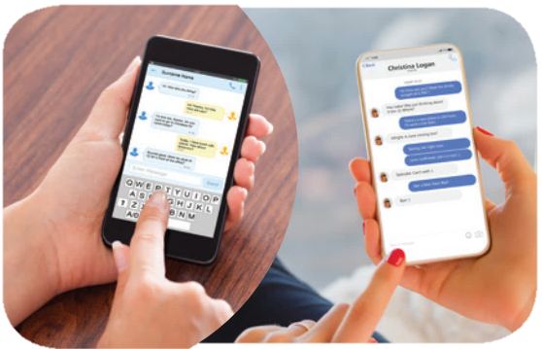
messaging friends

Slide 35

learn something about IT
computer skills
#5
get the information easily and quickly
online shopping

Slide 36

surfing the net

Slide 37

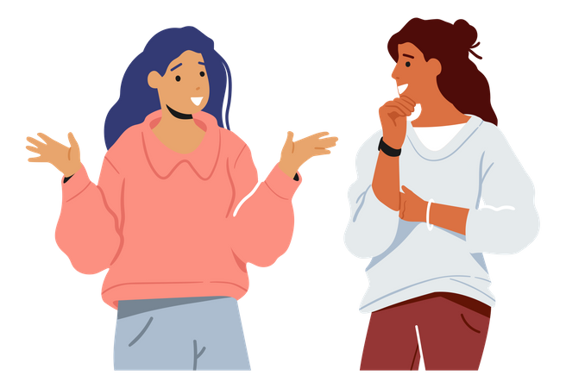
3. Work in pairs. Write the activities under the correct pictures.
Work in groups.
Ask one another the question below.
Then report your friends’ answers to the class.
If you have some free time this weekend, what will you do?
….

Slide 38
CONSOLIDATION
What have we learnt in this lesson?
✓ identify the topic of the unit
✓ use lexical items related to leisure activities

Slide 39
THANKS FOR YOUR ATTENTION!
Please keep this slide for attribution

