Slide 1


Slide 2


Unit
11
SCIENCE AND TECHNOLOGY
LESSON 7: LOOKING BACK AND PROJECT
1

Slide 3
LESSON 7: LOOKING BACK AND PROJECT
WARM-UP
Kim’s game
Task 1: Circle the option that goes with each verb.
Task 2: Fill in each gap with a word or phrase from the box.
VOCABULARY
Task 3: Which of the underlined parts in each question is incorrect? Find and correct it.
Task 4: Rewrite the sentences, using the words in BOLD.
GRAMMAR
PROJECT
Your invention
CONSOLIDATION
Wrap-up
Homework

Slide 4
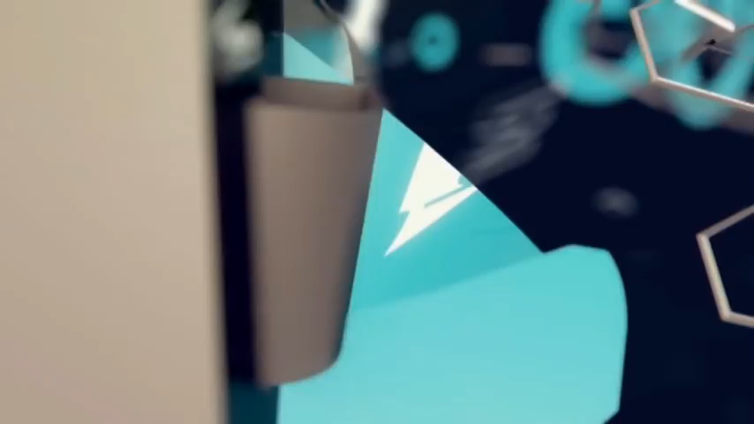
KIM’S GAME
WARM-UP
Notes:
Video link: https://www.youtube.com/watch?v=bNUfZ3_VkuE

Slide 5

KIM’S GAME
WARM-UP
10 inventions of all time
10. The paper
9. The compass
8. The refrigeration
7. The printing press
6. Plumbing
5. Medicine
4. Engines
3. The wheel
2. Communication
1. Electricity

Slide 6
VOCABULARY
1
Circle the option that goes with each verb.
A. an application
1.
create
B. attendance
A. a painting
2.
invent
B. a telephone
A. an art
3.
develop
B. a technology
A. a planet
4.
discover
B. a technology

Slide 7
VOCABULARY
2
Fill in each gap with a word or phrase from the box. You may have to change the form of the word or phrase.
eye-tracking application check attendance robot teacher face recognition
1. They will develop more _____________ to support human teachers at school.
2. Siri, the voice recognition technology, is a(n) ___________ of biometric technology.
3. Please look at this ______________ screen. It will check if you are a club member.
4. Teachers can ask students to wear ___________ glasses and check if they understand a less.
5. Schools can _______________ quickly and effectively using fingerprint scanners.
robot teachers
application
face recognition
eye-tracking
check attendance

Slide 8
GRAMMAR
3
Which of the underlined parts in each question is incorrect? Find and correct it.
1. He said that Issac Newton discovers gravity when an apple fell on him.
2. Our teacher said that the World Wide Web is a free space for people to share knowledge.
3. The man said that Nanolearning will make students’ learning more entertaining.
A
B
 discovered
C
A
B
C
 was
A
B
 would make
C

Slide 9
GRAMMAR
3
Which of the underlined parts in each question is incorrect? Find and correct it.
4. Mike said that he can design a robot in the future.
5. The headmaster said that his school would use voice recognition next year.
A
B
 could
C
A
B
C
 the next / following year

Slide 10
GRAMMAR
4
Rewrite the following sentences, using the words in BOLD.
1. “We can’t connect to the Internet to work online here,”
said Tom. THERE
2. “Science is becoming a more important subject in schools now,” Mr Thompson said. THEN
Tom said (that) they couldn’t connect to the Internet to work online there.
Mr Thompson said (that) science was becoming a more important subject in schools then.

Slide 11
GRAMMAR
4
Rewrite the following sentences, using the words in BOLD.
3. “The school will use a machine to check students’ attendance next year,” said the headmaster. WOULD
4. “We are having a science competition this week,” said the monitor to the class. THAT
The headmaster said (that) the school would use a machine to check students’ attendance the following year.
The monitor said to the class (that) they were having a science competition that week.

Slide 12
GRAMMAR
4
Rewrite the following sentences, using the words in BOLD.
5. “We don’t like robot teachers at all,” said the students. DIDN’T
The students said (that) they didn’t like robot teachers at all.

Slide 13

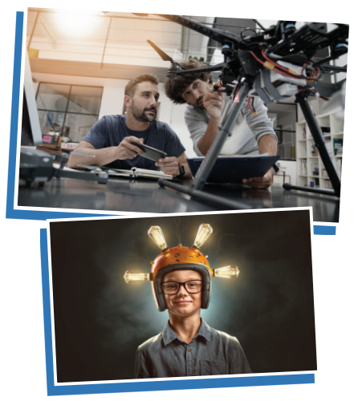
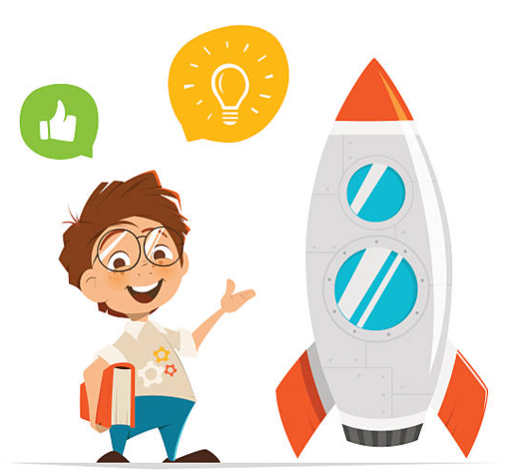
PROJECT

Slide 14

CONSOLIDATION
1
Wrap-up
What have we learnt in this lesson?
Review vocabulary in Unit 11
Review reported speech (Statements)

Slide 15

CONSOLIDATION
2
Homework
- Do the exercises in the workbook.

Slide 16

Website: hoclieu.vn
Fanpage: facebook.com/tienganhglobalsuccess.vn/

