Slide 1


Slide 2

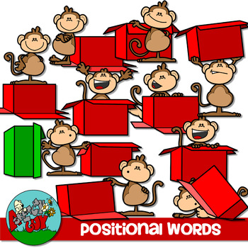
Unit
10
COMMUNICATION IN THE FUTURE
LESSON 3: A CLOSER LOOK 2
1

Slide 3
LESSON 3: A CLOSER LOOK 2
WARM-UP
Where is it?
Prepositions of place and time
Possessive pronouns
PRESENTATION
Task 1: Complete the sentences with at, in, in front of, on, opposite, or under.
Task 2: Circle the correct preposition.
Task 3. Complete the text with the prepositions from the box.
Task 5: Complete the second sentence so that it has the same meaning as the first sentence.
PRACTICE
PRODUCTION
Task 4: Work in pairs. Tell each other whether you agree or disagree with the ideas.
CONSOLIDATION
Wrap-up
Homework

Slide 4
WARM-UP
Answer the questions:
1. Where is teacher’s smartphone?
2. What will smartphones be like at the end of 2023?
3. What will smartphones be like in 10 years?
Where is it?

Slide 5





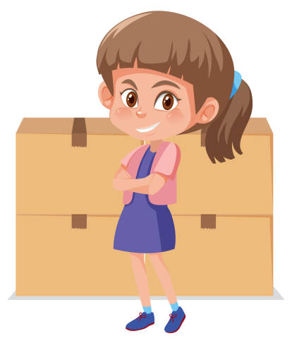
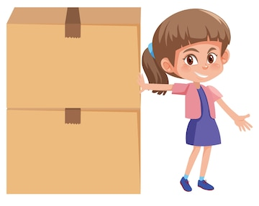

PRESENTATION
Prepositions of place
on
under
opposite
in front of
in
at

Slide 6

PRESENTATION
Prepositions of time
“in + a length of time” can express future meaning.
Example: Robots will replace human shop assistants in ten years.
“for + a length of time” says how long something goes on for.
Example: It rained for three hours yesterday.
“by + a specific time” means “not later than that time”.
Example: We’ll be there by 6 p.m.

Slide 7

PRESENTATION
Possessive pronouns
We can use possessive pronouns after of.
Example:
Mi is one of my friends.
Mi is a friend of mine.

Slide 8
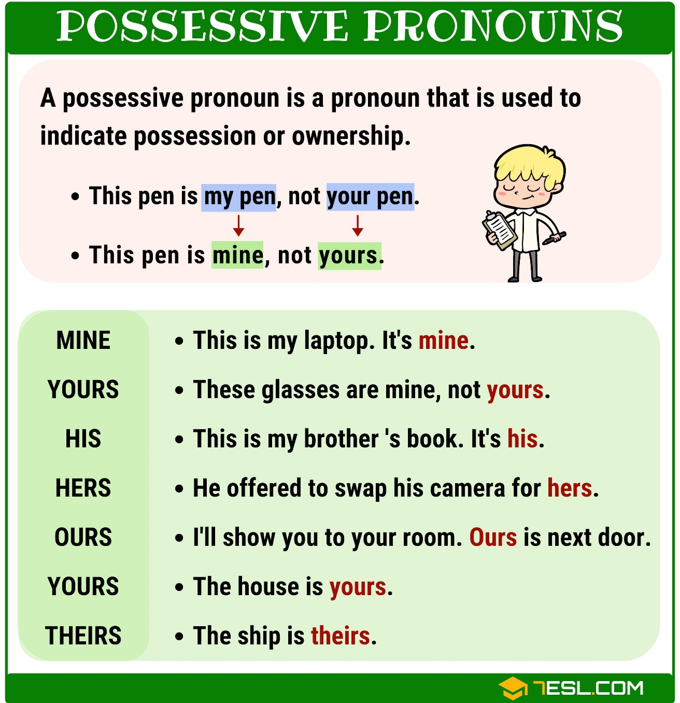
PRESENTATION

Slide 9

PRACTICE
1
Complete the sentences with at, in, in front of, on, opposite, or under.
1. Lily’s house is ______ the end of this street.
2. Players always sit _________ each other in a chess game.
3. She looked ______ the table and finally found her smartwatch.
4. Don’t walk ______ the street. Walk ______ the pavement.
5. Ann stood _________ me in a line to get on the bus.
at
opposite
under
in
on
in front of

Slide 10
PRACTICE
2
Circle the correct preposition in each sentence.
1. Let’s get ready by / on / for 10 a.m. We are meeting Dr Saito at 10:15.
2. The first camera phone appeared on / at / in May 1999 in Japan.
3. We will be away on / for / by two weeks.
4. In the UK, supermarkets always close early in / by / on Sundays.
5. I think language barriers will disappear in / for / by 30 years.

Slide 11
PRACTICE
3
Complete the text with the prepositions from the box. Use each preposition only ONCE.
in on at for by
in
I think smartphones will change a lot (1) ______ the near future. They will be much thinner. (2) ______ 2035, we might be able to roll a phone like a sheet of paper. They will become much smarter, too. They will be able to charge their battery automatically when we are (3) ______ home. They might check the latest news (4) ______ the Internet. We won’t have to wait (5) ______ a long time for these super smartphones.
By
at
on
for

Slide 12
PRACTICE
5
Complete the second sentence so that it has the same meaning as the first sentence.
1. Jack is one of her cousins.
Jack is a ______________________.
2. Is this one of his tablets?
Is this a _______________________?
3. Can I borrow a pencil of yours?
Can I borrow ___________________?
4. You look like Nick and Peter. Are you one of their relatives?
You look like Nick and Peter. Are you _________________?
5. Last year, two of our classmates won scholarships to the US.
Last year, _____________________ won scholarships to the US.
cousin of hers
tablet of his
one of your pencils
a relative of theirs
two classmates of ours

Slide 13
PRODUCTION
4
Work in pairs. Tell each other whether you agree or disagree with the following ideas:
We should not use our smartphones for more than a few hours every day.
By 2050, the way people communicate with each other will be different from now.

Slide 14

CONSOLIDATION
1
Wrap-up
What have we learnt in this lesson?
How to use prepositions of place and time
How to use possessive pronouns

Slide 15

CONSOLIDATION
2
Homework
Do the exercise in the Workbook

Slide 16

Website: hoclieu.vn
Fanpage: facebook.com/tienganhglobalsuccess.vn/

