Slide 2


Unit
8
SPORTS AND GAMES
LESSON 7: LOOKING BACK & PROJECT
Vocabulary
Grammar
1

Slide 3
LESSON 6: SKILLS 2
LESSON 1: GETTING STARTED
Mind map
WARM-UP
I. Looking back
PRESENTATION
Task 1: Find one odd word/ phrase in each question.
Task 2: Put the correct form of the verbs play, do, or go in the blanks
Task 3: Put the verbs in brackets in the correct form
Task 4: What do you say in these situations?
Task 5: Fill each blank with onE word to complete the passage
PRACTICE
II. Project
Task 6: Read the passage about the game Blind man’s bluff.
Task 7: Choose one of the following sports/ games and write about it.
PRODUCTION
CONSOLIDATION
Wrap-up
Homework

Slide 4
Game: Mind map
WARM-UP

Slide 5
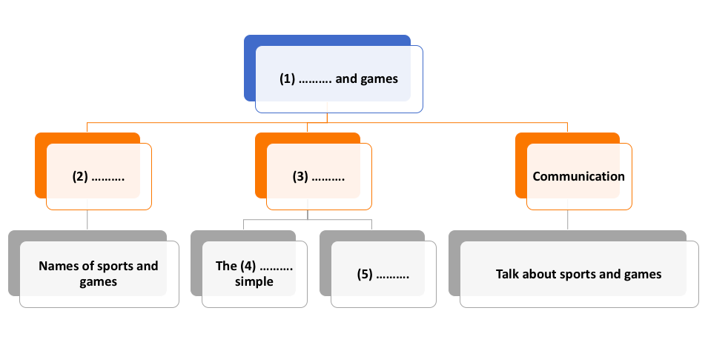
WARM-UP
Mind map
(1) Sports
(2) Vocabulary
(3) Grammar
(4) past
(5) Imparatives

Slide 6
I. VOCABULARY
PRACTICE

Slide 7
Find one odd word / phrase in each question.
1
1. | A. volleyball | B. badminton | C. bicycle
2. | A. playground | B. ball | C. racket
3. | A. running | B. cycling | C. driving
4. | A. sports shoes | B. winter sports | C. goggles
5. | A. sporty | B. intelligent | C. fit
bóng chuyển cầu lông xe đạp
sân chơi bóng vợt
chạy đi xe đạp lái xe
giày thể thao thể thao mùa đông kính bơi
dáng vẻ thể thao thông minh vừa vặn/ cân đối

Slide 8
Put the correct form of the verbs play, do or go in the blanks.
2
1. Duong can __________ karate.
Can + V nguyên thể: có thể
2. Duy isn't reading now. He ______________ table tennis with his friend.
“now” → dùng thì hiện tại tiếp diễn
3. Michael __________swimming nearly every day.
“every day” → dùng thì hiện tại đơn
4. Phong didn't play football yesterday. He __________fishing.
“yesterday” → dùng thì quá khứ đơn
5. Khang __________volleyball last Saturday.
“last Saturday” → dùng thì quá khứ đơn
6. The girls __________ aerobics in the playground now.
“now” → dùng thì hiện tại tiếp diễn
do
is playing
goes
went
played
are doing

Slide 9
II. GRAMMAR
PRACTICE

Slide 10
Put the verbs in brackets in the correct form.
3
1. The first Olympic Games (take) _______ place in Greece in 776 BC.
→ dùng thì quá khứ đơn
2. People (start) _______ to use computers about 50 years ago.
→ dùng thì quá khứ đơn
3. My brother (not like) _____________to play games when he was small.
→ dùng thì quá khứ đơn
4. - What _______ you (do) _______ last weekend?
- I (cycle) __________ round the lake with my friends. Then I (watch) _________ TV in the afternoon.
→ dùng thì quá khứ đơn
took
stated
didn’t like
did
do
cycled
watched

Slide 11
What do you say in these situations?
4
1. Your friends are making a lot of noise.
→ Please, stop ___________________.
2. The boy is watching TV for too long.
→__________________ to play with your friends.
3. Some children are feeding the animals at the zoo, but it is not allowed.
→________________the animals.
4. The teacher wants the boys to stand in line.
→_______________________.
5. Your mother tells you not to touch the dog.
→_______________________.
making noise.
Go out
Don't feed
Stand in line, boys!
Don’t touch the dog.

Slide 12
Fill each blank with ONE word to complete the passage.
5
Sports and games are very important in our lives. We all can (1) __________ a sport, or a game, or watch sports events on TV or at the stadium. When you listen to the radio every day, you can always (2)__________ sports news. When you open a newspaper, you will always find an article about your (3)__________kind of game. Television programmes about (4)__________ are also very popular, and you can watch something interesting every day. Stories about (5)_________sports stars are often very interesting.
play
hear
favourite
sports
famous

Slide 13
PROJECT
PRACTICE

Slide 14


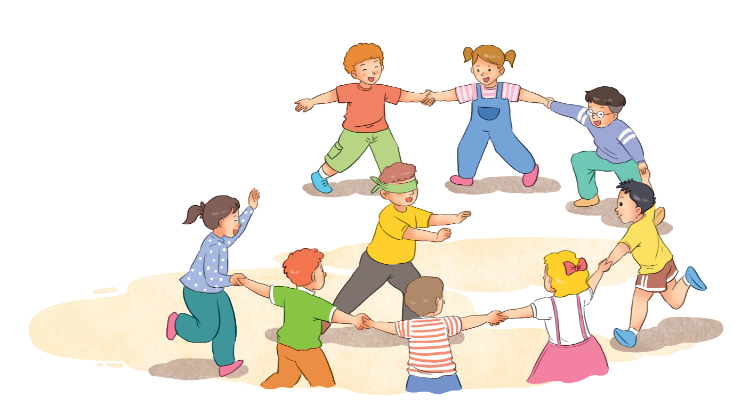
Read the information about a traditional game.
Name of the game: blind man’s buff
Number of players: five or more
Equipment: a blindfold, and open space
How to play:
1.
Players stand in a circle; one person blindfolded (the seeker) stands in the middle.
2.
The seeker tries to touch others without being caught.
3.
When the seeker catches a player, he / she tries to guess who it is by touching that player’s face and hair.
4.
When the seeker guesses that player’s name, he / she becomes the new seeker.

Slide 15

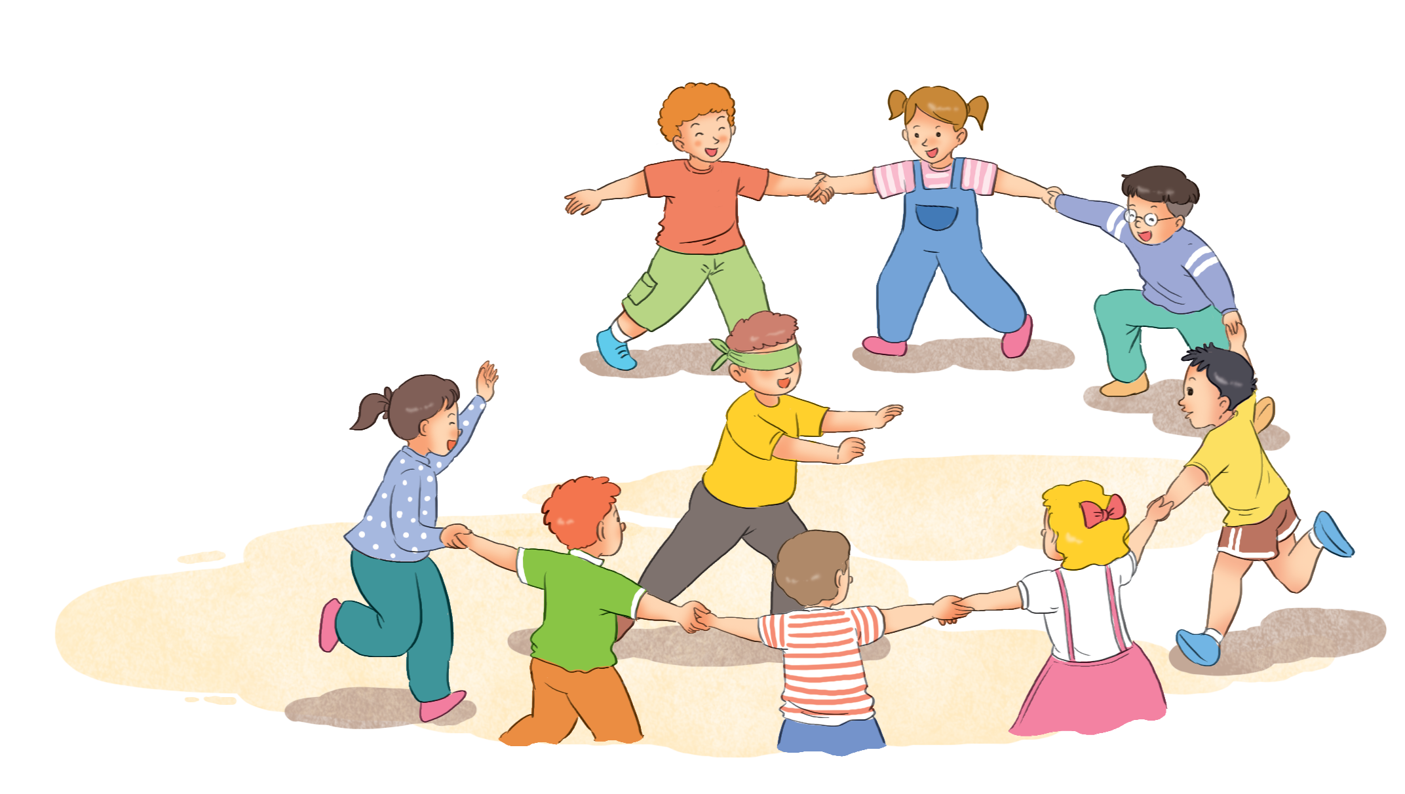
Choose one of the following games and write about it.
Tug of war (rope pulling)
Skipping
Wrestling
Cues:
Name of the game:
Number of players:
Equipment:
How to play:

Slide 16

Work in groups. Take turns to give presentation.

Slide 17

CONSOLIDATION
2
Homework
Prepare for the next lesson:
Unit 9 – Getting started

Slide 18






Website: hoclieu.vn
Fanpage: facebook.com/www.tienganhglobalsuccess.vn/

