Slide 2


Unit
8
SPORTS AND GAMES
LESSON 6: SKILLS 2
Listening
Writing
1

Slide 3
LESSON 6: SKILLS 2
LESSON 1: GETTING STARTED
WARM-UP
Who’s this?
I. Listening
PRESENTATION
Task 1: Listen to the passages. Who are they about?
Task 2: Listen to the passages again. Tick T or F
Task 3: Listen again and fill each blank with a word to complete each sentence
PRACTICE
II. Writing
Task 4: Work in pairs. Talk about the sport/ game you like. Use the following questions as cues
Task 5: Write a paragraph of 40-50 words about the sport/game you talked about in Task 4.
PRODUCTION
CONSOLIDATION
Wrap-up
Homework

Slide 4
Game: Choose the number
WARM-UP

Slide 5
WARM-UP
Choose the numbers
1
2
3
4
5
END GAME

Slide 6
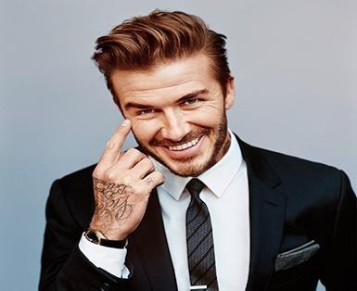
WARM-UP
Who’s this?
Question 1:
Give the correct name of sport which he plays
1. Football (David Beckham)
GO BACK

Slide 7
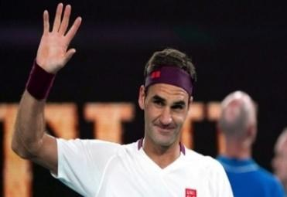
WARM-UP
Lucky numbers
Question 2:
Give the correct name of sport which he plays
→ Tennis (Roger Federer)
GO BACK

Slide 8
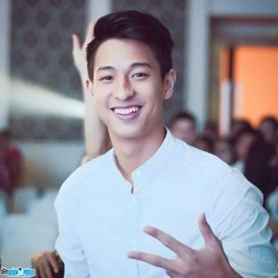
WARM-UP
Lucky numbers
Question 3:
Give the correct name of sport which he plays
Badminton
(Phạm Hồng Nam)
GO BACK

Slide 9
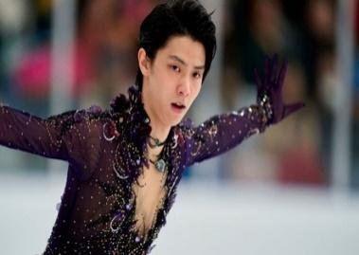
WARM-UP
Lucky numbers
Question 4:
Give the correct name of sport which he plays
→ Ice skating (Yuzuru Hanyu)
GO BACK

Slide 10
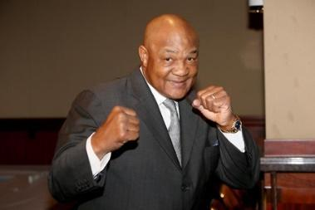
WARM-UP
Lucky numbers
Question 5:
Give the correct name of sport which he plays
→ Boxing (George Foreman)
GO BACK

Slide 11
I. LISTENING
PRACTICE

Slide 12

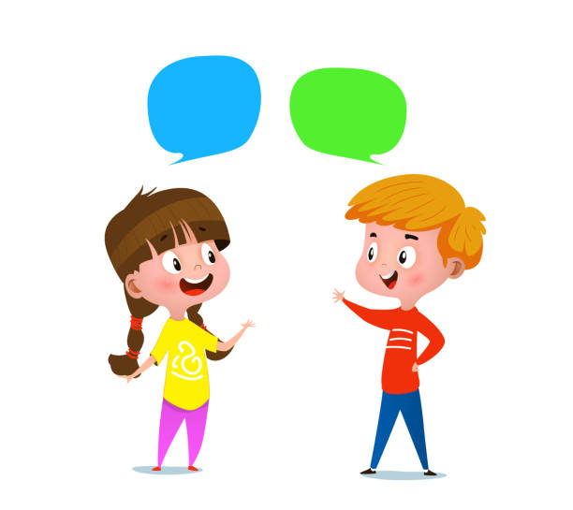
PRACTICE
1
Listen to the passages. Who are they about?
→ They are talking about Hai and Alice.

Slide 13
PRACTICE
2
Listen to the passages again. Then tick (✔) T (True) or F (False) for each sentence.
 | True | False
1. The passages are about two sportsmen.
2. Hai goes cycling at the weekend.
3. Hai's favourite sport is karate.
4. Alice doesn't like doing sport very much.
5. Alice plays computer games every day.
✓
students.
✓
✓
✓
✓
sometimes

Slide 14
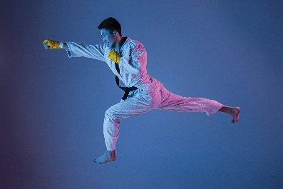

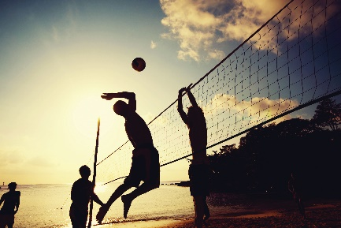
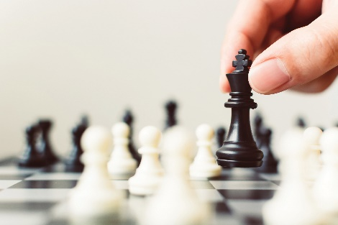
PRACTICE
3
Listen again and fill each blank with a word to complete each sentence.
1. Hai plays __________ at school.
2. Hai practises karate at the club __________ times a week.
3. __________ likes watching sport on TV.
4. Alice plays __________ every Saturday.
volleyball
a sport/ game
three
number
Alice
person
chess
a sport/ game

Slide 15
II. WRITING
PRACTICE

Slide 16
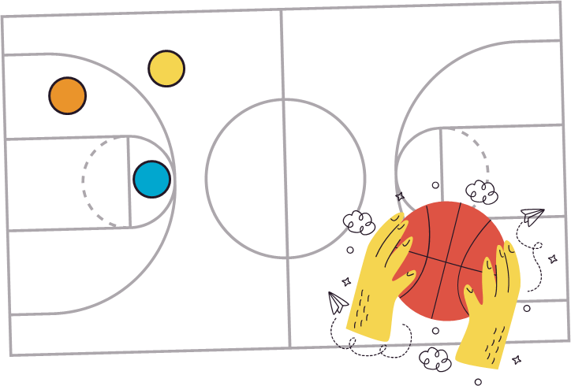
PRACTICE
4
Work in pairs. Talk about the sport/ game you like. Use the following questions as cues.
What is the name of the sport / game?
How many players are there?
How often do you play it?
What equipment does it need?
Why do you like it?

Slide 17

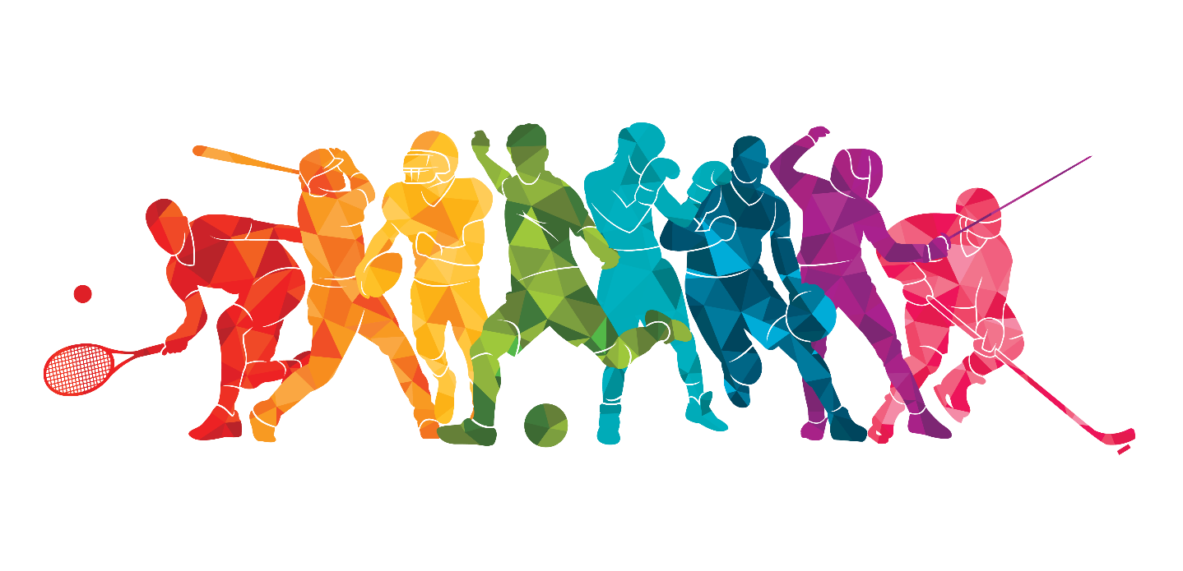
PRACTICE
Write a paragraph of 40-50 words about the sport/ game you talked about in Task 4. You can also refer to listening passages.
5

Slide 18
II. SPEAKING
PRACTICE

Slide 19
PRACTICE
4
Read the following facts about two famous sportspeople.
Hoang Giang
No.1 sportsman in shooting
Jenny Green
One of the best female golfers in history
- Born: 1978 in Viet Nam
-1995: finished sports school
- 1996: took part in a shooting competition
- 2001: won a gold medal for shooting
- Born: 1972 in Greenland
- 1987: became a member of local golf club
- 1994: took part in a female golf tournament
- 2002: became the female golf champion

Slide 20

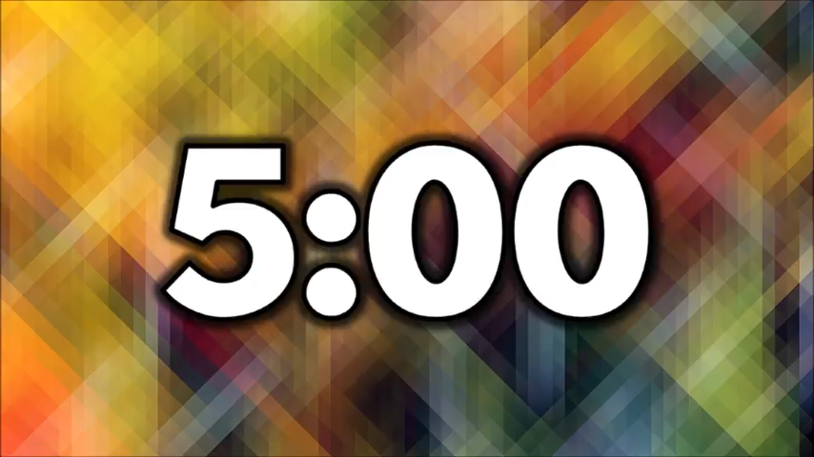
PRACTICE
5
Choose one sportsperson and talk about him/ her
- His/ her name
- The sport he/ she plays
- Why he/ she is famous
- You like him/her or not
Explain why
Example
- Jenny Green
- golf
- one of the best female golfers in history
- like because …
In group. Tell about him/her. Use your note.

Slide 21

CONSOLIDATION
1
Wrap-up
What have we learnt in this lesson?
Read for general and specific information about Pelé
Talk about famous sportspeople

Slide 22

CONSOLIDATION
2
Homework
Write down your opinion about s famous sportsman
Prepare for the next lesson: Skills 2

Slide 23






Website: hoclieu.vn
Fanpage: facebook.com/www.tienganhglobalsuccess.vn/

