Slide 1
Unit 8:
Sports and games
Lesson 2: A closer look 1

Slide 2
Unit
8
SPORTS AND GAMES
Vocabulary
Pronunciation
1

Slide 3
WARM-UP
BRAINSTORMING
- Teacher divides the class into two teams. One member, in turns, comes to the board and lists all the sports and games
- The team with more correct answers in two minutes is the winner.

Slide 4

WARM-UP
BRAINSTORMING
SPORTS
GAMES

Slide 5
Unit
8
SPORTS AND GAMES
I. Vocabulary

Slide 6


VOCABULARY
racket (n)
/ˈrækɪt/
cái vợt

Slide 7

VOCABULARY
goggles (n)
/ˈɡɒɡlz/
kính bơi

Slide 8
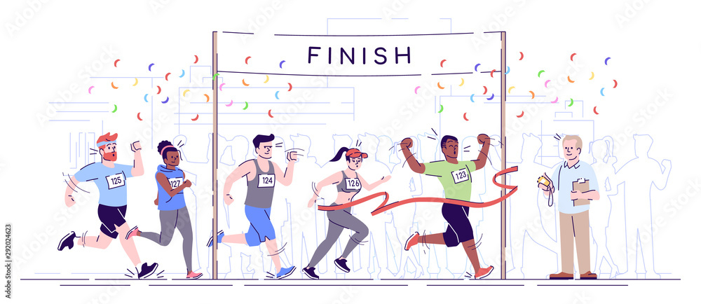
VOCABULARY
competition (n)
/ˌkɒmpəˈtɪʃn/
cuộc đua

Slide 9

VOCABULARY
champion (n)
/ˈtʃæmpiən/
nhà vô địch

Slide 10
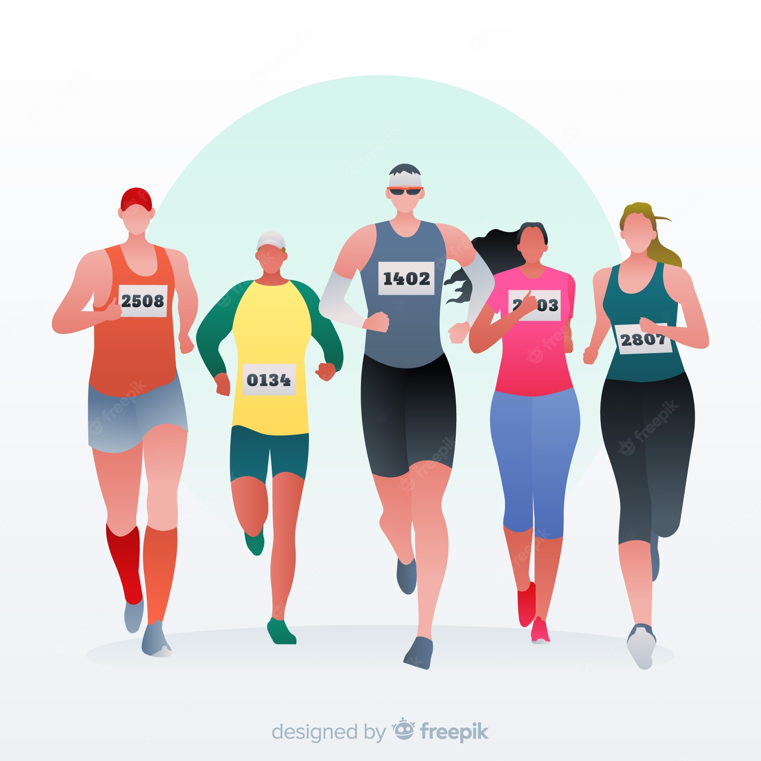
VOCABULARY
marathon (n)
/ˈmærəθən/
Cuộc đua ma-ra-tông

Slide 11

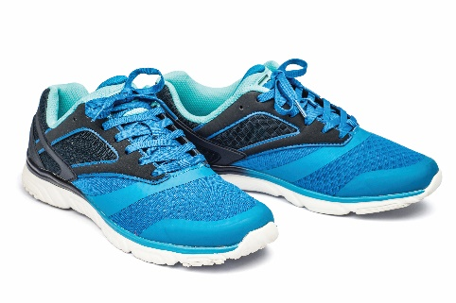


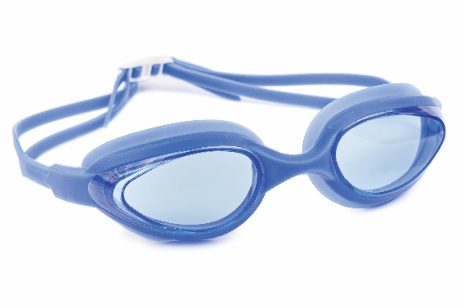
PRACTICE
1
Write the right words under the pictures.
ball
boat
3. __________
1. __________
2. __________
boat
ball
sport shoes
racket
goggles
sport shoes
4. __________
5. __________
racket
goggles

Slide 12
PRACTICE
2
What sports are these things for?
Match each thing in column A with a sport in column B
1. bicycle
a. boating
2. ball
b. swimming
3. boat
c. cycling
4. goggles
d. ball games
5. racket
e. badminton

Slide 13
PRACTICE
3
Write the right words under the pictures.
1. She won an international sports ____________.
2. He became the world tennis _____________ when he was very young.
3. “Can you send my _______________ to the winner of the contest?
4. My friend David is very ___________.
He does exercise every day.
5. The first _____________ took place in 1896.
competition
champion
champion
competition
congratulations
sporty
marathon
congratulations
sporty
marathon

Slide 14
Unit
8
SPORTS AND GAMES
II. Pronunciation
/e/ and /æ/

Slide 15
PRACTICE
4
Listen and repeat. Pay attention the sounds /e/ and /æ/.
/e/ | /æ/
chess tennis exerise contest | racket match marathon active

Slide 16
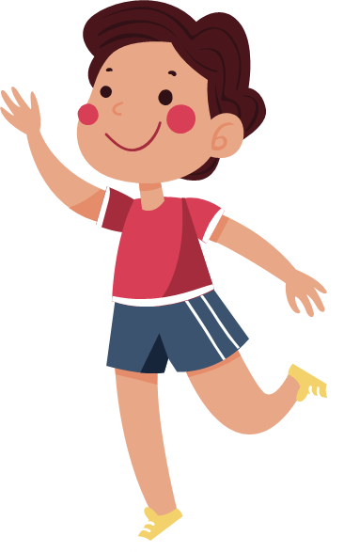
PRACTICE
5
Listen and repeat. Underline the words having the sounds /e/ and /æ/.
They cannot take part in this contest.
They began the match very late.
Please get the racket for me.
We play chess every Saturday.
My grandpa is old, but he’s active.

Slide 17

CONSOLIDATION
1
Wrap-up
What have we learnt in this lesson?
Use the lexical items related to the topic Sports and Games
Pronounce correctly the sounds /e/ and /æ/

Slide 18

CONSOLIDATION
2
Homework
Find 3 more sports or games that have the sound /e/ or /æ/.
Prepare for the next lesson: A closer look 2

