Slide 2



Unit
10
HOUSES IN THE FUTURE
LESSON 6: SKILLS 2
1

Slide 3
LESSON 6: SKILLS 2
LESSON 1: GETTING STARTED
WARM-UP
Warm up: Jumbled words
Task 1: Look at the pictures. Guess. Check as a class discussion. (p. 45)
Task 2: Work in pairs. Note down the name under the picture. (p. 45)
Task 3: Listen again and tick. (p. 45)
Task 4: Listen again and answer the questions. (p. 45)
LISTENING
WRITING
Task 5: Work in pairs. Discuss and fill in the table. (p. 45)
Task 6: Write 50 words about your dream house. Cross check. (p. 45)
Wrap-up
Homework
CONSOLIDATION

Slide 4
WARM-UP
REARRANGE THE JUMBLED WORDS
JUMBLED WORDS

Slide 5
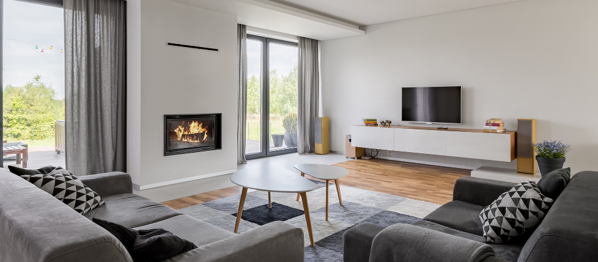
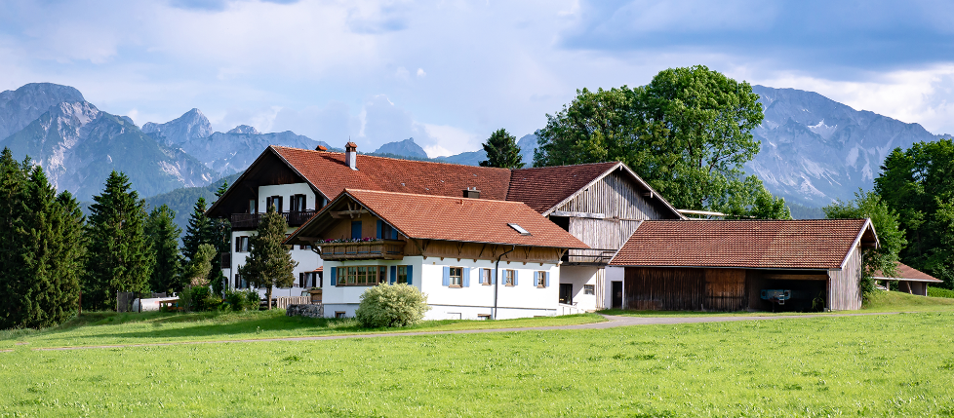

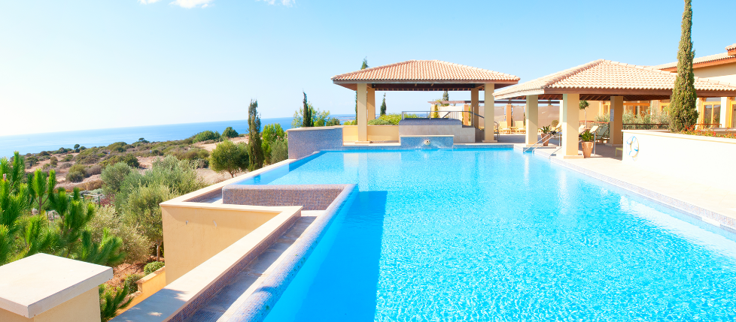
LISTENING
Can you describe these houses?
1
2
3

Slide 6


LISTENING
1
Listen to Nick and Linda talking about their dream house. Which one would each prefer?
1
2
Nick
(a flat in the city)
3
Linda
(a villa by the sea, with a swimming pool and a garden)

Slide 7
LISTENING
2
What is important to Nick? What is important to Linda?
Listen and tick.
Linda: Well, it's a big villa by the sea. It has a view of the sea. It has a swimming pool and a garden.
 | Linda | Nick
1. park view
2. city view
3. sea view
4. swimming pool
5. garden


Nick: It's a beautiful flat in the city. It has a park view in front and a city view at the back.



T

Slide 8
WRITING
3
Memory check. Answer the questions about their dream houses. Then listen and check again.
Nick: Can you tell me about your dream house, Linda?
Linda: Well, it's a big villa by the sea. It has a view of the sea. It has a swimming pool and a garden.
Nick: My dream house is different.
Linda: Really? What's it like?
Nick: It's a beautiful flat in the city. It has a park view in front and a city view at the back.
Linda: Oh, sounds great!
Nick: It has a super smart TV. I can watch films from other planets.
Linda: That sounds great, too. But I think it'll be...
1. What type of house does Linda have?
2. Where is her house?
3. What is around her house?
4. What type of house does Nick have?
5. Where is it?
→ She has a big villa.
→ Her house / It is by the sea.
→ There’s a swimming pool and a garden around her house.
→ He has a flat.
→ It’s in the city.

Slide 9

WRITING
4
Work in pairs. Discuss your dream house, and fill the table.
What type of dream house is it?
Type of house
Location
Number of rooms
Appliances in the house and what they will/ might do for you
It's a palace.
palace
in the mountains
Where is it?
It's in the mountains.

Slide 10
WRITING
5
Use the information in to write a paragraph of about 50 words about your dream house.
1. What type of dream house is it?
My dream house is a big palace. It is in the mountains. It is surrounded by lots of trees. It has seven rooms: three bedrooms, two bathrooms, one kitchen and one living room. There is a large swimming pool in front of it. I have some robots in the palace. They help me to clean the floor, cook meals, water flowers.... I'm happy to live in my palace.
2. Where is it?
3. What does it look like?
4. How many rooms are there?
5. What appliances are there and what will they help you to do?

Slide 11
Peer check
WRITING
4
No. | Question?
1 | Are the verbs in the correct form?
2 | Are the nouns in the correct form?
3 | Is the spelling correct?
4 | Has the paragraph answered all questions?

Slide 12

CONSOLIDATION
1
Wrap-up
What have we learnt in this lesson?
- Listening skill of listening for specific information about one’s favourite house.
- Writing a paragraph about one’s future house.

Slide 13

CONSOLIDATION
2
Homework
Rewrite the paragraph in your notebook.

Slide 14






Website: hoclieu.vn
Fanpage: facebook.com/www.tienganhglobalsuccess.vn/

