Slide 2



Unit
10
HOUSES IN THE FUTURE
LESSON 1: GETTING STARTED
Our houses in the future
1

Slide 3
LESSON 1: GETTING STARTED
LESSON 1: GETTING STARTED
WARM-UP
The Household race: Team A / Team B
Vocabulary
PRESENTATION
Task 1: Look at the picture. Answer some questions:
- Who are they?
- What is Phong doing?
- What are they talking about?
Task 2: Listen to the conversation and check the prediction (p. 38).
Task 3: Listen to the conversations again and work in pairs to do Ex. 2.
Task 4: Read and tick T/F 🡪 do Ex. 3
Task 5: Rearrange the words 🡪 Ex. 4
PRACTICE
PRODUCTION
Task 6: Game: 10 questions
CONSOLIDATION
Wrap-up
Homework

Slide 4
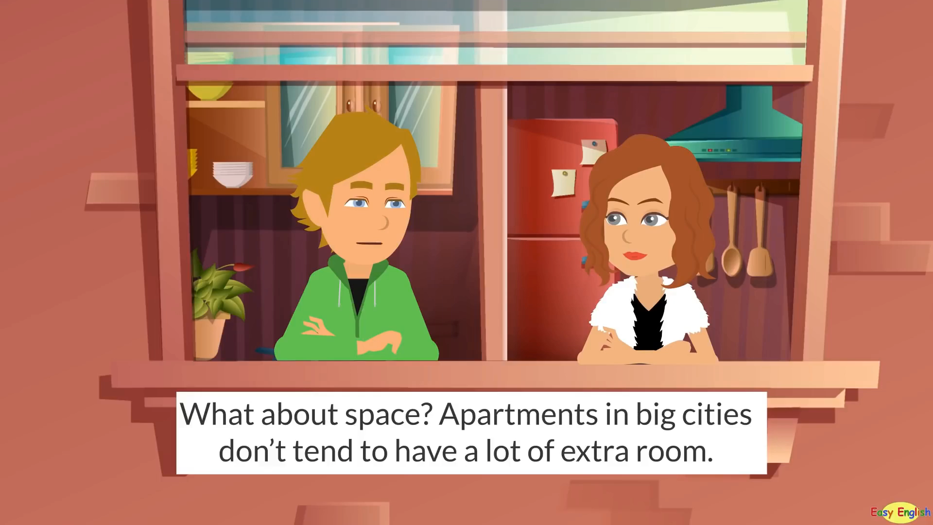
WARM-UP
Watch the video
Household race

Slide 5
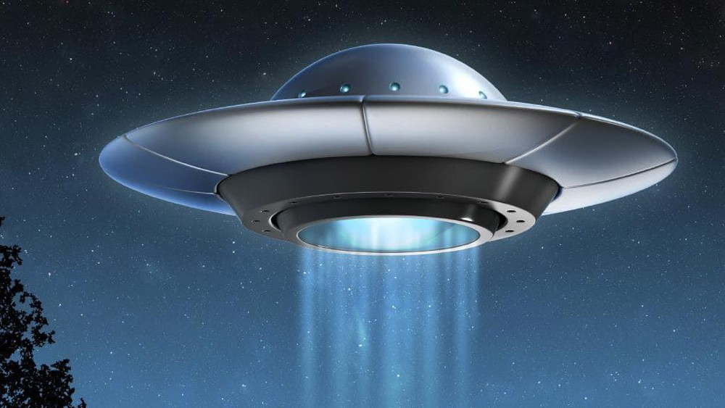
PRESENTATION
UFO (n)
/ˌjuː ef ˈəʊ/
vật thể bay không xác định

Slide 6
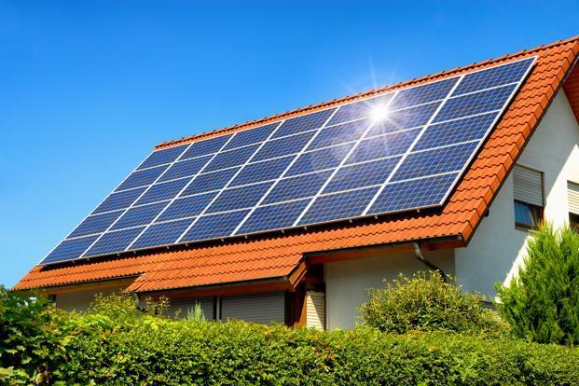
PRESENTATION
solar energy (n)
/ˈsəʊlə(r) ˈenə(r)dʒi/
năng lượng mặt trời

Slide 7

PRESENTATION
smart TV (n)
/ smɑːt ˌtiː ˈviː /
tivi thông minh

Slide 8
PRESENTATION
New words | Pronunciation | Meaning
1. UFO (n) | /ˈneɪbəhʊd/ | vật thể bay không xác định
2. solar energy (n) | /tuˈbɪ/ /get lɒst/ | năng lượng mặt trời
3. smart TV (n) | / smɑːt ˌtiː ˈviː / | tivi thông minh

Slide 9
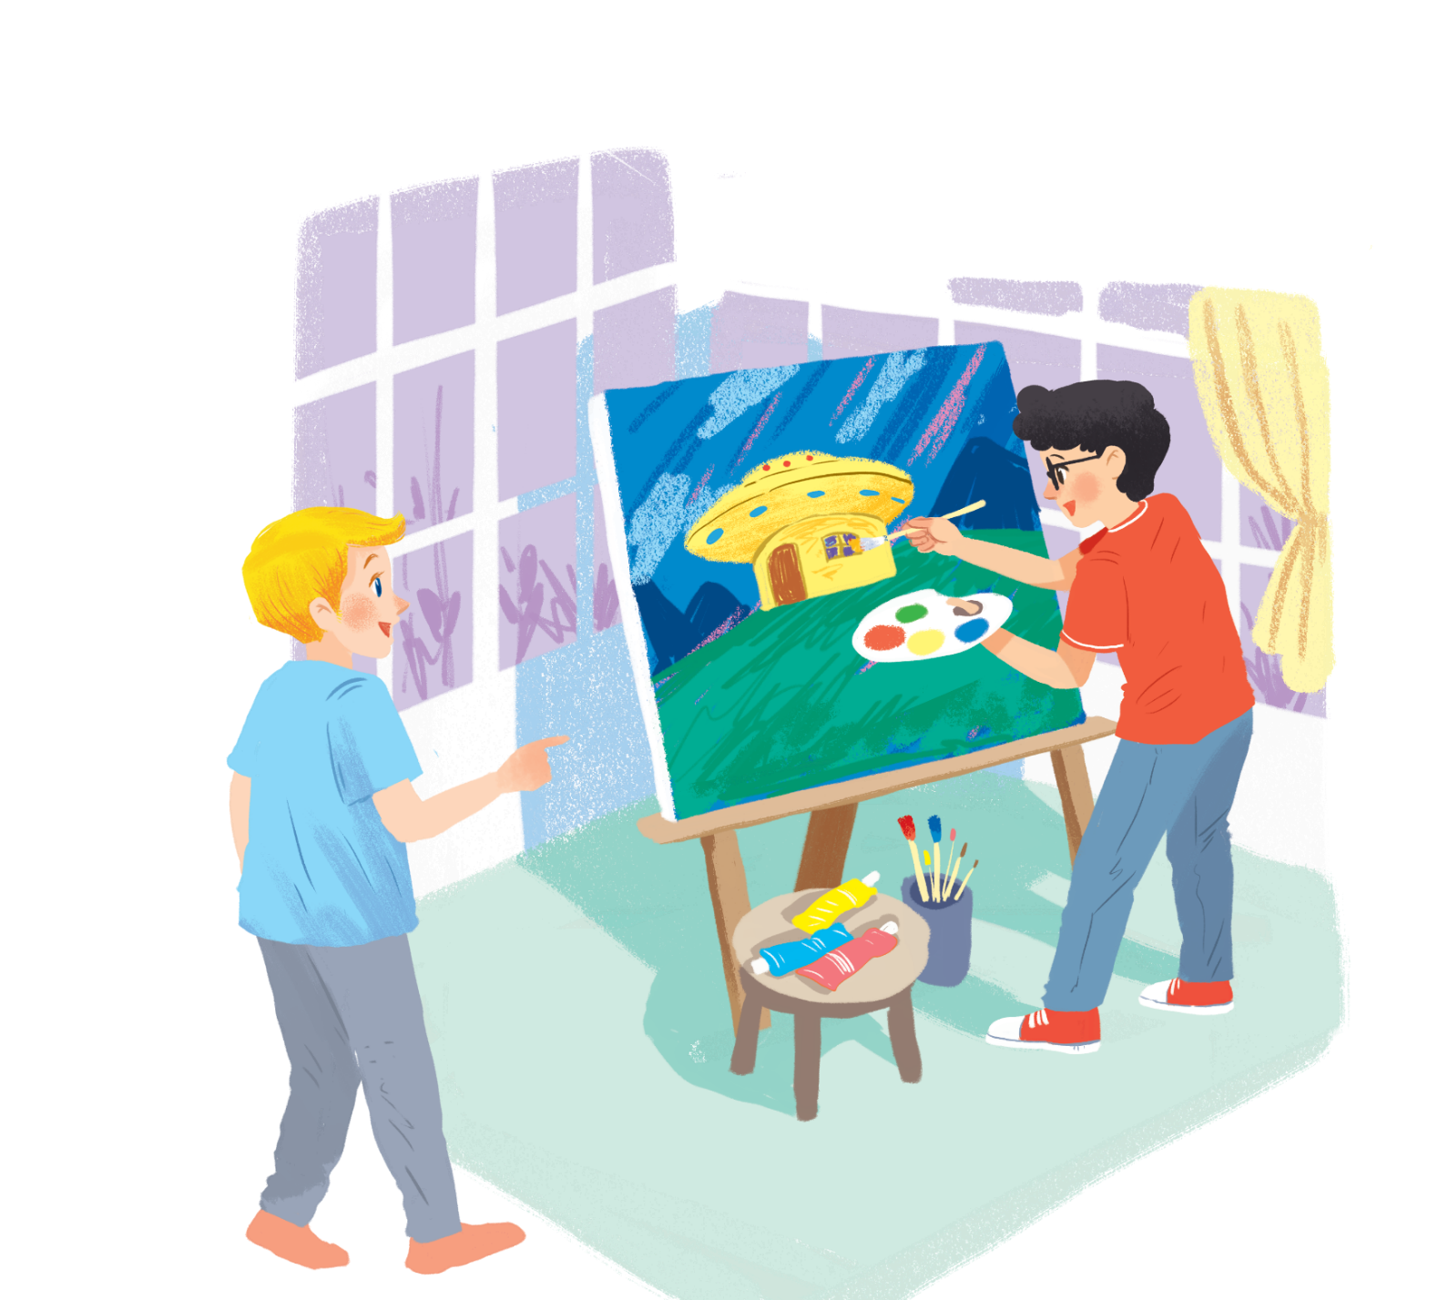
1. What can you see?
PRACTICE
Nick
2. What is Phong doing?
3. What are they talking about?
Phong

Slide 10

PRACTICE
1
Listen and read..
Nick: Fantastic! Which room will you like best?
Phong: My bedroom, of course.
Nick: What appliances might the house have?
Phong: My house might have some smart TVs and ten robots.
Nick: Sounds great! And how much will...
Nick: What are you doing, Phong?
Phong: I'm painting a picture of my house.
Nick: Your house! That's a UFO.
Phong: It looks like a UFO but it's my house in the future.
Nick: Where will it be?
Phong: It'll be in the mountains.
Nick: What will it be like?
Phong: It'll be a large house. It'll have twenty rooms.
Nick: Twenty rooms!
Phong: Yes, and it'll have solar energy

Slide 11
PRACTICE
2
Read the conversation again. Find and write down the words or phrases that show:
Type of house:
Location:
Appliances in the house:

Slide 12
PRACTICE
2
Read the conversation again. Find and write down the words or phrases that show:
TYPE OF HOUSE:
UFO house
Nick: What are you doing, Phong?
Phong: I'm painting a picture of my house.
Nick: Your house! That's a UFO.
Phong: It looks like a UFO but it's my house in the future.

Slide 13
PRACTICE
2
Read the conversation again. Find and write down the words or phrases that show:
LOCATION:
mountains
Nick: Where will it be?
Phong: It'll be in the mountains.

Slide 14
PRACTICE
2
Read the conversation again. Find and write down the words or phrases that show:
Appliances in the house:
twenty rooms, solar energy, some smart TVs and 10 robots.
Nick: What will it be like?
Phong: It'll be a large house. It'll have twenty rooms.
Nick: Twenty rooms!
Phong: Yes, and it'll have solar energy.
Nick: Fantastic! Which room will you like best?
Phong: My bedroom, of course.
Nick: What appliances might the house have?
Phong: My house might have some smart TVs and ten robots.

Slide 15

PRACTICE
3
Read the conversation again. Tick ✓ True (T) or False (F).
T
F
1. Phong's house will be in the mountains.
2. His house will be large.
3. There'll be a lot of rooms in his house.
4. He might have a smart TV and five robots.
have some smart TVs and ten robots.
Nick: What appliances might the house have?
Phong: My house might have some smart TVs and ten robots.

Slide 16
PRACTICE
4
Order the words to make a phrase about a place. Each group has one extra word.
Example: ocean / in / on / the
→ in the ocean
1. sea/ a/ by/ the
...........................................
2. on/ in/ the / city
............................................
3. the / in/ at / town
..........................................
4. the/ on/ in/ mountains
...........................................
by/in the sea
5. countryside / a/ the / in
.............................................
6. Moon / in / the / on
............................................
7. in / at/ the / sky
...........................................
in the countryside
in the city
on the Moon
in the town
in the sky
in the mountains

Slide 17

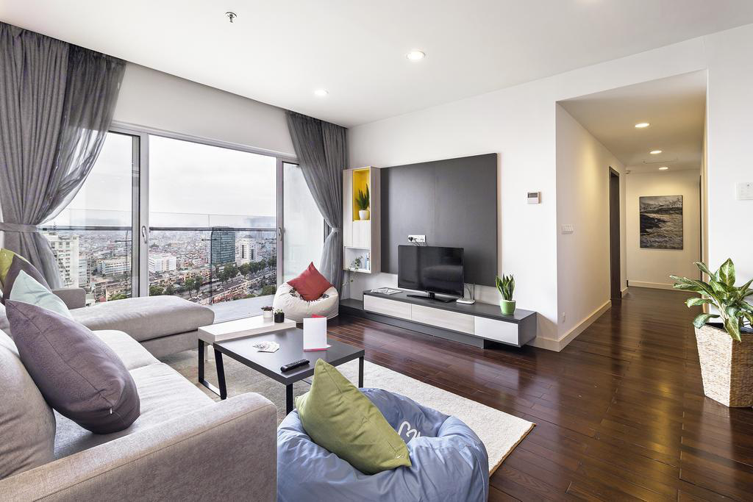
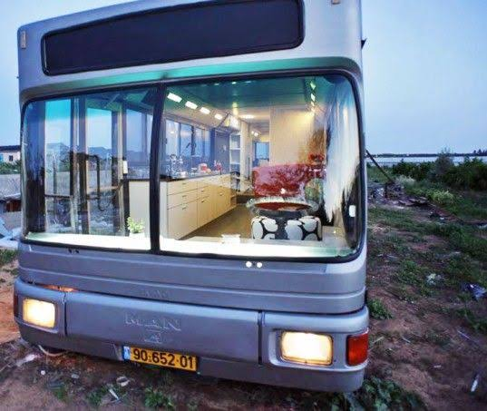
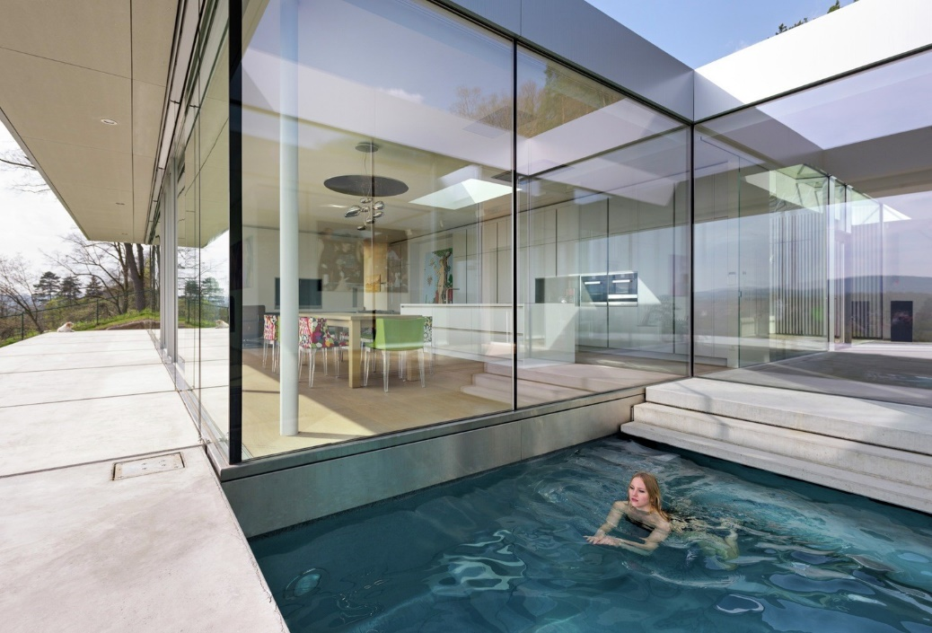
PRACTICE
5
Describe to your classmates what can you see outside the window of your future houses. Your group tries to guess where your house is.
UFO
Apartment
Villa
Motorhouse

Slide 18

PRODUCTION
6
10 questions
- Work in groups, think of a kind of house or appliances.
Example:
A: - Is it a type of house?
B: - No, it isn’t.
A: - Does it have a smart remote control?
B: - Yes, it is.
A: - Is it a smart TV?
B: - Yes, it is.
- Others ask Y/N questions and the group can only answer Yes or No.
- Who can guess the type of house/ household appliances is the winner.

Slide 19

CONSOLIDATION
1
Wrap-up
What have we learnt in this lesson?
identify the topic of the unit
use lexical items related to the unit topic
identify the language features that are covered in the unit

Slide 20

CONSOLIDATION
2
Homework
Prepare for the next lesson: A closer look 1

Slide 21






Website: hoclieu.vn
Fanpage: facebook.com/www.tienganhglobalsuccess.vn/

