Slide 1
Unit 9: NATURAL DISASTERS
Lesson 5: Skills 1

Slide 2
OBJECTIVES By the end of this lesson, students will be able to:
Knowledge
Personal qualities
Core competence
Read for specific information and talk about natural disasters
- Feel sympathy for people who are affected by natural disasters and be willing to help them
- Actively join in class activities
Develop communication
skills and creativity.

Slide 3
Warm-up
Work in 4 teams to choose the number and guest the name of the disasters.
Get 1 point/each correct disaster.
https://www.baamboozle.com/game/138678
Notes:
https://www.baamboozle.com/game/138678
Choose 1 team mode and count the point on the board

Slide 4
01
Reading
Earthquake and volcanic eruption

Slide 5
vocabulary

Slide 6
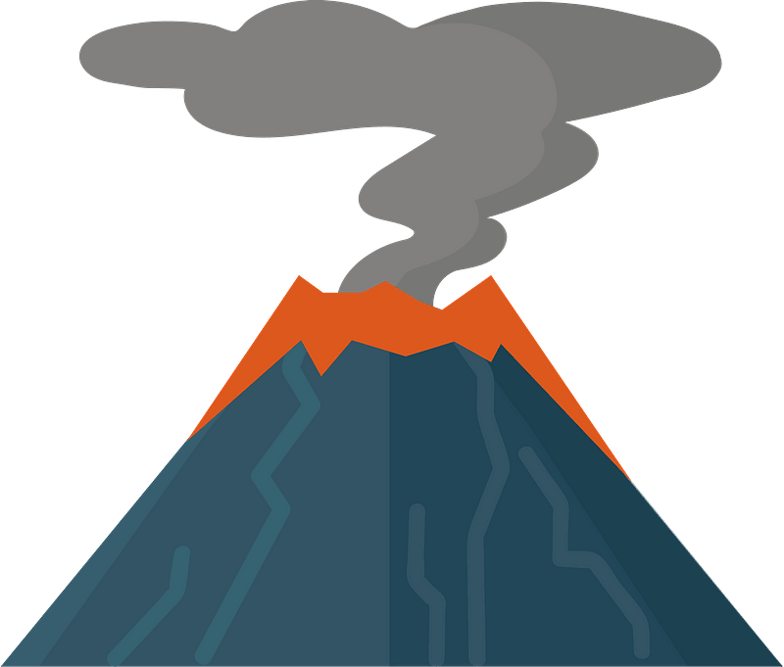

ash (n)
/æʃ/
tro

Slide 7

tsunami (n)
/tsuːˈnɑːmi/
trận sóng thần

Slide 8
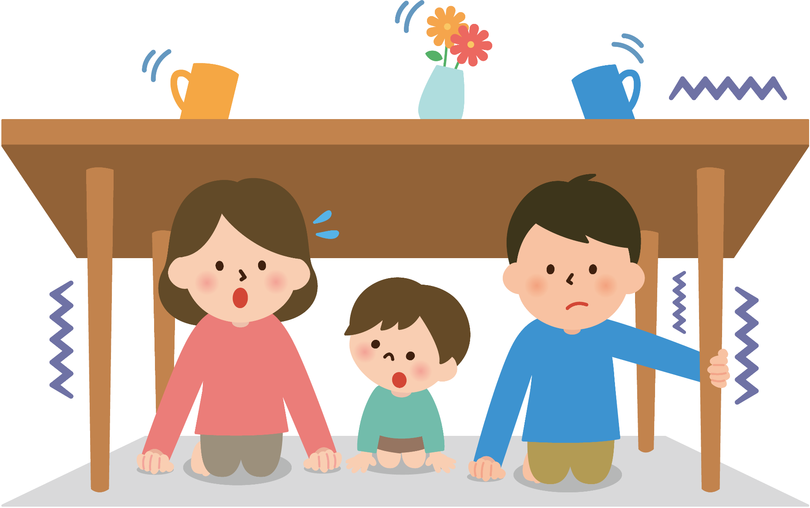
tremble (v)
/ˈtrembl/
rung lắc

Slide 9
VOCABULARY
New words | Pronunciation | Meaning
1. ash (n) | /æʃ/ | tro
2. tsunami (n) | /tsuːˈnɑːmi/ | trận sóng thần
3. tremble (v) | /ˈtrembl/ | rung lắc

Slide 10
TASK 1: Match the headlines (1 – 2) with the natural disasters (A – B).
Headlines | Natural disasters
1. 30 seconds of a slight shaking in Ha Noi
2. A thick layer of ash covers Tonga
A. volcanic eruption
B. earthquake

Slide 11
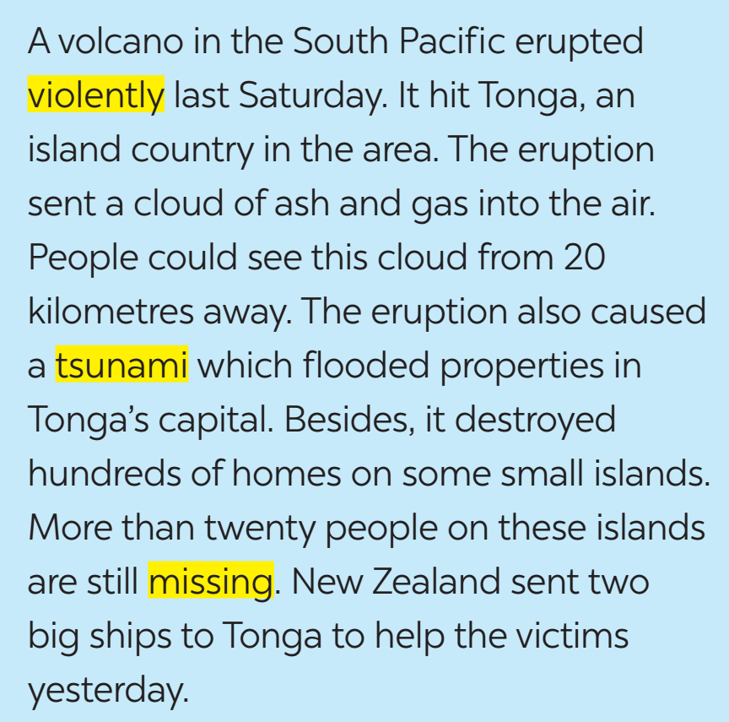
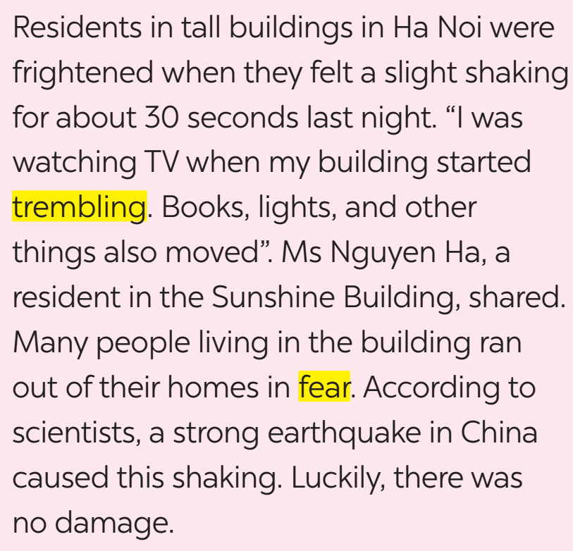
TASK 2: Read the two news articles. Match the highlighted words with their meanings.

Slide 12
TASK 2: Match the highlighted words with their meanings.
Highlighted words | Meanings
1. violently
2. tsunami
3. missing
a. not yet found
d. very strongly
e. very large waves in the sea

Slide 13
TASK 2: Match the highlighted words with their meanings.
Highlighted words | Meanings
4. trembling
5. fear
b. slightly shaking
c. the bad feeling you have when you are frightened

Slide 14
TASK 3: Read the articles again and answer the questions.
1. Where and when did the eruption happen?
2. What did the eruption cause?
3. What were the other effects of the eruption?
In the South Pacific last Saturday.
A volcano in the South Pacific erupted violently last Saturday.
A tsunami.
The eruption also caused a tsunami which flooded properties in Tonga's capital.
It destroyed hundreds of homes on some small islands, and more than twenty people on these islands are missing.
Besides, it destroyed hundreds of homes on some small islands. More than twenty people on these islands are still missing.

Slide 15
TASK 3: Read the articles again and answer the questions.
4. How long did the buildings shake?
5. What caused the shaking?
For about 30 seconds.
A strong earthquake in China.
Residents in tall buildings in Ha Noi were frightened when they felt a slight shaking for about 30 seconds last night.
According to scientists, a strong earthquake in China caused this shaking.

Slide 16
Snatch the words
Work in teams of 6
Quickly find the words to fill in the blank in the given text.
1 point/correct answer.
Notes:
https://www.baamboozle.com/game/138678
Choose 1 team mode and count the point on the board

Slide 17
Snatch the words
South Pacific Volcanic Eruption Impact on Tonga
• Volcanic _________ caused ash and gas cloud visible from 20km.
• Tsunami _______ Tonga's capital, destroyed hundreds of homes.
• Over twenty people on small islands remain _________.
• New Zealand sent two ships to assist _________.
eruption
flooded
missing
victims
Notes:
https://www.baamboozle.com/game/138678
Choose 1 team mode and count the point on the board

Slide 18
Snatch the words
Earthquake
Ha Noi Building Residents Fearful of ___________
• Residents in tall buildings in Ha Noi experienced slight __________ last night.
• Buildings trembled, books, lights moved.
• Many fled homes in ______.
• Scientists attribute shaking to a strong earthquake in China.
• Fortunately, no __________ was caused.
shaking
fear
damage
Notes:
https://www.baamboozle.com/game/138678
Choose 1 team mode and count the point on the board

Slide 19
02
Speaking
Reporting on natural disasters

Slide 20
TASK 4: Work in pairs. Match the questions with the answers.
a. Five days of heavy rain caused it.
b. Many houses were flooded, two villagers died, and five others were missing.
c. It was a serious flood.
d. Rescue workers looked for the missing people, and volunteers gave food and drinks to the victims.
e. It happened in a village in Phu Yen last week.
1. What kind of natural disaster was it?
2. When and where did it happen?
3. What caused it?
4. What were its effects?
5. How did people help the victims?

Slide 21
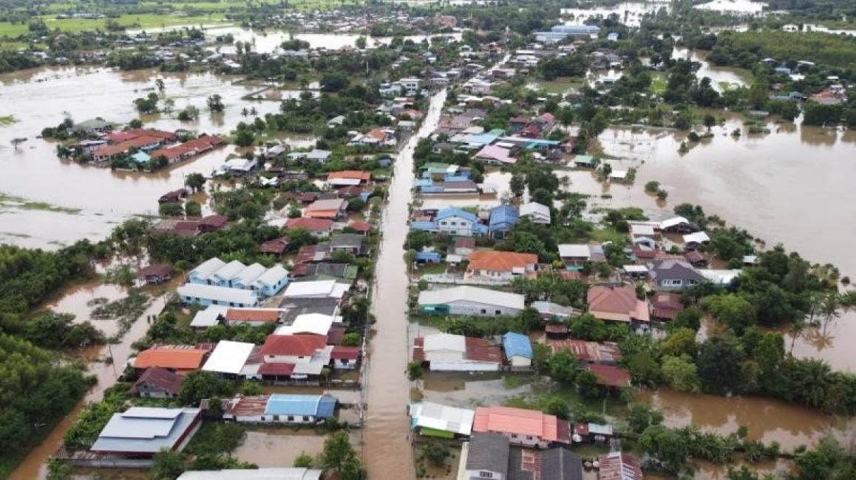
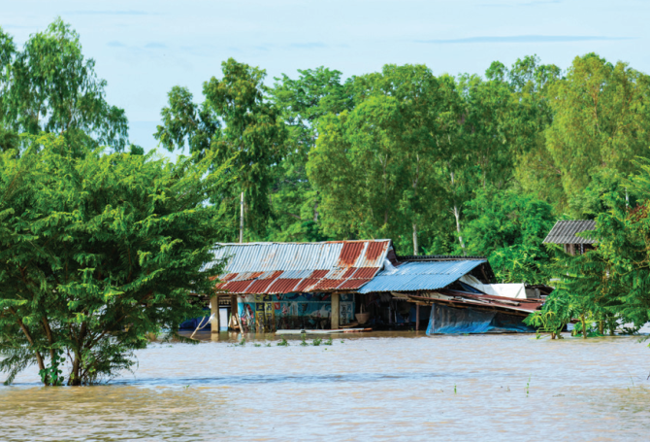
TASK 5: Work in groups. Prepare a short piece of news about the natural disaster in 4 or one you know of. Report the news to the class.
Sample:
Five days of heavy rain caused a serious flood in a village in Phu Yen. The flood happened last week. Many houses were flooded, two villagers died, and five others were missing. Rescue workers looked for the missing people, and volunteers gave food and drinks to the victims.

Slide 22
LET’S RECAP! WHAT HAVE WE LEARNT TODAY?!
01
02
READING
SPEAKING
South Pacific Volcanic Eruption Impact on Tonga
Ha Noi Building Residents Fearful of Earthquake.
Prepare a short piece of news about the natural disaster

Slide 23
Homework:
Complete the exercises in the workbook,
Prepare for the next lesson
Thanks for listening!

