Slide 1



Unit 9 Natural Disasters Lesson 4. Communication

Slide 2
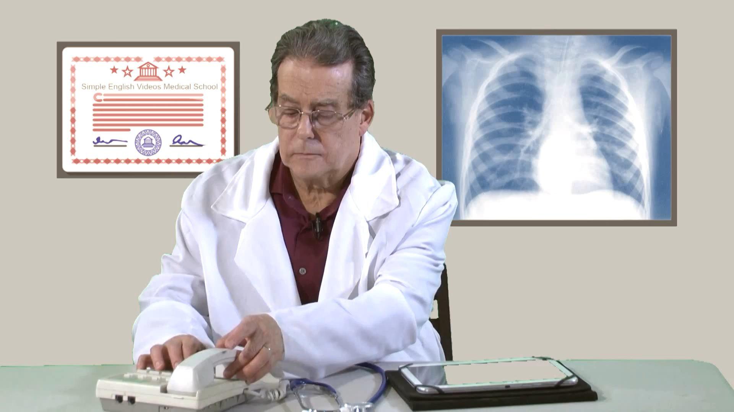
What news is this?
Did you notice the useful phrases used for giving and responding to news?
I’m afraid I have some bad news and some very bad news
That’s terrible. What could be worse?

Slide 3

OBJECTIVES
01
02
Use lexical items related to natural disasters.
Practise giving and responding to bad news.
03
Get some information about natural disasters.

Slide 4


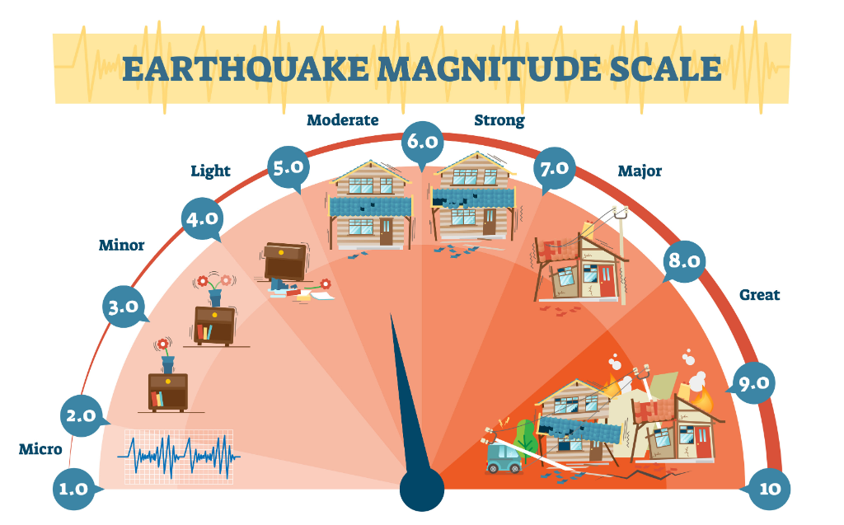
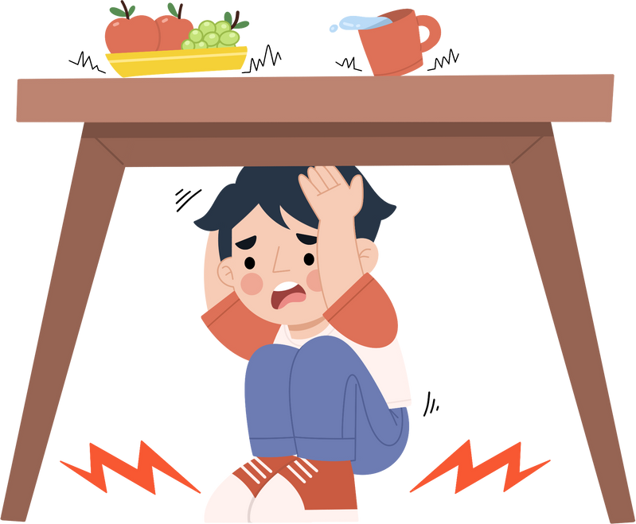
Vocabulary
richter scale (n)
shake (v)
fahrenheit (n)
/ʃeɪk/
/ˈfærənhaɪt/
/ˈrɪktə skeɪl/
rung, lắc
độ F (đo nhiệt độ)
độ rich te (đo độ mạnh của động đất)
Notes:
Matching
Click vào ảnh để nghe lại âm thanh

Slide 5

Ex 1 (p 96). Listen and read the dialogue below. Pay attention to the highlighted sentences.
Mark: Phong, why are you so sad?
Phong: My grandparents called this morning. A flood destroyed their house.
Mark: I’m sorry to hear that.
Phong: It also damaged all of their crops.
Mark: That’s awful. I hope your grandparents are safe.

Slide 6
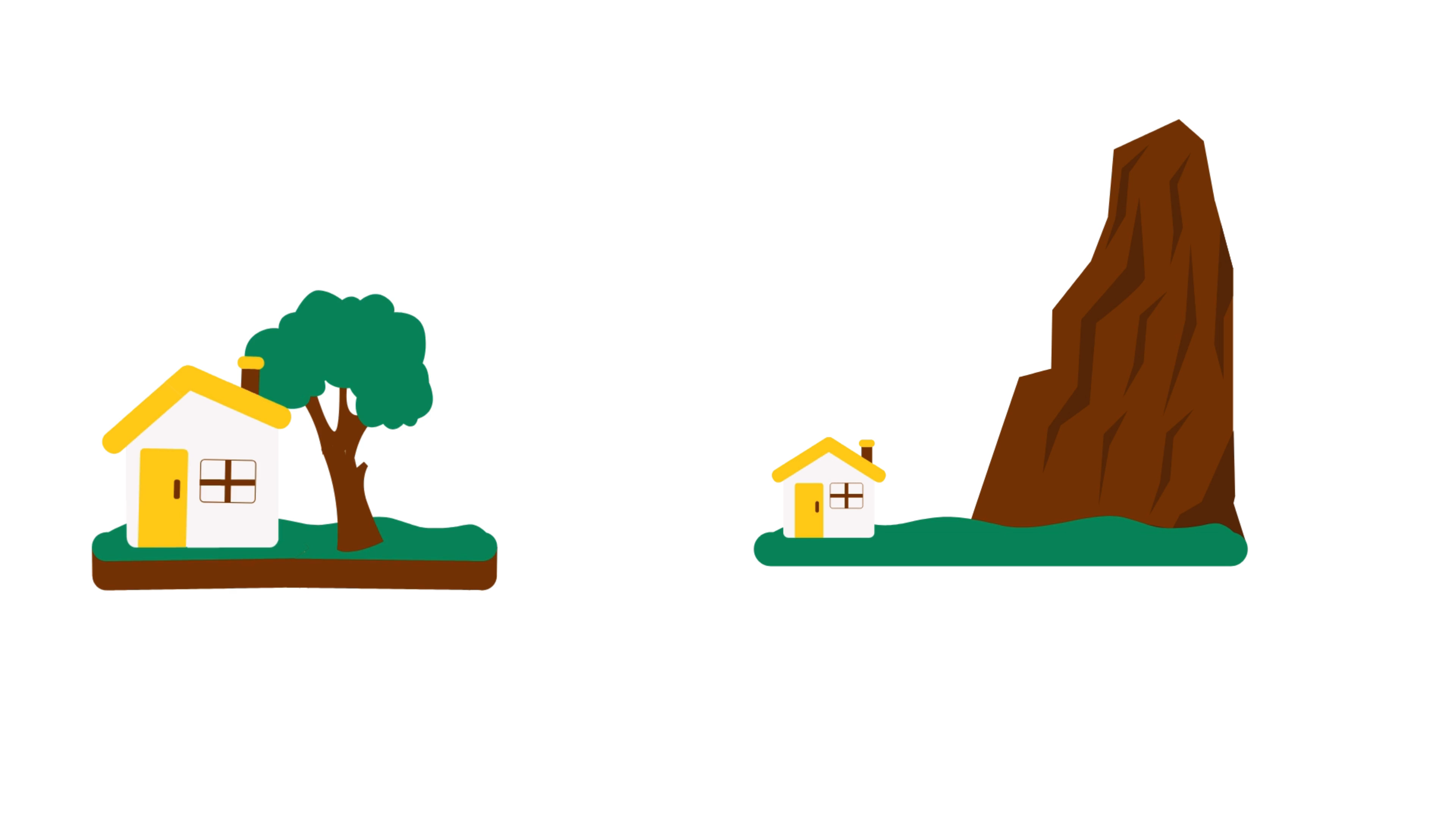
Ex 2 (p 96). Work in pairs. Practise giving and responding to bad news in the following situations.
Example:
Mark: Phong, why are you so sad?
Phong: My grandparents called this morning. A flood destroyed their house.
Mark: I’m sorry to hear that.
Phong: It also damaged all of their crops.
Mark: That’s awful. I hope your grandparents are safe.
You have a friend in a mountainous area. A landslide destroyed his family’s garden yesterday. You share this news with your classmate.
You hear that a big earthquake hit a city. You share this news with your classmate.

Slide 7

Can you tell me all types of natural disasters?
earthquakes, landslides, volcanic eruptions, floods, hurricanes, tornadoes, blizzards, tsunamis, cyclones, wildfires, and pandemics

Slide 8



Ex 3 (p 96). Can you predict natural disasters?
Nam
Ann
Tom
We were travelling on the road near a mountain. Suddenly, a lot of rocks and mud came down the mountain.
landslide
While I was working in the garden, I saw a big funnel of wind moving towards us very quickly.
tornado
Suddenly, everything in our living room began to shake. My sister and I quickly hid under the table.
earthquake

Slide 9
Ex 4 (p 96). Choose the correct answer to each question to see how much you know about natural disasters.
1: Which of these may cause landslides?
2: Which of these activities may cause landslides?
3: What scale is used for measuring earthquakes?
4: What natural disaster can an earthquake cause?
5: What do tornadoes form from?
6: Where do tornadoes mostly happen?
Heavy rain.
Wind.
Lightning.
Littering.
Cutting down trees.
Polluting the air.
Fahrenheit scale.
Celsius scale.
Richter scale.
A flood.
A landslide.
A tornado.
An earthquake.
A flood.
A thunderstorm.
In the USA.
In the UK.
In Viet Nam.

Slide 10
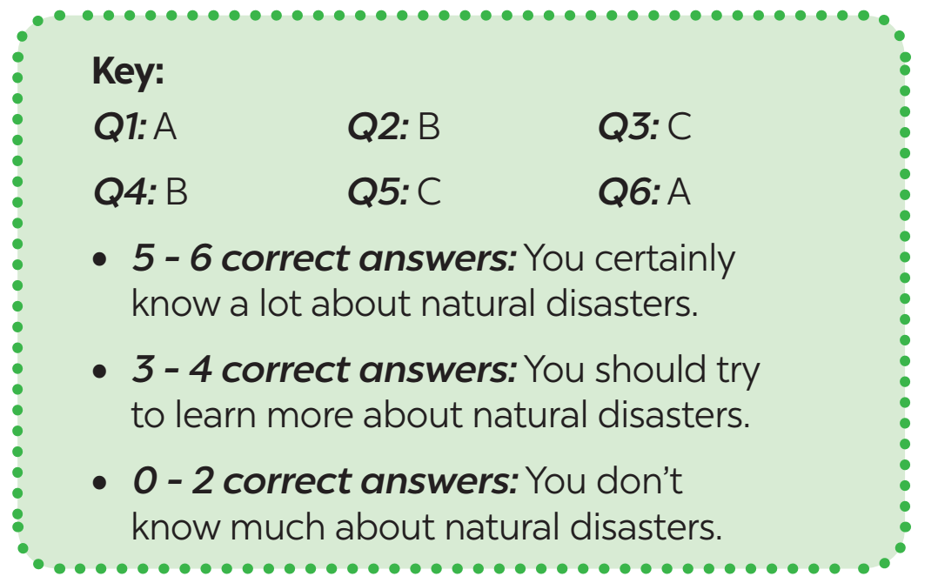
Let’s compare your answers

Slide 11

RECAP
What phrases are used for giving and responding to bad news?
Oh wow! Congratulations!
Oh dear. What's happened?
Oh no, that's awful.
I'm so sorry.
What a shame.
That's wonderful!
What a pity.

Slide 12
Thanks!
Do you have any questions?

