Slide 2
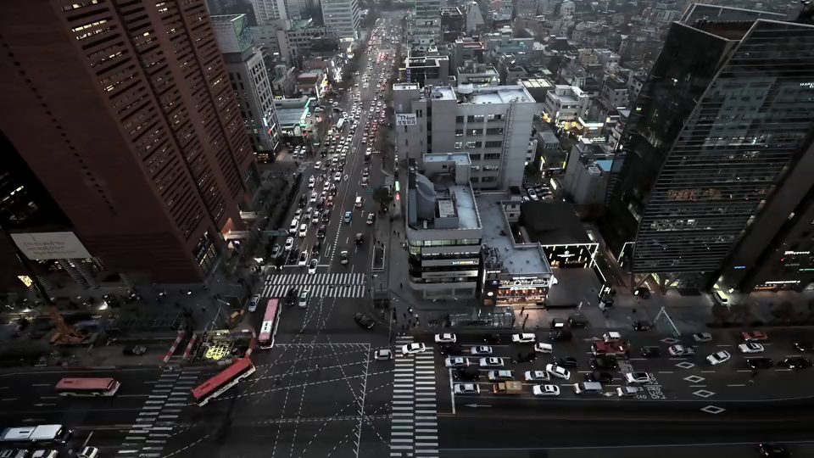


Unit
2
CITY LIFE
LESSON 7: LOOKING BACK & PROJECT

Slide 3

LESSON 7: LOOKING BACK & PROJECT
LESSON 1: GETTING STARTED
WARM-UP
Brainstorming
VOCABULARY
Task 1: Choose the correct answer to complete each sentence below.
Task 2: Fill in each gap with a word from the box to complete the passage.
Task 3: Complete the sentences with the particles in the box.
Task 4: Find a grammar mistake in each sentence and correct it.
GRAMMAR
PROJECT
A city in the future
Wrap-up
Homework
CONSOLIDATION

Slide 4
WARM-UP
BRAINSTORMING
- Work in teams.
- Members of each team take turns and write as many vocabulary about city as possible in ................. minutes.
- The group having more correct answers is the winner.

Slide 5
VOCABULARY
1
Choose the correct answer to complete each sentence below.
1. It takes Jane 30 minutes to travel from her house in the suburbs / downtown to her office in the city centre.
2. Minh prefers the metro / sky train. He finds it more comfortable to go underground than above the ground.
3. The city centre is now packed with high buildings. It looks like an ugly public amenity / concrete jungle.
4. He loves the nightlife of his city. He thinks that it is lively / noisy.
5. Ho Chi Minh City is a slow / bustling city. It is always full of activities.

Slide 6
VOCABULARY
2
Fill in each gap with a word from the box to complete the passage.
congestion peaceful safe liveable itch
Mia lives in a small town. In the past, there were not many people living in the town, so it was rather quiet and (1) ________. Nowadays, it is totally different. The more crowded the town is, the less (2) ____ it becomes. Crime rates are increasing quickly. Moreover, many car drivers don’t obey traffic rules, so they indirectly cause traffic (3) __________. Construction sites are everywhere in the town. The dust and dirt from these sites have caused many problems for people’s health, for example (4) _____ eyes, runny noses, and acne. All these things make Mia feel that her town is not as (5) ________ as before.
peaceful
safe
congestion
itchy
liveable

Slide 7
GRAMMAR
3
Complete the sentences with the particles in the box
out (x2) down with down on away
1. People are throwing ______ tons of food each year. This is such a waste!
2. The shopping mall is a popular place for teens to hang ______ with one another these days.
3. The city council wants to cut ________ construction noise by 20% in the next five years.
away
out
down on

Slide 8
GRAMMAR
3
Complete the sentences with the particles in the box
out (x2) down with down on away
4. The researchers carried ______ a study about people’s attitudes towards their cities.
5. Many people come __________ the flu in winter.
out
down with

Slide 9
GRAMMAR
4
4
Find a grammar mistake in each sentence and correct it.
1. The dirtier the air gets, more difficult it is for people to breathe.
2. My brother likes to get up the city by bike, but I prefer using public transport.
3. Nearer the school is, the more convenient it is for the students.
→ the more difficult
→ get around
→ The nearer

Slide 10
Note:
GRAMMAR
4
4
Find a grammar mistake in each sentence and correct it.
4. She came up with a cold after walking in the heavy rain.
5. The more slow the Internet is, the angrier the users get.
→ came down with
→ slower

Slide 11
GRAMMAR
Notes:
go around = turn round in a circle
go around (to) = visit sb / a place that is near
get around = to go to a lot of different places

Slide 12

PROJECT
4
A city in the future

Slide 13
PROJECT
- Work in groups. You have a few minutes to prepare for the presentation (which you prepare from lesson 1).
- Tick appropriate items while listening to your classmates’ presentations and write comments if you have any in checklists.
- The presenters should complete their self-assessment checklists after completing their presentation.

Slide 14
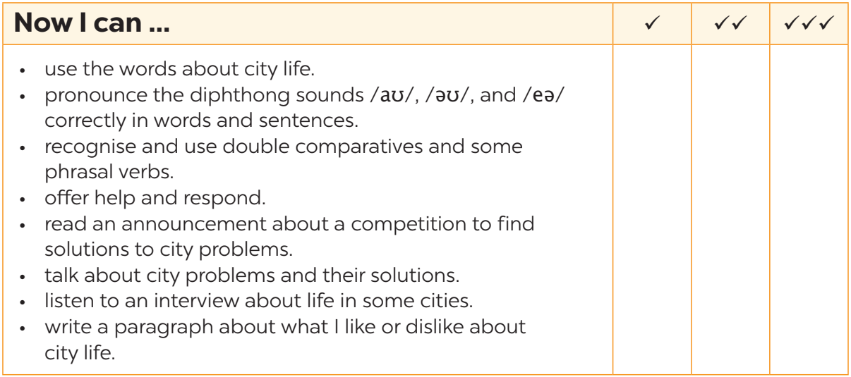
NOW I CAN...
Complete the self-assessment table.

Slide 15

CONSOLIDATION
1
Wrap-up
What have we learnt in this lesson?
Review the vocabulary and grammar of Unit 2;
Apply what they have learnt (vocabulary and grammar) into practice through a project.

Slide 16

CONSOLIDATION
2
Homework
- Prepare for the next lesson.

Slide 17
Website: hoclieu.vn
Fanpage: facebook.com/www.tienganhglobalsuccess.vn/

