Slide 2

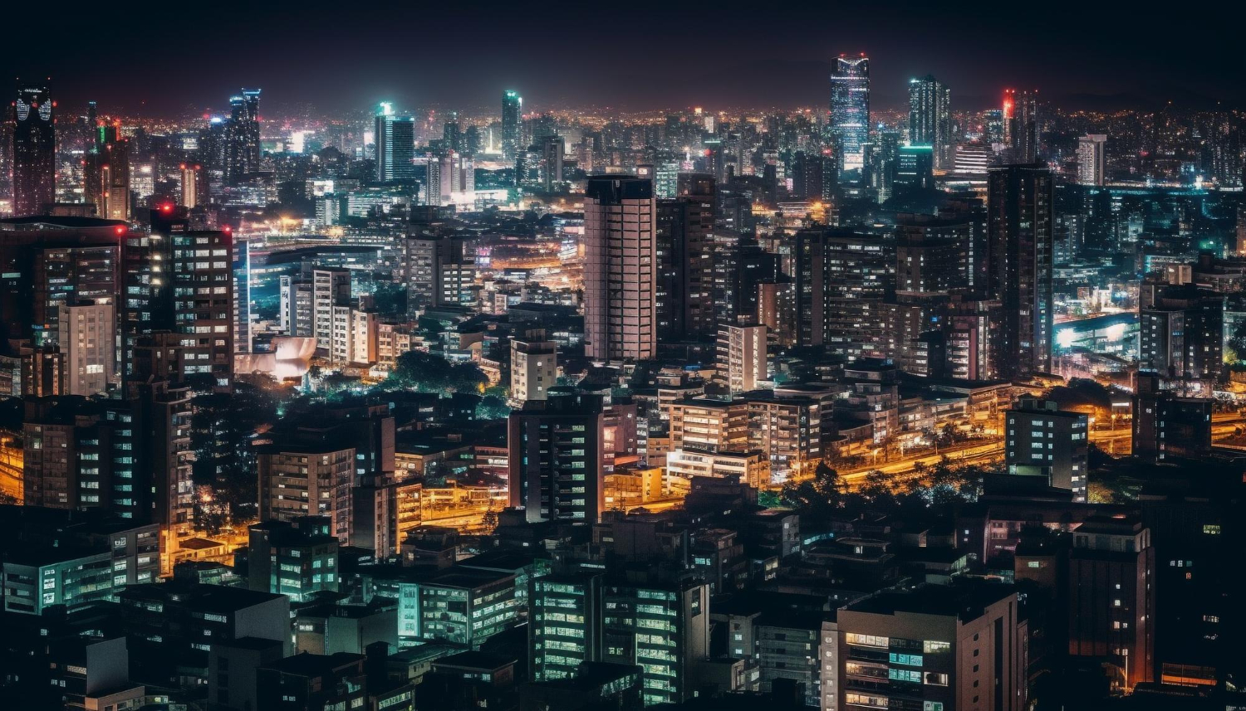


Unit
2
CITY LIFE
LESSON 3: A CLOSER LOOK 2

Slide 3
LESSON 3: A CLOSER LOOK 2
LESSON 1: GETTING STARTED
WARM-UP
Option 1: Think!
Option 2: Comparative Chain game.
PRESENTATION
Grammar explanation
Task 1: Choose the correct option to complete each sentence.
Task 2: Find a mistake in the underlined parts in each sentence below and correct it.
Task 3: Match a phrasal verb in column A with a suitable word / phrase in column B.
Task 4: Complete each sentence with a phrasal verb in 3. You can change the form of the verb when necessary.
PRACTICE
PRODUCTION
Task 5: Work in pairs. Tell each other whether you agree or disagree with the following ideas.
CONSOLIDATION
Wrap-up
Homework

Slide 4
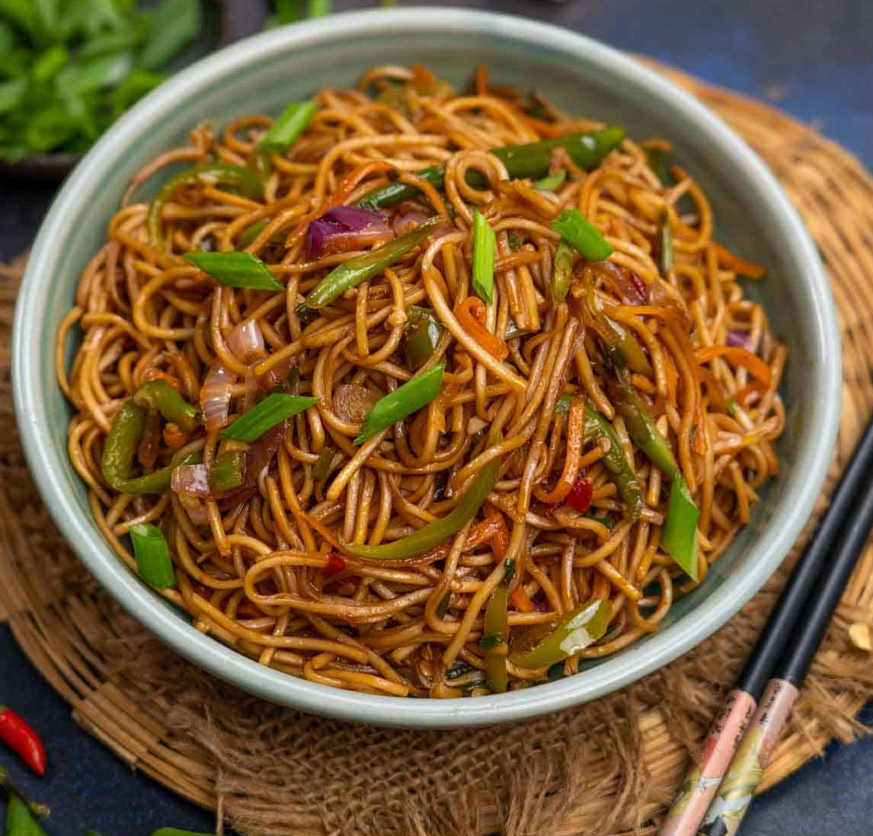
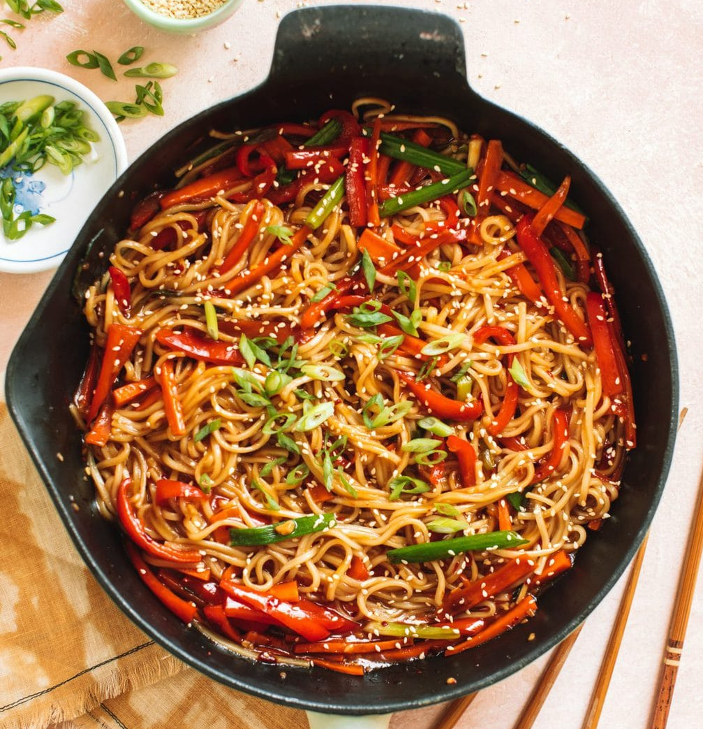

WARM-UP
OPTION 1
- Look at two bowls of spicy noodles.
- Which bowl of noodles do you prefer?
=> I like the second bowl more than the first bowl.

Slide 5
WARM-UP
OPTION 2
Comparative Chain game.

Slide 6
WARM-UP
OPTION 2
- Work in teams.
- Teacher chooses a category such as “transportation”.
- The first team names something related to the category, such as “underground train.”
HOW TO PLAY

Slide 7
WARM-UP
OPTION 2
- The next team must name something that is comparative to the previous item, such as “bus” or “taxi.” Then you use comparative to form a statement.
E.g. The bus is slower than the underground train.
HOW TO PLAY
- If a team cannot think of anything, they are out of the game.
- The last team remaining wins.

Slide 8
WARM-UP
OPTION 2
LET’S PLAY

Slide 9
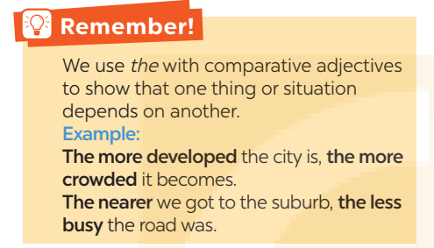
PRESENTATION
Look at the sentence:
The more expensive the rent in the city is, the fewer people can afford to live there.
You can use “the” with comparative adjectives to emphasize that one thing depends on another.
The + comparative adj 1 + clause 1, the + comparative adj 2 + clause 2.

Slide 10
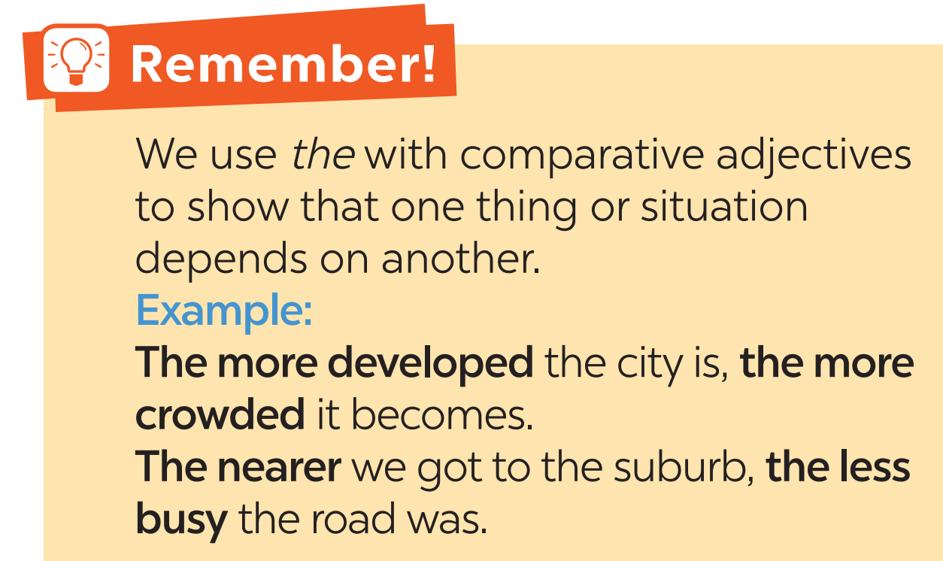
PRESENTATION

Slide 11
PRACTICE
1
Choose the correct option to complete each sentence.
1. Lan isn’t home yet. The later / more late it gets, the more worried I get about her.
2. He wants a new house. The larger the house is, the comfortable / more comfortable he feels.
3. She thinks the bigger the city is, higher / the higher the cost of living gets.
4. The famouser / more famous the city is, the higher number of tourists it can attract.
5. The larger population the town has, more difficult / the more difficult it is to find a job.

Slide 12
PRACTICE
2
Find a mistake in the underlined parts in each sentence below and correct it.
1. I love the spicy food in this city. The hottest the food is,
A B C
the more I like it.
D
2. I got stuck in a traffic jam yesterday. The more congested
A B
the road was, the tired I became.
C D
→ The hotter
→ more tired

Slide 13
PRACTICE
2
Find a mistake in the underlined parts in each sentence below and correct it.
3. The modern the library is, the more attractive it is to teenagers.
A B C D
4. The streets are getting dirtier. The more crowded this city is,
A B C
more polluted it becomes.
D
→ more modern
→ the more polluted

Slide 14
PRACTICE
2
Find a mistake in the underlined parts in each sentence below and correct it.
5. The denser the buildings are, the more ugly the city becomes.
A B
It’ll soon look like a concrete jungle.
C D
→ uglier

Slide 15
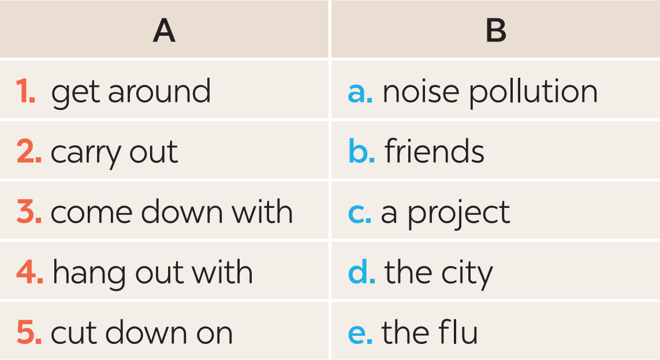
PRACTICE
3
Match a phrasal verb in column A with a suitable word / phrase in column B.

Slide 16
PRACTICE
PHRASAL VERBS | MEANING
get around
carry out
come down with
hang out with
cut down on
move from place to place
/ go to a lot of different places
conduct
catch (a disease)
spend time a lot of time with sb
reduce

Slide 17

PRACTICE
4
Complete each sentence with a phrasal verb in 3. You can change the form of the verb when necessary.
coming down with
1. I’m a cold. I have a runny nose and a sore throat.
cut down on
2. We all need to using our cars and ride our bikes more to reduce air pollution.
get around
3. When I was in town, I chose to by bus.
hang out with
4. Where do teenagers in your neighbourhood often each other?
carrying out
5. The authority is a plan to solve traffic congestion in the downtown area.

Slide 18

PRACTICE
EXTRA ACTIVITY
“FIND SOMEONE WHO............”

Slide 19
PRACTICE
EXTRA ACTIVITY
- Copy the table into notebooks.
- Ask your classmates to find at least one person who says “Yes” to each statement.
- The person who finishes table first will say Bingo and become the winner of the game.
Find someone who… | Name | More information
1. likes getting around by public transport.
2. carried out a project last week.
3. came down with a flu or a cold last year.
4. often hangs out with friends in their free time.
5. wants to cut down on the amount of water they are using each day.

Slide 20
PRACTICE
EXTRA ACTIVITY
Find someone who… | Name | More information
1. likes getting around by public transport.
2. carried out a project last week.
3. came down with a flu or a cold last year.
4. often hangs out with friends in their free time.
5. wants to cut down on the amount of water they are using each day.

Slide 21
PRODUCTION
5
Work in pairs. Tell each other whether you agree or disagree with the following ideas.
1. The busier the city is, the more unhappy its people are.
2. The older the city becomes, the less attractive it is to immigrants.
3. Your home town should cut down on noise pollution.

Slide 22
PRODUCTION
Some suggested ideas:
 | Agree | Disagree
1. The busier the city is, the more unhappy its people are. | Busy cities: high living costs, congested roads, long travelling time, etc. | Busy cities: lots of entertainment facilities, parks, playgrounds, etc.

Slide 23
PRODUCTION
Some suggested ideas:
 | Agree | Disagree
2. The older the city becomes, the less attractive it is to tourists. | Old cities: not many entertainment facilities, lack of public amenities, inconvenient public transportation. | Old cities: lots of cultural places, historical value, quiet and safe.

Slide 24
PRODUCTION
Some suggested ideas:
 | Agree | Disagree
3. Your home town should cut down on noise pollution. | My home town: lots of trucks and heavy lorries running on roads, construction sites everywhere, people playing music very loud at night. | My home town: a small and peaceful town, people mostly riding bikes, no big events happening in the town no noise pollution.

Slide 25

CONSOLIDATION
1
Wrap-up
What have we learnt in this lesson?
Recognise and use comparison of adjectives and some phrasal verbs.

Slide 26

CONSOLIDATION
2
Homework
- Do exercises in the workbook.
- Make 5 sentences by using double comparatives and phrasal verbs that you have learnt.

Slide 27
Website: hoclieu.vn
Fanpage: facebook.com/www.tienganhglobalsuccess.vn/

