Slide 1

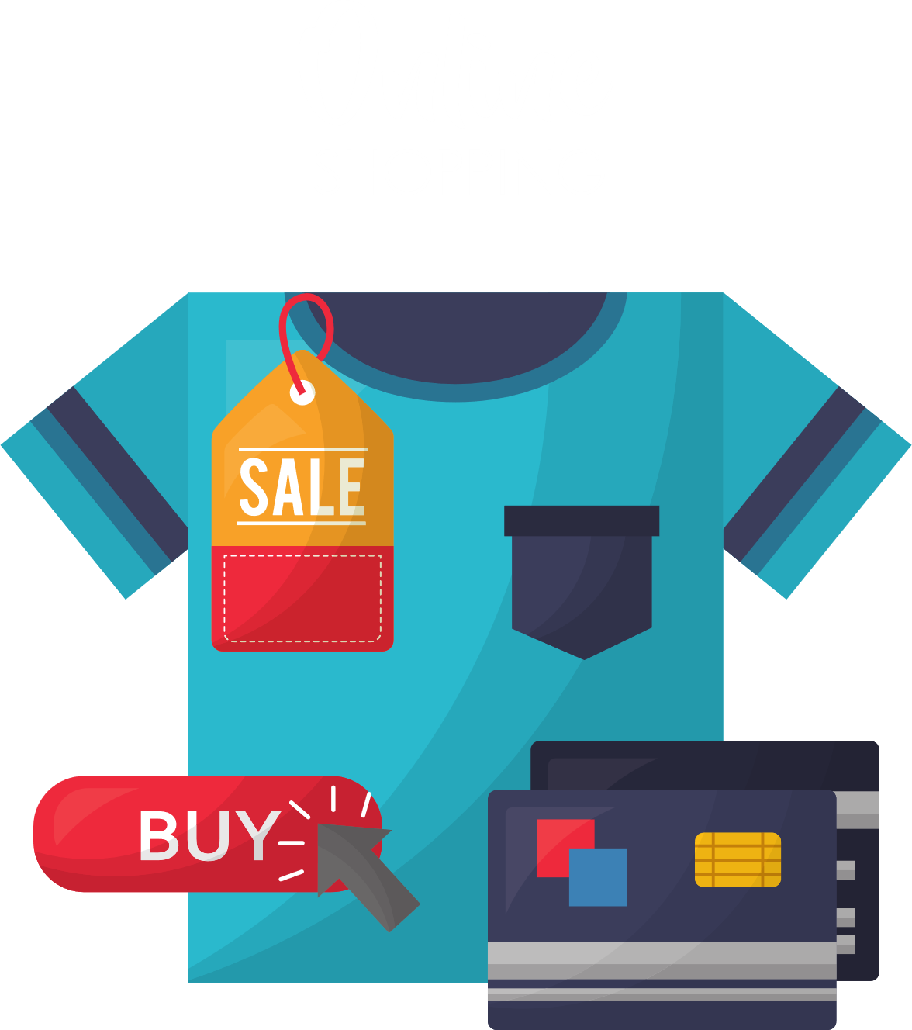

WELCOME TO OUR CLASS!

Slide 2

Chatting
Have you ever shopped online?
What do you need to shop online?
In your opinion, shopping online is safe or unsafe?

Slide 3
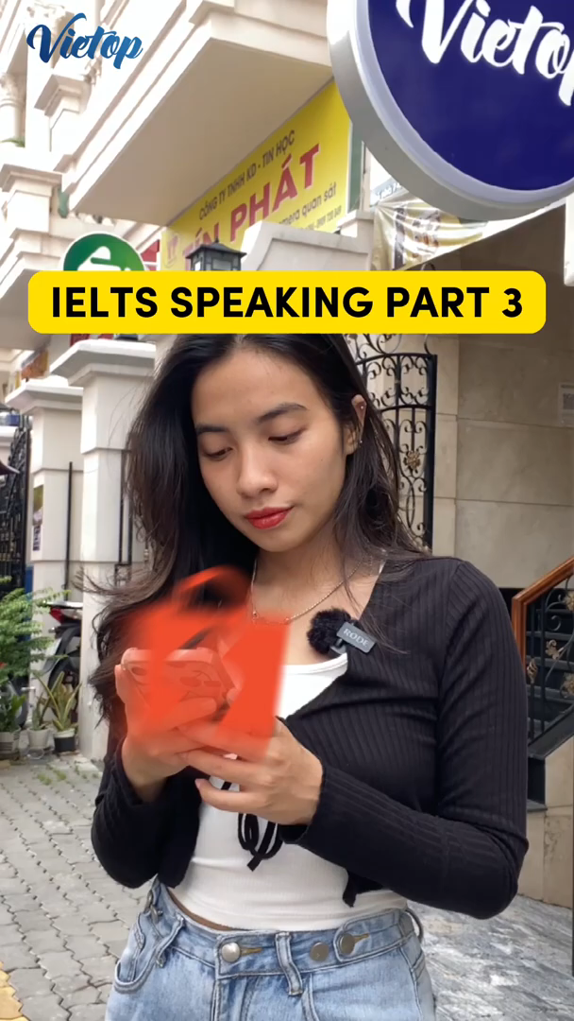
Watch about shopping online

Slide 4
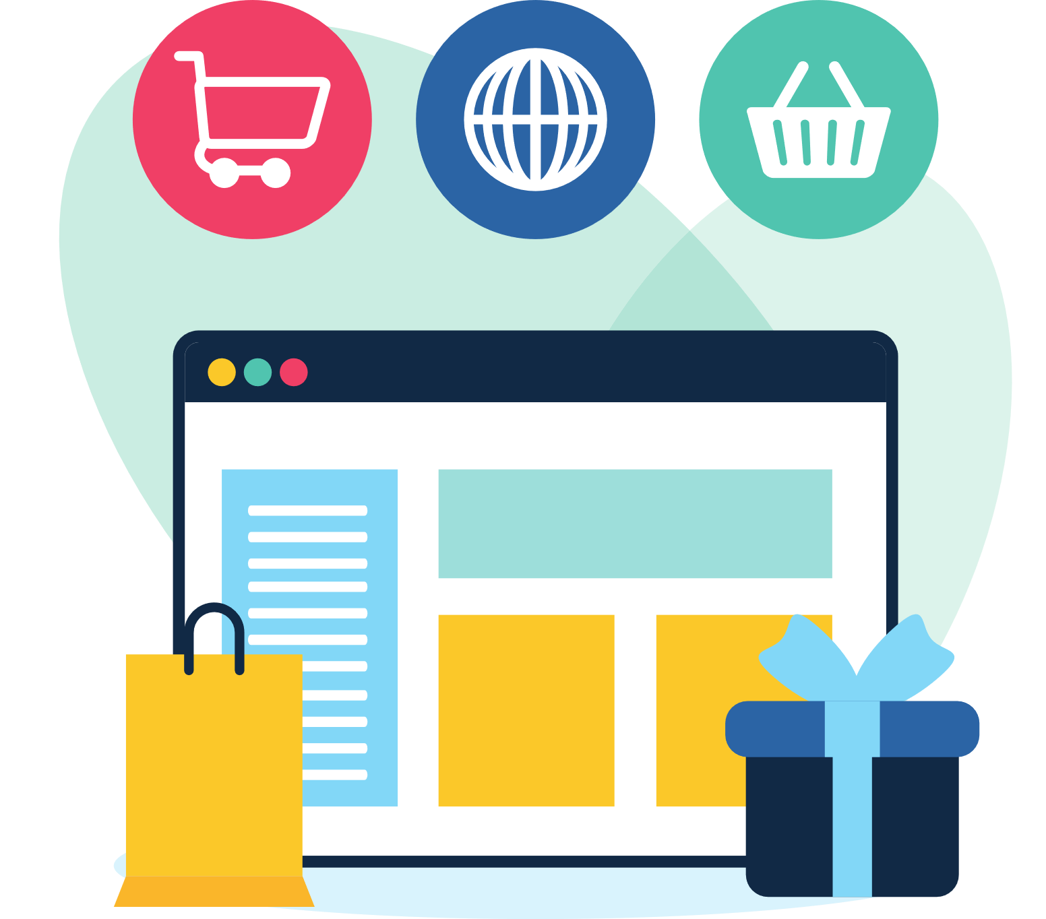
Unit 8:
SHOPPING
Lesson 6: Skills 2

Slide 5
VOCABULARY

Slide 6
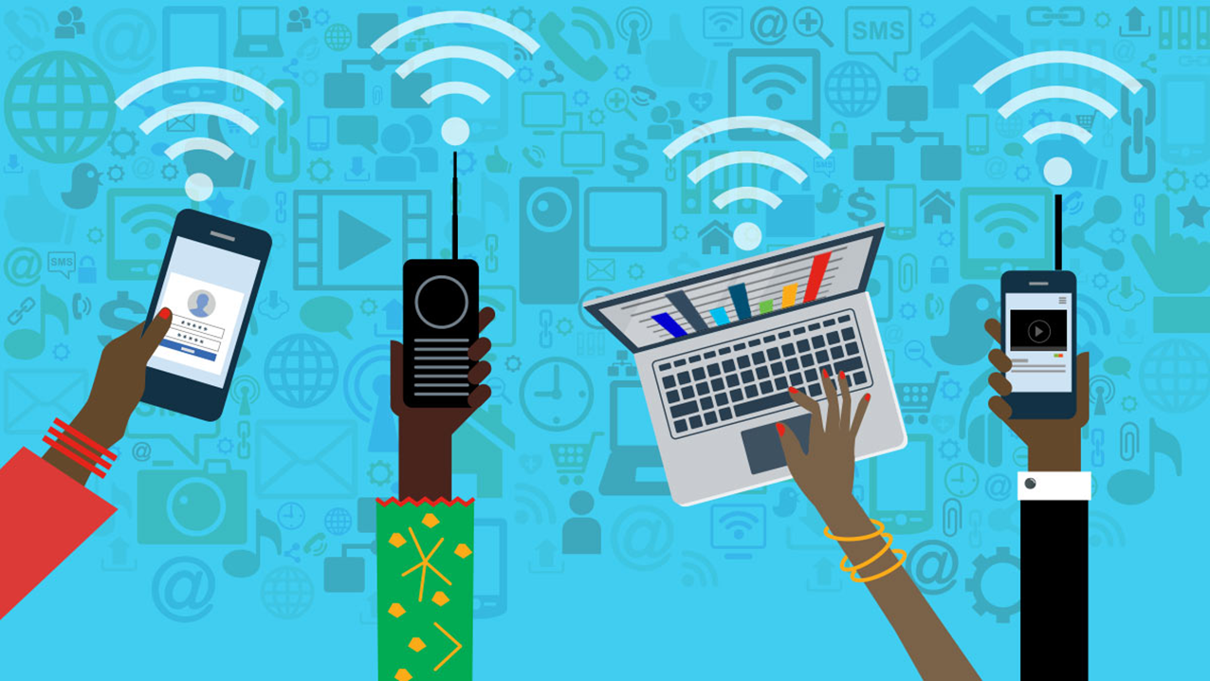

Vocabulary
access (n)
/ˈækses/
quyền truy cập vào

Slide 7
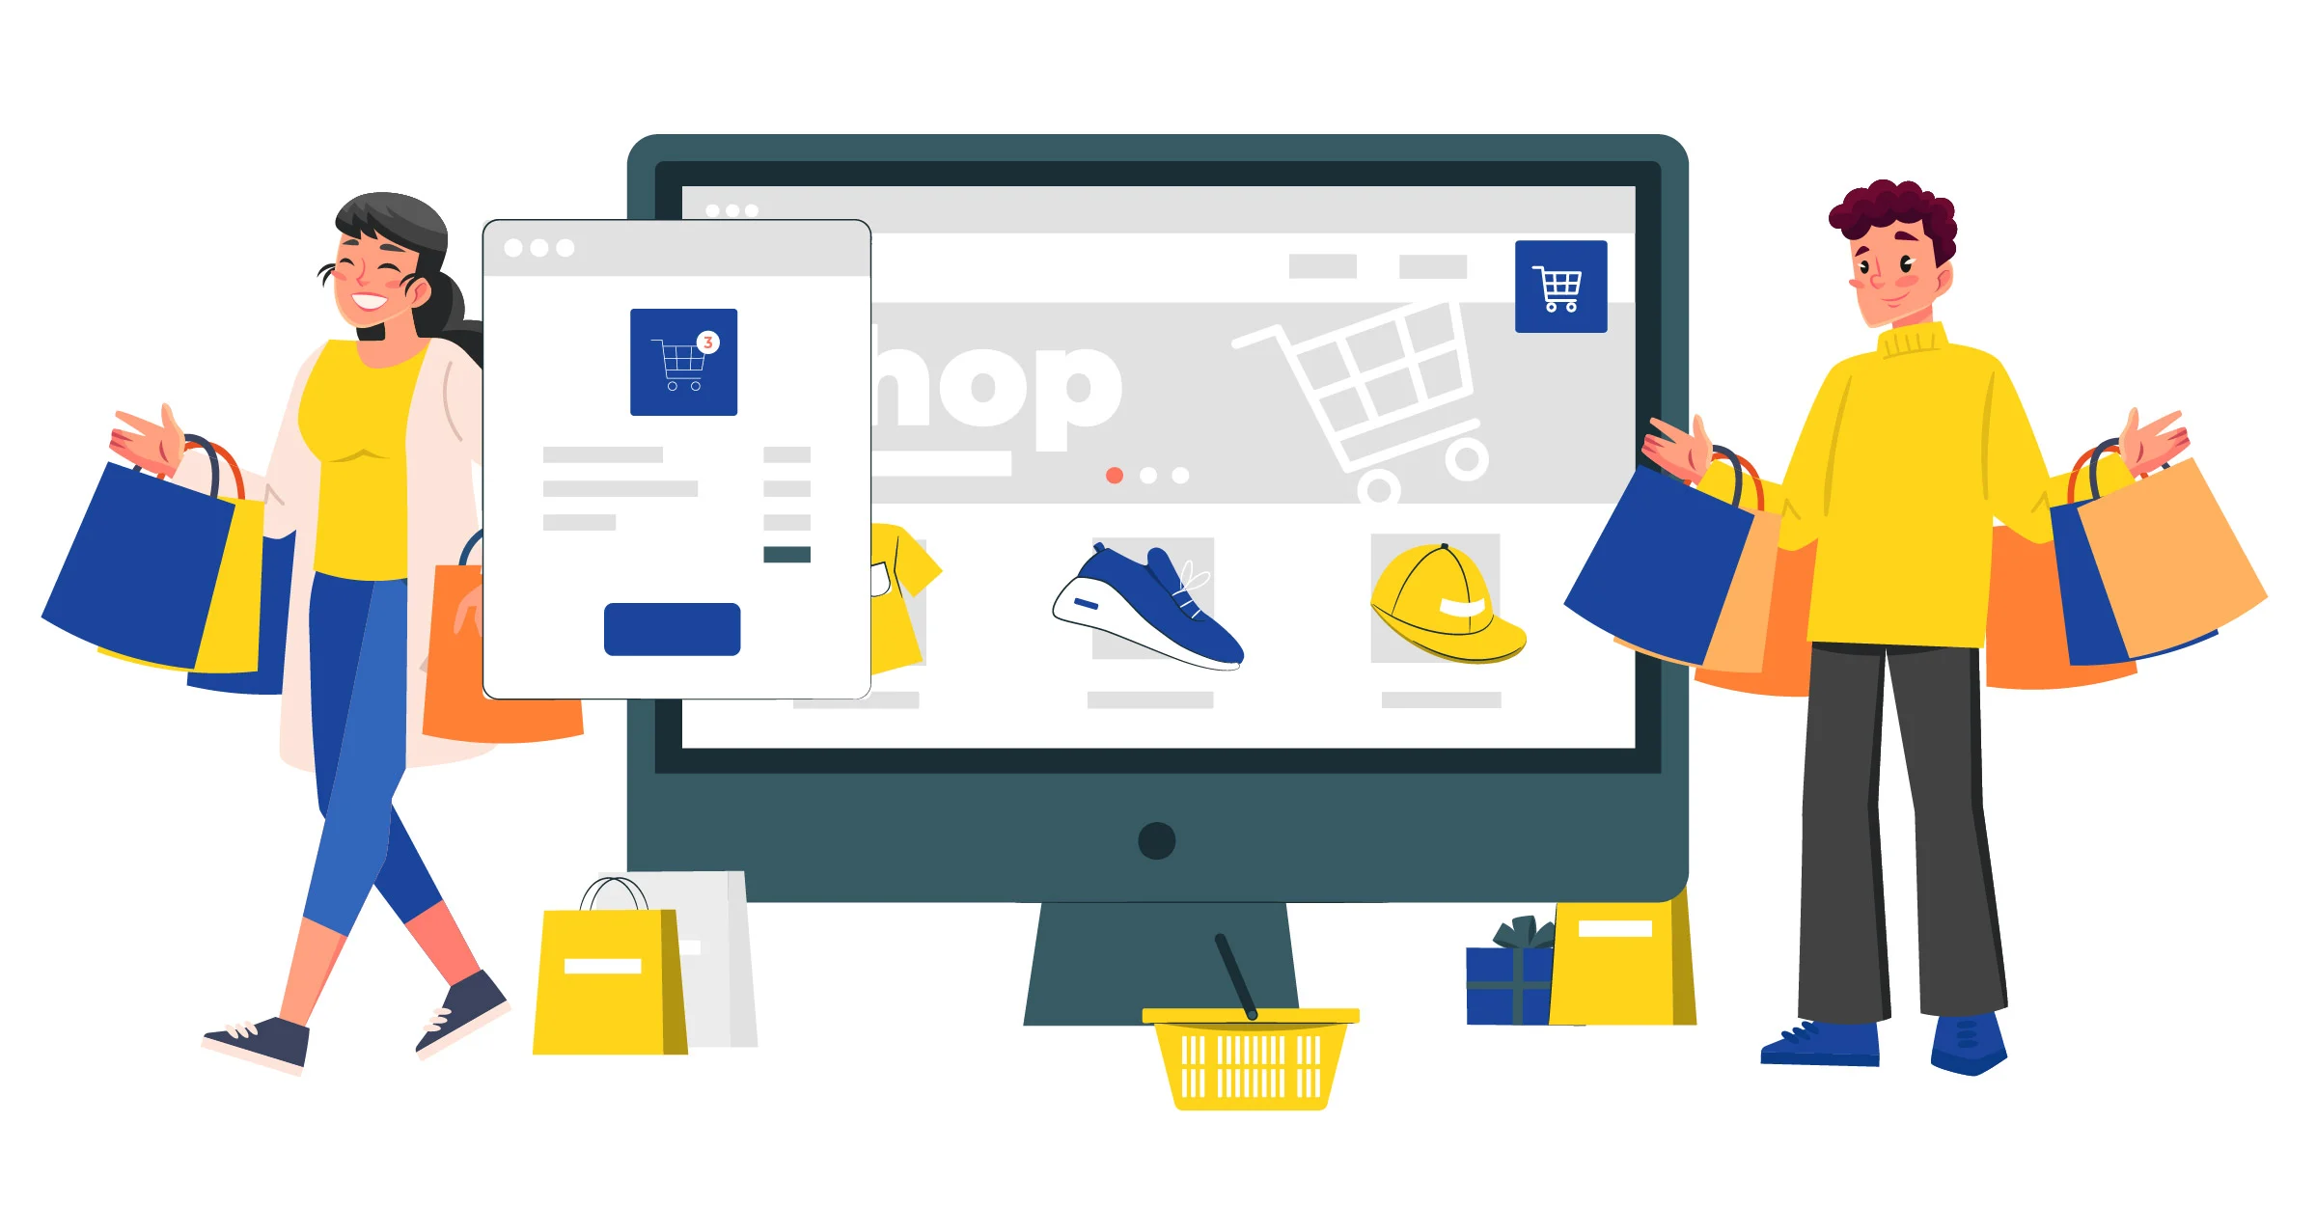
Vocabulary
purchase (v)
/ˈpɜːtʃəs/
mua sắm

Slide 8
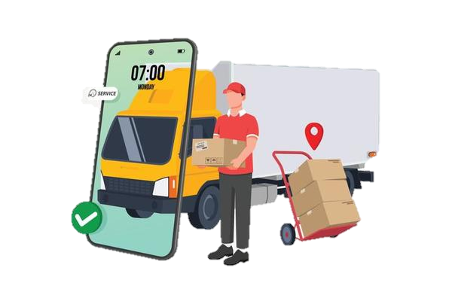
Vocabulary
Việc chuyển hàng,
giao hàng
shipping (n)
/ˈʃɪpɪŋ/

Slide 9
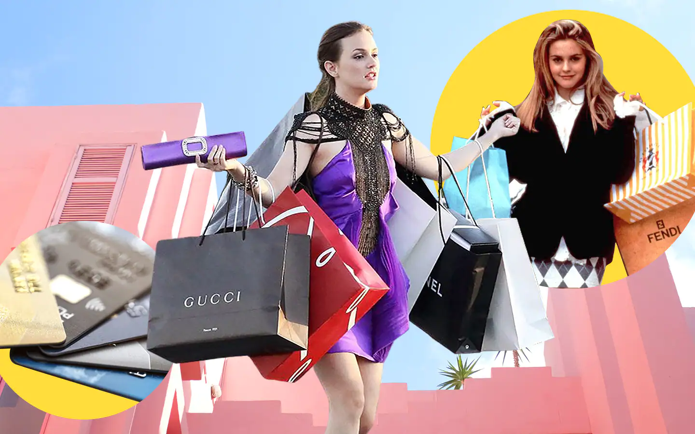
Vocabulary
overshopping (v)
/ˈəʊvə(r) ˈʃɒpɪŋ/
mua sắm quá đà

Slide 10
Vocabulary
access (n)
/ˈækses/
quyền truy cập vào
purchase (v)
/ˈpɜːtʃəs/
mua sắm
shipping (n)
/ˈʃɪpɪŋ/
Việc chuyển hàng,
giao hàng
overshopping (v)
/ˈəʊvə(r) ˈʃɒpɪŋ/
mua sắm quá đà

Slide 11
LISTENING

Slide 12

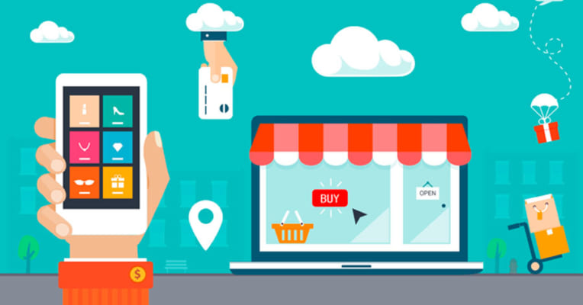
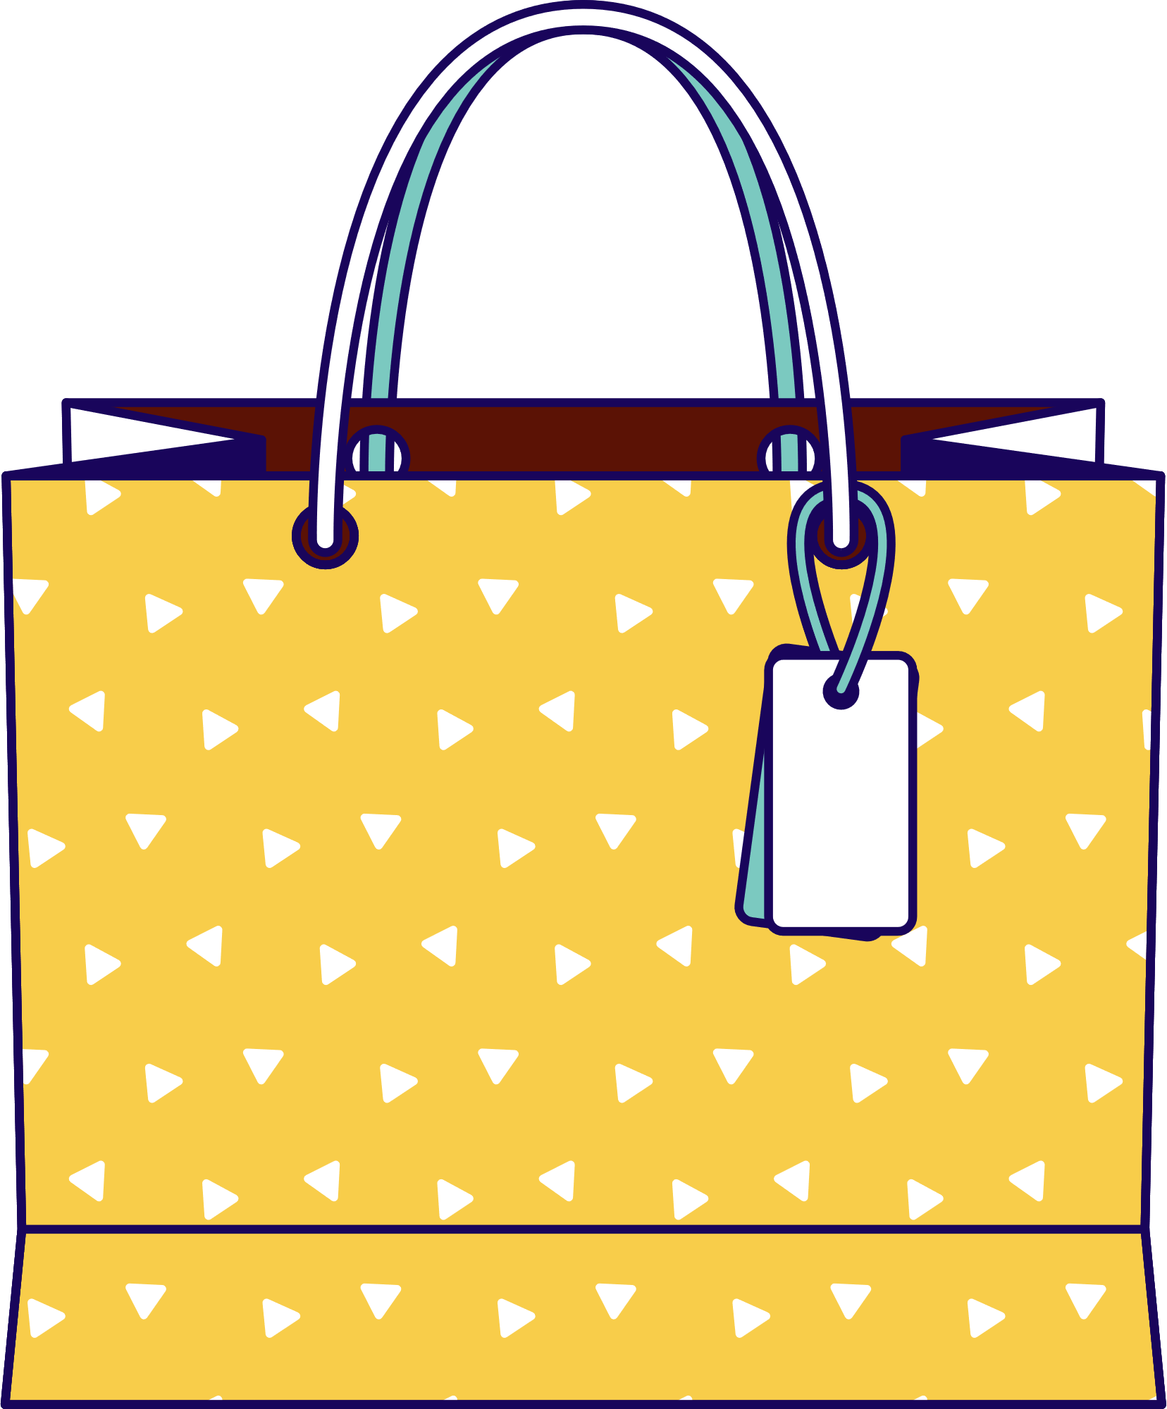

1. Work in pairs. Discuss and tick the things related to online shopping.
1. internet access
2. travelling
a smartphone/ laptop
a smartphone/laptop

Slide 13
2. Listen to a talk about online shopping and fill in each blank with a suitable word.
You can buy a product or ___________ online.
When shopping online, you visit a ___________ website.
Online shopping helps you save time and ___________.
If you return a product, you still must pay for the ______________.
Shopping online can make you become a ________________.
service
seller’s
money
shipping
shopaholic

Slide 14
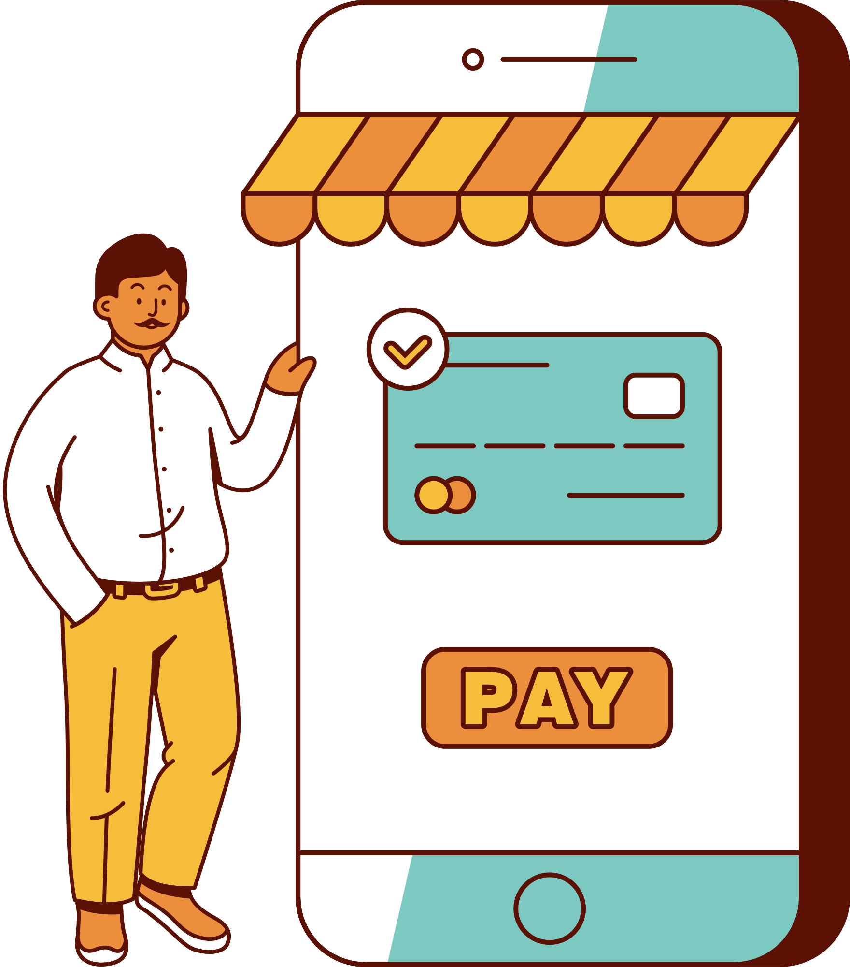
3. Listen again and choose the correct answer A, B, or C.
1. When you shop online, you can pay______ ways.
A. one B. two C. three
2. The talk does NOT describe online shopping as_______.
A. convenient B. ease C. interesting
3. The talk is mainly about _______ of online shopping.
A. always B. sometimes C. rarely

Slide 15
WRITING

Slide 16
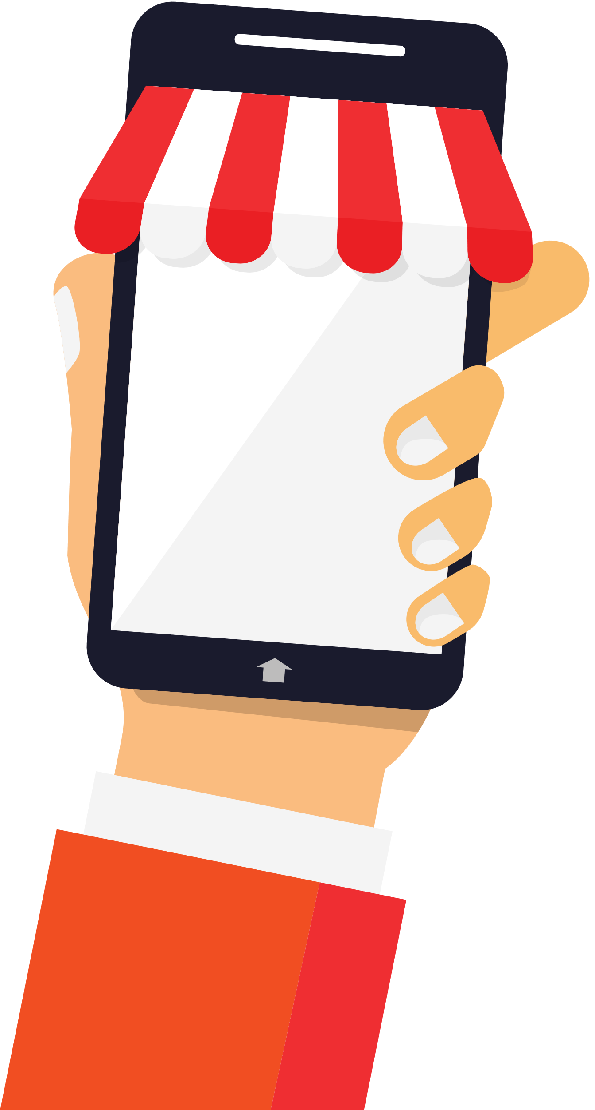
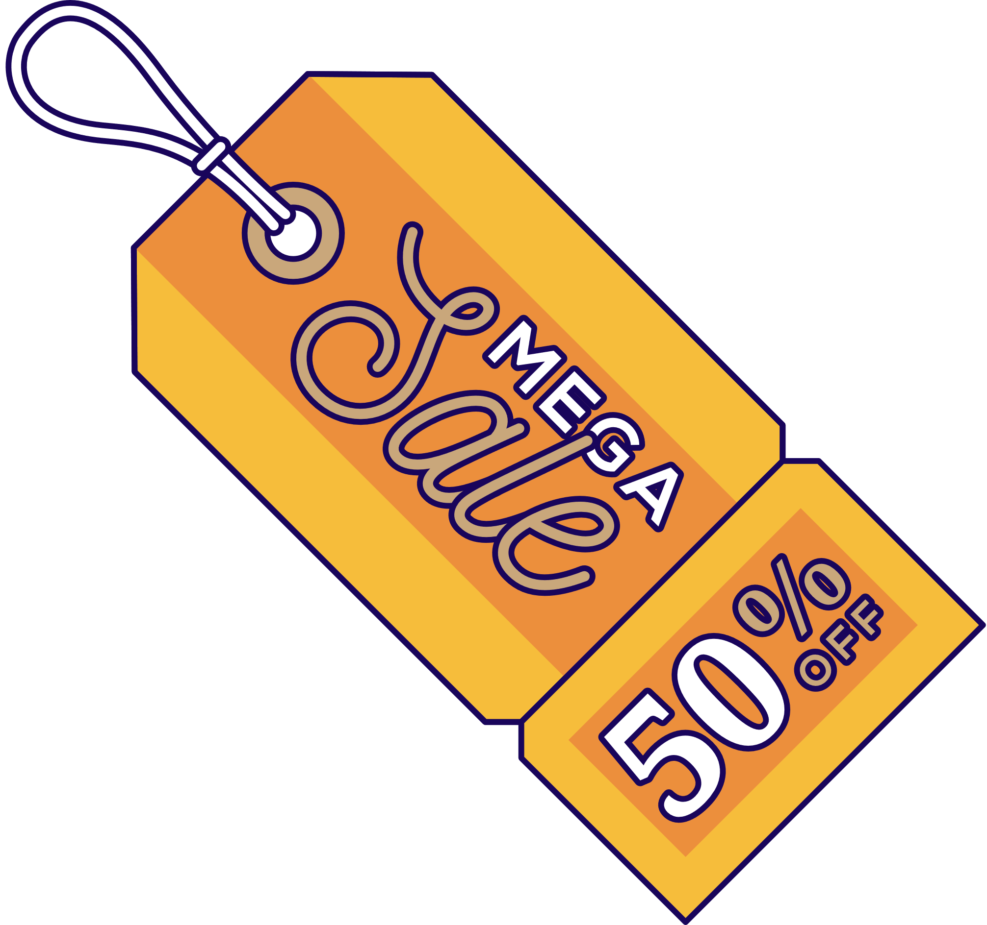
4. Work in pairs. Choose a type of shopping from the list. Discuss and take notes of its advantages and disadvantages.
1. Shopping online
2. Shopping at a supermarket
3. Shopping at an open-air market

Slide 17
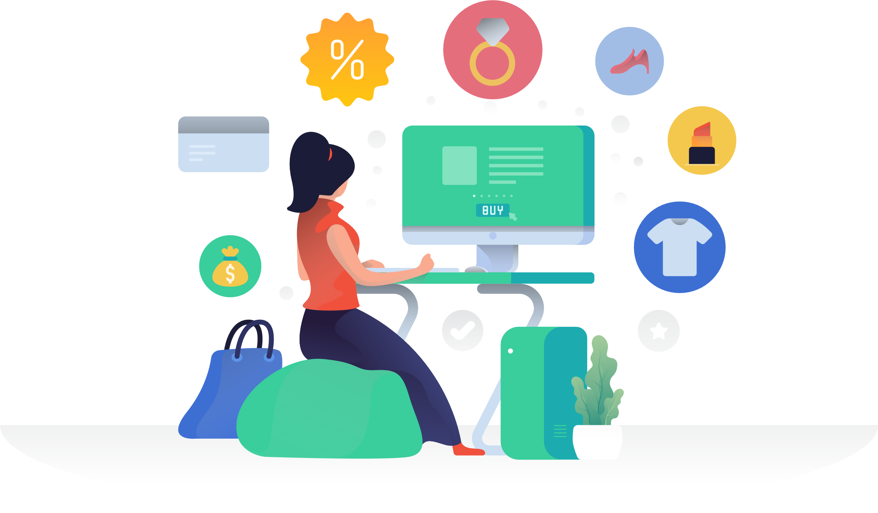
5. Write a paragraph (80-100 words) about the advantages or disadvantages of a type of shopping. Use the ideas in 4.
You can use the suggestions below:
Shopping…….. is interesting/ convenient/ safe/ ………
- Firstly, ……
- Secondly, …..

Slide 18
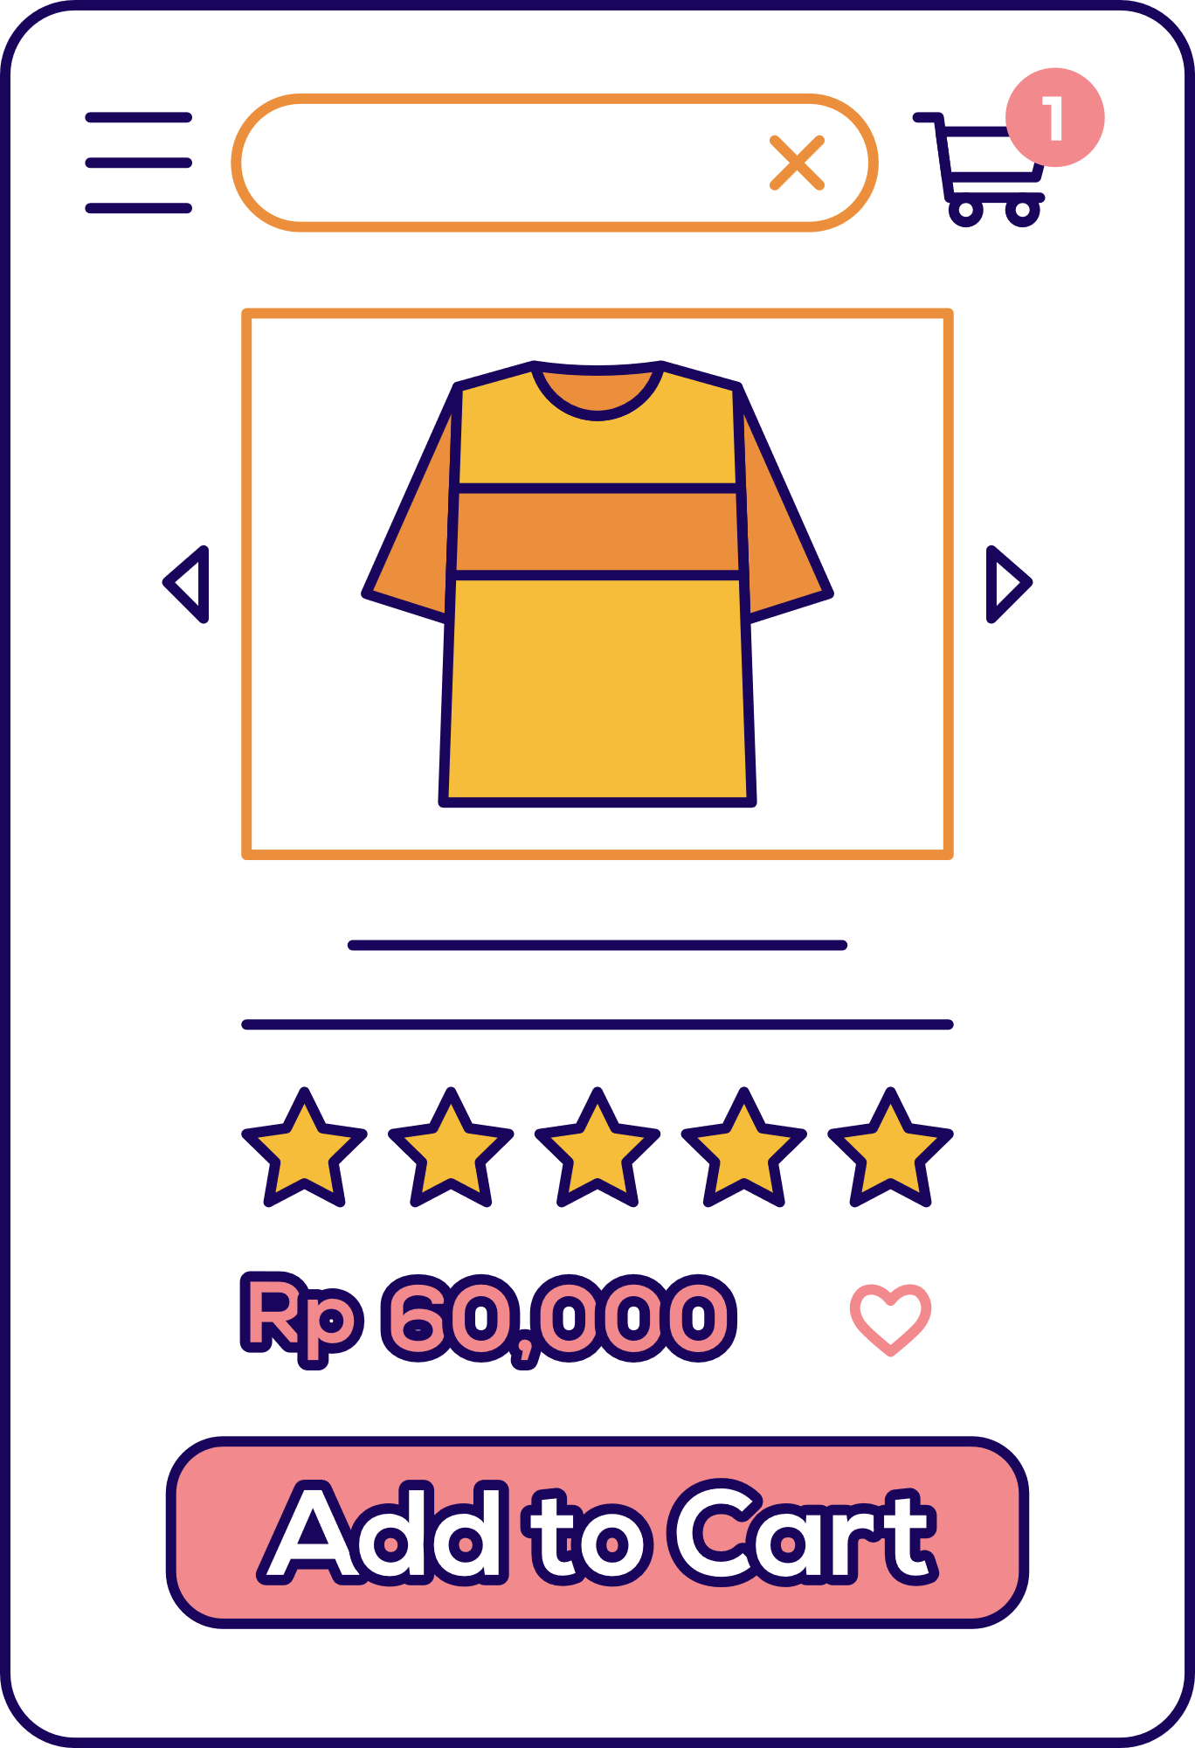
Suggested answer:
I often go shopping at the open-air market near my house. However, there are some things I don’t like about it. First, it is outdoor. On rainy or hot days, it is uncomfortable to shop. Secondly, the sellers usually ask for a higher price than the value of the goods and you have to bargain. It’s not easy if you don’t know the actual price of an item. Another disadvantage is hygiene. Fresh products like vegetables are often not very clean.

Slide 19
Wrap-up
What have we learned in this lesson?
Online shopping
Advantages or disadvantages of a kind of shopping.

Slide 20
Homework
Learn the new words by heart.
Rewrite the paragraph about the advantages or disadvantages of a type of shopping.
Prepare for the next lesson

Slide 21
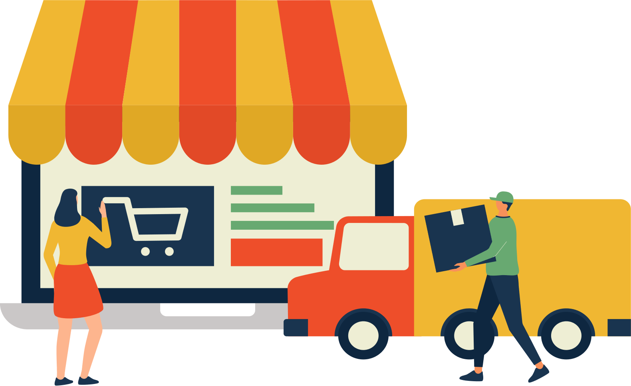
Thank You!

