Slide 1
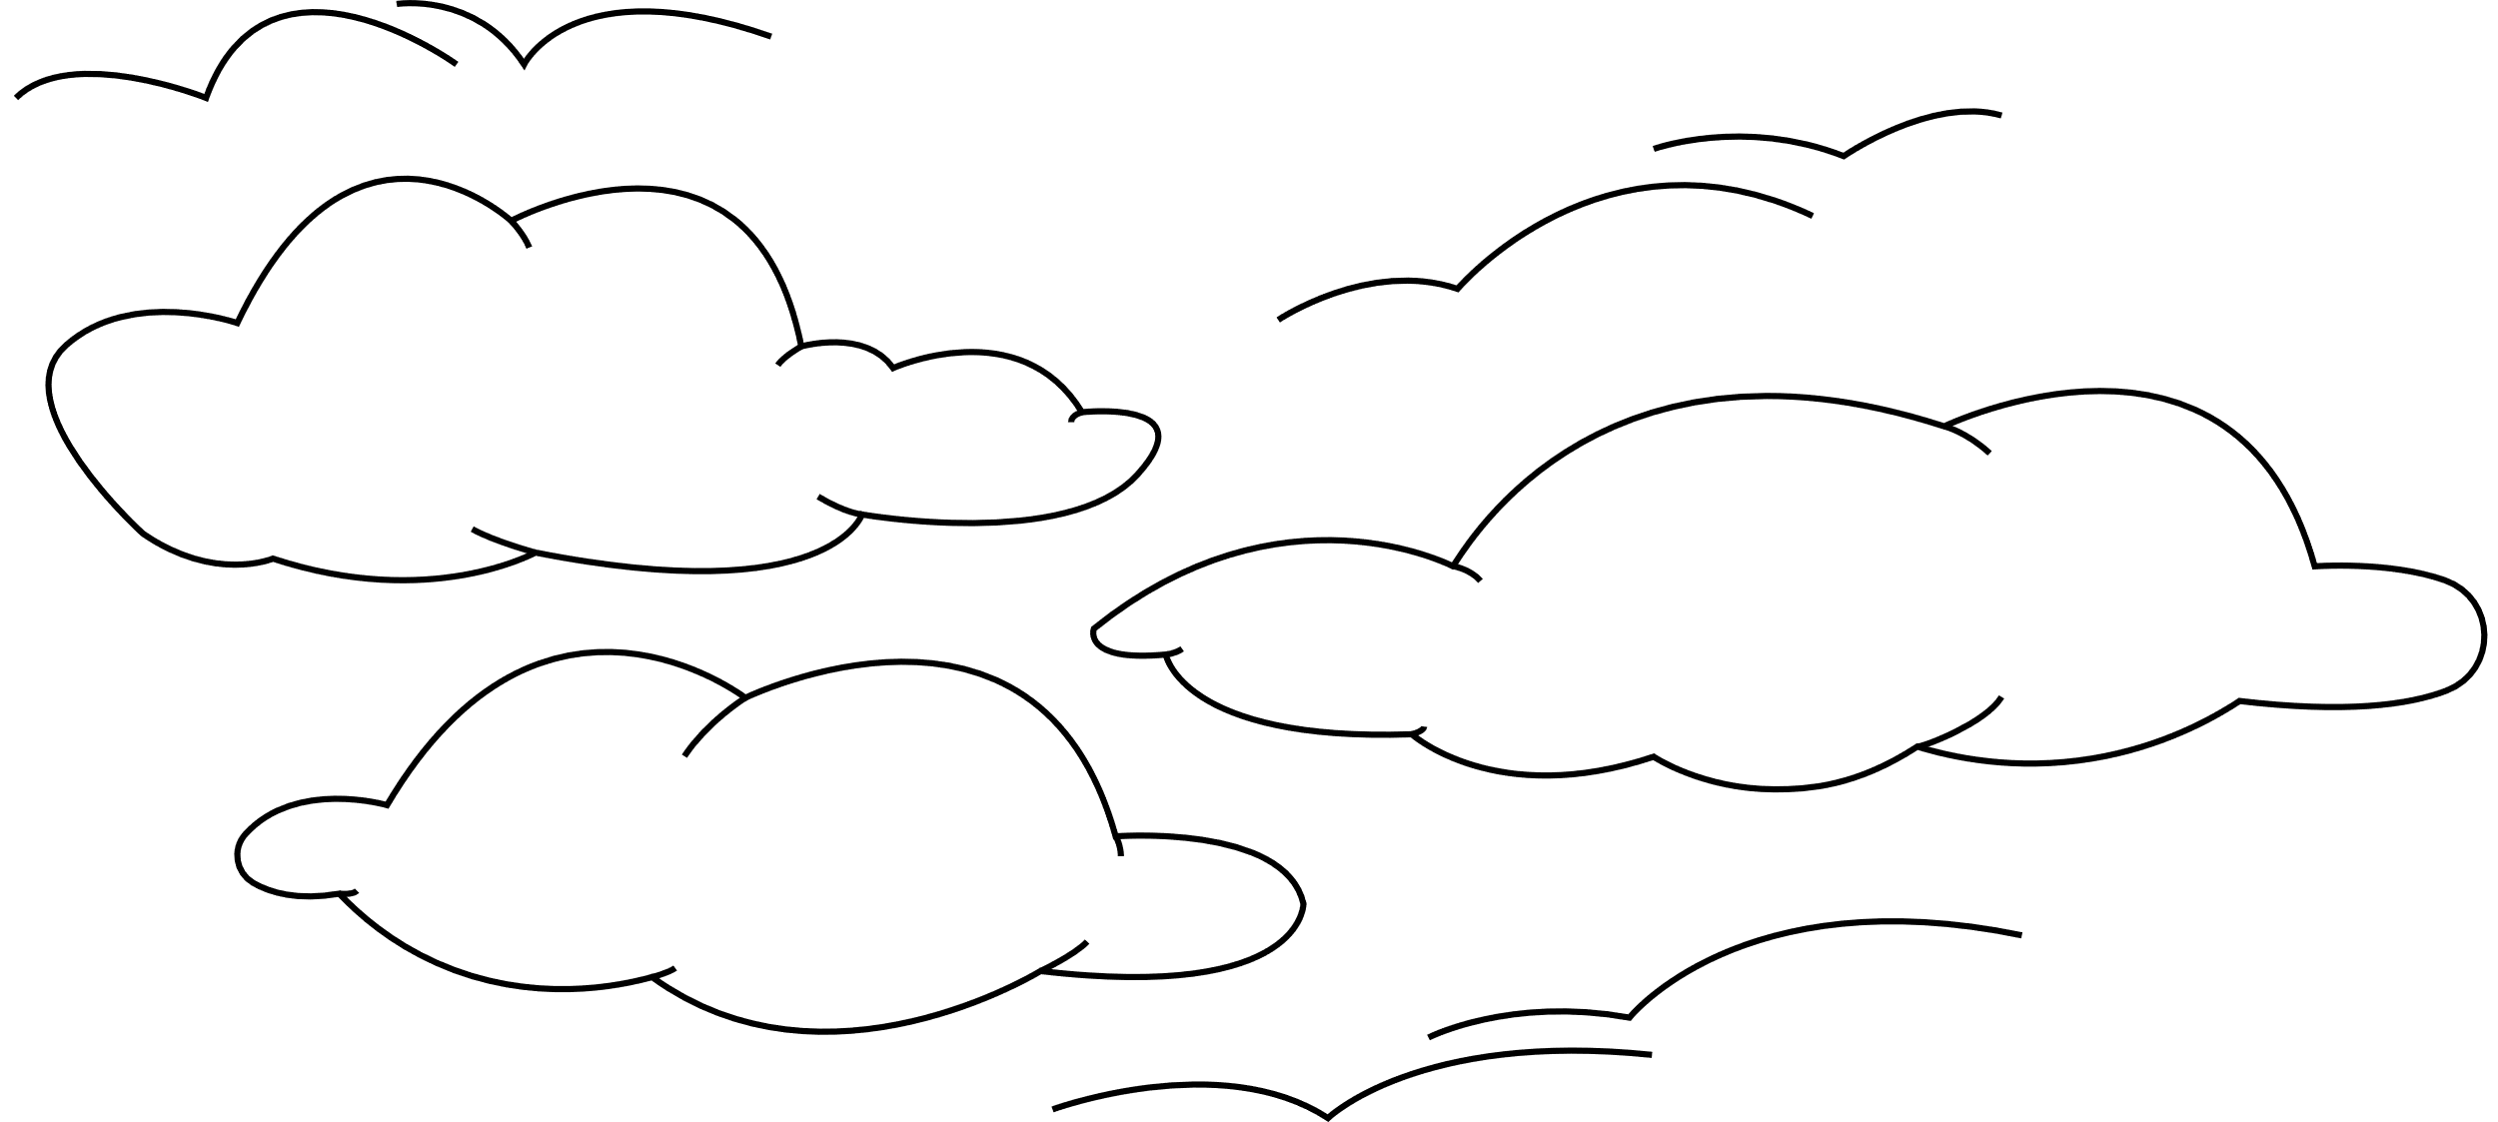
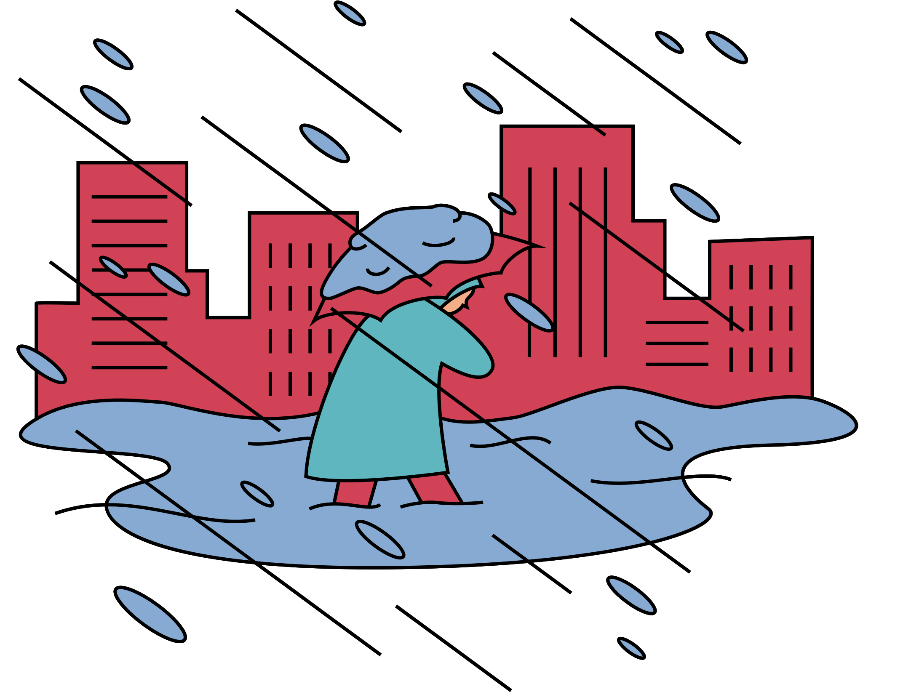
WELCOME TO OUR CLASS!

Slide 2
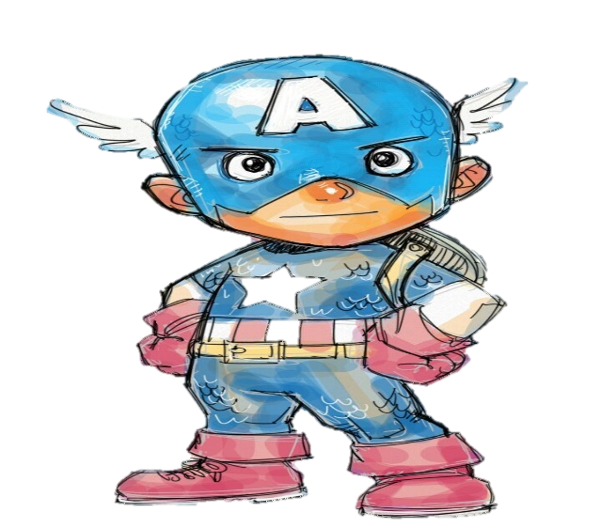








Slide 3


Guess what’s behind the wall
by removing the fewer bricks.

Slide 4
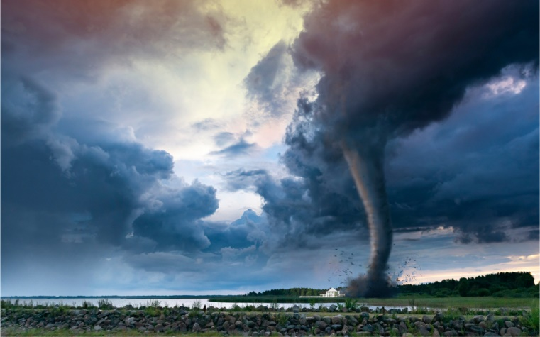
tornado
NEXT
Click on the bricks
CHECK

Slide 5
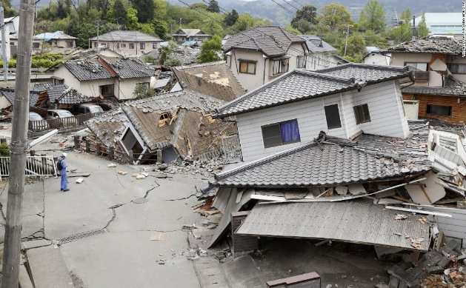
earthquake
NEXT
Click on the bricks
CHECK

Slide 6
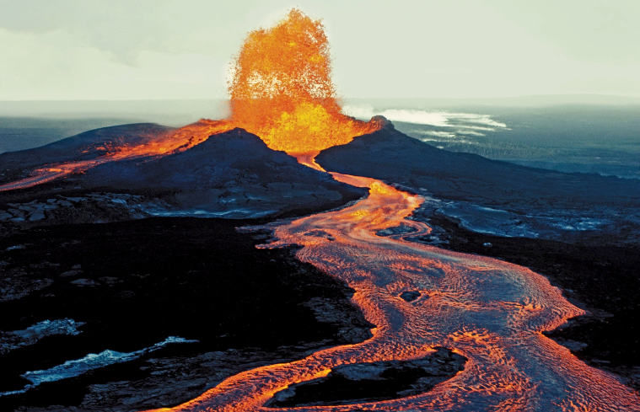
volcano
NEXT
Click on the bricks
CHECK

Slide 7
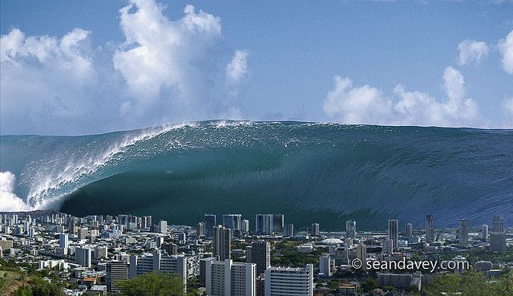
tidal wave
NEXT
Click on the bricks
CHECK

Slide 8
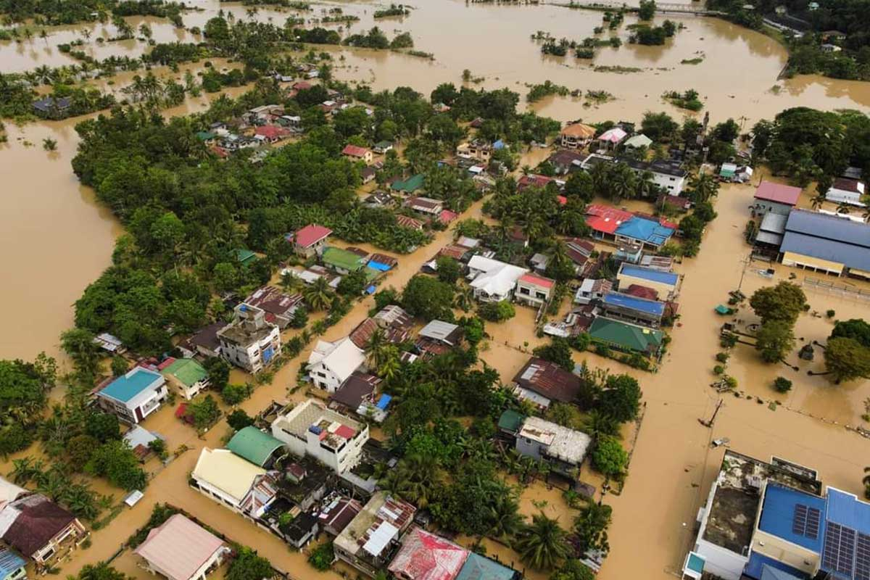
flood
NEXT
Click on the bricks
CHECK

Slide 9
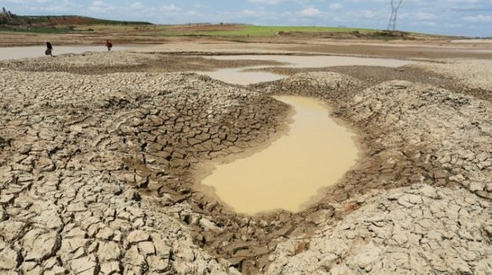
drought
NEXT
Click on the bricks
CHECK

Slide 10
Listen and repeat
earthquake
tornado
volcano
tidal wave/ tsunami
flood
drought

Slide 11
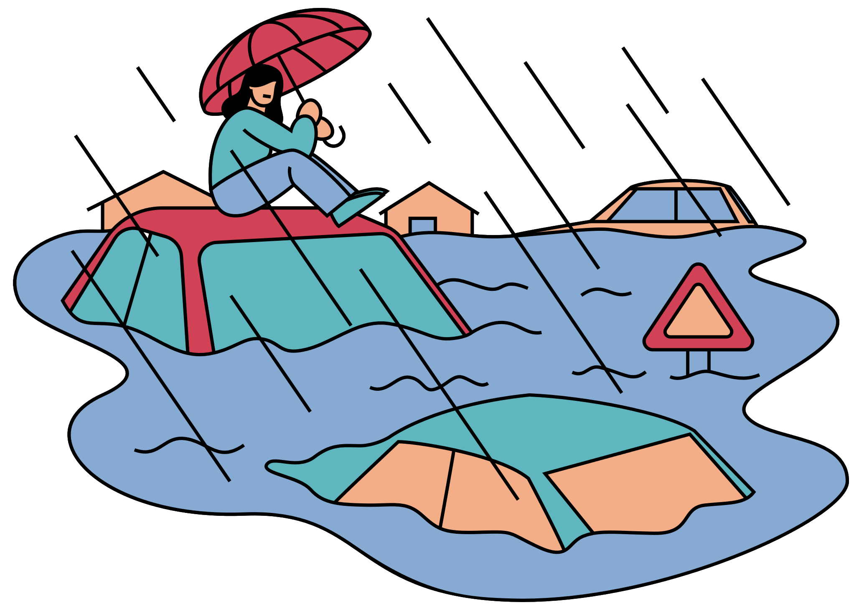
Unit 9:
NATURAL DISASTERS
Lesson 2: A Closer Look 1

Slide 12
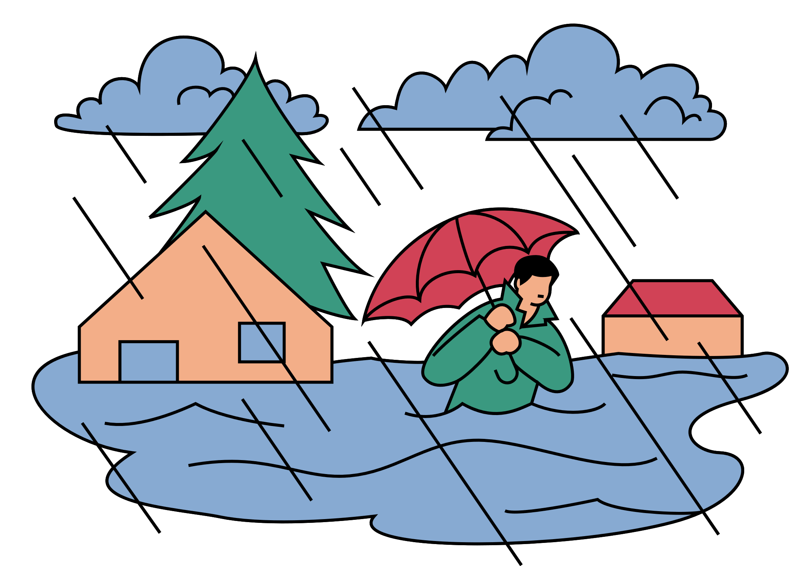
VOCABULARY

Slide 13
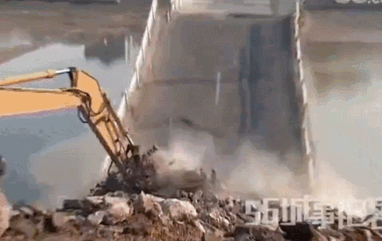

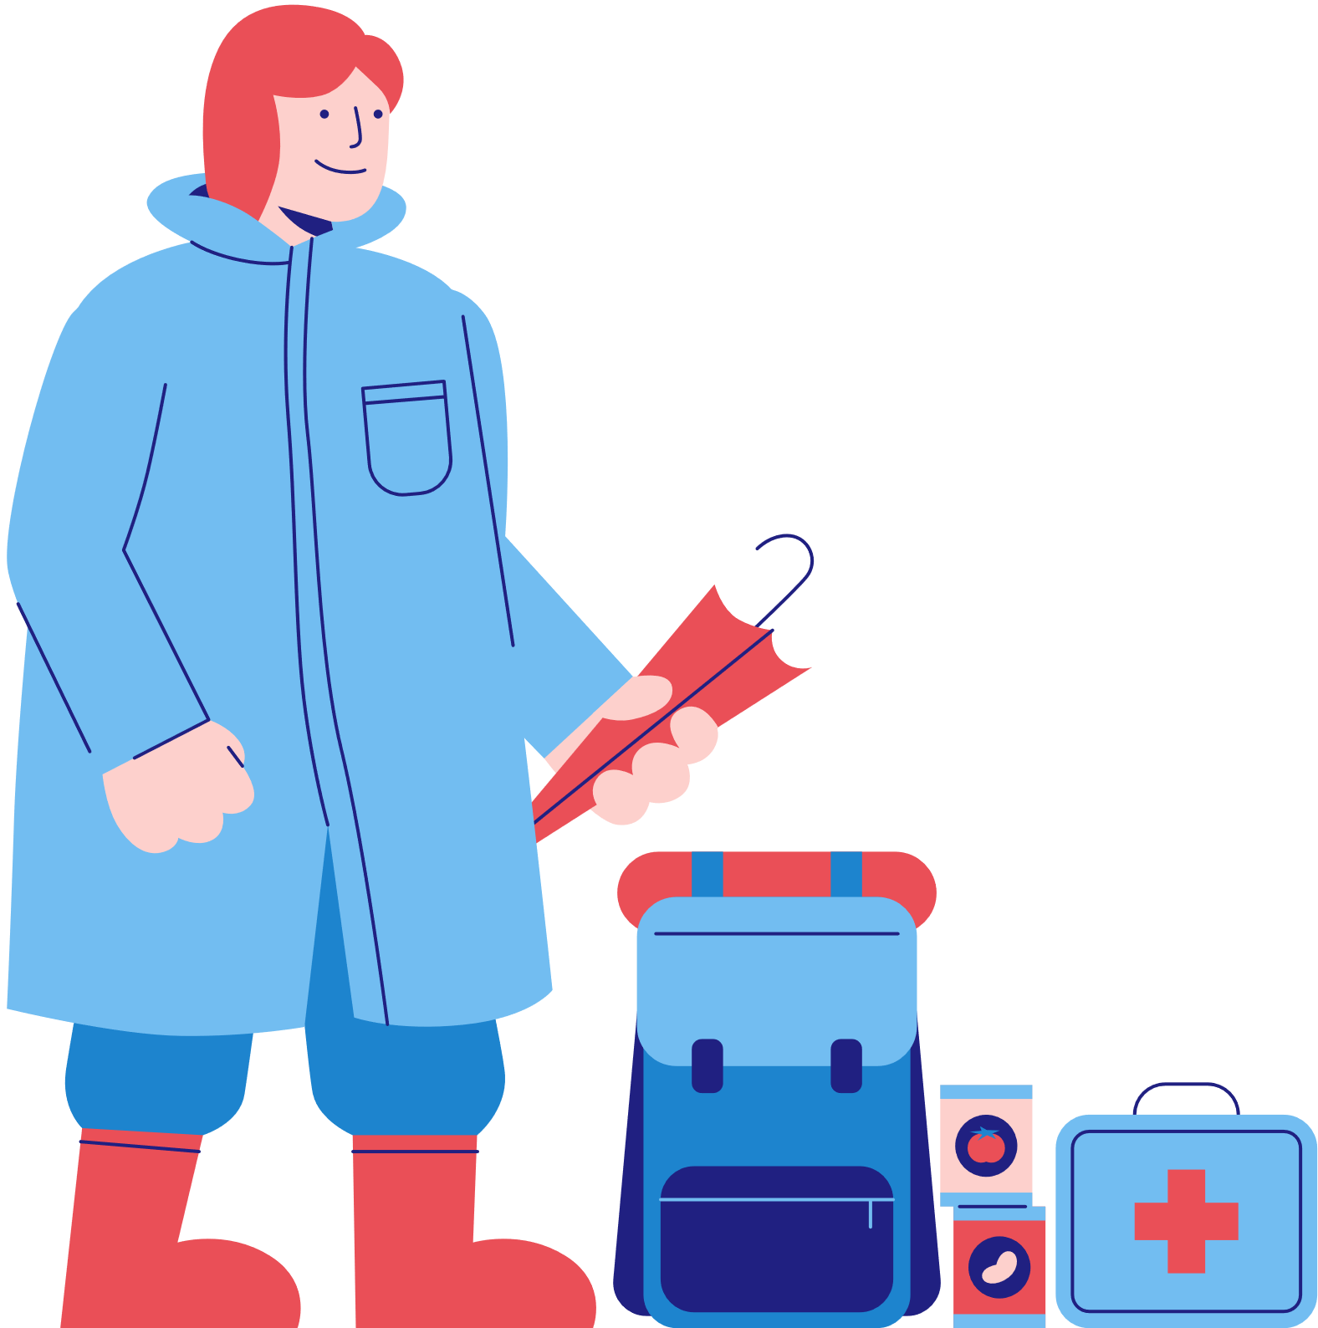
Vocabulary
destroy (v)
/dɪˈstrɔɪ/
phá hủy

Slide 14
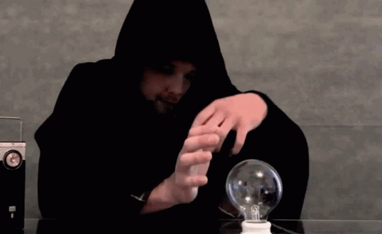
Vocabulary
predict (v)
/prɪˈdɪkt/
dự đoán

Slide 15
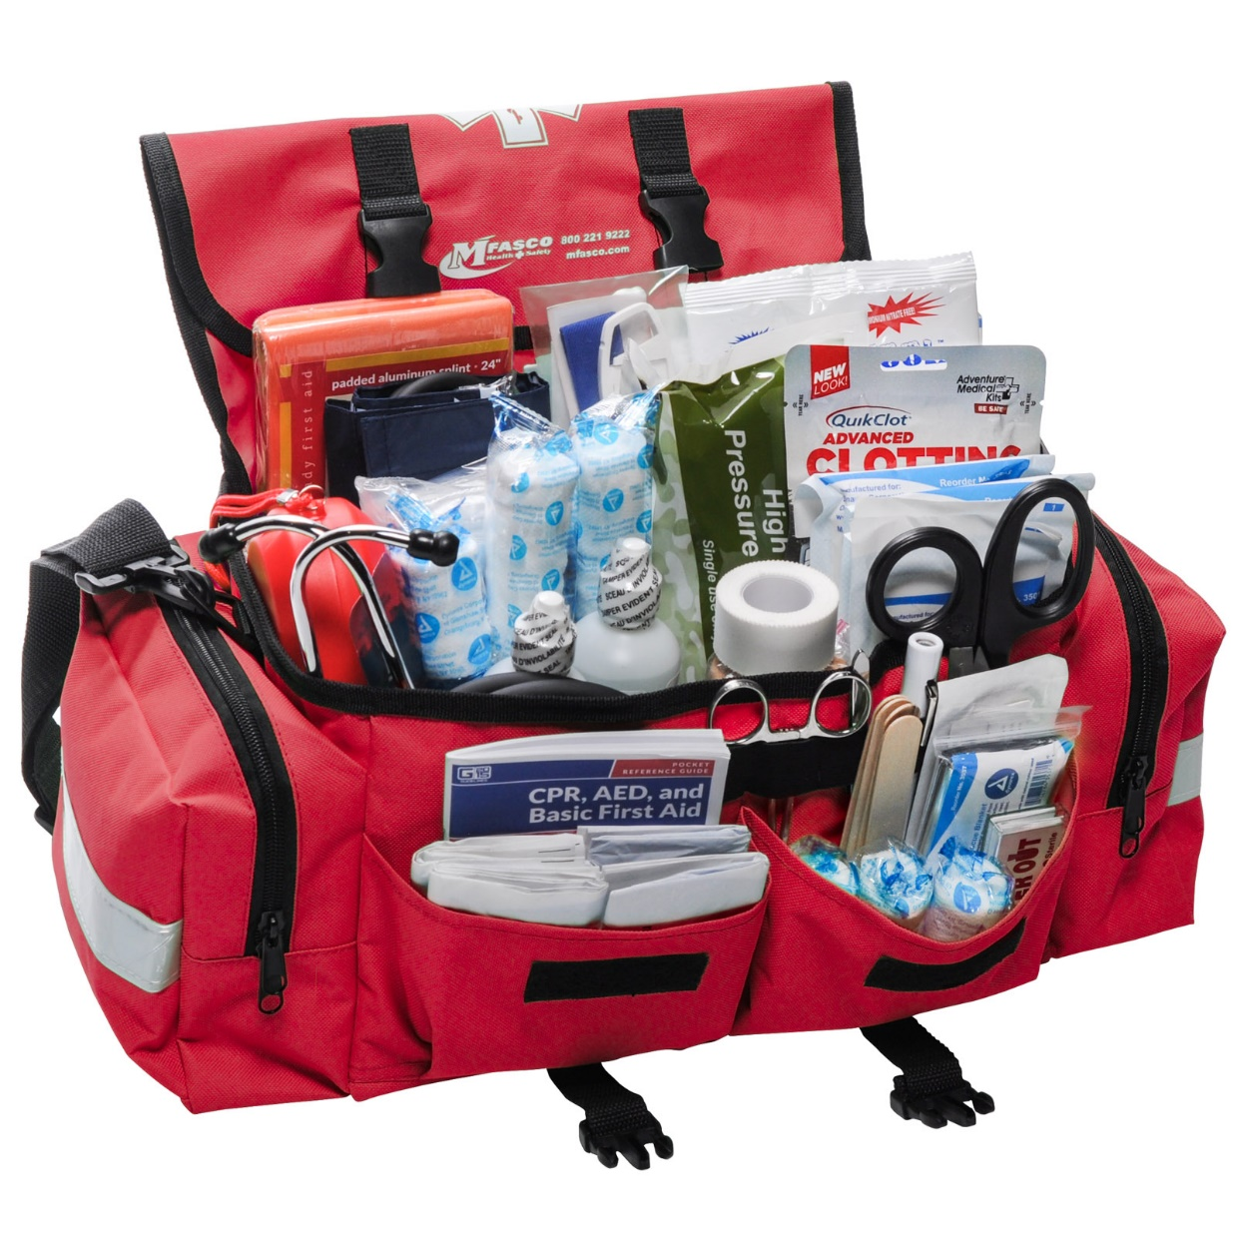
Vocabulary
emergency kit (n)
/ɪˈmɜːdʒənsikit/
bộ dụng cụ dùng trong trường hợp khẩn cấp

Slide 16
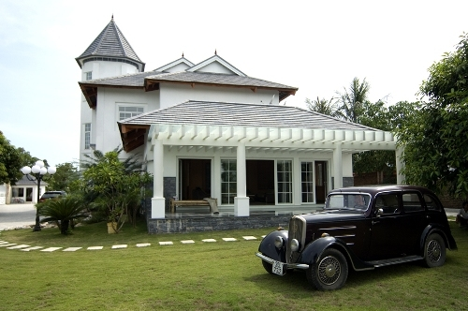
Vocabulary
property (n)
/ˈprɒpəti/
của cải, nhà cửa

Slide 17
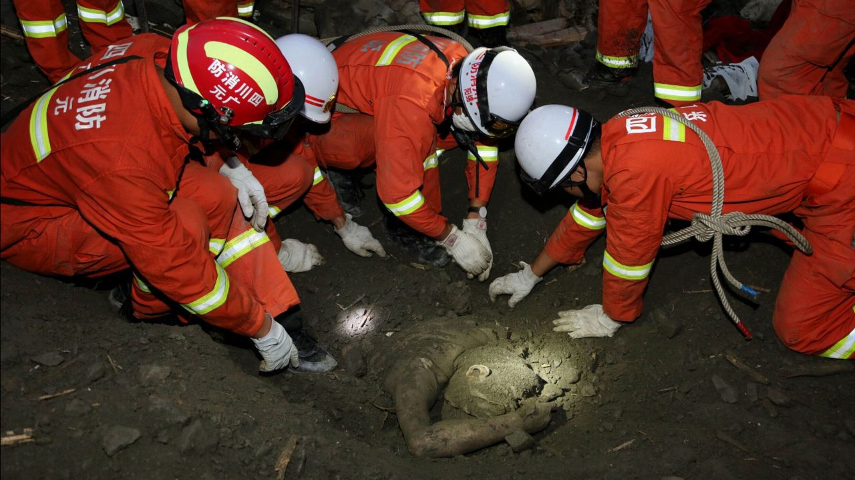
Vocabulary
rescue worker (n)
/ˈreskjuːˈwɜːkər /
nhân viên cứu hộ

Slide 18
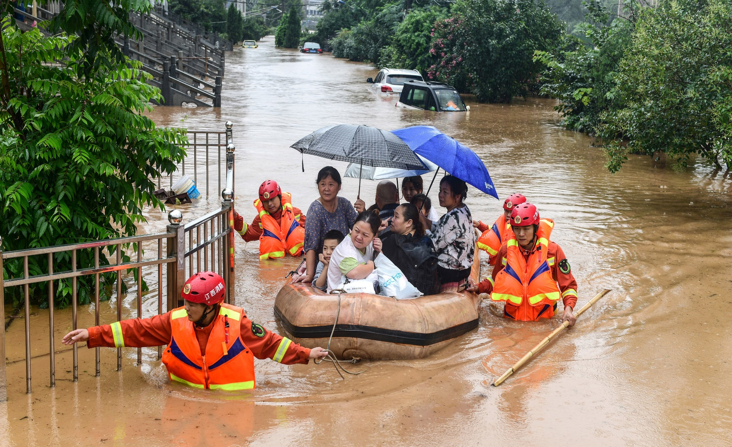
Vocabulary
victim (n)
/ˈvɪktəm/
nạn nhân

Slide 19
Vocabulary
- destroy (v) | /dɪˈstrɔɪ/ | phá hủy
- predict (v) | /prɪˈdɪkt/ | dự đoán
- emergency kit | /ɪˈmɜːdʒənsikit/ | bộ dụng cụ dùng trong trường hợp khẩn cấp
- property (n) | /ˈprɒpəti/ | của cải, nhà cửa
- rescue worker | /ˈreskjuːˈwɜːkər / | nhân viên cứu hộ
- victim (n) | /ˈvɪktəm/ | nạn nhân

Slide 20
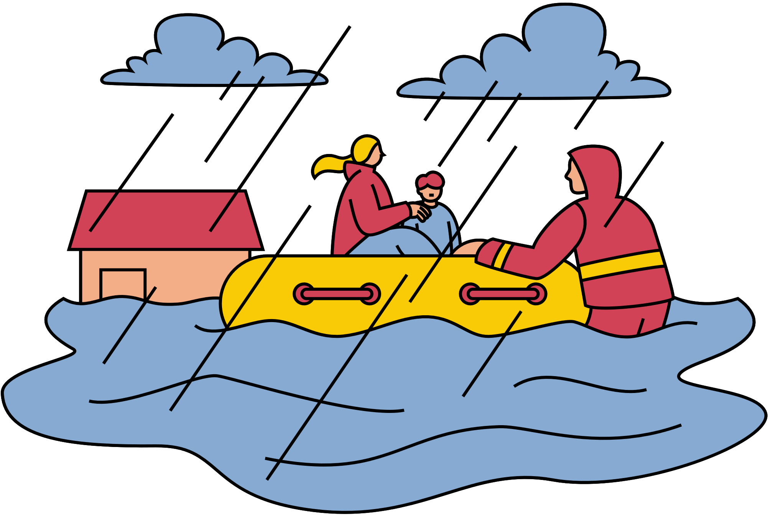
1. In column B, write the NOUN forms of the VERBS in column A.
A | B
1. destroy
2. erupt
3. warn
4. predict
5. damage
destruction
eruption
warning
prediction
damage

Slide 21
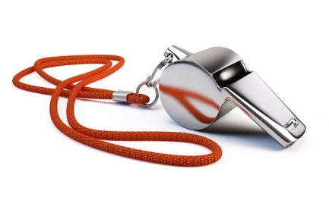

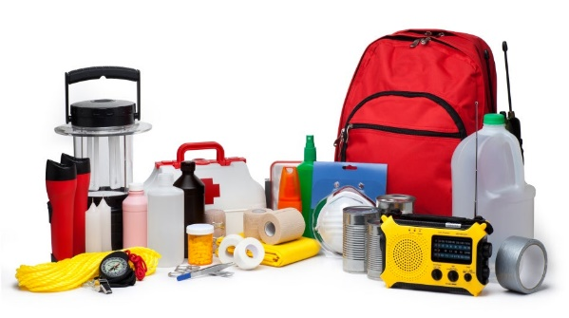
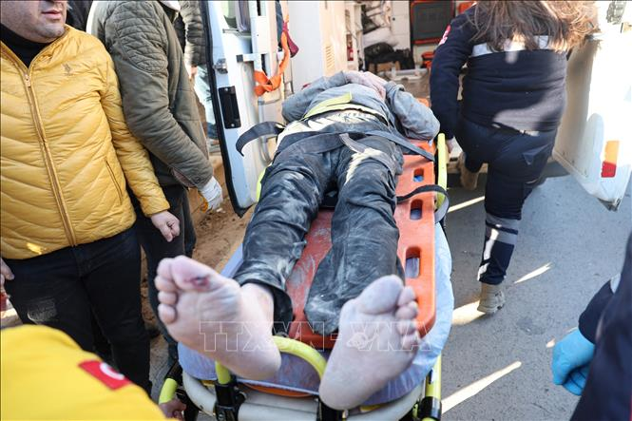
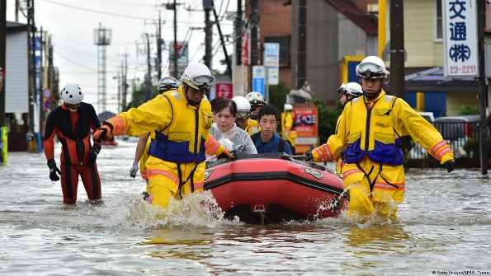
2. Write a word or phrase from the box under the correct picture
emergency kit victim rescue worker property whistle
whistle
property
emergency kit
victim
rescue worker

Slide 22
3. Fill in each blank with a word or phrase from the box.
warning predict property damage emergency kit
1. Natural disasters can cause serious ________ to human life.
2. Local authorities gave a flood ________ yesterday, so today people are moving to safer places.
3. To prepare for a natural disaster, we should make a(n) _____________.
4. It’s hard to believe that we cannot _______ when earthquakes will happen.
5. They lost all of their ________ because of the volcanic eruption.

Slide 23


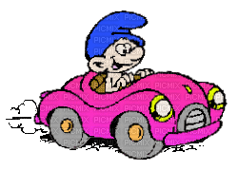
OBSTACLE RACE

Slide 24

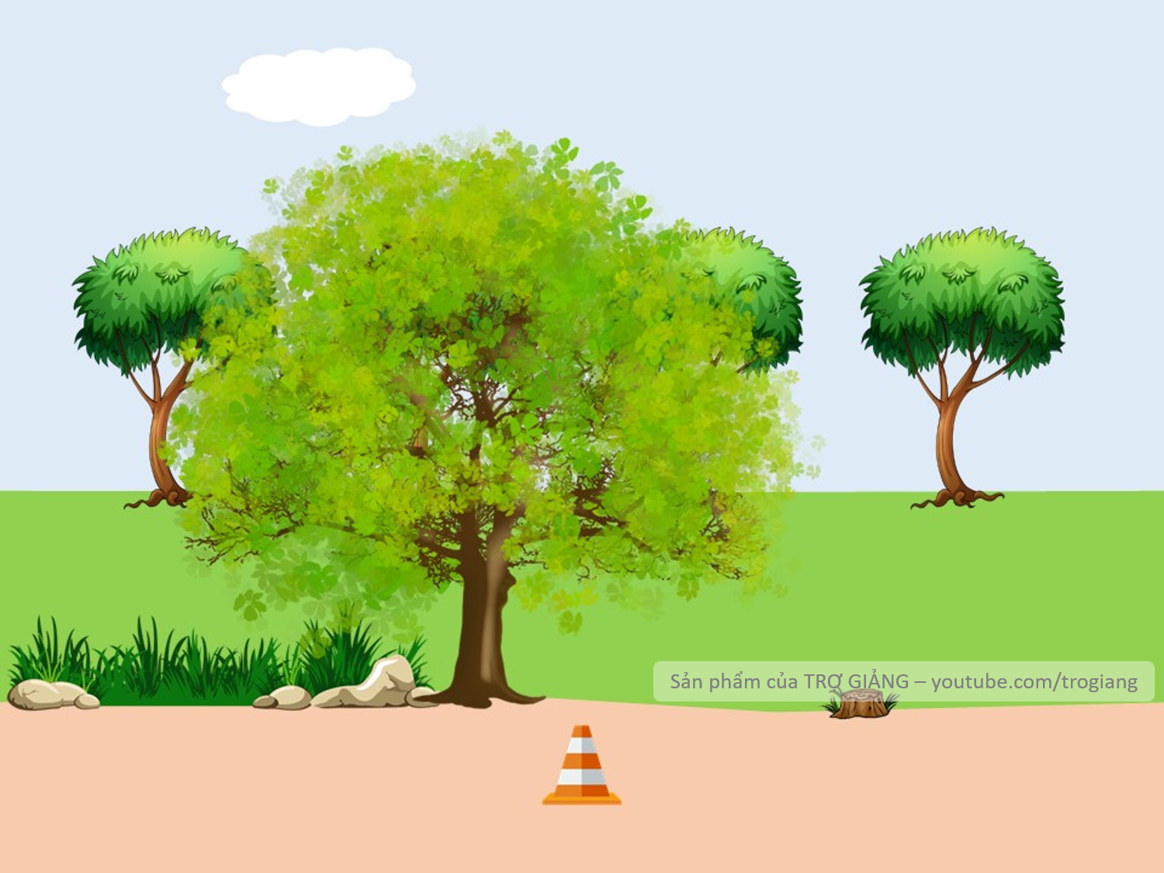



1. Natural disasters can cause serious ________ to human life.
damage
Click me if you need help.
damage

Slide 25
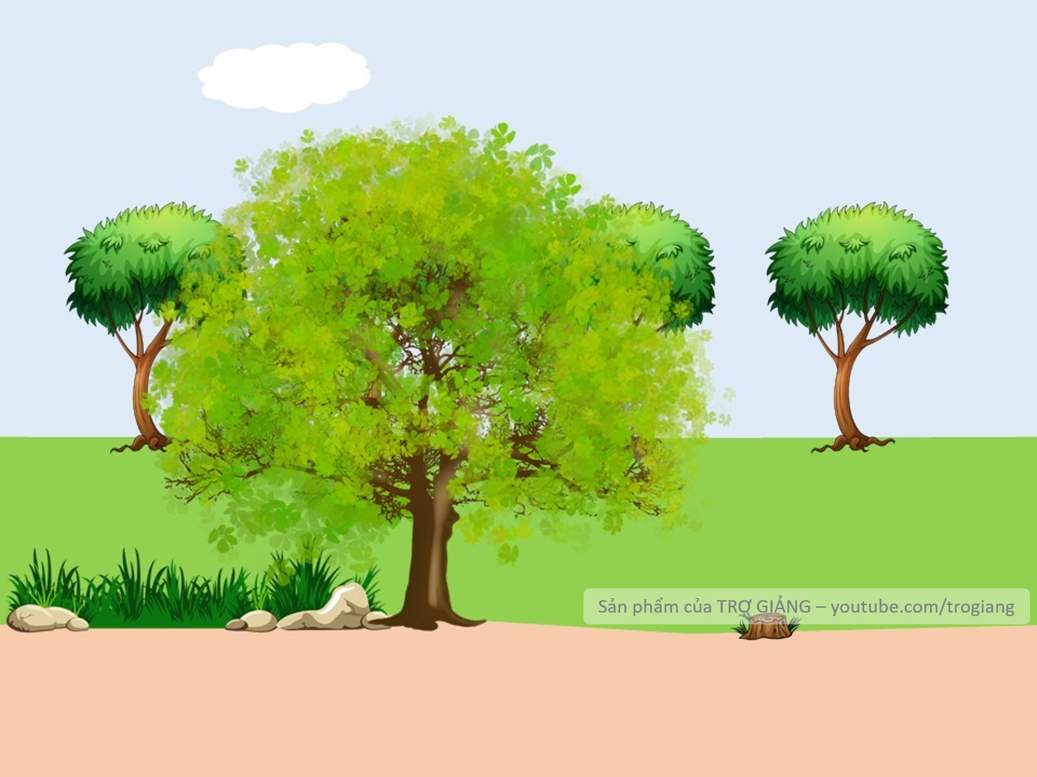


warning
2. Local authorities gave a flood __________ yesterday, so today people are moving to safer places.
Click me if you need help.
warning

Slide 26
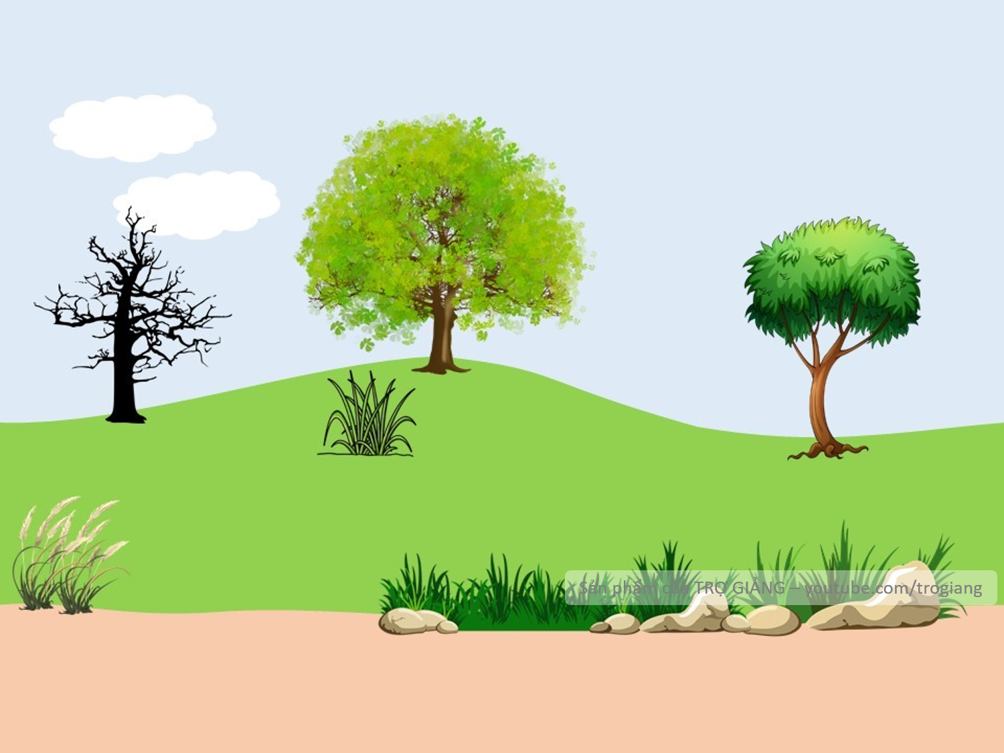


3. To prepare for a natural disaster, we should make a(n) _____________________.
emergency kit
Click me if you need help.
emergency kit

Slide 27
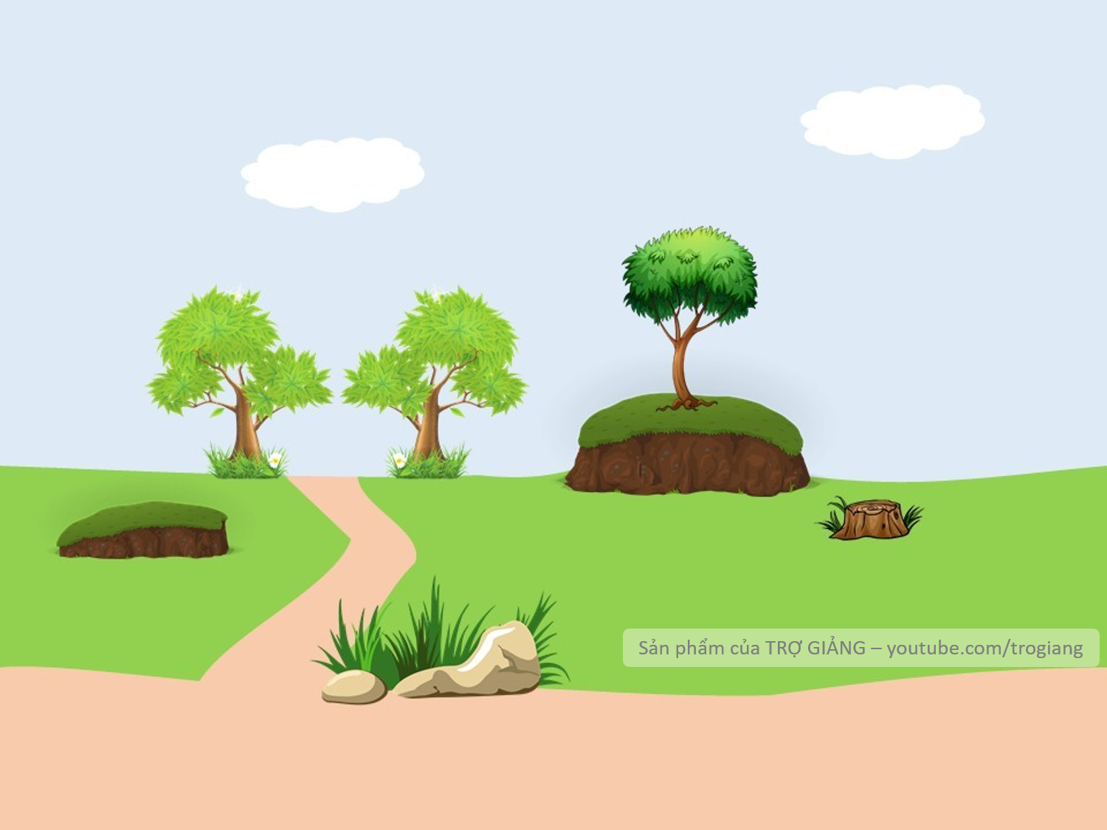
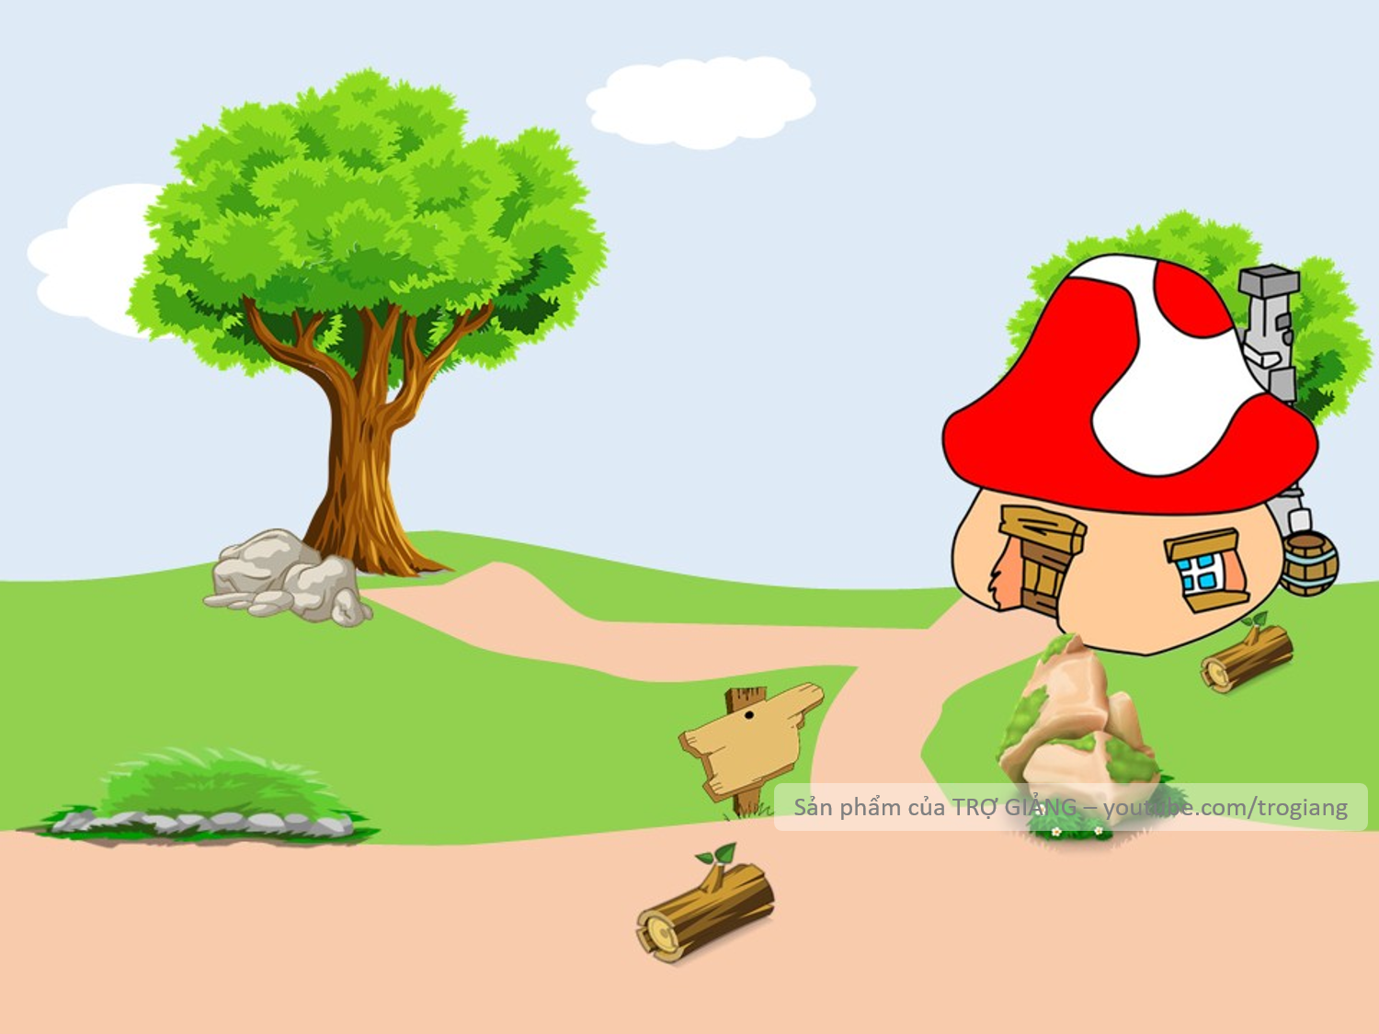

predict
4. It’s hard to believe that we cannot __________ when earthquakes will happen.
Click me if you need help
predict

Slide 28

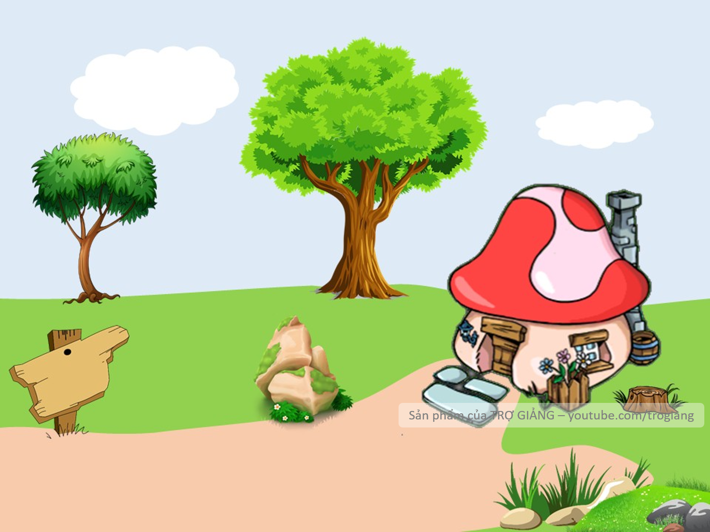




property
5. They lost all of their _________________ because of the volcanic eruption.
Welcome home!!!!
Click me if you need help
property

Slide 29
Look at the answers again.
warning predict property damage emergency kit
1. Natural disasters can cause serious ___________ to human life.
2. Local authorities gave a flood ___________ yesterday, so today people are moving to safer places.
3. To prepare for a natural disaster, we should make a(n) ______________.
4. It’s hard to believe that we cannot ___________ when earthquakes will happen.
5. They lost all of their ____________ because of the volcanic eruption.
damage
warning
emergency kit
predict
property

Slide 30
PRONUNCIATION

Slide 31
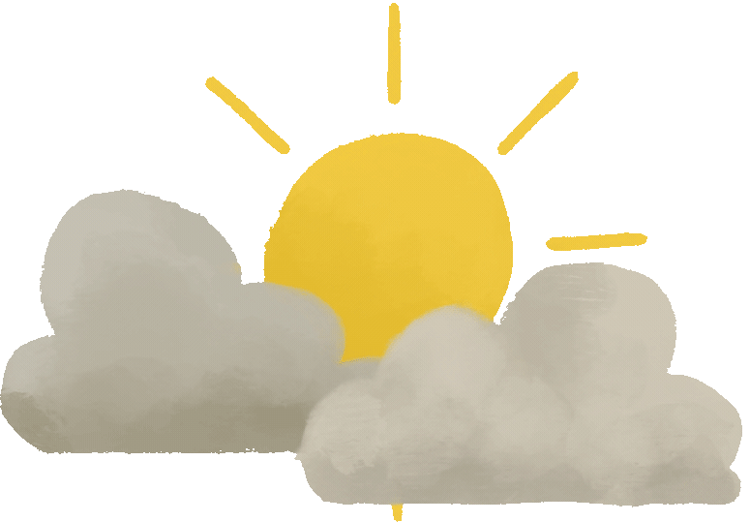

4. Listen and repeat the words. Pay attention to the word stress.
musical dangerous
humorous national
practical poisonous
personal marvellous

Slide 32


5. Listen and repeat the sentences. Mark the stress in the underlined words.
‘
1. The flood victims are collecting their personal property.
2. Avoid dangerous places, such as windows or bookcases, during an earthquake.
3. There are numerous tropical storms in this area every year.
4. Some natural disasters, such as landslides, usually happen in mountainous areas.
5. She gave us practical tips about treating poisonous wastes.
‘
‘
‘
‘
‘
‘
‘

Slide 33
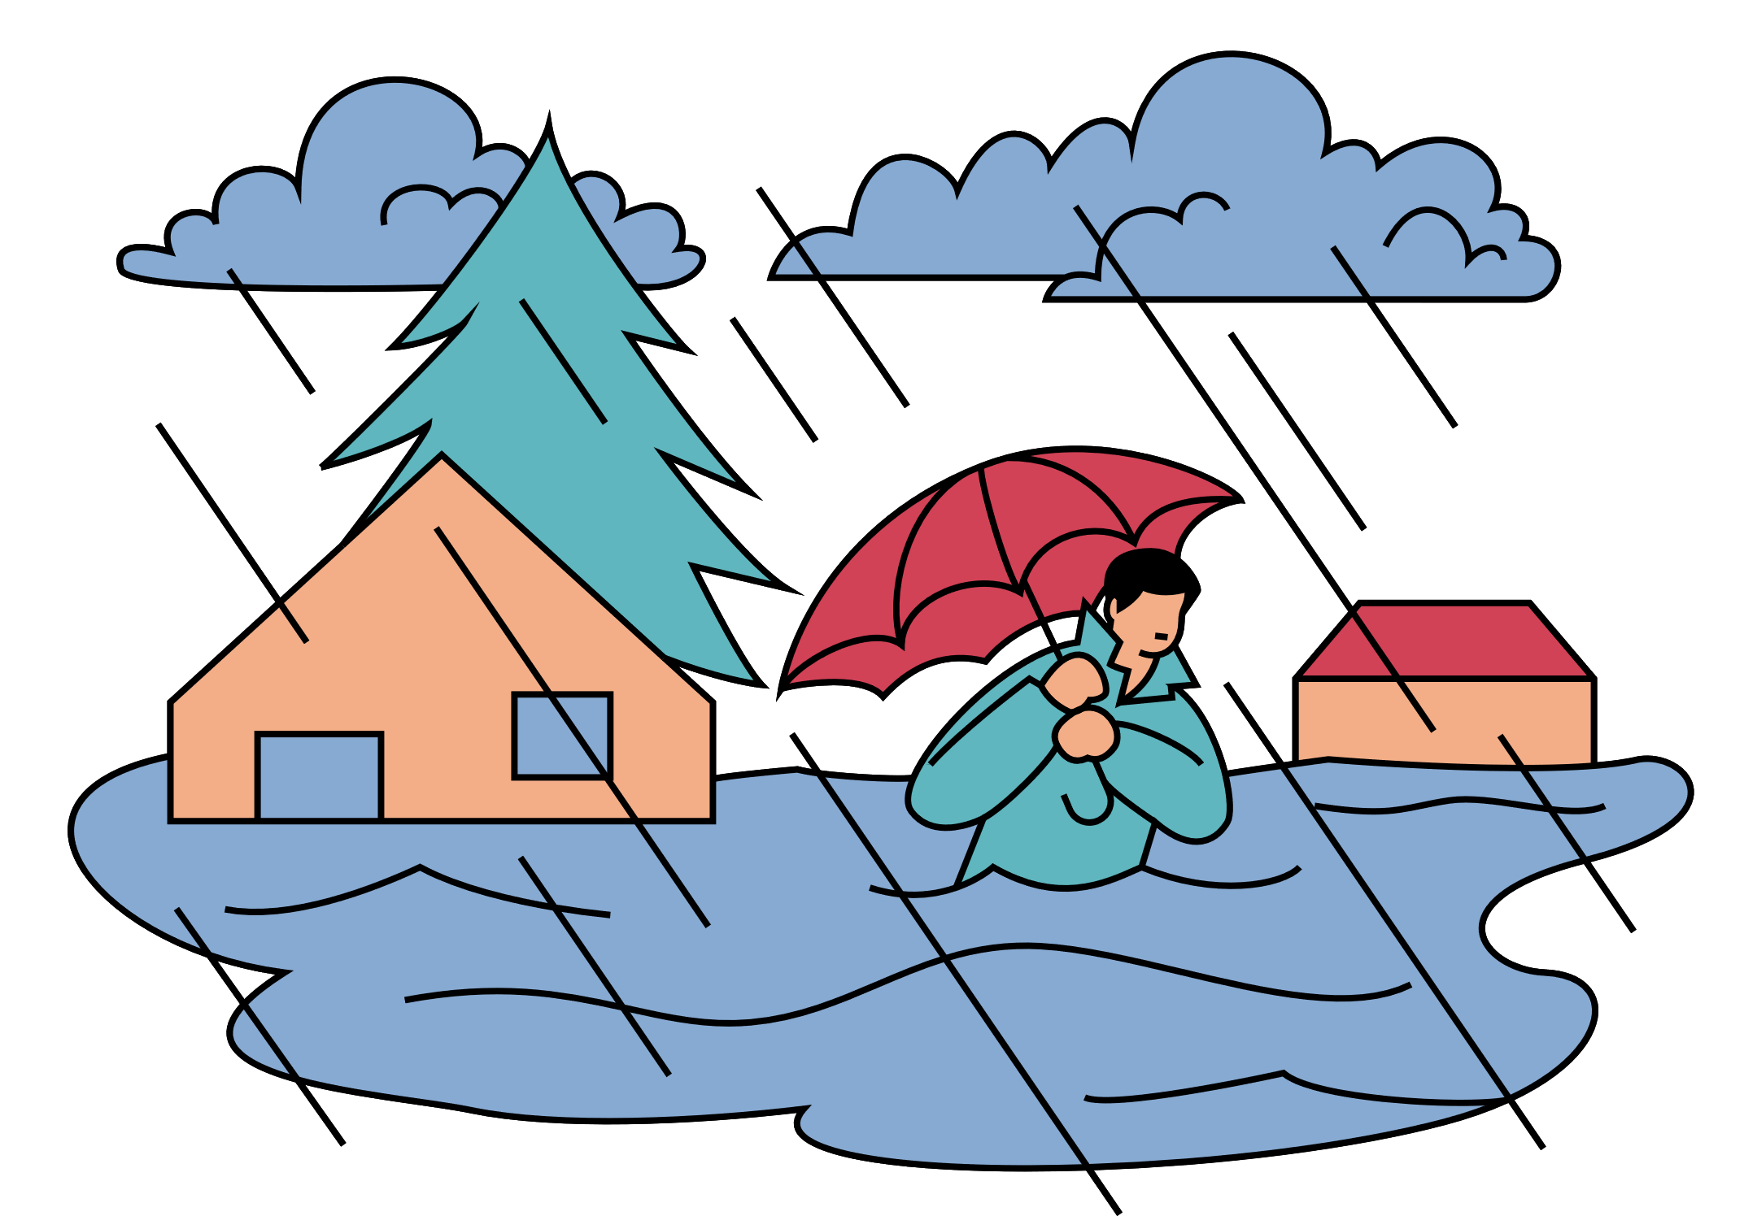
Wrap - up
Vocabulary related to the topic
Stress in words ending in –al & -ous

Slide 34
HOMEWORK
Learn by heart all the words that you have just learnt.
Prepare for Lesson 3 - A closer look 2.

Slide 35
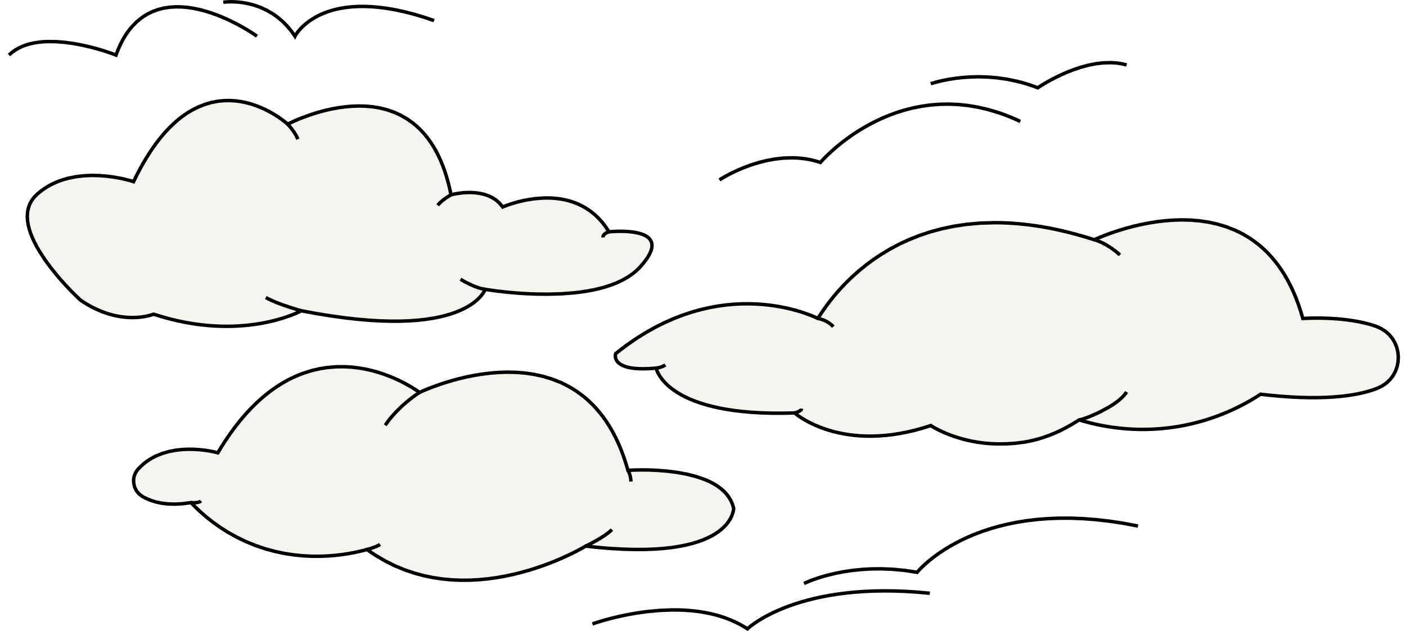
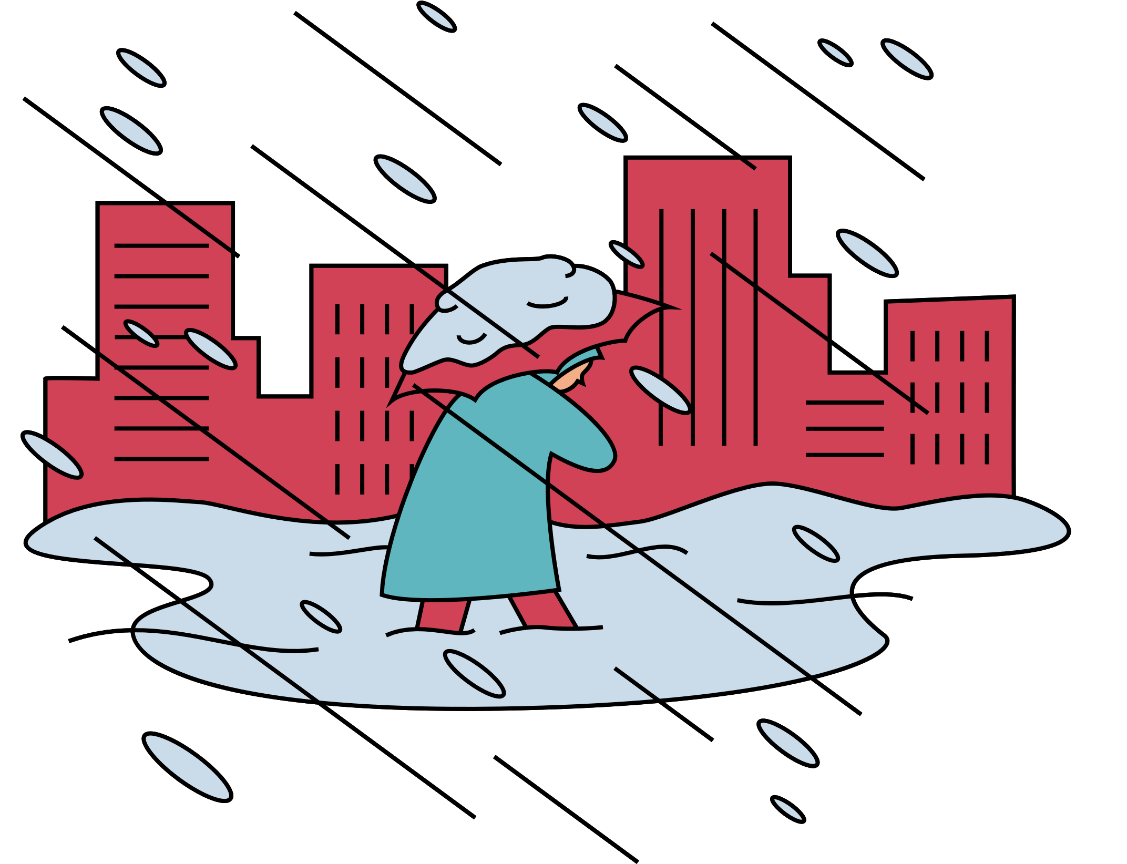
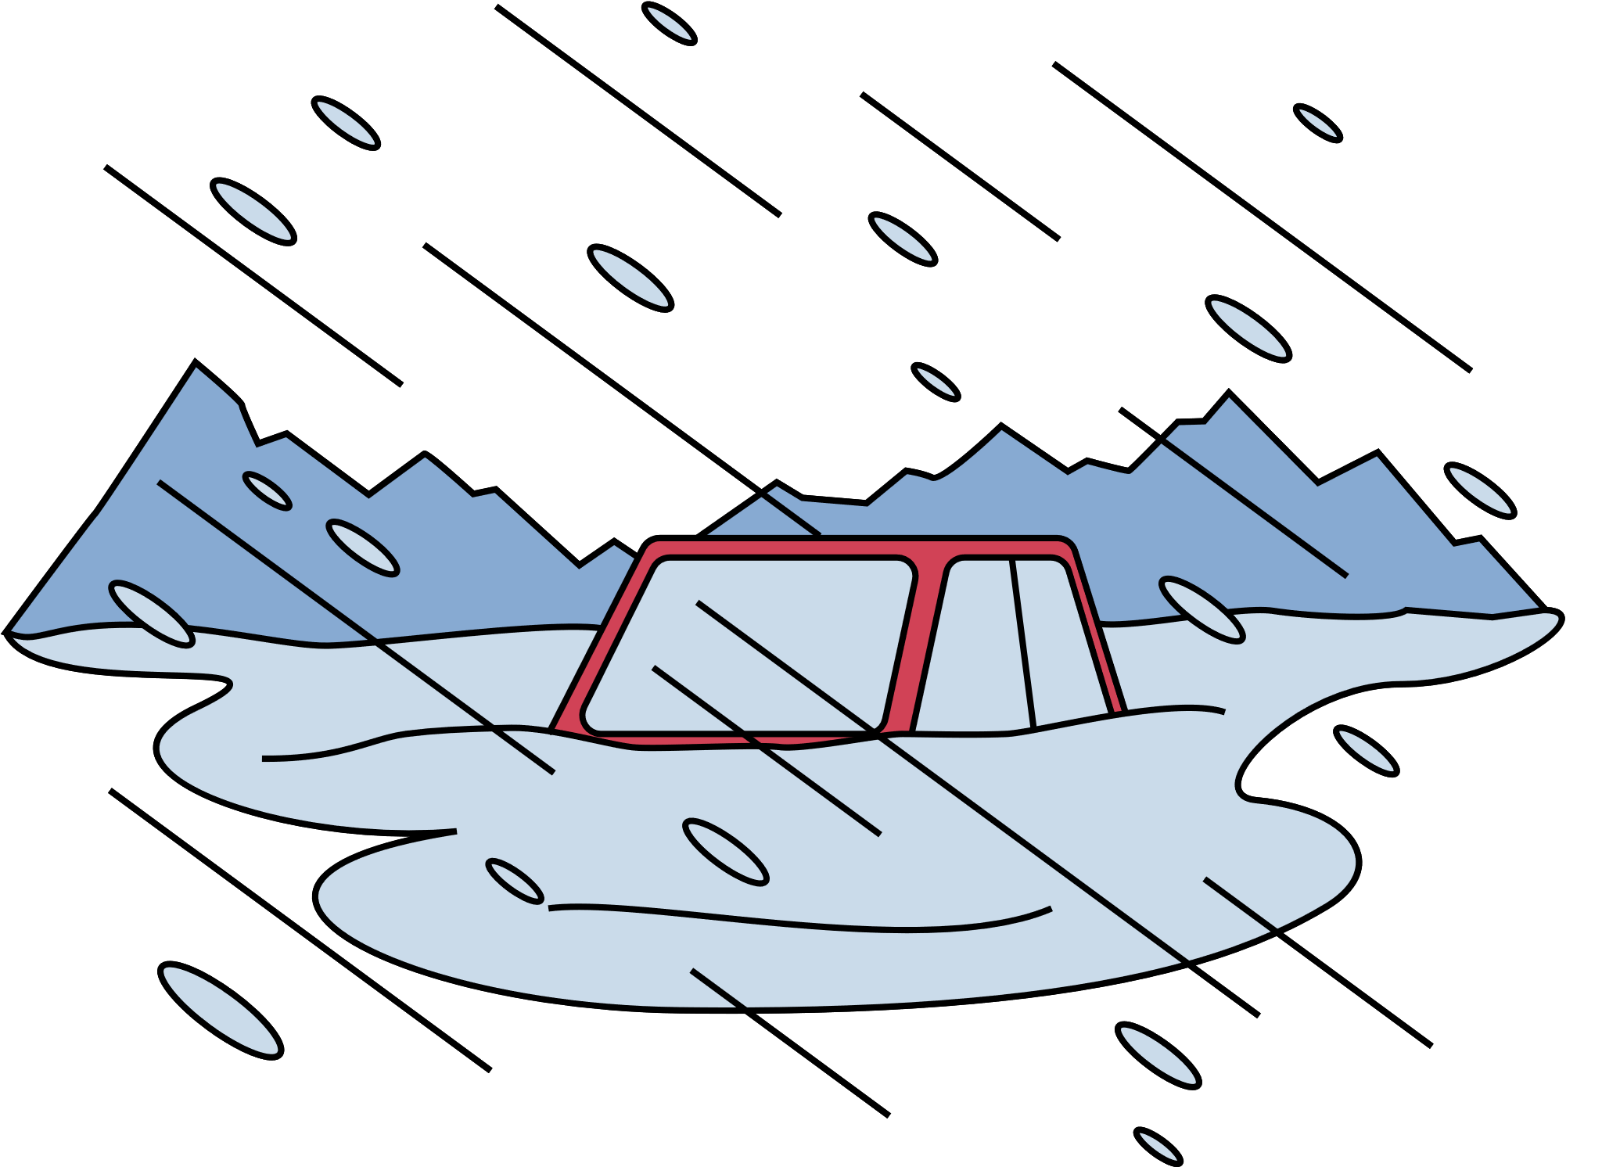

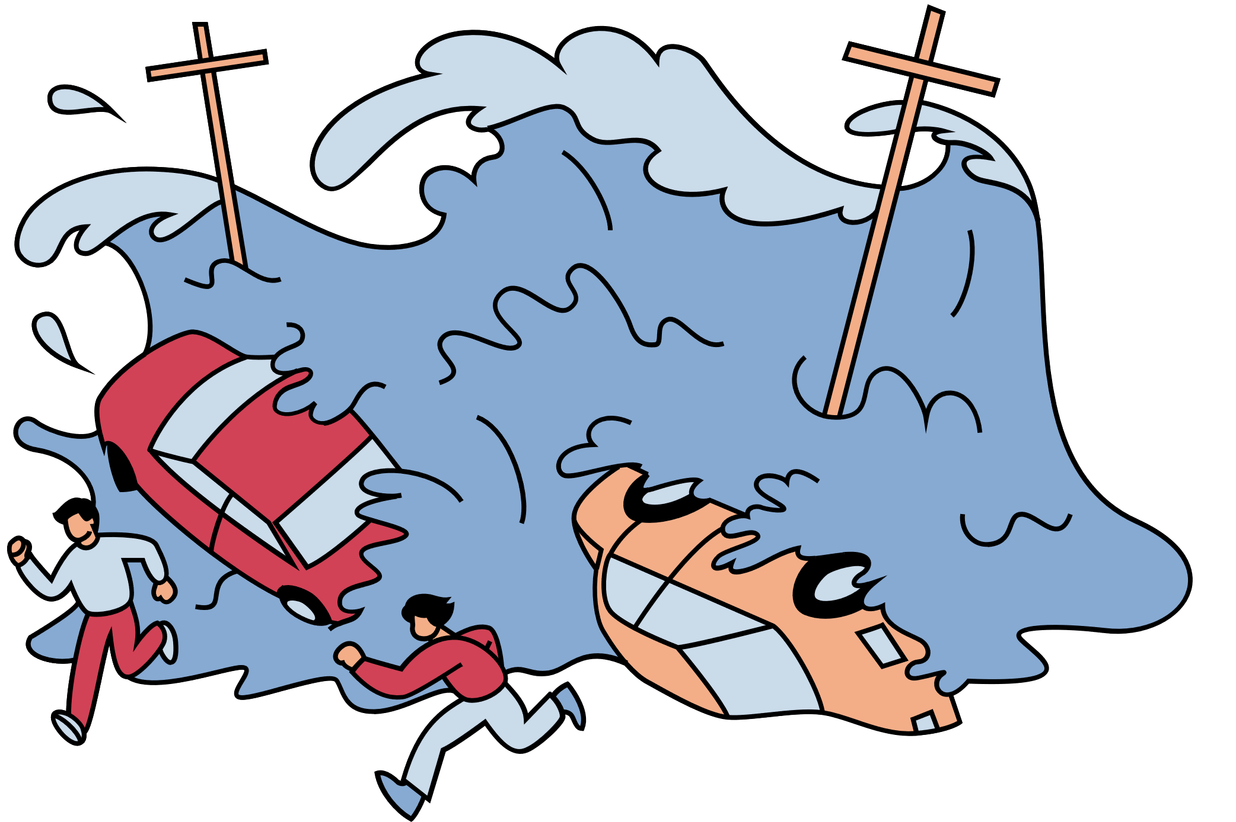
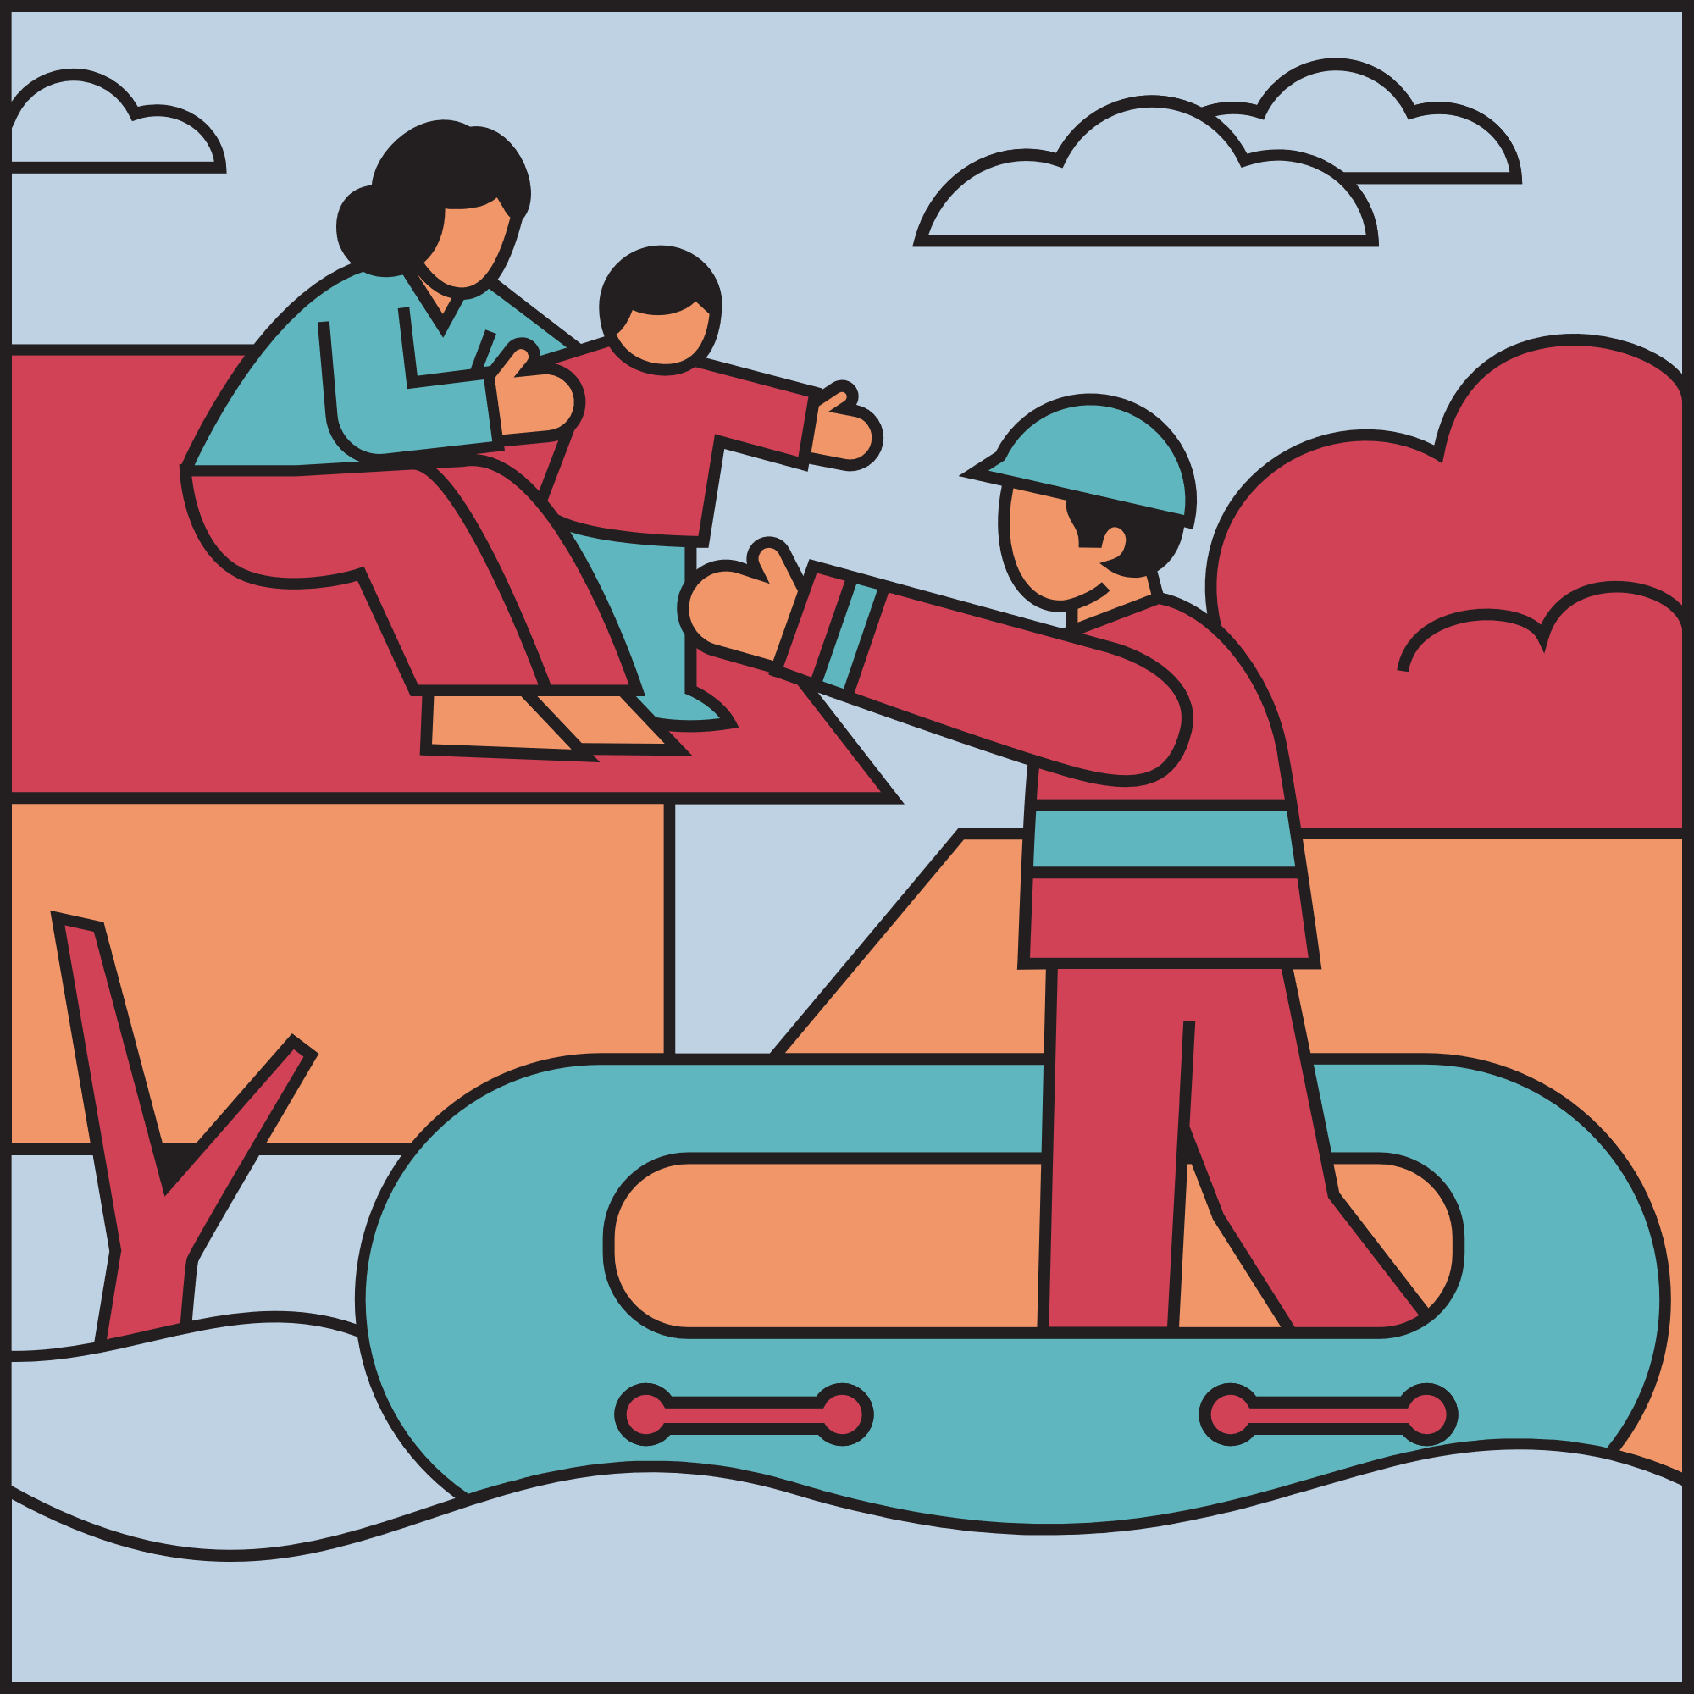
Resource Page

