Slide 1

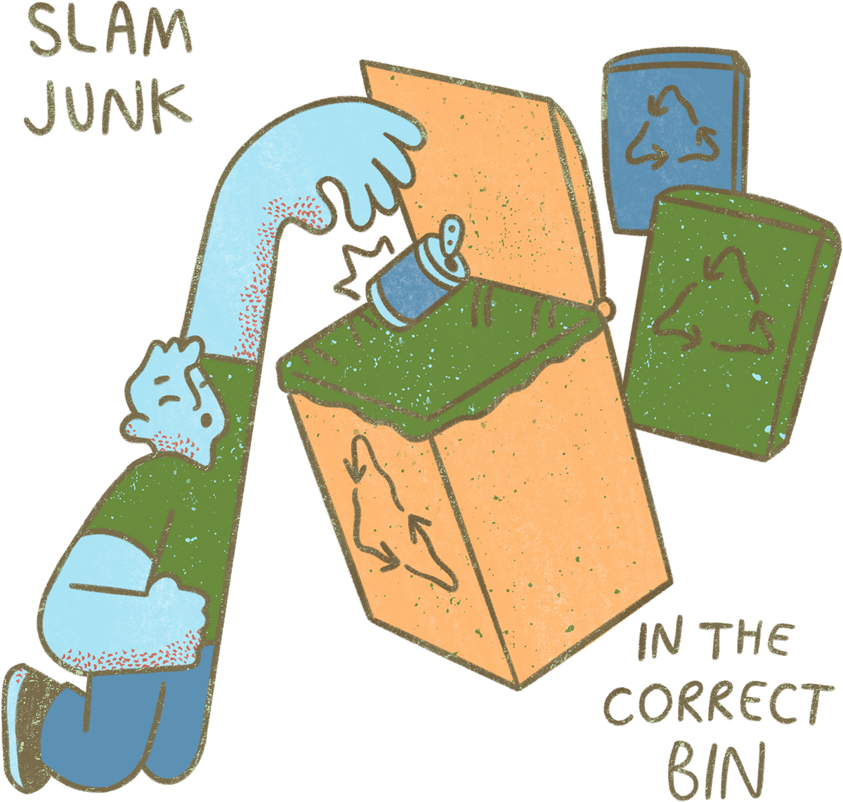

WELCOME TO OUR CLASS!

Slide 2
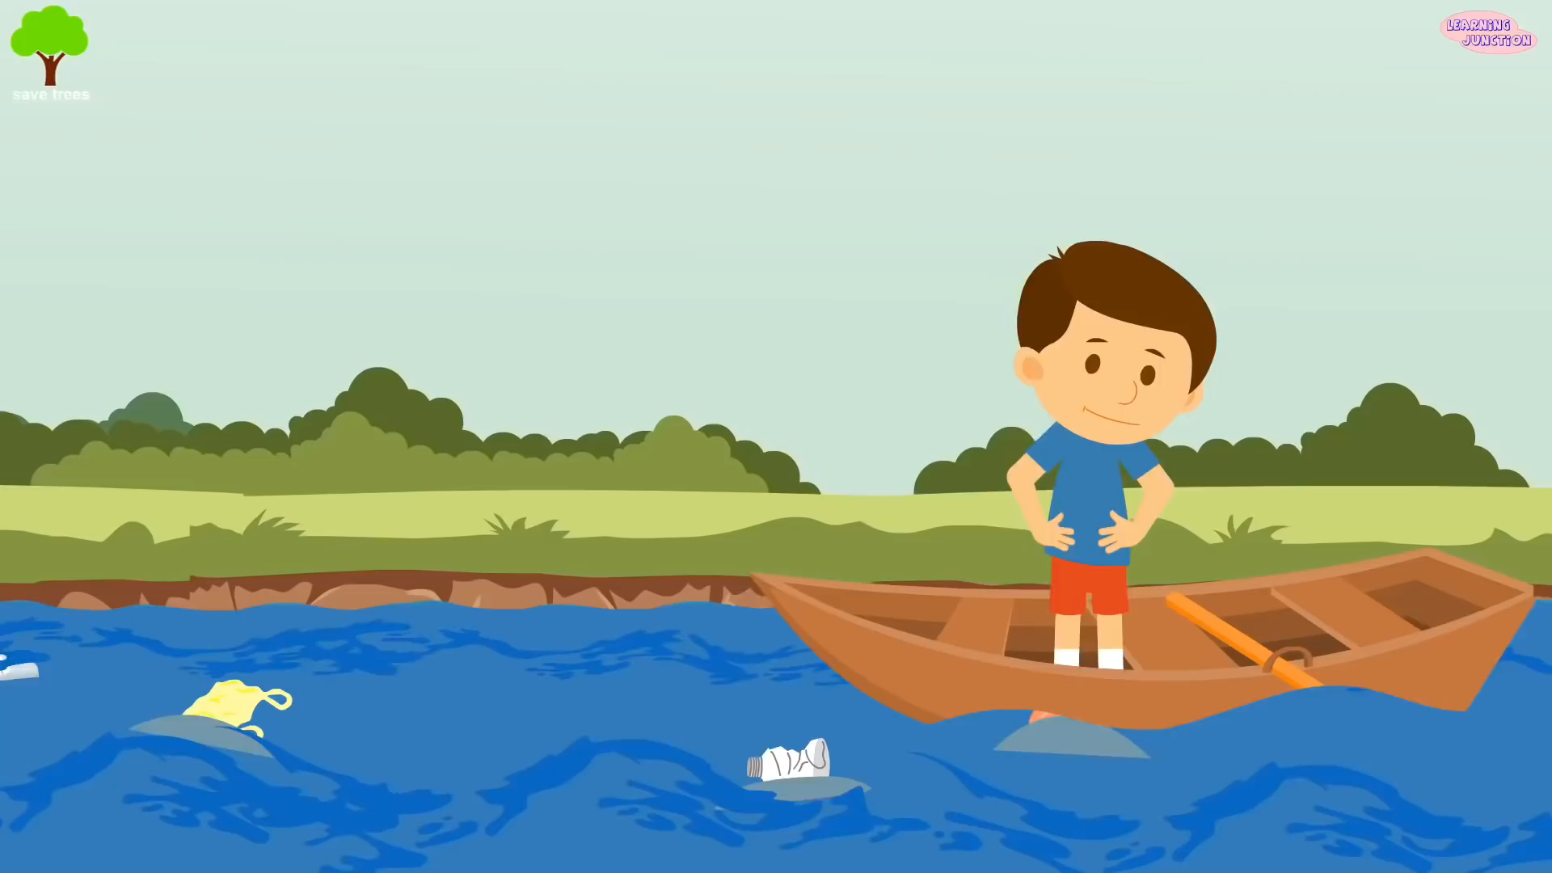
What’s the video about?

Slide 3


Unit 7:
ENVIRONMENT PROTECTION
Lesson 6: Skills2

Slide 4

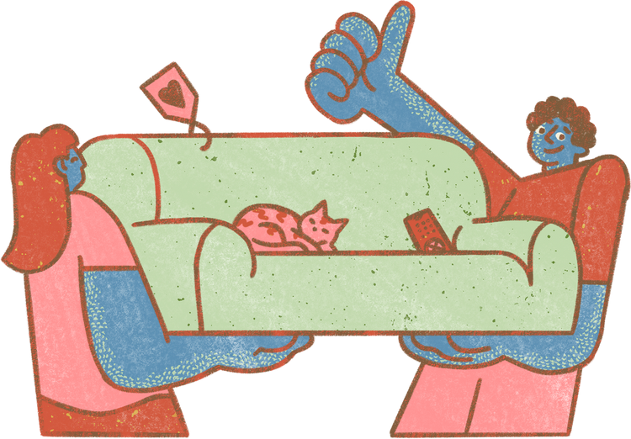
LISTENING

Slide 5

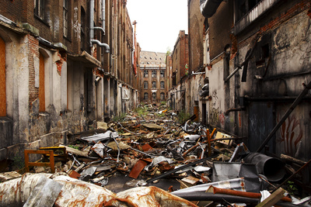
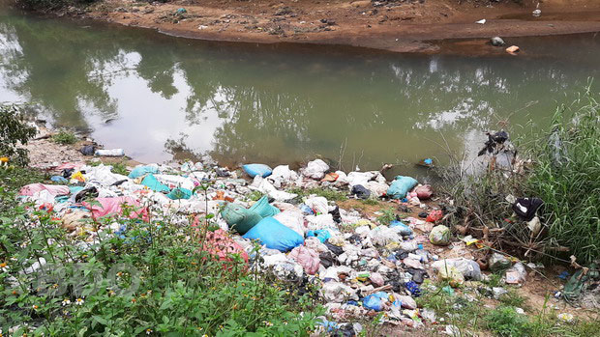
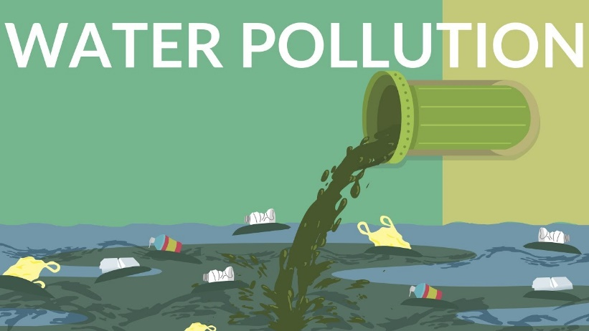
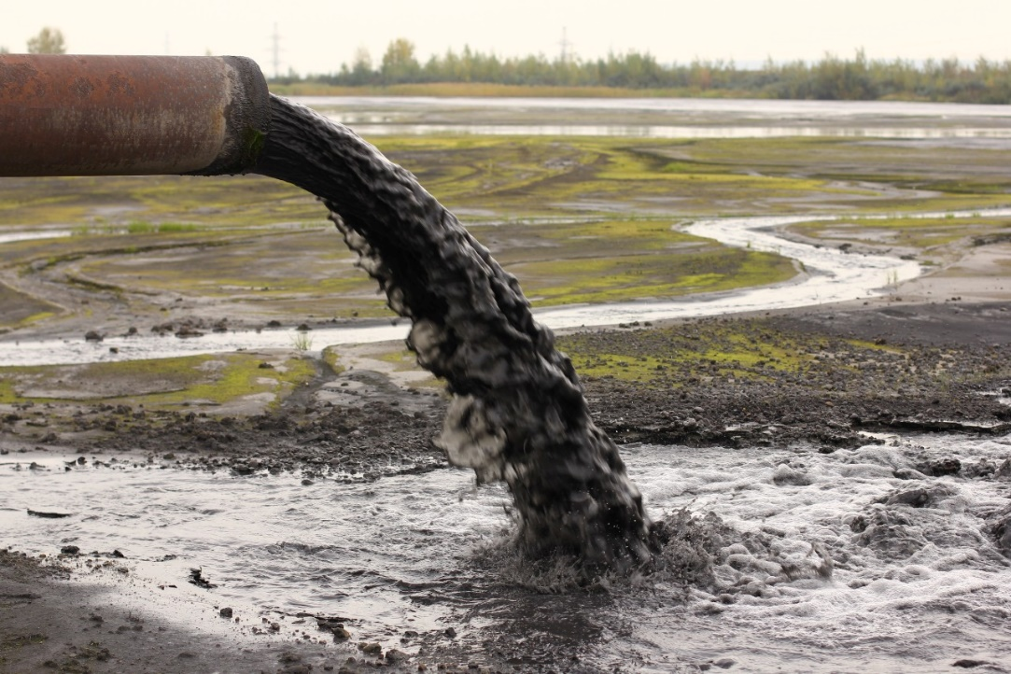
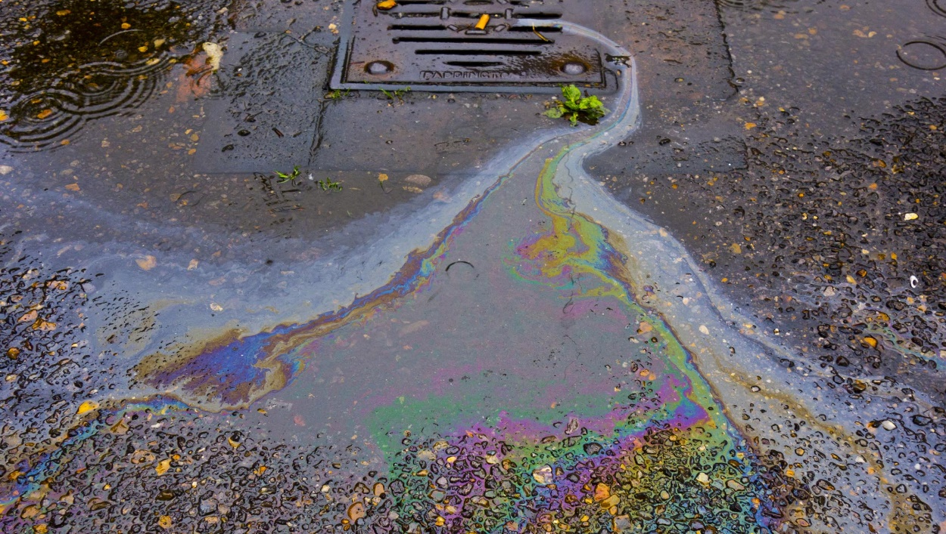
1. Work in groups. Make a list of some activities that cause water pollution
domestic waste
throwing rubbish
spilling fuel
industrial waste

Slide 6

2. Listen to the conversation and choose the correct word to complete each sentence
1. Polluted water is unsafe for drinking / cooking and for other uses.
2. Sometimes toxic substances flow into rivers from factories / hospitals.
3. Water pollution has a dangerous / harmful effect on our life.
4. We couldn’t / shouldn’t throw litter into rivers and lakes.

Slide 7

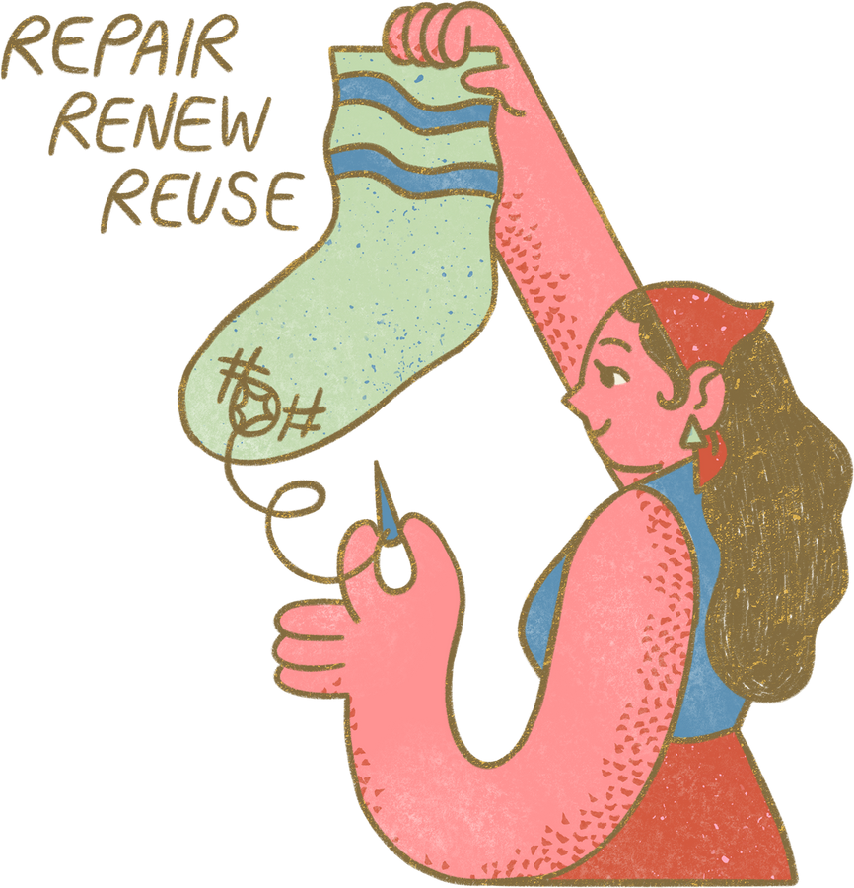
3. Listen again and give short answers to the following questions. Use no more than THREE words.
1. What is the listening text about?
2. How many sources of water pollution are there?
3. What are two common sources of drinking water?
Water pollution
Two
Rivers and lakes
4. What type of effect does water pollution have on our life?
5. What products can we use to reduce water pollution?
A harmful effect
Green products

Slide 8
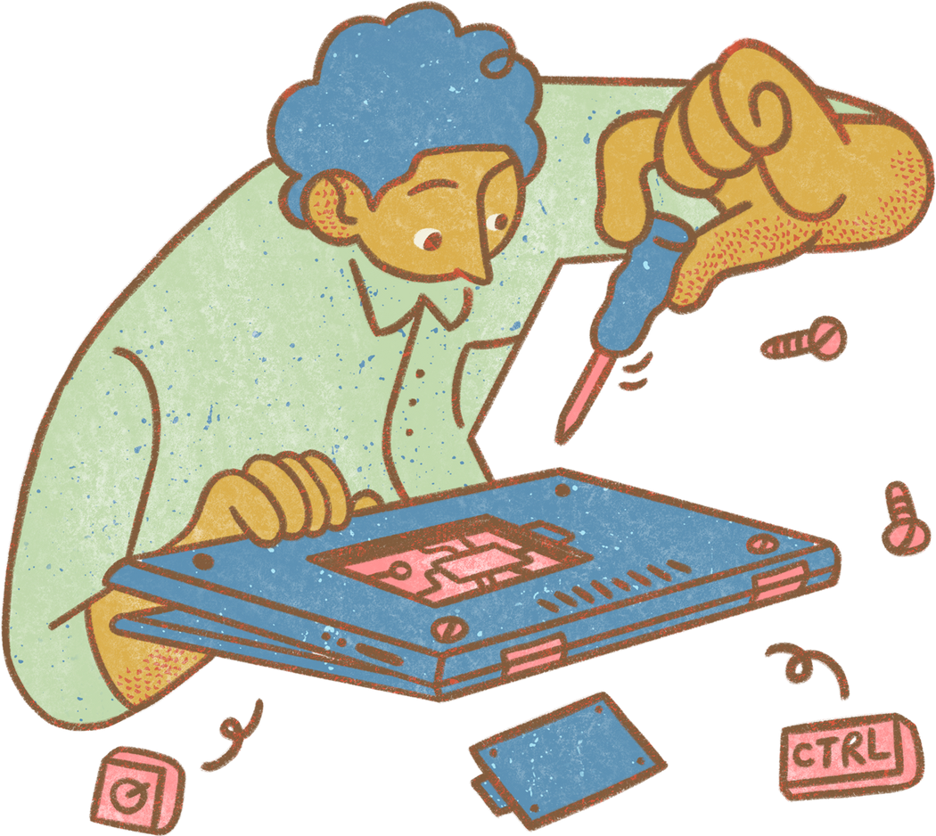
WRITING

Slide 9
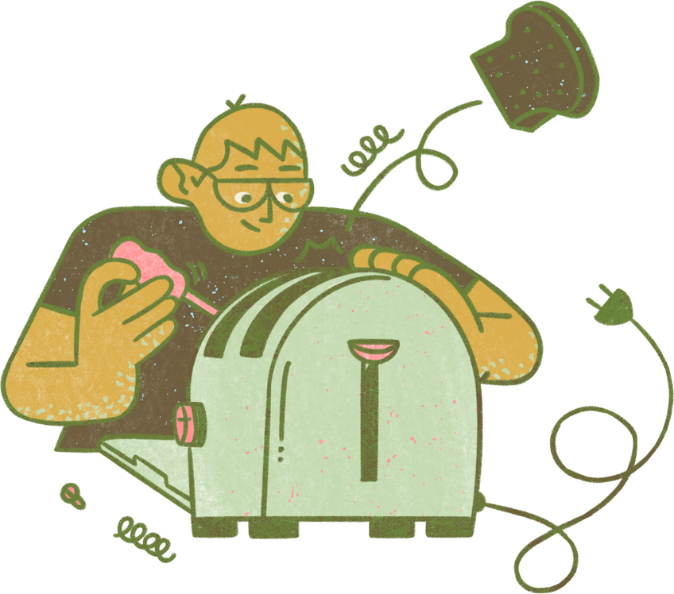
4. Work in pairs. Read the notice and match the headings (a – e) below with the numbers (1 – 5)
(1) ABS Secondary School
NOTICE
(2) March 10, 20...
Inter-School Writing Contest
(3) Our school is organizing an inter-school writing contest about the environment. Students from more than 10 schools from all over our town will participate. Interested students should contact the school by March 20, 20...
Contest details:
Time: 2 p.m. – 4 p.m., April 5
Place: School Grand Hall
Topic: Environmental Protection
(4) If you have any questions, please contact us at 031-823-1231 or email abs@fmail.com.
(5) Head Teacher
Dr. Adam Sanders (signed)
a. Name of institution or organization
(School, etc.)
b. Body (date / time / duration / place, etc.)
c. Date of writing the notice
d. Author’s name and signature
e. Contact details

Slide 10
5. Write a notice for the Go Green Club leader to invite students to attend a lecture on water pollution. Use the following details.
Go Green Club
NOTICE
January 12, 20...
Lecture On Water Pollution
___________________________
___________________________
Club Leader
Nguyen Hong Mai
Time: 2 p.m. – 4 p.m., March 6 Place: School Grand Hall Topic: Water pollution

Slide 11

Go Green Club
NOTICE
12 January, 2023
Lecture on Water Pollution
Green Earth Club is organizing a lecture about the Water Pollution. Students from all the classes can participate. Interested students should contact the school by 20 May, 2023.
Lecture details:
Time: 2 p.m - 4 p.m., 6 June
Place: School Grand Hall
Topic: Water Pollution
If you have any questions, please contact us at 045-281-4769 or email greenearthclub@gmail.com
Club Leader,
Nguyen Hong Mai

Slide 12
WRAP - UP

Slide 13
What have you learned today?
Listening about water pollution
Writing a notice

Slide 14



HOMEWORK
Do exercises in the workbook
Prepare for the next lesson

Slide 15
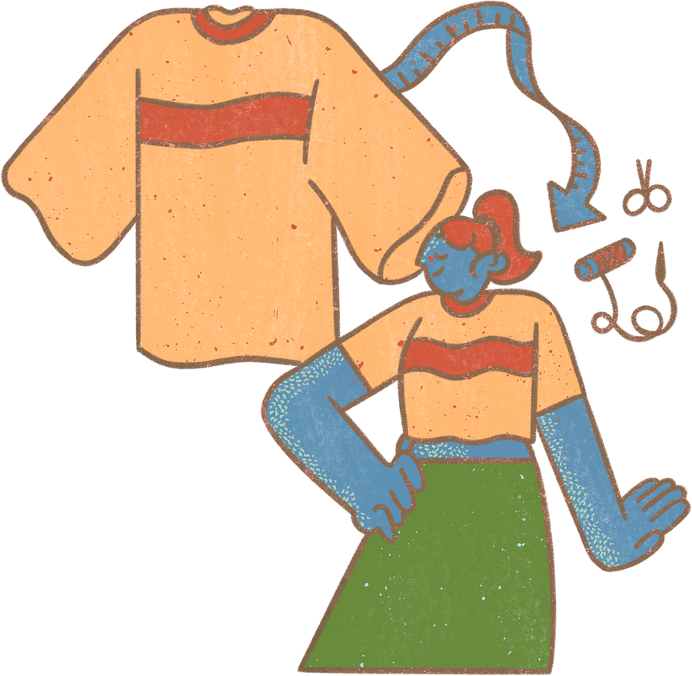
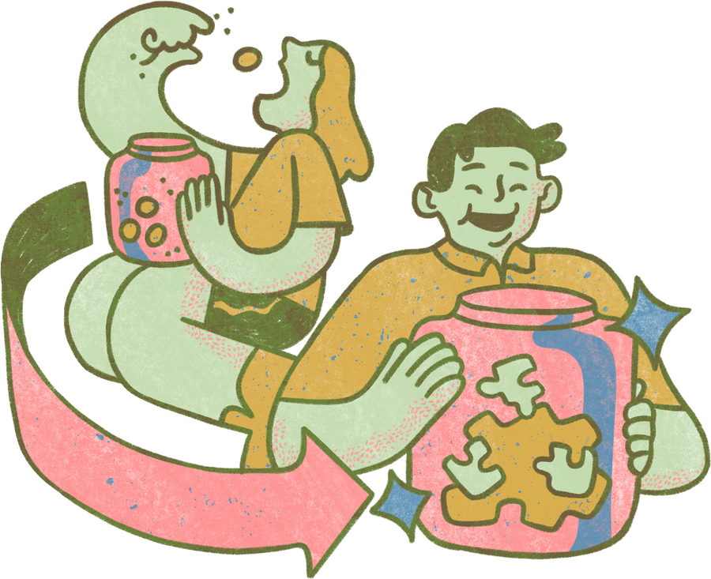
THANKS

