Slide 1




WAVES
& WAVE PROPERTIES
Unit Review Quiz

Slide 2
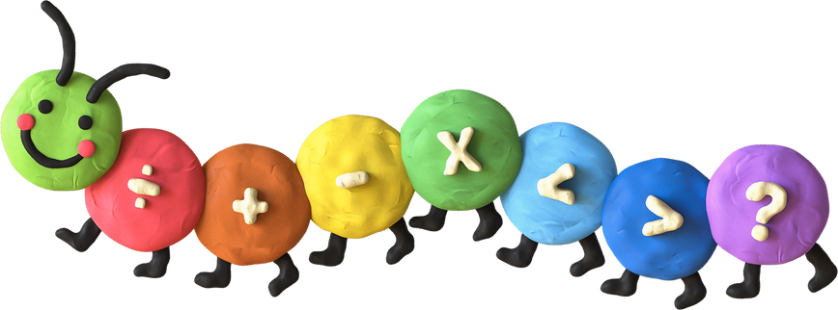

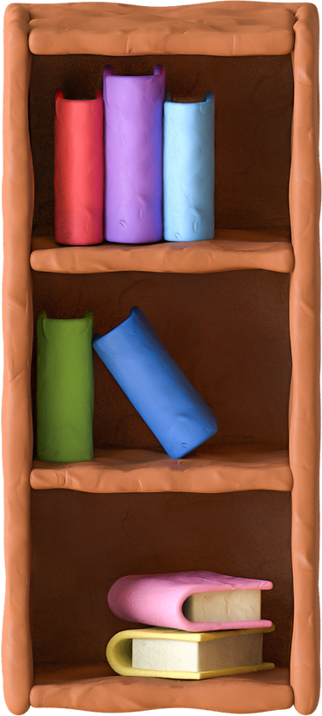
Unit 10
SCIENCE AND TECHNOLOGY

Slide 3

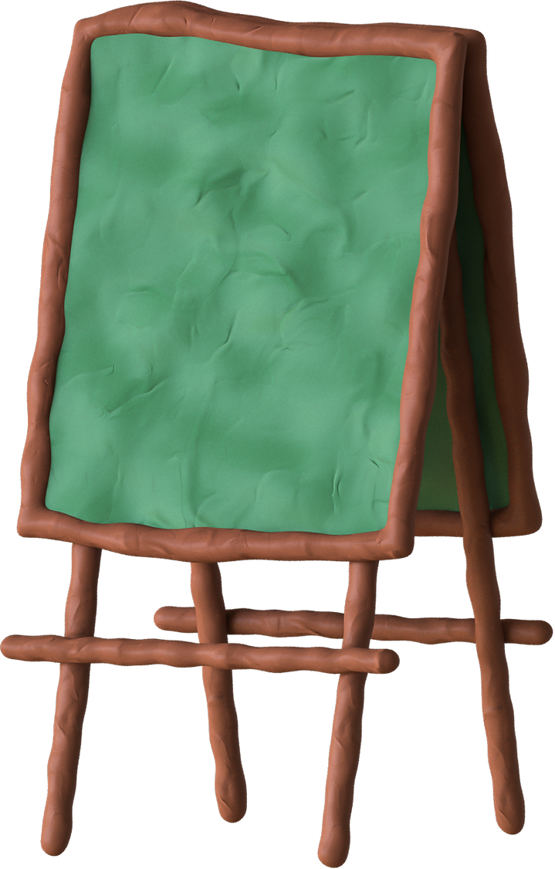
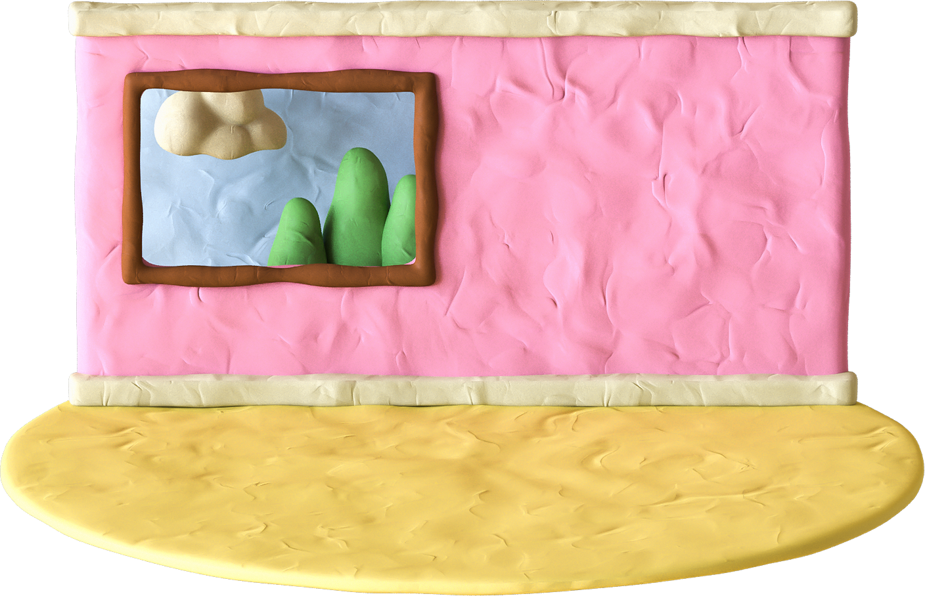
LESSON 6: SKILLS 2

Slide 4

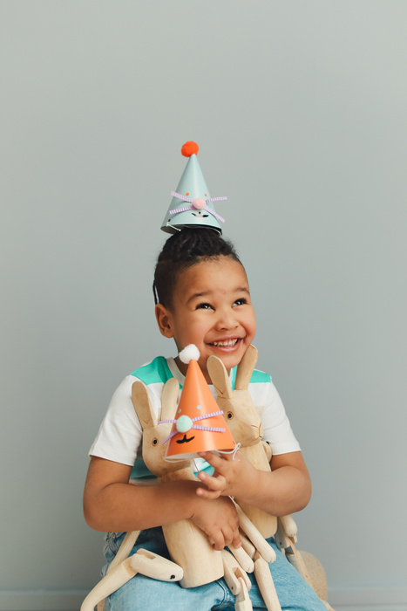



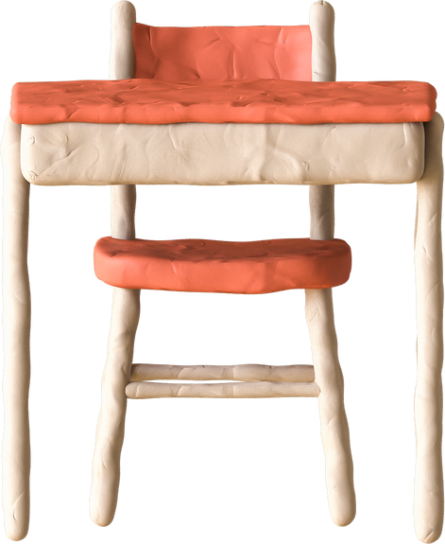
WARM -UP
Matt
Dani
Cia
Kim

Slide 5
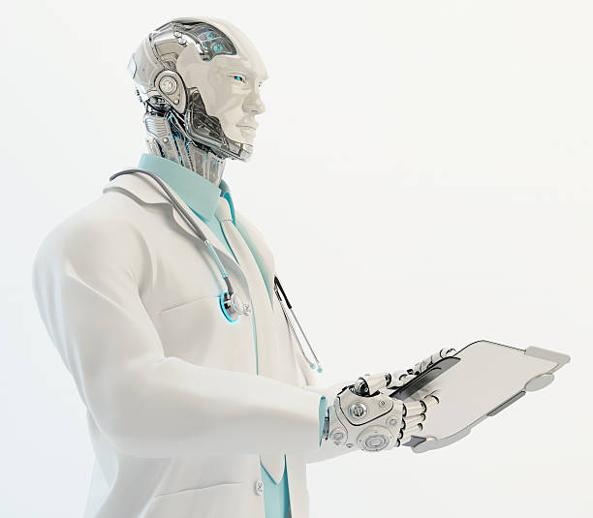
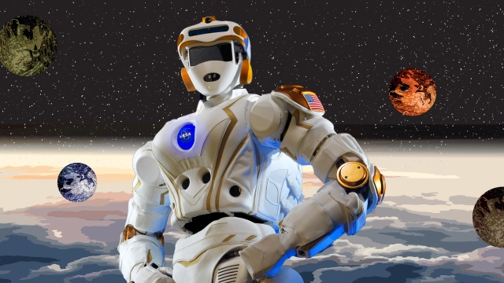
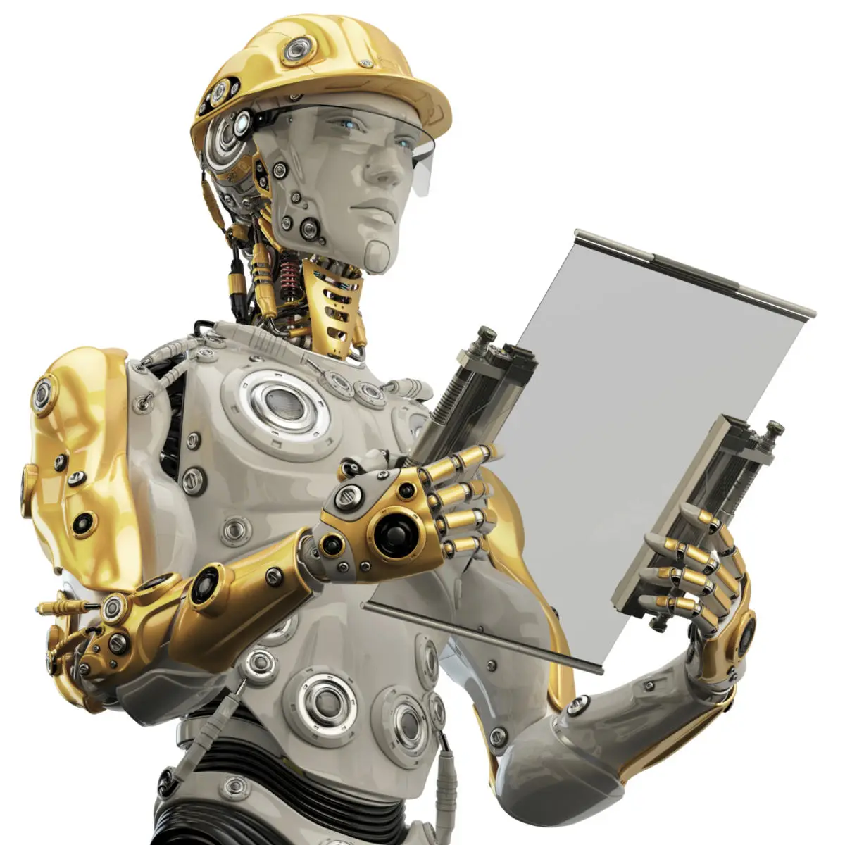
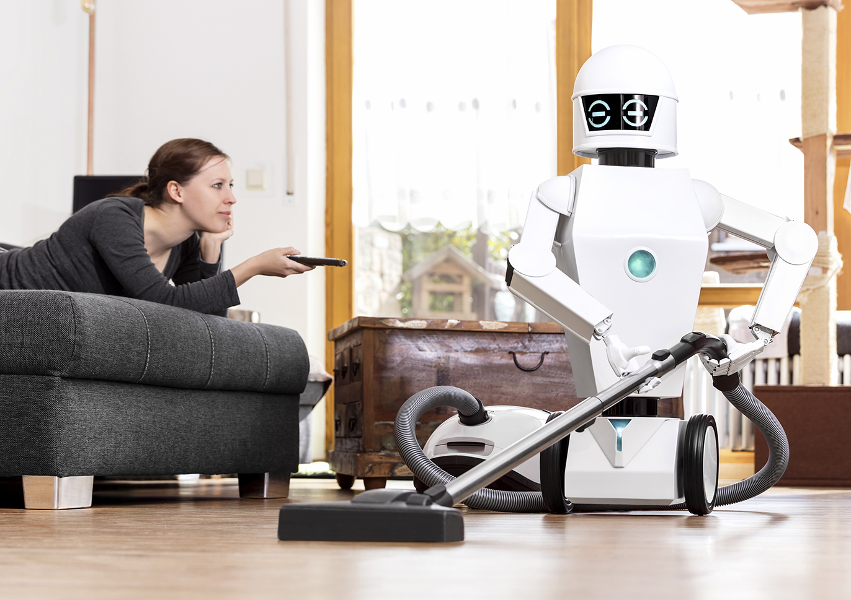


WARM-UP
NAME THE PICTURES
TYPES OF
ROBOTS

Slide 6
WARM-UP
NAME THE PICTURES
DOCTOR ROBOT
SPACE ROBOT
WORKER ROBOT
TEACHER ROBOT
HOME ROBOT
TEACHER ROBOT
TYPES OF
ROBOTS

Slide 7

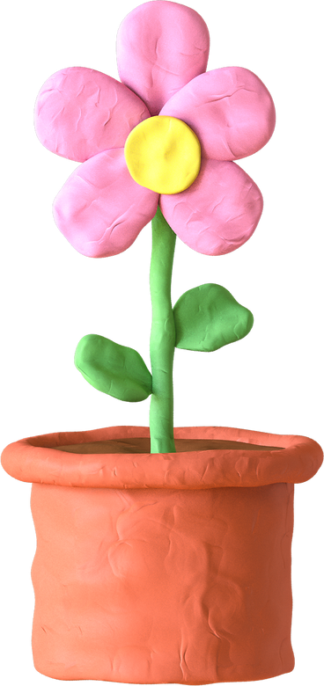
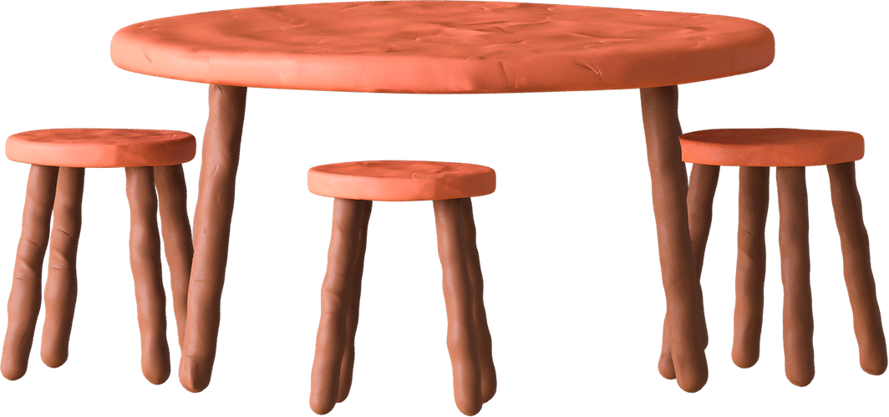
VOCABULARY

Slide 8


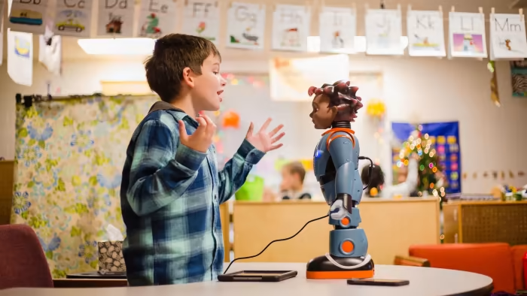

interact with (v)
/ˌɪntərˈækt wɪð/
tương tác với

Slide 9

emotional (v)
/ɪˌməʊʃənl/
thuộc tình cảm, dễ cảm động

Slide 10
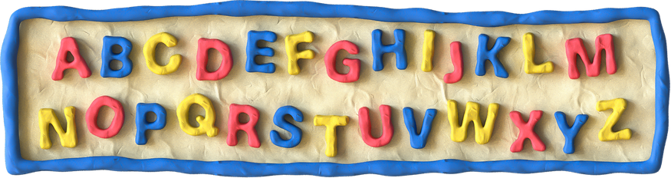
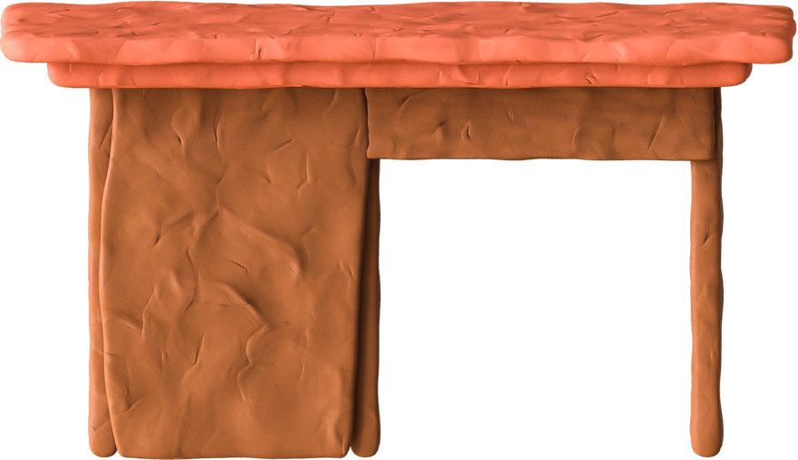
LISTENING

Slide 11
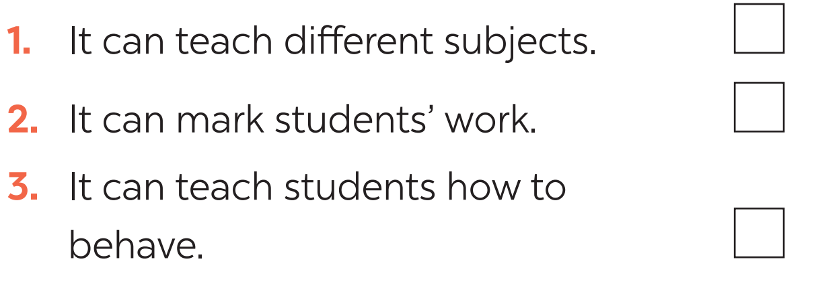
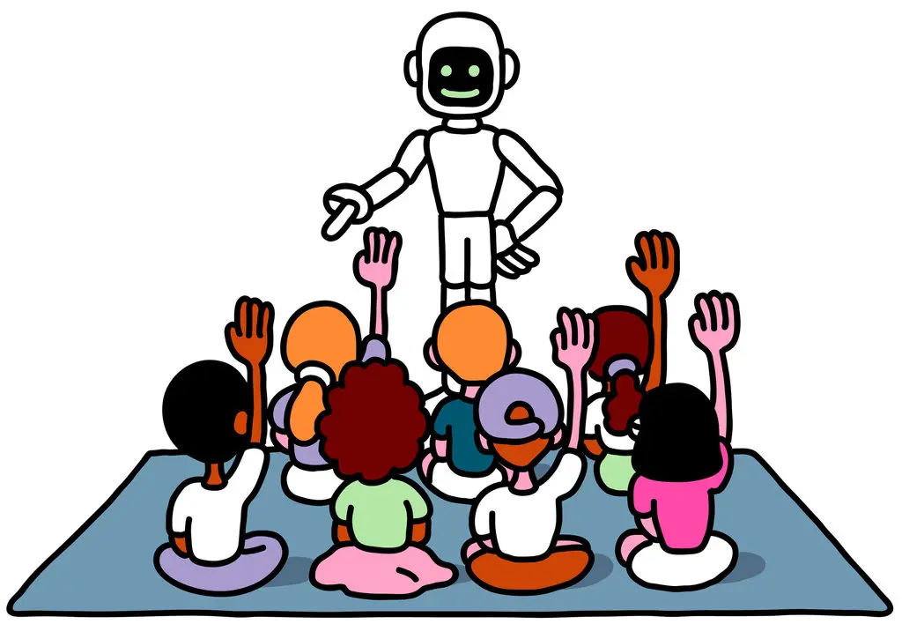

1. Tick the things that you think a robot teacher can do.
A robot teacher can dance, sing, and play with students, …

Slide 12
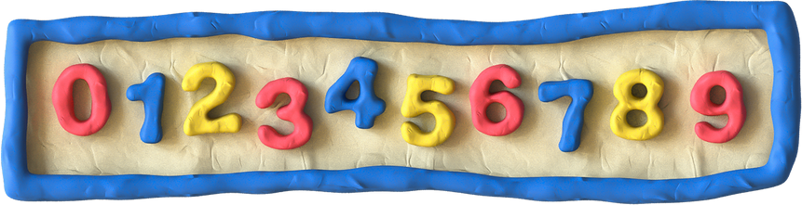
2. Listen to the conversation and fill in each blank with ONE word.
Things a robot teacher can do | Things a robot teacher can’t do
- speak many (1) _________ - teach languages, (2) ______ and many subjects. - (3) ________ with students | - teach students how to (4) ________ - have emotional connections with students - solve (5) _________ between students
languages
behave
maths
interact
problems

Slide 13
PRACTICE
3. Listen again and tick T (True) or F (False).
Statements | T | F
1. Elias can do a Gangnam style dance.
2. Students can practise English with the robot in real time.
3. The robot feels tired when it repeats words.
4. The robot asks questions that are too difficult for students to answer.
5. Robots can teach students how to behave correctly.

Slide 14
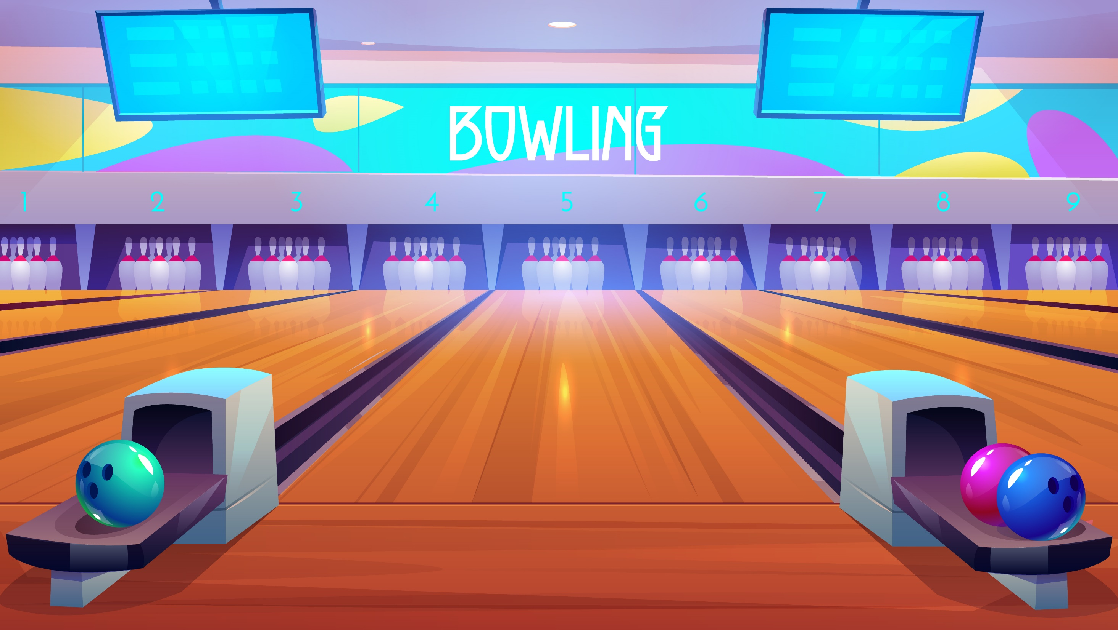
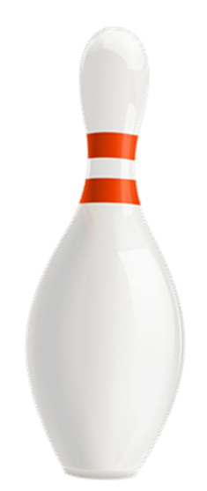



Slide 15
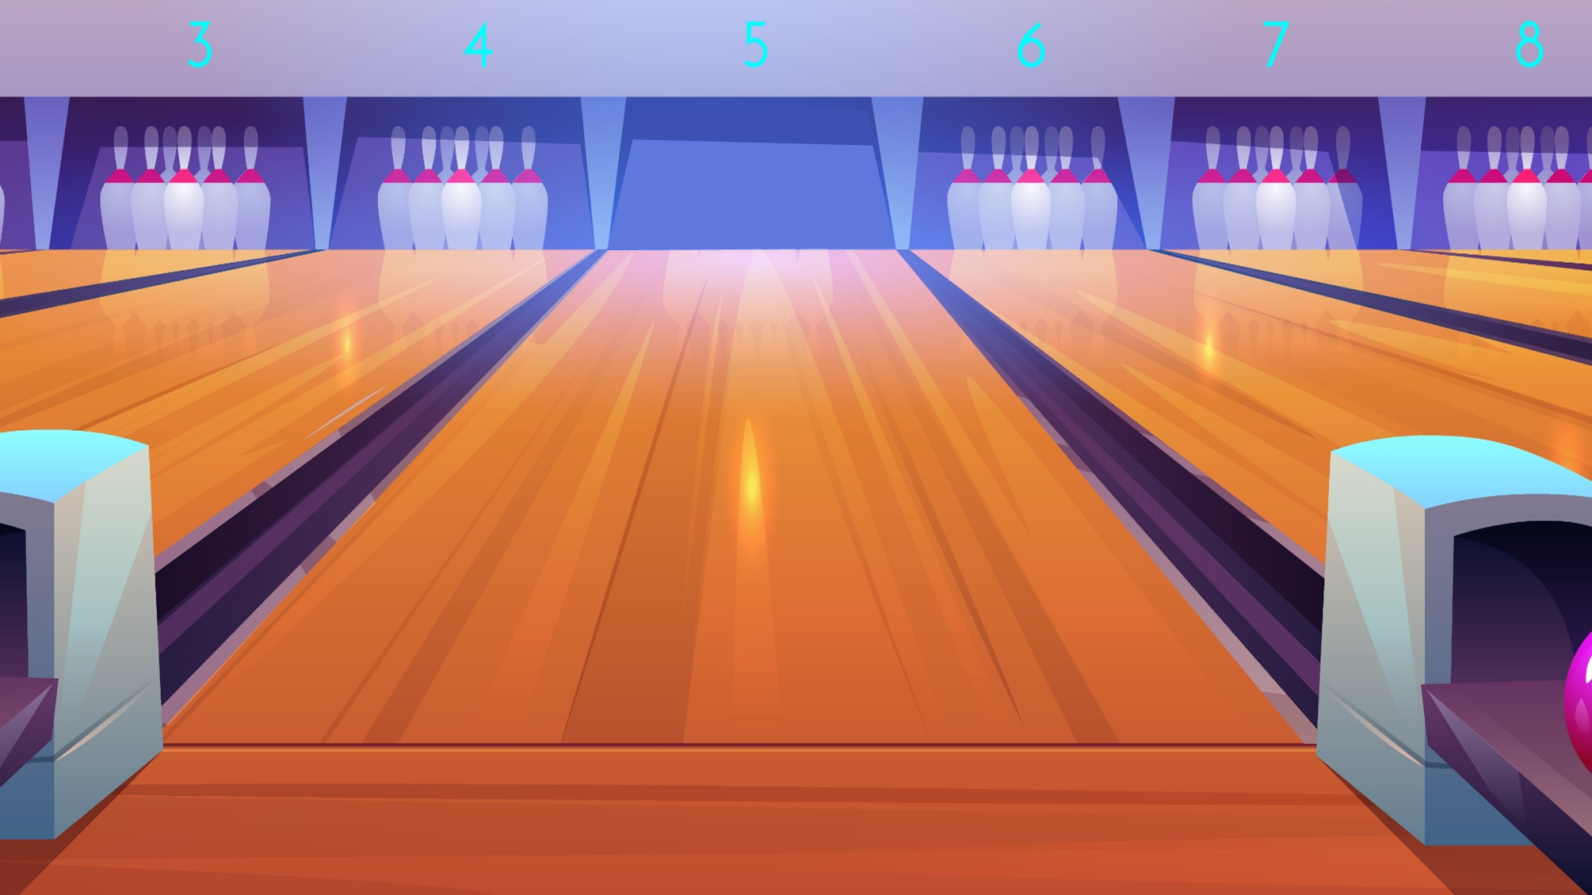



A. True
Listen again and tick T (True) or F (False).
1. Elias can do a Gangnam style dance.
B. False
Next

Slide 16
A. True
Listen again and tick T (True) or F (False).
2. Students can practise English with the robot in real time.
B. False
Next

Slide 17
A. True
Listen again and tick T (True) or F (False).
2. Students can practise English with the robot in real time.
B. False
Next

Slide 18
A. True
Listen again and tick T (True) or F (False).
3. The robot feels tired when it repeats words.
B. False
Next

Slide 19
A. True
Listen again and tick T (True) or F (False).
4. The robot asks questions that are too difficult for students to answer.
B. False
Next

Slide 20
A. True
Listen again and tick T (True) or F (False).
5. Robots can teach students how to behave correctly.
B. False
Next

Slide 21
CHECK AGAIN
3. Listen again and tick T (True) or F (False).
Statements | T | F
1. Elias can do a Gangnam style dance.
2. Students can practise English with the robot in real time.
3. The robot feels tired when it repeats words.
4. The robot asks questions that are too difficult for students to answer.
5. Robots can teach students how to behave correctly.

Slide 22
WRITING
4. Work in pairs. Discuss if you agree or disagree that robots will soon replace teachers at schools. Write the reasons in the table.
Agree | Disagree
1. Robots can better remember things than teachers. 2. 3. 4. | 1. Robots can’t understand students’ emotions. 2. 3. 4. 5.
Robots can talk for a longer time and not feel tired.
Robots can’t teach students how to behave well.
Robots can still interact well with students.
Robots can’t help solve problems among students.
Robots can store more data and information and tell them to students.
Robots can’t motivate students.
Robots don’t have emotional connections with students.

Slide 23
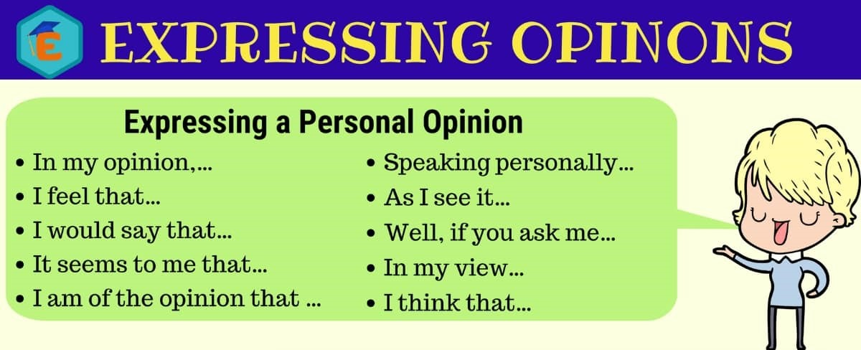
WRITING
5. Now write a paragraph (80 - 100 words) to express your opinion. Use the notes in 4.

Slide 24
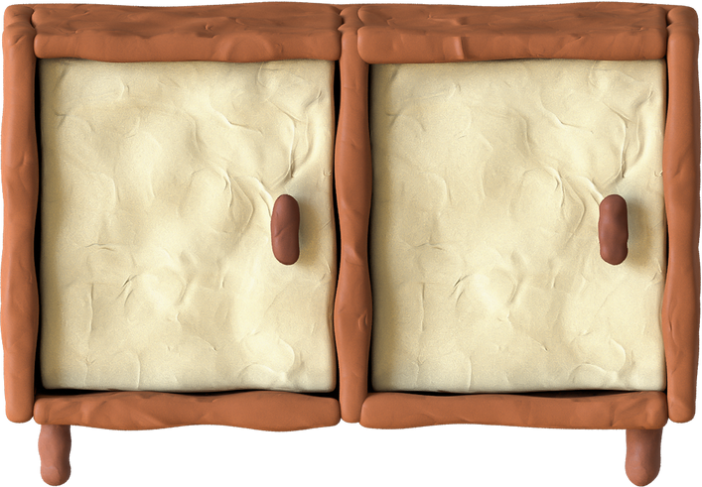
writing
Suggested answer:
I disagree that robots will soon replace teachers at school. First, although robots can store much information to provide to students, they cannot teach students how to behave in the right ways in different situations. Second, a robot can only teach what is programmed, but cannot help students deal with problems, especially troubles among students’ relationships. Third, a robot can speak, walk, do simple actions, but they cannot interact with students in the way human teachers do. Robots do not have emotions and feelings, so I believe they cannot help students to deal with problems related to feelings and emotions.

Slide 25
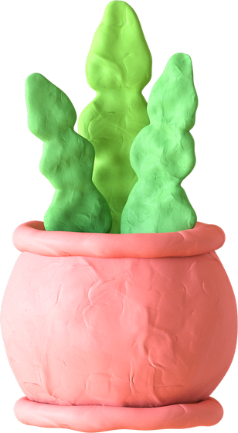

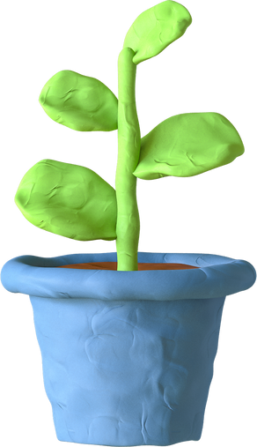
Wrap - up
What have we learnt in this lesson?
What a robot teacher can do and what it can’t do
The reasons robot teachers can or can’t replace teachers at school
How to write a paragraph expressing opinions

Slide 26
HOMEWORK
Learn the new words by heart
Rewrite the paragraph in the notebook
Do the exercises in the workbook

Slide 27
Thank You!
Any Question?

