Slide 1




WAVES
& WAVE PROPERTIES
Unit Review Quiz

Slide 2


Slide 3







LESSON 5 SKILLS 1
Start Now!

Slide 4
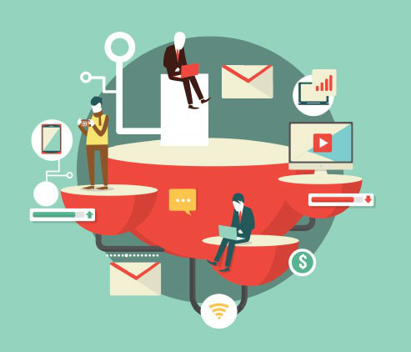
BRAINSTORMING
WARM-UP
Name the technological applications your school uses.

Slide 5
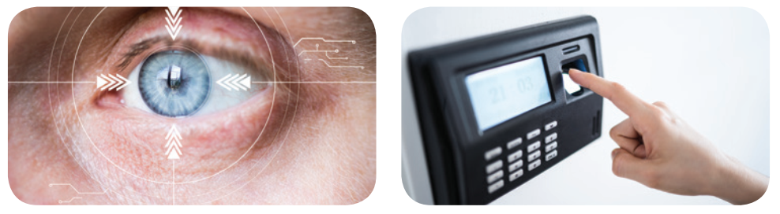

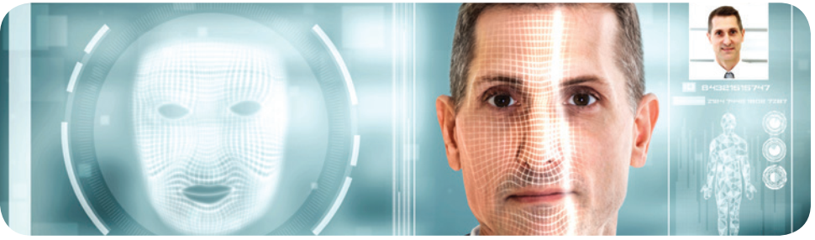
READING
1. Work in pairs. Name the technological applications in the pictures. Can they be used in schools?
eye-tracking
1. _______________
2. ________________
fingerprint scanner
3. _______________
face recognition

Slide 6
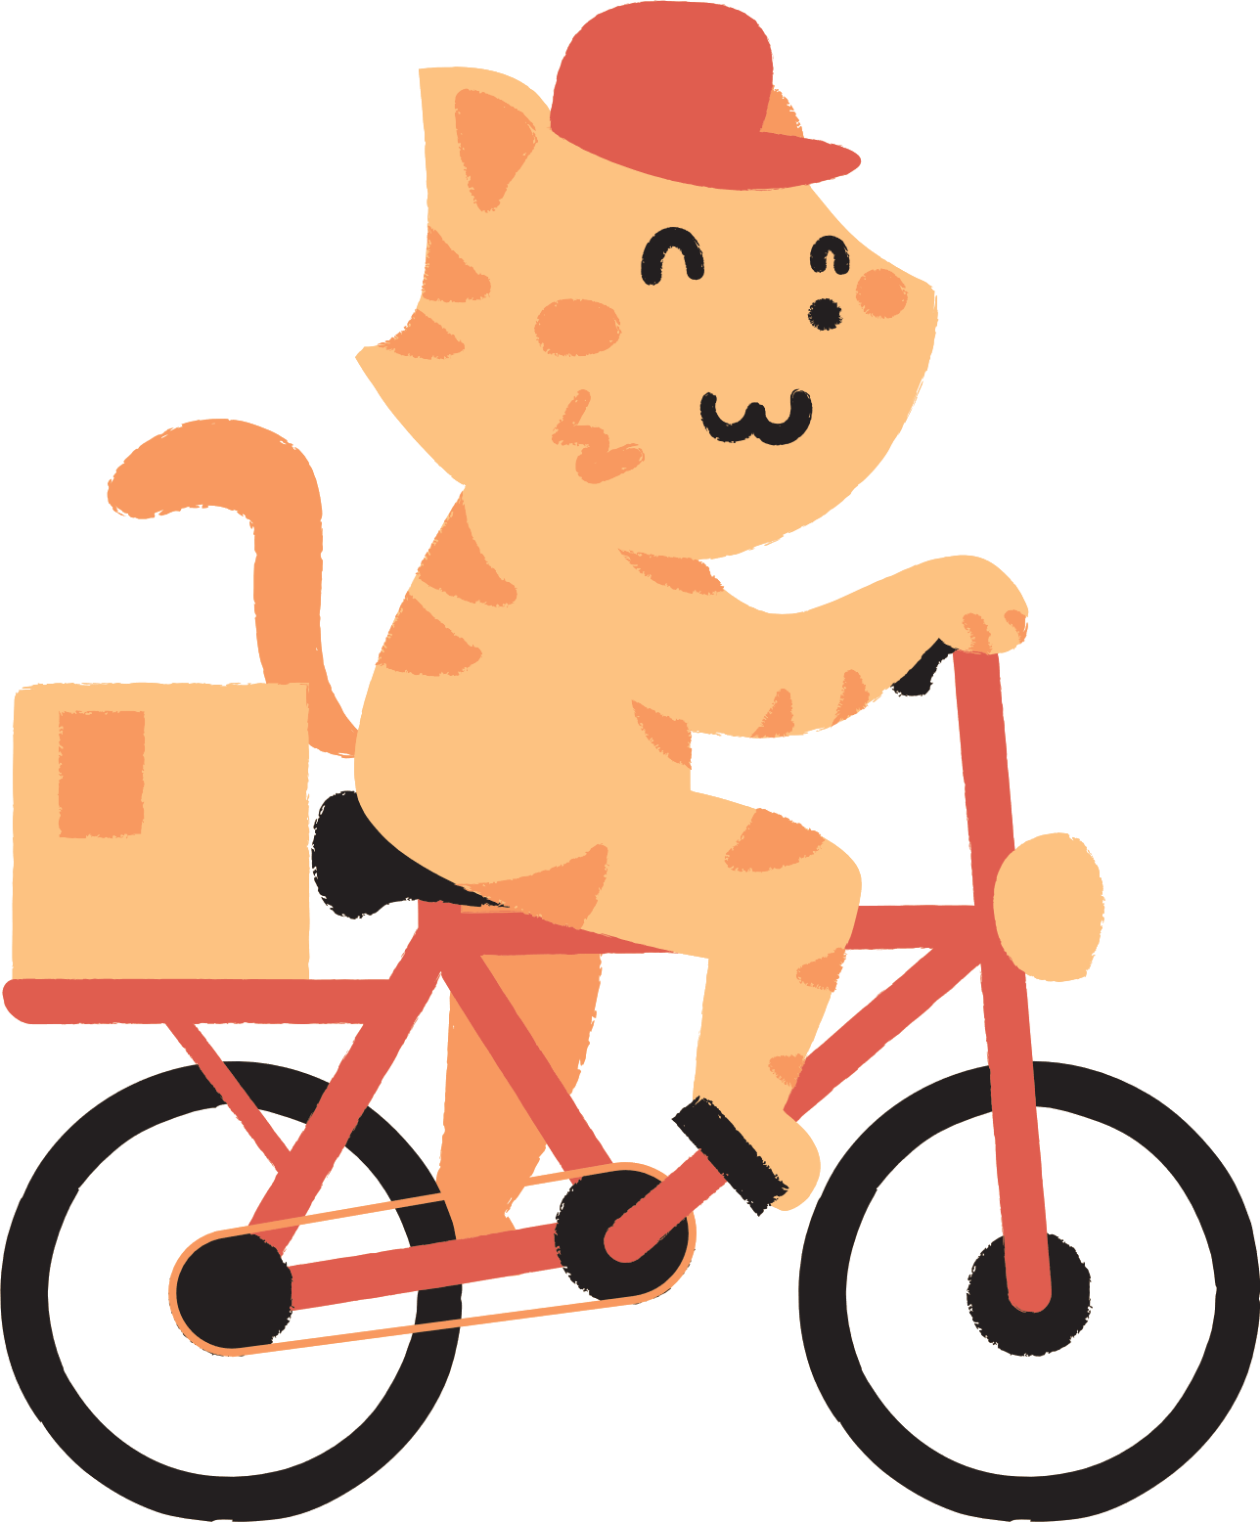

VOCABULARY

Slide 7

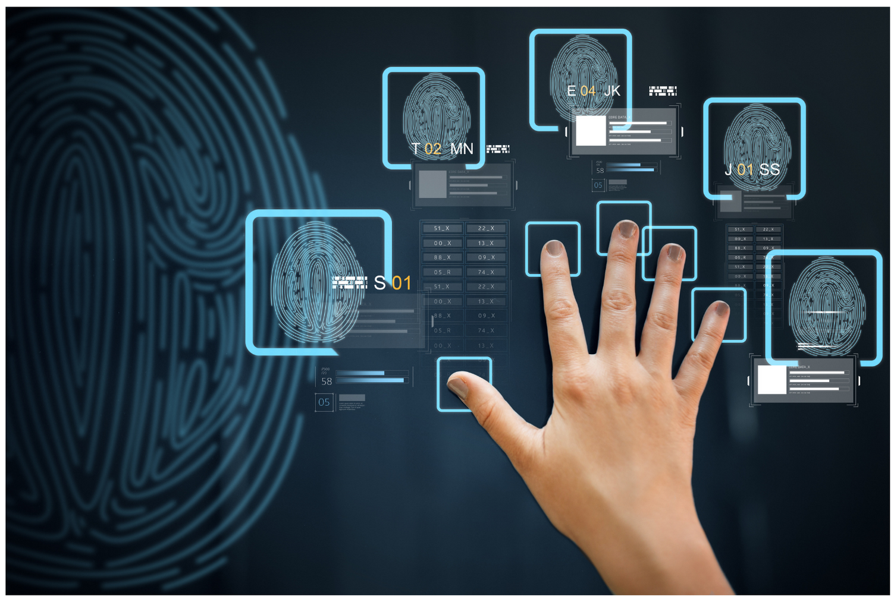

biometrics (n)
/ˌbaɪəʊˈmetrɪks/
khoa học sinh trắc

Slide 8

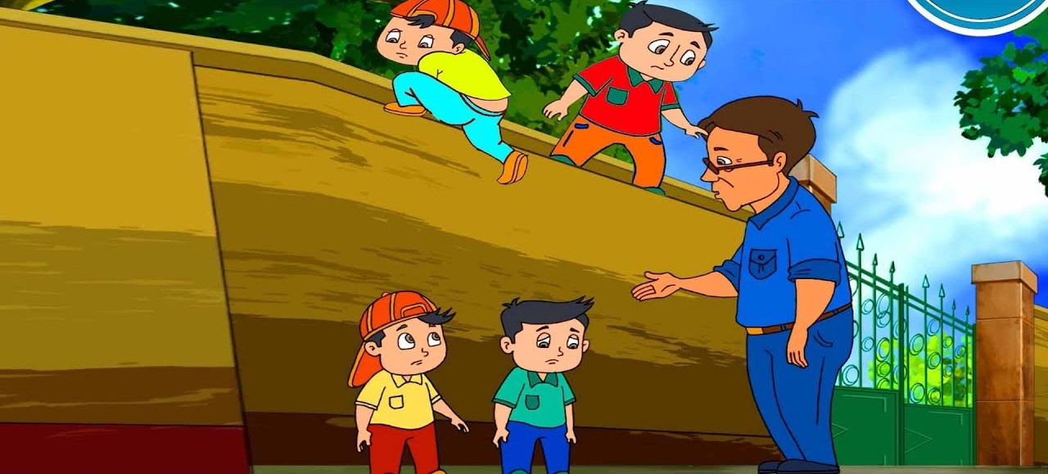
truancy (v)
/ˈtruːənsi/
trốn học, nghỉ học không phép

Slide 9
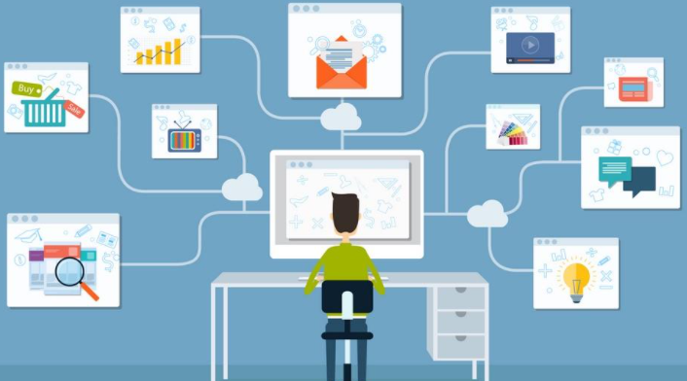
nanolearning (n)
/’nænəʊlɜːnɪŋ/
học thông qua những nội dung ngắn gọn, cô đọng
(chương trình cho phép người tham gia học một chủ đề nhất định trong thời gian từ 2-10 phút thông qua việc sử dụng phương tiện điện tử và không tương tác với người hướng dẫn trong thời gian thực)

Slide 10
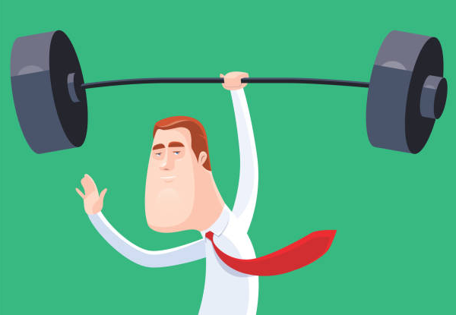
effortless (adj)
/ˈefətləs/
không cần nhiều nỗ lực

Slide 11
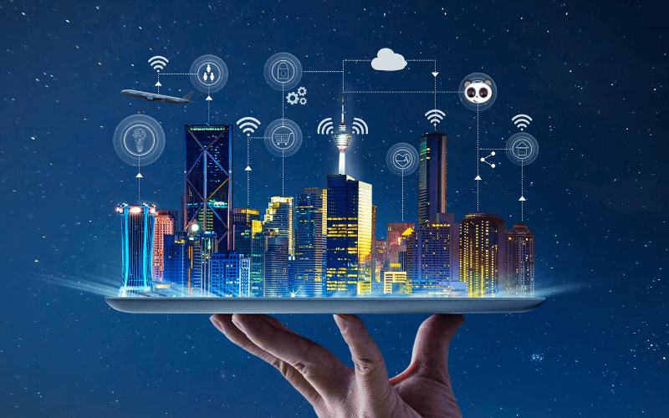
platform (n)
/ˈplætfɔːm/
nền tảng

Slide 12
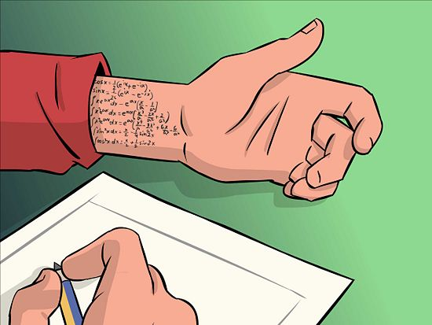
cheating (n)
/tʃiːtɪŋ/
gian lận

Slide 13
VOCABULARY
New words | Pronunciation | Meaning
1. biometrics (n) | /ˌbaɪəʊˈmetrɪks/ | khoa học sinh trắc
2. truancy (n) | /ˈtruːənsi/ | trốn học, nghỉ học không phép
3. nanolearning (n) | /’nænəʊlɜːnɪŋ/ | học thông qua những nội dung ngắn gọn, cô đọng
4. effortless(adj) | /ˈefətləs/ | không cần nhiều nỗ lực
5. platform(v) |  | nền tảng
6. cheating (n) | /tʃiːtɪŋ/ | gian lận

Slide 14
READING
2
2.Read the texts and tick B (Biometrics) or N (Nanolearning).
Benefits | B | N
1. It makes learning effortless.
2. It checks students’ understanding of the lessons.
3. Students use it when they borrow books and equipment.
4. It helps increase students’ learning attention.
5. It records students’ study activities and results.

Slide 15

games

Slide 16
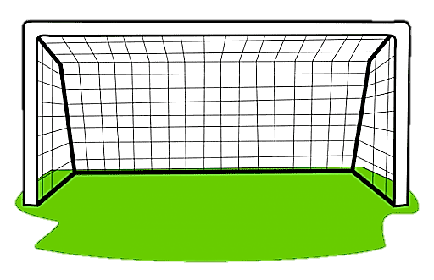


1. It makes learning effortless.
Biometrics
Nanolearn

Slide 17
2. It checks students’ understanding of the lessons.
Biometrics
Nanolearn

Slide 18
3. Students use it when they borrow books and equipment.
Biometrics
Nanolearn

Slide 19
3. Students use it when they borrow books and equipment.
Biometrics
Nanolearn

Slide 20
4. It helps increase students’ learning attention.
Biometrics
Nanolearn

Slide 21
4. It records students’ study activities and results.
Biometrics
Nanolearn

Slide 22

CHECK AGAIN
2
2.Read the texts and tick B (Biometrics) or N (Nanolearning).
Benefits | B | N
1. It makes learning effortless.
2. It checks students’ understanding of the lessons.
3. Students use it when they borrow books and equipment.
4. It helps increase students’ learning attention.
5. It records students’ study activities and results.

Slide 23

READING
3. Read the texts again and choose the correct answer A, B, or C.
1. What does checking students’ attendance mean?
A. Checking their presence.
B. Scanning their faces.
C. Checking their fingerprints.
2. With Nanolearning students can ______.
A. access large amounts of information
B. improve their learning quality
C. concentrate longer

Slide 24

READING
3. Read the passage and choose the correct answer A, B, or C.
3. What DOESN’T Nanolearning do?
A. Provide platform.
B. Report students’ results.
C. Entertain students.
4. The texts are from______.
A. science books
B. advertisements
C. manuals

Slide 25
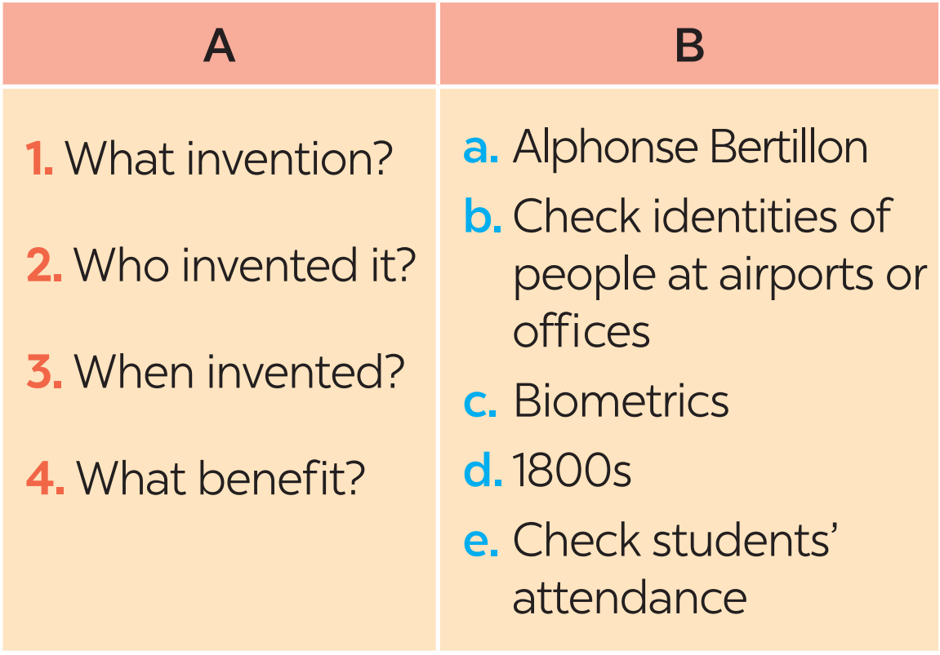
SPEAKING
4. Work in pairs. Discuss and match the questions in A with the answers in B, and then make a conversation about an invention.

Slide 26
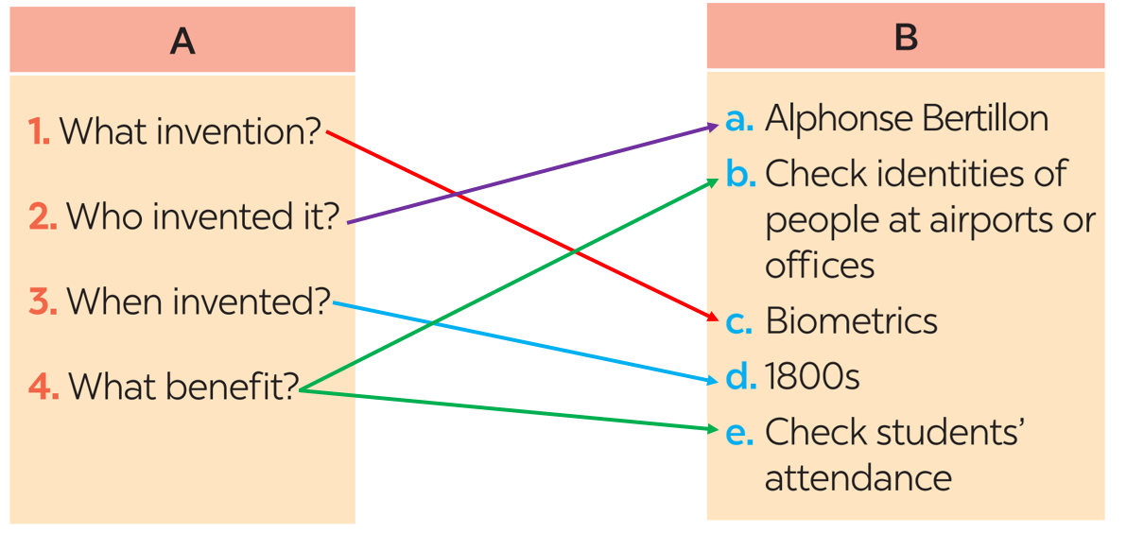
SPEAKING
4. Work in pairs. Discuss and match the questions in A with the answers in B, and then make a conversation about an invention.
A: What technology do you like?
B: I like ___________________.
A: Who invented it?
B: _______________________.
A: When did he invent it?
B: In _____________________.
A: How can it help us?
B: It can help us_____________.

Slide 27

SPEAKING
5. Work in groups. Ask and answer questions about a technology or an invention. Use the example in 4 as a cue. Then report your answers to the class.
Example:
Mi likes biometrics. Alphonse Bertillon invented it in 1800s. It is a very important technology. We use it to …

Slide 28
Wrap - up
What have we learnt in this lesson?
Some new technologies that are applied at schools
Information about some inventions, technologies

Slide 29



homework
Learn the new words by heart.
Do the exercises in the workbook.
Hannah
Daniel
Isabel
Aaron

Slide 30

thank you
for watching
See You Next time!

