Slide 1




WAVES
& WAVE PROPERTIES
Unit Review Quiz

Slide 2


Slide 3



LESSON 1: GETTING STARTED
Great news for students

Slide 4

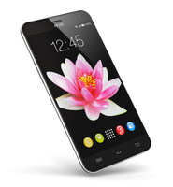
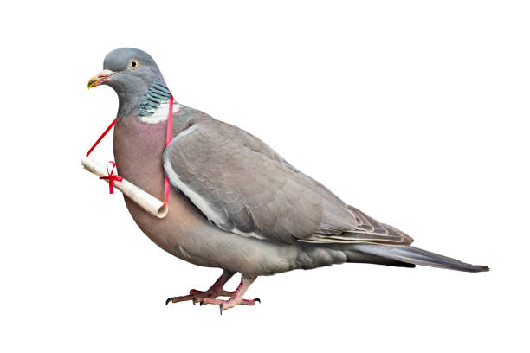

WARM-UP
The hidden word:
1. What is this?
SEIENCC
SMARTPHONE
_ _ _ _ _ _ _ _ _ _
PIGEON
2. My favourite bird is _ _ _ _ _ _ .
ACCOUNT
3. I don't have a Facebook _ _ _ _ _ _ _ .

Slide 5

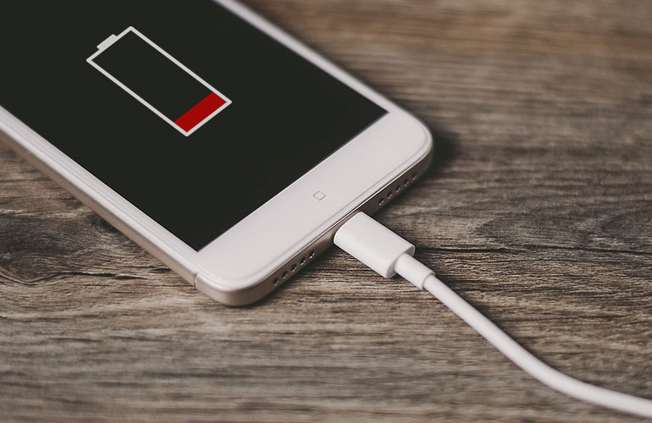
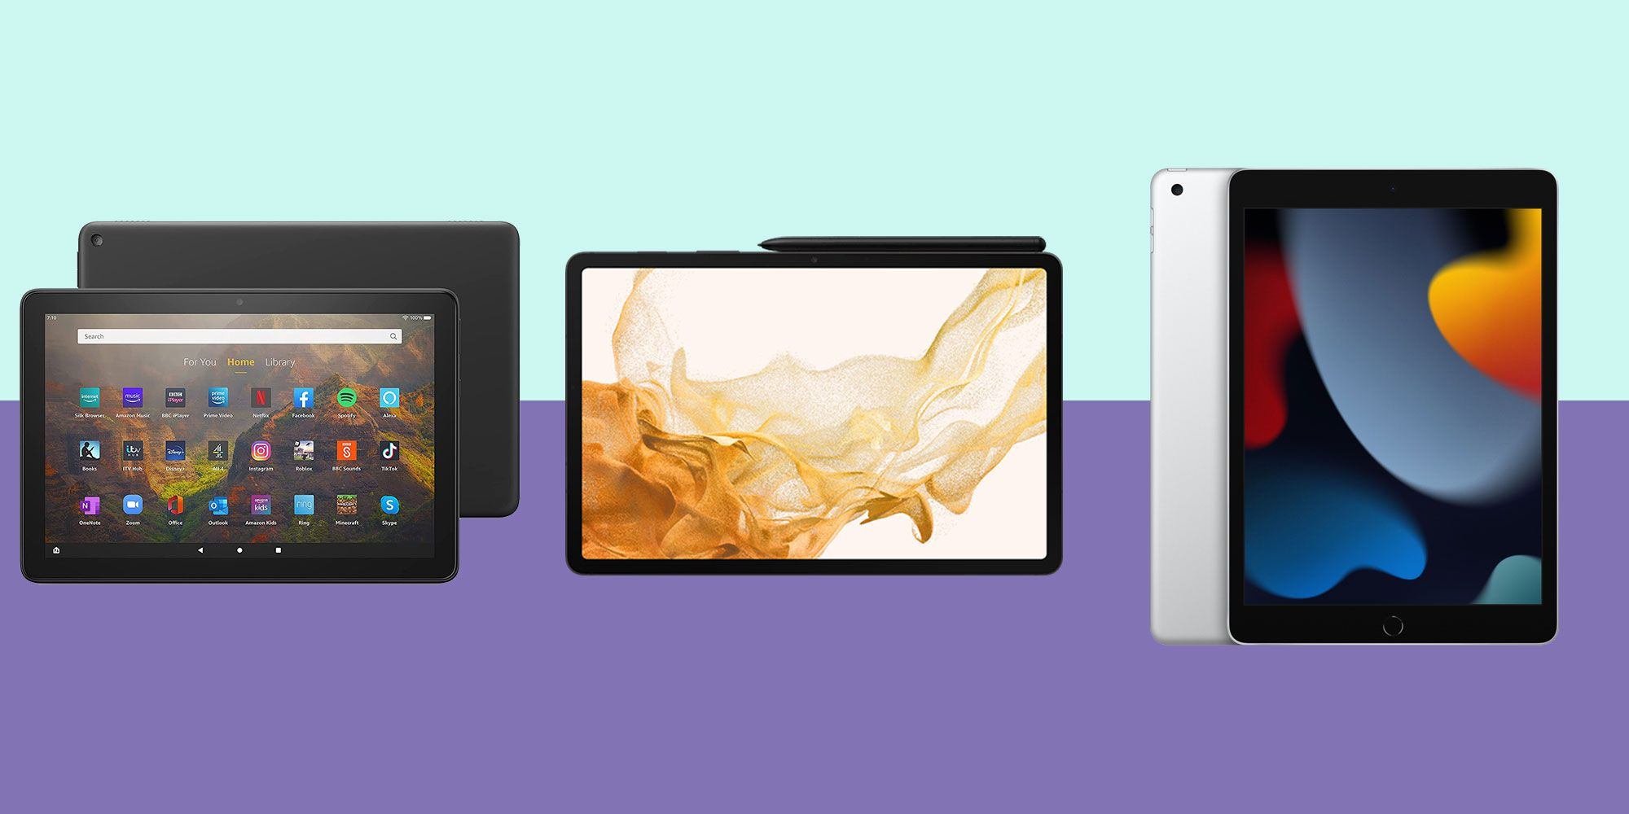
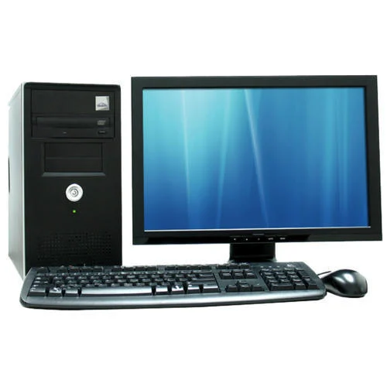
The hidden word:
EOTLHYGNCO
4. What are they?
7. Don't unplug my phone.
It's _ _ _ _ _ _ _ _ .
CHARGING
EMOJIS
_ _ _ _ _ _
TABLETS
5. I prefer using _ _ _ _ _ _ _ to smartphones .
8. What is this?
It's a _ _ _ _ _ _ _ _ .
TELEPATHY
6. _ _ _ _ _ _ _ _ _ the direct communication of thoughts or feelings from one person to another without using speech, writing, or any other normal method.
COMPUTER

Slide 6
ANSWERS
The hidden words:
SEIENCC
EOTLHYGNCO
SCIENCE
TECHNOLOGY
_ _ _ _ _ _ _
_ _ _ _ _ _ _ _ _ _

Slide 7

VOCABULARY

Slide 8
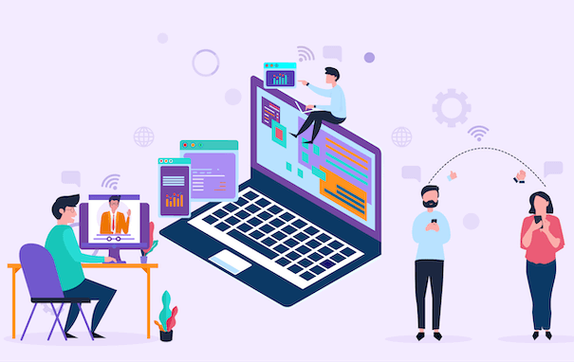

technology (n)
/tekˈnɒlədʒi/
công nghệ

Slide 9

face to face (adj)
/ˌfeɪs tə ˈfeɪs/
trực tiếp,
mặt đối mặt

Slide 10

epidemic (n)
/ˌepɪˈdemɪk/
đại dịch

Slide 11
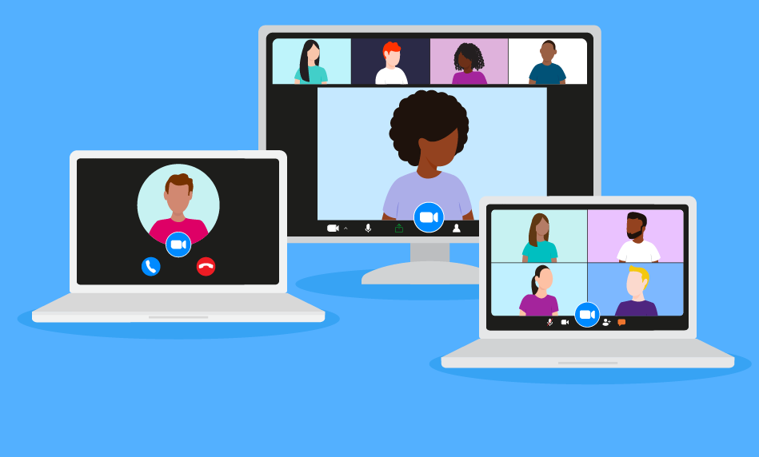
breakout room (n)
/ˈbreɪkaʊt rʊm /
phòng học chia nhỏ, chia nhóm

Slide 12
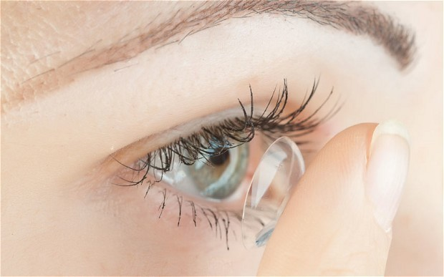
contact lens (n)
/ˈkɒntækt lenz/
kính áp tròng

Slide 13

invention (n)
/ɪnˈvenʃn/
phát minh

Slide 14
New words | Pronunciation | Meaning
1. technology (n) | /tekˈnɒlədʒi/ | công nghệ
2. face-to-face | /ˌfeɪs tə ˈfeɪs/ | trực tiếp, mặt đối mặt
3. epidemic (n) | /ˌepɪˈdemɪk/ | đại dịch
4. breakout room (n) | /ˈbreɪkaʊt ruːm/ | phòng học chia nhỏ
5. contact lens (v) | /ˈkɒntækt lenz/ | kính áp tròng
6. invention (n) | /ɪnˈvenʃn/ | phát minh

Slide 15
1. Listen and read.
Minh: Ann, do you like yesterday’s lesson? I really enjoy learning online .
Ann: I prefer having face-to-face classes. I like to interact with my classmates during the lessons.
Minh: I think online classes are convenient during bad weather or epidemics. Also, students can still interact when they are in breakout rooms.
Ann: But the Internet connection doesn’t always work well enough to learn online. And my eyes get tired when I work in front of the computer screen for a long time.
Minh: I know what you mean. But there’s some great news for us. 3D contact lenses will soon be available. With them, our eyes won’t get tired when looking at a computer screen all day long.
Ann:Wow, that’s brilliant!
Minh:Another helpful invention is robot teachers. They will teach us when our human teachers are not available or get ill. My uncle said the robots would be able to mark our work and give us feedback too.
Ann: Fantastic! I can’t wait.

Slide 16
PRACTICE
2. Read the conversation again and tick T (True) or F (False).
Statements | T | F
1. Ann and Minh had a face-to-face class yesterday.
2. Ann likes face-to-face classes because she can interact with her classmates.
3. Minh finds online classes inconvenient.
4. When students use 3D contact lenses, their eyes will not get tired.
5. Robot teachers will be able to mark papers and comment on students’ work.

Slide 17
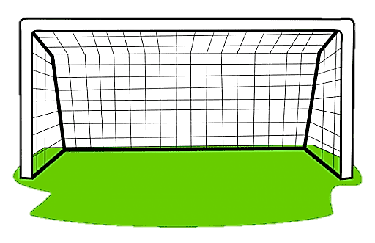


1. Ann and Minh had a face-to-face class yesterday.
True
False

Slide 18
2. Ann likes face-to-face classes because she can interact with her classmates.
True
False

Slide 19
1. Ann and Minh had a face-to-face class yesterday.
True
False

Slide 20
3. Minh finds online classes inconvenient.
True
False

Slide 21
4. When students use 3D contact lenses, their eyes will not get tired.
True
False

Slide 22
5. Robot teachers will be able to mark papers and comment on students’ work.
True
False

Slide 23

CHECK AGAIN
2. Read the conversation again and tick T (True) or F (False).
Statements | T | F
1. Ann and Minh had a face-to-face class yesterday.
2. Ann likes face-to-face classes because she can interact with her classmates.
3. Minh finds online classes inconvenient.
4. When students use 3D contact lenses, their eyes will not get tired.
5. Robot teachers will be able to mark papers and comment on students’ work.

Slide 24
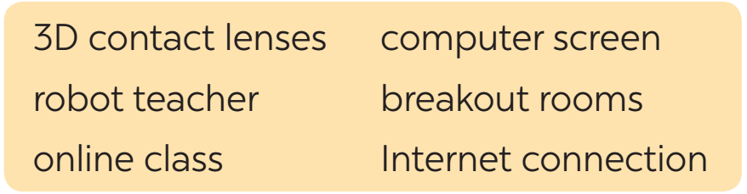
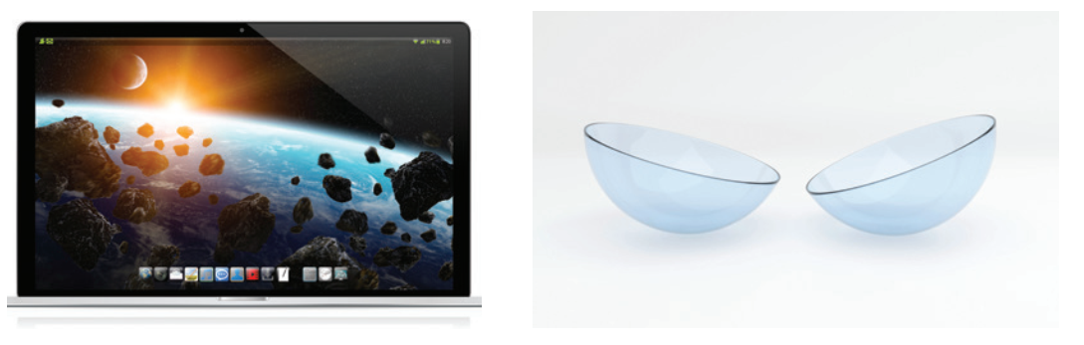

PRACTICE
3. Label each picture with a phrase from the box.
3D contact lenses
computer screen
2. _______________
1. ______________

Slide 25
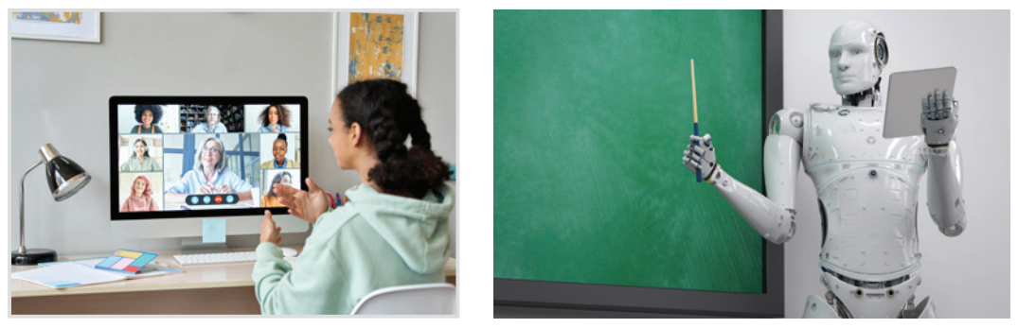
PRACTICE
3. Label each picture with a phrase from the box.
online class
3. ______________
4. _______________
robot teacher

Slide 26

PRACTICE
3. Label each picture with a phrase from the box.
Internet connection
breakout rooms
6. _________________
5. ______________

Slide 27
PRACTICE
4
4. Complete the sentences, using the phrases in 3.
1. I can’t see the documents on the computer very clearly. I need a larger ______________.
2. During our lessons, our teacher puts us into ______________ for group discussions.
3. A ____________ in Korea teaches English to primary students.
4. We had a(n) ____________ yesterday with a teacher in the US.
5. Can I wear ________________ and watch a movie too?
computer screen
breakout rooms
robot teacher
online class
3D contact lenses

Slide 28


PRACTICE
4
5
Do you know what things were invented in these years?
1. 1822: Charles Babbage invented it. Students use it to type essays and to learn online.
The first computer

Slide 29
PRACTICE
4
5
Do you know what things were invented in these years?
The telephone
2. 1876: Alexander Graham Bell invented it. We use it to communicate with our friends and families.

Slide 30
PRACTICE
4
5
Do you know what things were invented in these years?
3. 1928: Sir Alexander Fleming discovered it. It was the world’s first antibiotic.
Penicillin

Slide 31
PRACTICE
4
5
Do you know what things were invented in these years?
The WWW - World Wide Web
4. 1989: Tim Berner-Lee invented it. It links information sources so everyone can access them.

Slide 32
PRACTICE
4
5
Do you know what things were invented in these years?
5. 2000: Honda developed it. It can run, jump, and work as a bartender.
Robot ASIMO

Slide 33

WRAP - UP
What have we learnt in this lesson?
identify the topic of the unit
use lexical items related to science and technology
identify the language features that are covered in the unit

Slide 34
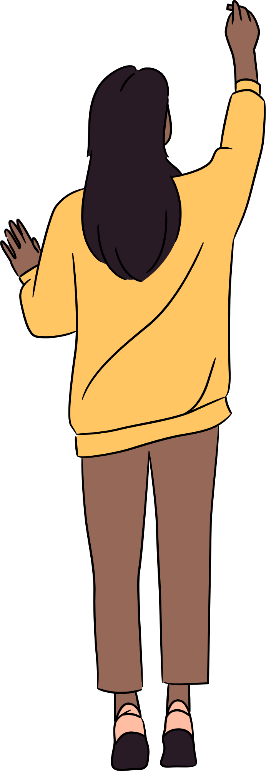
HOMEWORK
- Review technologies and inventions learnt in the lesson.
- Learn new words and phrases by heart.
- Do the exercises in the Workbook.
- Start preparing for the project of the unit.

Slide 35





THANK YOU FOR
WATCHING

