Slide 1

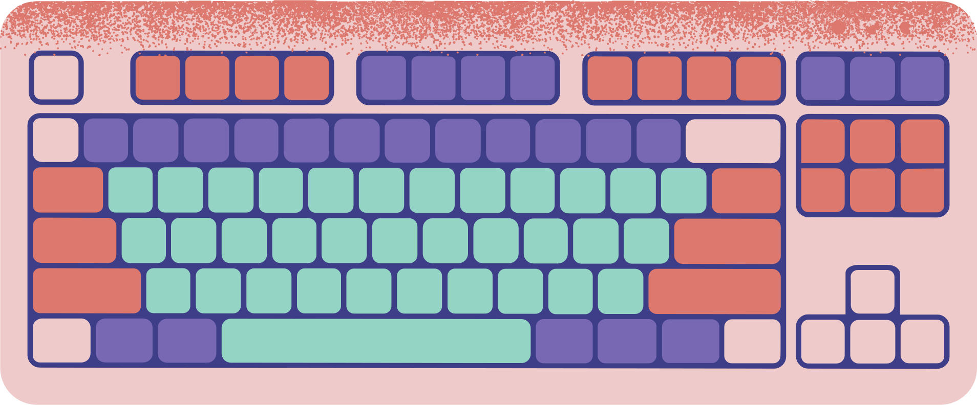








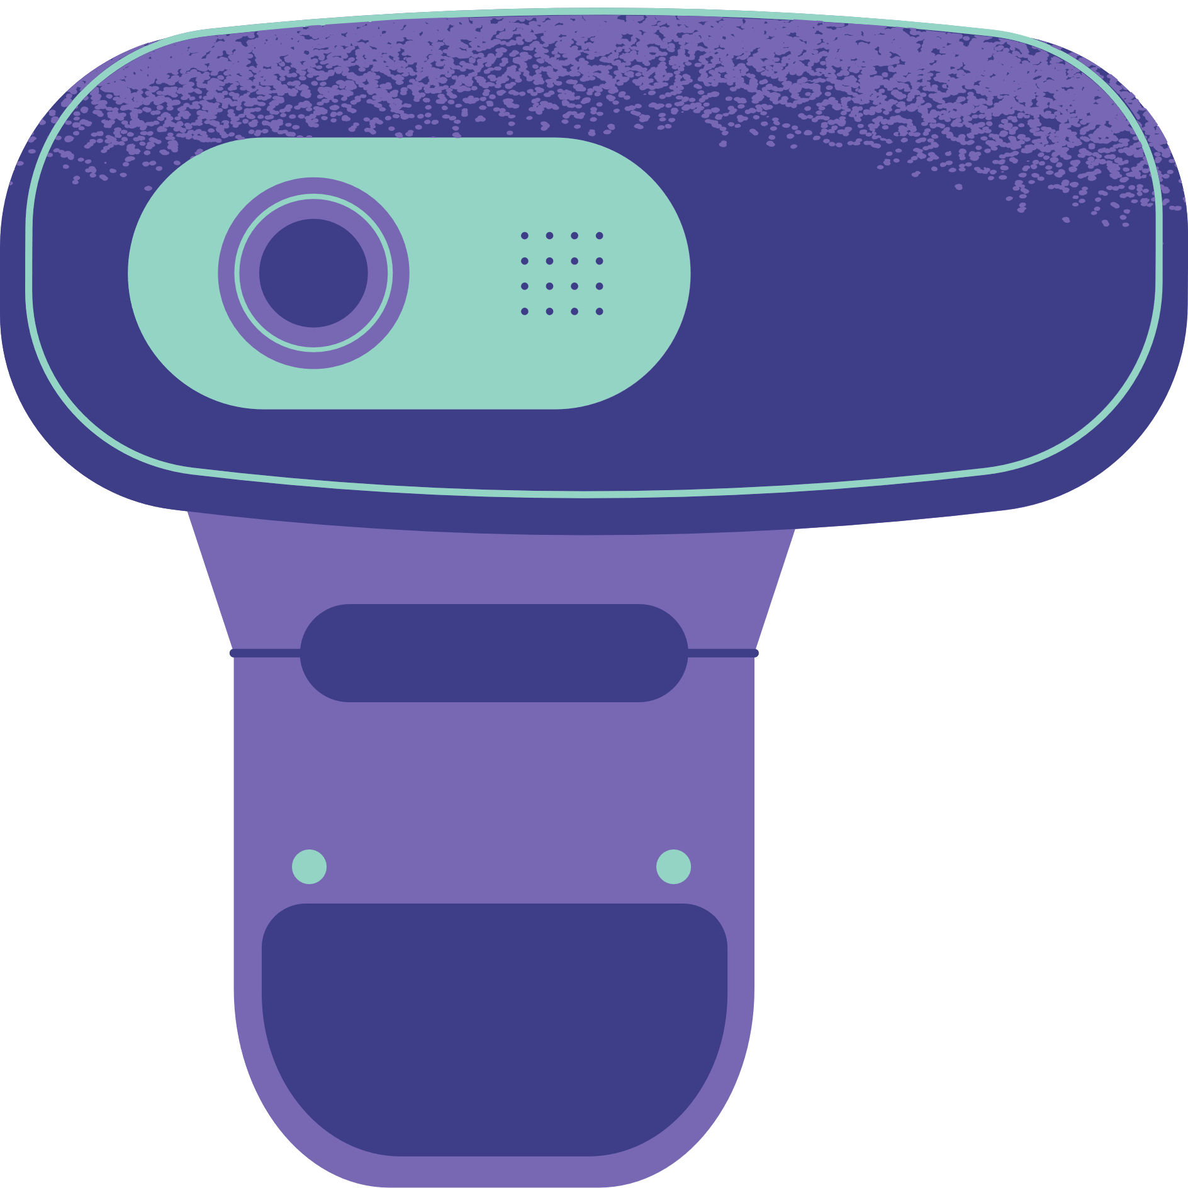

Unit 10: COMMUNICACTION IN THE FUTURE
LESSON 2: A CLOSER LOOK 1

Slide 2



Warm - up
1. devio receonnfc
2. atlbet
3. tinerent neitonccon
4. oomz ni
5. cebwam
→ video conference
JUMBLED WORDS
→ tablet
→ internet connection
→ zoom in
→ webcam

Slide 3


vocabulary

Slide 4
social network (n)
/ˌsəʊʃl ˈnetwɜːk/
mạng xã hội

Slide 5
voice message (n)
/ˈvɔɪs mesɪdʒ/
Tin nhắn thoại

Slide 6
group call (n)
/ɡruːp kɔːl/
Cuộc gọi nhóm

Slide 7
smartphone (n)
/ˈsmɑːtfəʊn/
Điện thoại thông minh

Slide 8
emoji (n)
/ɪˈməʊdʒi/
Biểu tượng cảm xúc

Slide 9
holography (n)
/hɒlˈɒɡrəfi/
Hình chiếu 3 chiều

Slide 10
VOCABULARY
New words | Pronunciation | Meaning
1. social network (n) | /ˌsəʊʃl ˈnetwɜːk/ | mạng xã hội
2. voice message (n) | /ˈvɔɪs mesɪdʒ/ | tin nhắn thoại
3. group call (n) | /ɡruːp kɔːl/ | cuộc gọi nhóm
4. smartphone (n) | /ˈsmɑːtfəʊn/ | điện thoại thông minh
5. emoji (n) | /ɪˈməʊdʒi/ | biểu tượng cảm xúc
6. holography (n) | /hɒlˈɒɡrəfi/ | hình chiếu 3 chiều

Slide 11
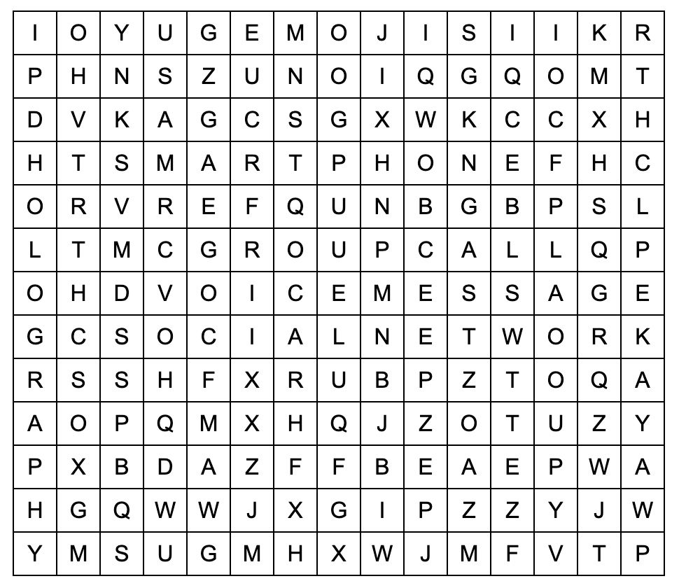
PRACTICE
Work in pairs. Find the words in the word search.
voice message
social network
group call
smart phone
emojis
holography

Slide 12
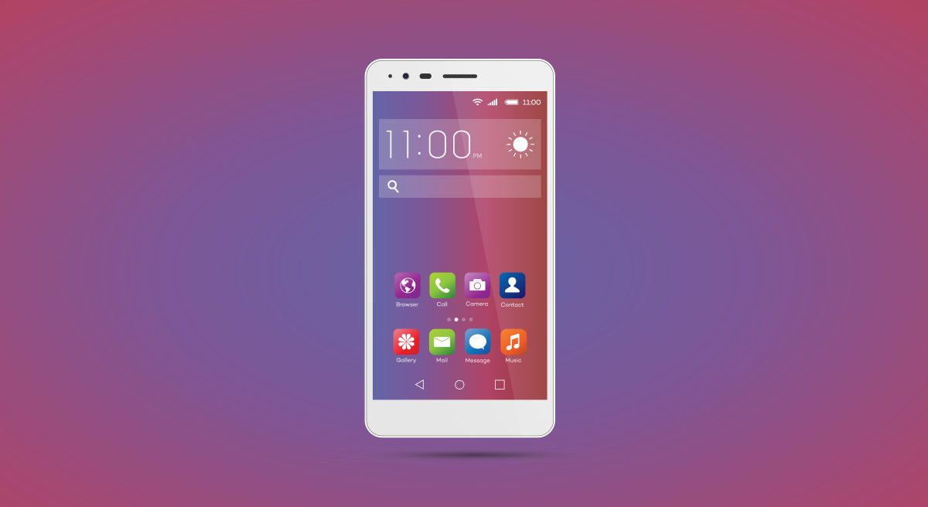
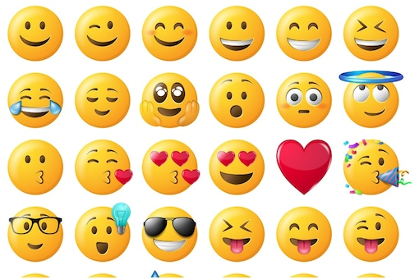
PRACTICE
1. Write the correct word or phrase from the box under each picture.
voice message smartphone social network
emojis group call holography
1. ___________
emojis
smart phone
2. ___________

Slide 13
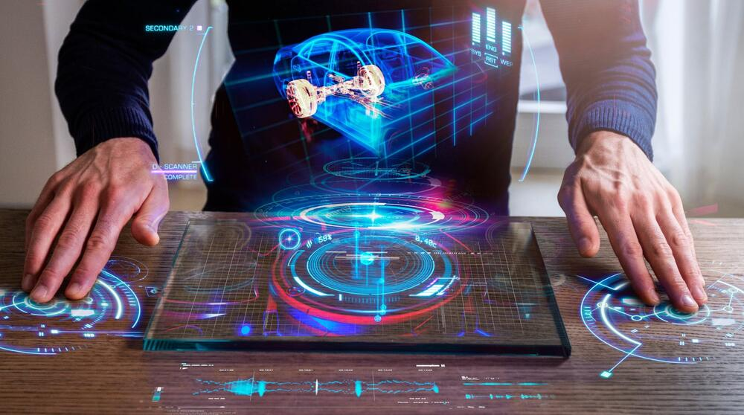
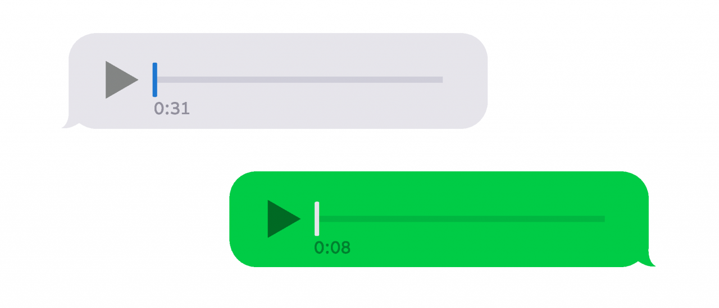
PRACTICE
1. Write the correct word or phrase from the box under each picture.
voice message smartphone social network
emojis group call holography
3. _____________
4. ___________
voice message
holography

Slide 14
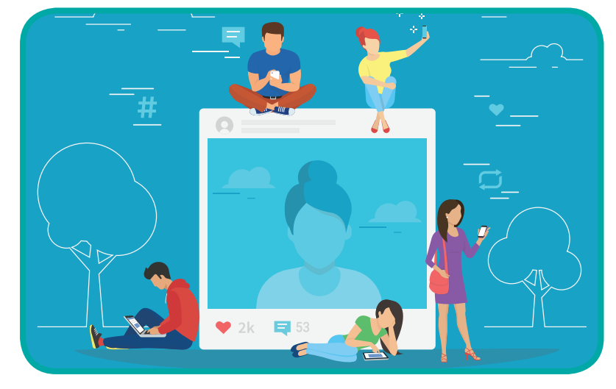
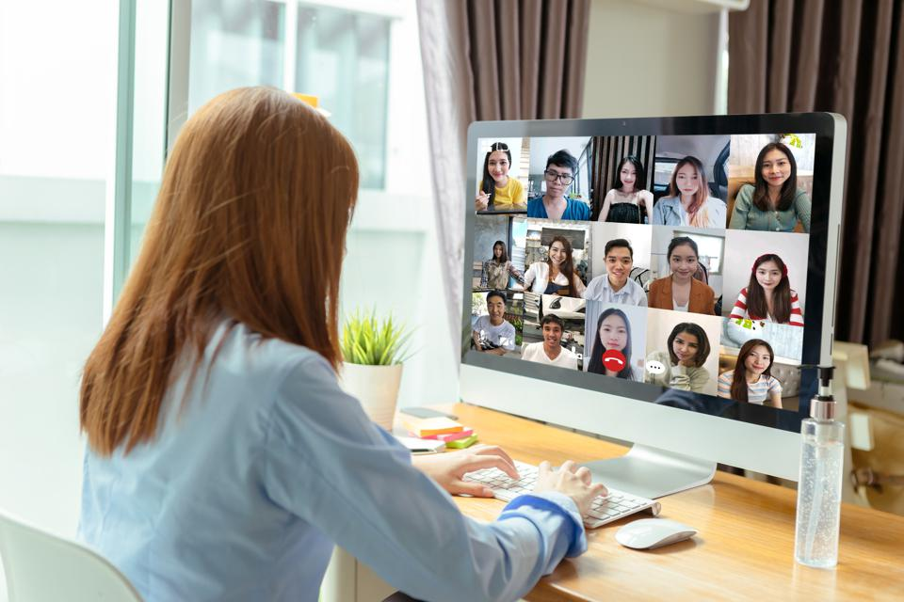
PRACTICE
1. Write the correct word or phrase from the box under each picture.
voice message smartphone social network
emojis group call holography
5. ___________
social network
6. ___________
group call

Slide 15
PRACTICE
2. Choose the correct answer A, B, or C.
1. Many people add ______ to their text messages to express their feelings.
A. emojis B. words C. letters
2. I send ______ messages when I don’t feel like typing.
A. group B. text C. voice
3. Many teenagers like to meet on social ______ rather than face to face.
A. television B. networks C. projects

Slide 16
PRACTICE
2. Choose the correct answer A, B, or C.
4. In a ______, people in different places can join the conversation.
A. voice message B. group call C. system of emojis
5. By using ______, you can attend a meeting with your 3D image instead of being there in person.
A. holography B. voice messages C. social networks

Slide 17
PRACTICE
3
3. Complete the sentences with the words from the box.
translation real language instantly private
1. Do you often send _______ messages to your friends?
2. Can learning English help you overcome the _________ barrier when living abroad?
3. Telephone helps you communicate in _______ time.
4. Do you think translators will lose their jobs when ___________ machines become popular?
5. Many people reply to messages _________, but others take a long time to respond.
private
language
real
translations
instantly

Slide 18
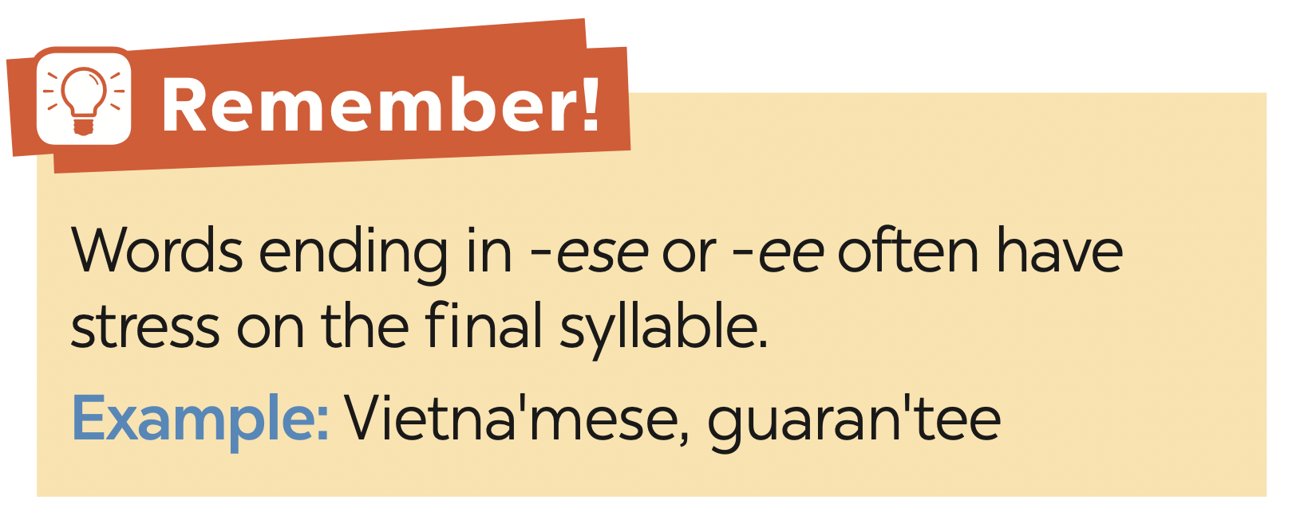
PRONUNCIATION

Slide 19

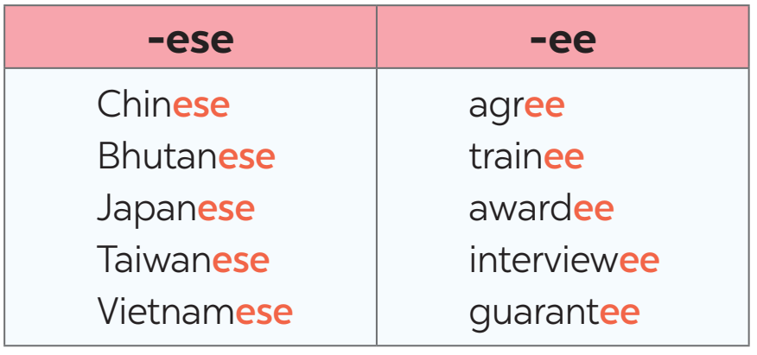
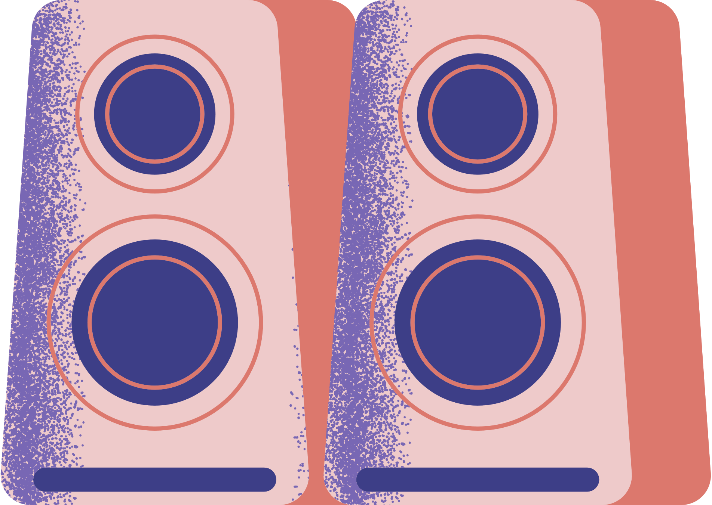
PRONUNCIATION
4. Listen and repeat the words. Pay attention to the word stress.

Slide 20
PRONUNCIATION
5. Mark the stress in the underlined words. Then listen and repeat the sentences.
1. The interviewees said that they were Taiwanese.
2. Joe agrees with me that learning Chinese is difficult.
3. She obtained a bachelor’s degree in Japanese.
4. The Taiwanese company gave each awardee a smartphone.
5. The Japanese teacher sent a video to the absentees on Monday.
‘
‘
‘
‘
‘
‘
‘
‘
‘
‘

Slide 21

GAMES

Slide 22




What does the picture describe?
group call
voice message
social network

Slide 23
What does the picture describe?
smart phone
holography
voice message

Slide 24
What does the picture describe?
emojis
group call
voice message

Slide 25
What does the picture describe?
group call
voice message
emojies

Slide 26
What does the picture describe?
Voice message
holography
message

Slide 27
What does the picture describe?
group call
voice message
holography

Slide 28

HOMEWORK
- Learn by heart all the words that you have just learnt.
- Do exercises in the workbook.
- Prepare for Lesson 3 - A closer look 2

Slide 29




Thank You
For Listening
CÔNG THÀNH_TRỌNG QUYỀN

